Slide 1
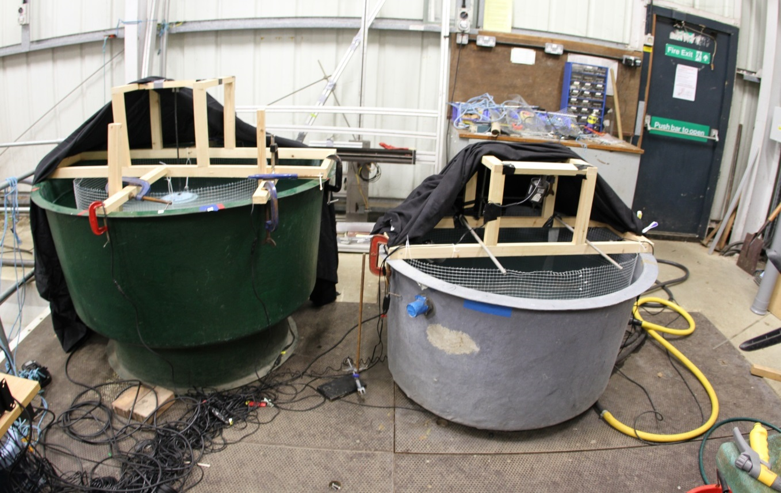
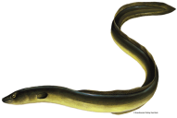
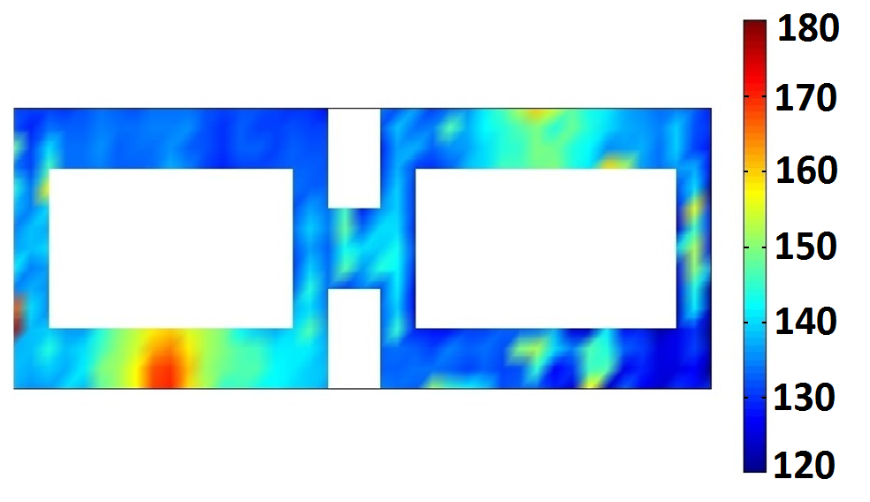
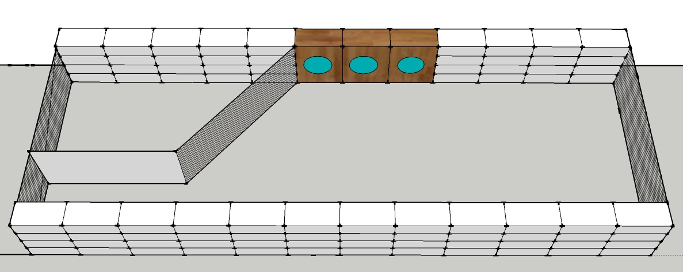
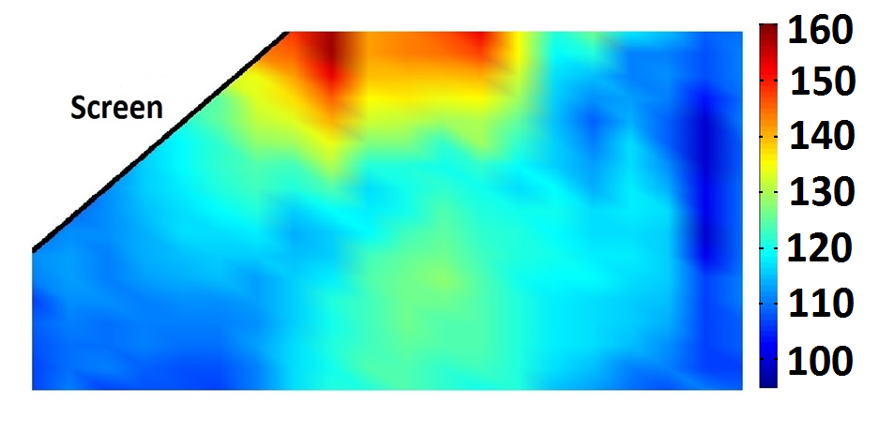
Understanding the impact of human sounds on eel behaviour, a way to develop behavioural guidance techniques
Mathias Deleau, Timothy Leighton, Paul White, Paul Kemp
Background
The European eel is listed as critically endangered by the IUCN. Since the seventies the number of eels reaching Europe has suffered an 95% decline. Seaward migrating adult eels are delayed by river structures (of which there are 26,000 in the UK) and can suffer high rates of injury and mortality at water pumps and hydropower facilities.
To prevent fish entering water intakes, screens are deployed as part of the EU Eel Regulation and UK Screening Regulations. Their morphology and weak swimming capabilities means traditional screens are ineffective at protecting eels.
Most of the literature to date has focused on the negative impacts of sounds on marine life, primarily marine mammals and, to a lesser extent, fish.
This work explores the use of sound to modify fish behavior to their benefit.
There is a need to develop behavioural guidance methods to divert eels from harmful areas and towards safe passage routes, to do that a greater understanding of the behavioural response of eels to sound is necessary.
Experimental approach:
Main Findings:
First Experiment:
Clear effect of sound on fish behaviours.
No obvious difference in the behavioural response in between the tested frequencies.
Variability of the response among the individuals.
Second Experiment:
No clear preference between the two choice of corridors (with or without sound).
Rejection and U-turn only happened in presence of the stimulus.
Rejection reached up to 12% of the passages attempts.
The stimulus had an effect on the swimming speed of the fish.
Third Experiment:
Significant difference between the Control treatments and the two treatments with Sound.
Rejection of the stimulus reached 16% of and 13% of the attempts for the Broadband and the Pulsed Stimulus.
Sound had an effect on the swimming speed of the fish.
First Experiment
1000 mm
Two video recorded tanks, the one with sound exposure and one used as a control. The experiment was conducted in dark conditions.
Eels were exposed to randomly ordered, tonal sounds of increasing intensities. The frequencies were 60,80,100,200,300,400,800,1000,2000 Hz. They started at a very low level (5 dB) and increased in 5 dB steps up to 130/150 dB re 1 uPa. Each tone lasted 30 s with a 15 s gap.
Their reactions were video recorded and analysed.
Second Experiment
dBs re 1 uPa
The experiments were conducted in an outdoor flume with a water flow of 10 cm/s.
Individual fish were released and allowed pass through the maze.
The maze consists of two chambers with two distinct corridors, one corridor included an acoustic stimulus (Red cones) and the other did not.
The progression of the fish and its behaviour were video recorded.
Third Experiment
dBs re 1 uPa
An experiment which more closely mimicked a reality scenario was designed in the same flume.
A single fish was released upstream to a setup involving a large screen and a by-pass channel.
A series of 3 speakers were setup anterior to the screen, to test the hypothesis that avoidance of the screen can be triggered by playing a broadband acoustic stimulus prior to the screen.
Three conditioned were tested (Continuous, Pulsed and No stimulus) and video analysis of the trails was conducted.
Mathias Deleau
Email: md3g12@soton.ac.uk

