Slide 1
‘In the way to do some good’
The Viscountess, the Scientific Philanthropist,
& the School of Industry
Isobel Stark,
Hartley Library, University of Southampton

Slide 2
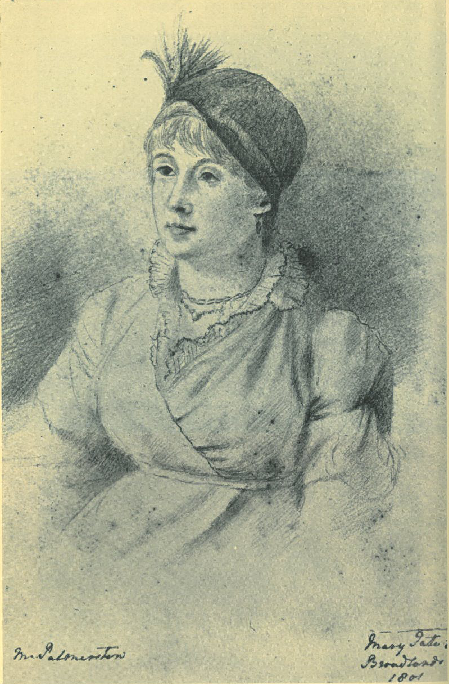
Mary Mee
Born 1752, died 1805
Married 2nd Viscount Palmerston in Bath,
7th January 1783
Children:
1784 - Henry (Harry) 1786 - Frances (Fanny) 1788 - William
1789 - Mary
1790 - Elizabeth (Lilly)
Mary, Viscountess Palmerston by Mary Tate,
reproduced in Connell, Portrait of A Whig Peer, p.129
Notes:
She was the daughter of Benjamin Mee, originally from Gloucester but long settled in London as a merchant. Her brother, also Benjamin, was at one point on the Board of Governors of the Bank of England. Although by the late 18th Century, it was increasing rare for aristocrats to marry into Trade, certainly compared to the level of intermarriage earlier in the century, it was something the Temples were well used to. Both the first viscountess and and Mee’s mother-in-law were merchants’ daughters.
While her paternal family had only just moved to London, her maternal family had a longer and more illustrious city pedigree but although they had villas and small country estates, they were still highly involved in city business.
social position was thus more precarious than it might at first seem.
ADDITIONAL INFO
In October 1782 carriage accident when Palmerston overturned his phaeton near Stoneham (north of Southampton) in which he was driving Mee and her elder sister, Sarah Culverden, had dislocated Mee’s elbow, kick started their courtship. Had known her husband since she was16 through her uncle William Godschall.
Mee was 28 when she married,
five children in relatively quick succession
Her relationship with her husband was warm and loving, despite their frequent separation. Her letters and diary entries after his sudden death in 1802 vividly express her grief.
She came out of mourning for one last full season in the spring of 1804 when her eldest daughter was 18 but by then she already knew she was ill.
She died on 20th January 1805, possibly of uterine cancer.
Mee was not fluent in French (Mee started to learn French in December 1788 but had still not mastered it by 1802)

Slide 3
“a pleasing, unaffected woman, who, tho’ she did squeeze thro’ the city gates into a Viscountess, bears her blushing honours without shaking them at you every moment”
Mrs Sheridan, 1786
Notes:
Mrs Richard Sheridan to Mrs Strafford Canning in 1786
By the 1780s when she married, there was increasing social pressure on peeress with mercantile roots to prove their suitability for the honour of their exalted rank.
Marrying up – had to prove worthy
Cult of domesticity, arranged, mercenary marriages less popular – disdain for women who had jumped several nice distinctions of rank, at the mercy of gossips who resented their ‘success’ as can been seen in Mrs Sheridan’s double edged compliment.
Mee’s philanthropic activities garner her social credit for behaving as a peeress ought to behave.
ADDITIONAL INFO
Temple family had been knights before they were viscounts, and were a cadet branch of the family that went on to became English dukes, they still held an Irish title of fairly recent origin.
not a wealthy family in comparison with other aristocrats. Their annual income was at most £19,000p.a. during their marriage.
tradition of marrying mercantile heiresses, although not very rich ones. Palmerston’s grandmother was the daughter of a governor of the Bank of England, his step-grandmother the widow of a wealthy pewterer and merchant, and his mother, daughter of a Lord Mayor of London.
aristocratic family but with strong familial ties to the mercantile and gentry classes.

Slide 4
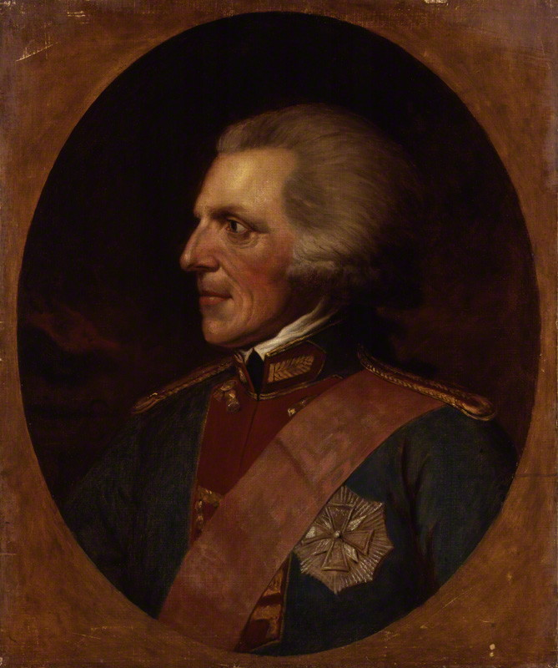
Benjamin Thompson, Count Rumford
“loyalist, traitor, spy, cryptographer, opportunist, womaniser, philanthropist, egotistical bore, soldier of fortune, military and technical advisor, inventor, plagiarist, expert on heat (especially fireplaces and ovens) and founder of the world's greatest showplace for the popularisation of science, the Royal Institution”
W. H. Brock quoted in Peter Day, '‘Mr Secretary, Colonel, Admiral, Philosopher Thompson’: The European Odyssey of Count Rumford', European Review, 3(2) (1995), 103-111 (p. 103)
Notes:
first met Benjamin Thompson, Count Rumford, on 18th June 1793 while they were on their continental tour and instantly struck up a friendship
He was interested in “the applications of science to the common purposes of life”.
His philosophy could be summed up in his query:
to make vicious and abandoned people happy, it has generally been supposed necessary first to make them virtuous. But why not reverse this order! Why not make them first happy and then virtuous! If happiness and virtue be inseparable, the end will be as certainly obtained by one method as by the other.
Rumford strongly believed in
voluntary charity, run on a settlement-wide basis by a committee made up of the highest ranks of society, while the administration should be carried out by those from the middle ranks.
XTRA INFO
1753-1814
Born and raised in Massachusetts
1780-81: undersecretary of the colonies
Served the elector of Bavaria in Munich
Set up a poor house
Ended vagrancy
Experimented in large-scale feeding of the poor
Founded in English Garden
Knighted in 1784 by GIII; count of the Holy Roman Empire in 1791 by Elector of Bavaria
Developed a more accurate theory of heat, claiming in a paper he presented to the Royal Society in 1798, that heat was produced by the motion of particles, contradicting the accepted caloric theory of heat.
Founded the Royal Institution in London in 1799, Palmerston was one of the first Visitors, Mee was one of the book holders for ladies’ subscriptions
Improved chimneys and fireplaces and invented the double boiler, and the kitchen range.
Reduced fuel used at Royal Infirmary in Edinburgh by 2/3s
Improved chimneys and fireplaces and invented the double boiler, and the kitchen range.

Slide 5
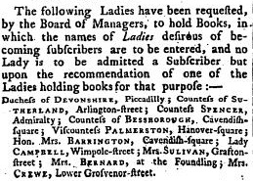
The Royal Institution
The Royal Institution of Great Britain, News, Lloyd’s Evening Post, 19th-23rd March 1800
Notes:
Mee and Rumford enjoyed a long correspondence. He wrote lengthy letters, often describing his experiments at the poor houses in Munich or military doings on the continent, mixed with gossip about mutual friends. Mee, in turn, passed on news from and about Rumford to her husband, uncle and other friends.
From 1799-1802 he lived in London and founded the Royal Institution, with which the Palmerstons were also closely involved
ADDITIONAL NOTES
Social networks - Whig aristocracy, esp. Devonshire/Spencer set. Countess Spencer (picture) also from 'trade' massive heiress and philanthropist.
She was not a political mover and shaker unlike some of her friends, such as the dowager Countess Spencer and her daughters, Georgiana, Duchess of Devonshire and Elizabeth, Countess of Bessborough, nor yet her successor as Viscountess Palmerston, Emily Lamb,
an intimate of the great and the good (the Princess of Wales called on her) and she regularly featured in the society columns, both attending entertainments and entertaining
like her husband, she was well connected with intellectual circles and counted Count Rumford, Sir Joshua Banks, the Berry sisters, and was one of the lady patronesses of the Royal Institution.
letters are full of political news and frequently note scientific developments, comets she was following, books she was reading as well as family news and social gossip
So how did a young woman from a non-aristocratic background learn to become, not only lady of the manor but a member of a political elite?

Slide 6
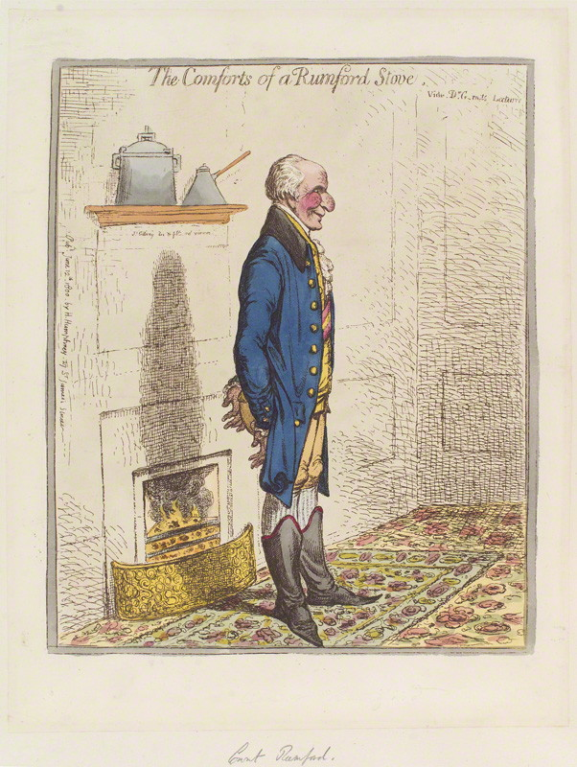
James Gillray,
'The Comforts of a Rumford Stove'
(London: Hannah Humphrey, 1800)
© National Portrait Gallery, London
Notes:
Rumford was an irascible character: he had strong views which he pursued enthusiastically.
Attracted the interest of a fellow Anglo-American, Sir Thomas Bernard.
In 1796 Bernard founded the Society for Bettering the Condition and Increasing the Comforts of the Poor (SBCP).
Rumford was given life membership of the Committee in recognition of his influence on their objectives.
hoped to bring in “a new era in the science of managing the poor”.
Like Rumford, the SCBP believed not only that it was important to inculcate a culture of self-help amongst the poor, but that misapplied charity could do more harm than good.
To begin with the Society very much promulgated Rumford’s ideas regarding the poor however the strong evangelical presence on the board of directors, gradually led to the SBCP taking on a more moralistic and socially conservative tone.
Mee shared her two main topics of interest with the SBCP: feeding the poor and educating the poor.
neither she, nor any members of her family, appear on the subscriptions lists
other Whig aristocrats do, notably Lady Spencer who gave ten guineas.
The SBCP supported schools of industry (as did Rumford). They singled out various schools as exemplars, including the schools run by William Gilpin at Boldre in the New Forest. Gilpin, formerly headmaster of the Cheam school and author on the picturesque, had retired to Boldre and using the profits from his hugely successful Travelogues, set up a school for industry in the village with both a boys’ and a girls’ section in 1791. There is no evidence that Mee visited the Boldre schools, although she may have heard of them.
Mee chose to educate the poor girls. There already was an endowed free school for boys in Romsey.

Slide 7
Lady Palmerston has established a soup-shop at Romsey, from which the poor are provided with large proportions, at very moderate prices. This charitable establishment is under the immediate inspection of her ladyship, who attends the delivery of the soup every day. There is also an institution under the same patroness, for the education of young girls, where above fifty are instructed in spinning and other acquirement necessary to make them excellent servants; both these liberal institutions are conformable to the plans of Count Rumford.
Winchester section, Hampshire Chronicle,
Monday 13th January 1802
Notes:
Mee’s school probably opened in 1800, certainly no earlier than autumn 1799 from references in letters.
an undated list of thirty ‘Girls at my school’ is written in the Account book and could date from any time from between December 1799 and January 1801. I
Jan 1801 school increasing to sixty, appointing of a sub-governess and needing to draw up rules
In 1802 an advert appeared in the Hampshire chronicle advertising Mee’s school and soup kitchen. Charitable undertakings bolstered a person’s social and symbolic capital in Georgian England.
Reports in London papers of regional charitable activity were even more about the social prestige of the donor.
Ostensibly reports of good deeds to act as a model for others, the reports in fact acted as adverts for the donor’s economic and social capital; it was not quiet charity by any means. National reputations could be built on the back of continued reports. Although only Mee received one known letter enquiring about her charitable establishments in Romsey, Lady Spencer was a well-known correspondent on all matters philanthropic and was consulted by people from all over the country. It is possible that had she lived longer, Mee may have become a ‘female expert’ in a small way.
Mee’s school was a very pragmatic enterprise. Aim to make girls employable.
She recognised the ‘opportunity cost’ of having children at school rather than working and her school was set up so that children were paid for any sewing and knitting work undertaken.
Unlike earlier schools of industry, she did not set out to profit from the children but sintead investable money in the school. In the 1720s, the SPCK championed Mrs Harris in Artleborough. Less school and more workshop, it ran for 15 hours a day with a short break for lunch, covered its costs and made as much as £500-£600 annual profit for the town coffers.
4 local ladies to act as visitors. All four families appear in Mee’s books as having recommended people to her for help.
Visitors and mee take turns to visit weekly
Governess wrote to Mee when away.
girls aged four to fourteen, Anglican & Dissenters
no stratification between the school of industry and another institution.
variety of backgrounds. Some had no father’s occupation listed,
labourers,
gardeners,
Bricklayers
Washerwomen
shoemakers,
butchers,
carpenters and
Tailors..
Mrs Rout, the governess, took the decision as to whether girls would be admitted and occasionally she did turn down a girl. Only those who could demonstrate that they would be likely to make use of the education offered were accepted (January 1803, Mee lists girls seeking admitted and notes one was ‘not approved by Mrs Rout’).
The move to make more general educational provision for the labouring and middling ranks of society only really gathered momentum in the late seventeenth and early eighteenth century. Reasons for the increased interest in education are manifold but a major driver appears to be the spread of Protestant Christianity. Protestantism emphasised the believer’s ability to read the Bible in a way that Catholicism did not. To be a truly devout Protestant nation meant to be a literate nation.
Coupled to the religious motivations were the Lockeian ideas that children were innocent tabula rasa to be carefully taught. “We have reason to conclude,” wrote Locke, “that great care is to be had of the forming children’s minds and giving them that seasoning early, which shall influence their lives always after.” A century later, Mee’s uncle believed “children should first be taught what is right before they are corrected for doing what is wrong”.
Grammar schools had existed since the middle ages, but they were increasingly restricted to the middle ranks.
Society for the Promotion of Christian Knowledge, were created in most London parishes, seeking to address the problem of child poverty and under-employment through education and work discipline.
By end of the century, many of the original charity schools were no longer educating the poorest in society but the children of semi-skilled and skilled artisans.
Many schools charged book and fuel fees which immediately put them out of the reach of the very poorest.
Opportunity cost; when a child was at school they could not be earning and adding to the family income.
1780s resurgence of schools in industry
1780s also new Sunday Schools
three tier system within charity schools. Trimmer declared the new schools were for the “bad and dull” children who could be trained up to work in manufactories or as common servants whereas the older style schools were for the “first degree among the Lower Orders” as there were “degrees of poverty as well as of opulence”.
Pitt’s Poor Law reform of 1795 advocated industrial schools in every parish, attendance would have been compulsory for the children of those on poor relief, bill failled
provision was piecemeal and usually only flourished under an enthusiastic patron, although even that did not guarantee success; both Trimmer’s school failed after 2 years
A 1803 government survey of children receiving parish poor relief found that only 11% of children were in schools of industry.
Famous industrial school at Bolder by William Gilpin, set up with proceeds of his books.

Slide 8
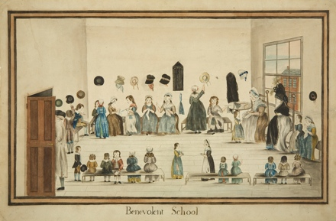
The Benevolent School, c. 1794 © Bristol Museum & Art Galleries
Notes:
Mee definitely preferred a well-educated girl. She praised Lady Carnegie as “the most sensible woman” she had ever met because of the quality of the education she gave her daughters and was aghast at the lack of education in Neapolitan noblewomen. However there was a consensus that education should differ based on rank.
Eighteenth-century educationalists emphasised practical, industrial, education over academic for the poor.
A significant minority viewed charity schools as disrupting the social order by educating children above their station: they were “more hurtful than beneficial: young persons who continue there so long as to read and write fluently become too delicate for hard labour and too proud for ordinary labour”.
Evangelical Sarah Trimmer wrote: “The children of the poor should not be educated in such a manner as to set them above the occupations of humble life, or so as to make them uncomfortable among their equals, and ambitious of associating with persons moving in a higher sphere, with whom they cannot possibly vie in experience or appearance without manifest injury to themselves.”
The Lockeian ideas as modified and expounded by educationalists such as the Anglican Edgeworths and dissenting Anna Barbauld, who believed that education should be stimulating, pleasurable, encouraging and, importantly, not limiting, were an anathema to Hannah More: “Is it not a fundamental error to consider children as innocent beings, whose little weaknesses may perhaps want some correction, rather than as beings who bring into the world a corrupt nature and evil dispositions, which it should be the great end of education to rectify.”
Subjects
spinning, knitting and all aspects of dressmaking, although the exact tasks would be age dependent; the youngest seem to have started with knitting.
Work was taken in at rates half the women’s rate and the girls were paid for the work they did.
Taught reading and spelling and their catechism (or equivalent for dissenters),
oldest girls were taught practical housekeeping skills.
Mrs Rout, the governess, had a supply of books to be given out gratis to those pupils who showed enthusiasm for reading.
No mention is made of writing but as the children’s parents were expected to be able to write absence notes
little purpose being able to spell if you cannot write, writing may well also have been on the curriculum.
arithmetic is not explicitly on the curriculum but basic numeracy would have been integral to dressmaking and knitting.
Mee unfortunately is quiet on her views about the teaching of writing, More thought it unsuitable for the poor, Gilpin only as added extra.
4 ½ hours in the winter, 6 hours in the summer with a two hour lunch break starting at noon. Girls could either go home at lunchtime or have their lunch in the governess’s ‘first kitchen’ and play in her garden.
Holidays were fixed at the discretion of the governess, in another pragmatic move, to be “most advantageous to the parents, and to the children, at the different seasons of the year”.
Each girl was expected to be clean and tidy (with short hair like Mee’s own daughters when young) and “as neat as the circumstances of her situation will admit of”.
Infant school
February 1803 an infant school was opened, taking girls and boys as young as two.
Mee demonstrated her pragmatic character, : “they all seemed delighted with the plan (not merely the beer) but of getting rid of their children which will allow them to go out”.
the total number of pupils was in the region of 100 girls.
Dinner
Continued bad behaviour would result in being excluded from the annual dinner.
In 1804, 136 girls, teachers and Mrs Smith the cook dined.
They were waited upon by the Lady Visitors, and other families and friends including Lord Ashburton
“their dinner Roast Beef, Plumb Pudding, Potatoes, Green Bread and strong and small beer – after dinner they went into the Spinning Room to dance […] Love Country Dances very well and Harry and Lilly etc danced with the infants. I never saw a gaier Ball & the pleasure arising from seeing so many happy is reflected back doubly upon those who enter it. They danced until 9 o’clock then had warm milk or water and a piece of cake”.
Another intangible reward was being invited to Broadlands. In January 1803, the school girls came to the house to receive their New Year prizes and Mee wrote to Harry later that day that “this morning had my school here and am quite ruined in presents”
Mee frequently made mock complaints to her son about the good behaviour of her schoolgirls costing her a fortune.
Harry replied in the same tone with a modest suggestion that she should “introduce some sly little discordant Pippin among them, and make the young ladies misbehave their prizes away in forfeits”.
school does not appear to have suffered from the absenteeism that occurred in other charity schools. This is probably due to the fact that the girls earned income by attending and the holidays were to be fixed at the parent’s convenience, so the economic pressures to remove children at harvest time and other local opportunities for temporary employment were not so acute.
Leavers
Mee remained interested in the girls once they left her school. She listed the leavers and their destinations (home, servants, dressmakers etc) every year in her books and invited the leavers back for the annual dinner. After the school had been going for a few years, she rented the house next to the school to provide workroom for those who haven’t gone on to other employment, to ensure that ‘her girls’ didn’t fall prey to that ‘degenerating evil, idleness’.
Legacy
Mee did not leave a legacy to her school.
not that unusual for the early nineteenth century.
Wanted to continue as she wrote in January 1803, “my hopes carry me to think when I no longer exist this school will live and flourish”.
May 1804, seven months before her death, Mee detailed her expenditure and debts and listed the allowances she would like to be paid after her death. “With respect to the School establishment it may be too expensive. I therefore have no right to be continued – I am sure I have no pretension to ask it.”
Family did support it until amalgamated into the Girls National School in the 1850s as part of a rationalisation of education in Romsey
the specialist needlework class in the National School was called Lady Palmerston’s until into 20thC and further education reforms

Slide 9
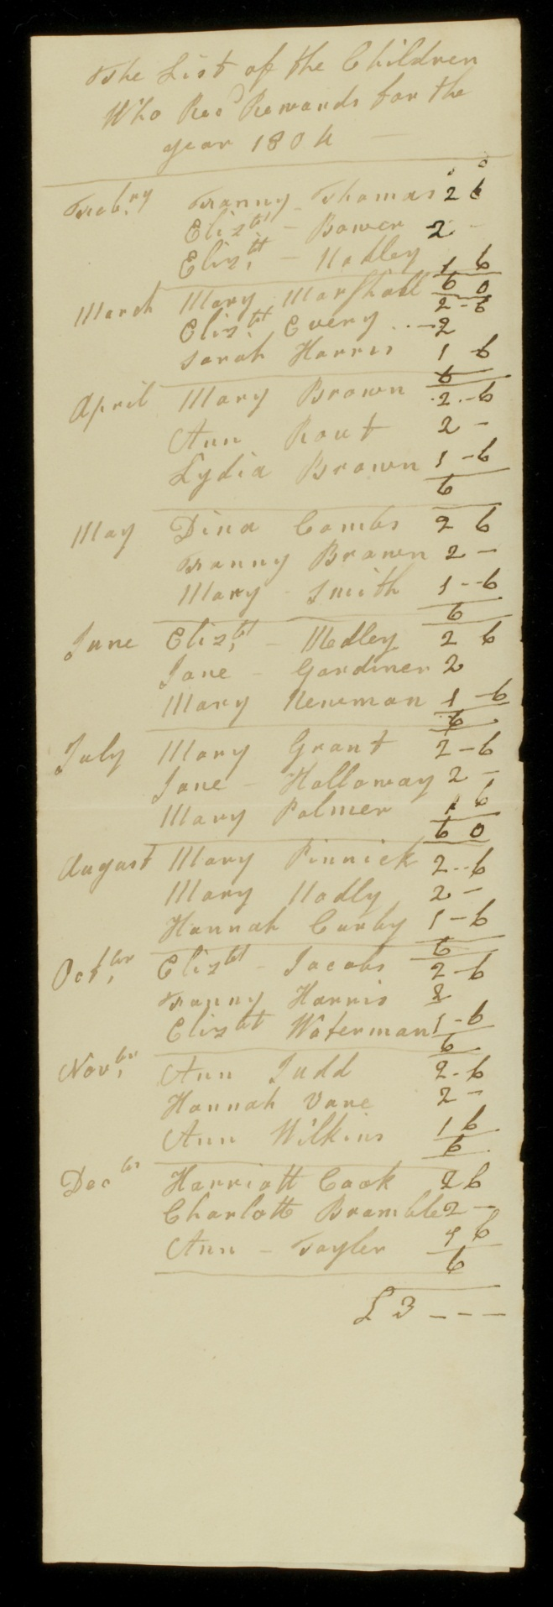
List of children who had rewards for the year 1802
© Broadlands Archive, University of Southampton
Notes:
Punishments
Punishments were usually in the form of a monetary fine from earnings and a headband to with the legend ‘for misbehaviour’ to be worn for the rest of the day.
“not very severe [and] more likely to produce a good effect from those commonly made”.
Lying warranted two days suspension, the loss of seven days earnings and wearing the black headband for seven days. Repetition of lying would lead to permanent exclusion.
Stealing: immediate expulsion, as Hannah Doling discovered in 1803 when she stole money from the teacher’s desk to buy peppermints.
All forfeited earnings were collected and given by Mee to the most deserving girl every Christmas and Whitsun. Monthly and annual rewards were given out; the monthly prizes were in the form of clothing of up to half a crown’s value for the third class, two shillings for the second class and one shilling and six pence for the first class and the girls would wear a white band emblazoned with ‘A Reward of Industry’.
Annual prizes of clothes were awarded.
Five prizes were available to each class. Given on new Year’s day
First Prize Gown, petticoat, shift, stockings, shoes, hat
Second Prize Gown
Third Prize Petticoat
Fourth Prize Shift
Fifth Prize Pair of stockings
The bill of S. Newell in December 1803 for the clothes for the school, came to £27.3.0. School leavers were given bonnets and in 1803 Mee planned to give all the girls cloaks to wear when going to church.

Slide 10
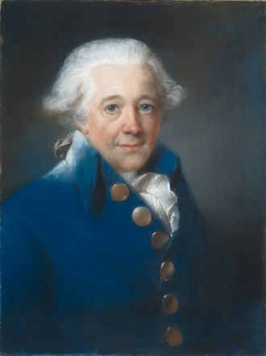
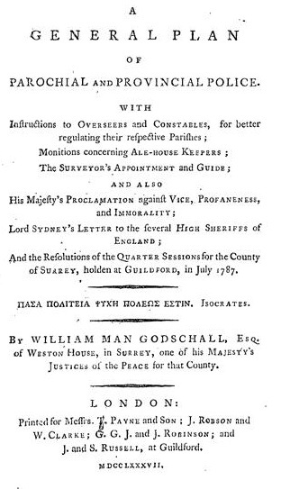
John Russell, William Man Godschall, 1791
© Metropolitan Museum of Art, New York
Notes:
Mee’s uncle by marriage, William Man Godschall. A local JP he had published a pamphlet on the concept of ‘police’, pamphlet with advice for Oversees of the Poor. That is police as in the concept of a regulation of society rather than police as in the Bow Street Runners.
We know she discussed her soup shop with Godschall and she may well have discussed more general ideas regarding charity, especially those concerning the education of the poor and the concept of ‘policing’ society.
Contemporary criticism
many were aware of the self-interested motives of some donors.
Charity was not a purely private affair; published subscription lists were used as adverts for the charity, listing not only the donors but also the amount given. Would-be donors could be shamed into subscribing in order not to be conspicuous by their absence. The publication of subscriptions lists could backfire on those who were perceived not to be doing their fair share, and in 1802, the aristocratic reticence to subscribe to the Patriotic Fund even cause the government to defend peers in the press.
Patrician subscribers were frequently sought to add social cachet. Lady Spencer is on record as saying she would donate anonymously to those causes where she felt she didn’t know enough about the cause to lend it her name.
middle rank subscribers to network with each other, to make business connections, to exert social power, and to bask in reflected glory regardless of how much they individually gave.
The annual dinner for major donors was frequently preceded by a church service during the day, with choreographed displays of deference by the recipients of charity to their benefactors. Those for London-based charities were often prominent features in the social calendar, and on at least one occasion a Royal review was rescheduled to avoid a clash with the Charity Schools parade.
1720s: Mandeville, The Fable of the Bees: Or, Private Vices, Publick Benefits. “pride and vanity have built more hospitals than all virtues together”.
Several decades later a French visitor commentated: "l'ostentation et la vanité ... tous ces actes de bienfaisance".
Modern criticism
EP Thompson claimed “the humanitarian tradition became warped beyond recognition”.
Porter, more charitably, saw donors as being driven by a variety of motivations depending on their philosophical background.
Prochaska “the conservative nature of much late eighteenth- and early nineteenth-century charity is indisputable”
Borsay saw philanthropy as “provid[ing] an altruistic façade behind which to pursue self-centred ambition
Rise of associative charity
Calls maintain a personal connection between donor and recipient.
Malthus : close monitoring of claimants on charities; create a bond of reciprocity between the giver and receiver
pre-empting the Bourdieusian theory of reciprocity, wherein the recipient is forced, by social expectations, to repay the charity in some form, for example, conforming to the behavioural expectations of the giver.
Symbolic violence,
charity could act in the direct opposition to the interests of the recipient and in the interests of the giver by reinforcing inequality,
misrecognised by both the donor and recipient as beneficial to both. T
“the giving and receiving of alms became increasingly a symbolic and exemplary exercise, as much an act of control as relief”. Nevertheless, the recipients of charity did not always behave as the givers wanted (as the behaviour of children and parents at the London charity schools’ parades demonstrated).
concern over the administration of charities, specially the parish based charity, namely the Poor Law Relief.
Many charity dinners : drinking clubs for gentlemen who has little interest in the supposed recipients of their charity.
The fear of maladminstration / desire to control how donations spent
change in giving habits.
inherited wealth was increasingly restricted to the nuclear family, at the expense of charities and extended family.
1675-1700 70% of wills included bequests whereas between 1800-1850 only 29.9% contained bequests.
Mortmain Act of 1736, which made it illegal to establish charitable trusts through a will at death, although individuals could still leave money to existing charities.
1727: London, Sir Thomas Guy’s in 1727.
1752: Hampshire, Richard Taunton, a Southampton wine merchant and former mayor, who left £13,000 to various charities on his death in 1752.
1802: Lord Palmerston’s single major bequest (£500) to Winchester Hospital was unusual enough to be reported as far afield as in the Bury and Norwich Post.

Slide 11
Notes:
Mee’s on-going involvement in her charitable establishments marks her out as unusual for her rank.
fellow wife of an Whig M.P., and daughter of a newly ennobled Irish peer, Mrs Frances Calvert did personally inoculate the local villagers on her estate against smallpox.
helped out the local schoolmistress over the course of several days when setting up the local Sunday school, not something she meant to carry on doing and in the future her visits were be more occasional.
Lady Spencer took close interest in her various causes at the administrative level but was unlikely to be found daily at her food charity.
Mee’s personal interest in her school in Romsey, in particular her close knowledge of the girls, was atypical.
Mee was on the cusp between ‘particular charity’ to larger, institutional based charity. While Mee may well have been concerned that her money was not wasted and may also have been subconsciously aware of the effect of her personal presence in creating a stronger bond of loyalty between the giver and the recipient, it is also clear from her letters, that she enjoyed the involvement and derived her own personal pleasure from seeing the results of what “interest[ed her] exceptionally”.
In many respects, Mary Mee behaved as a typical wealthy woman of the late eighteenth century.
societal norms in believing that the rich had a duty of care for, and the right to instruct, the poor.
never expressed the concept openly in her writing, her actions show she had indeed inculcated the concepts of policing.
Traditional charitable activity for the mistress of a great house: visiting the ill, clothing the poor, lending linens to new mothers, providing food in times of want.
school was more atypical in that it was a school of industry rather than a Sunday school or traditional charity school, however it fitted within accepted conservative bounds for the education of working class girls.
Criticism
Owen, in his work on English philanthropy,
“anachronisms”, “ineffective and ephemeral”
their advocates as labouring under “a series of misapprehensions about the currents that were revolutionising British life”.
question if schools of industry were even philanthropic ventures.
Harsh if deserved for Trimmer who thought that spending a day spinning constituted a good moral education to keep children “from the dangers to which idleness exposes every human being”,
unfair on those who saw schools of industry as an alternative to industrial workshops, with added free education,
ignores those who saw them as the only way for education to reach the very poorest in society. Mee’s school was philanthropic; it did not pay its own way through the children’s labour. Mee was not detached from the new forces of industry as Owen suggested; she toured factories with her husband and urged her children to maintain awareness of manufacturing conditions.
Palmerston set up schools for both boys and girls throughout his Irish estates and even when he was appted to the FO in 1830, he took time going through attendance lists sent to him by the school masters and mistresses, to decide which children should be rewarded with a shilling for best attendance, paid from his own pocket.
Dressmaking also taught at the girls schools that Palmerston supported on his estates in Sligo (Norton, EHR, 2004, p.1267), although the schoolmaster did complain about the lack of books to LP’s agents (only 44 books for 176 girls in 1843)
Mee:
Not an evangelical philanthropist,
more a rationalist, spurred on to action by the thought that she could improve the conditions of the poor rather than benefit her own or others’ souls.
Not a ‘great’ philanthropist, but she did spend a significant amount of her own annual allowance on her charity; from her own relatively modest income of £100 per quarter she spent over £66 in August 1799, at the same time as her family’s finances were under pressure. Many aristocrats did far less.
More akin to upper landed gentry: held an Irish title but with no major English estate,
her behaviour conformed more to the stereotypical landed gentry than it did to the major aristocracy.
Most Georgian charities were dominated by the middle classes.
The Aristocracy were not great philanthropists: apart from a few notable exceptions such as Lady Spencer, the 3rd Earl of Egremont and the 8th Earl of Winchelsea, there were no great aristocratic philanthropists who could compete with the likes of Hanway or Wilberforce for breadth of interest and charities supported.
Mee is certainly not in their league for sheer amount of money donated, but the type of charity she practised was certainly more like their interested, active philanthropy than the distant, figure-head charity most aristocrats bothered with.
She may in the most part, have followed the more aristocratic model of personal, localised projects rather than associational charity, but her choice of causes and personal involvement in her charities point forward to the more ‘middle class’ aristocracy of the nineteenth century.
Her son has often been called one of the last Georgians; perhaps it might be better to call his mother one of the first Victorians.

