Slide 1
Vacuum current emission and initiation in an LaB₆ hollow cathode
M. Praeger, A. Daykin-Iliopoulos, S. Gabriel 06/04/2018
Notes:
Please use the dd month yyyy format for the date for example 11 January 2008. The main title can be one or two lines long.

Slide 2
Motivation:
Gain insight into ignition processes in a hollow cathode:
Improve hollow cathode designs
Optimise starting procedures, etc.
Measurements of emission current before and during ignition.
Find alternatives to Xenon as a propellant:
Potential for improved performance?
Lower costs, especially during development
Evaluate the performance of Krypton in an LaB₆ hollow cathode.

Slide 3
The Experiment Apparatus:
2x large turbo pumps, 8600 L/s, ultimate pressure of 10⁻⁹ mbar
Background pressure of 10⁻⁵ and 10⁻⁷ mbar depending on the mass flow rate.
Full computer control and data logging system.

Slide 4
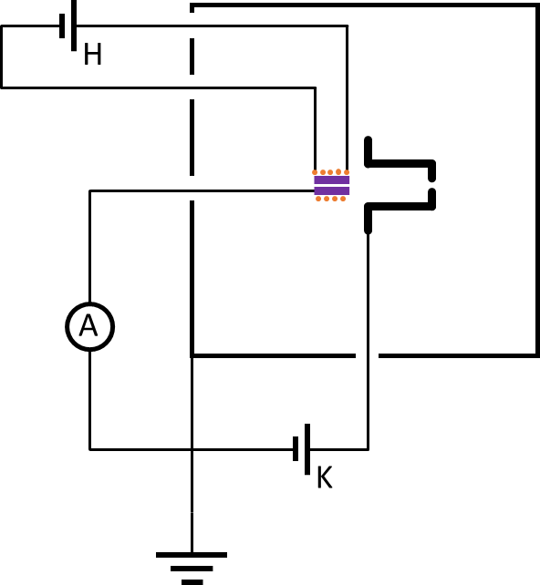
Electrical Configuration:
Schematic Circuit Diagram
These experiments focus only on keeper discharges.
No anode is used.
Hollow Cathode Device
Current Measurement Device
Heater Power Supply
Keeper Power Supply

Slide 5
The Hollow Cathode Device:
Purchased from Mars Space Ltd [1].
Potential to function either as a Neutraliser or as a Plasma Source.
LaB₆ emitter.
150 W heater.
Wide range of emission currents:
(few mA to 40 A).
*
[1] http://www.mars-space.co.uk
* View a heater-less hollow cathode at the TDHVL stand.

Slide 6
Experiment Procedure:
Automatic sequence of test conditions:
3 Current Measurements at each step:
Total of 4032 measurements.
Delays are included in sequence to allow for stabilisation.
Section of log data.
 | Min | Step | Max | Unit | # of steps
Heater Power | 0 | 10 | 150 | W | 16
Keeper Voltage | 0 | 5 | 100 | V | 21
Kr Flow Rate | 0 | 5 | 15 | sccm | 4

Slide 7
What is pre-ignition current?
Here, ignition status is defined relative to the vacuum current:
Vacuum Current:
Thermionic emission
This is the current measured with zero gas flow.
With gas flow - Define three different ignition states:
Pre-Ignition:
Current ≈ Vacuum Current
Ignition:
Current > Vacuum Current
Transient condition
Fully Ignited:
Current = Current Setpoint
Supply in current control mode

Slide 8
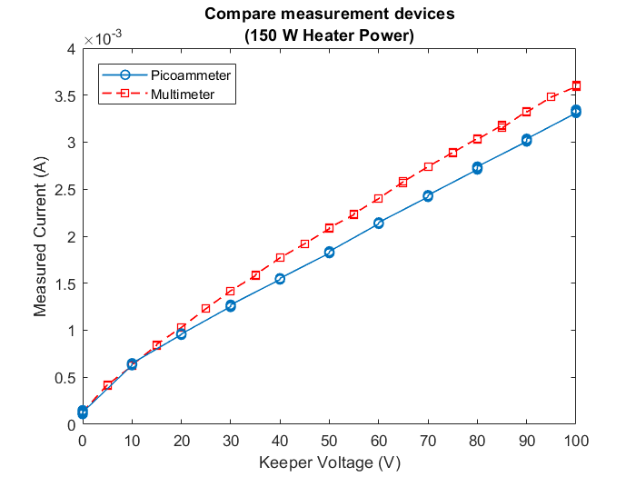
Results Outline:
Two sets of results:
Vacuum Current Data:
Small currents -> picoammeter.
Ignition Measurements:
(i.e. with gas flow)
Large currents -> multimeter.
Tests confirm reasonable agreement between the two instruments.

Slide 9
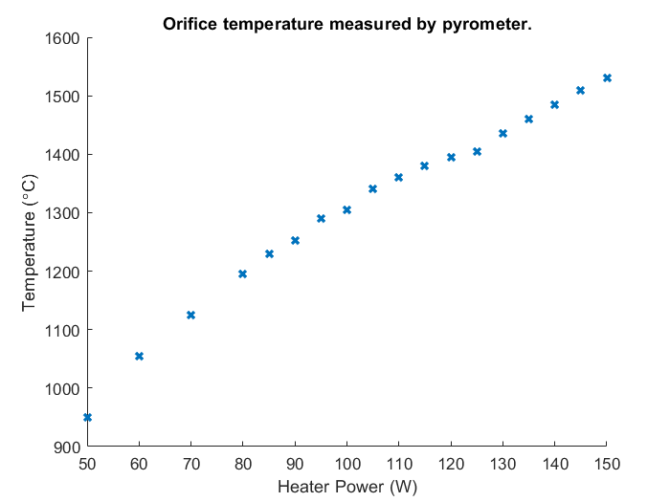
Pyrometer Measurements:
To relate heater power to temperature…
Hot wire pyrometer measurements of the orifice temperature vs heater power.
Orifice plate 1530°C @ 150 W.

Slide 10
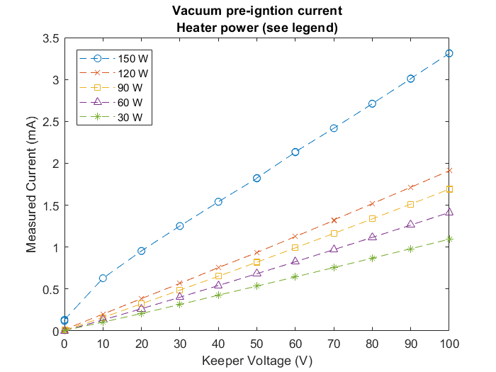
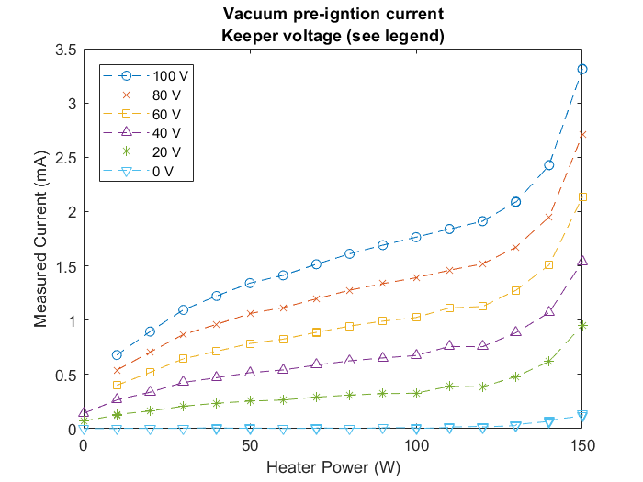
Vacuum Current Results:
Plotted against keeper voltage:
Plotted against heater power:
Peak vacuum current is ~3.5 mA for: heater power = 150 W, keeper voltage = 100 V
Sharp increase in current for heater powers > 120 W.

Slide 11
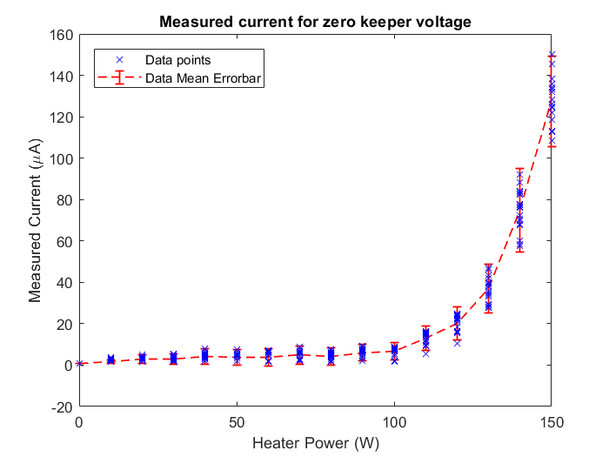
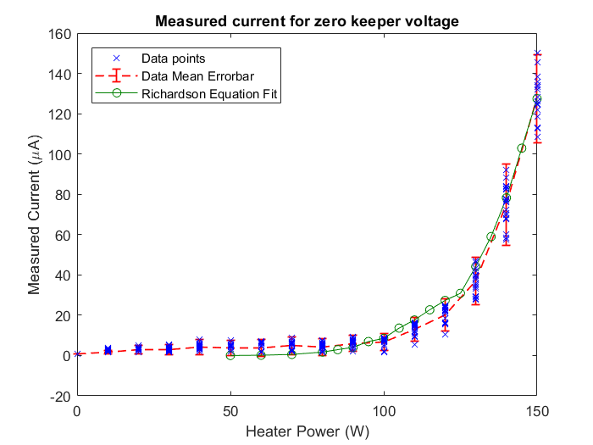
Vacuum Current Results 2:
Keeper Voltage = 0 V.
Current in the µA range
Can be fitted with the Richardson equation, but…
For 1530 °C emitter, effective emitter area has to be tiny:
0.0036 mm²
Actual emitter area is 141 mm².
Possibly, the orifice obstructs electron drift; decreasing the rate at which they arrive at grounded surfaces.
This mechanism needs further investigation.

Slide 12
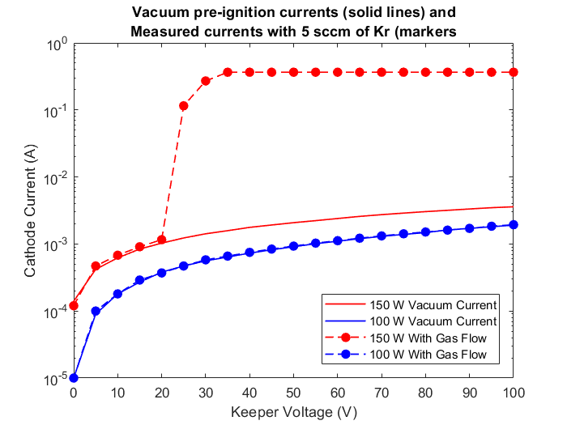
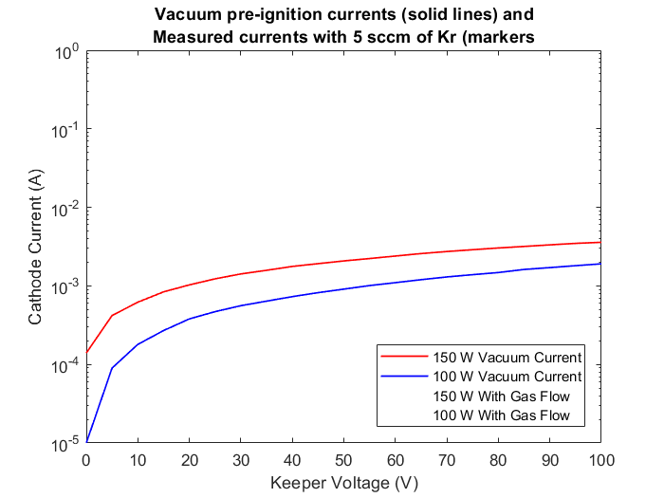
Kr Gas Flow Results:
Explanation of plot:
Notice current axis is log scale.
2 heater powers shown.
Vacuum Current:
Zero gas flow
With 5 sccm of Kr:
Pre-Ignition State
Ignition Phase
Fully Ignited State
Ignition Phase
Fully Ignited (At the supply limit of 350 mA)
Vacuum Current
Pre-Ignition

Slide 13
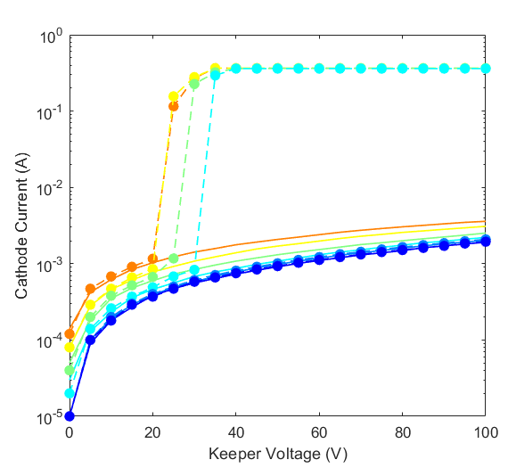
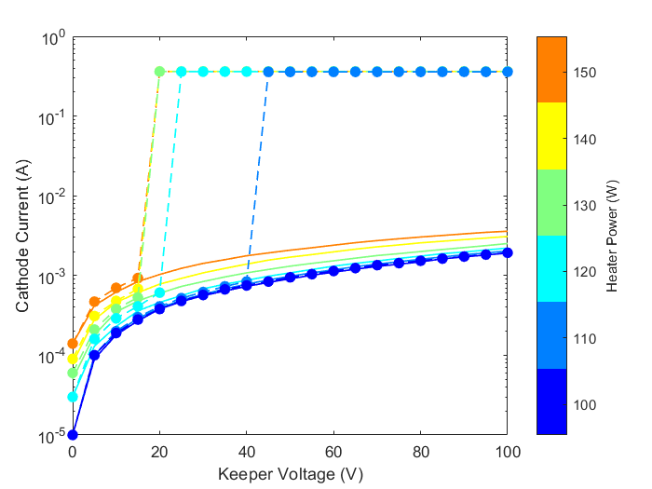
Compare Different Kr Flow Rates:
“Ignition phase” is observed for 5 sccm but direct change to “Fully Ignited” for 15 sccm.
Higher flow rate can reduce heater power & keeper voltage requirements for ignition.
Fully Ignited at 40 V, 120 W
Fully Ignited at 20 V, 130 W
Fully Ignited at 45 V, 110 W
Ignition Phase spans 25 to 35 V, 130 W
5 sccm Kr
15 sccm Kr

Slide 14
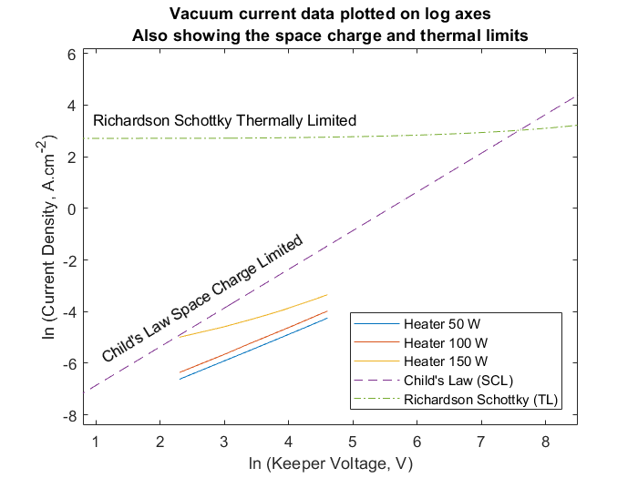
Preliminary Analysis: Vacuum Current
To give context to the measured data…
Plot Richardson equation:
For 1530 °C (i.e. at 150 W heater power).
Plot Child’s Law:
For 100 V keeper voltage.
To get current density, assume that 1 mm length of the inner surface area emits.
Straight lines on log-log axes (as for 50 W and 100 W) are consistent with Child’s law.
Many factors (e.g. geometry) are neglected.
Measured
Vacuum Current
Note: Both axes are logarithmic.

Slide 15
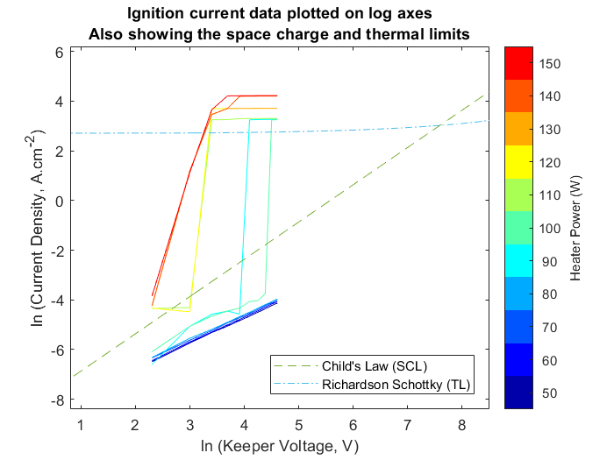
Ignition shown on log-log axes:
Keeper Current: 350 mA, 5 A, 9.5 A.
Kr flow rate: 5 sccm.
Perhaps coincidentally, current density in the “Fully Ignited” state is close to the value predicted by the Richardson equation.
For “Fully Ignited” plasma we actually measure the current passing through plasma sheaths at emitter and keeper surfaces.
During the “Ignition Phase” the current emission mechanism changes. (No longer SCL at emitter).
The exact mechanisms in operation cannot yet be stated and require further investigation.
Fully Ignited
15 sccm
10 sccm
5 sccm
Ignition Phase

Slide 16
Conclusion:
Pre-ignition currents are consistent with space charge limited behaviour.
On ignition, the physics changes significantly (closer to the thermally limited case).
More work is needed to fully understand the exact details of the mechanisms involved.
Demonstrated ignition of keeper discharge with Krypton.
Discharge current of 350 mA to 9.5 A.
Kr flow rates 5 – 15 sccm.
For keeper voltages as low as 20 V.
For heater power as low as 110 W.
First measurements of pre-ignition currents with Kr, for LaB₆ hollow cathode.
Accurate measurements down to µA range.
Potential to use pre-ignition currents for hollow cathode condition monitoring or diagnostics.

Slide 17
Notes:
You can use a full-bleed image to create impact on a page. Caption the image as shown.

