Slide 1
The transformation of communities through emigration: Care provision, inter-ethnic relations and the agency of older people ‘left behind’
Elisabeth Schröder-Butterfill
University of Southampton
emsb@soton.ac.uk

Slide 2
Strands in the literature
Community level: focus on receiving countries (diversity, integration, labour markets)
Sending countries: individuals and households ‘left behind’
Remittances
Vulnerability
Transnational families, ‘caring for’ and ‘caring about’

Slide 3
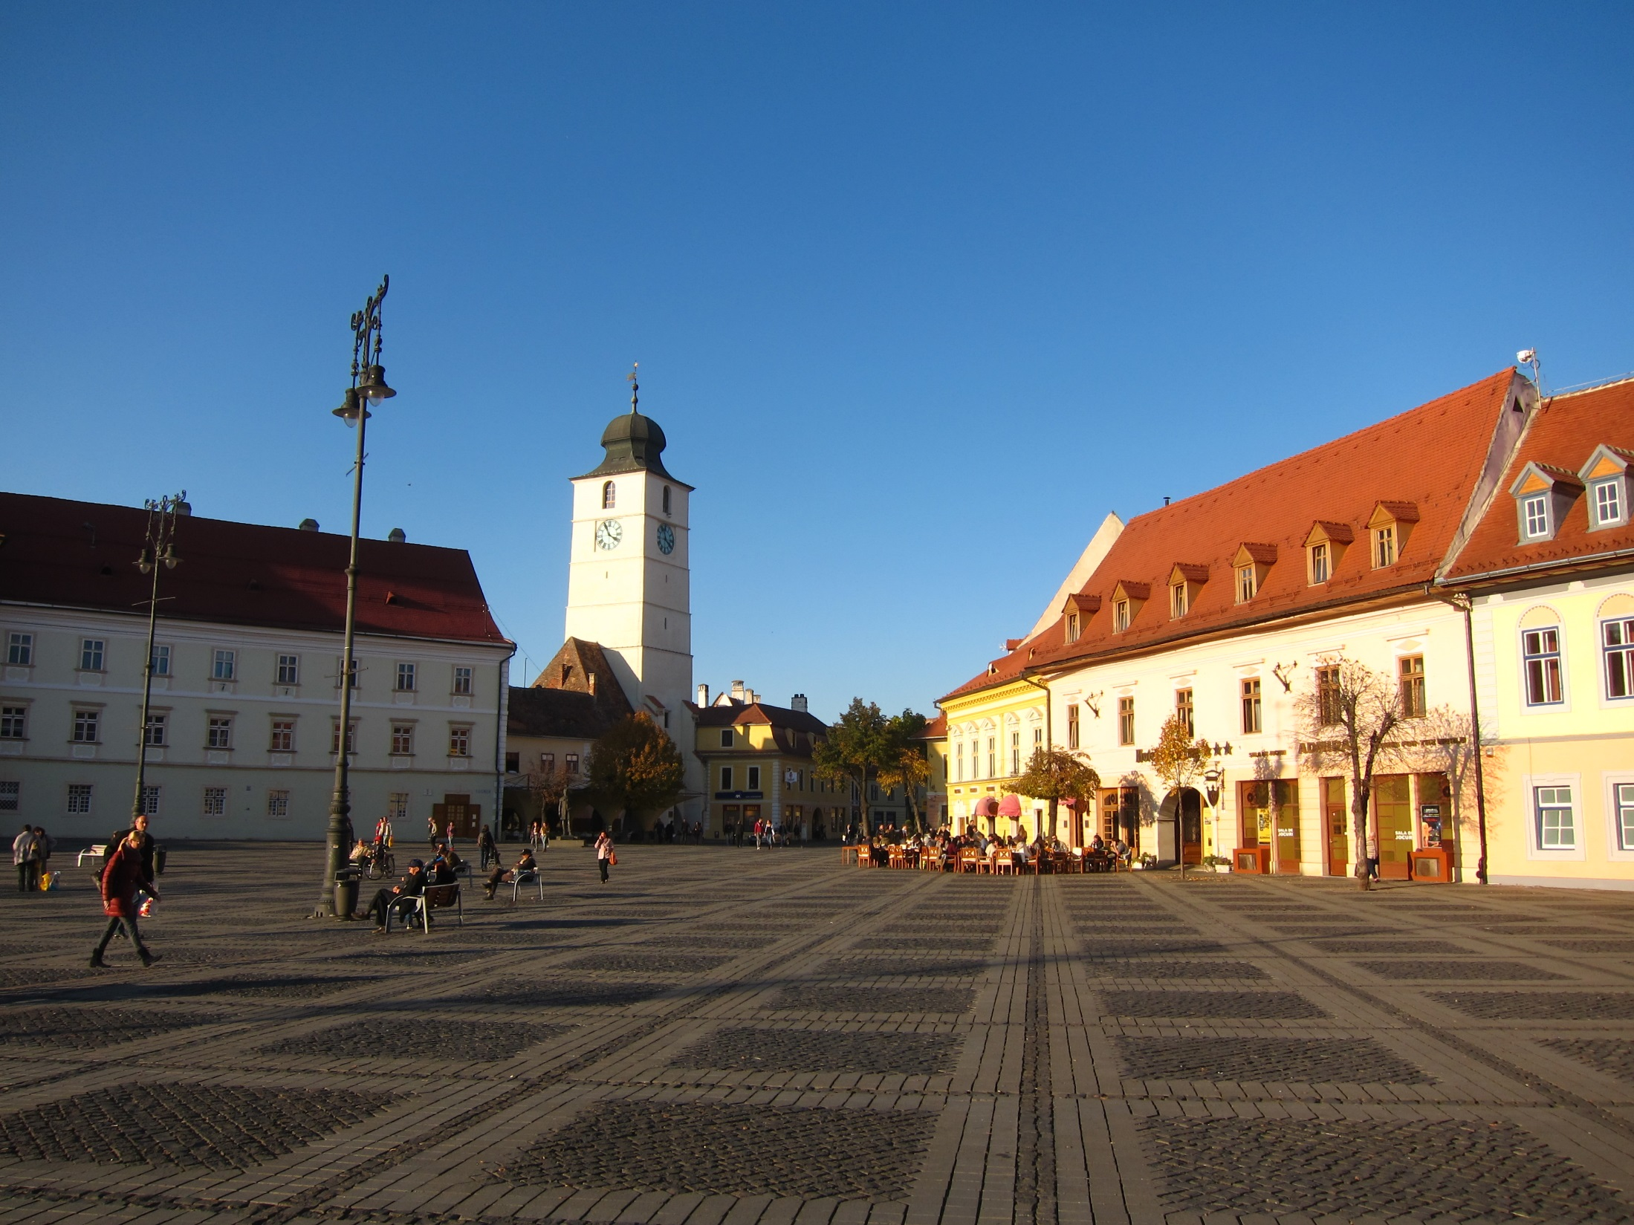
Emigration’s impact on sending communities
The transformation of networks
Older people’s agency

Slide 4
Transylvanian Saxons in Romania
German-speaking minority in Transylvania since C12th (cf. other German minorities across Eastern Europe and Central Asia).
Distinct identity, language (German), religion (Lutheran) and culture. Intermarriage rare until WW2.
Year | Population
1939 | 260,000
1966 | 151,000
1989 | 96,000
Today | 14,000
Decline in population numbers
since end of WW2
(deportation to Russia and subsequent release
to German; family reunification; German
state-sponsored ‘ransoming’;
mass exodus in 1990-91).
Large proportion of remaining
Saxons are over age 60.

Slide 5
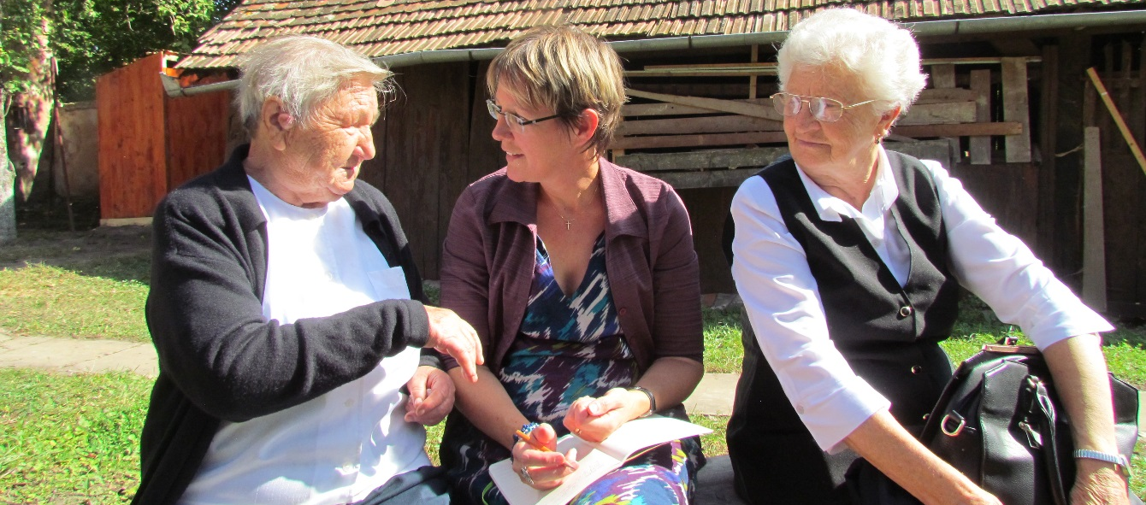
Methodology
Semi-structured interviews in Sibiu, Medias and surrounding villages (2008 and 2015-16).
Expert interviews (incl. vicars, care home staff, journalists, academics) [N=20];
Older Saxons (community-dwelling [N=30] and in old-age homes [N=24]).
Participation in events (e.g. church events, craft circles for older people, village reunions, activities in care home)
One month participant observation in a village near Brasov, including conversations with 25 elders.

Slide 6
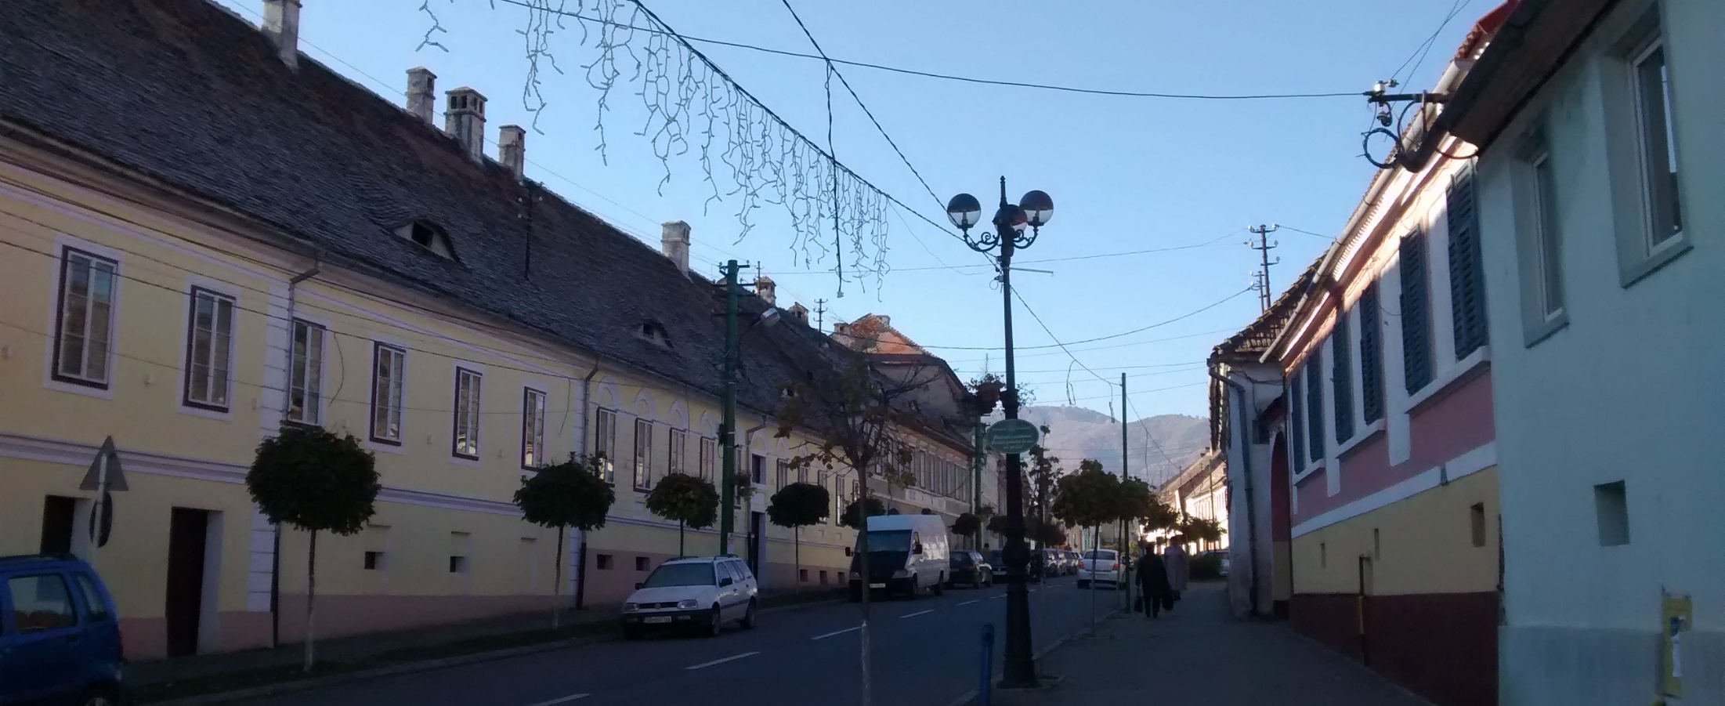
I grew up in this street, and … in this street only Saxons lived, [in] the whole street there was not a single Romanian family. … [Now] we are the only Germans here, with the vicar. The vicar and I.

Slide 7
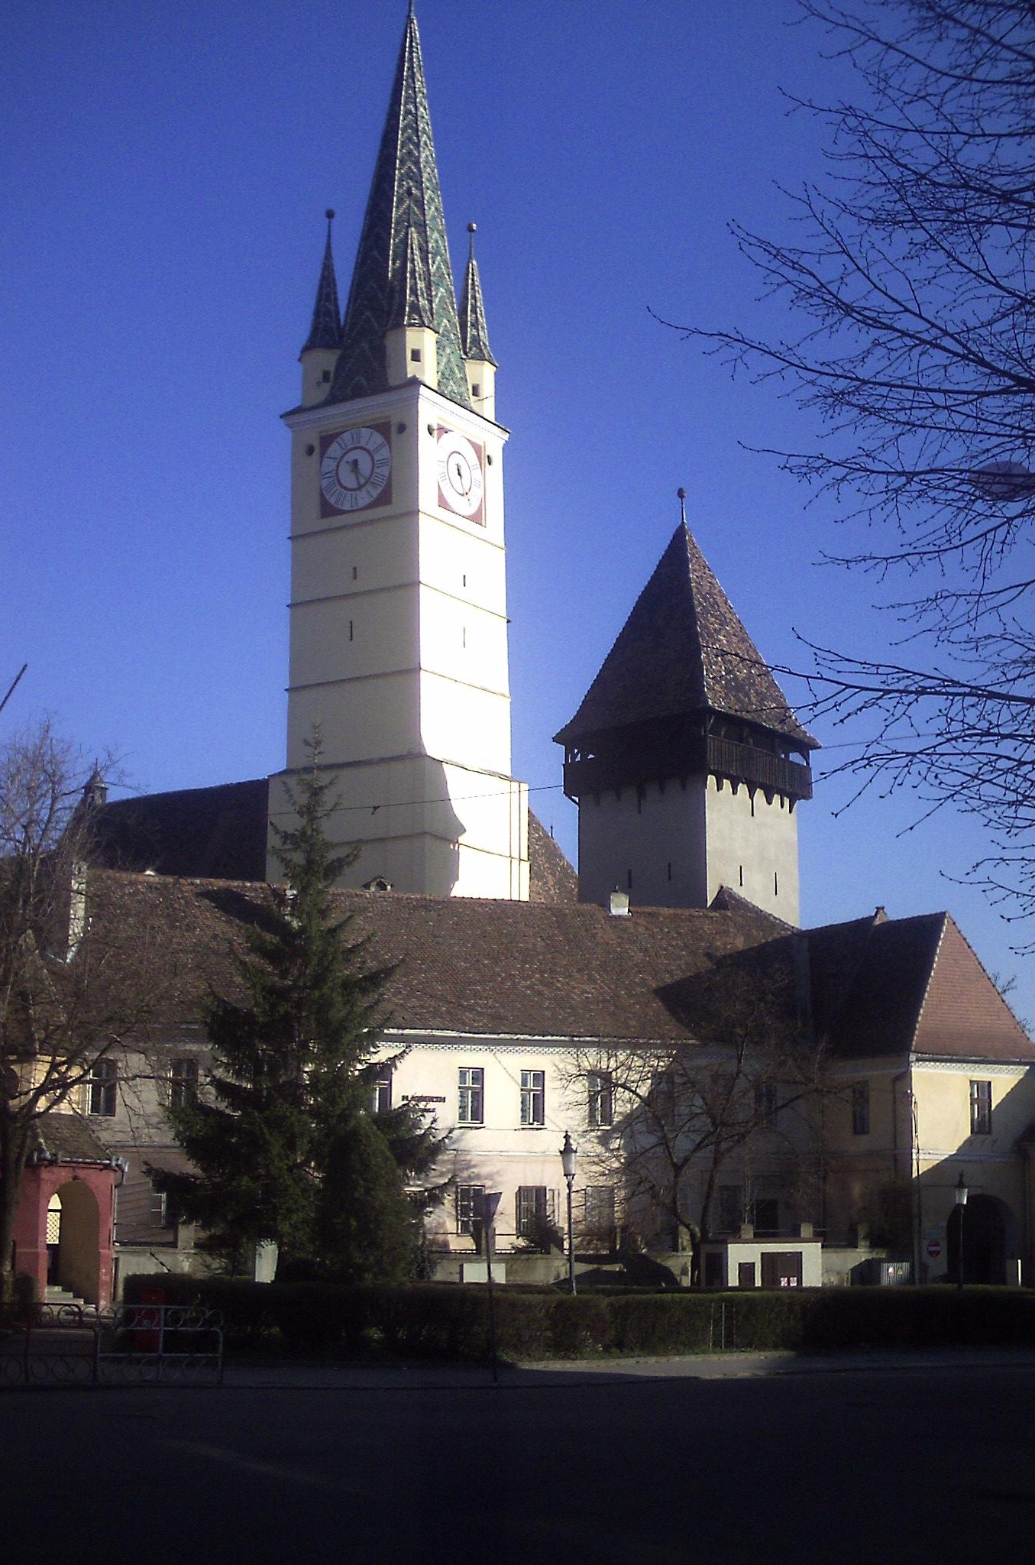
The role of the church
“We never needed a ‘Diakonie’ [church-based welfare services] until 1990, then communities were well structured into neighbourhoods, sisterhoods, brotherhoods, one used to help each other. … But after 1990, when all this collapsed, when these structures were no longer sustainable, i.e. one no longer had the people with whom one could do that, then the church took over.”
(Expert interview, vicar)

Slide 8
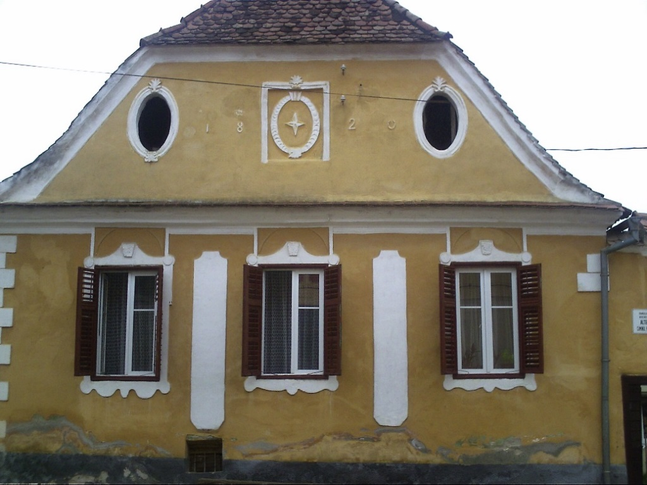
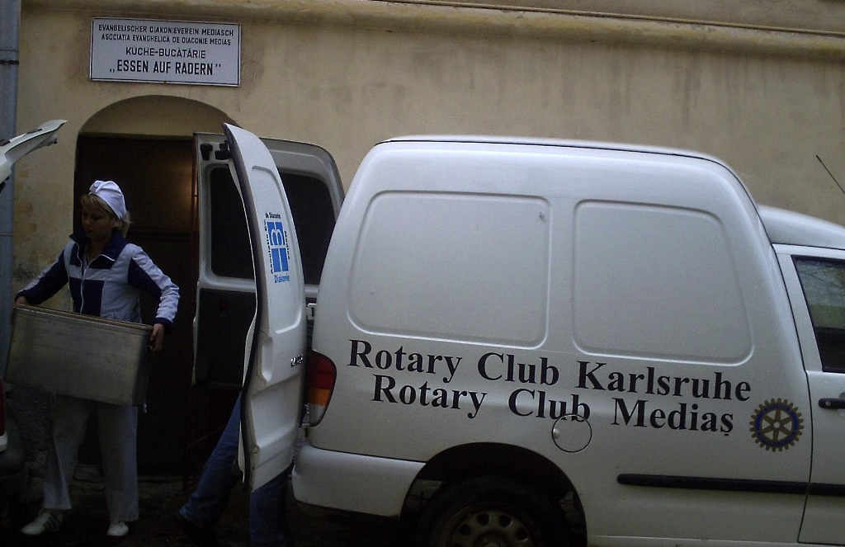
Older people’s role in church-based welfare
The vicar’s wife’s impromptu old-age home
Co-ordinating care-in-the-community

Slide 9
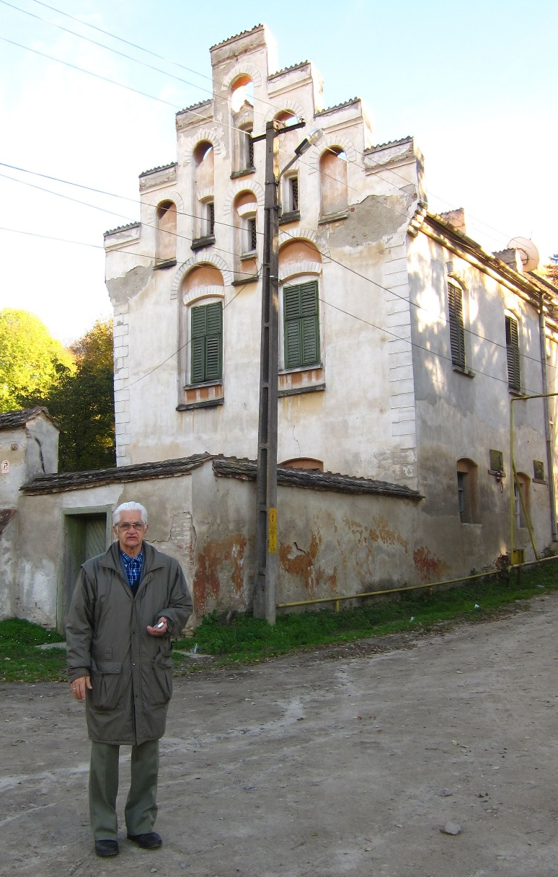
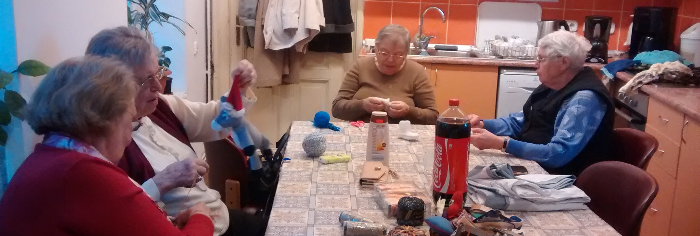

Slide 10
The transformation of local networks
“In the past the relations [with Romanians] were also good (well, not immediately after the war), but until ‘die Wende’ [i.e. 1990] the main contacts were always with other Germans. Now they are missing, and therefore there is greater orientation towards Romanian neighbours. Look at my parents, they live in the same house as a Romanian family and they help each other. It means I don’t have to stop by so often.”
(Expert interview, vicar)
“No, it wasn’t difficult for me. … I said to myself, there are people around, I am not alone. I am not in the woods, but in a community. … The Saxon neighbours were gone, then others came, the Romanians, but we get along. After all, we are neighbours.“
(Older woman)

Slide 11
Romanian neighbours replacing Saxon neighbours
JCS: “Do you still have ‘Kränzchen’ [traditional Saxon get-togethers involving cake, coffee and gossip]?
R: “Yes, but not Kränzchen… With my neighbour, I go to her and she comes to me, she asks me for things if she needs, and I ask her. Because she is very decent. She is Romanian but very decent. If I go to her on the first floor, she comes out and calls [in Romanian]: ‘I know you haven’t prepared yourself any food!’”
JCS: “And did she bring you food?”
R: “No, I went and ate at hers.”
(Divorced childless woman, now in an institution)

Slide 12
Care by Romanian neighbours
“Opposite us lived an older Saxon widower, he came to an arrangement with a Romanian family living outside Hermannstadt in a village. He invited the young Romanian family into his home. They took on the duty of caring for him until he died, and afterwards they inherited the house.”
(Expert interview, academic)
“Without this woman, I would long be in the cemetery!”
(Elderly widower, living alone, both children in Germany)

Slide 13
Funerary care
[That woman’s son] came willingly when my husband died. I just phoned him: ‘Danut, my husband has died!’ ‘Oh, I am coming!’ He came willingly, we washed my husband and prepared everything, the coffin, he also came to the church, to the Saxon church.” (Widowed woman living alone, only son in Germany)
(Expert interview, academic)
„For many it is important who will later carry me to my grave. For that reason nowadays some half-Roma are included, they then also come into the church. That is a price people are willing to pay.”
(Vicar)

Slide 14
Conclusions
Assessment of impacts of emigration requires wider perspective: social networks, community ties, civil society institutions.
Importance of wider historical perspective to appreciate significance and meaning of changes.
Later life as period of vulnerability and agency. Lifecourse perspective and/or longitudinal research helps to reveal this.

