Slide 1
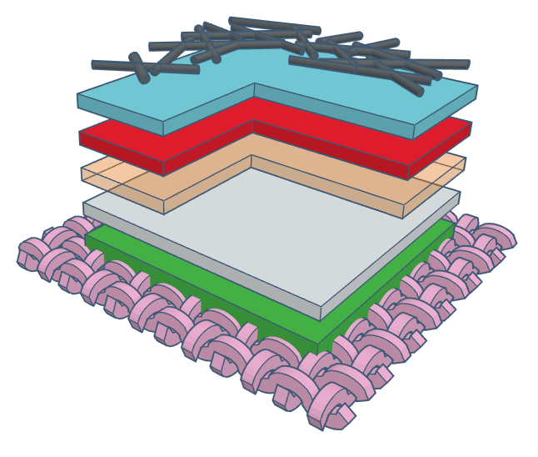
AgNW layer
PEDOT:PSS layer
Active layer
ZnO layer
Ag electrode
Interface layer
Woven textile

Slide 2
AgNW
PEDOT:PSS
Active layer
ZnO-NP
Ag electrode
Interface
Woven textile

