Slide 1
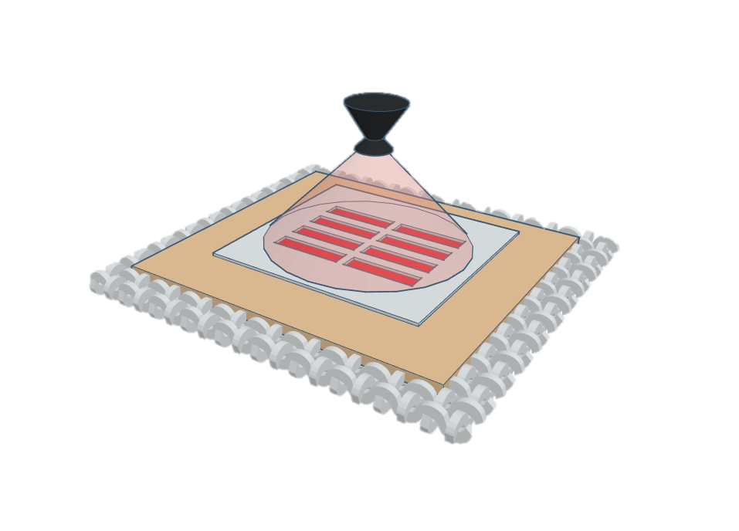
Spray nozzle
Spray mist
Patterned layer
Spray
shadow mask
Screen printed
Interface layer
Textile

Slide 3
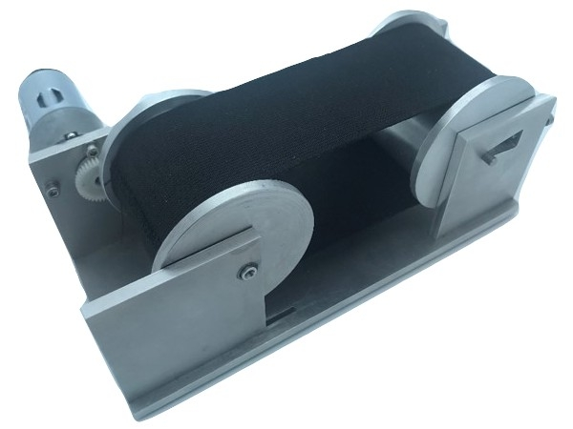
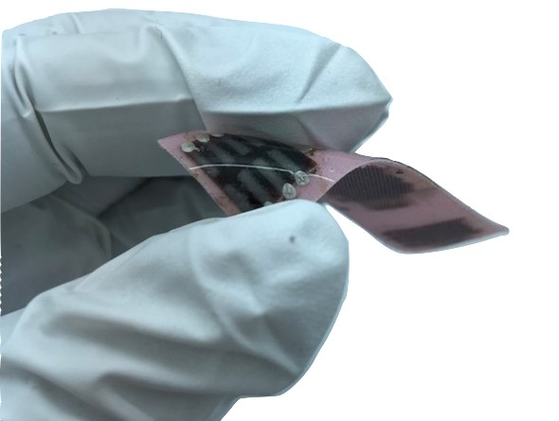
(a)
(b)

