Slide 2
‘Helpful and good fun’: Developing a social induction with students as partners
Neil Ford
Senior Teaching Fellow (Education Development)
Southampton Business School
European First Year Experience Conference, 17 June 2019, Cork Institute of Technology

Slide 3
Background and introduction

Slide 4
Rationale
Context
Aims
Approx. 250-300 1st years across 3 programmes
Business Management, Accounting & Finance, and Marketing
Peer Learning since 2016 – based on PAL/PASS
Research intensive
Education Development Office
High first year failure
BTEC vs A-Level performance
Modular curriculum + Large cohorts = Poor cohort identity/ social integration
Learning behaviours/ Student engagement
Student satisfaction
Adapt quickly to Uni life
Meet and work with students on the same programme
Share expectations/ behaviours
MODEL independent learning for HE
Discover available support
HAVE FUN!!!

Slide 5
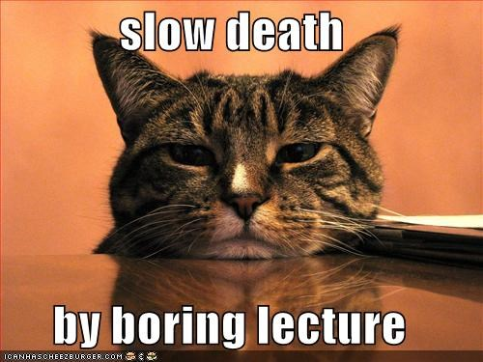
Traditional Induction
Induction contents
‘Welcome session’ (1 hour)
Head of School, Director of Programmes, Placements team, careers and employability, education development office, student administration
Programme talk (1 hour)
Programme Leader – covered course structure, progression, academic regulations
Academic integrity/ Senior Tutor/ Library session (2 hour lecture)
Types of academic offence, referencing, pastoral support, using the library
Learning at University (2 hour lecture)
Programme Leader – covered lectures/ seminars, grades, independent learning, study skills

Slide 6
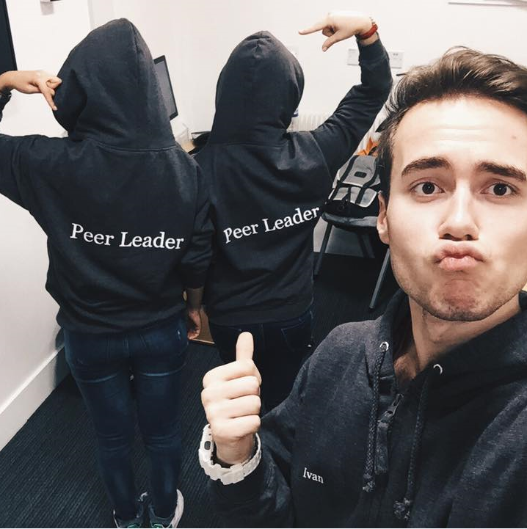

Slide 7
Methodology

Slide 8
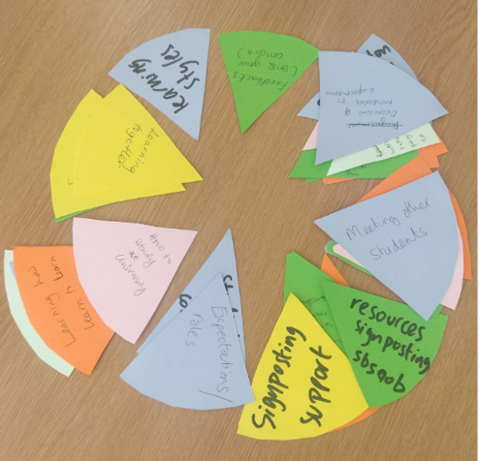
Partnership & pizza approach
Student Interns
Course Reps
Academic (AI Officer, FEC, Senior Tutor)
Students’ Union
Programme Leaders
Students
Staff
Student admin
Freshers
Library
Peer Leaders

Slide 9
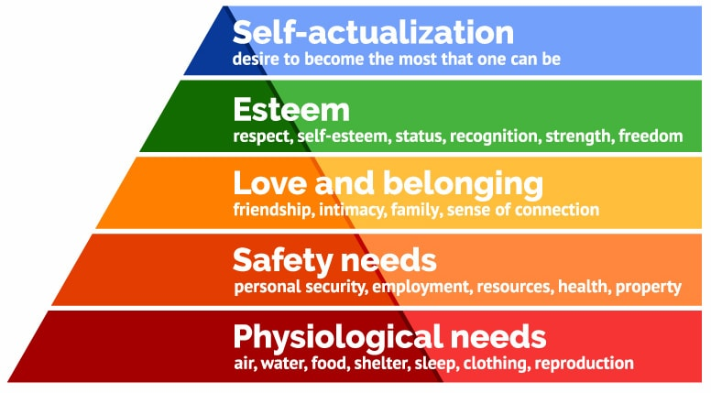
Pedagogic Approach: Social Identity

Slide 10
Stages of development
Consultation
Design/ preparation
Delivery
Evaluation
April-June
Student/ SSLCs
Programme Leaders
Stakeholders
May-September
Student Interns
Timetabling
Design activities
August-December
Pre-arrival materials
Induction week
Peer Learning
Sem. 1 modules
October-ongoing
Induction survey
Attendance data
Part 1 outcomes
AI cases

Slide 11
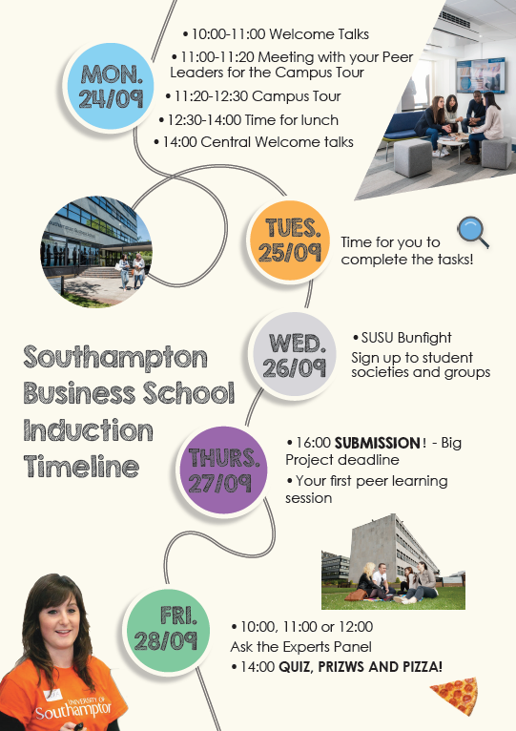
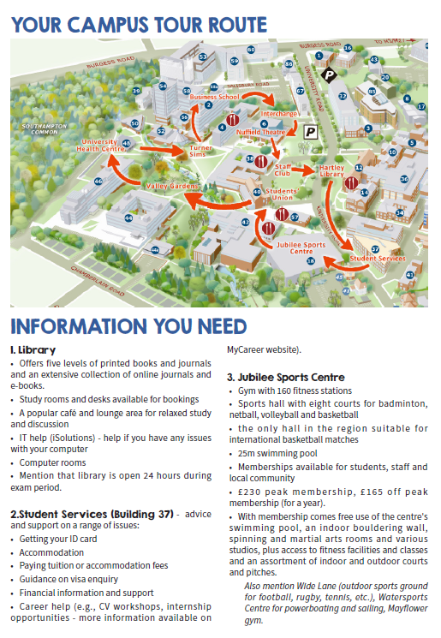
What did the new induction look like?

Slide 12
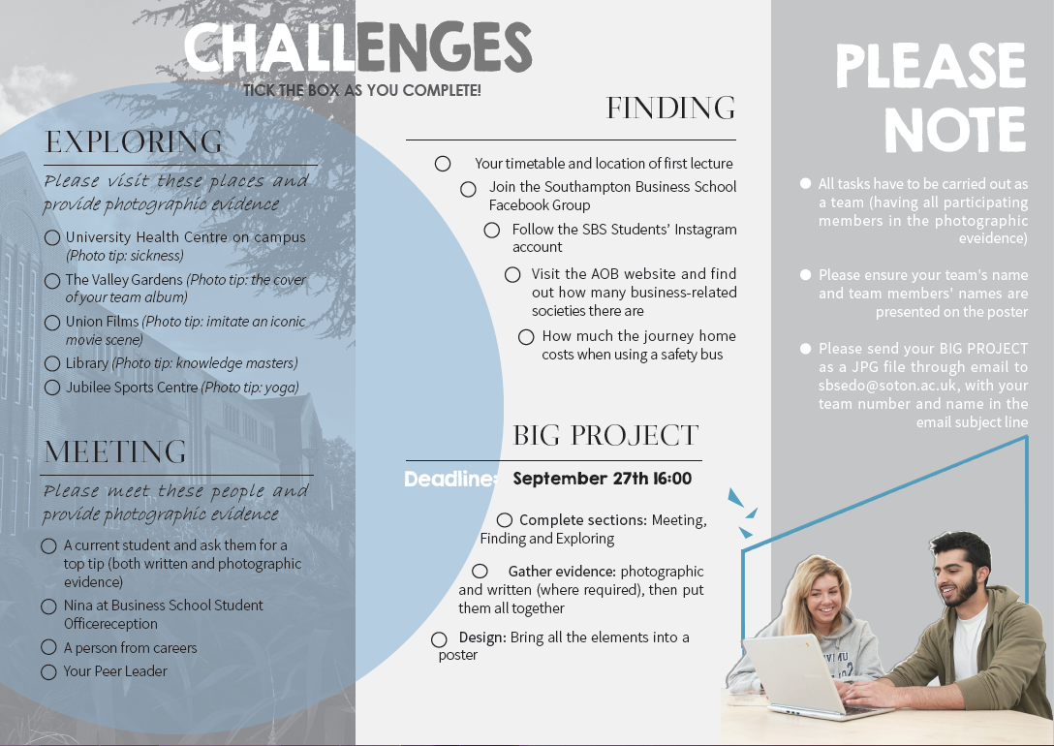

Slide 14
Outcomes

Slide 15
What was the result? Engagement with activities
Activity | Marketing | Business | Accounting | Total
Registration | 25 | 99 | 65 | 203
Welcome talk/ campus tour | 26 | 99 | 80 | 205
Peer Learning Session | 20 | 60 | 49 | 147
Ask the Experts Panel | 13 | 68 | 54 | 135
Quiz and Prize event | 101
Induction Challenge Entries | 19 (81 students)
AOB page views (Sept) | 4,331 (up from 2,767 in 2017-18)

Slide 16
What was the result?
Challenge Entries

Slide 17
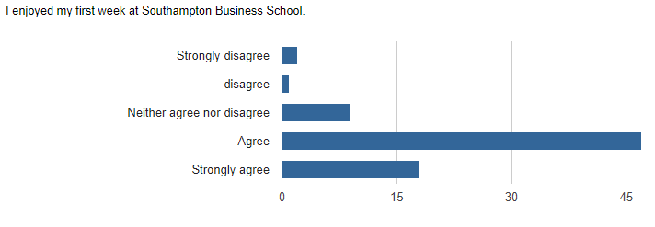
What was the result? Student Feedback (Survey)

Slide 18
What was the result? The best thing about induction was…
Making new friends
Meeting people on my course
Campus tour
The welcome quiz at the end in groups
Meeting people on my course
Getting a feel of what uni life is like
All the opportunities we were exposed to. It was easy to find ur way around it, since as a fresher I was so lost. Induction made it very easy.
Clearing up concerns
Peer learning session
Quiz and prizes

Slide 19
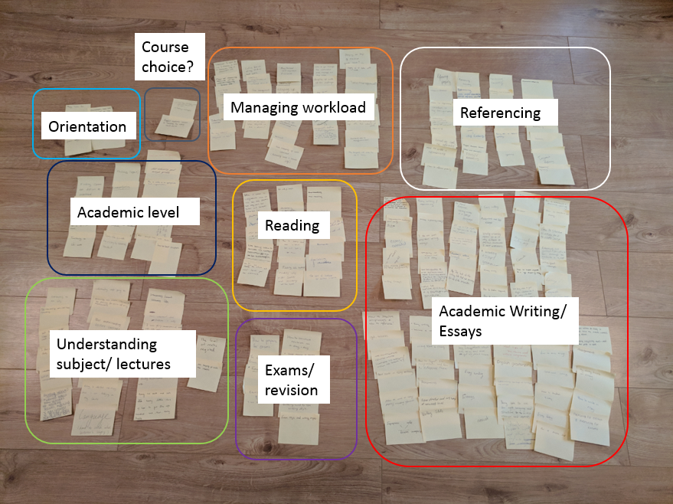

Slide 21
Summary and Conclusions

Slide 22
Summary and Conclusions
The value of partnership with both staff and students
Focus on the design of learning as much as the content
Peer engagement critical – benefits throughout the semester
Have fun!

