Slide 1
Chemical knockdown of Dnmt1 by 5-Azacitidine induced degradation.
Data from thesis titled;
Proteomic analysis of Wnt and epigenetic regulatory protein networks in colorectal cancer.
By Emily Hannah Bowler-Barnett

Slide 2
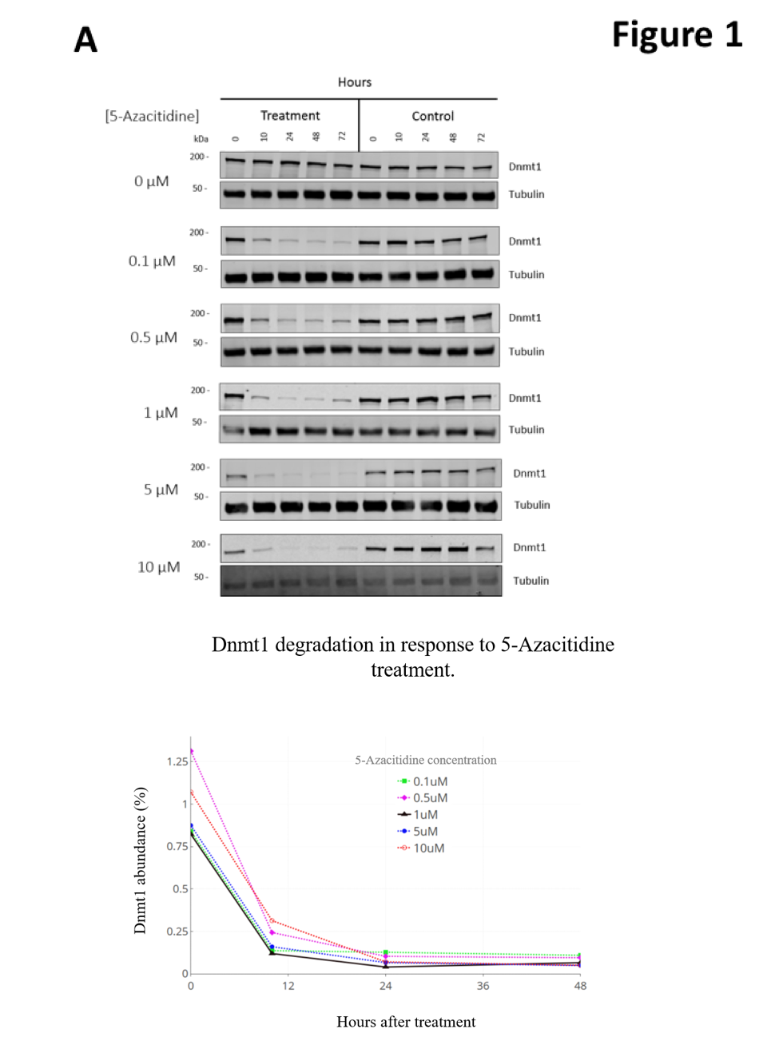
Western Blot analysis of Dnmt1 protein levels in HCT116 cells treated with Azacytidine. Concentrations of 5-Azactidine between 0.1μM and 10 μM were used to treat cells over a time course. 15 μg of whole cell protein lysates from HCT116 Azacytidine treated and control cells were loaded onto a single phase 8% SDS gel and analyzed by western blot analysis for protein expression of Dnmt1. Tubulin protein expression was used as a loading control. The associated plot shows the relative percentage abundance of Dnmt1 protein levels across the time course following treatment with Azacytidine dose-course. Dnmt1 protein abundance was normalized to loading control and plotted as a percentage of the expression in an untreated control for each concentration of Azacytidine.

Slide 3
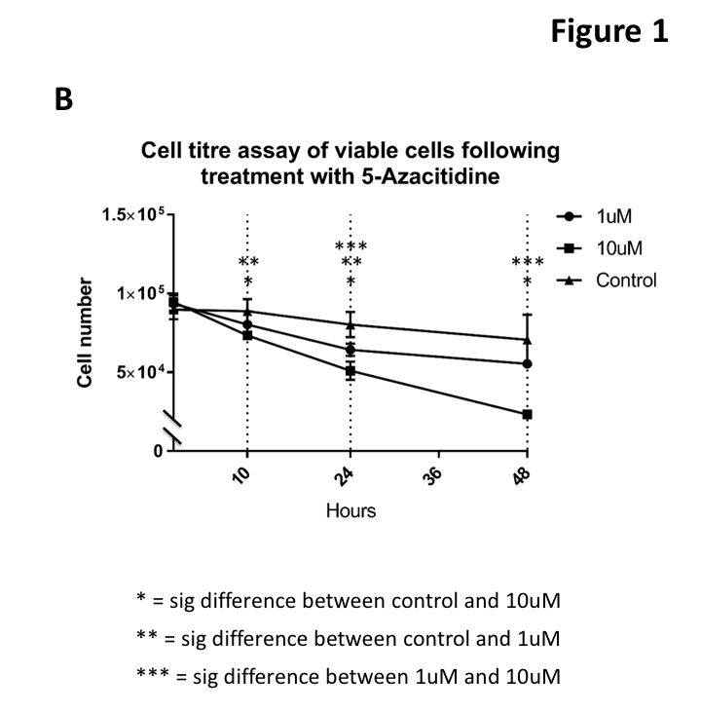
Cell titre assay of viable cells following treatment with Azacytidine. Cells were treated for the specified time points with 1 μM and 10 μM concentrations of Azacytidine over a period of 48 hours. The number of viable cells was assessed using a CellTitre assay (Promega). * = significant difference between control and 10 μM treated cells. ** = significant difference between control and 1 μM treated cells (Student’s t-test; p-value <0.05). *** = significant difference between 1 μM and 10 μM treated cells. N=4

Slide 4
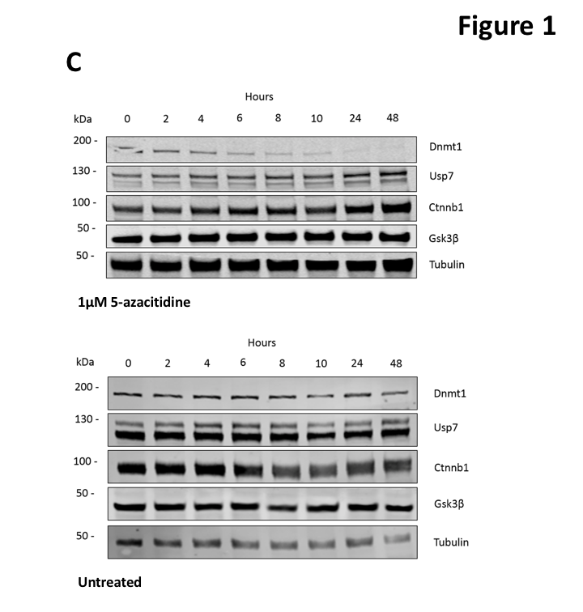
Time-dependent degradation of Dnmt1 in HCT116 cells following treatment with 1µM Azacytidine.15 μg of whole cell protein lysates from HCT116 1μM Azacytidine treated and control cells were loaded onto a single phase 8% SDS gel and analyzed by western blot analysis for protein abundance of Dnmt1, Usp7, Ctnnb1, and Gsk3ß. Usp7 antibody is double banded, which is thought to be another isoform with an as yet unknown function (Luo et al,. 2015) Tubulin protein expression was used as a loading control. N=3

Slide 5
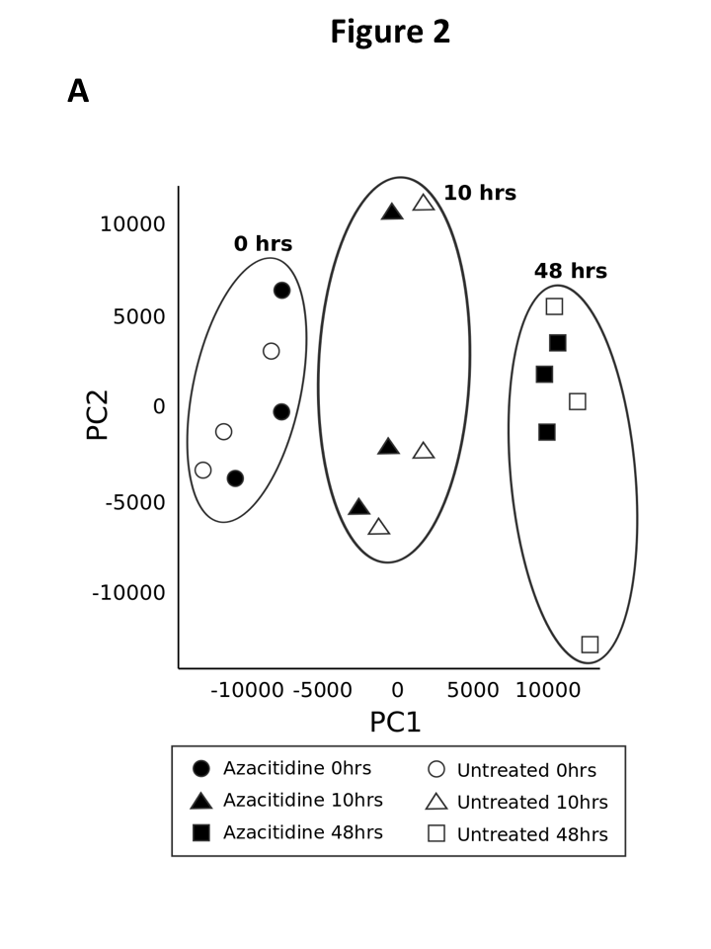
Principal Components Analysis of normalised nuclear proteome data from each sample. The first two principal components are shown in the plot and represent 25.38% of the variation (PC1) and 10.65% of the variation (PC2).

Slide 6
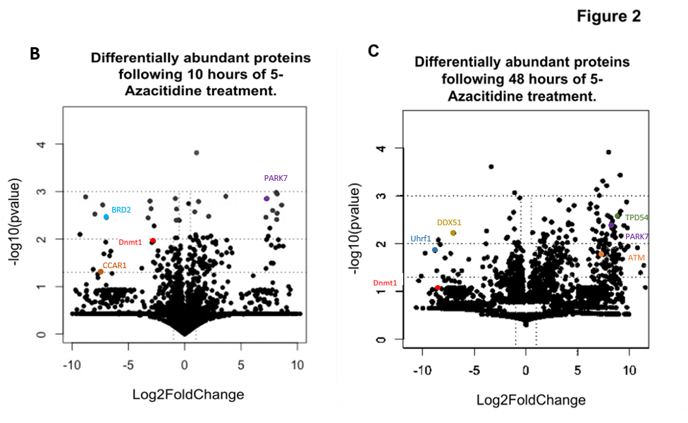
Proteins identified as differentially abundant following 10 hours of 5-Azacitidine treatment. Proteins treated for a period of 10 hours with 1μM of 5-Azacitidine with –log10 (Benjamini-Hochberg corrected p-value) were plotted against calculated fold change using R studio and the Calibrate package. Proteins with a log2 fold change of < 3 of the same directionality in the 10 hour control dataset were removed from this analysis.
Proteins identified as differentially abundant following 48 hours of 5-Azacitidine treatment. Proteins treated for a period of 48hours with 1μM of 5-Azacitidine with –log10 (Benjamini-Hochberg corrected p-value) were plotted against calculated fold change using R studio and the Calibrate package. Proteins with a log2 fold change of < 3 of the same directionality in the 48 hour control dataset were removed from this analysis.

Slide 7
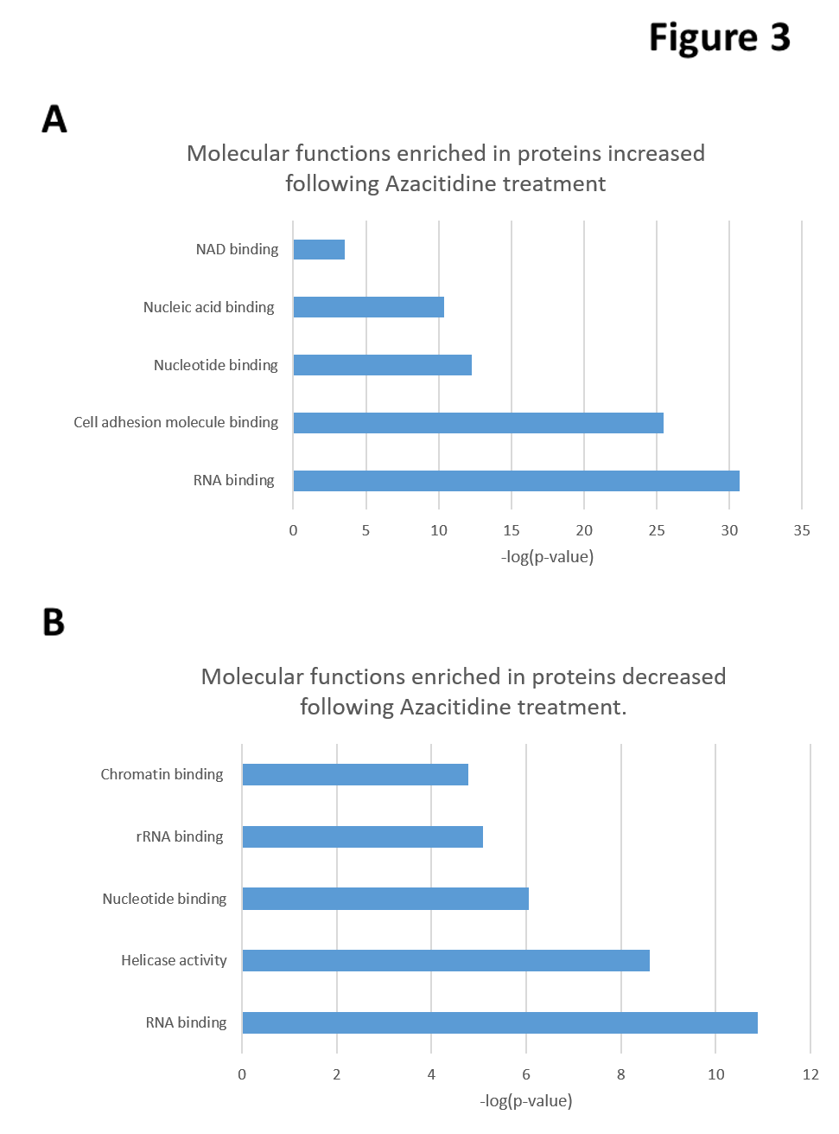
The most significant Gene Ontology molecular functions and biological process terms for the significantly increased (A) and significantly decreased proteins sets following Azacytidine treatment.(B). Analysis based on proteins that were differentially abundant following 48 hours of 5-Azacitidine treatment. Bonferroni corrected t-test, FDR<0.05

Slide 8
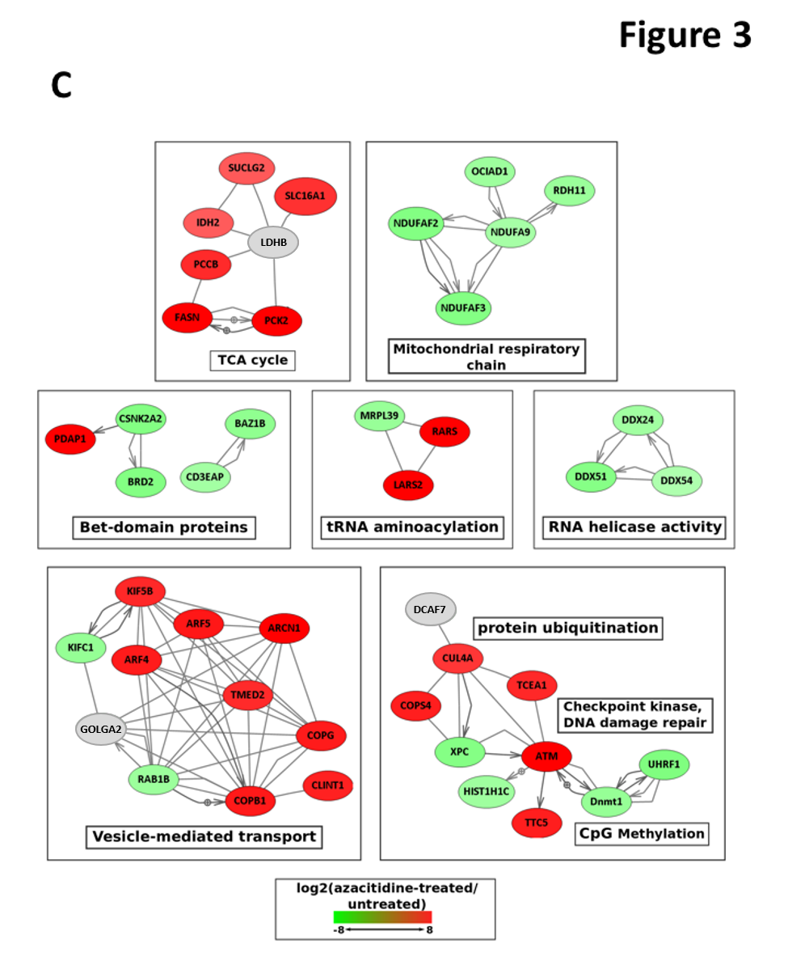
Selected protein interaction networks for proteins significantly increased or decreased in response to Azacytidine. Network edges have been pruned where necessary for clarity, and sub-networks are labelled with molecular functions or biological processes. Grey icons indicate proteins identified in this dataset but not significantly differentially abundant following Azacitidine treatment. Remaining icons are pseudocoloured to indicate abundance change following Azacitidine treatment. Significance calculated by Benjamini-Hochberg corrected p-value <0.05, FDR5%.

Slide 9
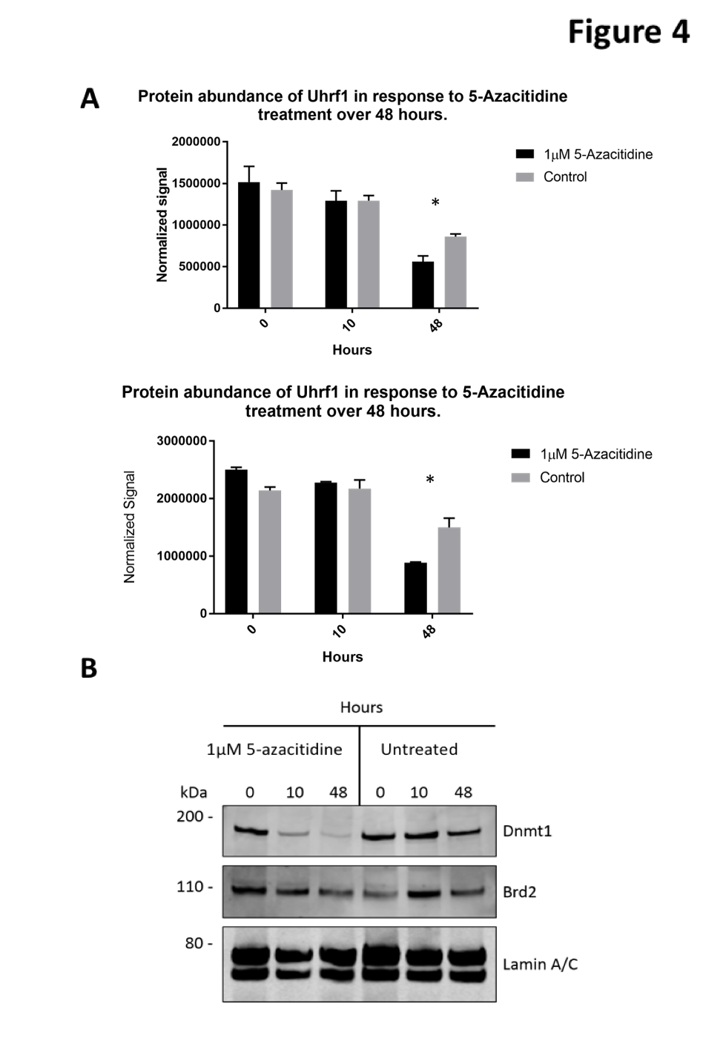
Graphical representation of western Blot analysis of Uhrf1 and Pkp2 in Azacytidine treated HCT116 cells. 15 μg of nuclear protein lysates from HCT116 Azacytidine treated and control cells were loaded onto a single phase 8% SDS gel and analyzed by western blot analysis for protein expression of Uhrf1, Pkp2. Lamin A/C protein expression was used as a loading control. Protein abundance was normalized to loading control and plotted graphically using GraphPad Prism. (T-test P value <0.05)N=3.
Western Blot analysis of Brd2 protein in Azacytidine treated HCT116 cells. 15 μg of nuclear protein lysates from HCT116 Azacytidine treated and control cells were loaded onto a single phase 8% SDS gel and analyzed by western blot analysis for protein expression of Dnmt1, and Brd2. LaminA/C protein expression was used as a loading control. N=3.

Slide 10
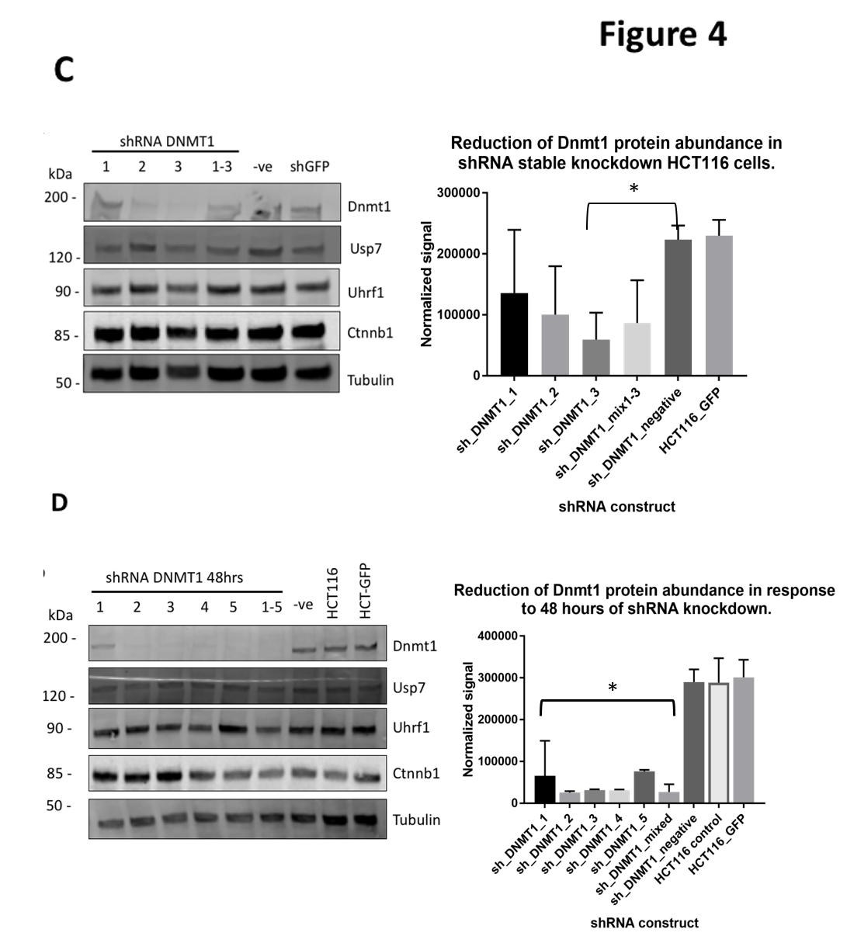
Western Blot analysis and graphical representation of Dnmt1 and Uhrf1 in stable shRNA knockdown of Dnmt1 HCT116 cells. 15 μg of whole cell protein lysates from HCT116 Azacytidine treated and control cells were loaded onto a single phase 8% SDS gel and analyzed by western blot analysis for protein expression of Dnmt1 and Uhrf1. Tubulin protein expression was used as a loading control. Dnmt1 protein abundance was normalized to tubulin signal and plotted graphically on GraphPad Prism. (T-test P value = <0.05) N=3
Western Blot analysis and graphical representation of Dnmt1, and Uhrf1 in transiently transduced shRNA knockdown of Dnmt1 HCT116 cells. 15 μg of whole cell protein lysates from HCT116 Azacytidine treated and control cells were loaded onto a single phase 8% SDS gel and analyzed by western blot analysis for protein expression of Dnmt1, Uhrf1, Usp7, and Ctnnb1. Tubulin protein expression was used as a loading control. Dnmt1 protein abundance was normalized to tubulin signal and plotted graphically on GraphPad Prism. (T-test p value <0.05) N=3.

Slide 11
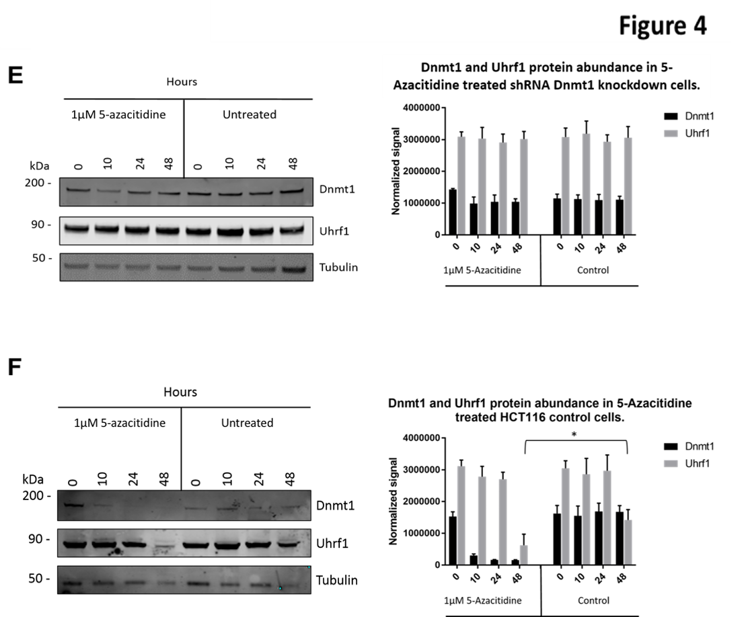
Western Blot analysis and graphical representation of 1µM 5-Azacitidine treatment of shRNA Dnmt1 stable knockdown HCT116 cells. 15 μg of whole cell protein lysates from shRNA-3 Dnmt1 knockdown HCT116 Azacytidine treated and control cells were loaded onto a single phase 8% SDS gel and analyzed by western blot analysis for protein expression of Dnmt1, and Uhrf1. Tubulin protein expression was used as a loading control. Dnmt1 and Uhrf1 signal was normalized to tubulin loading control and plotted graphically using GraphPad Prism. (T-test p value=<0.05)N=3.
Western Blot analysis and graphical representation of 1µM 5-Azacitidine treatment of HCT116 control cells. 15 μg of whole cell protein lysates from HCT116 Azacytidine treated and control cells were loaded onto a single phase 8% SDS gel and analyzed by western blot analysis for protein expression of Dnmt1, and Uhrf1. Tubulin protein expression was used as a loading control. Dnmt1 and Uhrf1 signal was normalized to tubulin loading control and plotted graphically using GraphPad Prism. (T-test p value=<0.05) N=3.

Slide 12
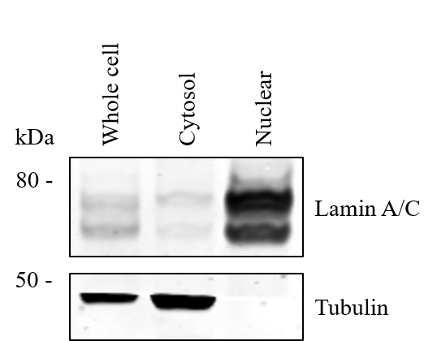
Subcellular fractionation of HCT116 cell lysates. HCT116 cells were grown to approximately 75% confluence and lysated using RIPA buffer to produce whole cell lysates or by Abcam nuclear fractionation kit protocols to produce nuclear- or cytosol- enriched lysates (Abcam, ab109719) which were then analysed by western blot. 15 µg of whole cell protein lysates from HCT116 whole cell, nuclear-enriched, or cytosol-enriched lysis protocols were loaded onto a single phase 8% SDS gel and analyzed by western blot analysis for protein expression of Lamin A/C and Tubulin. N=2.

Slide 13
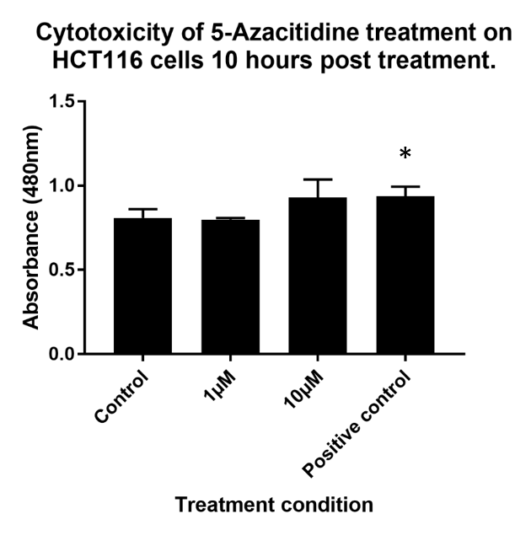
5-Azacitidine cellular toxicity measured by release of LDH. Cells were seeded in a 96 well plate and treated with 5-Azacitidine for 10 hours. Following treatment culture media was removed and analysed for LDH concentration using CytoTox 96 assay (Promega). Absorbances were measured using a colourimeter and plotted graphically using GraphPad Prism.. N=3, * = P value <0.05 (Student’s t-test).

Slide 14
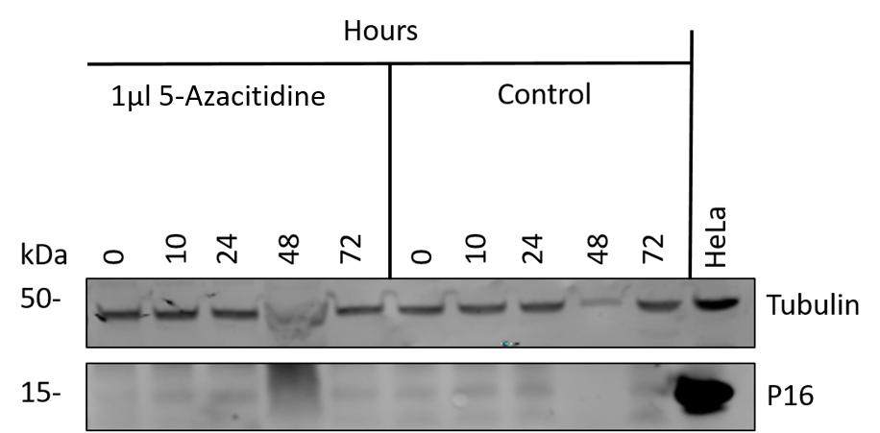
Expression of P16 in 5-Azacitidine treated HCT116 cells. Cells were seeded 24 hours and then treated with 1µl of 5-Azacitidine or PBS control for 48 hours, cells were then lysed using RIPA buffer and analysed by western blot. 15 µg of whole cell protein lysates from HCT116 5-Azacitidine treated and control cells were loaded onto a single phase 8% SDS gel and analyzed by western blot analysis for protein expression of P16. Tubulin protein expression was used as a loading control. N=3. HeLa whole cell lysate was used as a positive control for P16 expression.

Slide 15
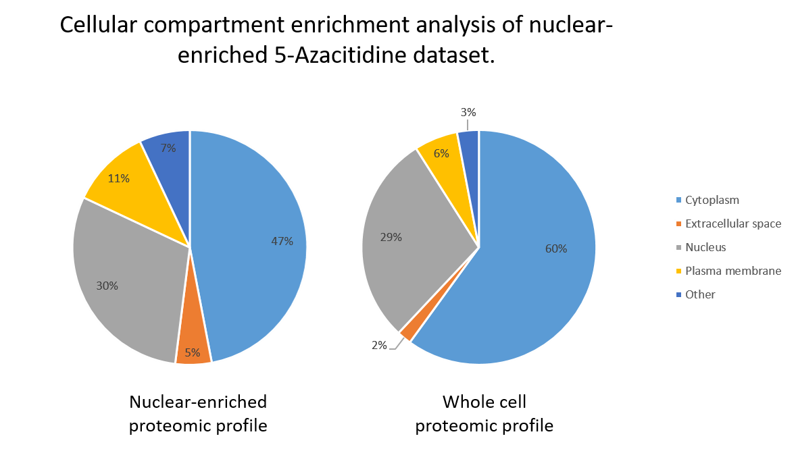
GO cellular compartment enrichment of nuclear-enriched 5-Azacitidine treated/control proteomic dataset. Proteins IDs from 5-Azacitidine proteomic analysis dataset and a comparable whole cell proteomic dataset were searched for their GO localization term using Ingenuity Pathway Analysis (IPA) (QIAGEN) (Bonferroni corrected t-test p value = <0.05). Results were plotted graphically as percentages of the whole using GraphPad Prism.

Slide 16
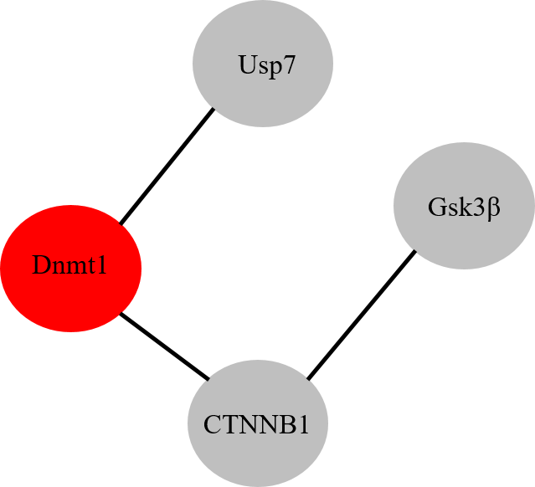
Interaction network of Dnmt1 and proteins assessed by western blot analysis for response to treatment by 5-Azacitidine. Proteomic fold change data in response to 5-Azacitidine was validated by western blot analysis. Proteins validated and known to interact (via String DB analysis) were plotted manually and pseudocoloured according to abundance change. Dnmt1 protein abundance was found to be significantly decreased (red) in response to 5-Azacitidine treatment, however interaction partners Usp7 and Beta-Catenin protein abundance was not altered (grey). Beta-Catenin interaction partner GSK3β protein abundance also remained unchanged. (p value = <0.05 Benjamini-Hochberg corrected t-test, FDR 5%)

Slide 17
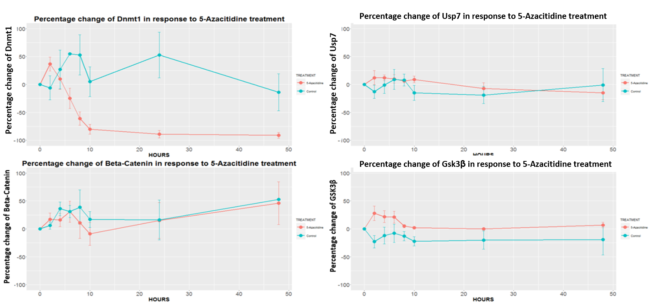
The percentage change of protein abundance of Dnmt1, Beta-Catenin, USP7, and GSK3β in response to 1µM of 5-Azacitidine treatment, over a period of 48 hours. Cells were treated with 1µM of 5-Azacitidine supplemented media 24 after culture seeding and protein abundance measured at time points up to 48 hours. Cells were then lysed and 15 µg of whole cell protein lysates were loaded onto a single phase 8% SDS gel and analyzed by western blot analysis for protein expression of Dnmt1, Usp7, Beta-Catenin and Gsk3β. Protein abundance was normalized to tubulin control and percentage change over time was calculated as normalized protein abundance change relative to 0 hour time point. Results were plotted graphically using RStudio and Ggplot2. N=3

Slide 18
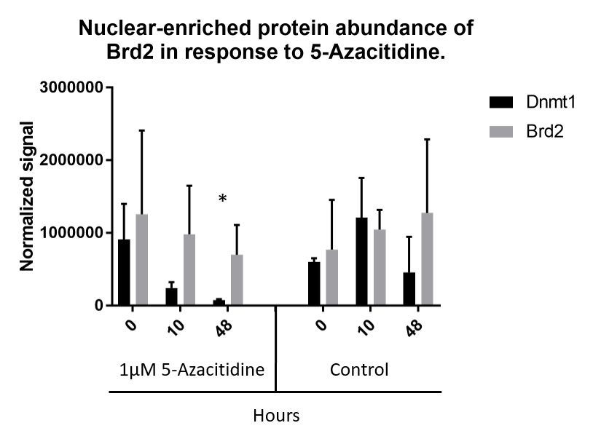
Graphical representation of western blot analysis of Brd2 protein abundance in nuclear-enriched 5-Azacitidine treated HCT116 cell, western blot shown in Fig4B. Graph shows relative protein abundance of Dnmt1 and Brd2 presented as normalized signal units, signal was normalized to Lamin A/C loading control. * = P value 0.002 significant difference in Dnmt1 protein levels following 48 hours of 5-Azacitidine treatment . (p value = <0.05 Benjamini-Hochberg corrected t-test, FDR 5%)

Slide 19
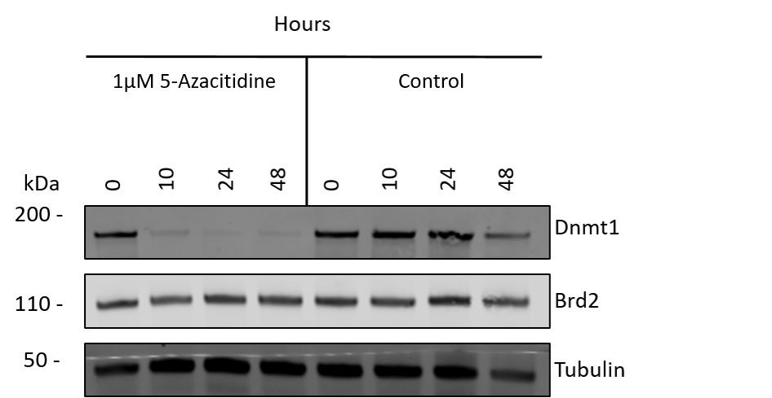
Western Blot analysis of total cell Brd2 protein abundance in 5-Azacitidine treated HCT116 cells including 24 hour treatment time point. 15 µg of whole cell protein lysates from HCT116 5-Azacitidine treated and control PBS treated control cells were loaded onto a single phase 8% SDS gel and analyzed by western blot analysis for protein expression of Dnmt1, and Brd2. Tubulin protein expression was used as a loading control. N=3

Slide 20
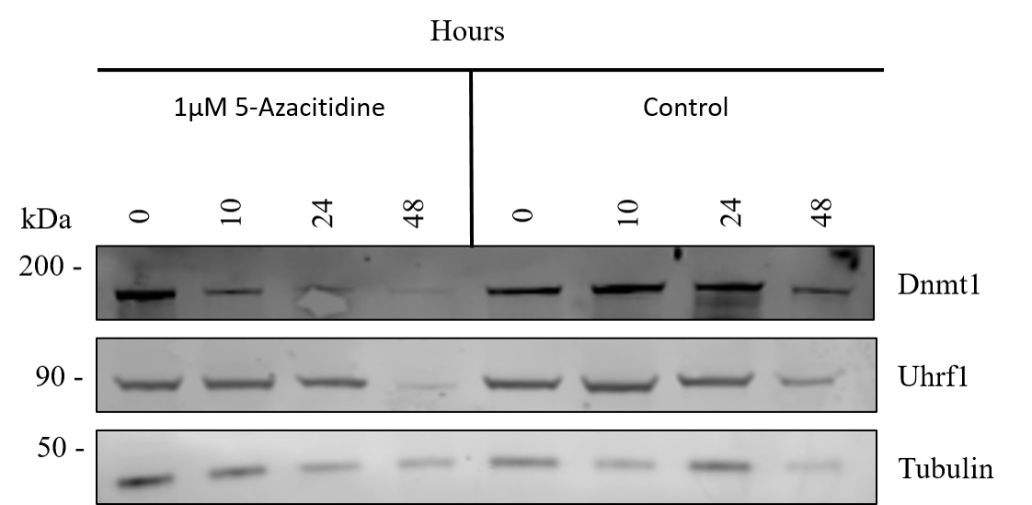
Western Blot analysis of Dnmt1 and Uhrf1 total protein abundance and in 5-Azacitidine treated HCT116 cells including 24 hour treatment time point. 15 µg of whole cell protein lysates from HCT116 5-Azacitidine treated and PBS treated control cells were loaded onto a single phase 8% SDS gel and analyzed by western blot analysis for protein expression of Dnmt1, Uurf1. Tubulin protein expression was used as a loading control. N=3

Slide 21
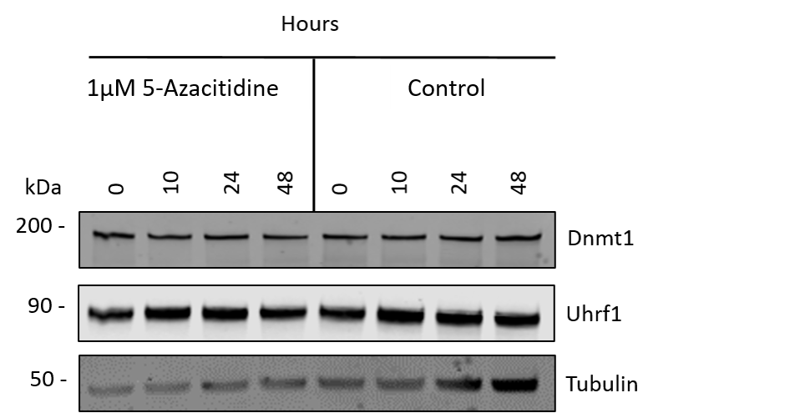
Western blot analysis of 1µM 5-Azacitidine treatment of shRNA negative control stable knockdown HCT116 cells. 15 µg of whole cell protein lysates from shRNA negative control knockdown HCT116 5-Azacitidine treated and PBS treated control cells were loaded onto a single phase 8% SDS gel and analyzed by western blot analysis for protein expression of Dnmt1, and Uhrf1. Tubulin protein expression was used as a loading control. N=3.

