Slide 1



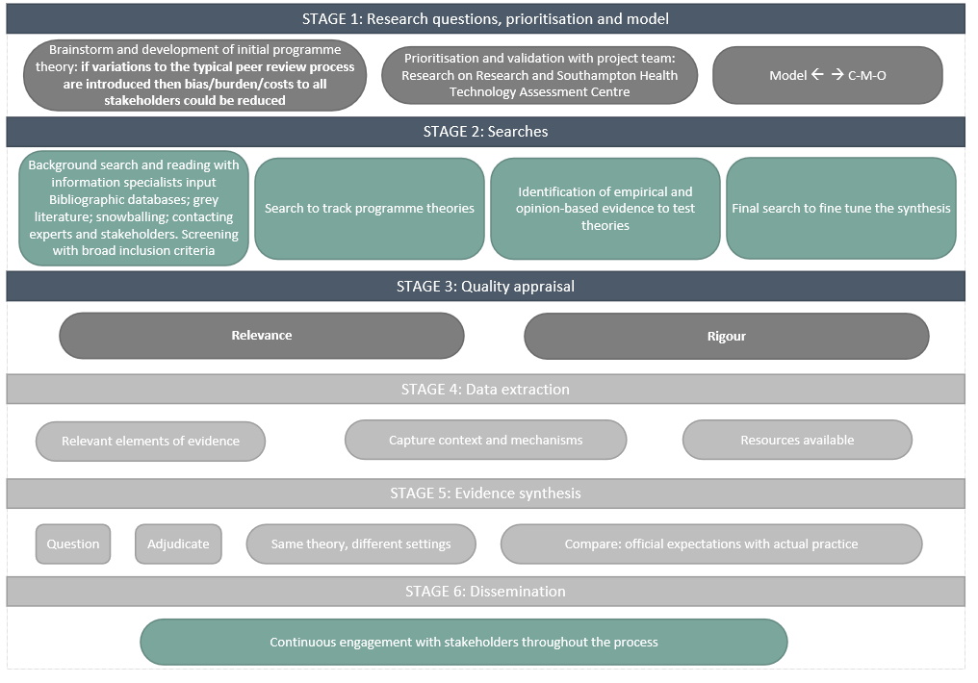



A realist synthesis of decision-making approaches to grant funding allocation
A. Recio Saucedo¹, K. Fackrell¹, K. Meadmore¹, A. Blatch-Jones¹, A. Bull¹, S. Fraser^{1,2}
NIHR Evaluation, Trials and Studies Coordinating Centre (NETSCC), University of Southampton, UK.
Academic Unit of Primary Care and Population Sciences, University of Southampton, UK
Introduction
For decades, allocation of research funds worldwide has relied on the assessment of research proposals by reviewers and funding committees, a process known as peer review. Robust procedures and efficient distribution are the foundation on which validity of peer review rests¹. Considering the place of peer review as the gold standard of the fund allocation system, it is surprising to find a lack of empirical evidence that asserts the stance of peer review as the mechanism used to distribute research funds; determine the quality of the research output of higher education institutions (e.g. Research Excellence Framework); or regulate career progression in academia. Lack of evidence on the benefits of alternative approaches to peer review brings challenges to research funders when exploring alternatives to enhance the peer review system or implement new decision making strategies.
Background
The review so far
In 2016, the NIHR NETSCC Push the Pace II systematically mapped peer review literature to identify evidence for timely and efficient peer review of health research funding².
The systematic map highlighted a need for a more systematic evaluation of alternative approaches to decision-making and the contexts in which these could operate more successfully.
A realist synthesis was chosen to provide an explanatory analysis⁴ of how and why peer-review or alternatives work in particular contexts. This approach will enhance our understanding of the value of peer review, providing fresh thinking in the revision of current practices to inform policies^{3,6}.
September 2019:
1824 results from electronic databases; 36 results from manual searches (Stages 1&2)
Types of sources: [books sections; conference paper or proceedings; electronic articles; webpages (n=77)]; journal articles (n=1747)
Sources with full text available (screening complete): 977
Title/Abstract (screening complete): 847
Sources transferred to Stage 3 for Quality appraisal: 215
*Researchers, reviewers, applicants, research managers: burden of peer review process
Aim and Methods
Preliminary categories of evidence
The RAMESES (Realist and Meta-narrative Evidence Syntheses: Evolving Standards) project I and II informed the planning of the realist review^{3,6}. Rycroft-Malone⁵ approach to conducting a realist synthesis is being used as a guiding method.
Stages of realist synthesis on peer review for funding allocation decisions
Research on Research next steps
Data sources: Medline (Ovid); MEDLINE In-Process & Other Non-Indexed Citations (Ovid); Embase (Ovid); The Cochrane Library; Psychinfo (Ebsco); Social Sciences Citation Index (Web of Science); and Delphis (University of Southampton Library database); IEEE Explore, ProQuest. Grey literature: unpublished articles, web searches Google scholar, Gates Foundation, RAND Corporation, RSM library, European Research Council, Reference sections of systematic reviews.
Findings from the realist synthesis will be used to 1. design a feasibility study to explore enhanced peer review processes 2. inform the wider programme of research conducted by NIHR Research on Research which may be transferable to other funding organisations.
References
1. Gurwitz et al. 2014. PLoS biology. Dec 2;12(12):e1002010. 2. Shepherd et al. 2018. PLoS ONE, 13(5), [e0196914]. 3. Wong et al. 2017. Health Serv Deliv Res;5(28) 4. Berg & Nanavati. 2016. Realist review: current practice and future prospects. 5. Rycroft-Malone et al. 2012. Implementation science, 7, 33. 6. Wong et al. 2014. Health Serv Deliv Res;2(30).
This study is funded by/supported by the National Institute for Health Research (NIHR). The views expressed are those of the author(s) and not necessarily those of the NIHR or the Department of Health and Social Care.
A.Recio-Saucedo@soton.ac.uk
@lexia14
*Thank you to Sarah Horne for the beautiful illustration of how researchers around the world look like any day of the week https://www.sarahhorne.studio/

