Slide 1
NewSpace Implications for Space Debris Modelling
Samuel Diserens (s.d.diserens@soton.ac.uk)
Hugh Lewis
Jörg Fliege
22 October 2019
I acknowledge financial support from the EPSRC Centre for Doctoral Training in Next Generation Computational Modelling grant EP/L015382/1
Notes:
Please use the dd month yyyy format for the date for example 11 January 2008. The main title can be one or two lines long.

Slide 2
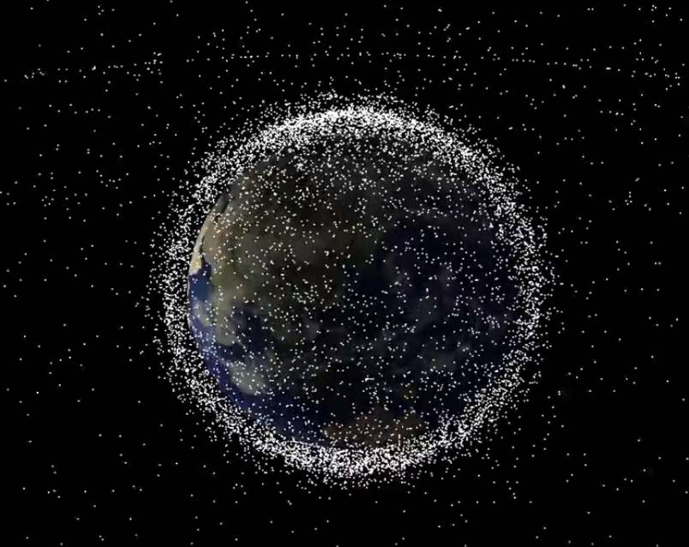
Introduction
Space Debris is a growing risk
34,000 objects > 10 cm
900,000 objects > 1 cm
(ESA January 2019)
Debris models are used to develop an understanding of the behaviour of this population
There are outstanding questions as to how ‘NewSpace’ affects the evolution of the environment as well as the suitability of the models used to understand it
Notes:
My research is about how the New Space movement effects the debris environment and the way in which we model it
Currently in 3rd year of my PhD at Soton as part of NGCM etc.

Slide 3
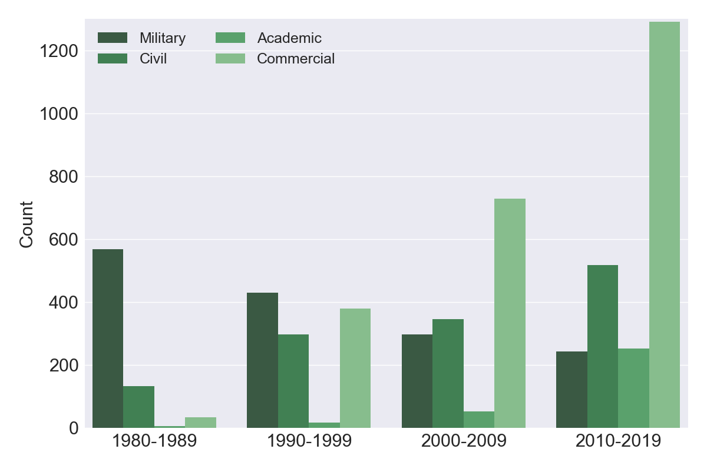
NewSpace Era

Slide 4
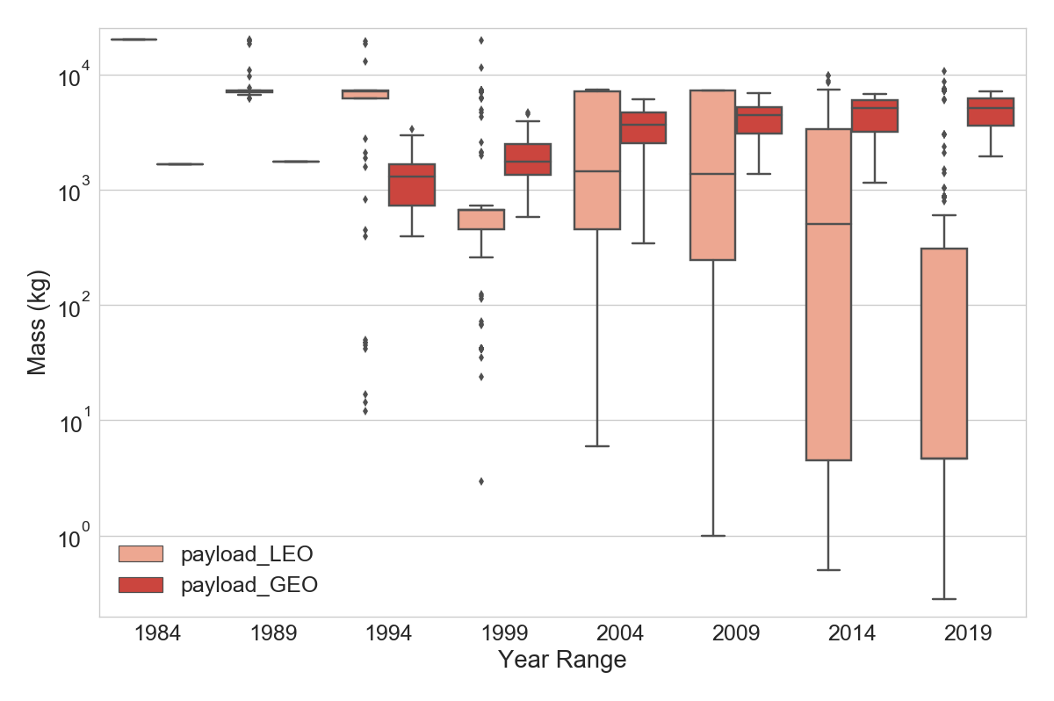
NewSpace Characteristics
Mass
Cross-Section

Slide 5
Accompanying Trends
Increasing adoption of debris mitigation measures
Including passivation of propellant tanks
Explosion rate constant despite population growth
Indicates decrease in probability of explosion
Traditionally propulsion-based explosions dominate
In future expect different explosion types to be more prevalent, e.g. battery-based
Collisions expected to dominate the future production of debris fragments
Notes:
Rate of explosions has remained consistent despite population growth –suggests decreased probability of explosion
Mitigation methods, including passivation methods such as propellant venting decrease risk of propulsion based explosion for defunct spacecraft
Result is that different explosion modes more prevalent in future environment
More Collisions expected with increasing numbers of spacecraft in clusters

Slide 6
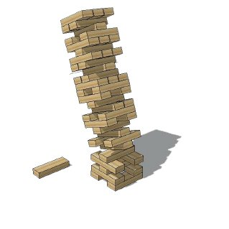
Challenges for Debris Modelling
Debris models are expected to provide answers to these questions
Debris modelling requires a range of assumptions to be made based on previous observations and knowledge
Models and assumptions must be challenged and tested in the face of changing behaviour
Notes:
- To attempt to answer these questions we turn to debris models
Current debris models are based on the traditional space industry
Traditional methods
Traditional questions to be answered
So we must ask
‘Have these assumptions changed’
‘Are these models still representative’

Slide 7
The NASA Standard Breakup Model
The first model to be tested
Current version developed in 1998 (Reynolds et al., 1998; Johnson et al., 2001; Krisko, 2011)
Has become the de facto breakup model, used in (almost) every space debris model currently in use
Simulates the breakup of in-orbit objects
Due to explosion; or
Due to collision of two objects
Generates fragments by characteristic length
Distributed according to a power law
$N\left(L_{c}\right)= \left\{\begin{aligned} 6 S L_{C}^{ −1.6}, if Explosion \\ 0.1 M_{e}^{0.75}L_{c}^{−1.71}, if Collision\end{aligned}\right.$
Notes:
First area to be investigated is that of spacecraft fragmentation
Largely this means the NASA Standard Breakup Model
Although there are others, such as Aerospace Corporations IMPACT model
Describes the distribution of fragments resulting from a breakup and the relationship between size, mass and velocity

Slide 8
Limits & Assumptions
NASA Breakup Model
NewSpace Spacecraft
Explosion model valid for 600-1000kg spacecraft.
Explosion distribution is independent of mass
Catastrophic collisions occurs for impact energy >40J/g of target mass
Mass of spacecraft concentrated in a single body
More spacecraft at size extremes, large and small
Lower density materials
Novel approaches to manufacturing, to materials and to debris shielding.
Complex structures
Notes:
Number of Explosion fragments independent of parent body mass
Identifies only a small mass range where this model is expected to be valid
- Discontinuity between catastrophic and non-catastrophic collisions
- It is worth noting that the experimental values found for the catastrophic threshold ranged from between 35 J/g and 45 J/g (McKnight et al., 1995)
- an analysis of on-orbit collisions (Pardini and Anselmo, 2014) showed that, of five events expected to have an energy-to-mass ratio greater than 40 J/g, only the intact-intact collision of the iridium and cosmos satellites underwent a catastrophic breakup

Slide 9
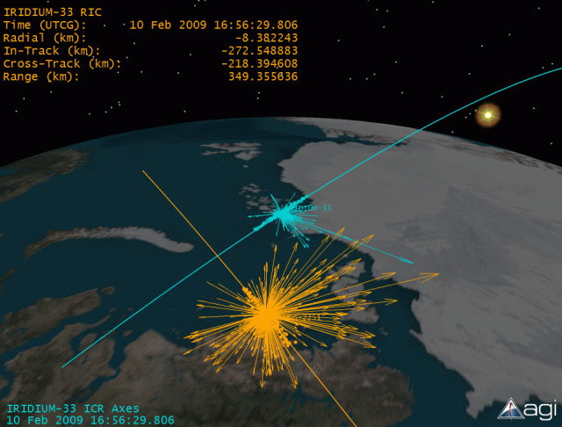
Test Cases
Few major breakups to use as reference data
Compare simulation results against SSN observations for small (>0.1 m), medium (> 0.4 m) and large (> 1.3 m) fragments (source: Space-Track)
Different Categories:
Rocket body explosions
Satellite explosions
Collisions
Notes:
While some of the smaller events are worthy of analysis causes are harder to identify and fewer data points
We want to test both modes of the model
The original model developed using debris clouds of rocket body breakups, so want to see how payload explosions compare with their different structure and energy source

Slide 10
Rocket Body Explosions

Slide 11
Satellite Explosions

Slide 12
Satellite Collisions

Slide 13
Comparing Results
Rocket body explosions:
Close fit for most rocket bodies
Worse fit for small rocket body (Pegasus)
Satellite explosions
Fewer medium and large fragments and more small objects than predicted
Collisions:
Steeper relationship between number and size
Fewer larger fragments and more smaller fragments are observed than are predicted
Extrapolation of results suggests there may be a significant under-prediction of objects under 10cm
Notes:
While this is indicative of variation from the predicted results it should be noted that there are relatively few data points to draw these conclusions from
We see that the results for payloads suggests that the model may over predict large fragments and under predict the smaller ones
We see that for rocket bodies the observations fit the model reasonably well for the most part, however:
This appears to be less true for the Pegasus RB which is significantly smaller ~(1/10) - and outside the recommened range for the model
This may be more representative of NewSpace launchers, e.g. Virgin Orbit

Slide 14
Impact On Environment Simulations
In simulations:
More overall fragments from breakups, but
Fewer high-mass collisions, and so
Fewer fragments produced from secondary events
This may be better in terms of space-sustainability
However, 1 cm fragments still pose a fatal risk to spacecraft
Increased issue of space-safety
Space-Sustainability
Space-Safety
Notes:
- Note that if tracking of 1 cm becomes available (space fence) then may be many more fragments than expected. This would result in a much greater overhead for operators and regulators in terms of collision avoidance

Slide 15
Conclusions
Commercial growth is accompanied by trends in spacecraft mass and cross-section
Decreasing in LEO, but increasing in GEO.
Deviation from assumptions in NASA Standard Breakup Model
Traditional large rocket bodies = good agreement
NewSpace = Over-predict large fragments; under-predict small fragments
Expect a meaningful difference between future environment and current simulations
More collisions, but involving a lower total mass
Lower growth in debris population
A shift from space sustainability issues towards space safety

