Slide 1
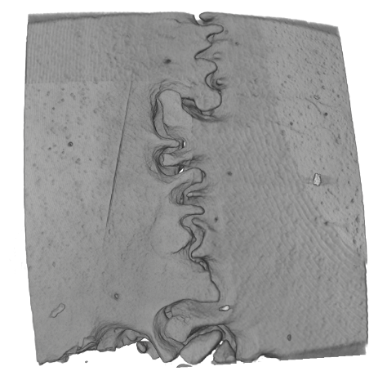
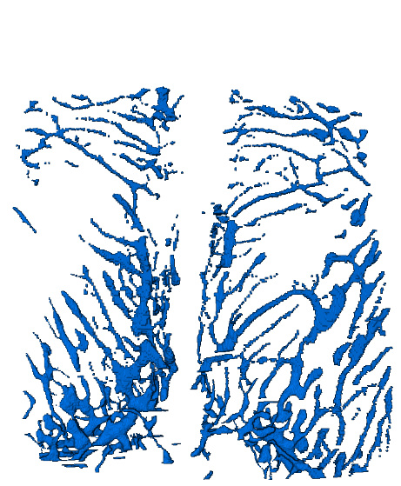
a
GFP RNA
VEGF₁₆₅ RNA
rhVEGF₁₆₅ protein
Skeletonized model
Intraosseous space
Calvarial bone
b
c

