Slide 1
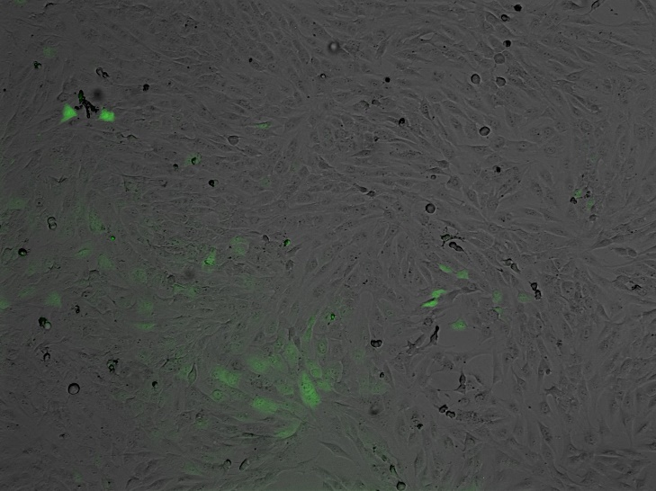
Figure 1: Contrasting effects of vegf RNA transfection and rhVEGF165 protein in vitro
1a GFP image
1b PicoGreen
1c VEGF ELISA in 24 well
a
b
c
d
e
f

