Slide 1
What is success anyway? − defining success in FutureLearn MOOCs
Smart approaches to MOOC research: What works and what goes wrong? #flnetwork
@AdrianaGWilde, Ed Zaluska and Dave Millard (@hoosfoos) 2 December 2015
Notes:
Hello everyone, I’m Adriana Wilde, PhD researcher in Computer Science, working under the supervision of Ed Zaluska and Dave Millard, and I’m here to talk about success in the context of FutureLearn MOOCs.

Slide 2

Notes:
Welcome all! The University of Southampton is a FutureLearn partner, one of the “early adopters” of the platform. We have created a number of FutureLearn MOOCS, such as Web Science (with several editions), Understanding Language and Developing your Research Project, to mention a few.

Slide 3
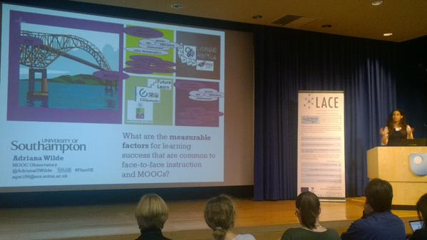
My research
Notes:
My PhD concerns (in a great part) looking at FL MOOC data and asking it “what are the measurable factors for learning success that are common to face-to-face instruction and MOOCs”.
This requires looking at success from both sides of this bridge.

Slide 4

Notes:
Specifically, I’m asking whether despite the differences in methods of instruction between face-to-face instruction and MOOCs, are there emerging commonalities? What works and what goes wrong, specifically when trying to characterise that elusive “successful learner”?

Slide 5

Notes:
In F2F instruction, we collect over several years a body of evidence that can be examined, to distinguish those who are successful from those who are not. We award degrees to the successful ones. We do interventions to increase the chances of success for those who still struggle in getting there.

Slide 6
In MOOCs, success may not be as evident as in F2F
Notes:
In MOOCs, there are several challenges: With such a short learning cycle, can we even think of doing interventions? What kind of data do we need to analyse? And if not wanting to do interventions, can we at least inform the learning design to increase success in future editions of the MOOC?

Slide 7

Retention = Completion
Notes:
For example, the distinction between retention and completion is quite blurry in some MOOCs, as passive students who are happy to click through (we’ve retained them this far), almost always complete. But this, as a measure of success is less meaningful than in F2F

Slide 8
Satisfaction or completion?
Learner self-paced
System-led paced
Onah & Sinclair (2015) Measuring Self-Regulated Learning in a Novel E-Learning Platform: eLDa. 15th Koli Calling Conference on Computing Education Research
Notes:
And completion is under tension: Self-paced learning is often associated with higher satisfaction, whereas MOOCs in which the pace is imposed by the system have lower attrition, i.e. better completion rates. But what is success anyway? Is it satisfaction or completion?

Slide 9

Satisfaction!
Notes:
Because learners who come to a MOOC with a specific goal, as in learning a method, a tool, which is used in the MOOC, but are not interested in other aspects of the topic, will be satisfied with the ability to pick and mix (and indeed, from their point of view, they’ll be successful if he/she master the specific objectives they set out the achieve … even if nothing else!)

Slide 10

Completion!
Notes:
Less satisfying, perhaps, are those MOOCs in which the activity design has been so carefully crafted that the only way to navigate the course is sequentially, at a prescribed way. Arguably, this structure scaffolds the learner and is that why it is associated with higher completion rates – but should we be measuring just that anyway?

Slide 11
Socialisation completion
Siemens, G. (2005) Connectivism: A learning theory for the digital age. International journal of instructional technology and distance learning, 2(1), 3-10
Notes:
On the topic of completion, ever since the influential paper by Siemens, there is some evidence that high participation in forums and other means of socialisation amongst learners enriches the learning process and can be associated with high completion rates.

Slide 12
Socialisation completion
Gillani, N and Eyton, R (2014) Communication patters in massively open online courses Internet and Higher Education 23, 18-26
Notes:
… but there is also some evidence that forum participation is not necessarily a predictor of completion. People often participate in discussion without completing assignments. In a study, 20% of students achieving over 90% used forum. 73% of forum participants received below 50% and accounted for 60% of discussion.

Slide 13

The length of the course as a variable
Ferguson, R. et al. (2015) Moving through MOOCS: pedagogy, learning design and patterns of engagement (EC-TEL 2015)
Notes:
The strategy of a shorter MOOC to increase retention (i.e. the course is over before they drop out), … but there is evidence that shorter MOOCs do not increase completion!

Slide 14
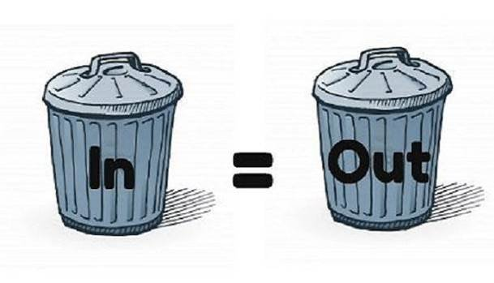
We cannot do ‘fantasy analytics’
Notes:
This is a fantastic quote from the latest LACE event which I attended (we cannot do fantasy analytics) – or as we say in computer science, garbage in, garbage out. Meaning that we can only do predictions based on what the data we actually have, and the quality of the predictions will depend on the quality of the data.

Slide 15

What do we have?
Comments
Enrolments
Step-activity
Question-response
Peer-review assignments
Peer-review reviews
Pre- and post- questionnaires
Notes:
Not saying it is garbage… but we can only do predictions using this!

Slide 16

What do we have?
Comments
Enrolments
Question-response
Step-activity
Peer-review assignments
Peer-review reviews
Pre- and post- questionnaires
Notes:
I believe that the pre- and post- questionnaires are the key to unlock the predictive potential of learning analytics of the learners’ early engagement in the course. In their current form, their use is limited though.

Slide 17
1.1 = 1.10
(everywhere but in FL MOOCs)
Notes:
When thinking about what works and what goes wrong – I couldn’t resist to tell you this! Beware of Excel!
This problem has a very easy fix (i.e. renaming all one-digit steps to avoid this conflict, so step 1.1 becomes 1.01, which IS different from 1.10 as originally intended)

Slide 18
Format inconsistencies
Notes:
And a final tale of what goes wrong… INCONSISTENCIES …to give you an example, in most FL MOOCs, the timestamps stored in the step-activity .csv file is first the first-visited time, followed by the last-completed time. But this is not the same in all cases! Causing scripts to fail!

Slide 19

So what is success anyway?
Hint: may not be completion!
Notes:
The literature suggests that the research community is ripe for an alternative metric for success that is relevant in the context of MOOCs and it has to be linked to the learner’s intent at the start of the course and whether this is achieved at the end. Is it certification? Is it a taste of the topic? Is it somewhere in between?

Slide 20

Thank you!
Photo: O. Ojuroye
@AdrianaGWilde #flnetwork
agw106@ecs.soton.ac.uk
Notes:
So, thank you for listening. I’ll be around for questions or comments, and I’m happy to stay in touch via email or Twitter too.

