Slide 1

What would you tell your future self?
Postcards from a workshop
Measuring the Impact of Workshops (MIW)
Oxford, 20 September 2016
@AdrianaGWilde
Notes:
Hi, I’m Adriana Wilde, from the University of Southampton, here to ask you “What would you tell your future self?”, to tell you of our experience in sending postcards from a workshop we ran and to learn how to better measure impact when planning future workshops

Slide 2


Context
HEA Fellow-led workshop series
STEM Pedagogies: Best Practice Considerations
11th July 2016 (24 participants / 11 UoS / 2 ECS)
Two four-talks sessions:
Innovations in Assessment and Feedback
Learner-Centred Interactions
One Group work session
How to make impact?
(and how to measure it?)
Notes:
The context of our experience was a HEA Fellow-led workshop in “STEM Pedagogies: Best Practice Considerations”. To organise this small-scale event I received a £500 grant plus support from the HEA, and it took place on the 11th July. We had a target of 25 participants, and had three no-shows, which was fine as we had accepted 27. Of those who came, 11 were from our university, 2 from my department specifically. Other people came from Bath, Derby, London, Swansea, Cardiff, Coventry and Portsmouth. We organised the workshop with two four-talks sessions of 15 minutes each and one Group work session.
As organisers, we felt we had already made impact even at the registration stage, given the diversity of attendees (in terms of affiliation, discipline and seniority), however we tried to organise the afternoon session to make impact on people’s practice beyond the day. How to measure it?

Slide 3
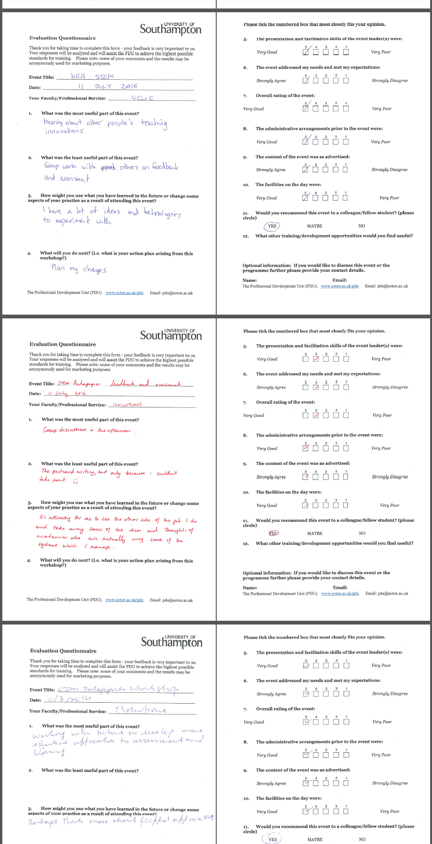
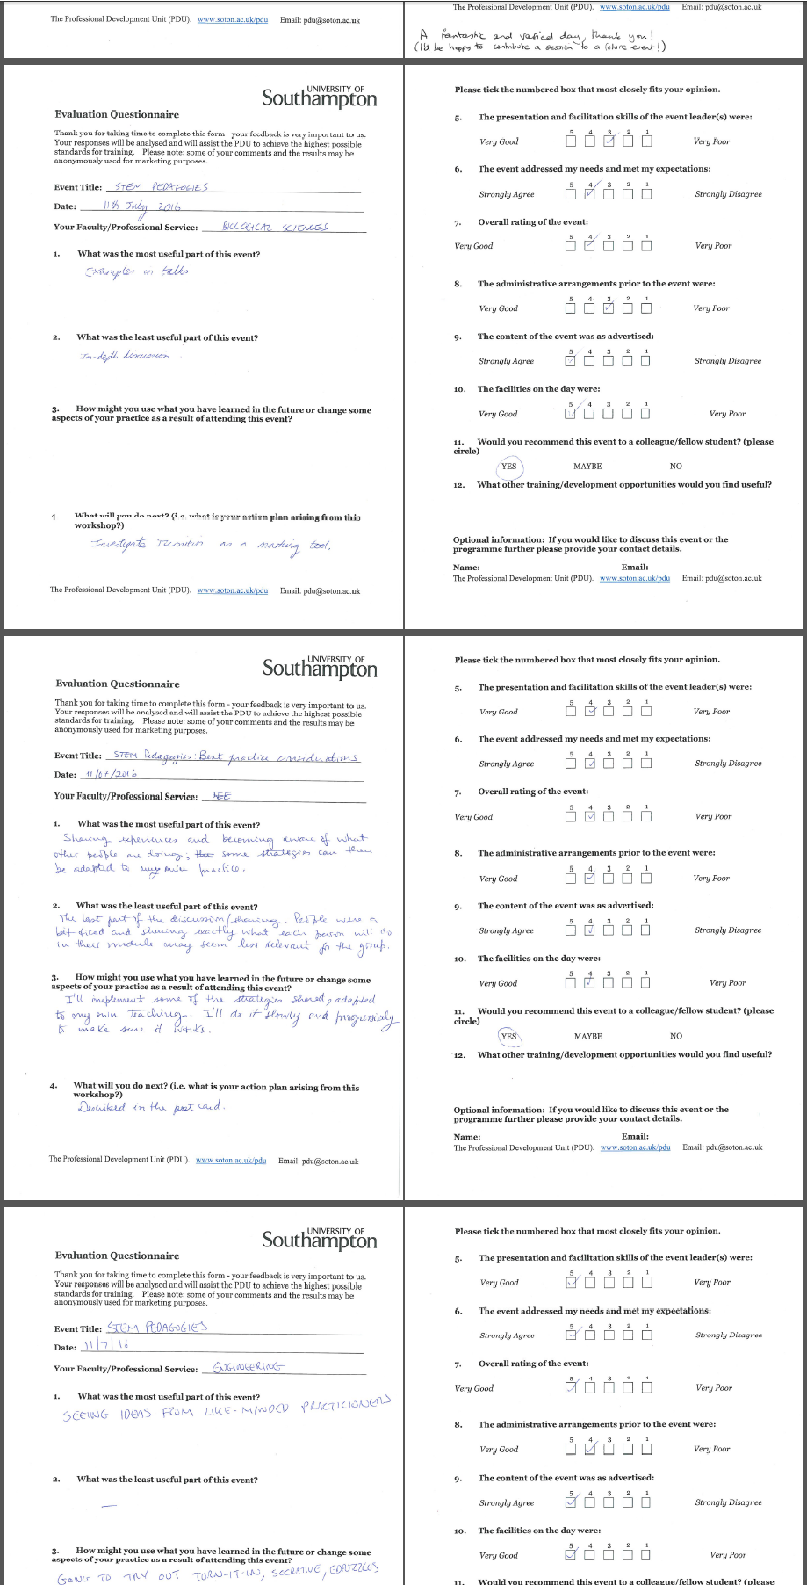
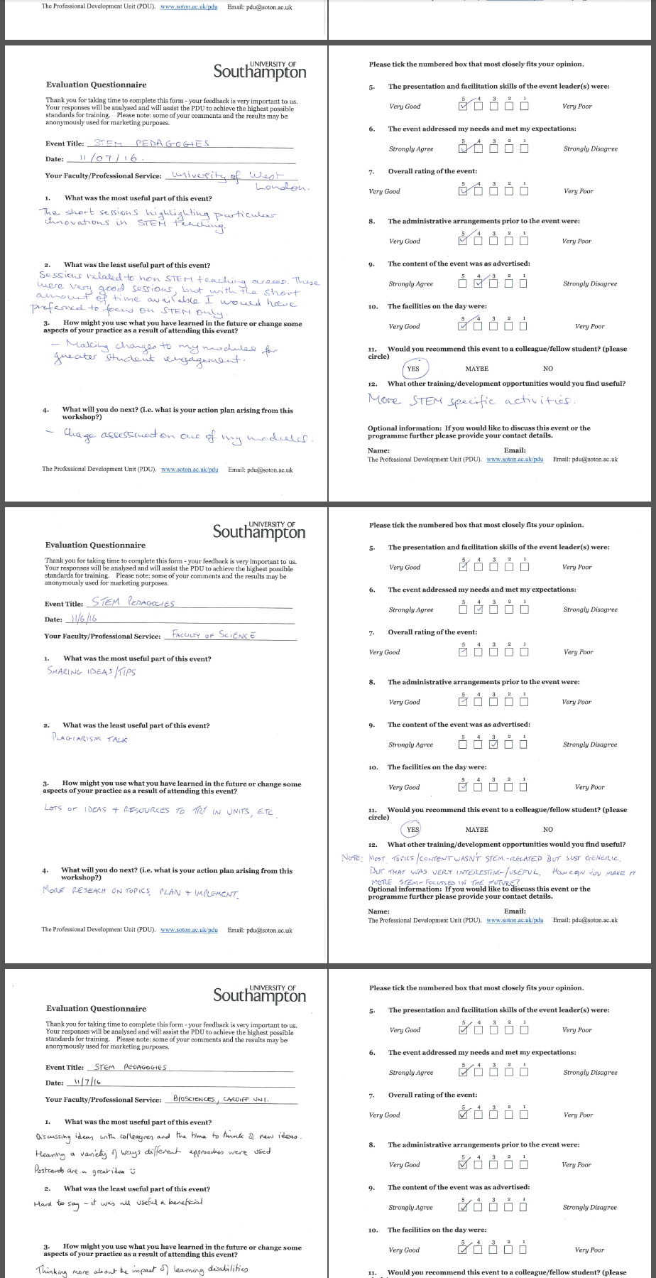
Context
Evaluation Questionnaires
Qualitative & Quantitative
Notes:
The instrument the University uses for evaluating training activities was used.
This has a number of open questions on one side of the page, and a number of 5-point Likert-scale questions on the back.

Slide 4
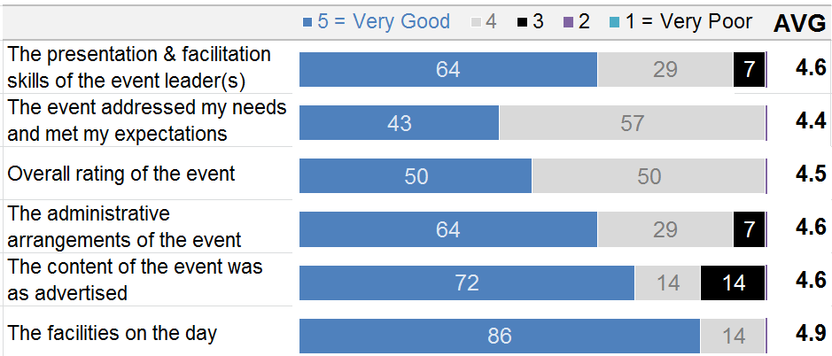
Context
Quantitative evaluation
Notes:
Starting with the quantitative evaluation (just because it’s easier!). Out of the 24 attendees, which included myself and colleagues from Chemistry, Oceanography and Biological Sciences who I roped in as co-organisers, we had 14 completed evaluation questionnaires, which we felt it was a very good completion rate given that this was given out at the end of the event (and people had trains to catch, etc.)

Slide 5

Context
Qualitative evaluation
Notes:
1. What was the most useful part of this event Short sessions highlighting particular innovations in STEM teaching The seeing and sharing of ideas with like-minded colleagues Learning about new software and approaches to teaching Discussing ideas with colleagues Having time to think of new ideas Collaborations and networking with STEM colleagues from other establishments Postcards are a great idea 2. What was the least useful part of the event? (8 responses were left blank) Some talk sessions were useful, but generic (e.g. plagiarism talk) - would have preferred more of a STEM focus throughout Would have liked more time to discuss ideas Discussion session (a broader discussion might have been more useful rather than a very focused discussion on what each individual was going to do - seemed less useful/ relevant) "Hard to say it was all useful and beneficial" "It was all useful" 3. How might you use what you have learned in the future or change some aspects of your practice as a result of attending this event? Make changes to enhance student engagement Introduce blended learning &/ or flipped classroom approach to encourage deep learning Be braver with technology, (e.g. Turnitin, Socrative and EDpuzzles) Develop & improve assessment design (e.g. embed online assessment formatively into a module) Share ideas with colleagues Think more about impact on learning disabilities 4. What will you do next? (i.e. what is your action plan arising from this workshop?) Use technology, (e.g. video, Turnitin, blended learning, flipped learning) Re-design modules, (e.g. embed more analytical questions into teaching as opposed to just factual recall) Re-design assessment, (e.g. online assessments, flexibility in module choice and types of assessment) Think about internationalisation of the curriculum & enhancing the engagement of international students

Slide 6
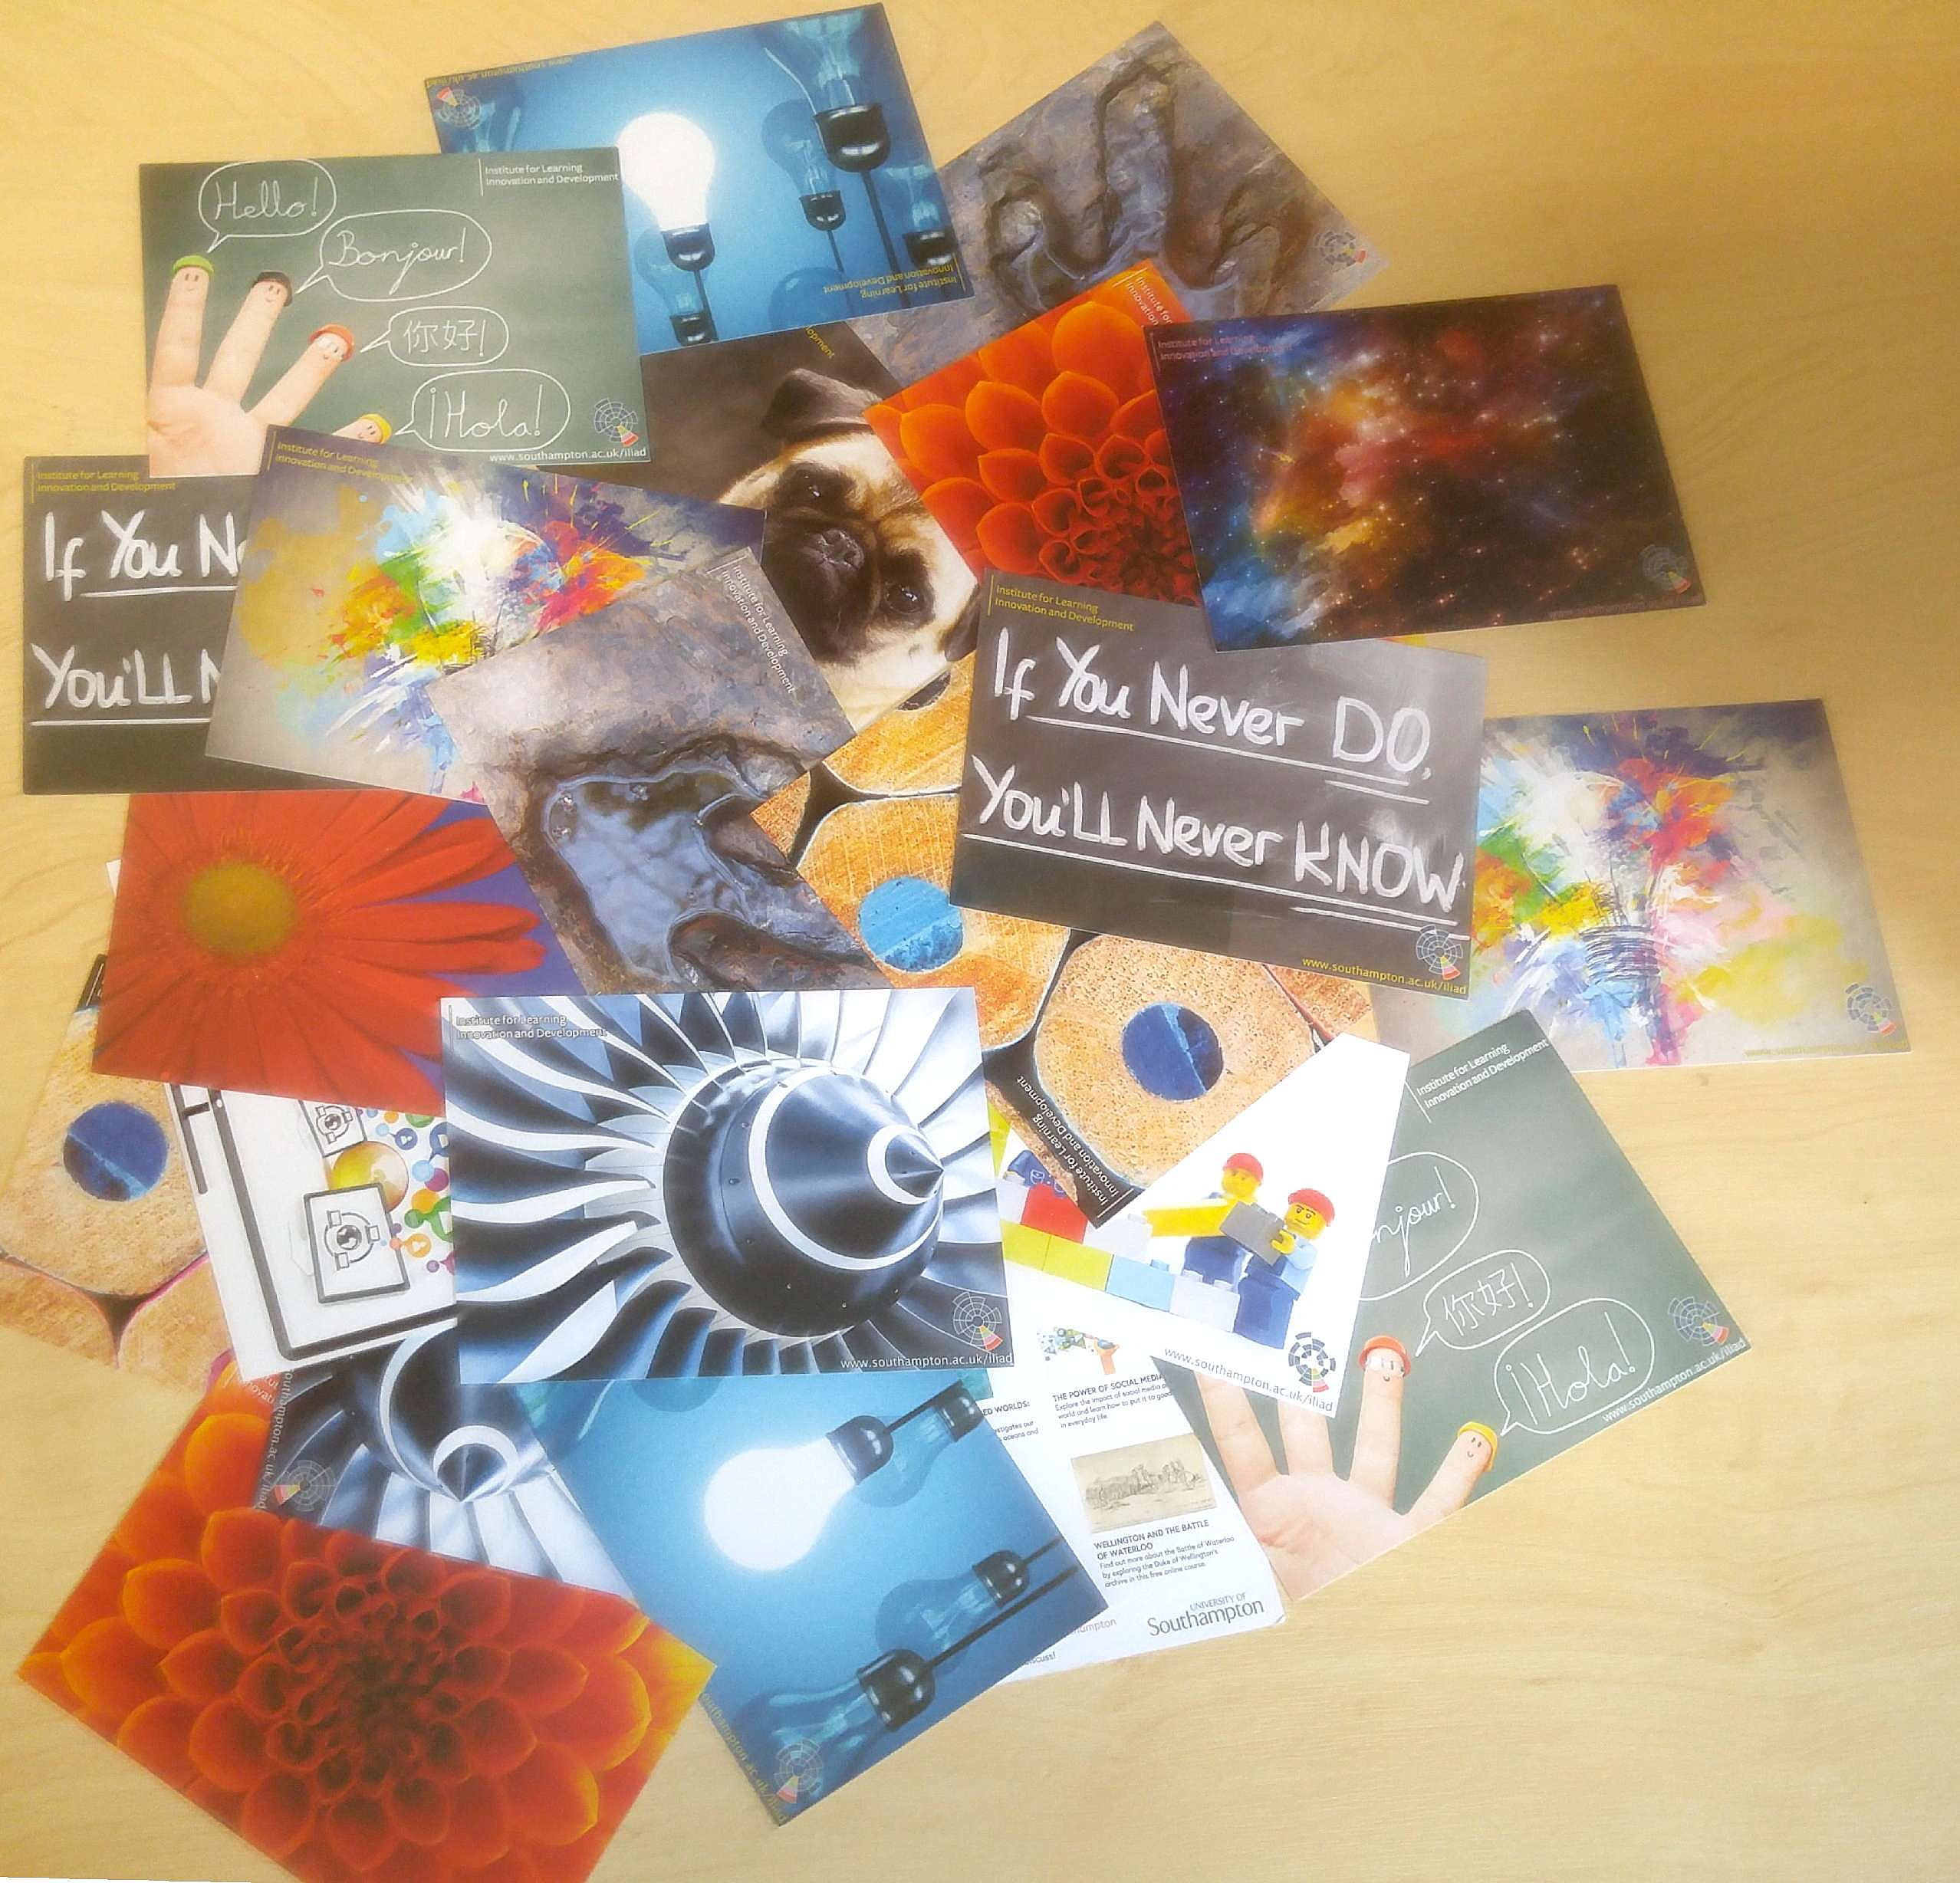
Impact beyond the event
Participants wrote to themselves a postcard as a reminder for future action.
How might you use what you have learned in the future or change some aspects of your practice as a result of attending this event?
What will you do next? (i.e. what is your action plan arising from this workshop?)
We posted them two months after the event.
Notes:
To extend the impact of the event beyond the 12th July, we requested participants to remind their future selves of their “good intentions” or promises to implement specific changes. For that, we circulated these postcards, and requested them to self-address them (to their work address), with a couple of reminders from the event which they would need before the start of the next semester. I haven’t planned doing any follow-up but perhaps I will, depending on what I learn today!

Slide 7

Take away
Evaluation questionnaires can be used to measure impact
Participants can write future plans in a postcard to extend the workshop impact beyond its time.
@AdrianaGWilde
Notes:
So this is it! Thank you very much for your attention. Here are a couple of take-aways from me.

