Slide 1
1/5
Total exposure
Mass: 13 a.u. Number: 13
WT/SP-A knockout
SP-D knockout
Air-liquid interface
Barrier
The circulatory system

Slide 2
2/5
WT/SP-A knockout
SP-D knockout
Retention
Mass: 13 a.u. Number: 6
Air-liquid interface
Retention
Mass: 13 a.u. Number: 6
Barrier
The circulatory system

Slide 3
3/5
WT/SP-A knockout
SP-D knockout
Retention
Mass: 13 a.u. Number: 6
Air-liquid interface
Retention
Mass: 13 a.u. Number: 6
Barrier
The circulatory system

Slide 4
4/5
WT/SP-A knockout
SP-D knockout
Retention
Mass: 11 a.u. Number: 4
Air-liquid interface
Retention
Mass: 9 a.u. Number: 4
!
!
Barrier
Blood flow
The circulatory system
Blood flow
High mass, low number
vs
Low mass, high number

Slide 5
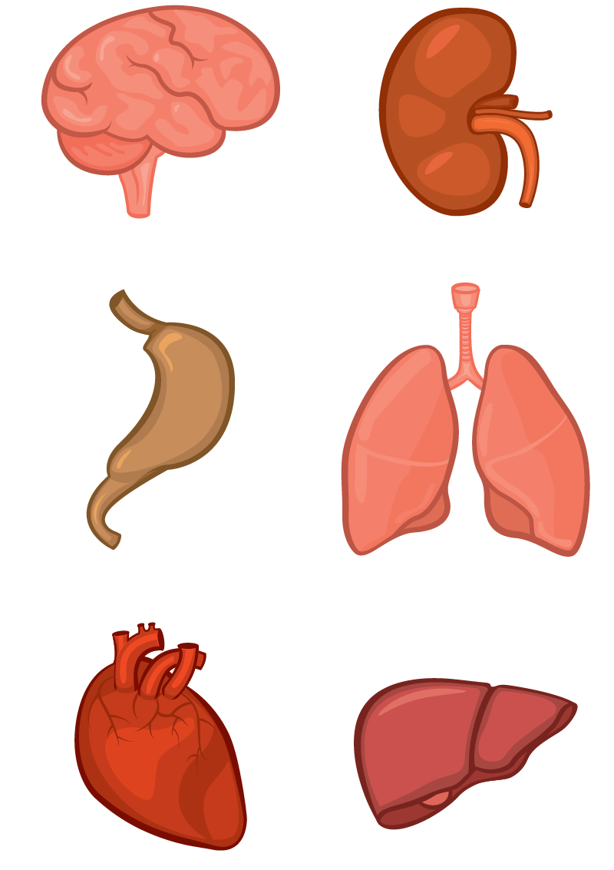
5/5
WT/SP-A knockout
SP-D knockout
Retention
Mass: 11 a.u. Number: 4
Air-liquid interface
Retention
Mass: 9 a.u. Number: 4
Barrier
Translocation
Blood flow
High mass, low number
vs
Low mass, high number

