Slide 1
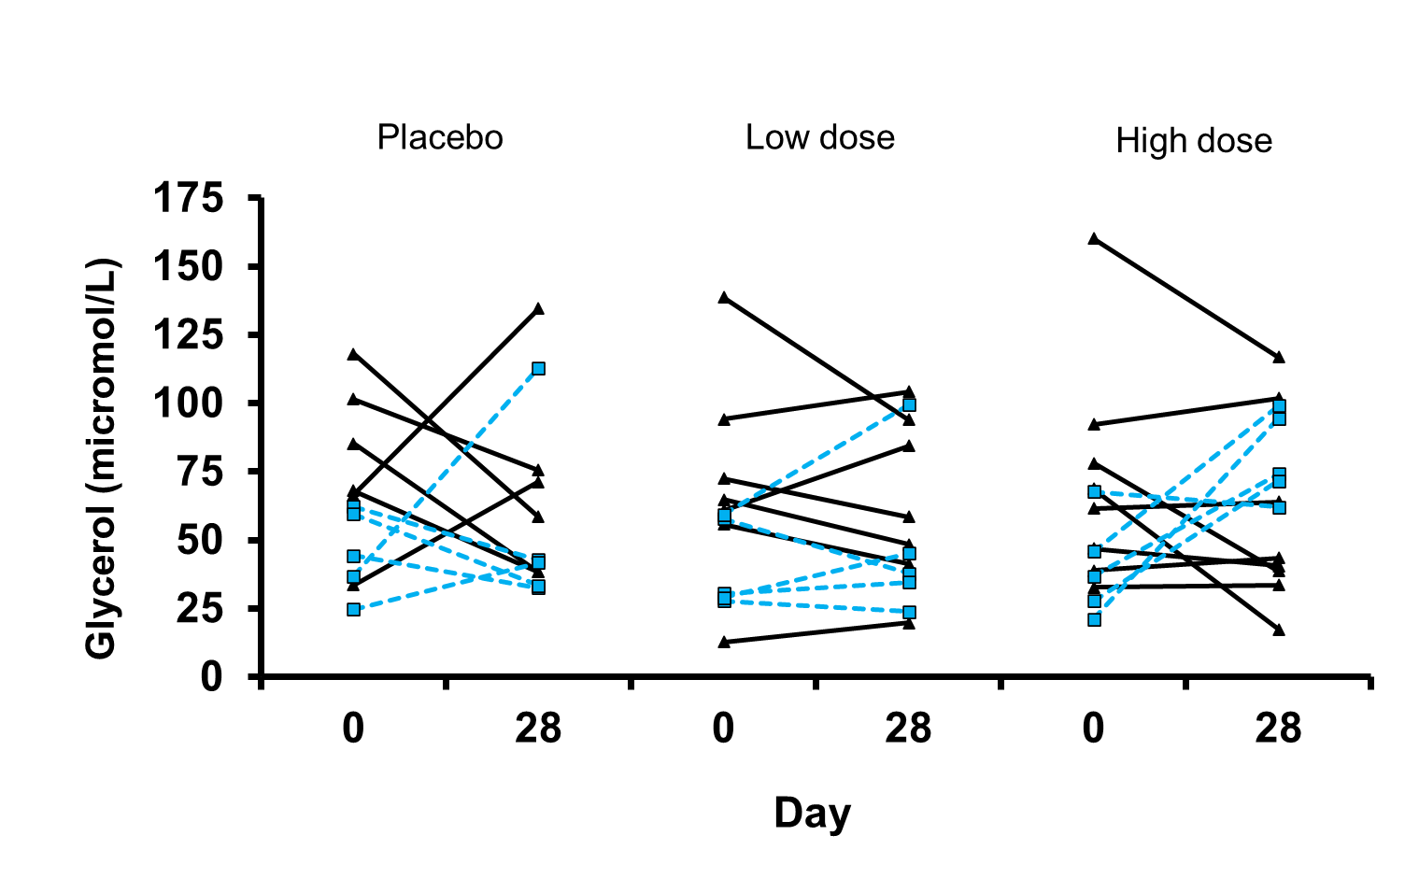
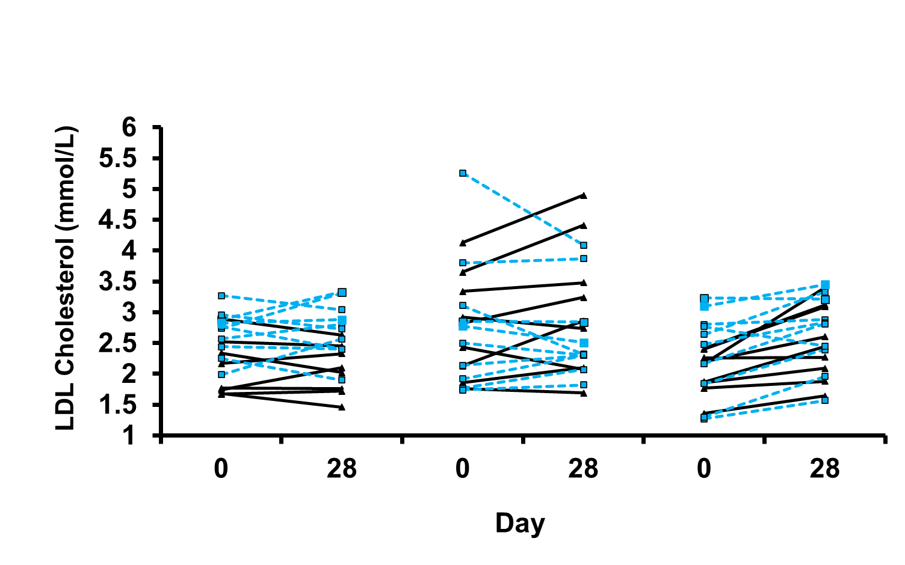
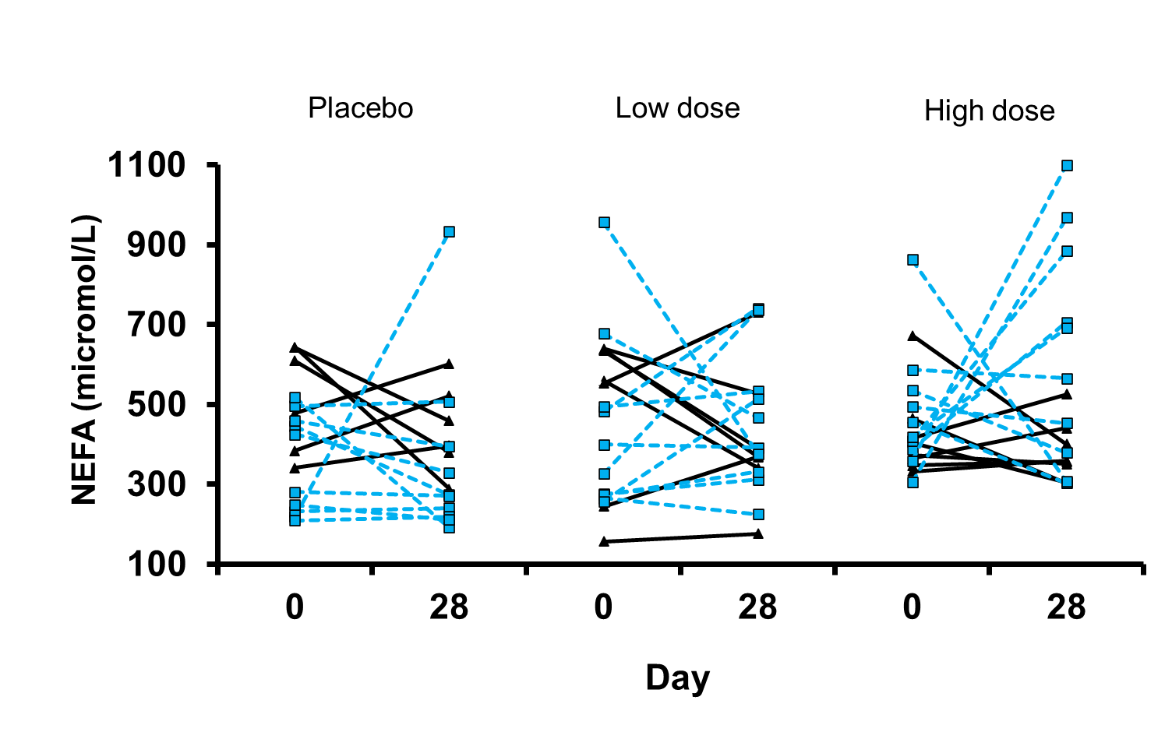
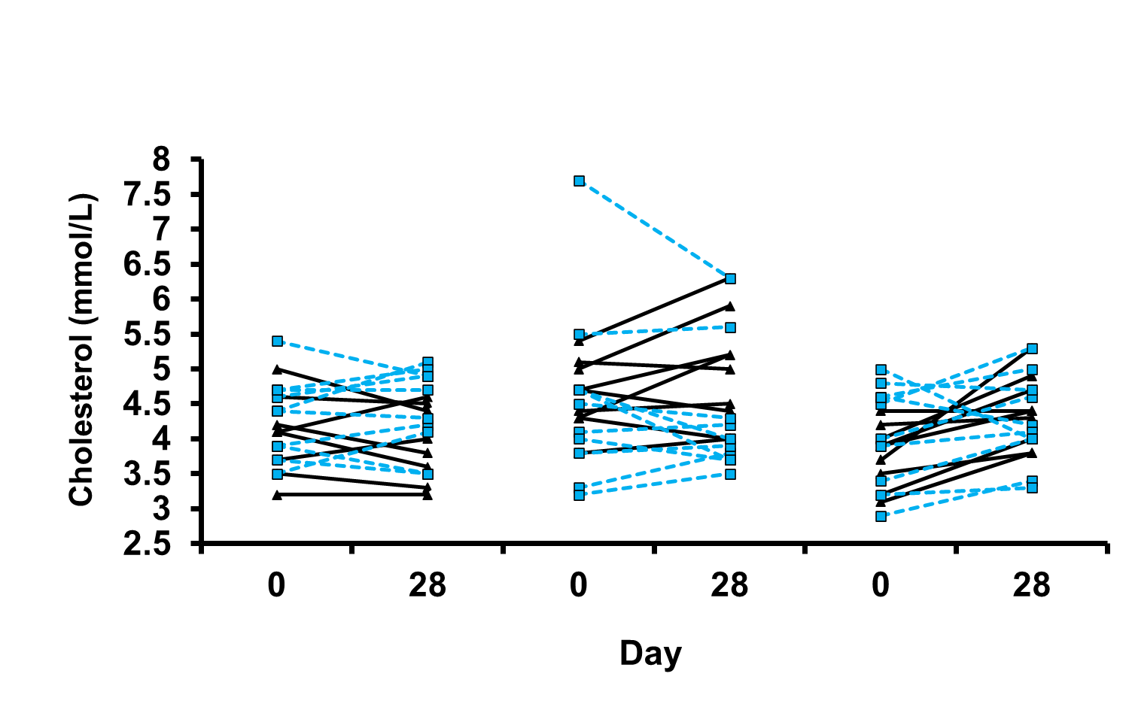
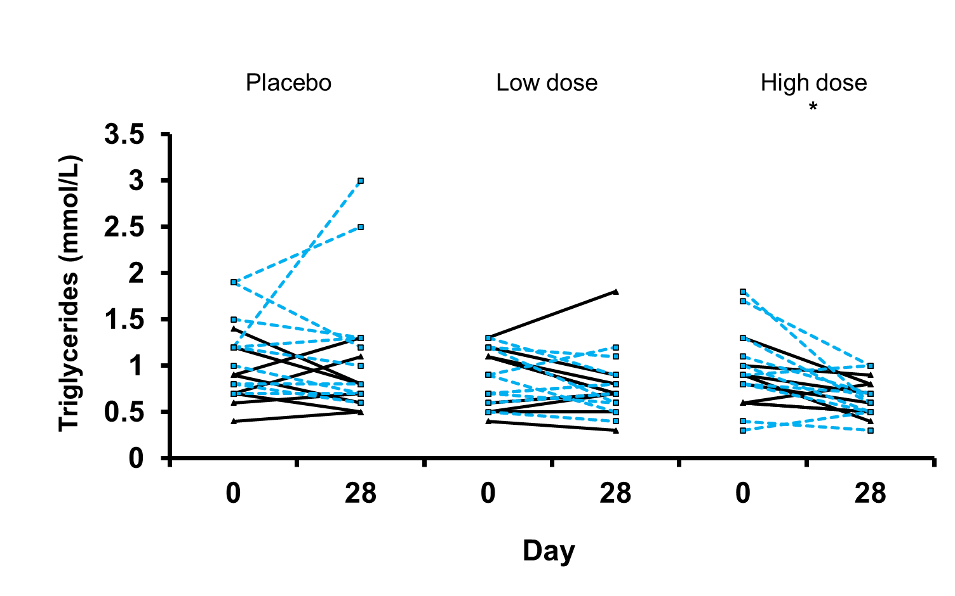
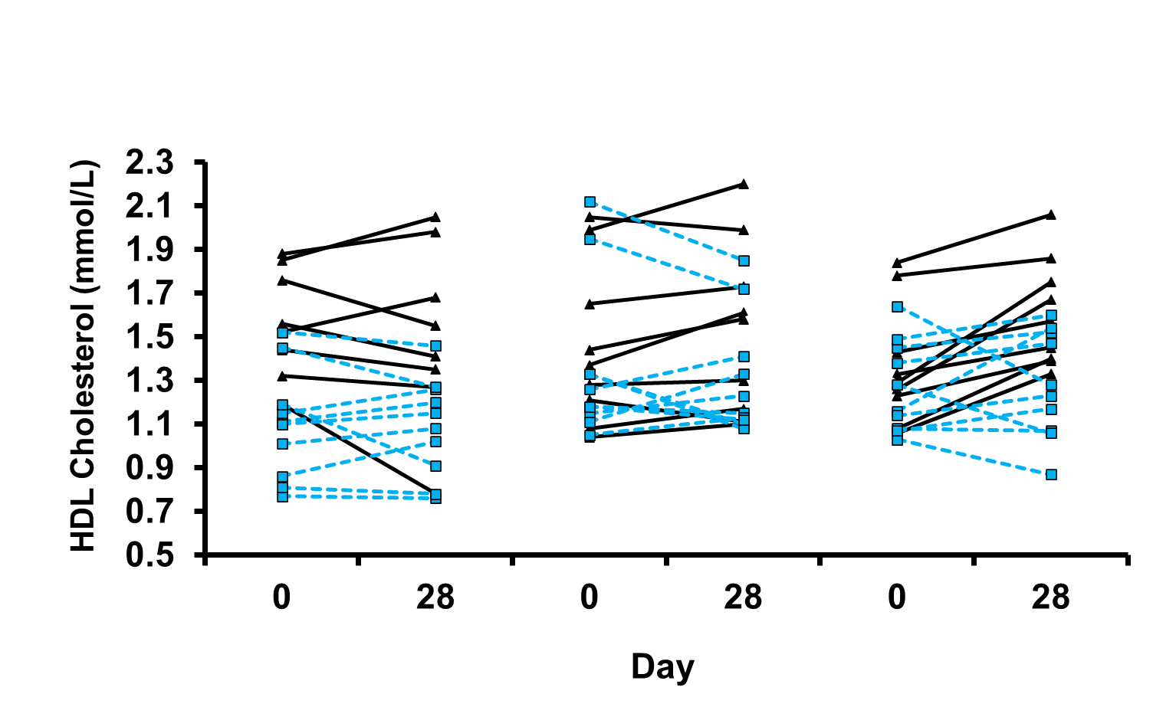
Figure 1A
Figure 1B
Figure 1C
Placebo
Low dose
High dose
Placebo
Low dose
High dose
Placebo
Low dose
High dose
Figure 1D
Figure 1E
Figure 1F

