Slide 1
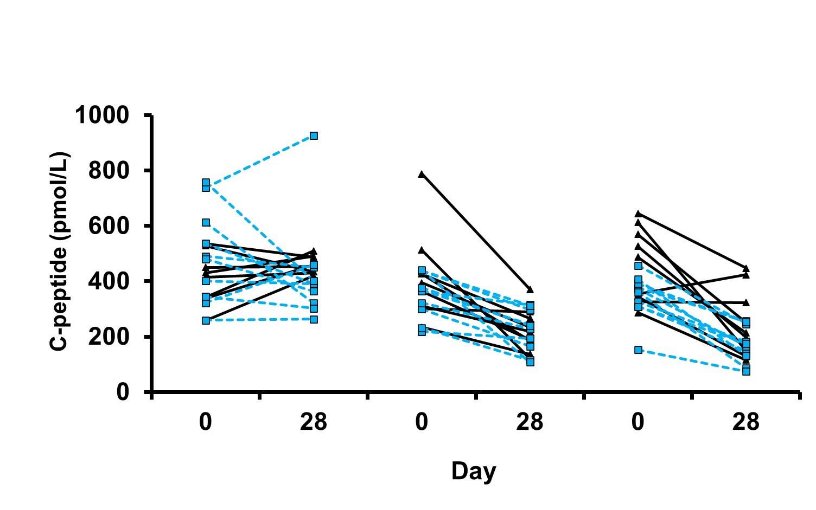
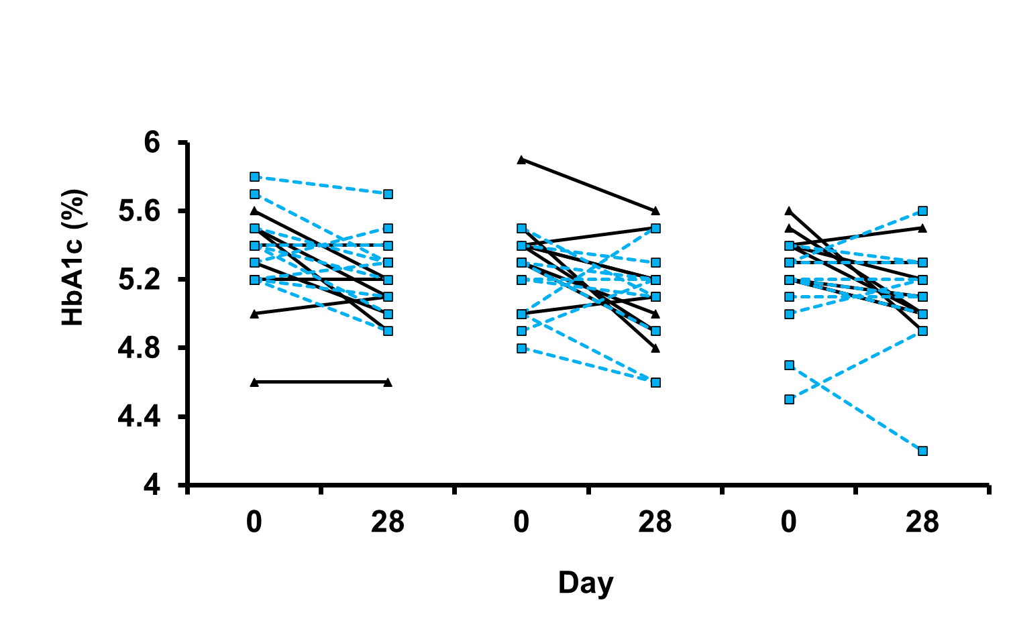
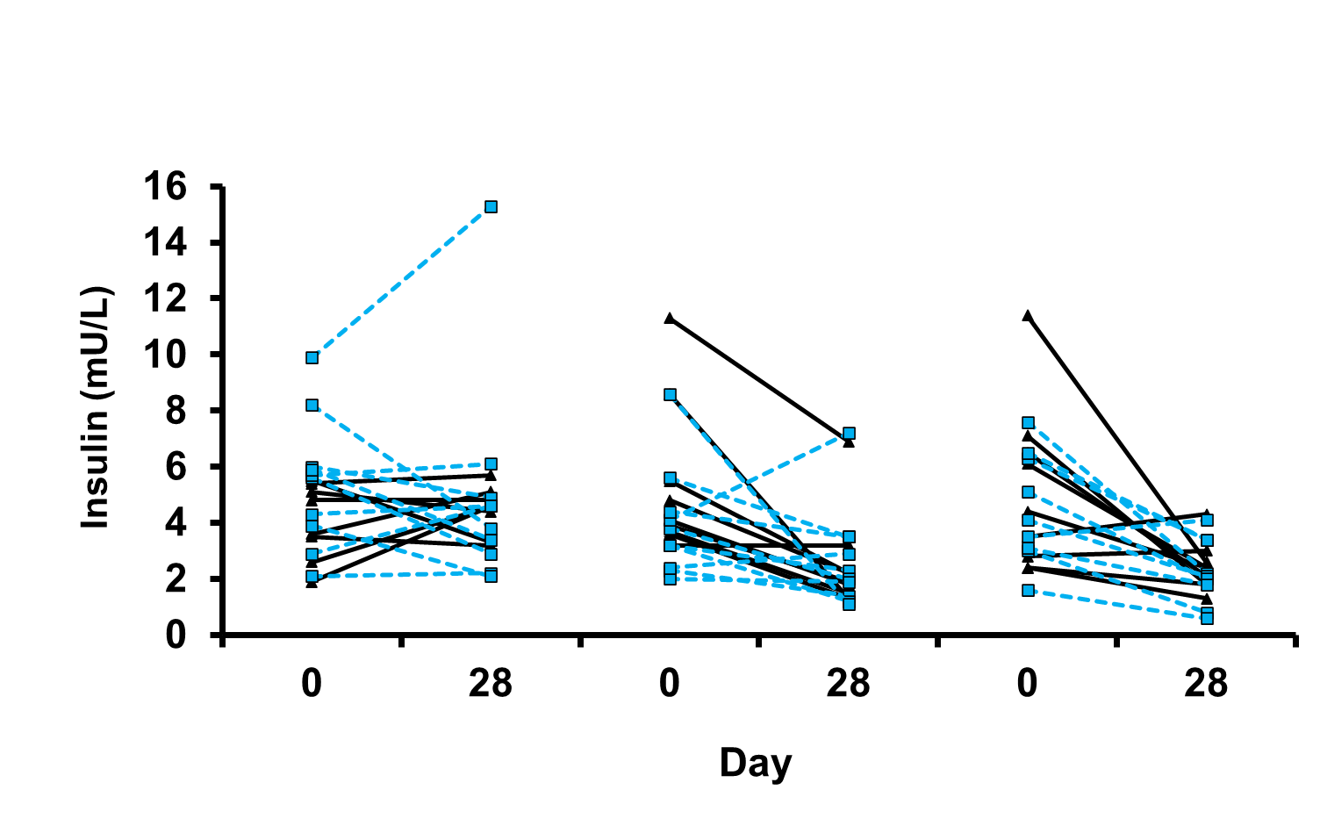
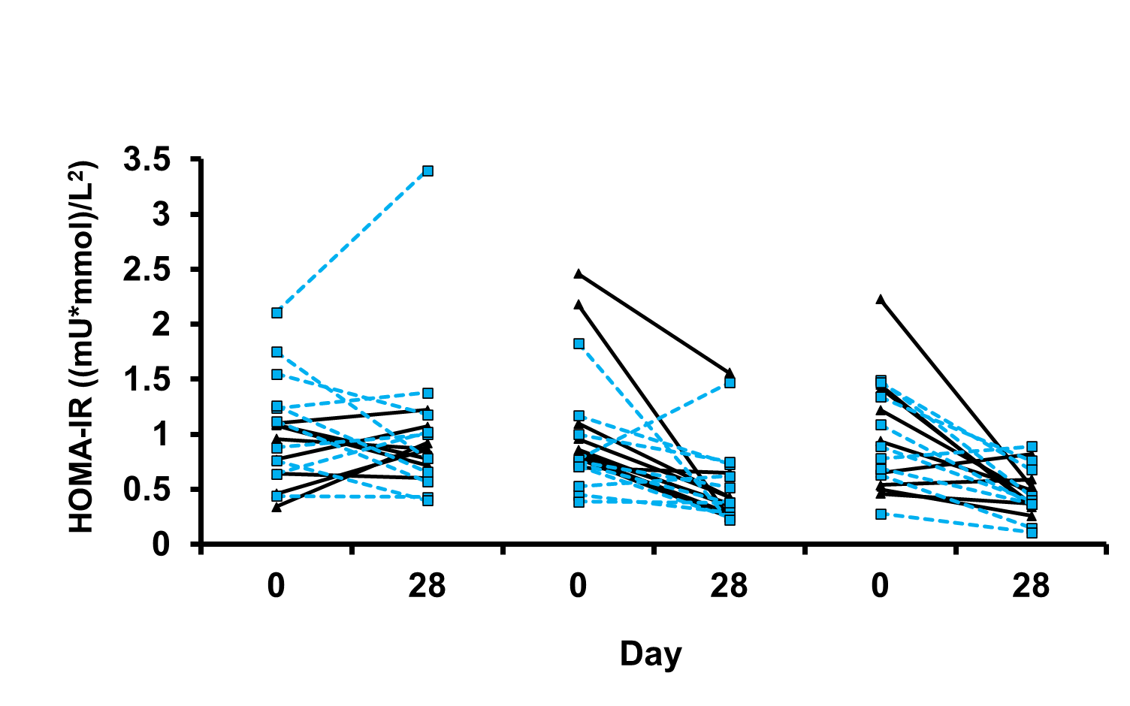
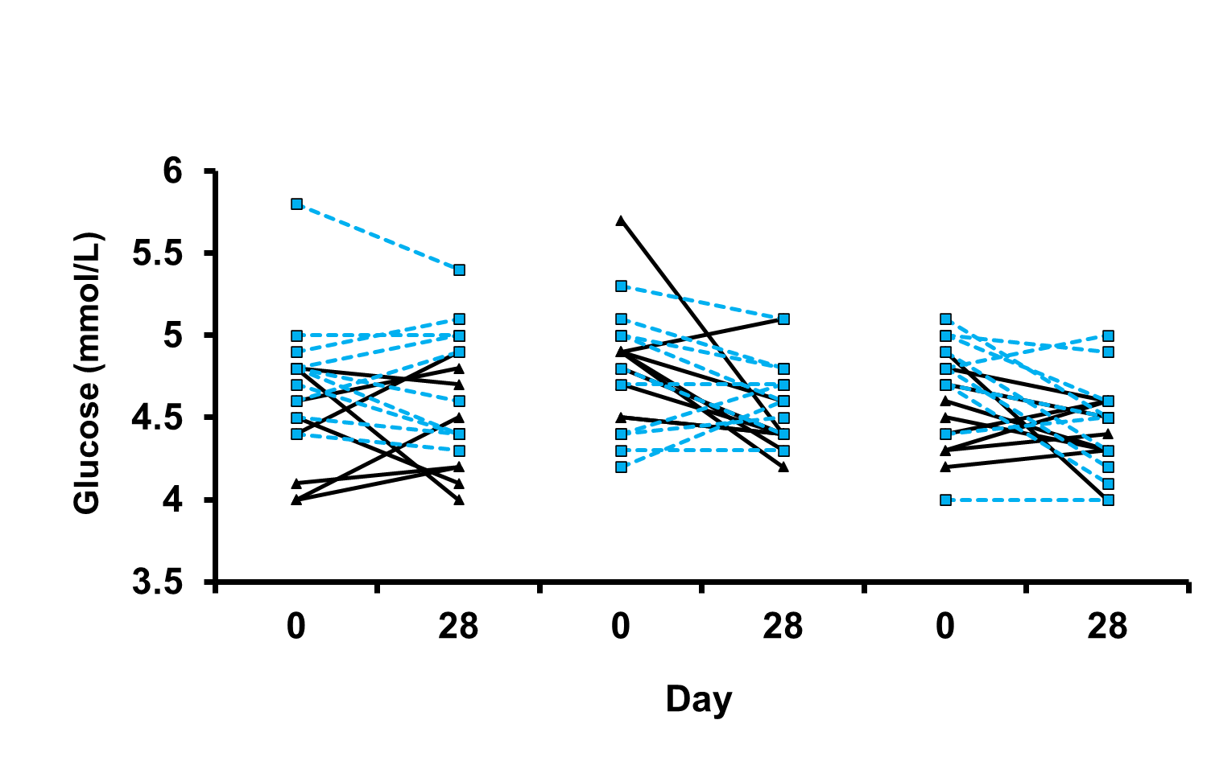
Placebo
Low dose
High dose
Placebo
Low dose
High dose
Placebo
Low dose
High dose
*
Figure 2A
Figure 2B
Figure 2C
Placebo
Low dose
High dose
Placebo
Low dose
High dose
Figure 2D
Figure 2E

