Slide 2
Not just data
Getting researchers to use DOIs for working papers at Southampton
Isobel Stark, Head of Research Data & Intellectual Property, University of Southampton Library 2021 UK DataCite Consortium Summer Meeting, 14th July 2021

Slide 3
UNIVERSITY OF SOUTHAMPTON
Large civic university on the south coast
Founded 1862 as Hartley Institute
Chartered as a University in 1952
Founder member of the Russell Group & Worldwide Universities Network (WUN)
350 undergraduate courses
220 postgraduate courses
Notes:
The research data team in the Library assign against the first five sequences.
The Worldpop and eCrystals suffix sequences are assigned by those research groups. The Research Data team mints Worldpop DOIs but eCrystals, as they run a separate repository, are able to mint their own as part of their publication process.

Slide 4
DATACITE @ SOTON
10.5258/
Started minting DOIs in 2013
As of 13th July 2021: 3635 DOIs minted
Several suffix sequences: - SOTON/nnnnnn Original ePrints - SOTON/Dnnnn Datasets - SOTON/Pnnnn Publication - SOTON/Tnnnn Theses - SOTON/WSI-WPnnn Web Science Institute Papers - SOTON/WPnnnnn Worldpop - SOTON/ecrystalsn eCrystals
Notes:
The research data team in the Library assign against the first five sequences.
The Worldpop and eCrystals suffix sequences are assigned by those research groups. The Research Data team mints Worldpop DOIs but eCrystals, as they run a separate repository, are able to mint their own as part of their publication process.
We mint DOIs against the following domains: *.soton.ac.uk soton.ac.uk ecrystals.chem.soton.ac.uk worldpop.org.uk *.worldpop.org.uk *.worldpop.org worldpop.org

Slide 5
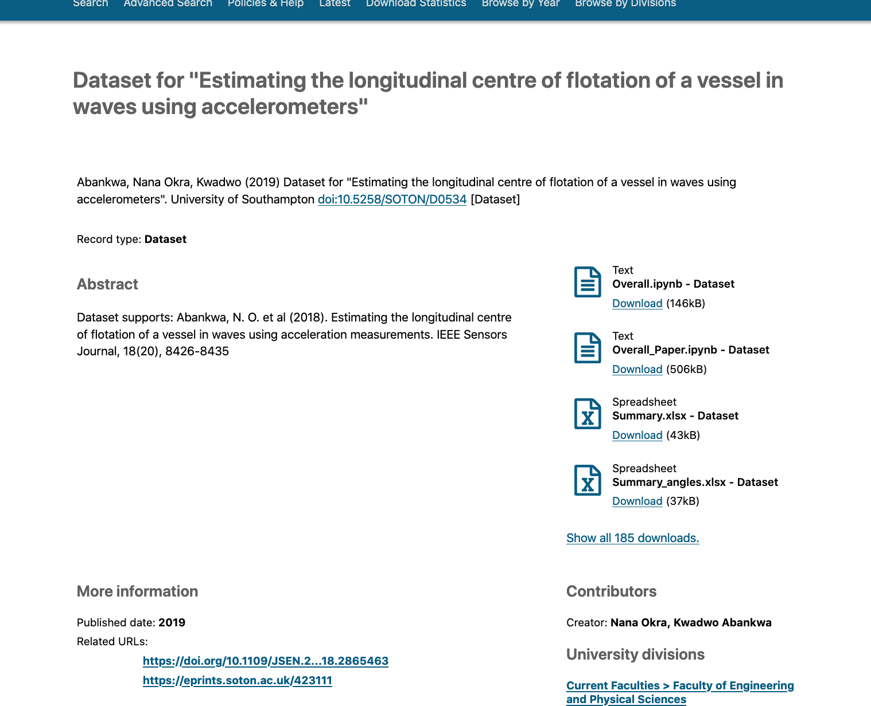
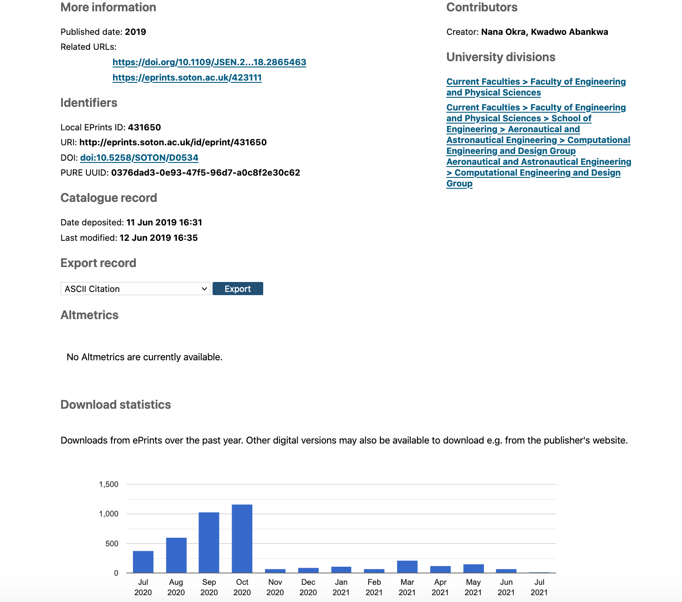
DOI: 10.5258/SOTON/D0534
Notes:
The majority of our DOIs point to our institutional repository, but our Worldpop sequence points to the datasets on the Worldpop servers and those minted by eCrystals point to http://ecrystals.chem.soton.ac.uk/ the archive of the Southampton Chemical Crystallography Group and the EPSRC UK National Crystallography Service.
Our main ePrints repository is unique as it is shared between publications and datasets. It is fed by our Pure CRIS, so no information is entered directly by humans into ePrints.

Slide 6
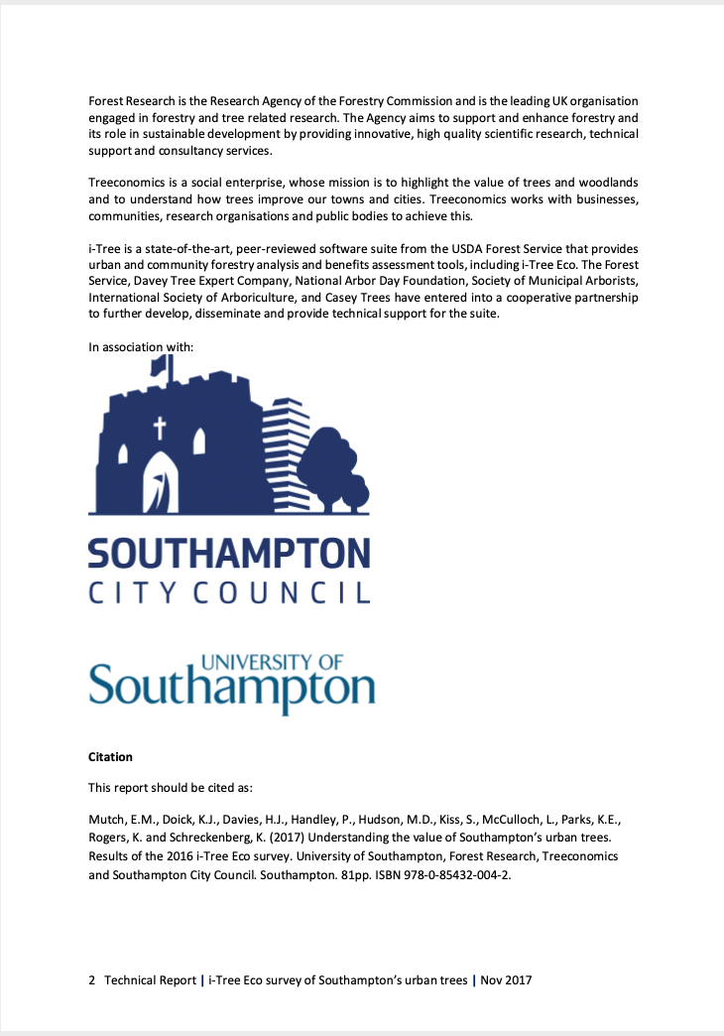
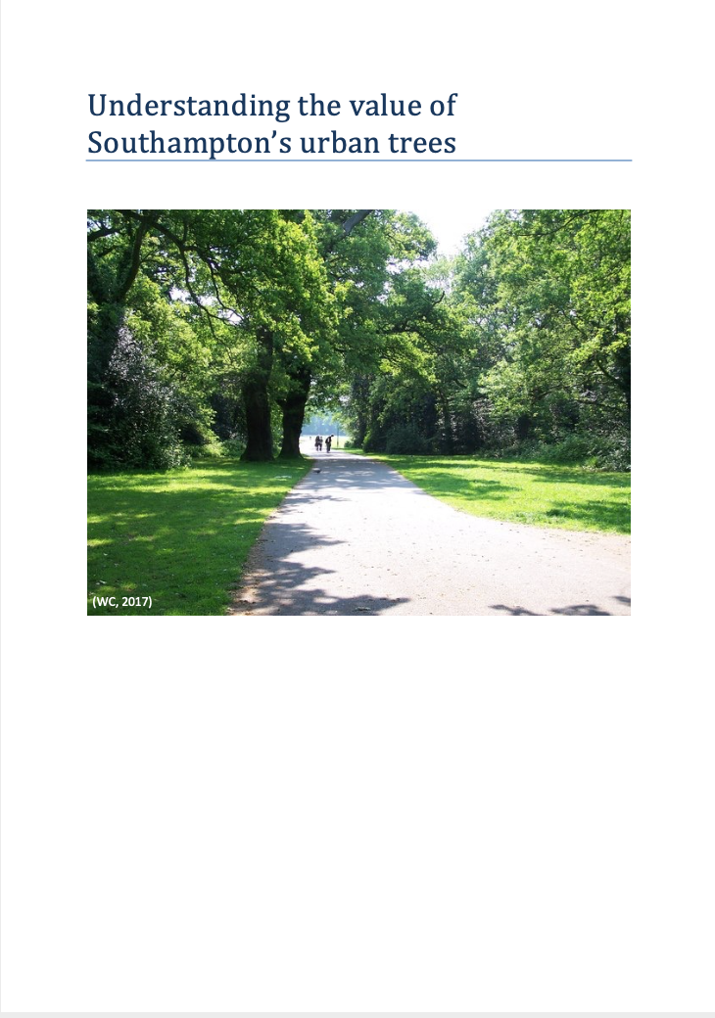
THE TREE REPORT
First report to be given new sequence DOI
Joint publication by the University and City Council
Minted November 2017
Report had ISBN but did not quote DOI in final version
doi:10.5258/SOTON/ P0001
Notes:
Hesitant researcher approached us about publishing the report in the repository. As it wasn’t a journal article the researcher was unsure we would take it.
We arranged for a DOI and an ISBN but the DOI was not quoted in the publication, despite our suggestion.
We have subsequently had several groups approach us when they have wanted to get greater visibility for a working paper and we were actively approaching research groups in the University who we knew had working paper series, for example Web Science Institute, Southampton Law School and Southampton Business School. But then everything ground to a halt with the double whammy of the final REF push and the pandemic. Nevertheless, the Sustainable Energy group registered working papers with us, the Southampton Marine and Maritime Institute have their first DOI’d paper in the pipeline so the message is getting out.

Slide 7
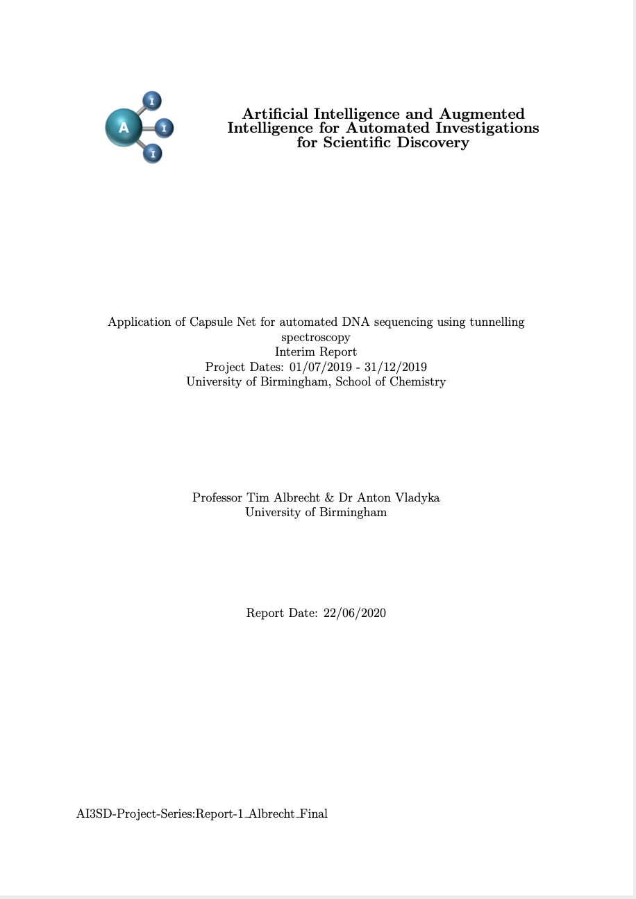
AI3SD
EPSRC Network+ project
Started in late 2018
Three separate series - events - project reports - interview
DOIs from main publication series
78 DOIs assigned to project outputs
doi:10.5258/SOTON/P0036
Notes:
Our first majority success in persuading researchers to use DOIs for publications was the ESPRC Network+ funded Artificial Intelligence and Augmented Intelligence for Automated Investigations for Scientific Discovery project.
The newly appointed research fellow in their first postdoc role, came to the Library in late 2018 to ask for advice on how to produce a report series. We were lucky because she had had good advice from our team during her PhD about depositing the data and so felt confident to ask us for help.

Slide 8
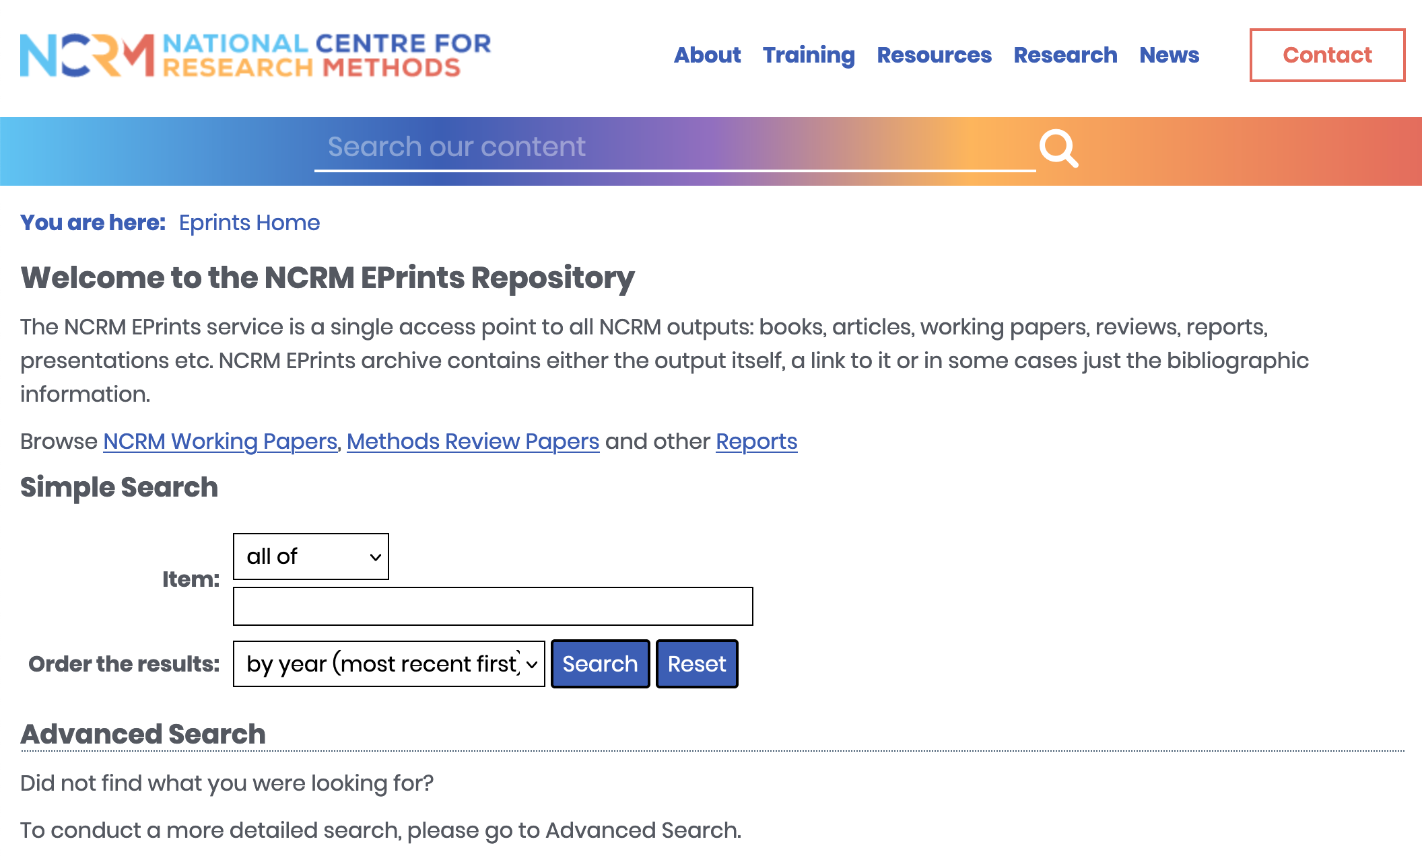
NCRM
National Centre for Research Methods
ESRC funded based at Southampton, with partners Edinburgh and Manchester
Own repository at eprints.ncrm.ac.uk
Notes:
Currently investigating with NCRM the possibility of them assigning and minted DOIs under our oversee for the publications in the NCRM repository.
The centre has been based at Southampton since its inception. The repository is highly structured with its own controlled vocabulary. Materials was well-used by social scientists and students around the UK and beyond.
As they run an ePrints server there is the possibility of using the ePrints DOI minter plug-in

Slide 9
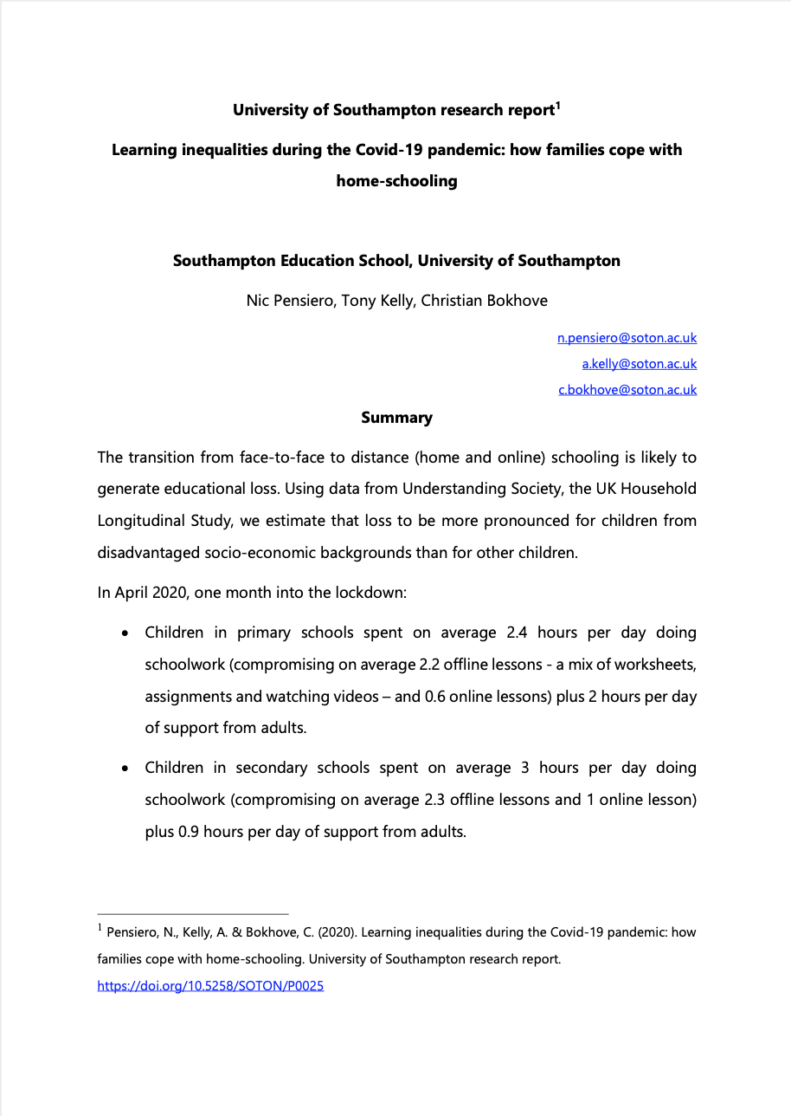
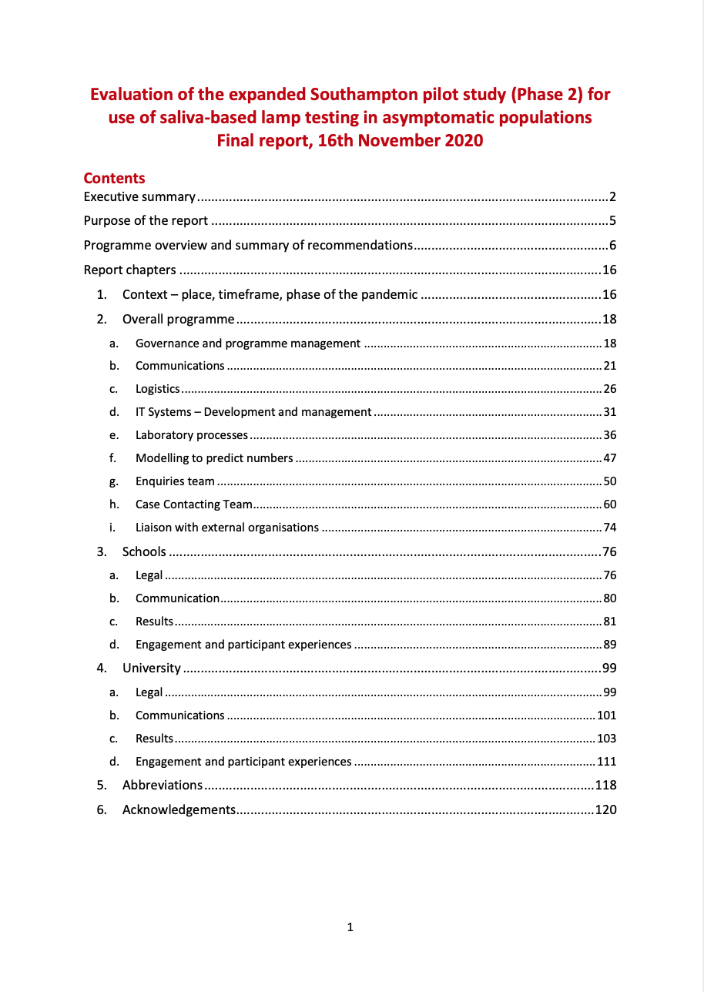
COVID PAPERS
Approached by both researchers and our Communications and Marketing dept
University was already a signatory to the Wellcome statement on sharing Covid-19 related research
Mixed bag on including the DOI in the publication
L-R. doi:10.5258/SOTON/P0025 doi:10.5258/SOTON/P0045. doi:10.5258/SOTON/P0071
Notes:
We had:
Early research on the effect inequalities on home-schooling published in July 2020, DOI included in report
Our own version of a submission to the Cabinet Office on the results of the Southampton Saliva testing study, November 2020, DOI not included in report
Glossy publication for internal research on the impact of Covid on our own ECRs in March 2021, DOI not included in report (nor publisher, nor publication year)

Slide 10
WHERE NEXT?
Image: James Allan / Winding country road / CC BY-SA 2.0
Notes:
Comms & Marketing - press officers onside to ask all researchers of their publication has a DOI and include it in the notes for editors in press releases. Already discussed the possibility of DOIs pointing to project website landing for publication in first instance but after an agreed period changing the DOI to land on the repository page - web editors need to be persuaded to use DOI links rather than publisher or ePrints urls - graphic designers have to learn that all publications should include a date, publisher and a PID at minimum
Research Groups
We can help
It doesn’t need to be just data
Now the REF is behind us, we can take our message out and about re improving our publication practice for all types of outputs
We have found that the best way to get the message across is in small face-to-face (or screen to screen) groups with pieces in research and faculty newsletters as back-up but not primary communication.
Need to work with administrators in departments with long running working paper/research report series to work on including publication information within the report, and possibly having a sequence which they assign to publications rather than the assignment being done by the Research Data team in the library

Slide 11
Sam – the reason for the muffled sound
Image: Isobel Stark, CC-BY
Notes:
This is Sam, our 2 year old mog, who cuddled up to the warm laptop and sat on the microphone during the presentation.

Slide 12
Thank you! Email: researchdata@soton.ac.uk Presentation doi:10.5258/SOTON/P0098 Creative Commons CC-BY 4.0 (except image on slide 10 by James Allan / Winding country road / CC BY-SA 2.0)

