Slide 1
Cal7
PR8
PBS
SV
SV
+
alum
SV
+
CpG
SV
+
CpG/ alum
PBS
SV
SV
+
alum
SV
+
CpG
SV
+
CpG/ alum
PC
Figure S1. Related to Figure 1. Hemagglutination inhibition (HI) titers. Mice were immunized with SV alone, SV plus alum, SV plus CpG–ODN, or SV plus CpG/alum subcutaneously. Mice administered PBS subcutaneously were considered control mice. Levels of HI titer in the plasma samples of immunized mice were determined. The dashed line shows the detection threshold for a positive response. In the right graph, the plasma samples obtained from PR8-immunized mice were used as a positive control (PC). n = 5 per group. Data are means ± SD. N.D.: not detected. ####P <0.0001 vs. SV alone group; **P <0.01 as indicated by Tukey’s test.
Figure S1. Shibuya et al.

Slide 2
Control
SV + CpG/alum
IFN-γ⁺
87
8.9
3.6
IFN-γ
CD4
FSC
CD8a
Figure S2. Related to Figure 1. Gating strategy for identifying IFN-γ-producing cells. Splenocytes obtained from SV plus CpG/alum-immunized mice were incubated in the presence of SV with protein transport inhibitor cocktail for 24 h in vitro and the intracellular levels of IFN-γ in live cells were evaluated by flow cytometry. Representative flow cytometry plots from data presented in Figure 1E are shown.
Figure S2. Shibuya et al.

Slide 3
A
B
Figure S3. Related to Figure 3. Serum transfer. A mixture of 6 × 10² TCID₅₀ PR8 and 2-fold diluted serum obtained from PBS-treated control mice, SV plus alum-, SV plus CpG–ODN-, or SV plus CpG/alum-immunized mice was administered to naïve mice intranasally. We monitored (A) percentages of initial body weights and (B) survival for the next 15 days. (A, B) n = 5 per group. (A) Data are means ± SD. (B) **P <0.01 between SV plus CpG–ODN group vs. SV plus CpG/alum group as indicated by comparing Kaplan-Meier curves using the log-rank test.
Figure S3. Shibuya et al.

Slide 4
IgG1
IgG2b
IgG2c
Purified
total mIgG
Purified mIgG2
Purified
total mIgG
Purified mIgG2
Purified
total mIgG
Purified mIgG2
Figure S4. Related to Figure 3. Isolation of mIgG2. Total mIgG and mIgG2 were purified from the serum of SV plus CpG/alum-immunized mice. Levels of SV-specific mIgG1, mIgG2b, and mIgG2c in 5 ng of purified mIgG were evaluated by ELISA. n = 5 per group. Data are means ± SD.
Figure S4. Shibuya et al.

Slide 5
CD3⁺
Control
CD3⁺
SV + CpG/alum
CD3
CD4
IFN-γ
IFN-γ
Figure S5. Related to Figure 4. IFN-γ-producing cells in the lung. After treatment with PBS or immunization with SV plus CpG/alum, mice were challenged with 1.2 × 10³ TCID₅₀ PR8. Four days after the challenge, the mice were treated with Brefeldin A intraperitoneally followed by harvesting of the lung. Single cell suspensions samples were prepared and intracellular IFN-γ was analyzed in live CD45⁺ cells by flow cytometry. Representative flow cytometry plots are shown.
Figure S5. Shibuya et al.

Slide 6
A
B
Figure S6. Related to Figure 4. Requirement of IFN-γ for cross-protection. A mixture of 1.2 × 10 TCID₅₀ PR8 and 2-fold diluted serum obtained from SV plus alum-immunized mice was administered to naïve mice intranasally. These mice were treated with recombinant IFN-γ, and we monitored (A) percentages of initial body weights and (B) survival for the next 15 days. (A, B) n = 5 per group. (A) Data are means ± SD. (B) **P <0.01 as indicated by comparing Kaplan-Meier curves using the log-rank test.
Figure S6. Shibuya et al.

Slide 7
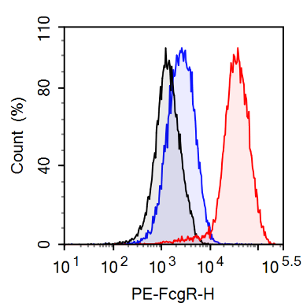
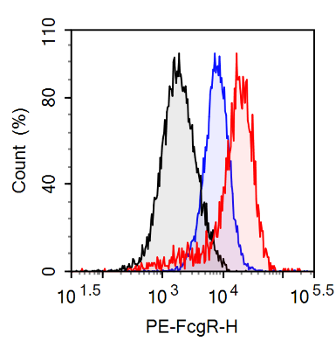
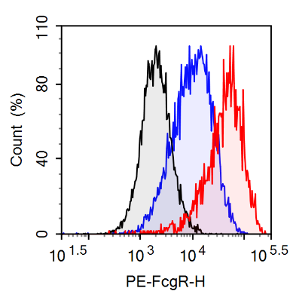
FcγRI
FcγRIIb
FcγRIII
FcγRIV
Isotype control
PBS
PR8
Figure S7. Related to Figure 5. Expression change in FcγRs on alveolar macrophages after virus infection. On day 5 after naïve mice were challenged with 1.2 × 10³ TCID₅₀ PR8 or treated with PBS intranasally, the expression of FcγRI, FcγRIIb, FcγRIII, and FcγRIV on alveolar macrophages was determined by flow cytometry.
Figure S7. Shibuya et al.

Slide 8
A
B
FcγRIIb
CD45⁺
AM
Count (%)
CD45
CD11c
Isotype control (staining control)
Isotype Ab
FSC
Siglec-F
anti-IFN-γ Ab
Figure S8. Related to Figure 5. FcγRIIb expression on alveolar macrophages. After immunization with SV plus CpG/alum, anti-IFN-γ antibody or isotype antibody was injected before PR8 challenge. Five days after PR8 challenge, the expression of FcγRs on alveolar macrophages were determined by flow cytometry. (A) Gating strategy for alveolar macrophages is shown. We defined alveolar macrophages in BALF as 7-AAD⁻ CD45⁺ CD11c⁺ Siglec-F⁺ cells. (B) Representative histogram of FcγRIIb staining on alveolar macrophages from data presented in Figure 5C is shown.
Figure S8. Shibuya et al.

Slide 9
A
B
Count (%)
Isotype control (staining control)
PR8
PR8 + rIFN-γ
PR8 + PBS
PR8 + rIFN-γ
Figure S9. Related to Figure 5. Expression change in FcγRIIb on alveolar macrophages after IFN-γ treatment. Naïve mice were challenged with 1.2 × 10³ TCID₅₀ PR8 and recombinant IFN-γ was administered intranasally on 4 day after the virus challenge. On day 5 after the challenge, the expression of FcγRIIb on alveolar macrophages was determined by flow cytometry. (A) Representative histogram of FcγRIIb staining on alveolar macrophages from data presented in Figure S9B and (B) FcγRIIb expression mean fluorescence intensity (MFI) is shown. (B) n = 5 per group. Data are means ± SD. ***P <0.001 as indicated by Student’s t-test.
Figure S9. Shibuya et al.

