Slide 1
Modelling and Optimising Femtosecond Laser Machining using Deep Learning
Ben Mills, James A Grant-Jacob, Michael McDonnell,
and Robert W Eason
b.mills@soton.ac.uk
Optoelectronics Research Centre, University of Southampton, UK
Notes:
Please use the dd month yyyy format for the date for example 11 January 2008. The main title can be one or two lines long.

Slide 2
Outline
Motivation
Introduction to neural networks
Using a digital micromirror device (DMD), as an intensity spatial light modulator, for laser machining
Training a neural network to predict the outcome of laser machining
Conclusions
Notes:
If using a school logo, make sure that if you have a long page title, it does not encroach on the logo. Allow about 2cm around the logo. Run the page title onto two lines if necessary.

Slide 3
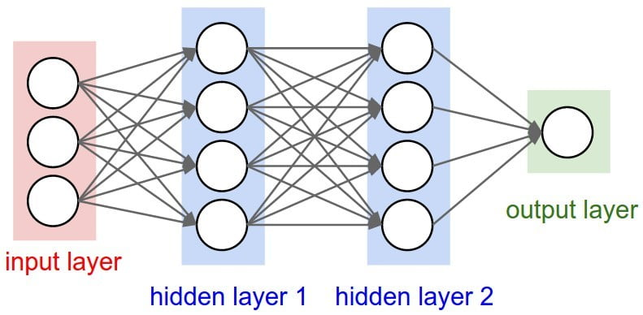
What is a Neural Network?
A network of nonlinear functions, with an input layer and an output layer
Transforms data from one domain to another domain
Notes:
If using a school logo, make sure that if you have a long page title, it does not encroach on the logo. Allow about 2cm around the logo. Run the page title onto two lines if necessary.

Slide 4
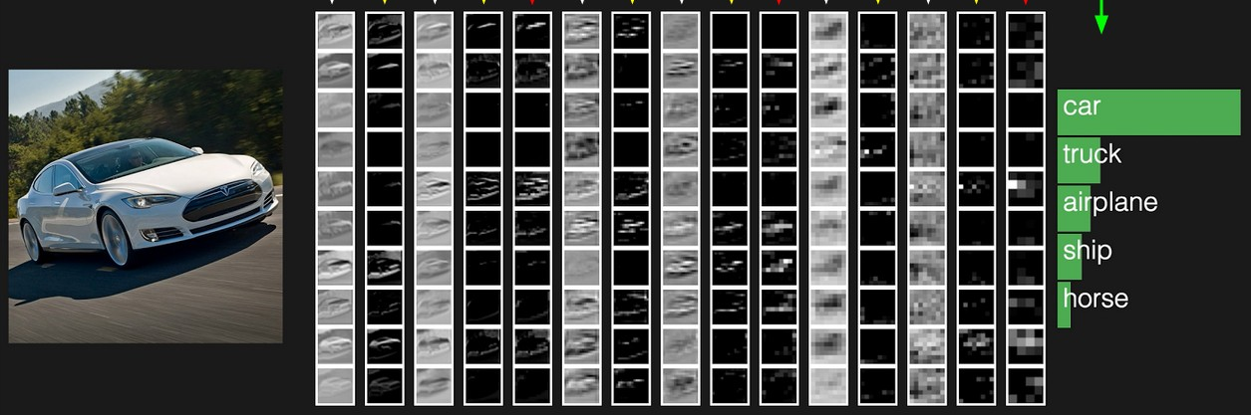
What is a Neural Network?
We actually use variants of convolutional neural networks
As used in self-driving cars and medical diagnostics
The neurons in the network learn to recognise objects
Perfect for image data
Notes:
If using a school logo, make sure that if you have a long page title, it does not encroach on the logo. Allow about 2cm around the logo. Run the page title onto two lines if necessary.

Slide 5
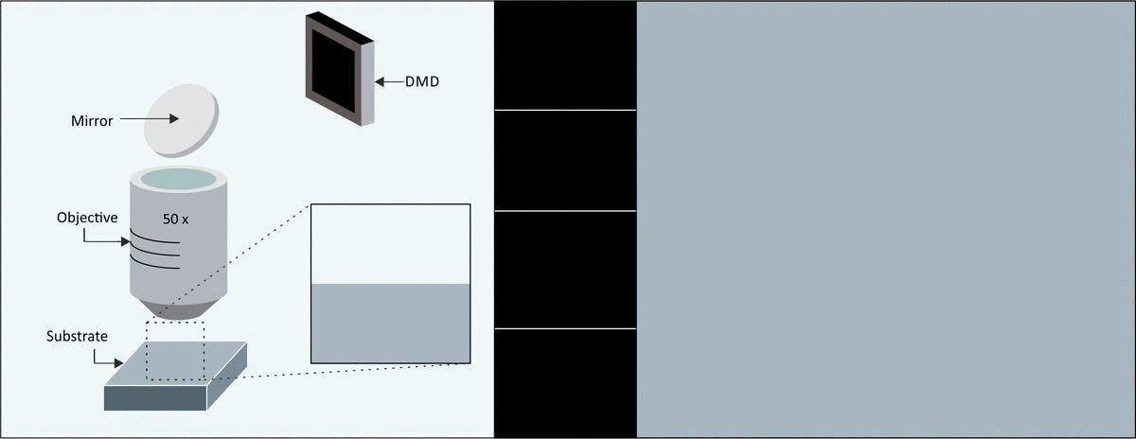
Key Technology –Beam Shaping
Change the spatial intensity profile of every laser pulse
Using a digital micromirror device (DMD), which is a spatial light modulator

Slide 6
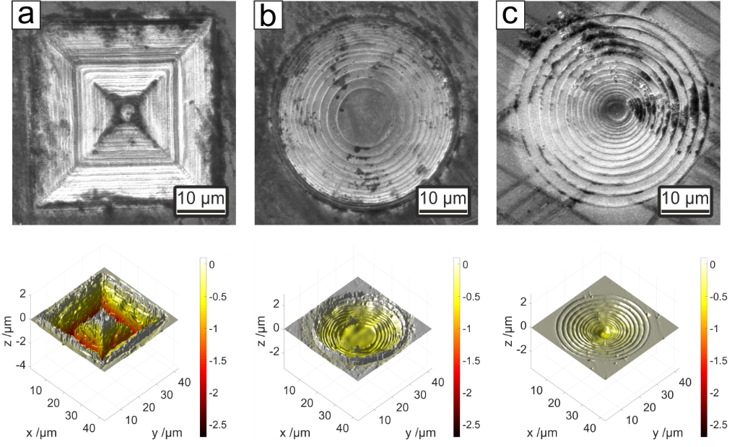
Key Technology –Beam Shaping
6

Slide 7
The Research Objective
In order to achieve this, the NN needs to learn the complex interaction of light and matter

Slide 8
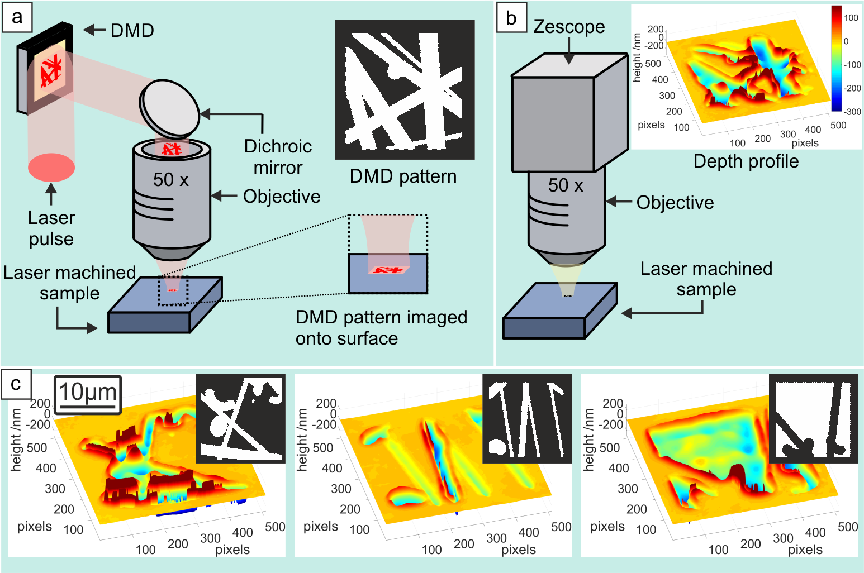
Training Data Collection
Objective is to train a NN to convert DMD pattern into depth profile
INPUT data = DMD pattern
OUTPUT data = depth profile

Slide 9
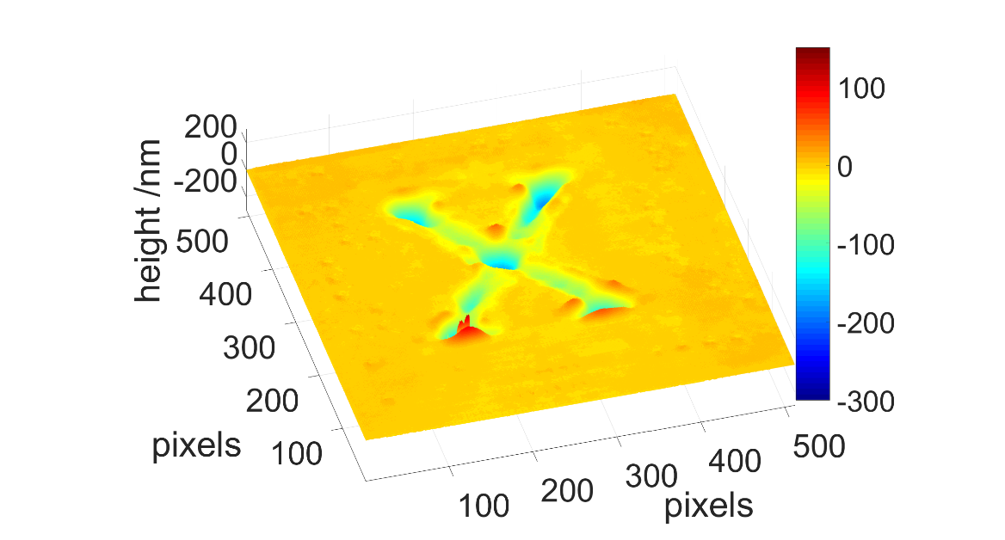
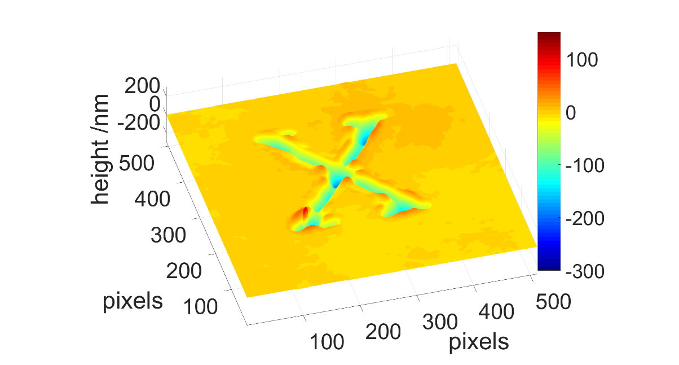
Experimental or Predicted?
The NN has never seen this beam shape

Slide 10
Experimental or Predicted?
The NN has never seen this beam shape
Predicted
Experimental

Slide 11
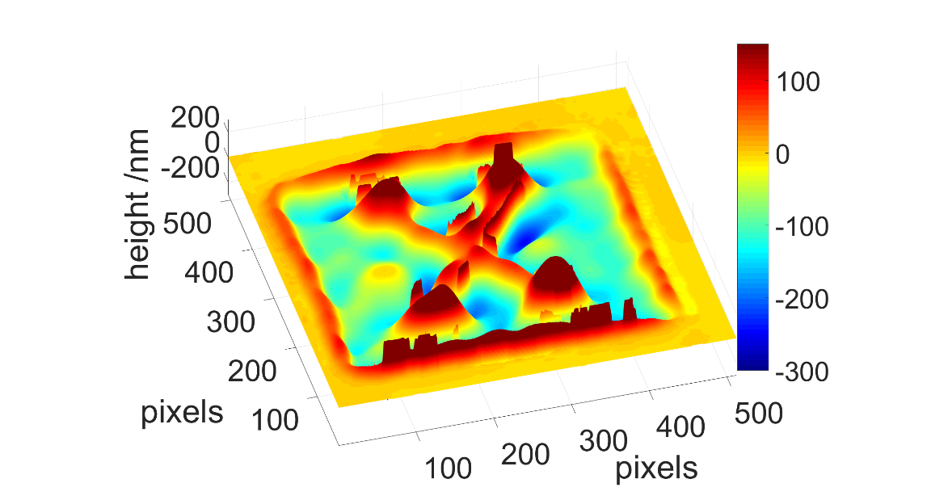
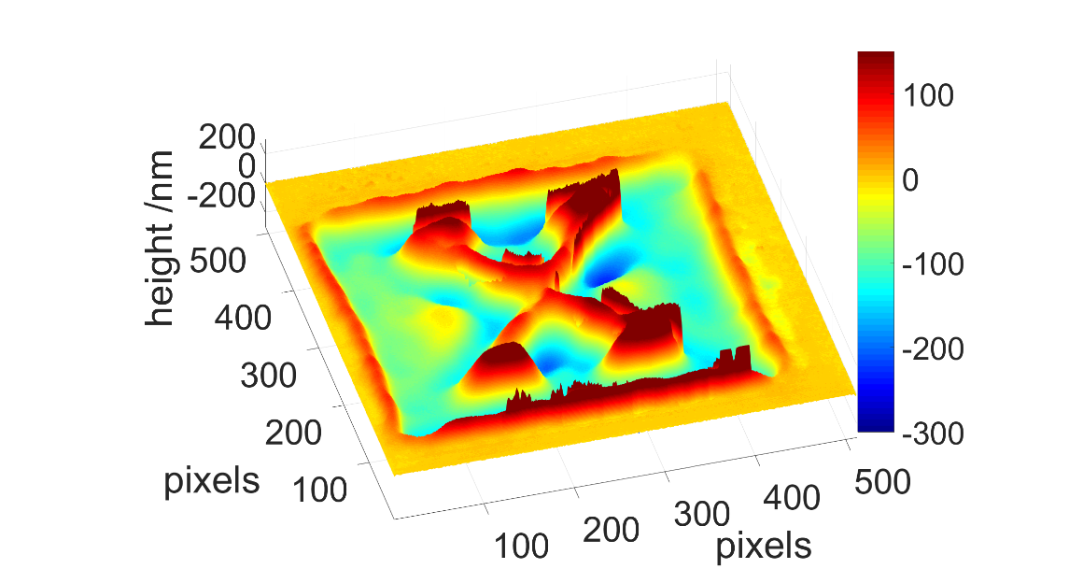
Experimental or Predicted?
The NN has never seen this beam shape

Slide 12
Experimental or Predicted?
The NN has never seen this beam shape
Experimental
Predicted

Slide 13
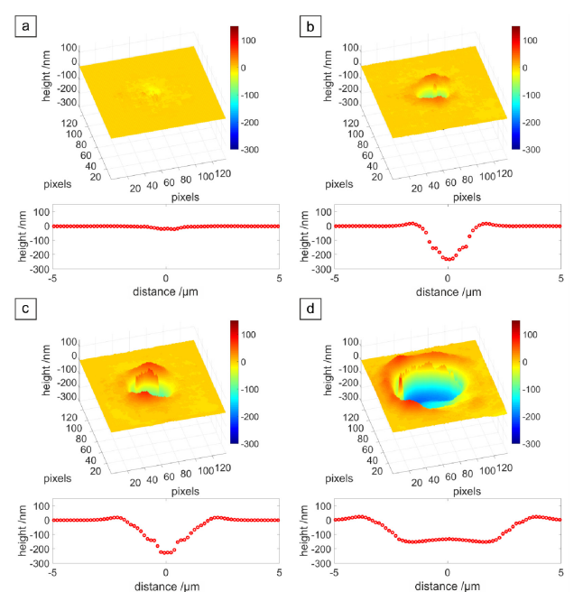
Predictive Capabilities
The trained NN can then be used to predict almost any beam profile
Showing here, prediction for laser machining with a circular beam profile with diameter a) 1 µm, b), 3 µm, c) 5 µm and d) 7 µm

Slide 14
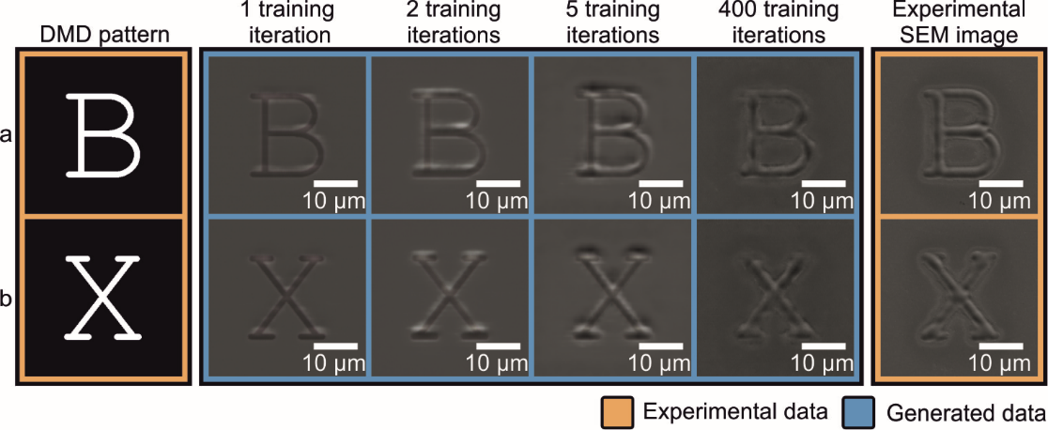
Predictive Capabilities
A neural network can be trained to predict the appearance of the sample, for different beam shapes, if it was imaged using an scanning electron microscope (SEM)

Slide 15
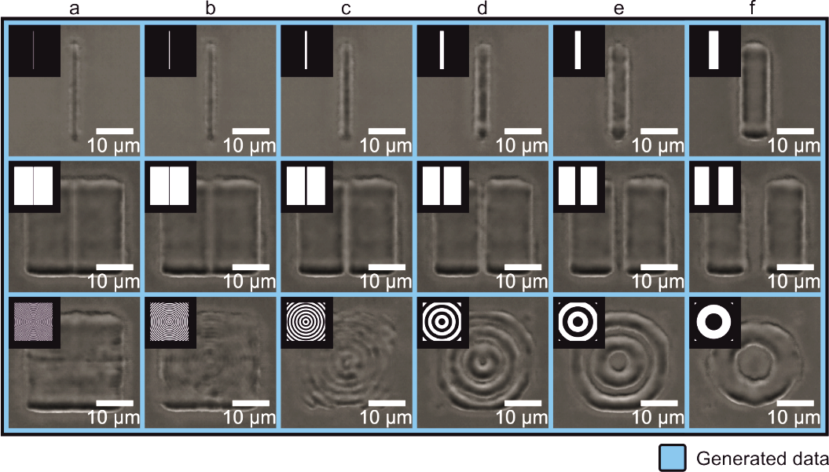
Predictive Capabilities
All these images were created via a neural network

Slide 16
Predictive Capabilities
The neural network has “discovered” a property that we refer to as the diffraction limit

Slide 17
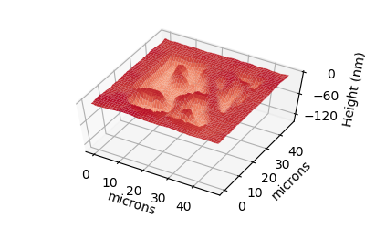
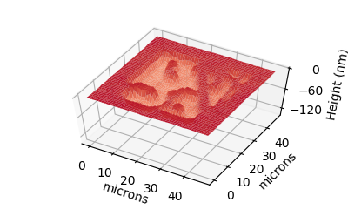
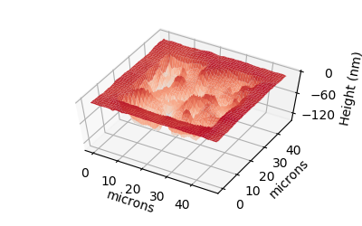
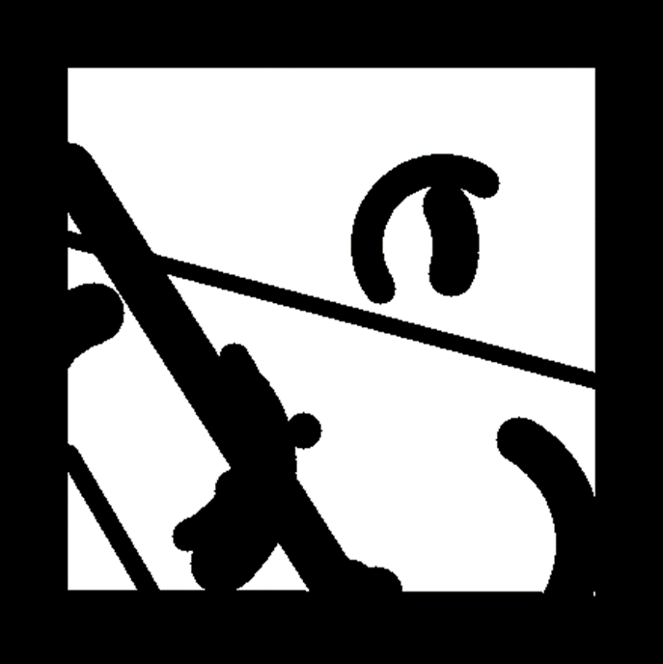
Extension to 3-pulse prediction
DMD Stack
Experimental Profile
Generated Profile

Slide 18
Extension to 3-pulse prediction
DMD Stack
Experimental Profile
Generated Profile

Slide 19
Extension to 3-pulse prediction
DMD Stack
Experimental Profile
Generated Profile

Slide 20
Extension to 3-pulse prediction
DMD Stack
Experimental Profile
Generated Profile
The network has never seen this experimental data.
However, the profiles generated by the neural network match the experimental results.
Neural network confirmed to correctly simulate multiple pulse femtosecond ablation

Slide 21
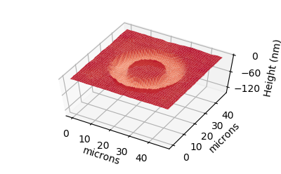
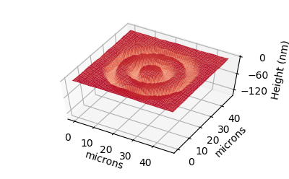
Extension to 3-pulse prediction
The neural network can then used to simulate femtosecond ablation using any set of DMD patterns.
Here, showing machining with a single pulse, with ring patterns

Slide 22
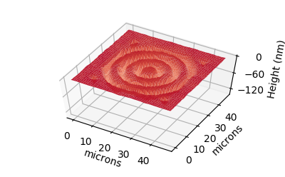
Extension to 3-pulse prediction
The prediction from
one pulse with three rings
and
three pulses with one ring each
are identical.

Slide 23
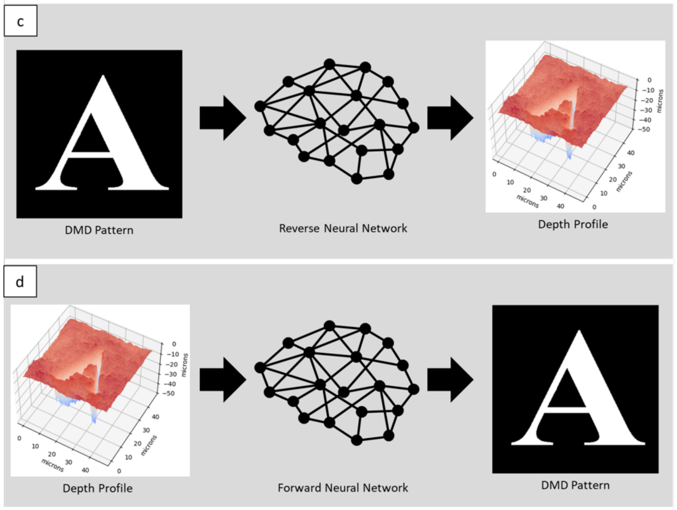
The “reverse” is also possible
We can also train a neural network to perform the “reverse” calculation:
i.e. for a desired sample profile, what beam shape do we need?
McDonnell et al. "Identification of spatial intensity profiles from femtosecond", accepted Optics Express (2021)

Slide 24
Conclusions
A CNN was trained in order to predict the outcome of laser machining.
Importantly, there was no need for any information regarding the underlying physical processes.
Each prediction took ~10 milliseconds.
Industrial applications, e.g. for immediate optimisation of machining parameters for product design, via the “reverse” neural network approach.
This work was supported via EPSRC: grant numbers EP/N03368X/1, EP/N509747/1 and EP/T026197/1

