Slide 1
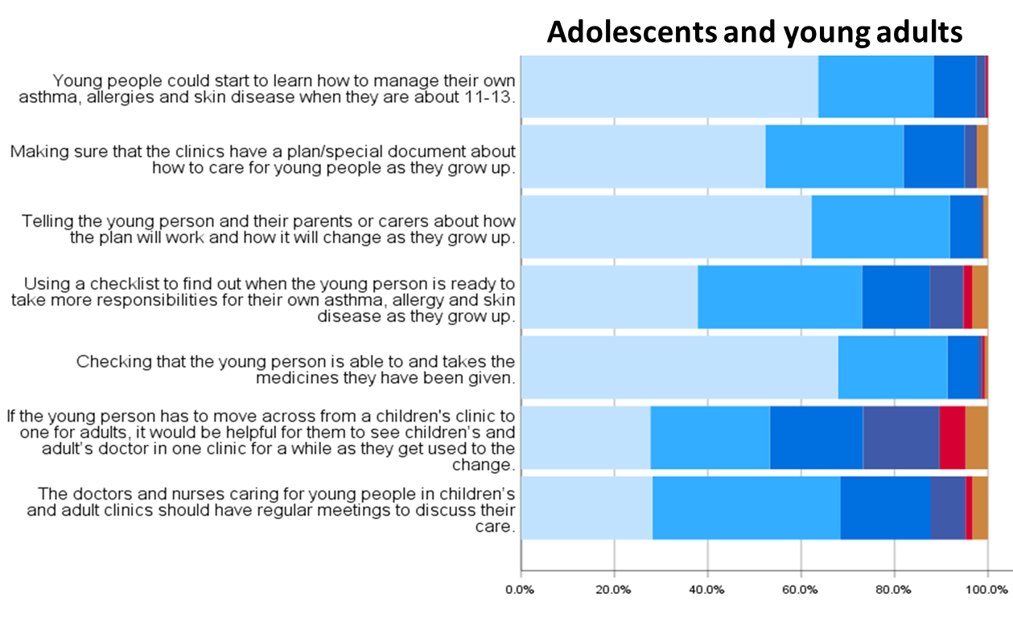
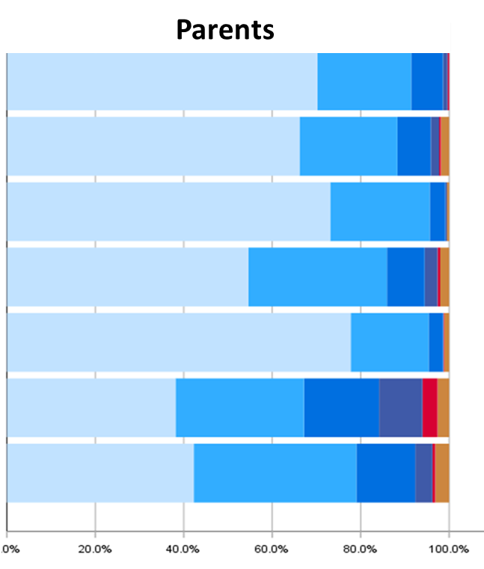
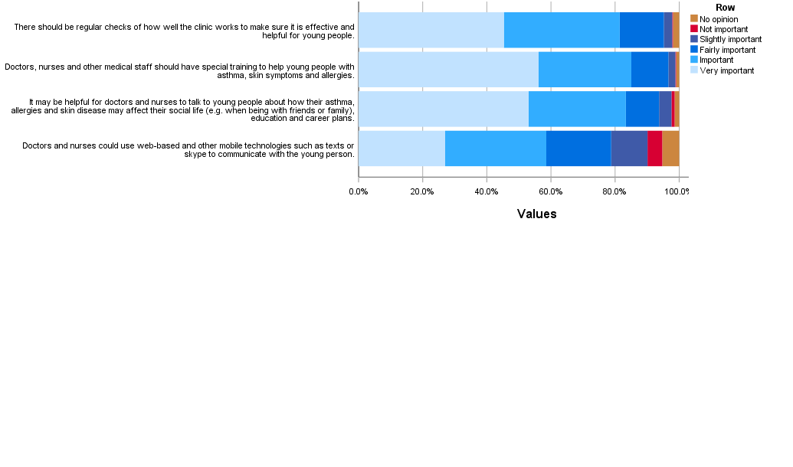
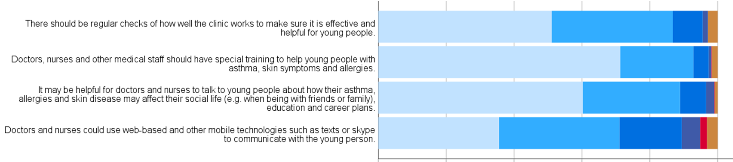
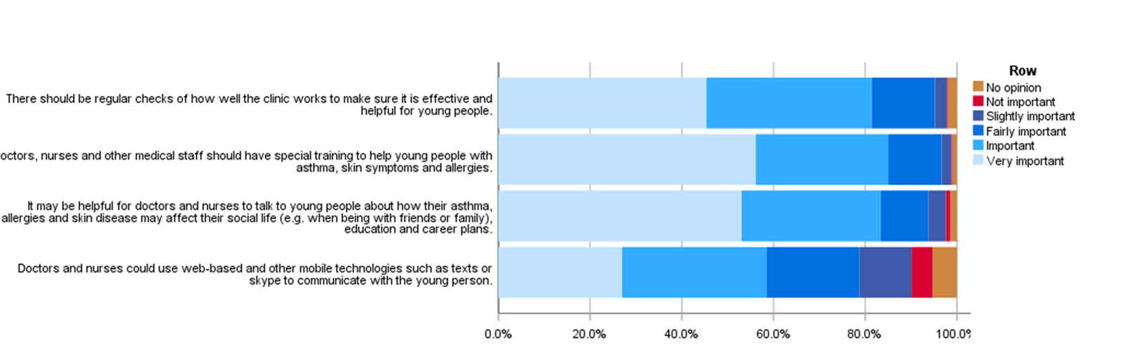
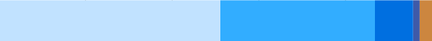
Importance
0% 20% 40% 60% 80% 100%
Supportive
Conditionally supportive
Not supportive
Perception that responsibility for education lies on both parents and HCPs (P)
Need to start learning about self-management earlier (AYA, P)
Learn to self-manage from age 11-13 years
AYA
Parent
It promotes confidence, autonomy, independence (AYA,P)
It promotes increased awareness of the risks, symptoms and treatment; reduce the risk and need for treatment (AYA,P)
Use web-based and other mobile technologies to communicate with AYA
AYA
Parent
It promotes good communication and supports management (AYA, P)
More meaningful for AYA (AYA,P)
It promotes self-efficacy and empowerment (AYA, P)
HCPs should be encouraged to introduce sensitive topics into the clinic discussion (AYA, P)
Discussions about how their symptoms may affect day to day life may improve adherence and how to manage future emergencies (P)
Psychological support may be needed to reduce anxiety or support development (P)
Need for additional help or resources
Engage with community/school and peers to discuss and support living with and managing AYA’s allergies and asthma (P)
Promote positive self-image with eczema or appearance
HCP mediation between AYA and family, e.g. tackling overprotective regimes or AYA adherence
Discuss with AYA about how their condition may affect their social life, education and career plans.
AYA
Parent
Z
Need or importance for awareness of the risk/signs and treatment (HCP & patients) (P)
Perceived lack of input, empathy or knowledge from HCP (especially emergency & GP) or caregivers (P)
Develop mandatory, essential and useful recommendation (P)
Need for regular education/training of HCP, caregivers and patients
Special training for HCP on how to support AYA in living with and managing asthma, skin symptoms and allergies.
AYA
Parent
Regular audits in clinics
AYA
Parent
Centres must be evaluated to be sure of their effectiveness and efficiency in supporting AYA to self-manage (also to be evaluated by patients) (P)
Very important
Important
Fairly important
Slightly important
Not important
No opinion
Figure 1. Summary of feedback on generic recommendations

Slide 2
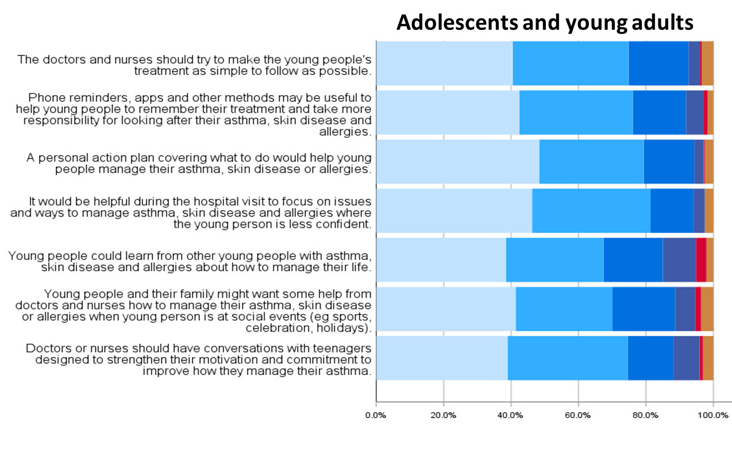
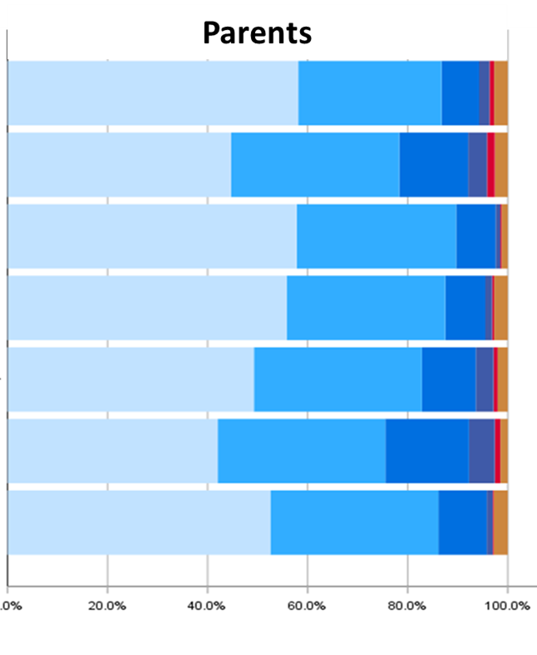
Importance
0% 20% 40% 60% 80% 100%
Supportive
Conditionally supportive
Not supportive
Make treatment easy to understand and to follow
AYA
Parent
Increase adherence and effectiveness (P)
Lower anxiety and increase self-efficacy and empowerment
AYA
Parent
Promotes good communication and accurate guidance for management (AYA, P)
More meaningful for teens (AYA, P)
Promotes self-efficacy and empowerment
Would undermine AYA’s need to take responsibility for own care
Apps, phones, other methods to help remember about their treatment
Develop a Personal Action Plan
HCP should develop an action plan with the AYA that is individualised and appropriate.
AYA
Parent
Focus consultation on areas where AYA less confident
AYA
Parent
Peer support from other AYA with allergy/asthma how to manage their life
AYA
Parent
Would welcome such help (AYA, P)
Recommendation is not understood
Focus support on social contexts
AYA
Parent
More meaningful for teens with emotional support and normalisation (P)
Promotes self-efficacy, empowerment, and autonomy (P)
Practical help, advice and support (P)
Adolescent
Parent
Choose motivational conversation
AYA
Parent
Communication is essential for self-confidence and improved care
This will reinforce good adherence, self-management, involvement in social activities
Very important
Important
Fairly important
Slightly important
Not important
No opinion
Figure 2. Summary of feedback on adherence and self-management recommendations

Slide 3
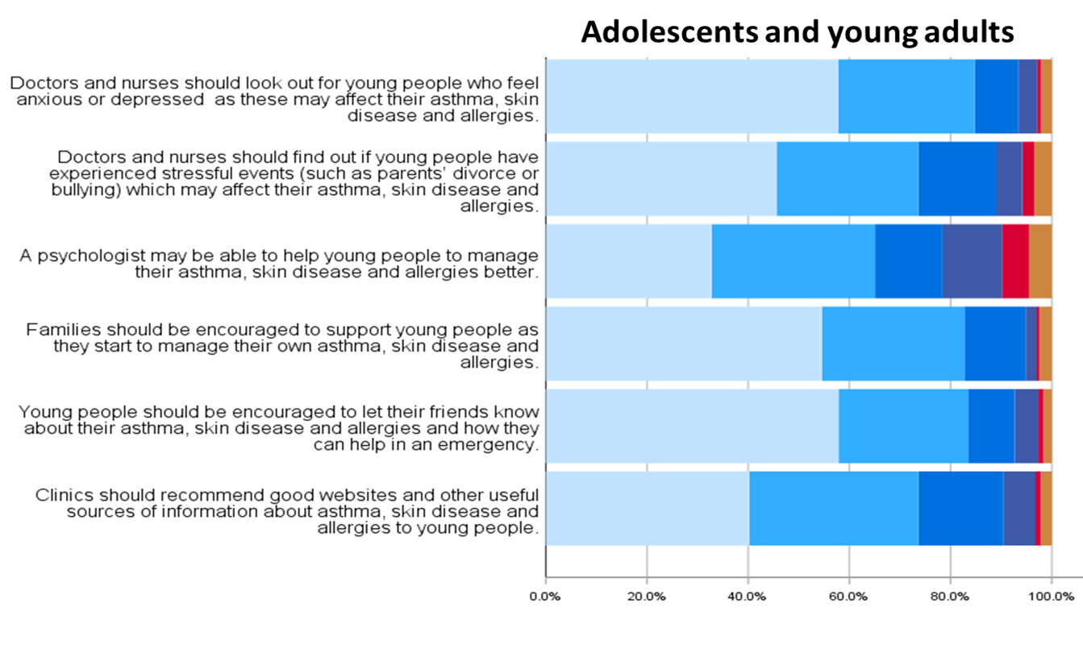
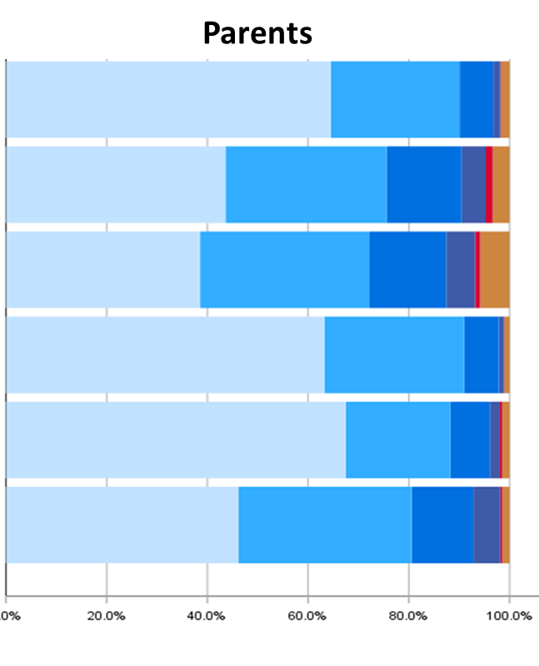



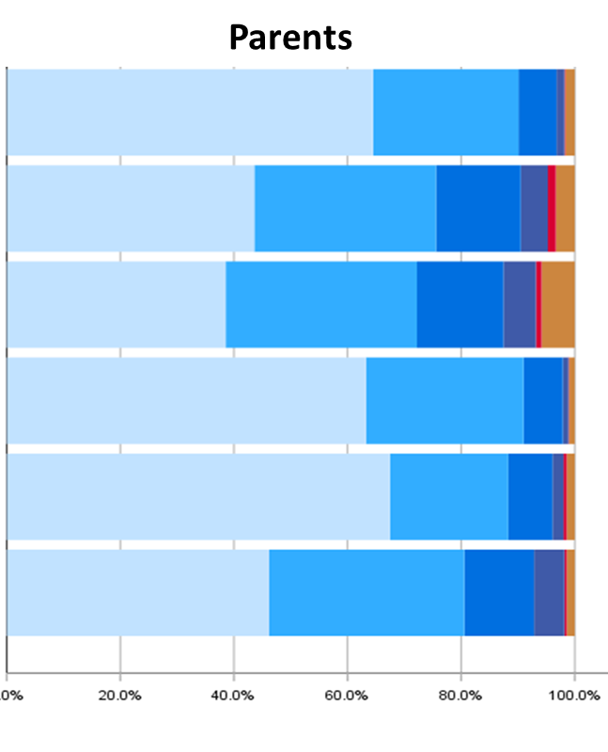
Importance
Supportive
Conditionally supportive
Not supportive
0% 20% 40% 60% 80% 100%
Prevention: minimise negative outcomes including isolation, bullying, depression. anxiety, death, low confidence, exacerbations or refusal of treatment (P)
This is important (P)
Psychological support needed
Be aware of potential anxiety and depression
AYA
Parent
Mention of possible stress factors (P)
Stress can impact on asthma, allergy or eczema
Be aware of potential life stressors not necessarily related to condition.
AYA
Parent
Be aware when referral to psychologist may be warranted.
AYA
Parent
Important to manage anxiety, stress, depression, improve self-confidence and treatment efficacy (P)
Dependent on AYA's mental health or wishes (P)
Family should be encouraged to support AYA to self-manage when developmentally appropriate
AYA
Parent
Need for confidence, autonomy or independence
Responsibility perceived to lie with parents and families
Dependent on the parents’ ability; need to support parents and families (P)
Responsibility perceived to lie with parents and families
Support from contacts (e.g friends, schoolmates, sportmates) is very important for AYA (AYA,P)
Need for awareness of the risks, signs, prevention and treatment (e.g friends, school, contacts) (AYA,P)
Need to help especially in emergency situations when need AAI or inhalers (P)
Need to reduce risk for feeling different, experiencing embarrassment or bullying (P)
Challenging topic for AYA; AYA do not like talking about it (P)
AYA should be encouraged and supported to tell friends about condition and management
AYA
Parent
Clinics should recommend good developmentally appropriate sources of information
AYA
Parent
Need for concise, clear, updated and accurate sourses of information (P)
Need for further and attractive information with new technologies; knowledge is power
Very important
Important
Fairly important
Slightly important
Not important
No opinion
Figure 3. Summary of feedback on psychology and support recommendations

Slide 4
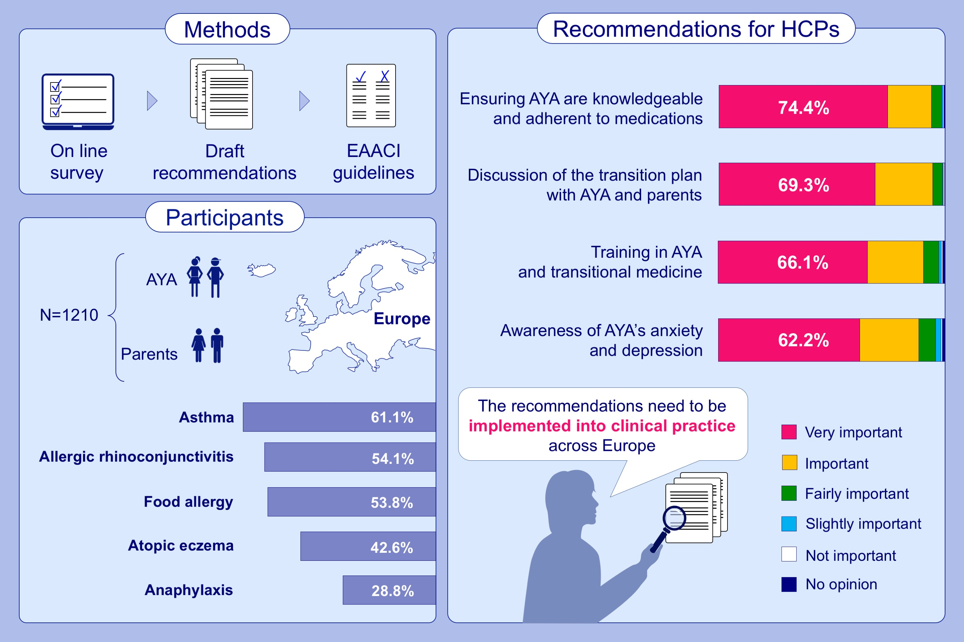
Figure 4. Summary of the feedback on draft recommendations of EAACI Guideline on the effective transition of adolescents and young adults with allergy and/or asthma.

