Slide 1
Predictive Visualisation of Fibre Laser Machining via Deep Learning
Alexander F. Courtier¹, Michael McDonnell¹, Matt Praeger¹, James A. Grant-Jacob¹, Christophe Codemard^{1,2}, Paul Harrison², Ben Mills¹, Michalis Zervas¹
¹ Optoelectronics Research Centre, University of Southampton, University Road, Southampton, SO17 1BJ, United Kingdom
² TRUMPF Laser UK, 6 Wellington Park, Toolbar Way, Hedge End, Southampton, SO30 2QU, United Kingdom

Slide 2
Outline
Motivation
Introduction to laser cutting
Introduction to deep learning
Imaging of laser cutting
Using deep learning to model laser cutting defects
Conclusions

Slide 3
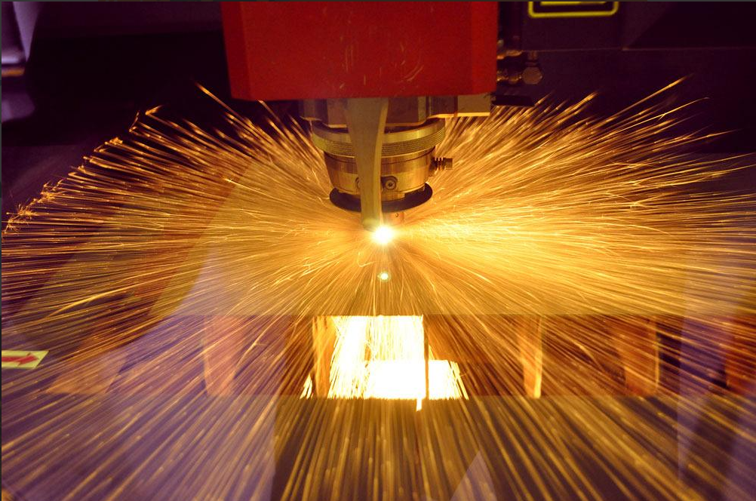
Motivation
Laser cutting enables fast, precise, contact-free cutting of materials.
However, modelling of light-matter interactions can be challenging.
Can Deep Learning model and predict laser cutting defects based on laser parameters?

Slide 4
Fibre Laser Cutting
Continuous wave laser cutting is achieved by irradiating and locally melting the workpiece, and removing the molten material with an assist gas.
Fast, precise, and contact-free.
However, defects can be formed at the edge of the cut, negatively impacting cut quality.

Slide 5
Deep Learning
Deep Learning is a subset of machine learning using deep Neural Networks (NNs).
NNs can act as universal function approximators, and therefore can be used to model any complex system.
Used for tasks such as classification, regression, and image generation.

Slide 6
Deep Learning
Deep Learning is a subset of machine learning using deep Neural Networks (NNs).
NNs can act as universal function approximators, and therefore can be used to model any complex system.
Used for tasks such as classification, regression, and image generation.

Slide 7
Convolutional Neural Networks
Extracts features from datasets using convolutional filters
Can be used to transform images into a numerical label
Highly suitable for image analysis

Slide 8
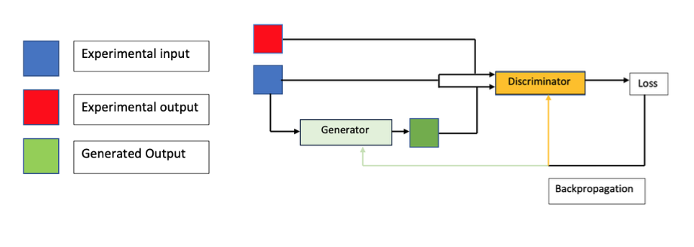
Generative Adversarial Networks (GAN)
Formed of a generator network and a discriminator network working in opposition
The generator predicts an output, if a labelled input is used they are called Conditional GANs (CGANs)
The discriminator determines if an output is experimental or predicted

Slide 9
Imaging of Laser Cutting
2mm thick stainless steel sheets were cut by fibre laser a 2kW, 1075nm at ten cutting speeds, 15 m/min to 24 m/min.
Imaged after machining using 5x optical microscope
Experimental image of laser cut edge

Slide 10
Experimental
15 m/min
16 m/min
17 m/min
18 m/min
19 m/min
20 m/min
21 m/min
22 m/min
23 m/min
24 m/min

Slide 11
Identification of Laser Cutting Speed
A CNN identifies the cutting speed using images of the laser cut.
99.9% accuracy.
Trained for 10 epochs on ~90000 images and tested on ~10000 images.
Demonstrates that each cutting speed produces unique defects.
11

Slide 12
Parameter to Image Visualisation
Successfully reproduces defects from parameters
Speed shown: 15 m/min
Reproduces angle of striations (22.5±2.2⁰ experimentally, and 26.8±2.2⁰ predicted)
12

Slide 13
Parameter to Image Visualisation
Successfully reproduces defects from parameters
Speed shown: 15 m/min
Reproduces angle of striations (22.5±2.2⁰ experimentally, and 26.8±2.2⁰ predicted)
Experimental
Predicted
13

Slide 14
Parameter to Image Visualisation
Successfully reproduces defects from parameters
Speed shown: 20 m/min
Reproduces angle of striations (32.7±3.0⁰ experimentally, and 36.9 ±3.6⁰ predicted)
14

Slide 15
Parameter to Image Visualisation
Successfully reproduces defects from parameters
Speed shown: 20 m/min
Reproduces angle of striations (32.7±3.0⁰ experimentally, and 36.9 ±3.6⁰ predicted)
Experimental
Predicted
15

Slide 16
Adjacent Image Visualisation
Successfully predicts defects from adjacent images
Can use a predicted image as an input
Can be chained to predict subsequent predicted images
Speed shown: 15 m/min
16

Slide 17
Adjacent Image Visualisation
Successfully predicts defects from adjacent images
Can use a predicted image as an input
Can be chained to predict subsequent predicted images
Speed shown: 15 m/min
Experimental
Predicted
17

Slide 18
Adjacent Image Visualisation
Successfully predicts defects from adjacent images
Can use a predicted image as an input
Can be chained to predict subsequent predicted images
Speed shown: 20 m/min
18

Slide 19
Adjacent Image Visualisation
Successfully predicts defects from adjacent images
Can use a predicted image as an input
Can be chained to predict subsequent predicted images
Speed shown: 20 m/min
Experimental
Predicted
19

Slide 20
Conclusions
CNNs can distinguish laser cutting defects by cutting speed with 99.9% accuracy.
CGANs can accurately visualise laser cutting defects from laser cutting parameters and adjacent images.
May have applications in real-time monitoring and real-time predictions of laser cutting defects, to optimise the laser cutting process.
This work was supported under EPSRC (grant numbers EP/N03368X/1 and EP/N509747/1)

