Slide 1
Living with Russell-Silver syndrome: falling short?
Funded by
Lisa Ballard
Health Psychologist in Training
RfPB

Slide 2
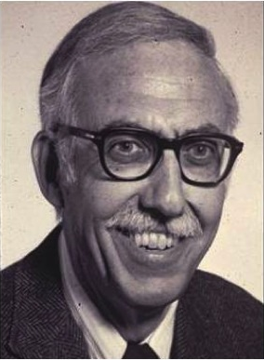
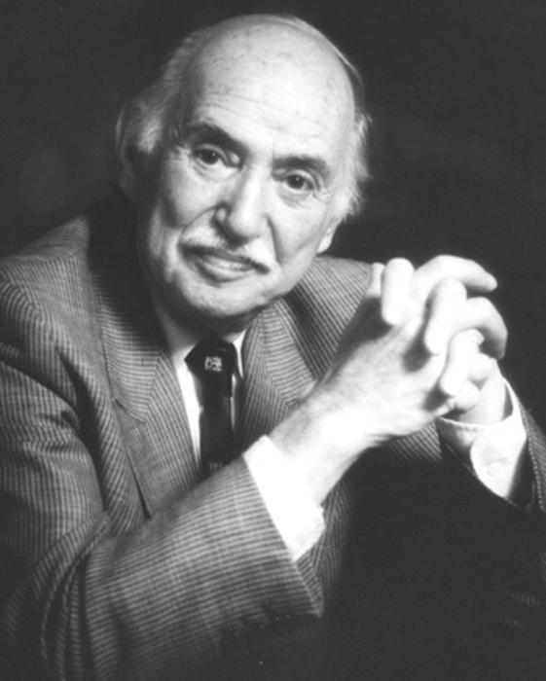
What is Russell-Silver syndrome?
Russell-Silver syndrome (RSS), also known as Silver-Russell syndrome, is a growth disorder.
Henry Silver et al. 1953
Alexander Russell 1954

Slide 3
What is Russell-Silver syndrome?
Children are born with unexplained low birth weight. Growth is affected during childhood and results in below average height in adulthood (5’2” men/4’8” women).
Body and face asymmetry.
Children have a distinctive facial appearance.
Treatment is growth hormone therapy (GH).
In some people with RSS a genetic change is found: 40-50% are found to have a problem on chromosome 11 and in another 5-10% on chromosome 7, for the other 40% the cause is unknown.

Slide 4
Why research this condition?
We do not know what it means to live with this rare genetic condition.
Exploring the lived experience of adults with RSS will provide valuable information to aid families in making difficult decisions about treatment as well as informing patients living with this syndrome.
Child Growth Foundation support this research – long term health and effects of GH.

Slide 5
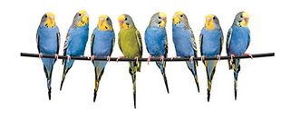
Background
Differing from the ‘norm’ could result in unpleasant feelings or emotions¹
A preference for symmetrical faces may be related to sexual selection and mate choice in males and females² and for symmetrical bodies ³ and may be an indicator of health⁴
Children with short stature (SS), compared to peers with normal stature, can often feel less satisfied with their appearance ⁵
Skills in resilience and coping are important¹
1. Harcourt and Rumsey, 2012 2. Rhodes, 2006, Thornhill and Gangestad, 1999, Griffey and Little, 2014, Perrett et al., 1999, Little et al., 2008 3. Gangestad and Simpson, 2000; Concar, 1995 4. Thornhill and Gangestad, 1999 5. Laub, 2012.
Notes:
We are increasingly living in a society that values appearance and anyone that differs from the ‘norm’ or what is culturally defined as ‘attractive’ can experience psychological distress based on others reactions and perceptions as well as their own (Harcourt and Rumsey, 2012).
Harcourt and Rumsey (2012) found that a significant amount of people with a visible difference experienced negative emotions like self-consciousness, anxiety and depression, negative evaluation of self, low self-esteem and difficulties in social situations. However, many people seem to cope effectively with the challenges of looking differently (ibid).
In a study of 458 participants with a visible difference, Rumsey et al. (2004), found importantly that the severity of the difference was not related to the amount of psychological distress experienced. It appears that negative emotions and poor adjustment are not just related to the experience of others around the person, but on how that person perceives and copes with this visible difference, so skills like resilience and coping skills are important (Harcourt and Rumsey, 2012).

Slide 6
Methodology
Qualitative.
Method – semi-structured, in depth interviews.
15 participants.
6 were female.
9 were treated with growth hormone (GH).
Participant’s ages ranged from 25-69.

Slide 7
Analysis
Thematic analysis
Essentially a method for identifying and
analysing patterns in qualitative data

Slide 8
Thematic Map
Appearance & body image
‘Being a big person in a little body’ Confidence & self-esteem
Resilience
What is it like to live with RSS?
Romantic relationships

Slide 9
Thematic Map
Appearance & body image
Bits I don’t like
‘Symmetry’s a good thing’
What is it like to live with RSS?
Romantic relationships
Ideal man/woman
‘Mayor of the friend zone’

Slide 10
Results
’Symmetry’s a good thing’
Oli (5’1”, 39 years old)
‘Symmetry’s a good thing, it always has been.
It’s the standard in everything else [...] that’s
actually a big problem and people notice and
that, in my later teen years really got to me, a
lot.’

Slide 11
Results
Bits I don’t like
Glenn (5’, 69 years old)
‘I didn’t like the way I looked. I didn’t actually look at myself in the mirror with the ability to analyse very quickly what I exactly looked like, until I was probably about ten [...] And I didn’t like what I was seeing. And so I could understand why the girls liked me for my personality, but short and ugly, I don’t think so’.

Slide 12
Results
‘Mayor of the friend zone’
Todd (5’6”, 34 years old)
‘I think one area where it did really did have an impact was with girls in that kind of teenage phase [...] I think I had pretty low sort of sexual self esteem, all the way through my teenage years and actually probably through most of my 20s [...] I was very definitely kind of mayor of the friend zone [...] I think I was always maybe slightly resentful that people would judge me very quickly on what I was’

Slide 13
Results
Ideal man
Warner (4’9”, 37 years old)
‘[B]ecause girls are not going to find me attractive physically. I have to accept that […] because I’m, because of my height, I guess most girls are looking for guys who’re a bit taller. And my lack of muscle. Girls are looking for guys that have sort of got a bit more muscle’.

Slide 14
Conclusions
Main findings
Adolescents, especially males, have appearance related concerns that impact on romantic relationships
Application of this research
Psychological support
Health care professionals
Child Growth Foundation

Slide 15
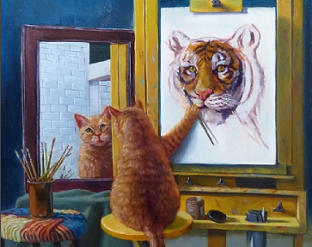
Last word from Luke (4’8”, 40 years old)
‘[I]t should be more about
being a big person in a little
body you know what I mean,
and then sort of you know
who you are, what you
stand for and how to cope
with things’.

Slide 16
With thanks to:
Dr Elizabeth Jenkinson (DoS)
Professor Angela Fenwick (Second supervisor)
Professor Karen Temple
Dr Kemi Lokulo-Sodipe
Dr Justin Davies
Dr Hazel Inskip
Dr Deborah Mackay
Dr Chris Byrne
Dr Emma Wakeling
Dr Renuka Dias
Mrs Jenny Childs (Child Growth Foundation)

