Slide 1


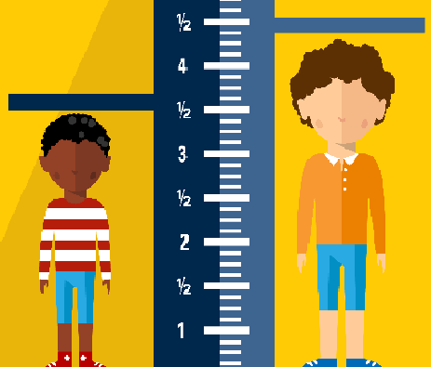
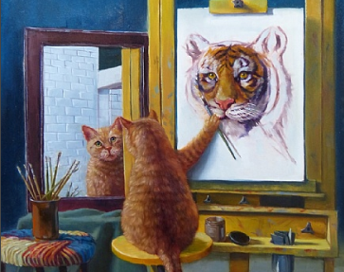
Understanding the lived experience of Russell-Silver syndrome – recommendations for healthcare professionals Lisa Marie Ballard¹, Angela Fenwick² and Elizabeth Jenkinson³ 1. University Hospital Southampton NHS Foundation Trust. 2. University of Southampton. 3. University of the West of England
Background - Russell-Silver syndrome (RSS) is a rare genetic condition and is characterised by slow pre and post-natal growth, short stature (SS) in adulthood, triangular facial appearance and body and facial asymmetry. Very little is known about what it is like to live with this rare condition beyond what is reported in the clinical literature and a need for clear guidance for patients, families and health care professionals (HCPs) in how to communicate and support these patients has been identified. Our research aim was to understand what it means to live with RSS. [line about appearance research.
Methods - Fifteen in-depth, semi structured interviews were conducted with participants from the UK aged between 25-69 (6 women) and thematic analysis was used to identify themes.
Results - Four themes were identified in the data focusing on visible differences (height, face shape, asymmetry, low muscle mass) which impacted participant’s confidence and self-esteem. Some participants remained very resilient to this impact, others experienced psychological distress. These issues impacted significantly on male participants ability to form romantic/intimate relationships in adolescence and adulthood.
It’s not all about height
‘Symmetry’s a good thing, it always has been. It’s the standard in everything else [...] that’s actually a big problem and people notice and that in my later teen years really got to me, a lot. [...] it’s not something you can get over or improve unless you somehow get the right side of your body bigger than your left side through some miracle of medical medicine, other than that, it’s there and there’s no cure’. (Oli)
Sharing, comparing and compensating
‘It was nice knowing that you weren’t on your own and that there was other people like you, and that was good knowing that other people had symptoms similar to me, and just knowing that you weren’t unique or a sort of freak or mutation, which sometimes you do think that you’re kind of a freak of nature, because in some ways that’s what Russell-Silver is’. (Judy)
‘Being a big person in a little body’
‘‘[I]t should be more about being a big person in a little body you know what I mean, and then sort of you know who you are, what you stand for and how to cope with things […] who cares that you have a condition, it’s not important, what’s important is your own self esteem and that kind of thing really. I think more emphasis should be put on that.’ (Luke)
‘Mayor of the friend zone’
‘One area where it did really have an impact was with girls in that teenage phase [...] all the way through my teenage years and through most of my 20s [...] I was very definitely kind of mayor of the friend zone that I’d become very good friends with all of these very beautiful girls [...] I sort of really struggled with forming relationships’. (Todd)
Discussion - The focus for HCPs involved in the care of children with growth problems is often on height, for which there is a clear treatment pathway using growth hormone therapy, but no robust evidence to support its effectiveness in children with RSS. Our research suggests patients struggle with varied psychosocial, appearance and body image related concerns which often overshadow a concern about height. However, psychological support is not currently routinely offered. HCPs working with children and adolescents with RSS should be trained to identify patients psychosocial and appearance related concerns and future research should evaluate the potential of psychosocial support/interventions for this overlooked patient group.
Lisa Ballard was funded by the UK National Institute for Health Research, Research for Patient Benefit programme (PB-PG-1111-26003), was supported by the NIHR Wessex CRN and this research partially fulfilled the requirements of the University of the West
of England for the degree of Professional Doctorate in Health Psychology.

