Slide 1


Living with RSS: UK Adult & Adolescent Research Findings
Funded by
Dr Lisa Hodges (PhD)
RfPB

Slide 2
Today’s session
9-9:30 Research findings
9:30-10:00 Workshop – Producing materials
10:00-10:30 Research findings
Please feel free to interrupt me!

Slide 3
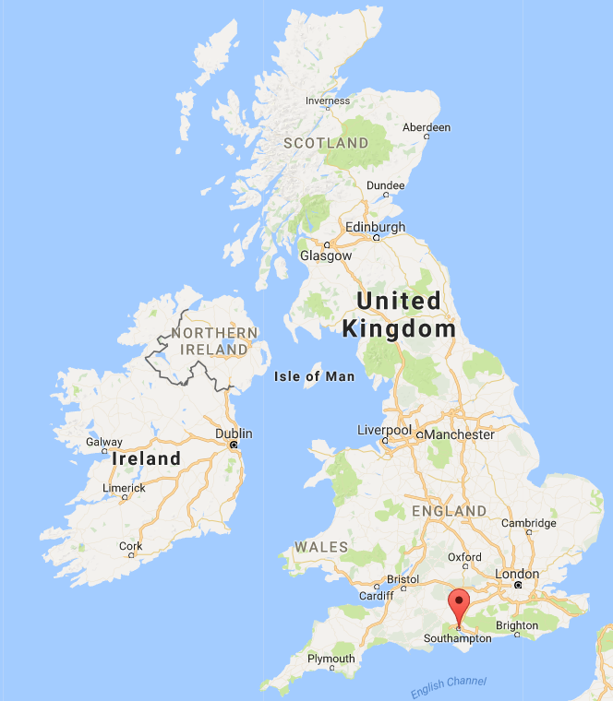
A bit about me
I’m from Southampton in England
I have worked in the National Health Service (NHS) of over nine years
I’m a health psychologist
I’m a research fellow at the University of Southampton
My research interests are: lived experience of genetic conditions and communication of genetic information within families.

Slide 4
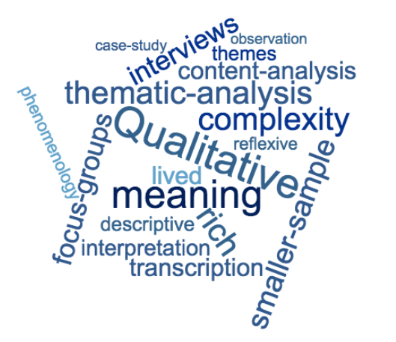
Study overview
Lived experience study
Interviewed 20 participants
(adults & young people)
Aims:
What is it like to live with RSS?

Slide 5
Why?
Lots of research on characteristics and treatment, but nothing on what it is like to live with RSS
Child Growth Foundation
Treatment decisions
Adulthood

Slide 6
Study participants
Twenty participants (genetically confirmed)
Nine women, eleven men
Fifteen adults, five young people
Aged 13-69
Table 1. Adult data
Employed | Romantic relationship | Started their own families
93% | 80% in a relationship (married 46%) | 40%

Slide 7
Adult height
Men* | Age range | Height | Percentile | *Average height for men in the general population is 173cm (Royal College of Paediatrics and Child Health, 2015) compared with 156cm in this sample of men with RSS.
Darin | 31-40 | 152cm | 0.08
Todd | 31-40 | 168cm | 16
Warner | 31-40 | 135cm | 0
Oli | 31-40 | 155cm | 0.3
Grant | 21-30 | 168cm | 16
Eric | 31-40 | 168cm | 16
Elliot | 31-40 | 165cm | 8
Luke | 31-40 | 142cm | 0
Glenn | 61-70 | 152cm | 0.1
Women* | Age range | Height |  | *Average height for women in the general population is 163cm (Royal College of Paediatrics and Child Health, 2015) compared with 144cm in this sample of women with RSS.
Bonnie | 31-40 | 147cm | 2
Maddy | 21-30 | 160cm | 40
Judy | 31-40 | 130cm | 0
Mina | 21-30 | 142cm | 0.3
Wendy | 41-50 | 140cm | 0.1
Joanne | 51-60 | 145cm | 0.9

Slide 8
Adolescent height
Pseudonym | Age | Height | Percentile
Corinne | 14-17 | 152cm | 4
Maria | 14-17 | 152cm | 23
Stacy | 14-17 | 152cm | 16
Adam | 14-17 | 163cm | 54
Ryan | 14-17 | 163cm | 4

Slide 9
Adult findings
“It’s not just all about height”
“Mayor of the friend zone” – men’s experiences
Chronic illness – women’s experiences
Coping
N.B Some of these characteristics of RSS may not apply

Slide 10
Adult findings
“It’s not just all about height”
Height was not participants’ main concern
Many participants were unhappy with the way they looked
These concerns started around aged ten
Many participants reported experiencing anxiety and depression – centered around teenage years.

Slide 11
Adult findings
“It’s not just all about height”
“Russell-Silver is multi-faceted, the main thing people will notice will be the height, but actually the things that I notice are not the height. If I could change one thing, it wouldn’t be my height it would be my speech [...] I’d say it has been a worse problem than my height.” (Warner)

Slide 12
Adult findings
“It’s not just all about height”
Asymmetry/scarring
“I think the asymmetry; it took me a long time, because I can really see it. And generally stuff with your arms by your legs and [...] the bad scarring on my legs; that’s took me quite a long time”. (Bonnie)

Slide 13
Adult findings
“It’s not just all about height”
Asymmetry/weight
“A more horrific example would be when I started picking up the weight and the left side of the fat on my body was like, bulbous, was standing out more than the right side, I could see it and it’s this double whammy where there’s this thing about the unattractiveness of overweight and then this extra unattractiveness.” (Oli)

Slide 14
Adult findings
“Mayor of the friend zone” – men’s experiences of RSS
What is the ‘friend zone’?
Many men in the study reported challenges when dating during adolescence.

Slide 15
Adult findings
“Mayor of the friend zone” – men’s experiences of RSS
”I think one area where it did really did have an impact was with girls in that teenage phase. I think I had pretty low sexual self-esteem all the way through my teenage years and actually probably through most of my 20s. I was very definitely mayor of the friend zone, I’d become very good friends with all of these very beautiful girls. I really struggled with forming relationships.” (Todd)

Slide 16
Adult findings
“Mayor of the friend zone” – men’s experiences of RSS
“Because of my height, I guess most girls are looking for guys who are a bit taller. And my lack of muscle. Girls are looking for guys that have got a bit more muscle. Not every girl. But generally if you take a hundred random women, how many of them, if you stick in a guy, six feet tall with average build, and you take me, you’d be lucky if one of them picks me over the other, that’s just reality.” (Warner)

Slide 17
Adult findings
“Mayor of the friend zone” –
Not exclusively men
“I was quite boy mad actually, when I think back. I just didn’t have a lot of boyfriends. They all liked me, but just not that way. I was a bit of a clown really I suppose. I was one of the lads.” (Wendy)

Slide 18
Adult findings
“Mayor of the friend zone” –
Infertility and gynecological issues
“Well the best word is devastating” (Joanne)
“The hardest times that I’ve had“ (Judy)

Slide 19
Adult findings
Chronic illness – women’s experiences of RSS
Many women described their experience of RSS as one of pain and disability
They experienced pain, tiredness and felt generally ‘unwell’ compared to those around them.

Slide 20
Adult findings
Chronic illness – women’s experiences of RSS
“Do you know what, it’d just be nice to feel really well for one day? It’d be great. I haven’t felt really well since, it was about two years ago. And I went to work one day and I went ‘I feel great today! I feel absolutely fantastic!’ By the evening, I’d worn myself out. I can remember it happening; it was about two years ago.” (Bonnie)

Slide 21
Adult findings
Chronic illness – women’s experiences of RSS
“I mean you do have to be careful. I’m very, very careful not to take sick leave, because I think since I got to thirty, my arm has kind of gone, I can move it, but I don’t I think I can use it very well. You know if you do this a lot [hides arm] people don’t notice that you can’t do much with it. And then I think things [are] steadily going; my back, my arms, my legs, my hands.” (Joanne)

Slide 22
Adult findings
Coping
Most participants at the time of interview were happy and healthy
Although many had experienced challenges in the past relating to RSS
They coped with these challenges in different ways.

Slide 23
Adult findings
Coping
Friendships
“One thing that I think Russell-Silver has never held me back on is my social life.” (Warner)

Slide 24
Adult findings
Coping
Comparison
“I’m not sure if I felt lucky I wasn’t one of them or unlucky that I was one of them. Sort of a mixture of the two. I think that I’m almost something between what people would call normality and this group and for me that’s even more frustrating because I can’t identify myself with them, but I can identify with them.” (Oli)

Slide 25
Adult findings
Coping
Compensating
“I had to learn to use my mind pretty quickly and a sense of humour as a way to kind of survive.” (Todd)

Slide 26
Findings from young people
“I’m different! Why?”
Dating
Chronic illness
Hopes and fears

Slide 27
Findings from young people
”I’m different! Why?”
“I’ve learnt that you’re not always going to be perfect, there’s always going to be something.” (Stacy)
What has had the biggest impact/ what would you like to change?
Participant | Comment
Stacy | Height and strength
Maria | Big forehead
Adam | Other things not height
Ryan | Injections

Slide 28
Findings from young people
Dating
Small sample
Findings from adult data not reflected in data from young people
May not have felt comfortable discussing dating with me
May not have had any issues.

Slide 29
Findings from young people
Dating
“I’ve had one time where I went to go talk to a girl and she says ‘Oh you look well young!’ but I’m like ‘Well I’m the same age as you!’ and obviously, she didn’t believe me. I don’t think it’s affected me. They call me cute or something like that. It might be a bit of a bonus, but I don’t think it affects me.” (Ryan)

Slide 30
Findings from young people
Chronic illness
Young women had a similar experience to the adult women
Neither of the young men reported any pain or disability.

Slide 31
Findings from young people
Chronic illness
“My wrists when I was writing get really sore and painful after writing long pieces. I can write short passages but writing longer, I find it really difficult, so I’d use a laptop for it, because it just hurts.” (Stacy)

Slide 32
Findings from young people
Chronic illness
Trip to a theme park
“It really bothered my dad actually because he was going ‘She’s not disabled, why is she in a wheelchair?’ And I don’t think it actually bothered me, but the fact that people stared did, because it was a real difference, because if you are just walking around no-one stares at you, but I was pushed into the disabled queue, and all the kids were looking at me getting out of the chair, and I just went ‘Oh, I feel a bit on the spot.” (Stacy)

Slide 33
Findings from young people
Hopes and fears
I asked participants about their hopes and fears for the future
Most focused on fears over future employment

Slide 34
Findings from young people
Hopes and fears
“I hope that doesn’t affect getting a job because of my wrists, my wrists do hurt, writing and that, and I just wonder. Probably either in vetting, maybe. I hope to have a good future. Hope it doesn’t really affect me.” (Stacy)

Slide 35
Findings from young people
Hopes and fears
“I also hope that because you see stuff like people giving jobs to taller people because they think they’re more able and stuff, I just hope people won’t judge me because of that. I would tell them that, I think that’s the main thing, if I tell them that I had this thing [RSS], that they’d say ‘Oh, she’s weird, she has a genetic condition’.” (Maria)
“I think one of the main things is, it might sound crazy, but I don’t want to not get a job because of the size that I am, because I want to be a teacher when I’m older, and I don’t know if it will or not, but I just don’t want it to affect me in the long-run, but I don’t think it will.” (Ryan)

Slide 36
Comparison to other research
Dating and romantic relationships – Turner syndrome1 and Achondroplasia2
Not disclosing syndrome – chronic illness3 (to maintain a ‘normal’ life)
Female ideal – Turner syndrome4 and infertility5
Male ideal - culture of muscularity6
Cleft lip/palate – appearance related concerns7
Chronic fatigue – unsympathetic health professionals8

Slide 37
What does all this mean?
1. Psychological assessment & support
Expert consensus
Appearance-related concerns
2. You don’t stop having RSS when you reach 18
In the UK there is no adult service
Young people are led to think that RSS will not affect them in adulthood
My data does not support this.

Slide 38
References
1. Boman, U. W., Moller, A. and Albertson-Wikland, K. 1998 Psychological aspects of Turner syndrome. Journal of Psychosomatic Obstetrics & Gynecology, 19, 1-18.
Carel, J.-C., Elie, C., Ecosse, E., Tauber, M., Léger, J., Cabrol, S., Nicolino, M., Brauner, R., Chaussain, J.-L. and Coste, J. 2006 Self-Esteem and Social Adjustment in Young Women with Turner Syndrome—Influence of Pubertal Management and Sexuality: Population-Based Cohort Study. The Journal of Clinical Endocrinology & Metabolism, 91, 2972-2979.
Kagan-Krieger, S. 1998 Brief Report: Women with Turner Syndrome: A Maturational and Developmental Perspective. Journal of Adult Development, 5, 125-135.
Sutton, E. J., Sutton, E. J., Mcinerney-Leo, A., Bondy, C. A. and Gollust, S. E. 2005 Turner syndrome: Four challenges across the lifespan. American journal of medical genetics. Part A, 139A, 57-66.
2. Gollust, S. E., Gollust, S. E., Thompson, R. E., Gooding, H. C. and Biesecker, B. B. 2003 Living with achondroplasia in an average-sized world: An assessment of quality of life. American journal of medical genetics. Part A, 120A, 447-458.
3. Kirk, S. 2010 How children and young people construct and negotiate living with medical technology. Soc Sci Med, 71, 1796-803.
4. Clauson, S., Hollins Martin, C. and Watt, G. 2012 Anxiety as a cause of attachment avoidance in women with Turner Syndrome. Sexual and Relationship Therapy, 27, 377-390.
5. Kitzinger, C. 2002 'The thief of womanhood': Women's experience of polycystic ovarian syndrome. Social science & medicine (1982), 54, 349-361.
6. Ambwani, S. and Strauss, J. 2007 Love Thyself Before Loving Others? A Qualitative and Quantitative Analysis of Gender Differences in Body Image and Romantic Love. Sex Roles, 56, 13-21.
7. Stock, N. M., Feragen, K. B. and Rumsey, N. 2015 "It Doesn't All Just Stop at 18": Psychological Adjustment and Support Needs of Adults Born With Cleft Lip and/or Palate. The Cleft palate-craniofacial journal, 52, 543-554.
8. Picariello, F., Ali, S., Moss-Morris, R. and Chalder, T. 2015 The most popular terms for medically unexplained symptoms: the views of CFS patients. J Psychosom Res, 78, 420-6.
Anderson, V. R., Jason, L. A., Hlavaty, L. E., Porter, N. and Cudia, J. 2012 A review and meta-synthesis of qualitative studies on myalgic encephalomyelitis/chronic fatigue syndrome. Patient Educ Couns, 86, 147-55.

Slide 39
Feedback
Do any of you identify with these experiences?
Who needs to know about these findings?
Is there anything that could have made a difference for you during adolescence?

Slide 40
Workshop

