Slide 1
We have no commercial disclosure
myKinMatters: sharing genetic health information via an online tool
L.M. Ballard, S. Dheensa, M. Weal, A. Fenwick, A. Lucassen.
ESHG June 2018

Slide 2
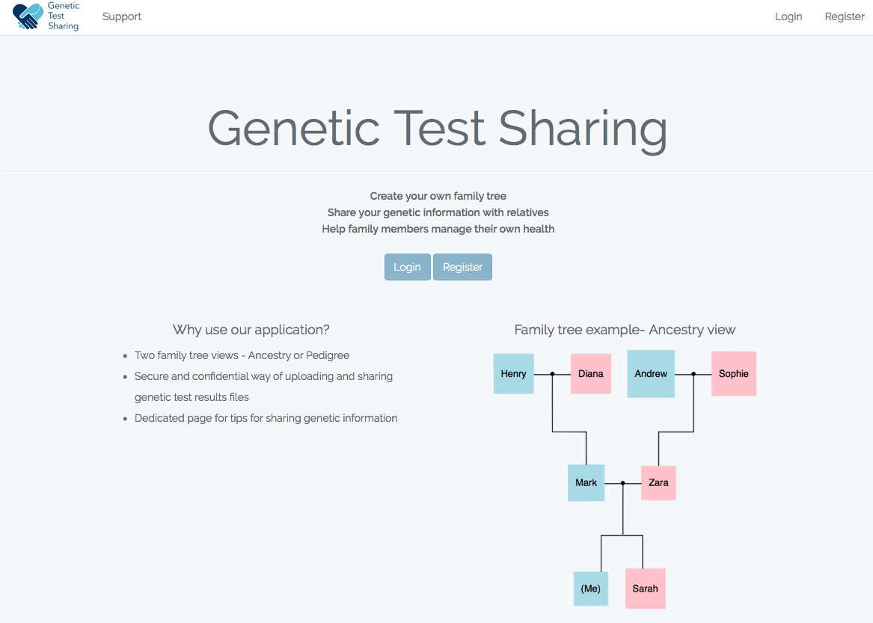
myKinMatters

Slide 3
Background
The result of an individual’s genomic test can clarify risks for close relatives¹
However:
patients do not always communicate their results to those to whom it is relevant²⁻⁵
the quality of information communicated may be poor⁶
patients want more information and help through online sources^{7,8}
healthcare deals with individuals. Not well set up to manage relatives too.

Slide 4
Online behaviour change intervention
myKinMatters
Online behaviour change intervention
Identify essential ingredients of intervention
Interviews with 100kGP participants - Results
Identify theory
Identify behaviour change techniques
Interviews with 100kGP participants - apps
Meta synthesis of previous interventions
Identify barriers & facilitators to communication

Slide 5
Barriers & Facilitators to Communication
Why inform at risk relatives?
How to inform at risk relatives?
The correct relatives get the correct information
Quality of relationship
Not all information is conveyed
Protect relative from information
Not the health information ‘gate keeper’
Proband is uncertain what information to communicate to whom
Knowledge
Finding the ‘right time’
How proband feels
Quality of relationship
Encouragement and support from HPs
Proband has a positive test result
Proband wishes to avoid anticipated regret

Slide 6
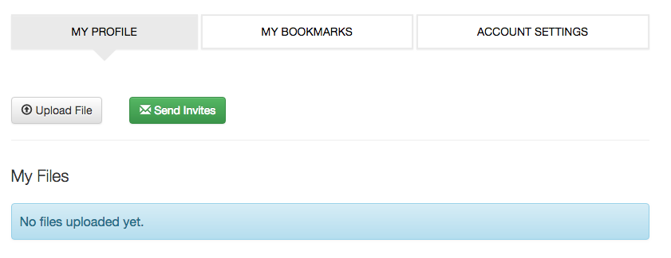
University of California, San Francisco

Slide 7
What do participants think of Kintalk?
Feedback
– would want to have a conversation first (cold, robotic, out of the blue)
– wouldn’t use (use own email)
– if received a kintalk invite from a relative, they would be grateful, but would prefer a conversation.

Slide 8
Building myKinMatters
What we wanted
Family tree/pedigree
Share function
Section for tips on communicating with relatives
Embeded into MyMedical Record

Slide 9
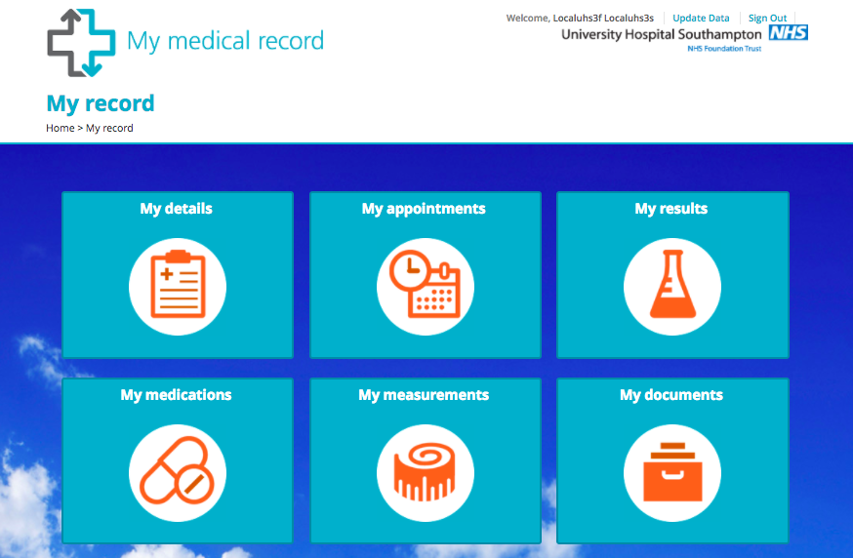

Slide 10
Case Study
Name: Lisa Simpson Age: 28 Reason for Referral: Breast Cancer

Slide 11
myKinMatters

Slide 12
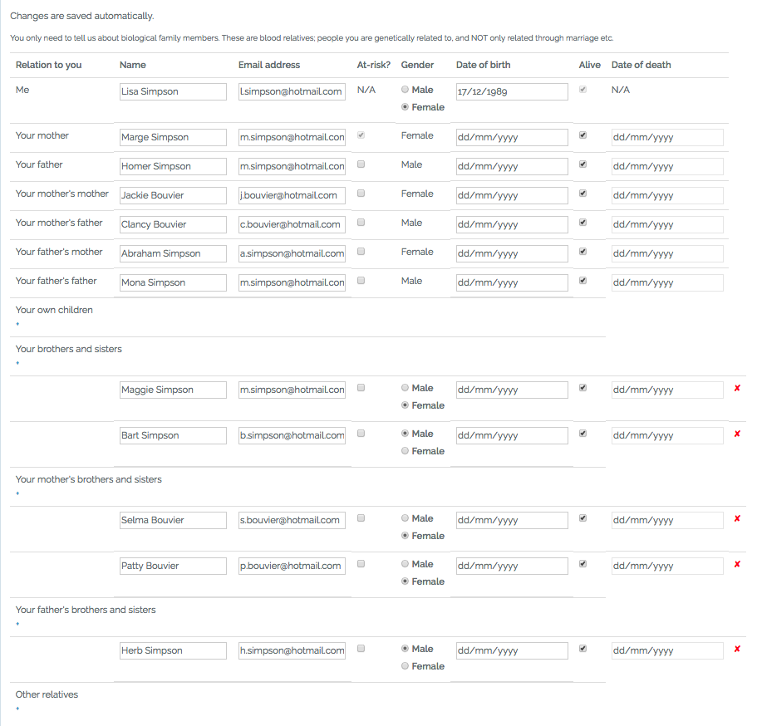

Slide 13
Case Study
Appointment 1: Lisa decides to have genetic testing.
Appointment 2: Lisa is told she has a BRCA1 mutation.

Slide 14
At risk family members

Slide 15
Case Study
Lisa talks to her parents to let them know they should see their a HP about getting genetic testing

Slide 16
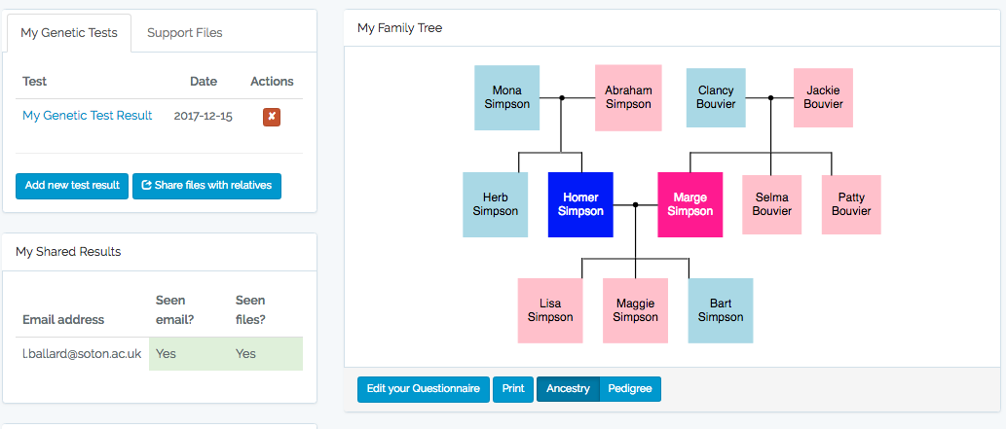
Family Tree/Pedigree View

Slide 17
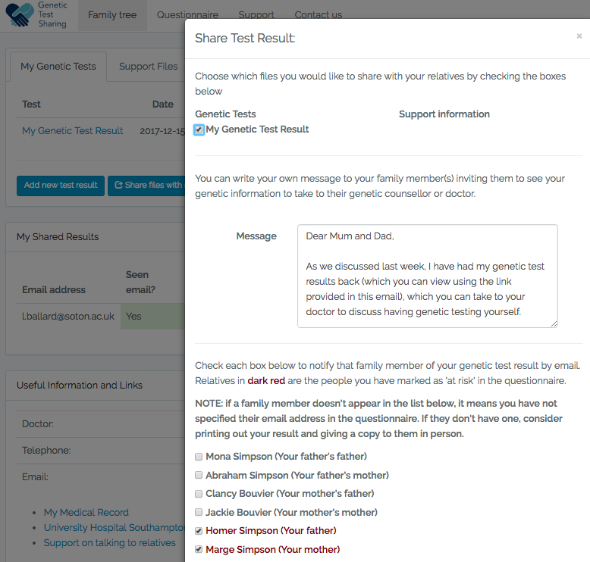
myKinMatters

Slide 18
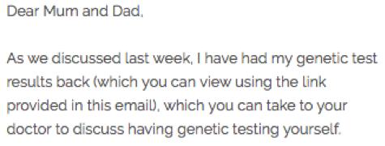
myKinMatters
myKinMatters

Slide 19
Case Study
Appointment 3: Lisa’s mother, Marge, is also told she carries a BRCA1 mutation and should let her sisters know.

Slide 20
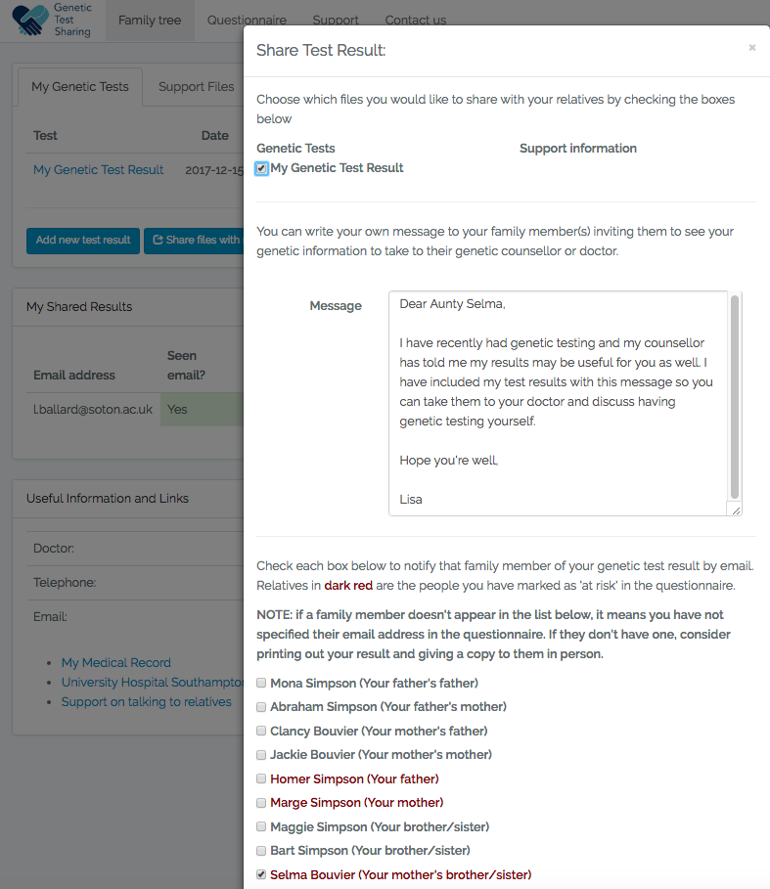
myKinMatters

Slide 21
Barriers & Facilitators to Communication
Why inform at risk relatives?
How to inform at risk relatives?
The correct relatives get the correct information
Quality of relationship
Not all information is conveyed
Protect relative from information
Not the health information ‘gate keeper’
Proband is uncertain what information to communicate to whom
Knowledge
Finding the ‘right time’
How proband feels
Quality of relationship
Encouragement and support from HPs
Also:
Pedigree for non-specialist HPs
Collecting contact information from outset
Embedded in an existing NHS system
Proband has a positive test result
Proband wishes to avoid anticipated regret

Slide 22
Summary
Different from sending an email
Sharing in this context means the right people having appropriate access to information
Will not solve all issues, but part of a larger intervention
Next step…testing.

Slide 23
References
1. Parker M, Lucassen AM. Genetic information: a joint account? British Medical Journal. 2004;329(165-167). 2.Forrest LE, Burke J, Bacic S, Amor DJ. Increased genetic counseling support improves communication of genetic information in families. Genet Med. 2008;10(3):167-72.
3. Kardashian A, Fehniger J, Creasman J, Cheung E, Beattie M. A Pilot study of the Sharing Risk Information Tool (ShaRIT) for Families with Hereditary Breast and Ovarian Cancer Syndrome. Hereditary Cancer in Clinical Practice. 2012;10(4):1-10.
4. Montgomery SV, Barsevick AM, Egleston BL, Bingler R, Ruth K, Miller SM, et al. Preparing individuals to communicate genetic test results to their relatives: report of a randomized control trial. Fam Cancer. 2013;12(3):537-46.
5. Roshanai AH, Rosenquist R, Lampic C, Nordin K. Does enhanced information at cancer genetic counseling improve counselees' knowledge, risk perception, satisfaction and negotiation of information to at-risk relatives?--a randomized study. Acta Oncol. 2009;48(7):999-1009.
6. Clarke S, Butler K, Esplen MJ. The phases of disclosing BRCA1/2 genetic information to offspring. Psycho-Oncology. 2008;17(8):797-803.
7. Lapointe J, Bouchard K, Godard B, Simard J, Dorval M. Life events may contribute to family communication about cancer risk following BRCA1/2 testing. Journal of Genetic Counselling. 2013;22:249-57.
8. Taylor K. Connected health: How digital technology is transforming health and social care. London: Deloitte Centre of Health Solutions; 2015.

Slide 24
Acknowledgements
Electronic and Computer Science students
James Lister Maksim Romanovich
Daniel Lockyer Luke Pullman
Clinical Ethics and Law in Southampton Research Group
Prof Anneke Lucassen Dr Shiri Shkedi-Rafid
Dr Angela Fenwick Dr Juliette Schuurmans
Dr Sandi Dheensa Dr Kathleen Kendall
Dr Gill Crawford Dr Mirjam Plantinga
Dr Peta Coulson-Smith Julia el Mecky
Wessex Medical Research Innovation Fund

