Slide 1


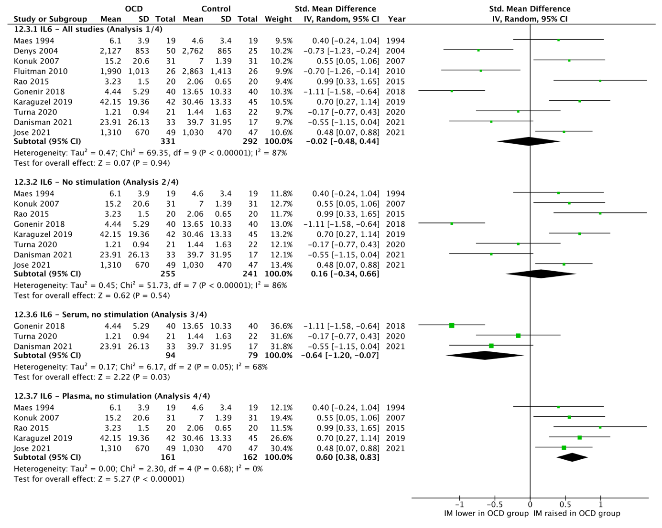
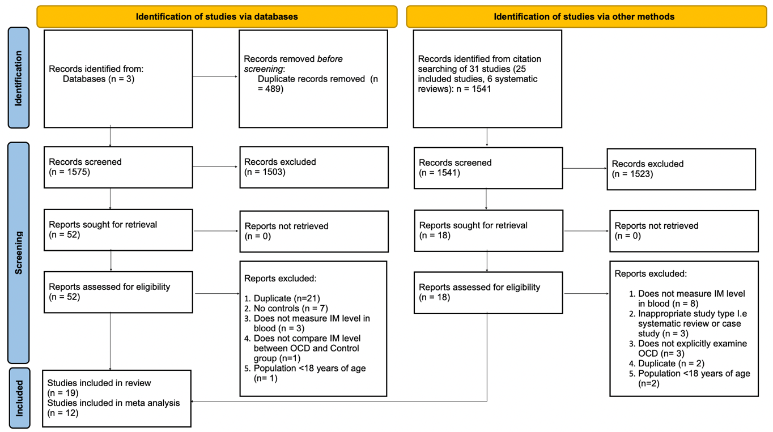
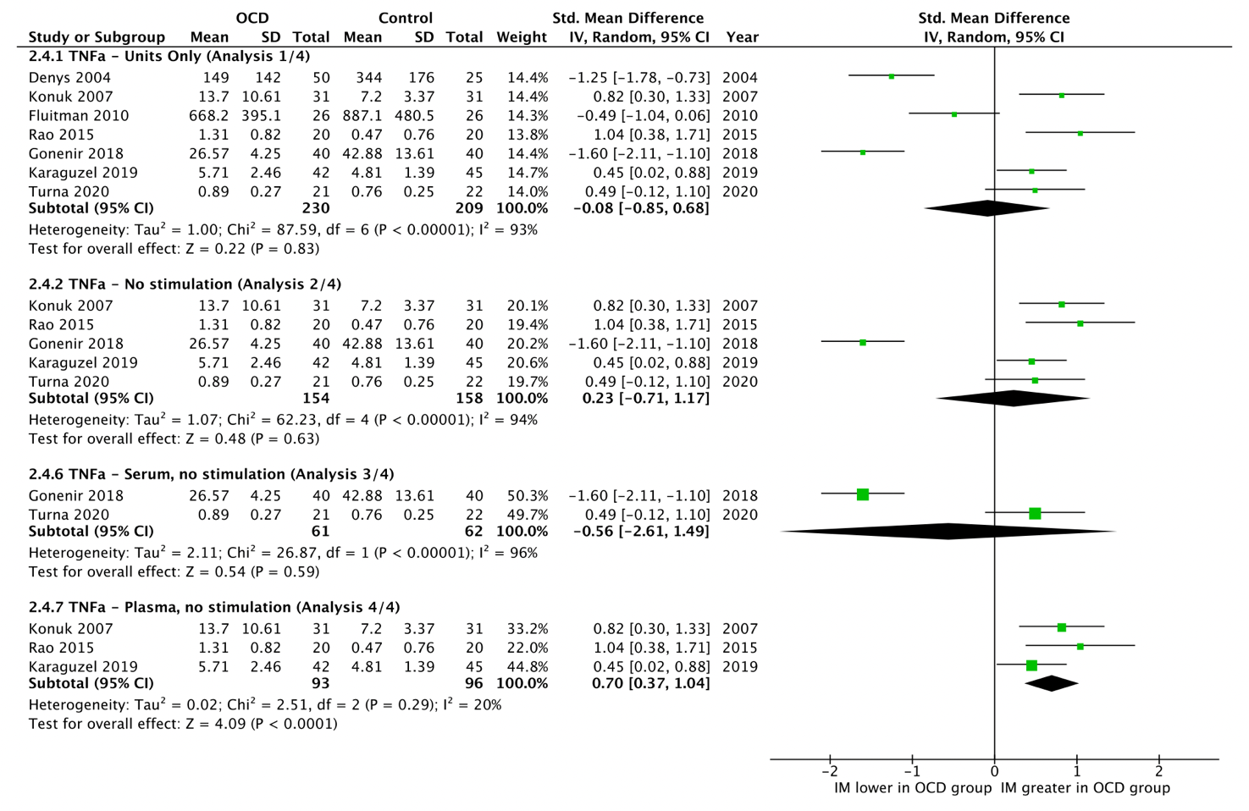
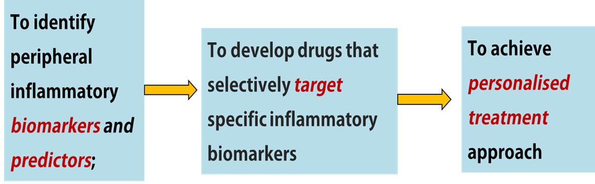
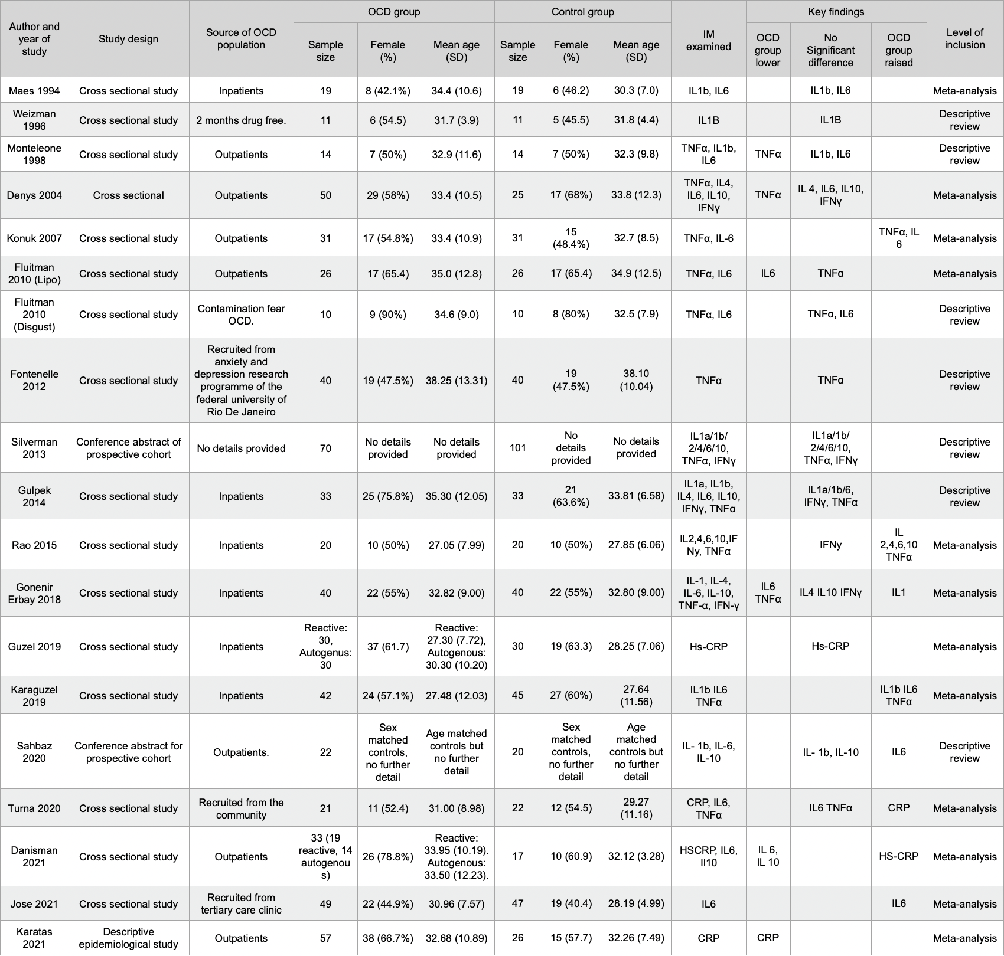
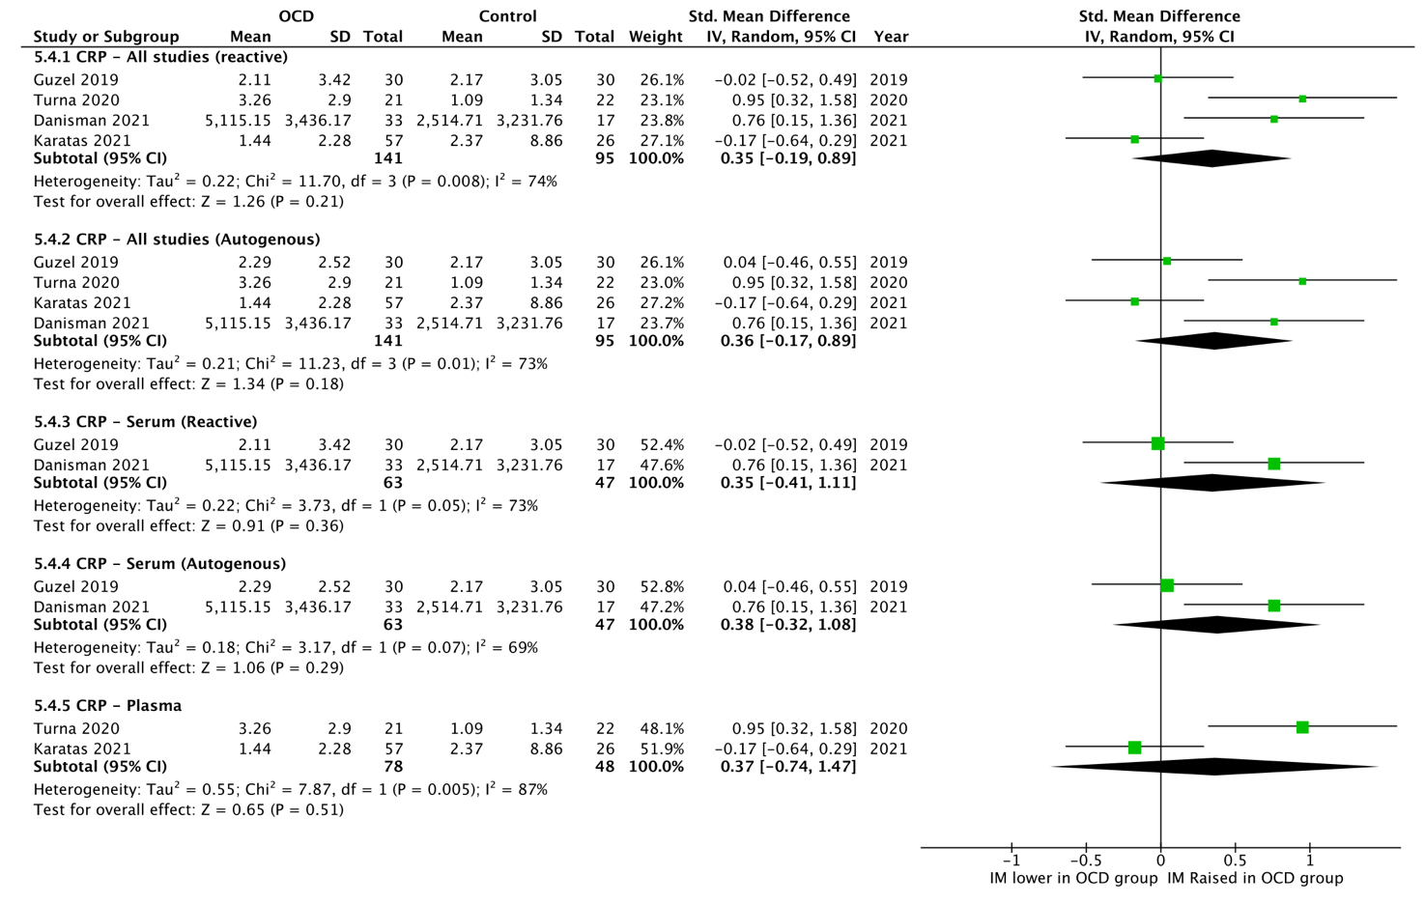
Inflammatory Markers associated with Obsessive-Compulsive Disorder:
A Systematic Review and Meta-Analysis
Matthew Constable, Ruihua Hou*
Faculty of Medicine, University of Southampton *Correspondence: Prof. Ruihua Hou Email: r.hou@soton.ac.uk
Introduction
Obsessive-compulsive disorder (OCD) is a prevalent, long-lasting mental health disorder; consists of either obsessive thoughts, compulsive behaviours, or both. With 1-3% of the UK population currently having OCD, the impact of this condition is profound. The severity of OCD symptoms varies amongst individuals, ranging from minor distress to severe debilitating disability. The aetiology of OCD is complex, multifaceted and is not entirely understood. A growing number of studies have examined the link between inflammatory markers and the pathophysiology of obsessive-compulsive disorder (OCD). However, findings vary widely across studies and this association has yet to be fully identified. There are a few systematic reviews have been conducted previously, however, no meta-analysis has been conducted so far.
Aims
This review aims to systematically evaluate evidence from studies examining peripheral inflammatory markers in adult participants with OCD compared to controls. Peripheral inflammatory markers examined included CRP, TNFα, IFNγ, IL1, IL4, IL6, and IL10.
Results
Conclusions
This is an up-to-date systematic review examining peripheral inflammatory markers in OCD.
Our study is also the most recent meta-analysis conducted on this topic.
Two inflammatory markers were identified to have significant associations with OCD, including:
IL6
TNFα
However, the study was limited due to high heterogeneity across studies.
Our review highlights the need for larger sample size and standardised sample processing in further research.
Future translation
Understanding of cytokines may elucidate a unique inflammatory signature for diagnosis and treatment response
Mechanistic knowledge will guide our search for new pharmacological targets.
No significant difference for overall inflammatory marker assessments.
However, sub-analyses found significant increase in plasma IL6 examining (Effect size (ES): 0.60, 95% confidence intervals (CI): 0.38, 0.83) and TNFα (ES: 0.70, CI: 0.37, 1.04)
No significant differences in terms of measures of CRP, IFNγ, IL1, IL4, or IL10
Methods
This systematic review includes 19 studies incorporating 1,225 participants. The meta-analysis includes 12 studies incorporating 796 participants. Studies identified by the search strategy underwent two screening stages, detailed in the methods, before a final list of included studies was obtained.
Figure 2. IL6 Standardised Mean Difference Forest Plot
Figure 1 Prisma Flow Diagram
Figure 3. TNFα Standardised Mean Difference Forest Plot
The authors declare no conflict of interest
Table 1. Study Characteristics and Findings
Figure 4. CRP Standardised Mean Difference Forest Plot

