Slide 1

Mental Health & Money in IAPT
Sarah Murphy

Slide 2

With many grappling with cost-of-living pressures and the challenges of managing their money in uncertain times, it is no surprise that 19 million people in the UK feel worried when thinking about their financial situation.

Slide 3
People need help now more than ever
Now, more than ever, people need money guidance and debt advice to get their finances back on track. You can play a key role in helping provide this support.
74%
50%
91%
13%
Of adults who have experienced a mental health problem in the last 3 years struggle to keep up with bills and payments*.
Of people in problem debt have a health mental problem**
Of people who experienced a mental health problem said they avoid talking about money.***
Of people in problem debt thought about suicide (2018)****
3
** Adult Financial Wellbeing Survey (2021), Money and Pensions Service ** The Facts (2019), Money and Mental Health Policy Institute. *** Talk Money Week Survey, (2022), Money and Pensions Service. ****A Silent Killer (2018) Money and Mental Health Policy Institute
Notes:
People with depression who are also in financial difficulty are 4.2 times more likely to still have depression when contacted 18 months later than people without financial difficulty. For those with anxiety, having financial difficulties means you are 1.8 times more likely to still be experiencing anxiety 18 months later than if your finances were sound.

Slide 4
Money problem
Mental Health problem
Notes:
So, why is there a link between our overall health and wellbeing and our financial wellbeing?
If we take an example of someone who lives with a health condition- their condition may mean that they are either unable to work or less able to work full time, so their ability to increase their income may be limited. If day to day costs go up, or things like adaptations to their home are needed this will put strain on the finances. If you don’t have a lot of money, it can mean that you aren’t able to buy items that would be beneficial for your health- healthy food, gym memberships, trainers to go running for example. Or to be able to take part in activities that are good for your social and mental wellbeing, such as trips to the cinema or meals out with friends.
There may be more going out than coming in, which can push people to borrow money. That money has to be paid back, usually with interest. Having concerns about money is stressful. Stress impacts on both our physical and mental health, which could worsen our health condition- and so the cycle continues.
If you’re ticking along in life and have good health, a sudden change of circumstances such as losing your job, having to reduce your hours, a relationship breakdown or bereavement can cause a money problem. You may find you suddenly have more going out than coming in. This is stressful and can impact on your mental and physical health. Some symptoms of mental health problems, such as anxiety, low mood, mania and psychosis can make dealing with finances more difficult, further exacerbating the money problem.

Slide 5
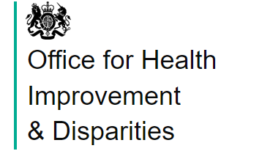
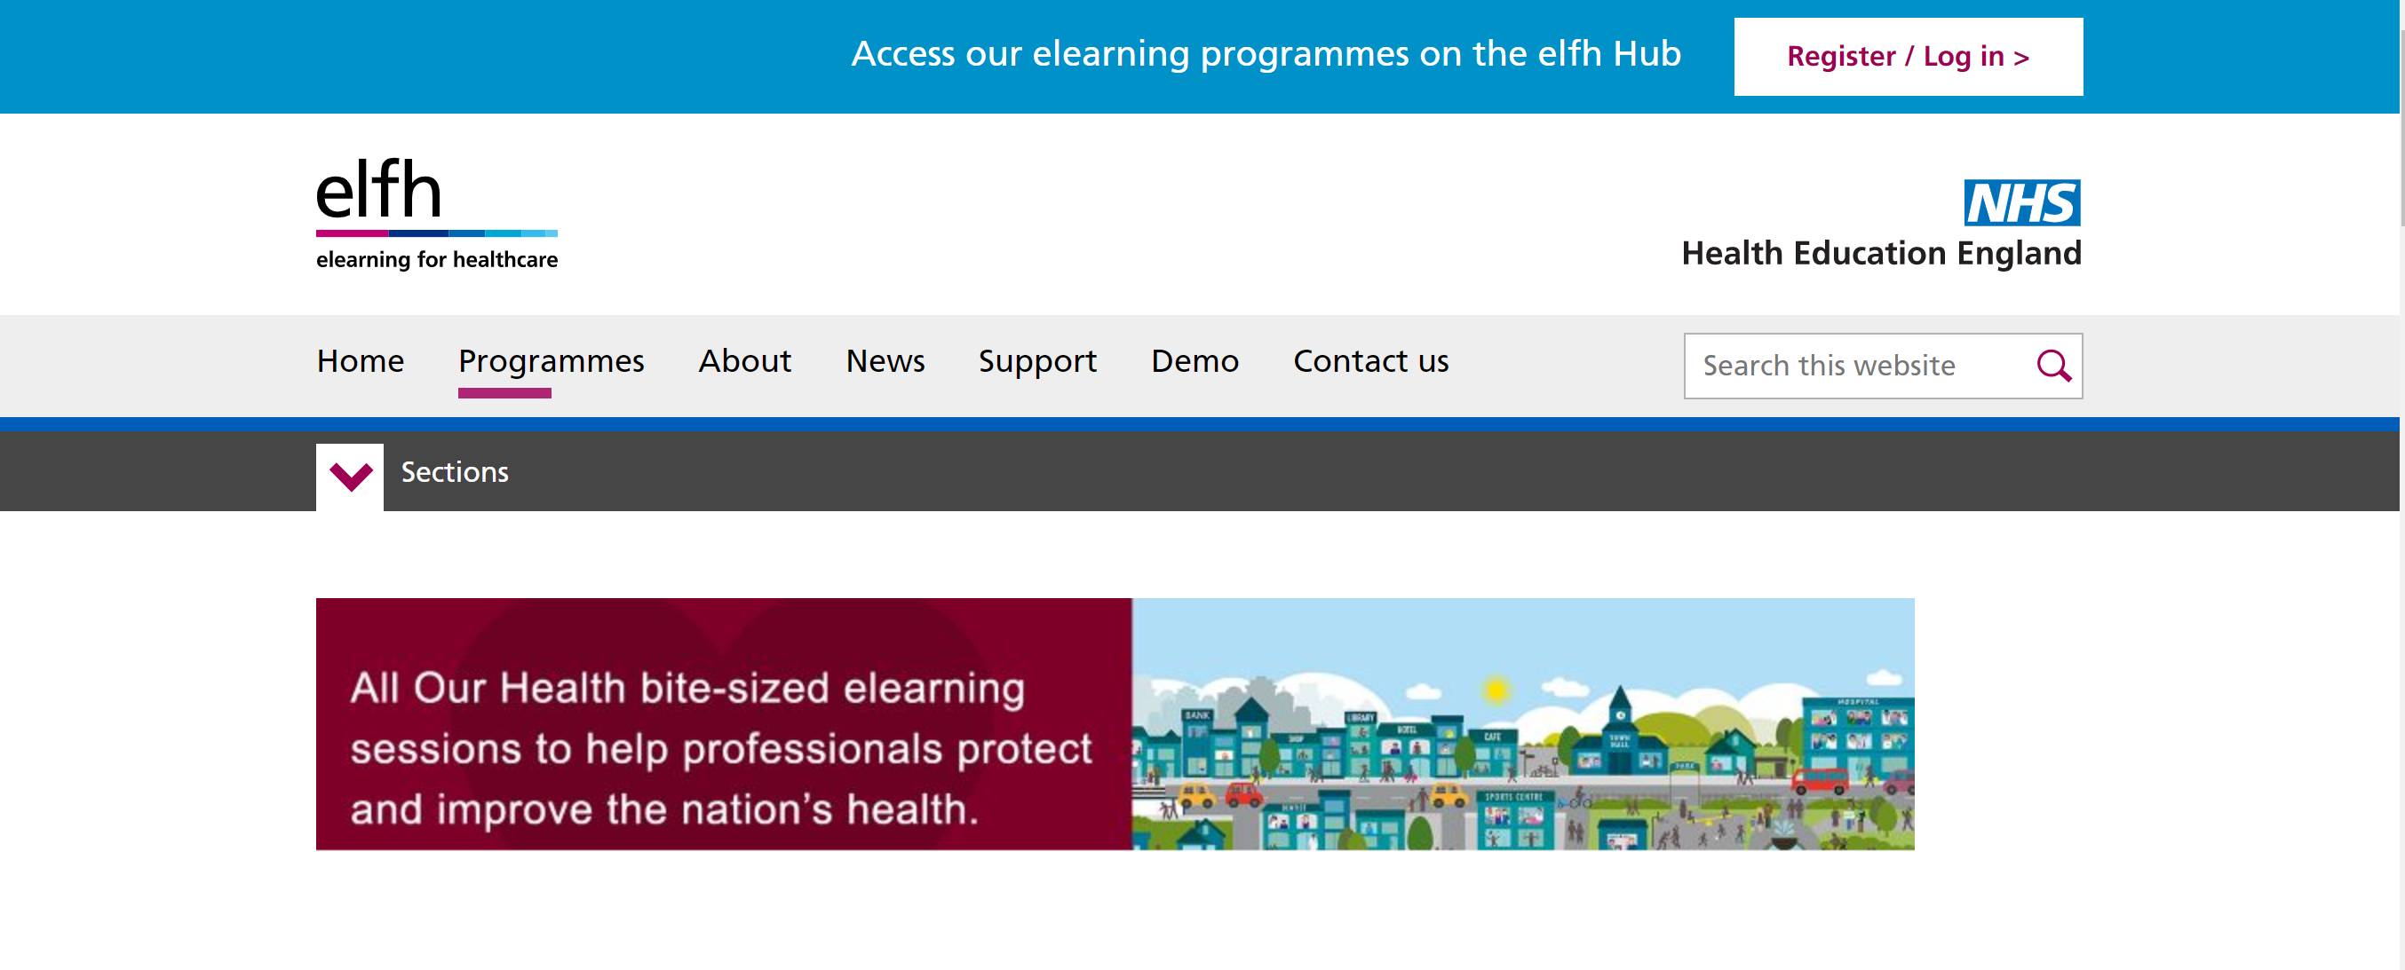
eLearning All Our Health- Financial Wellbeing
We worked with the Office for Health Improvement & Disparities to create a bite-size eLearning for healthcare professionals
It covers the links between our health and money, practical actions frontline healthcare professionals can take, and a range of useful resources.
It advocates a Very Brief Intervention model- Ask, Assist, Act.
All Our Health - elearning for healthcare (e-lfh.org.uk)

Slide 6

Is it ok if I ask you about money and finances?
We’ve got some helpful information to share with you on money and finances, if you’d like to hear more?
Would you like me to refer you to ……?
6

Slide 7






What MoneyHelper offers
We have a wealth of money and pensions guidance that may be valuable for you and the people you help.
Guidance
Tools and calculators
Debt advice locator services and tools
Core money and pension guidance This has not changed and is our same great preventative money guidance content that helps people covering a broad spectrum of money topics and debt issues.
Money guidance content & videos More bite-sized, visual money guidance content with clear calls to action to help people improve their financial situation. It seeks to target and engage hard to reach people and for those with a specific set of money guidance needs relevant to challenges today.
Bill prioritiser An easy-to-use, interactive online tool for anyone struggling to keep on top of bills and payments. It helps people prioritise and make sense of how best to tackle things before they miss payments. The tool also directs people to debt advice if they need it.
Money Manager tool A tool for people already on Universal Credit or waiting for their first payment. Offers dedicated money guidance including budgeting, borrowing, managing housing costs and other specific financial support.
Other MoneyHelper tools and calculators A suite of tools and calculators which can help people budget, save and cut back on costs, find impartial advisers, or financially plan for life events from retiring to having a baby.
Debt Advice Locator tool A tool to help consumers find free online, telephone and face-to-face debt advice services in the UK.
Debt advice
This is not a service that MoneyHelper provides, however, we signpost an independent, free debt advice partners across the UK who help people in problem debt who need support.

Slide 8
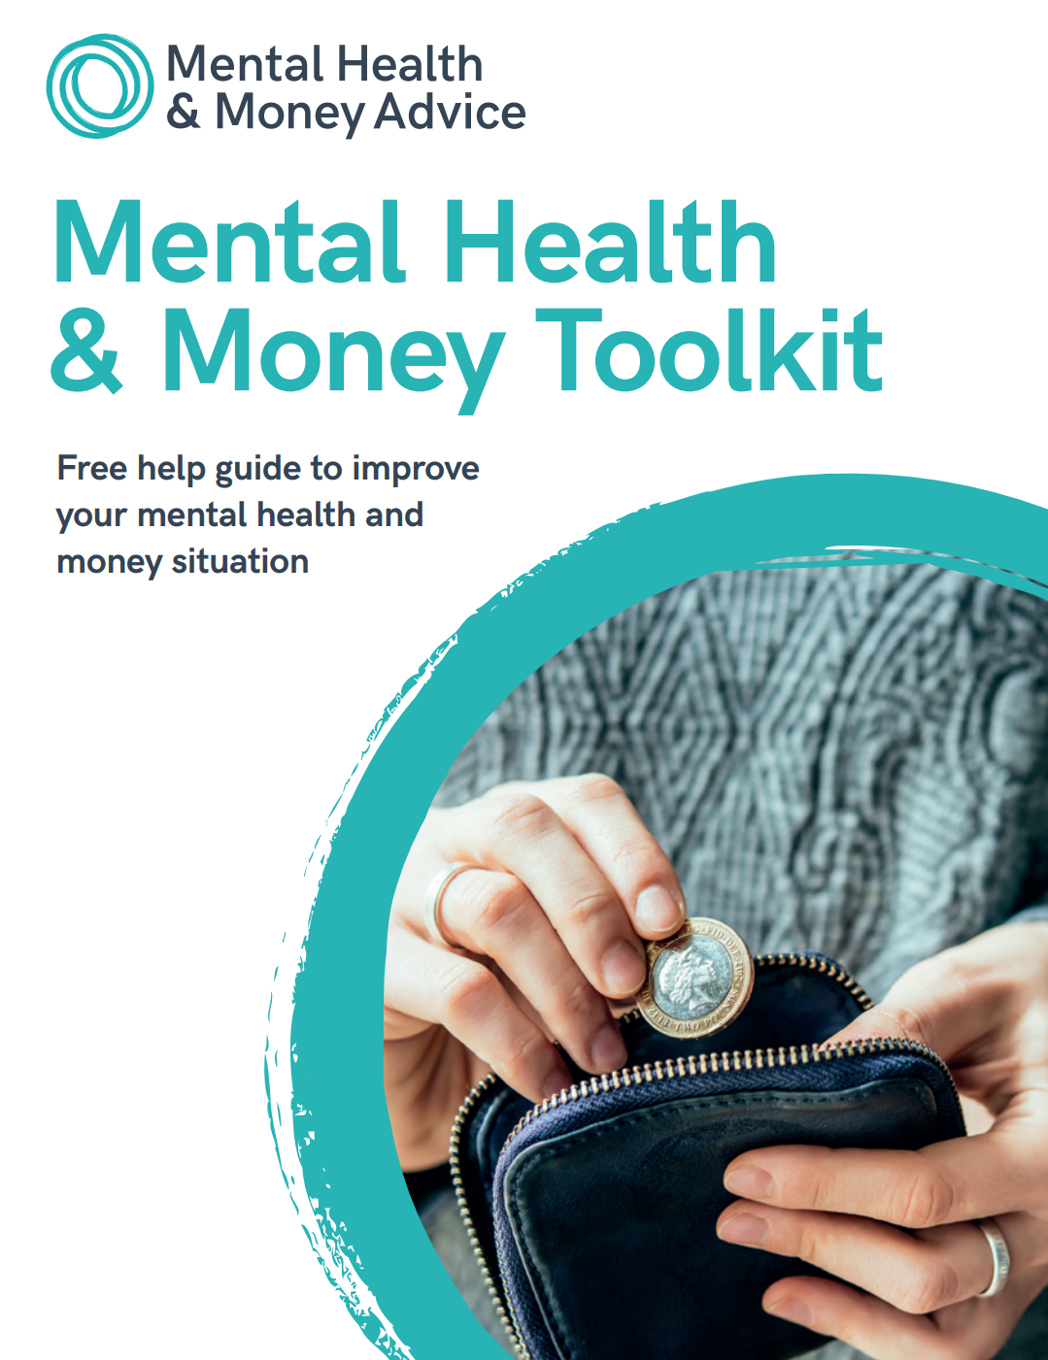
How we can help you to help others Mental Health & Money Toolkit
Developed by Mental Health & Money Advice with support from Money & Pensions Service and the National Academy for Social Prescribing.
Co-produced with people with lived experience and link workers and written by a Senior PWP.
A toolkit you can work through with your clients or on their own.
Contains a range of CBT exercises to support avoidance and build self-esteem, plus some key money guidance information, including an income and expenditure sheet and how to access free debt advice.
Access it online or email us if you’d like some hard copies; partners@maps.org.uk
mhma.org.uk/toolkit
Notes:
HARD COPIES ARE AVAILABLE FOR REGIONAL MANAGERS TO ORDER AND GET DELIVERED TO RELEVANT SITES. WE JUST NEED TO KNOW HOW MANY YOU NEED

Slide 9
Don’t forget to look after your own financial wellbeing!

Slide 10
Thank you
Sarah Murphy
Senior Health & Social Care Strategy Lead
Sarah.murphy@maps.org.uk

Slide 11
Psychological Mechanisms
Frankham, Richardson & Maguire (2020):
Objective financial hardship
Depression
Stress
Poor wellbeing
Hopelessness
Subjective financial hardship
Shame
Anxiety

Slide 12
Psychological Mechanisms Frankham, Richardson & Maguire(2020): Systematic review of research
Objective financial hardship
Protective factors:
Self-Esteem
Personal Agency
Active Coping
Poor mental health

Slide 13
Psychological Mechanisms
How stressed people feel about their debt is more important than the actual amount of debt in terms of impact on depression (Bridges & Disney, 2010).
Materialism linked to poor mental health, but this is moderated by greater mindfulness (Liu et al., 2017).
Believing finances will get worse predicts poor mental health (Brown et al., 2005).
Study of older adult in china found that social network and how much help people felt they had (anticipated support) moderated impact of depression on debt (Gao et al., 2022).
Notes:
Study connection with host town important as well

Slide 14

A psychological approach: space from money worries
Computer based intervention, CBT, ACT and mindfulness. Designed range of mental health and financial situations:
9 sessions:
1. Money and Mental Health.
2. Your Thoughts about Money.
3. Changing Your Thoughts about Money.
4. Getting Active on a Budget.
5. Facing your Financial Fears.
6. Managing Worry about Money.
7. Acceptance and Hope about Money Difficulties.
8. Getting Control over Impulsive Spending.
9. Staying Financially Healthy.
If you have silvercloud in your service, you can access this as part of package

Slide 15
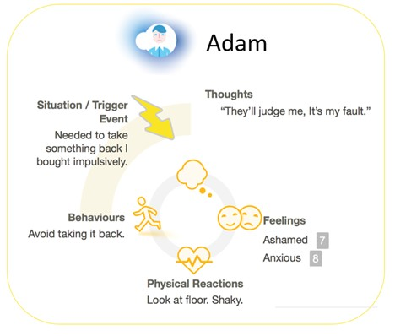

Slide 16
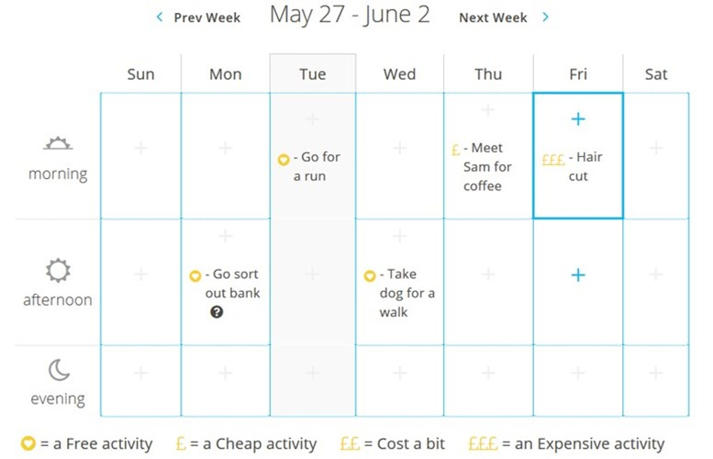

Slide 17
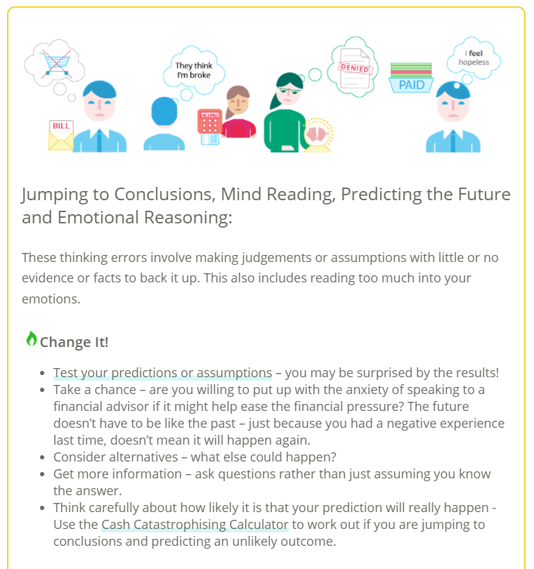

Slide 18
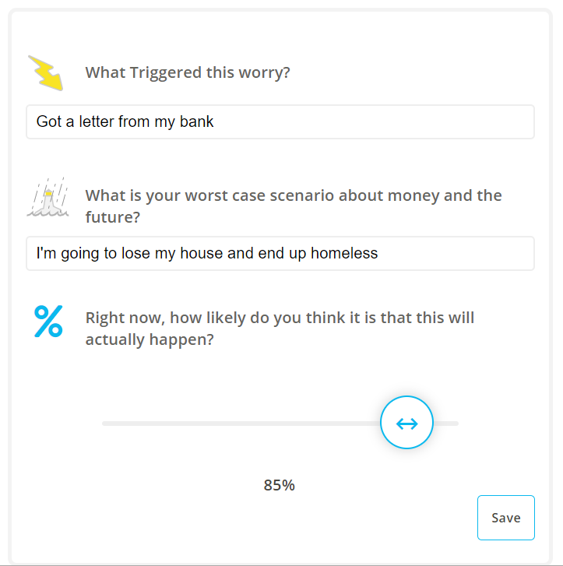
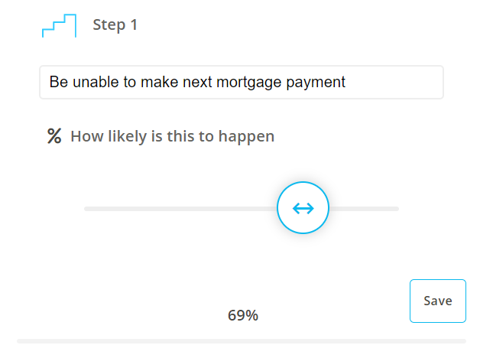
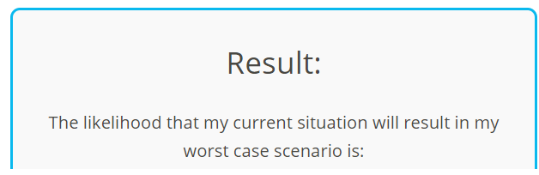

Slide 19
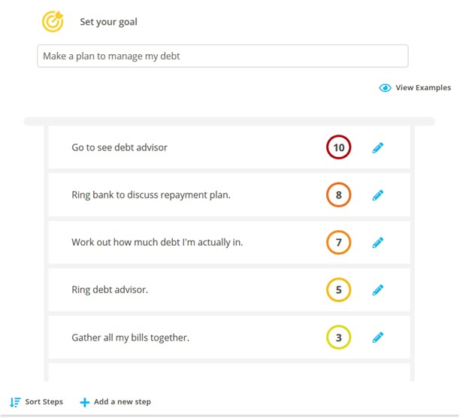

Slide 20
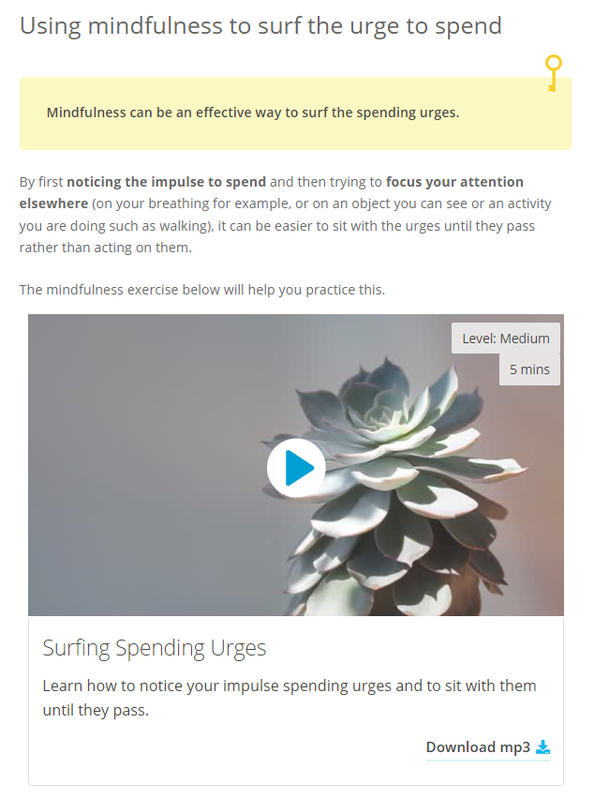

Slide 21
A psychological approach: space from money worries
Case series with 30 people in IAPT showed (Richardson et al., 2022):
77% completion.
Positive ratings
Reduced depression and anxiety (GAD-7 and PHQ-9)
Reduced perceived financial distress
Reduced scores on a ‘money and mental health scale’ (e.g. ”I feel hopeless about my financial situation.” “ I avoid finances because it makes me feel anxious”)

