Slide 1
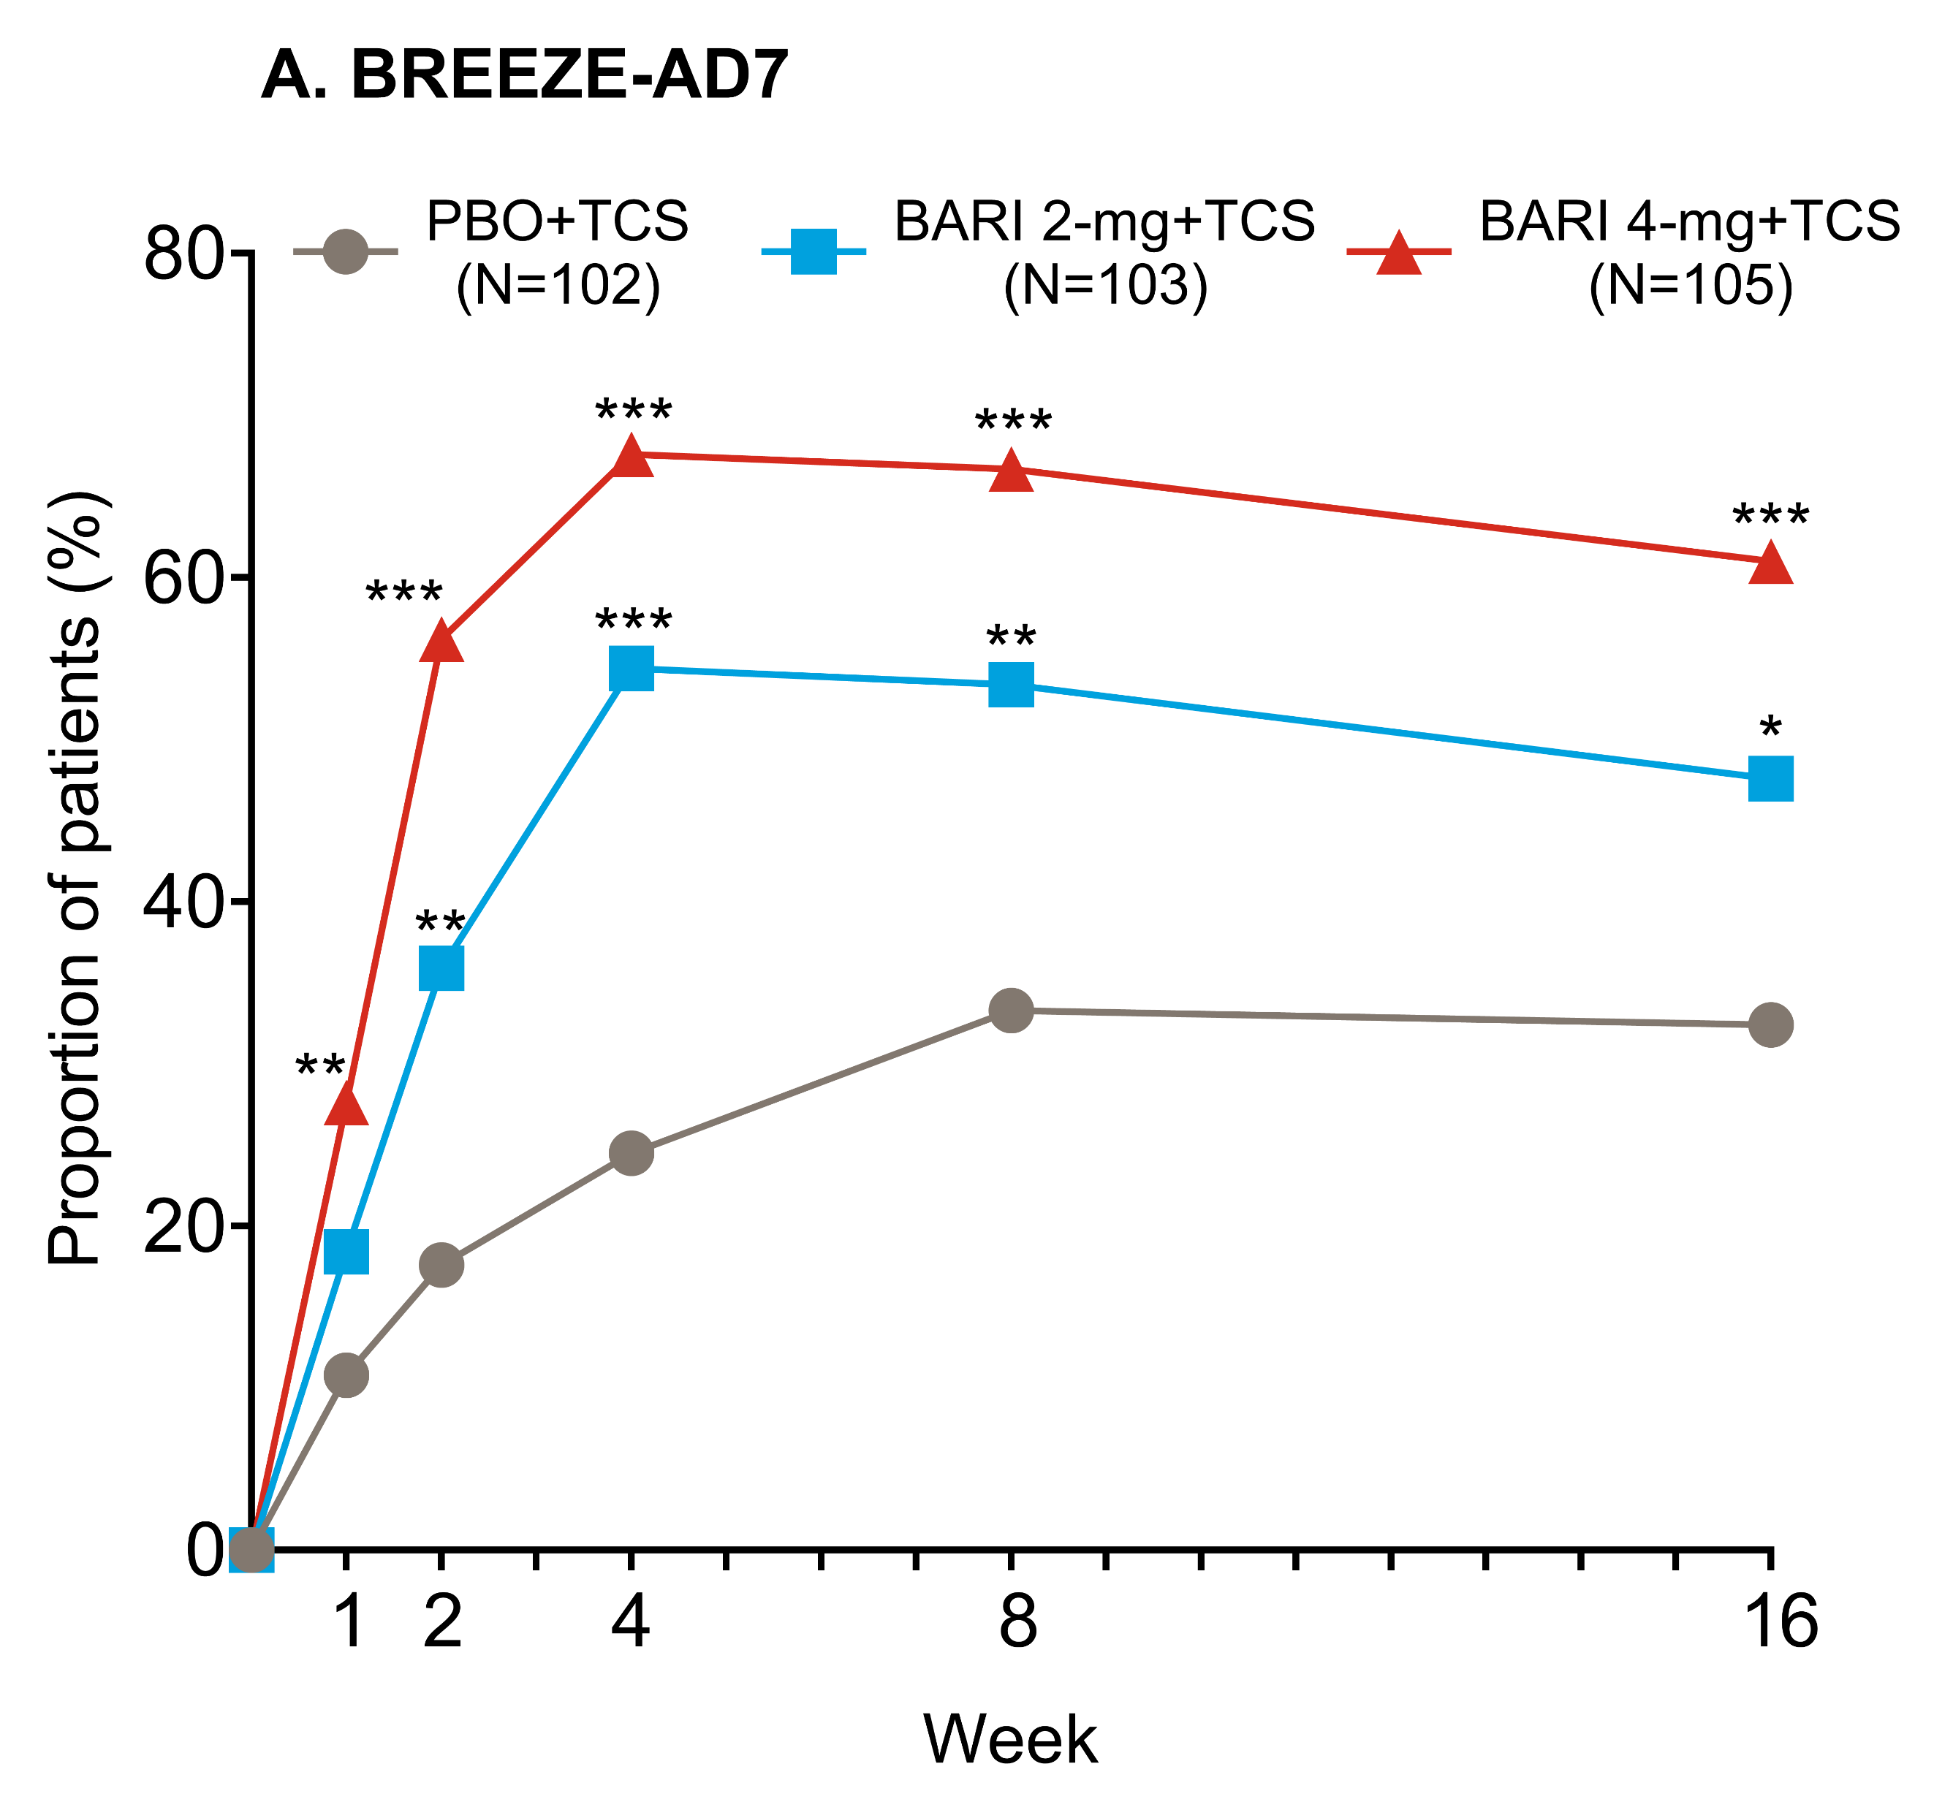
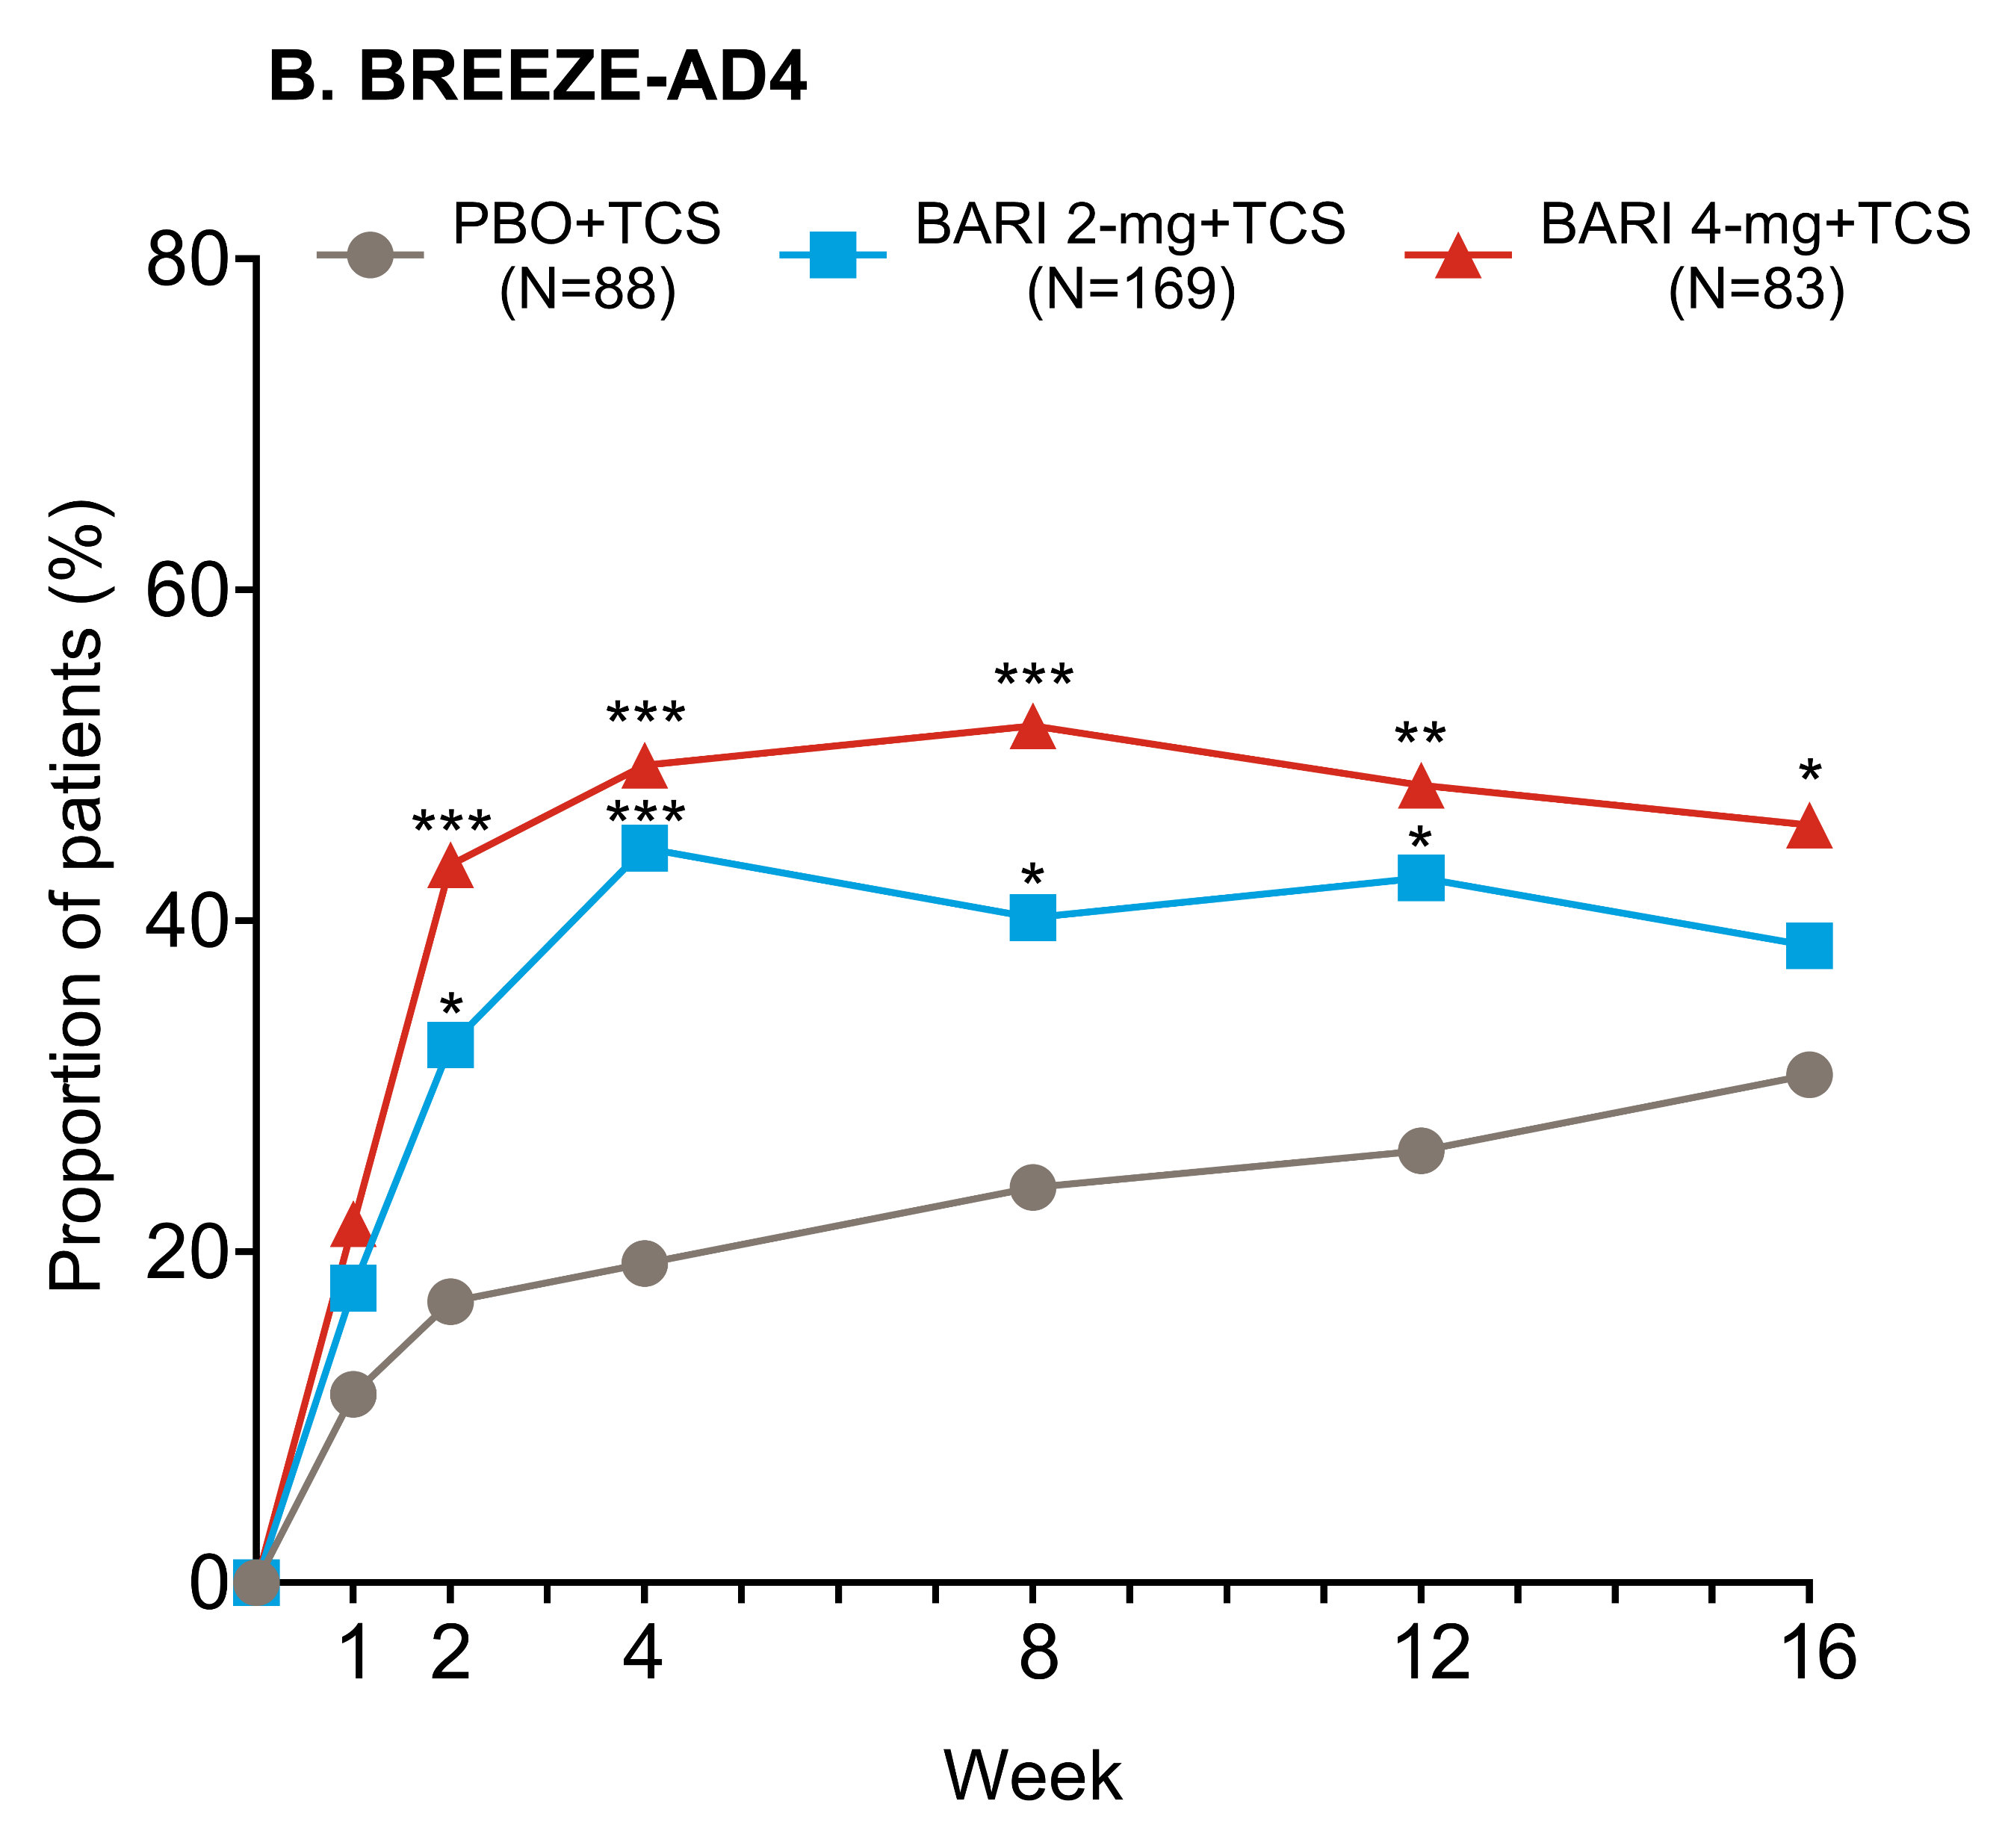
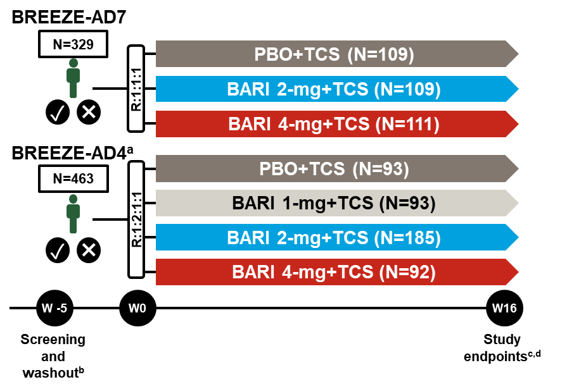
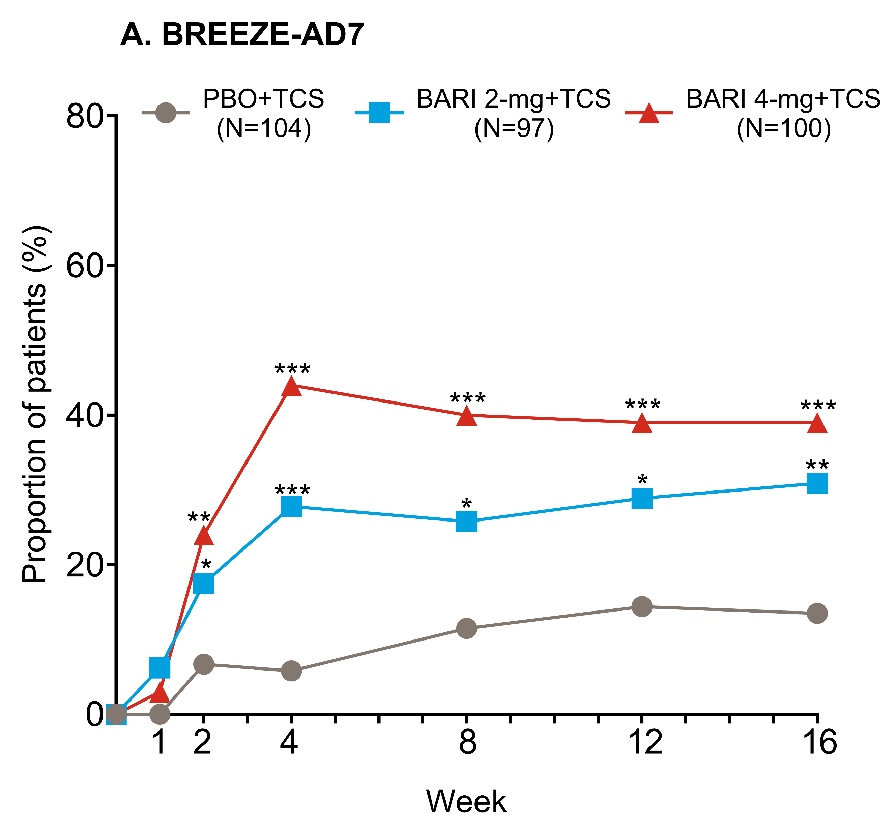
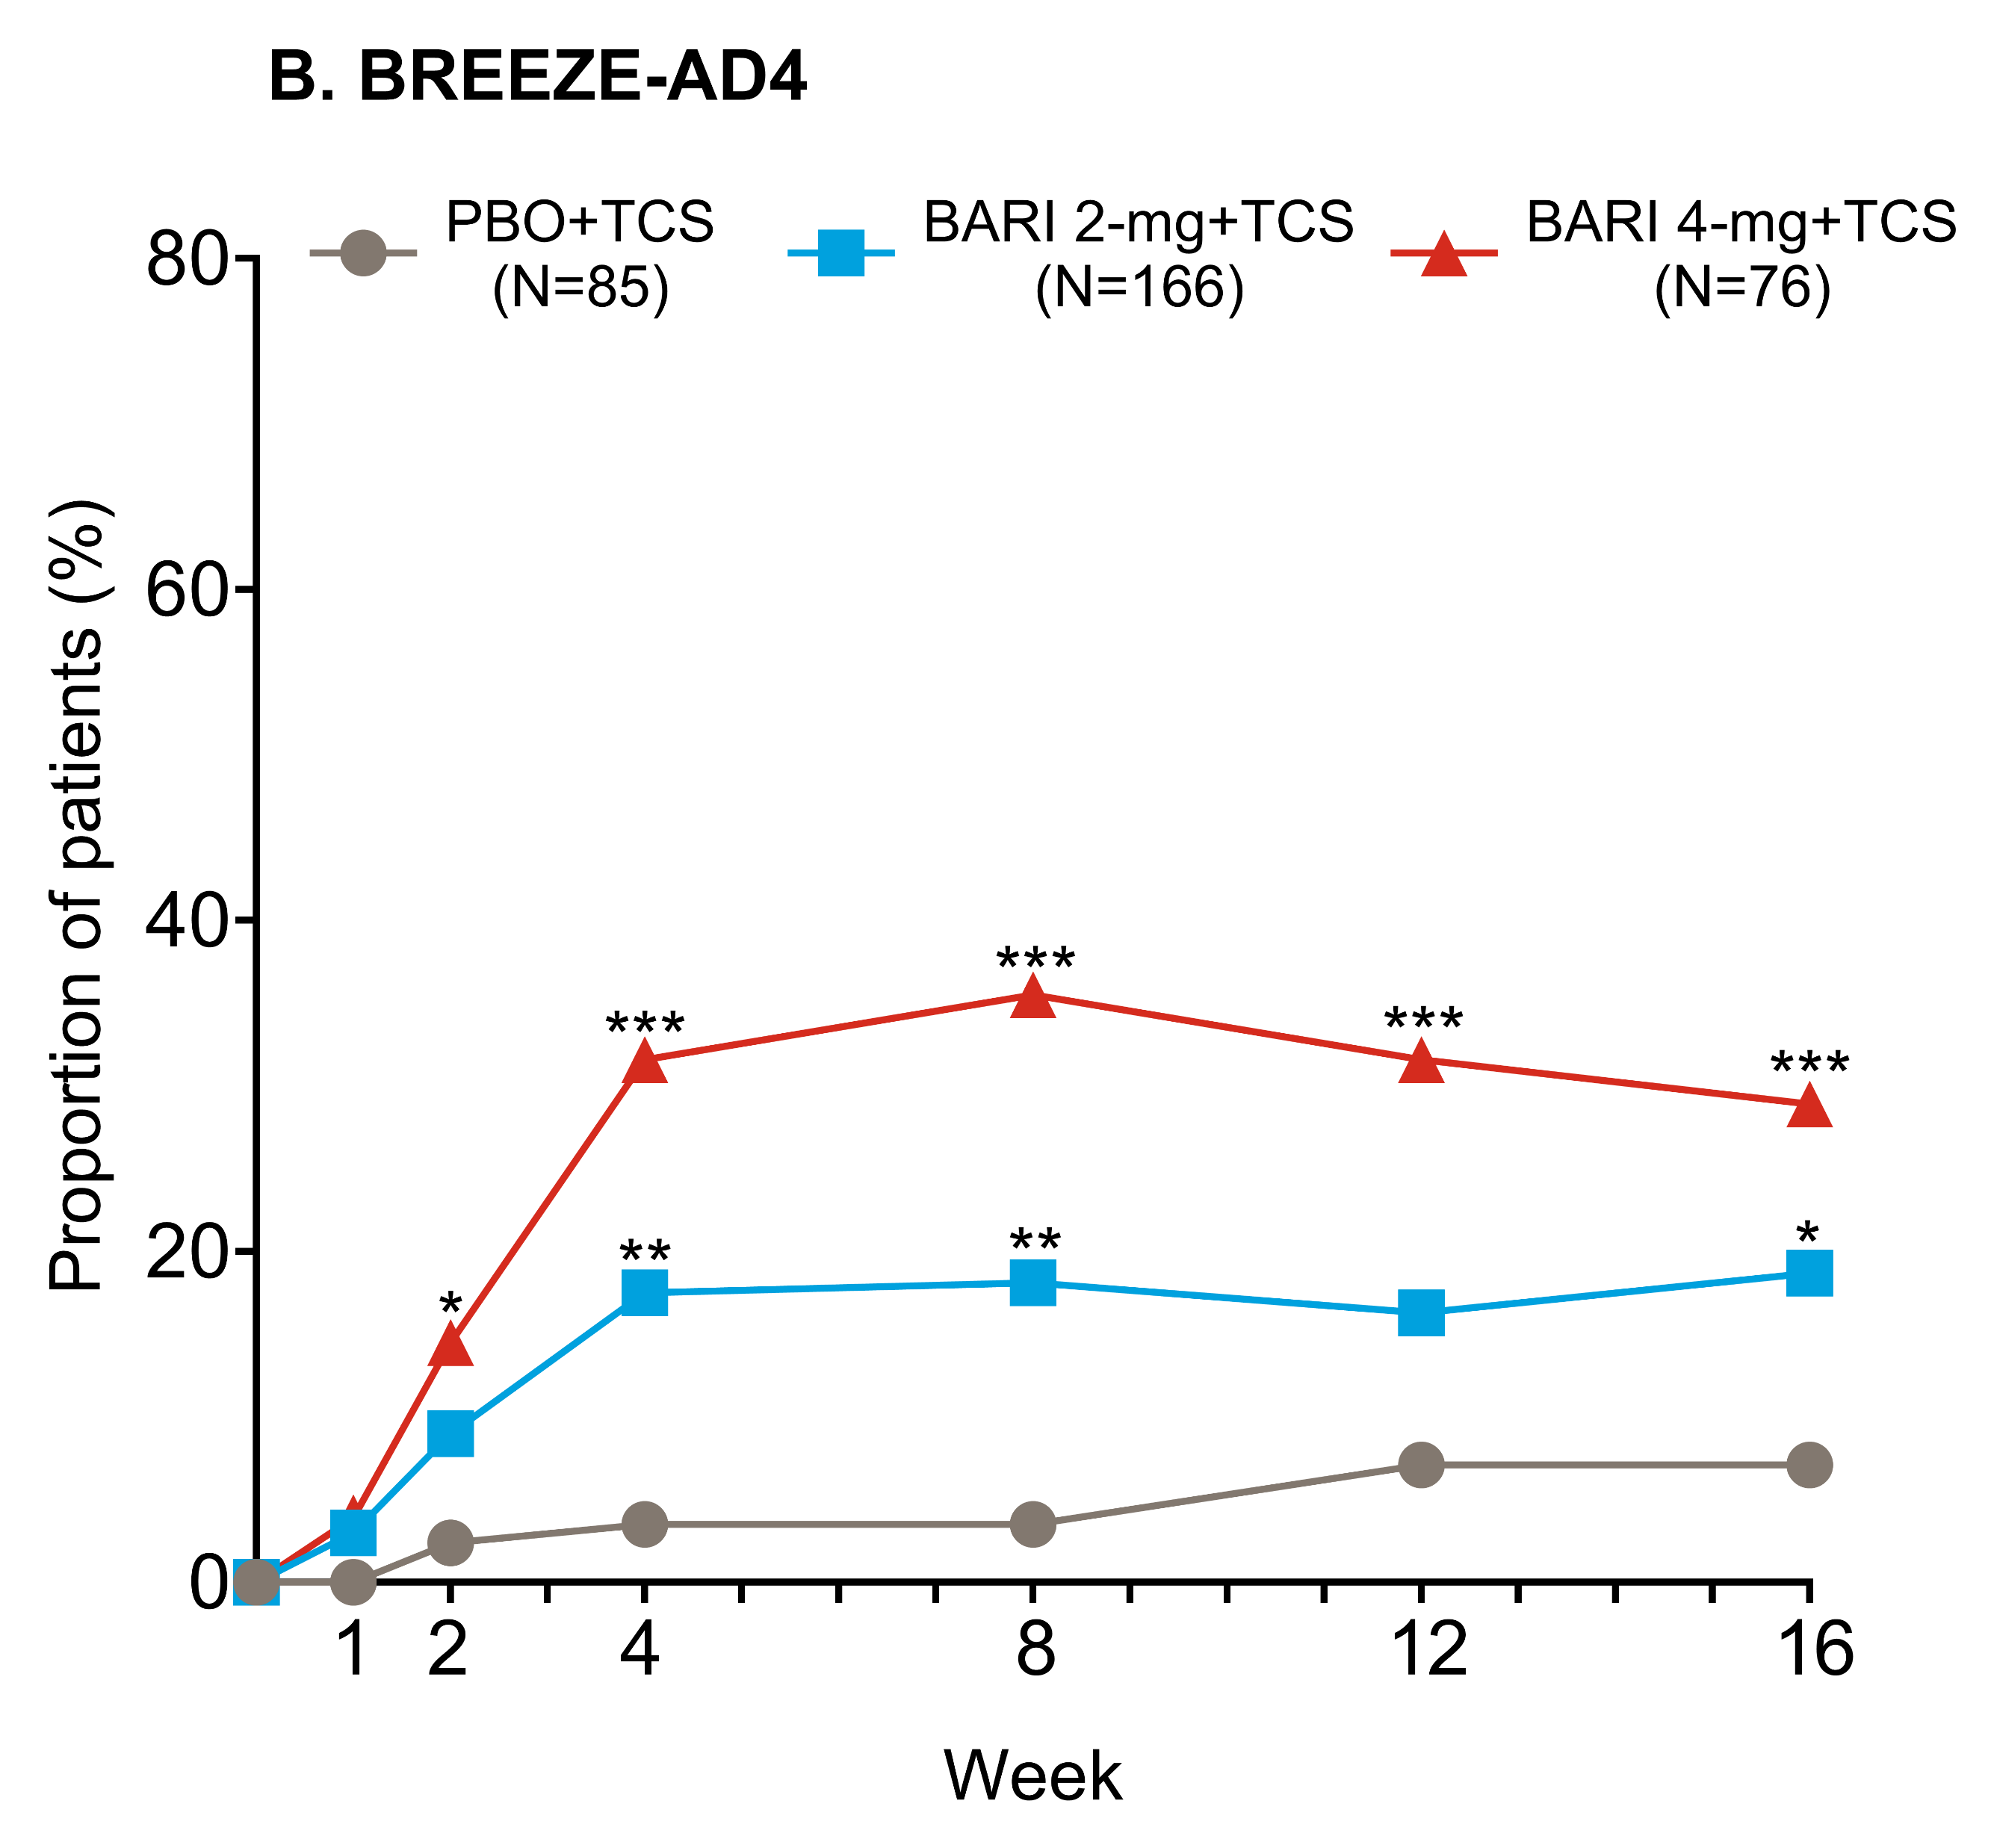
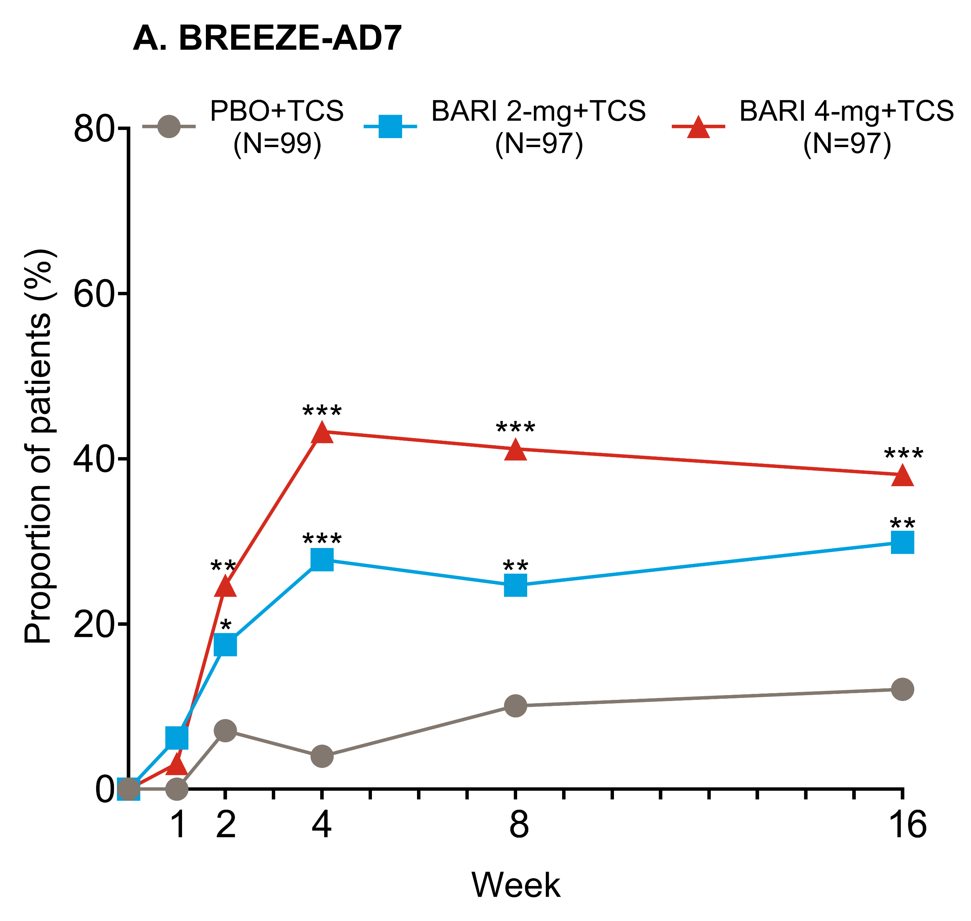
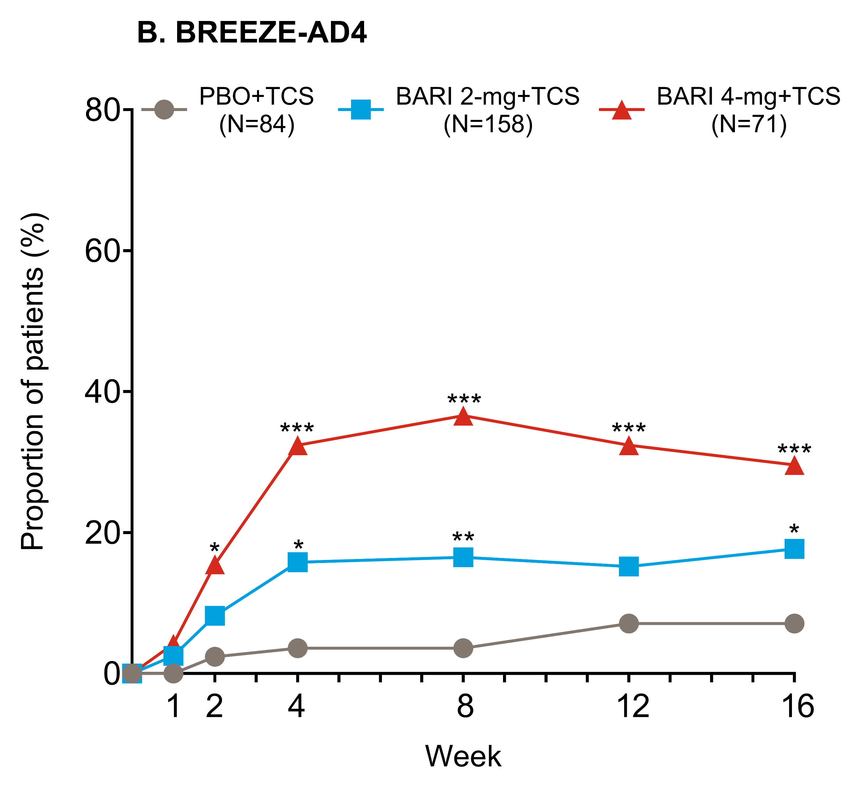
Clinical Benefit Of Baricitinib Treatment For Moderate-to-Severe Atopic Dermatitis In Combination With Topical Corticosteroids: A Post-hoc Analysis Of The Phase 3 Trials BREEZE-AD7 and BREEZE-AD4
P86
Mahreen Ameen¹, Michael Ardern-Jones², Hamish Hunter³, Susanne Grond⁴, Fan Emily Yang⁴, Yun-Fei Chen⁴, Robert McKenzie⁴, and Alan Irvine⁵
¹Royal Free London NHS Foundation Trust, London, UK, ²University Hospital Southampton, Southampton, UK, ³Northern Care Alliance NHS Foundation Trust and the University of Manchester, Manchester, UK, ⁴Eli Lilly and Company, Indianapolis, IN, USA , ⁵Trinity College Dublin, Dublin, Ireland
background
Baricitinib (BARI), an oral Janus kinase 1/2 inhibitor, is approved for adults with moderate-to-severe atopic dermatitis (AD) in Europe, Japan, and multiple other countries
The National Institute for Health and Care Excellence (NICE) guidelines define adequate response to BARI as a reduction of at least 50% in Eczema Area and Severity Index (EASI 50) and ≥4-point reduction in Dermatology Life Quality Index (DLQI) after 16-weeks of treatment initiation
BREEZE-AD7 (NCT03733301)^{1,2} and BREEZE-AD4 (NCT03428100)³ are multicentre, randomised, double-blind, placebo-controlled, phase 3 studies evaluating the efficacy and safety of BARI in combination with topical corticosteroids (TCS) in adults with moderate-to-severe AD
KEY RESULTS
EASI 50 and DLQI ≥4-point improvement from baseline
Objective
This analysis reports simultaneous improvements in clinical signs and Quality-of-Life (QoL), in addition to improvements in itch, to assess clinical benefit with BARI treatment
Methods
Study design, BREEZE-AD7 and BREEze-AD4
Figure 1: Proportion of patients achieving EASI 50 and DLQI ≥ 4-point improvement from week 0 through week 16 in BREEZE-AD7 (A) and BREEZE-AD4 (B), for patients with baseline DLQI ≥4. * p≤0.05, ** p≤0.01, *** p≤0.001 vs. PBO from logistic regression analysis.
BARI = baricitinib; DLQI = Dermatology Life Quality Index; EASI = Eczema Area and Severity Index; PBO = placebo; TCS = topical corticosteroids.
EASI 50 and Itch NRS ≥4-point improvement from baseline
ª Patients in BREEZE-AD4 were followed for 52 weeks; ^{b} All patients washed out of AD treatments;
^{c} Proportion of patients achieving EASI 75 (BREEZE-AD4); ^{d} Proportion of patients achieving vIGA-AD (0,1) with a ≥2-point improvement (BREEZE-AD7). Only BARI 4-mg and 2-mg are reported in the current analysis.
Key Inclusion Criteria
≥18 years old and diagnosis of AD for ≥12 months
Moderate-to-severe AD at screening and randomisation, defined as:
Validated Investigator’s Global Assessment (vIGA) for AD™ ≥3
EASI ≥16
Body surface area ≥10%
History of inadequate response to topical therapies
Experienced cyclosporine failure, intolerance or contraindication (BREEZE-AD4 only)
Assessments
Reported here are the results of BARI 4-mg and 2-mg vs. PBO
Endpoints reported from baseline through Week 16 include the proportion of patients achieving:
50% improvement in EASI (EASI 50) and ≥4-point improvement in DLQI
EASI 50 and ≥4-point improvement in Itch NRS
EASI 50 and ≥4-point improvement in DLQI and ≥4-point improvement in Itch NRS
Statistical Analysis
Logistic regression was applied with treatment, geographic region, baseline disease severity (IGA) as factors
Patients who received rescue treatment or with missing data were considered non-responders
Figure 2: Proportion of patients achieving EASI 50 and itch NRS ≥4-point improvement from week 1 through week 16 in BREEZE-AD7 (A) and BREEZE-AD4 (B), for patients with baseline Itch ≥4. * p≤0.05, ** p≤0.01, *** p≤0.001 vs. PBO from logistic regression analysis.
BARI = baricitinib; EASI = Eczema Area and Severity Index; Itch NRS = Itch Numeric Rating Scale; PBO = placebo; TCS = topical corticosteroids.
EASI 50 and DLQI ≥4-point improvement and Itch NRS ≥4-point improvement from baseline
Baseline Characteristics and Disease Severity
 | BREEZE-AD7 |  |  | BREEZE-AD4
 | PBO | BARI | BARI | PBO | BARI | BARI
 | +TCS | 2-mg | 4-mg | +TCS | 2-mg | 4-mg
 |  | +TCS | +TCS |  | +TCS | +TCS
 | (N=109) | (N=109) | (N=111) | (N=93) | (N=185) | (N=92)
Age, years | 33.7 (13.2) | 33.8 (12.8) | 33.9 (11.4) | 38.7 (13.6) | 37.3 (13.6) | 38.7 (13.3)
Female, n (%) | 38 (34.9) | 39 (35.8) | 36 (32.4) | 44 (47.3) | 52 (28.1) | 35 (38.0)
Time since AD diagnosis, years | 22.0 (12.2) | 24.6 (14.8) | 25.5 (13.2) | 27.2 (15.6) | 25.3 (13.7) | 26.1 (15.0)
EASI score | 28.5 (12.3) | 29.3 (11.9) | 30.9 (12.6) | 30.9 (11.6) | 30.6 (12.4) | 32.7 (13.7)
vIGA-AD of 3, n (%) | 60 (55.6) | 59 (54.1) | 61 (55.0) | 43 (46.2) | 91 (49.5) | 45 (48.9)
vIGA-AD of 4, n (%) | 48 (44.4) | 50 (45.9) | 50 (45.0) | 50 (53.8) | 93 (50.5) | 47 (51.1)
DLQI | 15.0 (7.9) | 15.0 (7.7) | 14.7 (7.9) | 14.5 (6.9) | 13.6 (7.4) | 14.0 (8.1)
Itch NRS | 7.4 (1.7) | 7.0 (2.1) | 7.0 (2.0) | 7.1 (1.9) | 6.7 (1.9) | 6.7 (2.3)
Figure 3: Proportion of patients achieving EASI 50, DLQI ≥4-point improvement and itch NRS ≥4-point improvement from week 0 through week 16 in BREEZE-AD7 (A) and BREEZE-AD4 (B), for patients with baseline DLQI ≥4 and Itch ≥4. * p≤0.05, ** p≤0.01, *** p≤0.001 vs. PBO from logistic regression analysis.
BARI = baricitinib; DLQI = Dermatology Life Quality Index; EASI = Eczema Area and Severity Index; Itch NRS = Itch Numeric Rating Scale; PBO = placebo; TCS = topical corticosteroids.
Conclusions
In both BREEZE-AD7 and BREEZE-AD4, BARI in combination with TCS resulted in rapid and significant simultaneous improvement in at least two AD domains, including clinical signs (EASI), itch (Itch NRS) and QoL (DLQI), compared to PBO
For patients treated with BARI, statistically significant improvements in at least two AD domains vs. PBO were seen as early as Week 2
BARI in combination with TCS provides a clinically meaningful benefit for patients with AD in controlling skin signs, symptoms and QoL
Table 1: Baseline characteristics and disease measures for patients enrolled in BREEZE-AD7 and BREEZE-AD4. Data are mean (standard deviation) of available data, unless stated otherwise. BARI = baricitinib; DLQI = Dermatology Life Quality Index; EASI = Eczema Area and Severity Index; Itch NRS = Itch Numeric Rating Scale; PBO = placebo; TCS = topical corticosteroids; vIGA-AD = Validated Investigator's Global Assessment for Atopic Dermatitis.
REFERENCES
Reich K, et al. JAMA Dermatol.2020;156:1333-1343.
https://clinicaltrials.gov/ct2/show/NCT03733301.
https://clinicaltrials.gov/ct2/show/record/NCT03428100.
DISCLOSURES
M Ameen has received speaker fees, support for attending meetings and has participated on a data safety monitoring board or advisory board for Eli Lilly and Company. M Ardern-Jones has speaker fees and support for attending meetings and/or travel from Eli Lilly and Company. H Hunter has received consultancy fees and/or honoraria and/or travel bursaries from La Roche-Posay, Janssen, Abbvie, UCB, Sanofi Genzyme Novartis, Almirall, Leo, and Eli Lilly and Company. S Grond, F E Yang, Y Chen and R McKenzie are employees and shareholders of Eli Lilly Company. A Irvine has received consulting and speaker fees for Eli Lilly and Company. Writing support was provided by Fionnuala Murphy, PhD, an employee of Eli Lilly and Company.
Abbreviations: AD = Atopic dermatitis; BARI = baricitinib; DLQI = Dermatology Life Quality Index; EASI = Eczema Area and Severity Index; Itch NRS = Itch Numeric Rating Scale; NICE = National Institute for Health and Care Excellence; PBO = placebo; TCS = Topical Corticosteroids; vIGA-AD = Validated Investigator's Global Assessment for Atopic Dermatitis.
Scan or click the QR code or use this URL (https://lillyscience.lilly.com/congress/bad2022) for a list of all Lilly content presented at the congress. Other company and product names are trademarks of their respective owners.
British Association of Dermatologists (BAD); Glasgow, United Kingdom; 2022
Study was sponsored by Eli Lilly and Company, under license from Incyte Corporation

Slide 2
BACKGROUND AND OBJECTIVE
Background
Baricitinib (BARI), an oral Janus kinase 1/2 inhibitor, is approved for adults with moderate-to-severe atopic dermatitis (AD) in Europe, Japan and multiple other countries
National Institute for Health and Care Excellence (NICE) guidelines define adequate response to BARI as a reduction of at least 50% in Eczema Area and Severity Index (EASI 50) and ≥4-point reduction in Dermatology Life Quality Index (DLQI) after 16-weeks of treatment initiation
BREEZE-AD7 (NCT03733301)^{1,2} and BREEZE-AD4 (NCT03428100)³ are multicentre, randomised, double-blind, placebo-controlled, phase 3 studies evaluating the efficacy and safety of BARI in combination with topical corticosteroids (TCS) in adults with moderate-to-severe AD
Objective
This analysis reports simultaneous improvements in clinical signs and Quality-of-Life (QoL), in addition to improvements in itch, to assess clinical benefit with BARI treatment
Notes:
A Study of Baricitinib (LY3009104) in Combination With Topical Corticosteroids in Adults With Moderate to Severe Atopic Dermatitis - Full Text View - ClinicalTrials.gov
A Long-term Study of Baricitinib (LY3009104) With Topical Corticosteroids in Adults With Moderate to Severe Atopic Dermatitis That Are Not Controlled With Cyclosporine or for Those Who Cannot Take Oral Cyclosporine Because it is Not Medically Advisable - Full Text View - ClinicalTrials.gov

Slide 3
METHODS Study Design, BREEZE-AD7 and BREEZE-AD4
ª Patients in BREEZE-AD4 were followed for 52 weeks; ^{b} All patients washed out of AD treatments; ^{c} Proportion of patients achieving EASI 75 (BREEZE-AD4); ^{d} Proportion of patients achieving vIGA-AD (0,1) with a ≥2-point improvement (BREEZE-AD7). Only BARI 2-mg and 4-mg are reported in the current analysis. AD = atopic dermatitis; BARI = baricitinib; PBO = placebo; TCS = topical corticosteroids; vIGA-AD =Validated Investigator’s Global Assessment for AD.
Notes:
Please see poster Bari000139_JAIY+JAIN+Head+and+Neck_YKR1.0_15Jul21. Slide 3/4/5 contain annotated figures of the study

Slide 4
Key Inclusion Criteria
≥18 years old and diagnosis of AD for ≥12 months
Moderate-to-severe AD at screening and randomization, defined as:
Validated Investigator’s Global Assessment (vIGA) for AD™ ≥3
EASI ≥16
Body surface area ≥10%
History of inadequate response to topical therapies
Experienced cyclosporine failure, intolerance or contraindication (BREEZE-AD4 only)
Notes:
Please see poster Bari000139_JAIY+JAIN+Head+and+Neck_YKR1.0_15Jul21. Slide 3/4/5 contain annotated figures of the study

Slide 5
Methods
Assessments
Reported here are the results of BARI 4-mg and 2-mg vs. PBO
Endpoints reported from baseline through Week 16 include the proportion of patients achieving:
50% improvement in EASI (EASI 50) and ≥4-point improvement DLQI
EASI 50 and ≥4-point improvement in Itch NRS
EASI 50 and ≥4-point improvement DLQI and ≥4-point improvement in Itch NRS
Statistical Analysis
Logistic regression was applied with treatment, geographic region, baseline disease severity (IGA) as factors.
Patients who received rescue treatment or with missing data were considered non-responders.

Slide 6
Baseline characteristics and disease measures
 | BREEZE-AD7 |  |  | BREEZE-AD4
 | PBO | BARI | BARI | PBO | BARI | BARI
 | +TCS | 2-mg | 4-mg | +TCS | 2-mg | 4-mg
 |  | +TCS | +TCS |  | +TCS | +TCS
 | (N=109) | (N=109) | (N=111) | (N=93) | (N=185) | (N=92)
Age, years | 33.7 (13.2) | 33.8 (12.8) | 33.9 (11.4) | 38.7 (13.6) | 37.3 (13.6) | 38.7 (13.3)
Female, n (%) | 38 (34.9) | 39 (35.8) | 36 (32.4) | 44 (47.3) | 52 (28.1) | 35 (38.0)
Time since AD diagnosis, years | 22.0 (12.2) | 24.6 (14.8) | 25.5 (13.2) | 27.2 (15.6) | 25.3 (13.7) | 26.1 (15.0)
EASI score | 28.5 (12.3) | 29.3 (11.9) | 30.9 (12.6) | 30.9 (11.6) | 30.6 (12.4) | 32.7 (13.7)
vIGA-AD of 3, n (%) | 60 (55.6) | 59 (54.1) | 61 (55.0) | 43 (46.2) | 91 (49.5) | 45 (48.9)
vIGA-AD of 4, n (%) | 48 (44.4) | 50 (45.9) | 50 (45.0) | 50 (53.8) | 93 (50.5) | 47 (51.1)
DLQI | 15.0 (7.9) | 15.0 (7.7) | 14.7 (7.9) | 14.5 (6.9) | 13.6 (7.4) | 14.0 (8.1)
Itch NRS | 7.4 (1.7) | 7.0 (2.1) | 7.0 (2.0) | 7.1 (1.9) | 6.7 (1.9) | 6.7 (2.3)
Table 1: Baseline characteristics and disease measures for patients enrolled in BREEZE-AD7 and BREEZE-AD4. Data are mean (standard deviation) of available data, unless stated otherwise. AD = atopic dermatitis; BARI = baricitinib; DLQI = Dermatology Life Quality Index; EASI = Eczema Area and Severity Index; Itch NRS = Itch Numeric Rating Scale; PBO = placebo; TCS = topical corticosteroids; vIGA-AD = Validated Investigator's Global Assessment for Atopic Dermatitis.
Notes:
Age, Female = in file t_dem_itt
Disease severity characteristics – Time since AD diagnosis, EASI score, vIGA-AD, DLQI and Itch NRS in file t_adcc_itt
Duration since AD diagnosis (years) = Page 1
EASI = Page 3
Investigator's Global Assessment, n(%) = Page 3
DLQI (Dermatology Life Quality Index ) = Page 6
Itch NRS = Page 6

Slide 7
Key Results
Key Results
EASI 50 and DLQI ≥4-point improvement from baseline
Figure 1: Proportion of patients achieving EASI 50 and DLQI ≥ 4-point improvement from week 0 through week 16 in BREEZE-AD7 (A) and BREEZE-AD4 (B), for patients with baseline DLQI ≥4. * p≤0.05, ** p≤0.01, *** p≤0.001 vs. PBO from logistic regression analysis. BARI = baricitinib; DLQI = Dermatology Life Quality Index; EASI = Eczema Area and Severity Index; PBO = placebo; TCS = topical corticosteroids.
Notes:
Folder AD7 = t_easi50_dlqi4_nri_itt_wk0to16r
Folder AD4 = t_easi50_dlqi4_nri_itt_wk0to16r

Slide 8
Key Results
Key Results
EASI 50 and Itch NRS ≥4-point improvement from baseline
Figure 2: Proportion of patients achieving EASI 50 and itch NRS ≥4-point improvement from week 1 through week 16 in BREEZE-AD7 (A) and BREEZE-AD4 (B), for patients with baseline Itch ≥4. * p≤0.05, ** p≤0.01, *** p≤0.001 vs. PBO from logistic regression analysis. BARI = baricitinib; EASI = Eczema Area and Severity Index; Itch NRS = Itch Numeric Rating Scale; PBO = placebo; TCS = topical corticosteroids.
Notes:
Folder AD7 = t_easi50_itch4_nri_itt_wk0to16r
Folder AD4 = t_easi50_itch4_nri_itt_wk0to16r

Slide 9
Key Results
Key Results
EASI 50 and DLQI ≥4-point improvement and Itch NRS ≥4-point improvement from baseline
Figure 3: Proportion of patients achieving EASI 50, DLQI ≥4-point improvement and itch NRS ≥4-point improvement from week 0 through week 16 in BREEZE-AD7 (A) and BREEZE-AD4 (B), for patients with baseline DLQI ≥4 and Itch ≥4. * p≤0.05, ** p≤0.01, *** p≤0.001 vs. PBO from logistic regression analysis. BARI = baricitinib; DLQI = Dermatology Life Quality Index; EASI = Eczema Area and Severity Index; Itch NRS = Itch Numeric Rating Scale; PBO = placebo; TCS = topical corticosteroids.
Notes:
Folder AD7 = t_easi_dlqi_itch_nri_itt_w0t16r
Folder AD4 = t_easi_dlqi_itch_nri_itt_w0t16r

Slide 10
CONCLUSIONS
In both BREEZE-AD7 and BREEZE-AD4, BARI in combination with TCS resulted in rapid and significant simultaneous improvement in at least two AD domains, including clinical signs (EASI), itch (Itch NRS) and QoL (DLQI), compared to PBO
For patients treated with BARI, statistically significant improvements in at least two AD domains vs. PBO were seen as early as Week 2
BARI in combination with TCS provides a clinically meaningful benefit for patients with AD in controlling skin signs, symptoms and QoL

Slide 11
Additional
REFERENCES
Reich K, et al. JAMA Dermatol.2020;156:1333-1343.
https://clinicaltrials.gov/ct2/show/NCT03733301.
https://clinicaltrials.gov/ct2/show/record/NCT03428100.
Abbreviations: AD = Atopic dermatitis; BARI = baricitinib; DLQI = Dermatology Life Quality Index; EASI = Eczema Area and Severity Index; Itch NRS = Itch Numeric Rating Scale; NICE = National Institute for Health and Care Excellence; PBO = placebo; TCS = Topical Corticosteroids; vIGA-AD = Validated Investigator's Global Assessment for Atopic Dermatitis.

Slide 12
DISCLOSURES
M Ameen has received speaker fees, support for attending meetings and has participated on a data safety monitoring board or advisory board for Eli Lilly and Company. M Ardern-Jones has speaker fees and support for attending meetings and/or travel from Eli Lilly and Company. H Hunter has received consultancy fees and/or honoraria and/or travel bursaries from La Roche-Posay, Janssen, Abbvie, UCB, Sanofi Genzyme Novartis, Almirall, Leo, and Eli Lilly and Company. S Grond, F E Yang, Y Chen and R McKenzie are employees and shareholders of Eli Lilly Company. A Irvine has received consulting and speaker fees for Eli Lilly and Company.

