Slide 1
Are we actually monitoring mental health service effectiveness? Lessons from national data on incidents and workforce Samuel Woodnutt BA PGCAP PGCE PGDip MSc RMN QTS FHEA Principal Teaching Fellow – Director of Programmes for Nursing and Midwifery - University of Southampton

Slide 2
Question(s)
What number of nurses, or composition of the mental health nursing workforce produces the most effective care?
What does this mean?

Slide 3
Design
Descriptive analysis of the national incident reporting (NRLS, NHS England) and workforce (NHS Digital) databases for mental health in England
Sample: 2015-2022
All incidents for mental health services
Registered nurses working in mental health
Method: All data downloaded, merged and processed in R and MS Excel

Slide 4
Incident Category: | Q1 2015 | Q1 2022 | Difference | % change
Self-harm | 12809 | 25037 | 12228 | 95%
Aggression | 9085 | 8449 | -636 | -7%
Patient accident | 8956 | 7260 | -1696 | -19%
Transfer | 4596 | 7910 | 3314 | 72%
Medication | 4749 | 4438 | -311 | -7%
Infrastructure | 3547 | 5007 | 1460 | 41%
Treatment or procedure | 1076 | 4211 | 3135 | 291%
Documentation | 1392 | 3318 | 1926 | 138%
Consent or confidential | 994 | 2316 | 1322 | 132%
Care implementation | 851 | 1614 | 763 | 90%
Safeguarding | 835 | 1520 | 685 | 82%
Clinical assessment | 273 | 1677 | 1404 | 514%
Infection control | 229 | 490 | 261 | 113%
Medical device | 79 | 167 | 88 | 111%
Other | 2121 | 2458 | 337 | 16%
Total: | 51592 | 75872 | 24280 | 46%
46% increase in all incidents
6% increase in vol. of registered nurses
(NRLS, 2022)

Slide 5
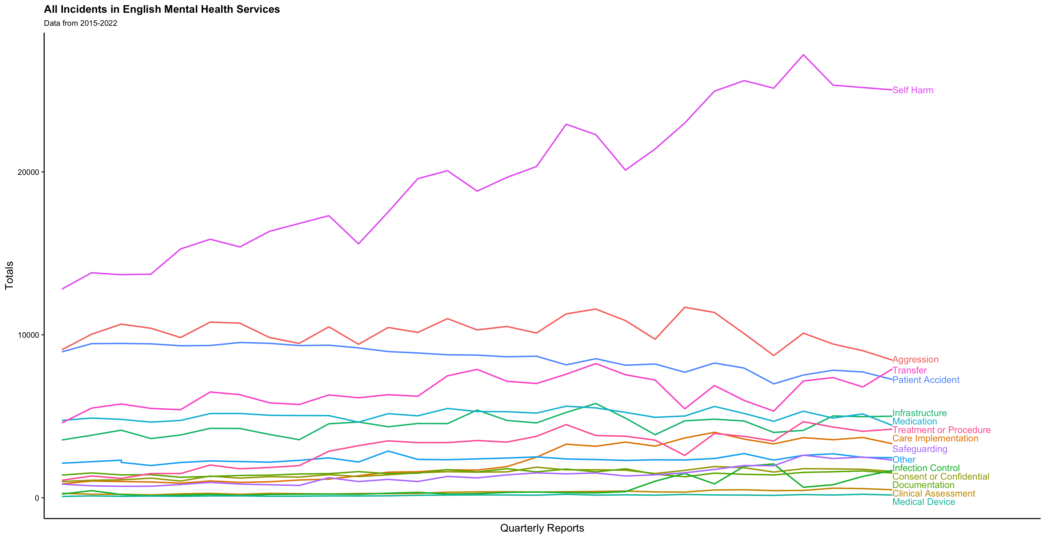

Slide 6
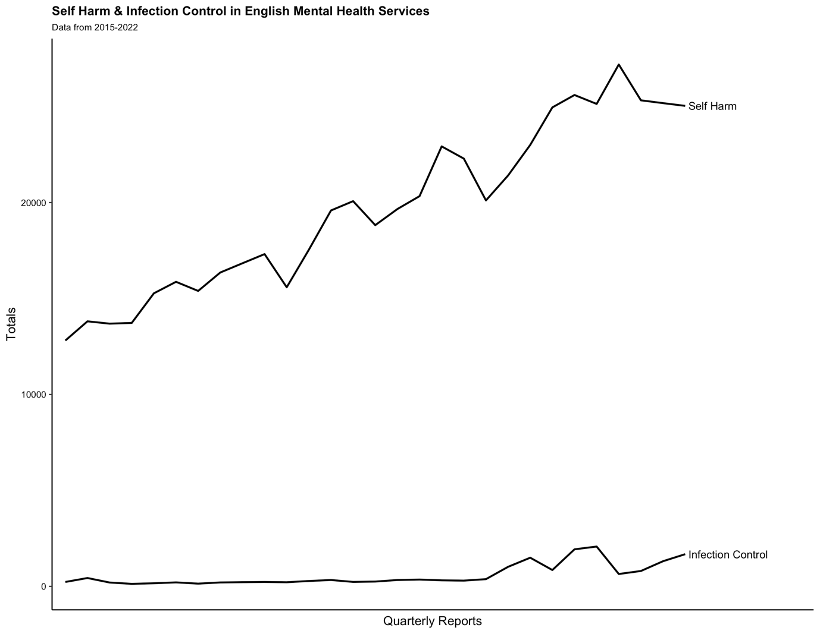

Slide 7
Covid-19 pandemic
 | Q1 2020 | Q2 2020 | Q3 2020 | Q4 2020 | Q1 2021 | Q2 2021 | Q3 2021 | Q4 2021 | Q1 2022
Self-harm reports (% change to previous quarter) | 21410 (6%) | 23002 (7%) | 24957 (9%) | 25603 (3%) | 25138 (-2%) | 27191 (8%) | 25236 (-7%) | 25179 (-0.2%) | 25037 (-0.5%)
Infection control reports (% change to previous quarter) | 1018 (170%) | 1493 (47%) | 851 (-43%) | 1930 (127%) | 2075 (8%) | 644 (-69%) | 589 (-9%) | 563 (-4%) | 490 (-12%)

Slide 8
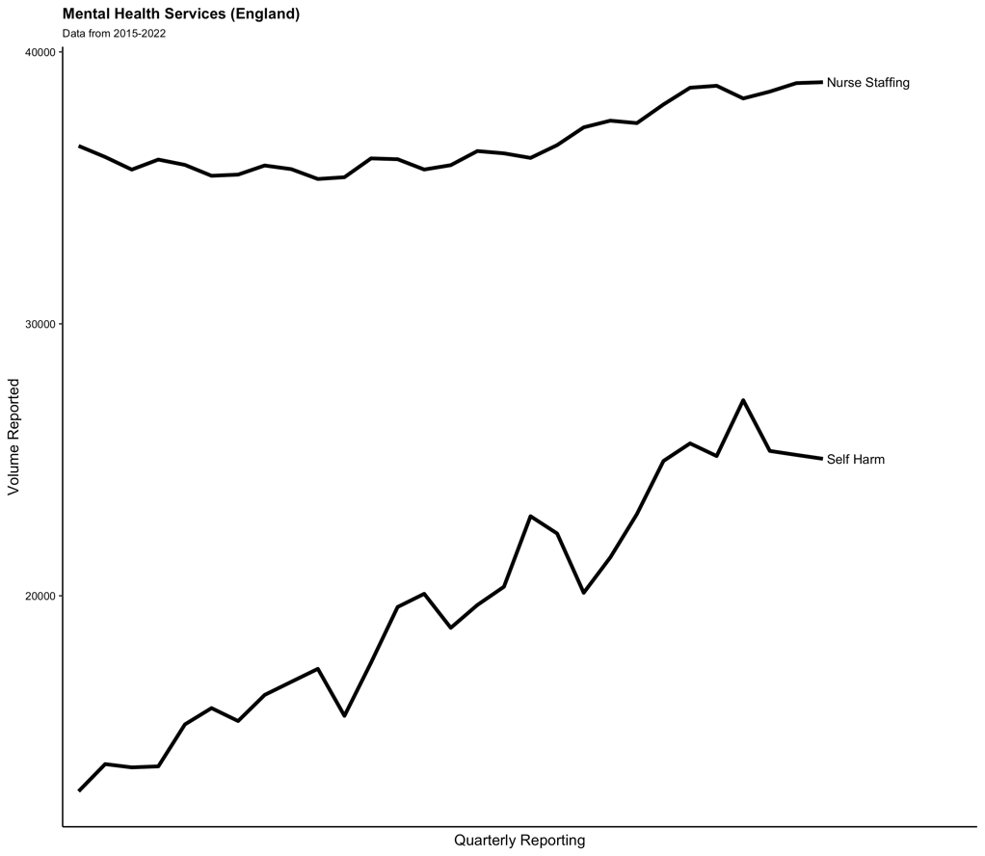
6% increase in vol. of registered nurses
95% increase in self-harm

Slide 9
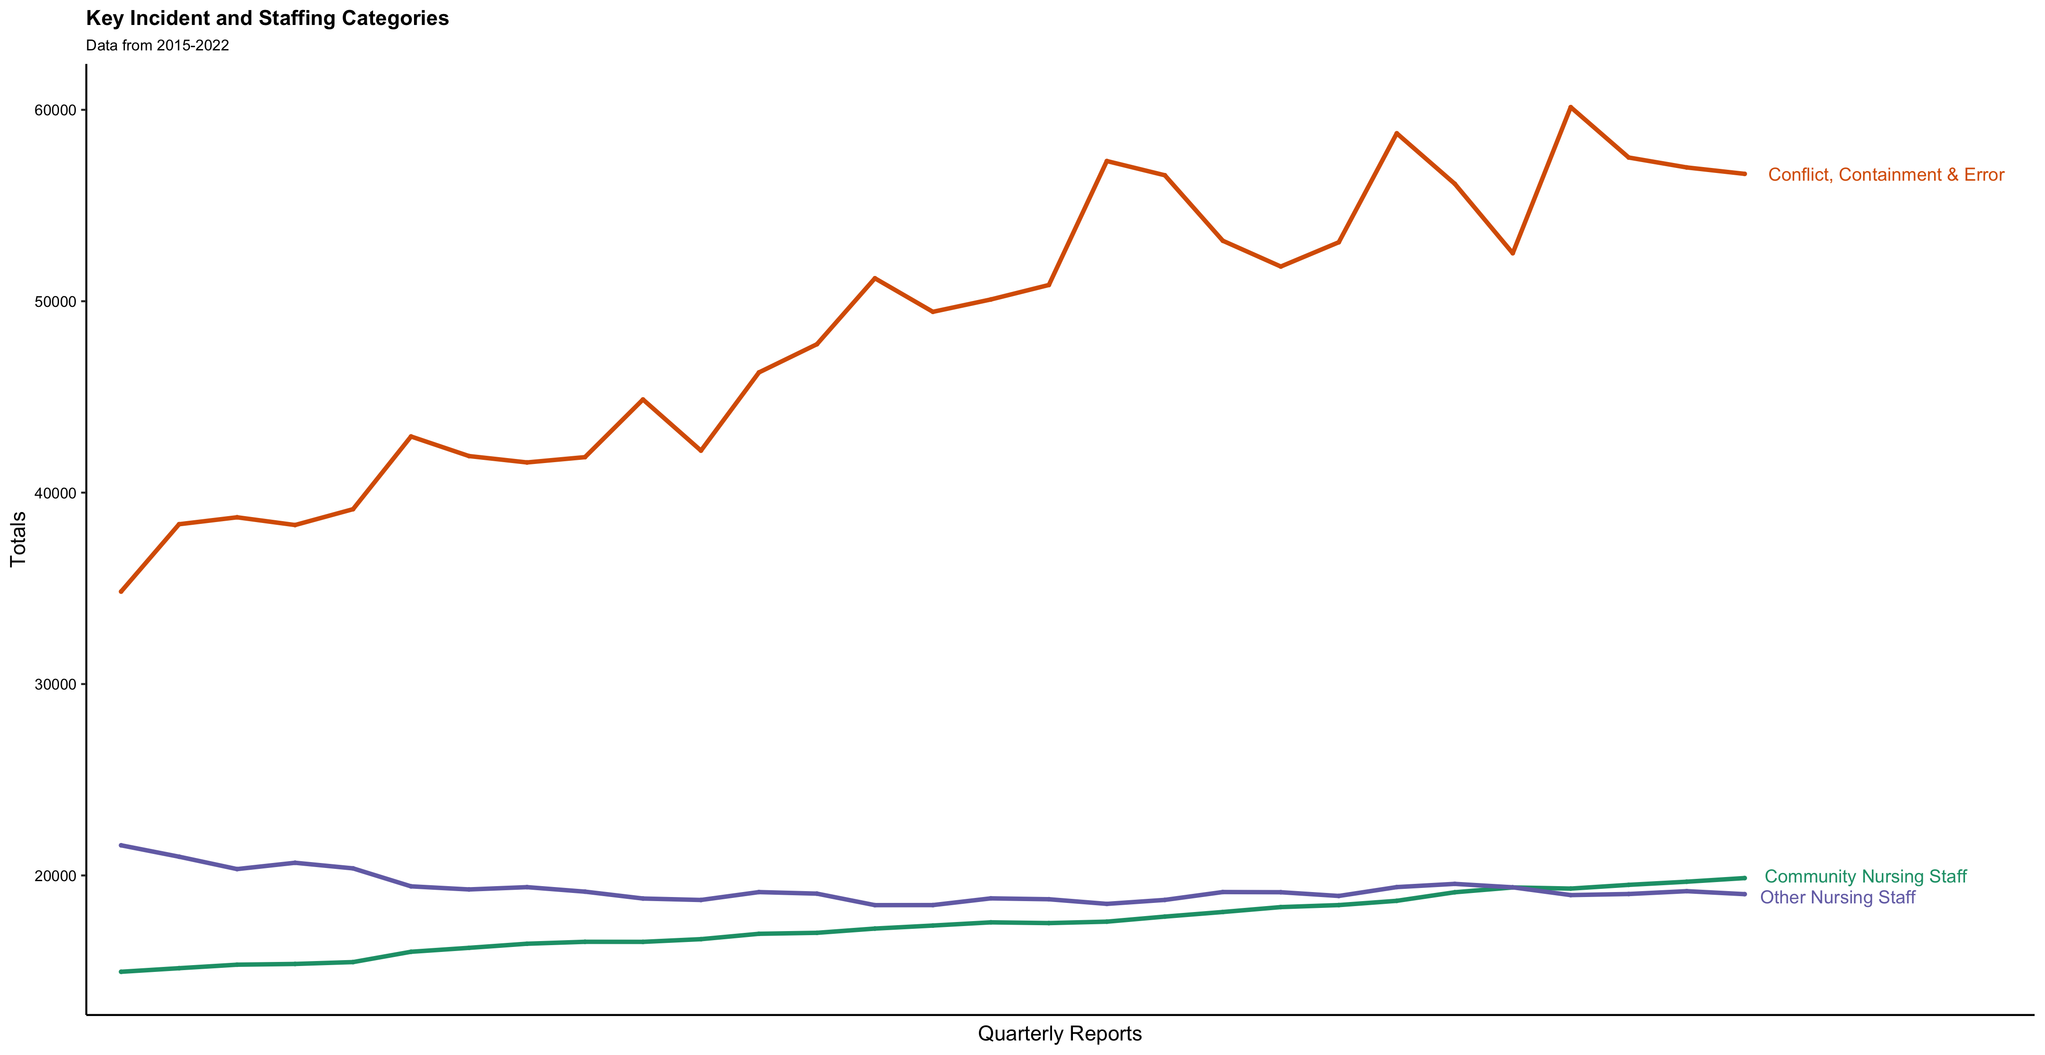
Hospital-based mental health nurses down 12%
Community mental health nurses up 33%

Slide 10
Somatic Care (Headlines)
More registered nurses means less care is missed (Griffiths et al., 2018)
Large samples from multiple studies indicate that the more nurses that are available, the less likely death is to occur (Rae et al., 2021)
Longitudinal evidence from multiple studies indicates low volume of nurses to mortality is a causal relationship (Dall’Ora et al., 2022)
QI tools show reliability in measuring nursing time to complete routine tasks (observations) (Dall’Ora et al., 2022)

Slide 11
Acute hospitals data
(NRLS, 2022)

Slide 12
Acute hospitals data
Paradigm reflects service that monitors itself well (causes of incidents are not the same as illness/mortality)
(NRLS, 2022)

Slide 13
Mental health service data
(NRLS, 2021)

Slide 14
Mental health service data
Paradigm reflects service that monitors its patients/illnesses well, less focus on service behaviour
(NRLS, 2021)

Slide 15
Somatic Care
Sphere of research:
Mental Health Care

Slide 16
Systematic Review – nursing sensitive indicators
 | Conflict (composite measure) | Containment (composite measure) | All restraint (manual and mechanical) | Seclusion | All aggression and/or violence | Self-harm | Medication refusal | Demand for sedation
Overall staff to patient ratio | = | = | +/-/= | +/-/= | +/- |  |  | +
Registered nurse to patient ratio | +/- | +/- | - | - | +/- | - |  | +
Gender (proportion of staff male) | + | + | + | - | -
Staff education level |  |  | -/= | - | -/=
Staff experience level |  |  | - | -/= | -/= |  | -
Presence of student nurses |  |  |  |  |  | + |  | -
Presence of agency/substitute staff | - | +/- |  |  |  |  | +
Staff physical stature |  |  |  | -
Staff ethnicity (proportion of white staff) |  | +
31 studies:
20 cross-sectional
6 case-control
5 cohort
+ positive association
- Inverse association
= no association
(Woodnutt, 2022)

Slide 17
Containment Interventions
Moral Paradigm
Treatment Paradigm
Safety Paradigm
1800s
1900s
2010s
Mental illness is the result of immoral afflictions and people should be separated from society…
Physical restriction of patients (e.g. restraint, seclusion) is helpful to recovery; the most unwell patients receive the most restrictions…
Physical restriction is harmful and undesirable, is associated with poor outcomes but remains necessary for safety…
(Du Plessis, 2012; Doedens et al., 2020; Woodnutt, 2022)

Slide 18
Whilst the paradigm or concept of mental ill health and treatment has evolved, the way we monitor care has not…
Treatment Paradigm
Safety Paradigm
1900s
2010s
How we monitor/report
How we practice

Slide 19
Provocative Statements
It is really difficult to tell what good psychiatric care looks like
Evidencing the impact of staff on care is hugely problematic
The incident reporting paradigm reflects containment-focused care which is an epistemic injustice
Containment is likely under-reported, however, conflict is likely over-reported
We need to accurately record incident causes from a health service perspective, not just patient health outcomes

Slide 20
References
Bowers, L. et al. (2015) 'Reducing conflict and containment rates on acute psychiatric wards: The Safewards cluster randomised controlled trial', International journal of nursing studies, 52(9), pp. 1412-1422.
Cutler, N.A. et al. (2021a) 'How does the environment influence consumers' perceptions of safety in acute mental health units? A qualitative study', Journal of Clinical Nursing, 30(5-6), pp. 765-772.
Cutler, N.A. et al. (2020) 'Nurses' influence on consumers' experience of safety in acute mental health units: A qualitative study', Journal of Clinical Nursing, 29(21-22), pp. 4379-4386.
Cutler, N.A. et al. (2021b) 'Understanding how personhood impacts consumers’ feelings of safety in acute mental health units: a qualitative study', International Journal of Mental Health Nursing, 30(2), pp. 479-486.
Dall'Ora, C. et al. (2022) 'Nurse staffing levels and patient outcomes: A systematic review of longitudinal studies', International Journal of Nursing Studies, p. 104311.
Dall’Ora, C. et al. (2022) 'Development and validation of a methodology to measure the time taken by hospital nurses to make vital signs observations', Nurse Researcher, 30(2).
Doedens, P. et al. (2020) 'Influence of nursing staff attitudes and characteristics on the use of coercive measures in acute mental health services—A systematic review', Journal of psychiatric and mental health nursing, 27(4), pp. 446-459.
Doedens, P. et al. (2021) 'Influence of nursing staff characteristics on seclusion in acute mental health care—A prospective two-year follow-up study', Archives of psychiatric nursing, 35(5), pp. 491-498.
Du Plessis, R. (2012) 'The influence of moral therapy on the landscape design of lunatic asylums built in the nineteenth century', de arte, 47(86), pp. 19-38.
Fukasawa, M. et al. (2018) 'Relationship between the use of seclusion and mechanical restraint and the nurse-bed ratio in psychiatric wards in Japan', International Journal of Law and Psychiatry, 60, pp. 57-63.
Griffiths, P. et al. (2018) 'The association between nurse staffing and omissions in nursing care: a systematic review', Journal of advanced nursing, 74(7), pp. 1474-1487.
NHS Digital (2022) NHS Workforce Statistics - October 2022 (Including selected provisional statistics). Available at: https://digital.nhs.uk/data-and-information/publications/statistical/nhs-workforce-statistics/october-2022#resources.
NRLS (2021) National patient safety incident reports up to June 2021. Available at: https://www.england.nhs.uk/publication/national-patient-safety-incident-reports-up-to-june-2021/.
Park, S. et al. (2020) 'Nurse staffing and health outcomes of psychiatric inpatients: A secondary analysis of National Health Insurance claims data’.
Rae, P.J. et al. (2021) 'Outcomes sensitive to critical care nurse staffing levels: A systematic review', Intensive and Critical Care Nursing, 67, p. 103110.
Rouski, C. et al. (2021) 'The quest for genuine care: A qualitative study of the experiences of young people who self-harm in residential care', Clinical child psychology and psychiatry, 26(2), pp. 418-429.
Woodnutt, S. (2022) 'Safe staffing in mental health services: Current evidence and next steps', International Mental Health Nursing Research Conference 2022. University of Oxford.

