Slide 1
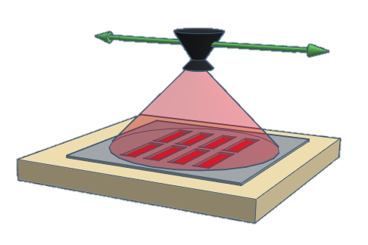
Spray nozzle
Sprayed mist
Spray mask
Glass slide

Slide 3
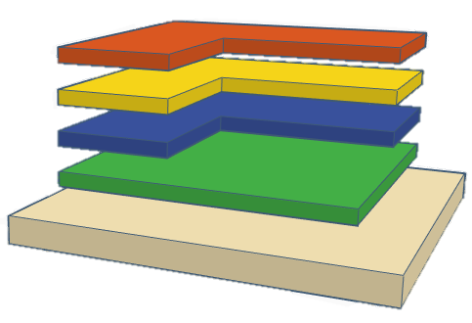
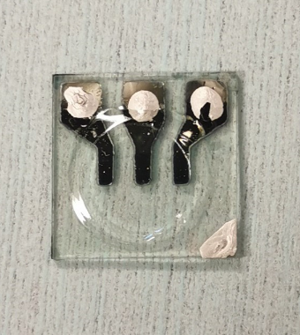
Top electrode
Light emitting layer
PEDTO:PSS layer
Bottom electrode
ITO glass slide

Slide 4
(a)
(b)
(c)
(d)

Slide 5
(a)
(b)
(c)
(d)
(e)
(f)
(g)
(h)

Slide 6
(a)
(b)
(c)
200 nm
(d)
(e)
(f)
300 nm

Slide 7
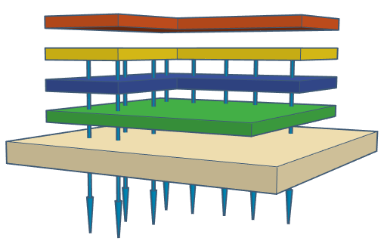
Ultraviolet light (UV) Electrochemical Cells
Ag electrode
Active layer
PEDTO:PSS
ITO electrode
Glass slide
Bottom illumination
Ultraviolet light emission

