Slide 1
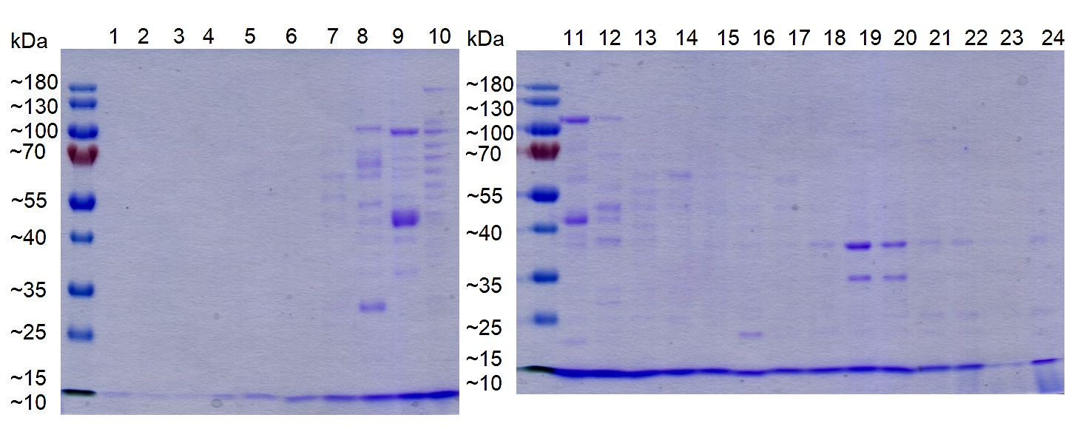
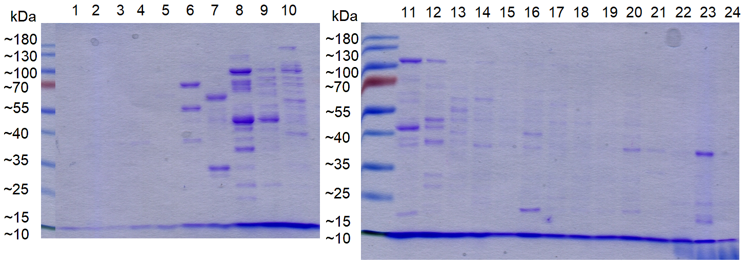
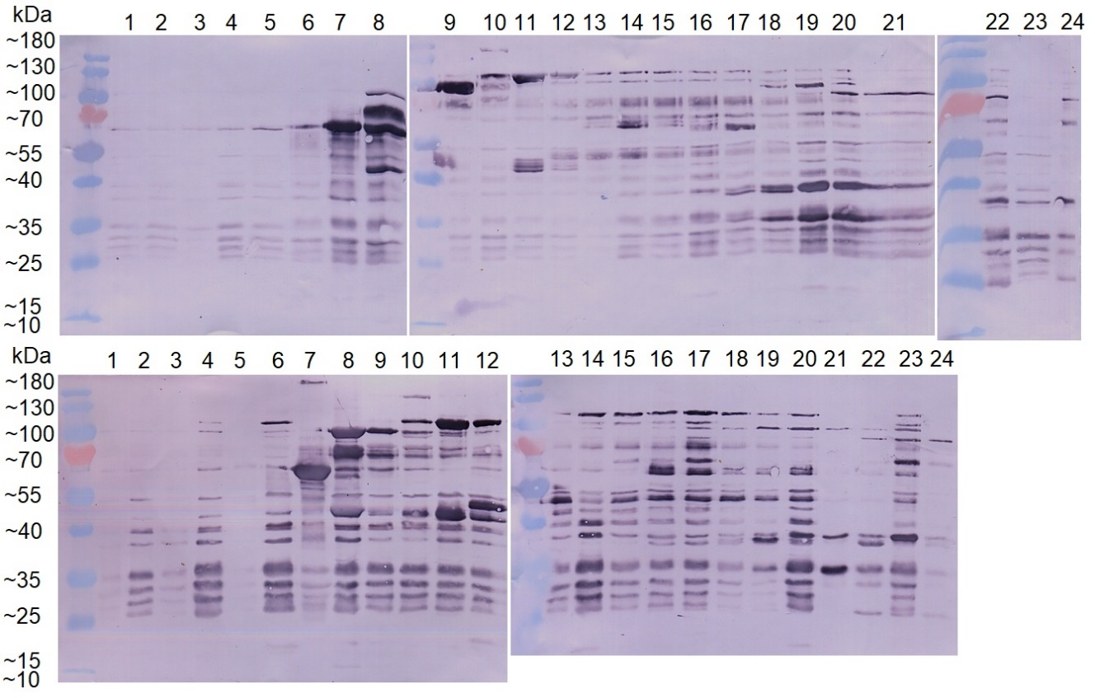
A)
-Desferal
B)
+Desferal
C)
-Desferal
D)
+Desferal
Supplementary Figure 1. Pilot experiments. N. gonorrhoeae P9-17 was grown without Desferal (panel A, C) and with Desferal (panel B, D) and whole cell lysates separated by IEF and fractions 1-24 run on SDS-Page. A) and B) are SDS-PAGE gels stained with Coomasie blue and C) and D) are immunoblots showing the reactivity of mouse antisera to P9-17 OM. The experiments were done twice and were reproducible; data are shown from one experiment as representative.

