Slide 1
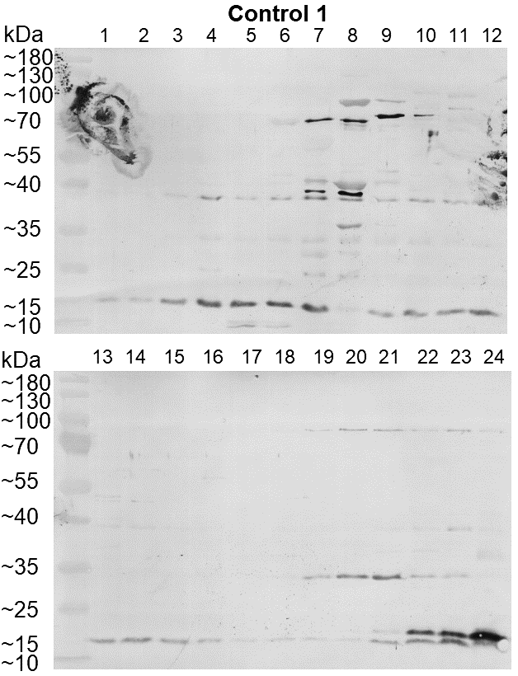
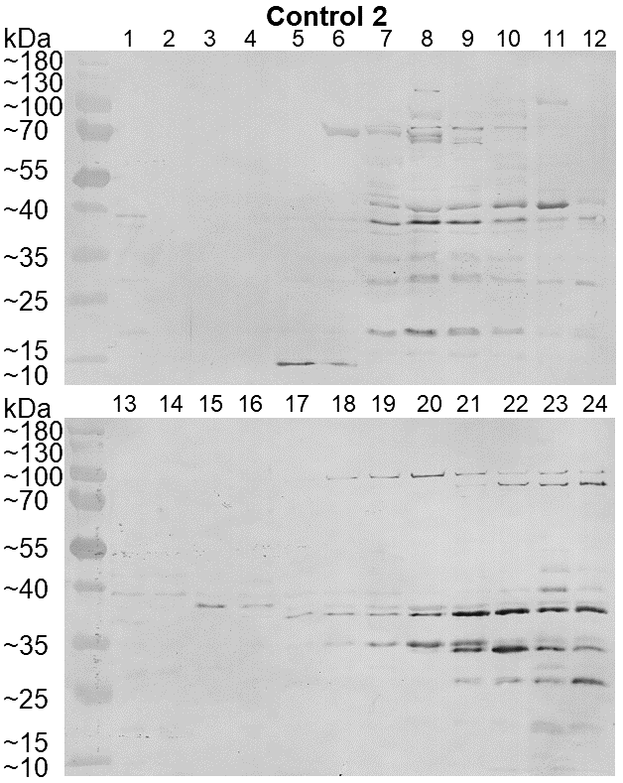
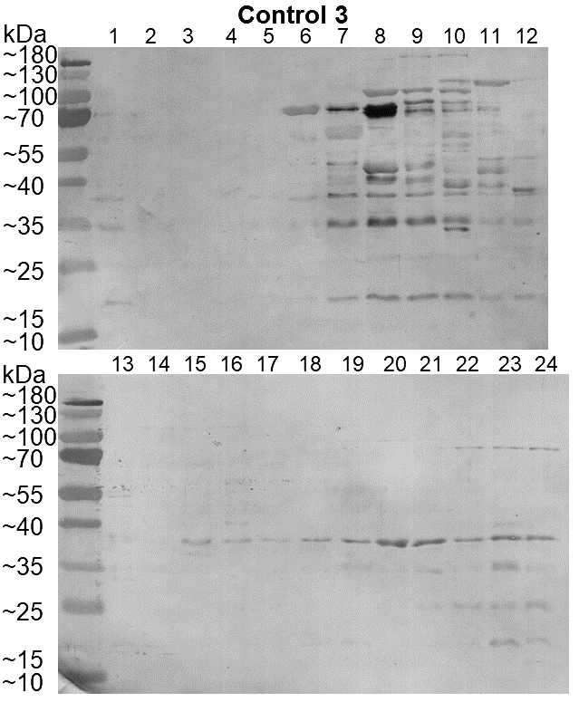
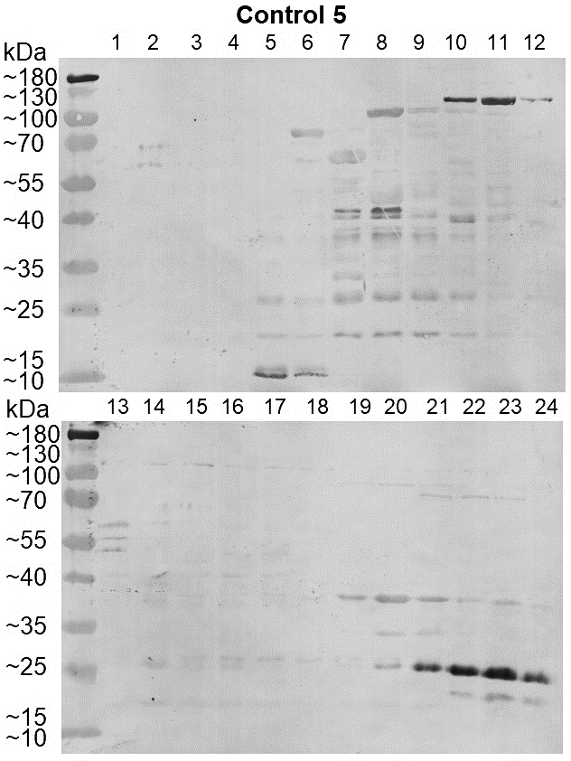
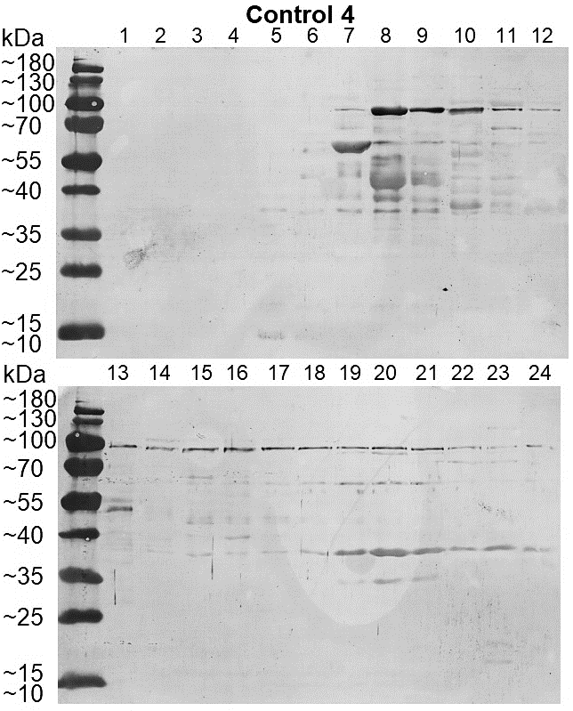
Control 1
Control 2
Control 3
Control 4
Control 5
Supplementary Figure 3. Western blots for individual sera from individuals with no known history of gonococcal infection (Controls 1 – 5). Sera were tested at a dilution of 1/200 overnight at 4° C on whole cell lysates of heterologous gonococcal strain P9-17.

