Slide 1
Critical Communicative Methodology and Collaborative Research to Enhance the Education and Inclusion of Students With SEND in Mainstream Schools
Vasilis Strogilos, Associate Professor, University of Southampton, UK
Cleo Barron, Researcher, University of Southampton, UK
BERA 2023
v.strogilos@soton.ac.uk
Twitter:@VStrogilos

Slide 2
Aim of presentation
To describe the use of Critical Communicative Methodology (CCM) as a collaborative research approach to co-construct knowledge/co-create findings with participants in a research project aimed to enhance the inclusion of students with special educational needs and/or disabilities (SEND) in three mainstream schools in England
To discuss how the generation of qualitative findings with the participants led to the co-creation of a toolkit to improve the services schools provide to students with SEND and their families
To discuss how we can do research inclusively (Nind, 2014) through the use of reflective conversations, communicative focus groups (CFG) and communicative observations
Notes:
How we translated research knowledge/findings into a toolkit with examples of effective practices, to enhance the education and inclusion of students with SEND in mainstream schools

Slide 3
Resource provision classrooms (RPC)
Resourced Provisions are where places are reserved at a mainstream school for pupils with a specific type of SEN, taught mainly within mainstream classes, but requiring a base and some specialist facilities around the school.
Resourced provisions:
receive additional funding from the local authority specifically for the purpose of the provision
provide additional specialist facilities on a mainstream school site for a small number of pupils
in RP pupils spend most of their time (usually well over 50% of their timetable) in mainstream classes
are usually for pupils with EHC plans
(DfE, 2015; 2017)

Slide 4
Aims of the primary research project
To describe and evaluate with the participants the effective practices and challenges in educating students with SEND in resource provision and mainstream classrooms, and
To create an online guidance document/toolkit with effective practices that all schools with resource provision could use to improve their inclusive practice.
Participants: 3 schools with resource provision, resource provision managers, teachers, TAs, mothers and students with SEND

Slide 5
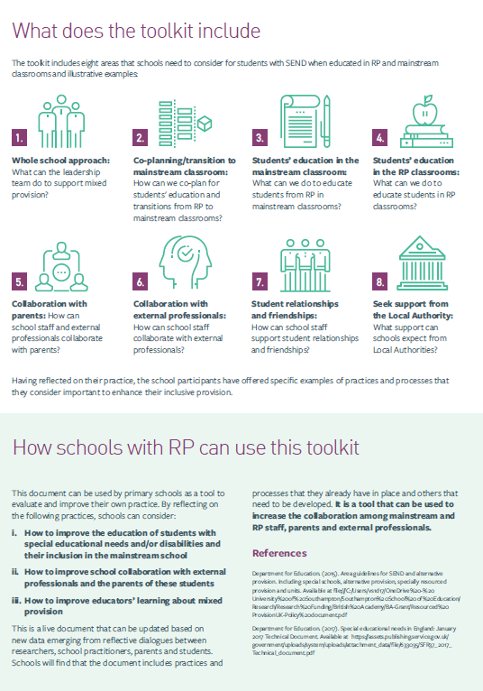
The toolkit

Slide 6
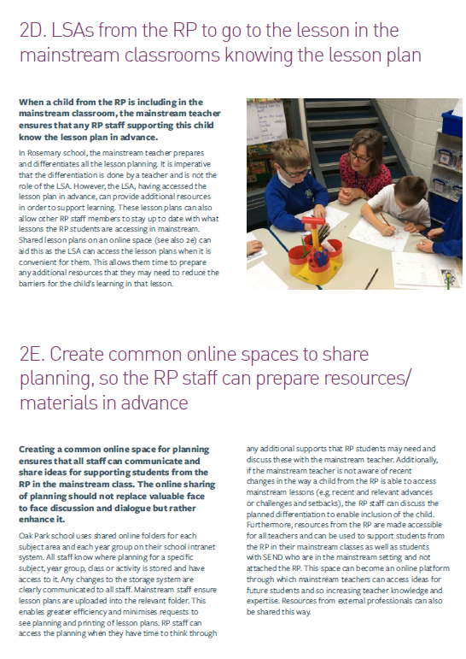
The toolkit

Slide 7
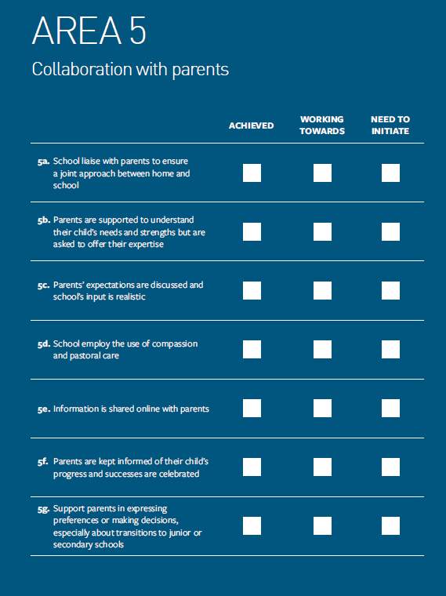
The toolkit

Slide 8
Critical Communicative Methodology (CCM)
Gómez et al. (2011) developed and described critical communication as a methodology with important impact in transforming situations of inequality and exclusion based on egalitarian dialogue
Epistemological position of CCM: Transformation of social and educational inequalities as a result of research that is based on dialogue
CCM positions dialogue as the basis for understanding and explaining social reality to improve the participants’ situation, especially those belonging to vulnerable groups (Gómez et al. 2011)
Notes:
Continuous and egalitarian dialogue between researchers and research participants is the core of CCM.

Slide 9
Egalitarian dialogue
Contributions are based on the validity of reasoning and not on the position of power held by those making the contributions (Flecha, 2000)
The dialogue includes theoretical and research-based knowledge that researchers bring to the conversation and the knowledge that participants bring from their own lifeworld
Achieve consensus granted on validity claims (Gómez et al. 2011)
Can lead to personal and social transformation

Slide 10
Communicative data collection tools
Communicative daily life stories
Communicative focus groups (CFG)
Communicative observations

Slide 11
Finding participants- Setting the scene
Email to schools: why we selected you.
Not experts but share our knowledge and learn from you
Aim to work as equal partners to co-create inclusive practices that can help their and other schools.
‘Win-win’ situation for researchers and research participants.

Slide 12
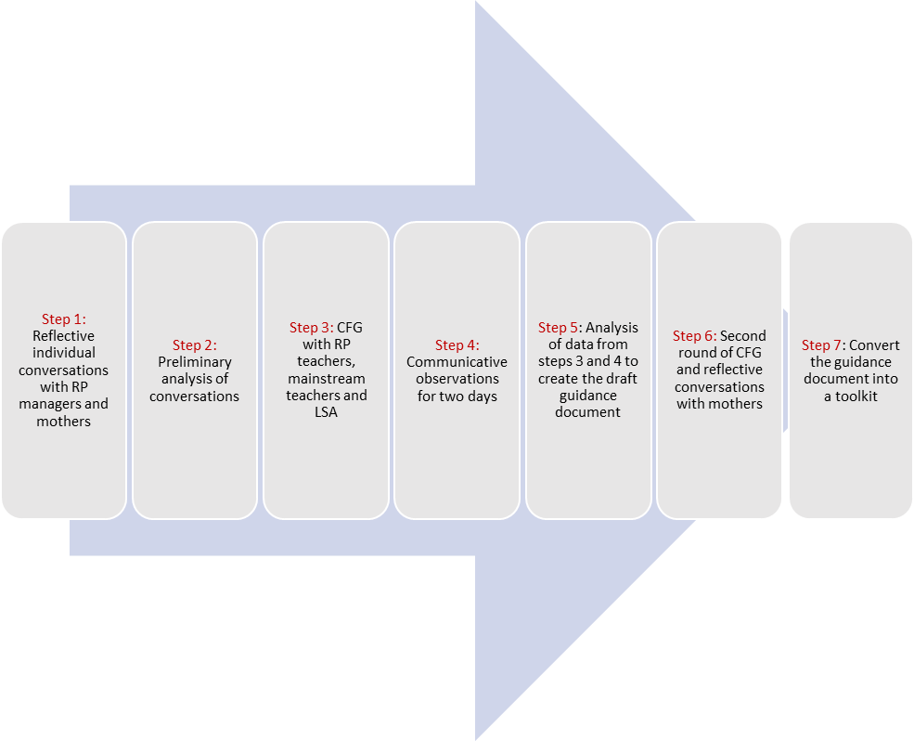

Slide 13
Step 1: Reflective conversations with resource provision managers and mothers
To discuss how they conceptualise the role of resource provision,
To discuss the academic knowledge that we were planning to bring to the forthcoming CFG (in step 3)
Reflective conversations with mothers: to talk about their expectations, the challenges and ways to overcome them.
Notes:
Overall, we found these conversations very useful for the next steps because the managers gave an overview of resource provision in these schools, and they helped us identify related academic knowledge and specific knowledge from each school that we could transfer to the other two

Slide 14
Use of academic knowledge
Mother: But I still can't understand in my head how you can have 80% of the class do multiplication and then he's over in the corner trying to count to five in a box. So, what happens the rest of the day… because there's 30 other children in the class that are flying high. I understand that he is taking stuff in... But I also don't know what I've done and if I've done the right thing, because he could maybe be counting to 10 now...
Researcher: In a special school?
Mother: In a special needs school...I don't know, this is...in my mind, he's not getting enough one-to-one support in this environment… He's got to go to junior school next year, and he can't count to 5. And what do I do then? …I don't know that stuff and I'm freaking out about it pretty much.
Researcher: I fully understand that you're worried about the educational goals and how far he can reach...but maybe I could share my academic experience with you. I fully support inclusion because …
Mother: Yeah.
Researcher: …because, we talked before about inclusion, the idea of inclusion is not that all children will learn multiplication at the same time, will learn to read at the same time. So, we try to differentiate for each child. I can understand that the gap with the other children might be huge, and I am sure with the right support in a mainstream school can learn to count to 10 but to be in a special school to just learn to count to 10, but then has no connections with mainstream children. Of course, it's not ideal. There are pros and cons, but at least in research and in policy, there is a strong emphasis on inclusion because we want them in mainstream. We don't want them in segregated places.
Mother: Mm-Hmm.
Researcher: So what I'm trying to tell you is I fully understand your concerns. We know from research that most parents, say pretty much the same. But if you could see the small steps that he might be making alongside the mainstream children, celebrate these little steps...
Mother: Yes, I am. And yesterday he counted...did his...sang his ABCs. I nearly fell off my chair, so he's sucking things in …

Slide 15
Transformative element
Mother: You might...you might come on to this, but...I don't get anything from him at home, his... worlds are very separate. So, I am fairly in the dark unless I push the school or I call a meeting or just to say like, I need... so I can't celebrate his little successes because I probably don't know what they are because he won't replicate them at home.
Researcher: Maybe this is something that you need to tell the school that you would’ve enjoyed more communication about his progress and this is a very good point for me to discuss with the school staff, if you allow me…
Mother: Yeah, because I don't...I don't hear from them very often, if I'm honest. I'm in contact with them, if I ask a question but it's not regularly that I have an update about the little progress…

Slide 16
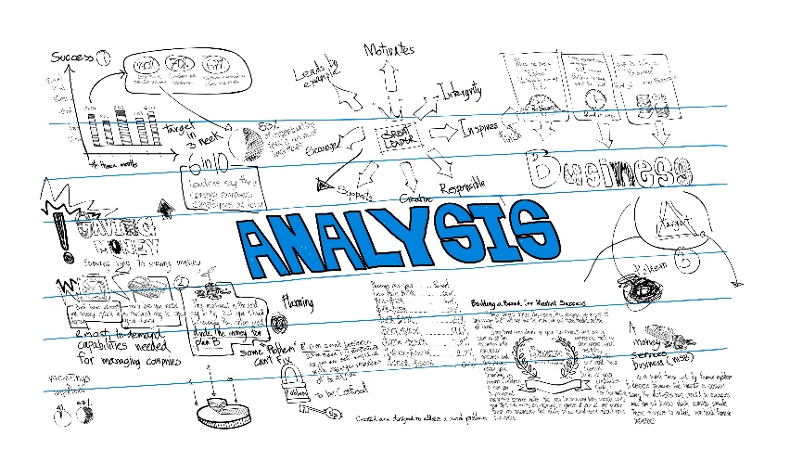
Step 2: Preliminary analysis
Preliminary thematic analysis (Braun and Clarke, 2019)
Transfer some of the main themes to the CFG and to finalise the prior research findings and other academic knowledge that we were planning to use.
Created written notes for the school staff with the themes that we wanted to discuss, and what research says about some of these themes:
i) general policy issues about resource provision;
ii) staff roles in resource provision and mainstream class;
iii) views of teachers, LSAs, students and parents about resource provision;
iv) co-planning between staff in resource provision and mainstream school for students who are educated in both settings; and
iv) other issues that participants wanted to discuss.

Slide 17
Step 3: First round of Communicative Focus Groups
To discuss effective practices and challenges of resource provision based on prior research findings and participants’ experiences.
We discussed the themes mentioned in step 2 and we compared what research says with what is happening in their school.
Other themes initiated by the participants, such as the difficulties that some autistic children had to transition from resource provision to mainstream classroom.
Notes:
For example, we mentioned that in Warren et al.’ s (2020) study the staff indicated that student friendships were mainly formed with the other pupils in the resource provision and discussed if this was the case in their school and why

Slide 18
Example of transformation of practice
RP teacher: I think maybe, as Kathryn (mainstream teacher) said earlier, when we have parents' evening, it might be perhaps nice at that time if the parents of the resource provision children that are including into mainstream are offered to speak to the class teacher at those points of time throughout the year. It might be something we could develop, perhaps.
LSA: That's a nice idea.
RP teacher: Because, obviously, although we do communicate, it might just actually be nice for the parents to hear it from the class teacher. That might be more, I don’t know, better perhaps.
LSA: That would be lovely.
RP teacher: That might something we could think about.
Researcher: And maybe it will give them the impression that my child is part of the mainstream school, too.
LSA: That is a good idea.
RP teacher: I think that might be something…we can think about doing.

Slide 19
Practitioner’s valid reasoning challenged researchers assumptions
RP manager: They do cope, but maybe another child in resource provision class probably wouldn't or a couple of them wouldn't cope with the, oh, you’ve got to wait five minutes or they're not quite ready. They wouldn’t cope with that.
LSA: For example, we've got a very autistic little girl who would never cope with going to mainstream class
RP manager: Making the change.
LSA: Even though she's very good at a lot of her subjects, just that
RP manager: Environment.
LSA: It's too overwhelming… With all of the other children, and it might be… it's out of her comfort zone completely and she'd never go.
RP manager: It's not of benefit. It's just a stressor.
RP manager: No, it's not of benefit, and it's a judgment call on staff that you decide those things. And we always try. If it doesn't work one time, then we're, well, let's pause it for a minute and then see…but it's got to think of the child first, really, and what's best for them.
LSA: It's almost failing the child, isn't it?
RP manager: Yeah.

Slide 20
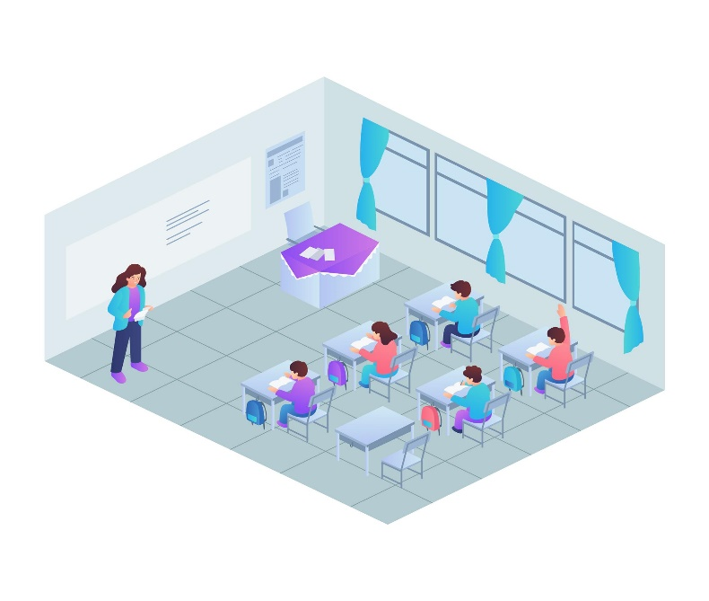
Step 4: Communicative observations
We spent two days in each school with the three students to observe and discuss their experiences in both mainstream and resource provision classrooms
Children’s preferred communication skills
Students’ assent
We asked one child to take photos or draw the places he liked in school, and we discussed his choices.
We discussed our interpretations with the school staff during the observations, and in the second CFG and reflective discussions with mothers (in step 6).
Notes:
For example, during the CFG in Redbrick we said that although in the mainstream classroom they offered opportunities for Gary to work independently or to be supported by a classmate, we questioned the lack of differentiation of some activities that were challenging for him. This opened a discussion about the difficulties that LSAs have to differentiate when they do not know the lesson plan in advance and made the participants think ways to overcome it such as sharing the lesson plans the week before. We added this as an effective practice in the toolkit (see effective practice 2D in the toolkit).

Slide 21
Step 5: Exclusionary and transformative practices
Effective and exclusionary dimensions as well as transformative ones which help to overcome the exclusionary (Gómez et al. 2006)
The main task was to translate the previous generated findings into a draft guidance document with effective practices to respond to the exclusionary ones.
Eight main themes with effective practices in a draft guidance document, which we sent to schools before the second CFG
Colour coded the effective practices mentioned in each school to compare them across the three schools. This contributed to practice transformation in each school

Slide 22
Step 6: Second round of CFG and reflective conversations with mothers
Confirm effective and exclusionary practices with the school participants
Discuss the accuracy of researchers’ representation of participants’ practice, to identify missing practices, to explore how similar or different where the practices among the three schools, and to reflect on how, and if, they wanted to transform their practice
Explain to mothers how we used their concerns, dilemmas and recommendations to create effective practices for schools
Finalise the ‘guidance document’
Convert the guidance document into a toolkit by adding practical
examples
Notes:
For example, their concern that they do not know the mainstream teacher of their child was translated into a practice that the schools have to consider: ‘Parents collaborate with mainstream teachers not only staff in the resource provision’ (effective practice 5i in the toolkit).

Slide 23
Step 7: Converting the guidance document into a toolkit
Individual and group meetings with the resource provision managers, the teachers and the LSA to develop examples of good practice or to finalise examples that were mentioned during the CFG.
It includes the practices that schools need to consider when educating students in both resource provision and mainstream classrooms and practical examples to help readers understand the effective practices.
Aims to improve educators’ learning about resource provision and to increase collaboration among mainstream and resource provision staff, parents and external professionals.
It is intended for use as a tool for all schools with resource provision to evaluate and transform their practice
An amalgam of research- and practice- based knowledge and an example of how communicative methodologies such as CCM can offer practical tools to support schools in transforming their practice towards more inclusion.

Slide 24
Conclusions
The use of reflective conversations, CFG and communicative observations supported researchers and participants in co-constructing new understandings to enhance inclusive practices in an inclusive way
Valid reasonings from researchers and participants highlight the impact of the egalitarian dialogue in transforming researchers’ and participants’ understandings (knowledge co-construction)
CCM’s unique contribution is the focus on the value of the dialogue and not only on the value of the voice of the participants
Overall, this study showed that CCM has the potential to generate knowledge with the participants in a way that makes them feel that they have the power to decide about their practice and lives
Notes:
It is the egalitarian dialogue that enhances the criticality and communication in the research process that helps people transform their lives.

Slide 25
Link to the project’s website for the toolkit

Slide 26
References
Department for Education. 2015. Area guidelines for SEND and alternative provision. Including special schools, alternative provision, specially resourced provision and units. Available at file:///C:/Users/vs1d17/OneDrive%20-%20University%20of%20Southampton/Southampton%20School%20of%20Education/Research/Research%20Funding/British%20Academy/BA-Grant/Resourced%20ProvisionUK-Policy%20document.pdf Accessed 06 Sep 2022.
Department for Education. 2017. Special educational needs in England: January 2017 Technical Document. Available at https://assets.publishing.service.gov.uk/government/uploads/system/uploads/attachment_data/file/633035/SFR37_2017_Technical_document.pdf Accessed 06 Sep 2022.
Gómez, A., Puigvert, L., and Flecha, R., 2011. Critical communicative methodology: Informing real social transformation through research. Qualitative Inquiry, 17(3), 235–245. https://doi.org/10.1177/1077800410397802
Puigvert, L., Christou, M., and Holford, J., 2012. Critical communicative methodology: Including vulnerable voices in research through dialogue. Cambridge Journal of Education, 42(4), 513-526. https://doi.org/10.1080/0305764X.2012.733341
Strogilos, V & Ward, R. J. (2023). Resourced Provision in Mainstream Schools for Students With Special Educational Needs and/or Disabilities: Inclusive Service or Safe Space? Journals of Research in Special Educational Needs. https://doi.org/10.1111/1471-3802.12622
Warren, A., Buckingham, K., & Parsons, S. (2020). Everyday experiences of inclusion in Primary resourced provision: the voices of autistic pupils and their teachers. European Journal of Special Needs Education, 36(5), 803–818.

Slide 27
Thank You!

Slide 28
Draft guidance document
Area 4. Collaboration with parents
Parents of students in the RPC:
4a. Collaborate with mainstream teachers, not only staff in the RPC (Stoke Park, Ashley infant, parents)
Example: Schools need to create opportunities for parents to meet mainstream teachers e.g. pick up their child from mainstream class
4b. Socialise with all parents in the school, not just parents of the RPC (Stoke Park, parents)
4c. Are supported to understand their child’s needs and strengths but are asked to offer their expertise (Ashley Infant, Liss Junior)
4d. Parents’ expectations are discussed when they are confused and school’s input is realistic (Ashley Infant, Liss Junior, Stoke Park)
Example: Discuss with parents why more one-to-one support in RP is not always possible (Stoke Park)
4e. Information is shared online with parents (Ashley Infant)
Example: Share observations of the child via ‘Evidence me’; Videos on how to teach their children
Area 2. In the mainstream classroom
2a. When TAs from RPC work in mainstream class
Provide support to all children not only to children from RPC (Stoke Park)
Do not sit next to the child from RPC for one-to-one all the time (Stoke Park & Liss Junior)
Provide behaviour management in line with school’s policy (Ashley Infant)
2b. Mainstream staff learn by observing how RP staff work (e.g. communication) with children with LD in mainstream class (Stoke Park)
2c. Differentiate for all children in the mainstream class, especially in the content of teaching in main subjects and provide stations for individual work (Stoke Park, Liss Junior, Ashley Infant)
2d. Augmentative and alternative communication is used in both mainstream and RPC (Ashley Infant). Example: IEP, visual timetables
2e. All students are allocated learning partners, including those from RPC, who change every fortnight (Stoke Park)
2f. Resources are provided to aid concentration and access to learning when quiet/ concentration needed and are removed when participation is needed (Stoke Park)
Example: Wobble cushion to sit on during carpet time to help with sensory issues, ear defenders when classroom environment is too noisy, separate workstation. Ask the child to remove the ear defenders, or to leave the workstation and come and work with other children

Slide 29
Effective practice in the toolkit

Slide 30
Effective practice in the toolkit

Slide 31
Back

