Slide 1
IMMUNE
SYSTEM
Th
INNATE
IMMUNITY
ACQUIRED
IMMUNITY
Activation
Other non-
specific factors
Complement
system
Phagocytosis
Cell-mediated
immunity
Humoral
immunity
Epithelial barriers
Neutrophils
T lymphocytes
B lymphocytes
Plasma
cells
Digestive features
Eosinophils
Antigen- presentation
CD8+ cytotoxic
T cells
IFN-γ
TNF-α
TNF-β
Immuno-
globulins
CD4+ Th1 cells
IFN-γ
IL-2
Stimulate cell-mediated immunity, humoral immunity and phagocytosis
Anti-microbial
proteins
Monocytes,
Macrophages,
Dentritic cells
CD4+ regulatory
T cells
IL-10
TGF-β
Natural killer cells
CD4+ Th2 cells
IL-4
IL-5
IL-10
IL-13
Stimulate humoral immunity and eosinophils
CD4+ Th17 cells
Other innate cells
(ILCs, MAIT cells)
IL-17 IL-21
IL-22 IL-6
TNF-α
Inflammatory
response

Slide 3
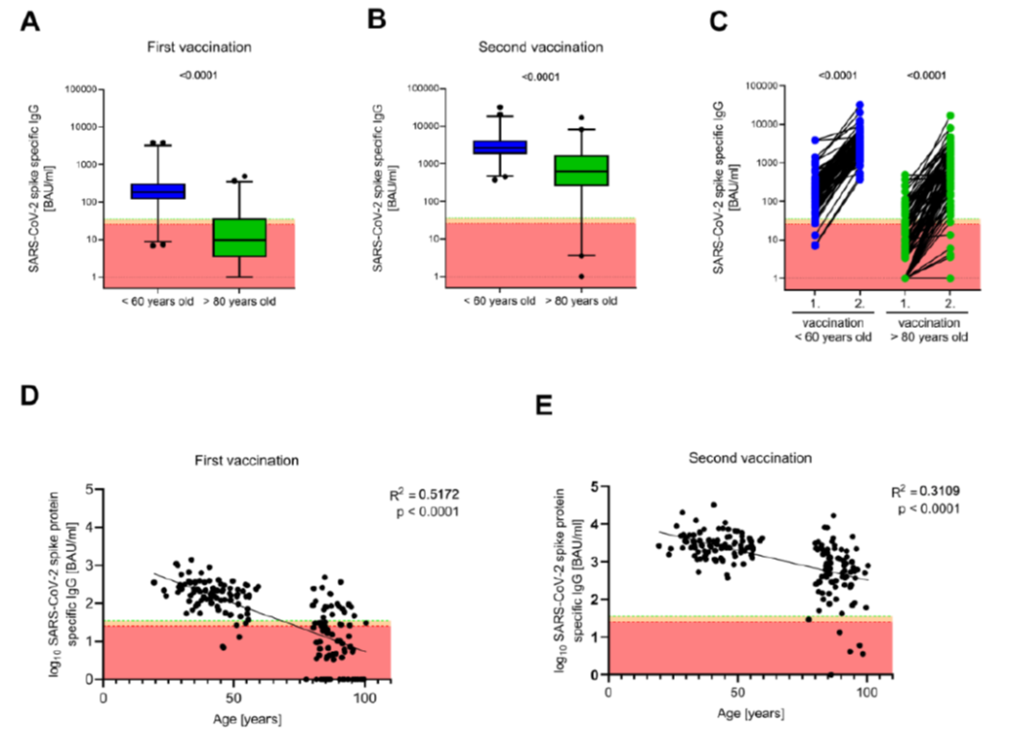

Slide 4
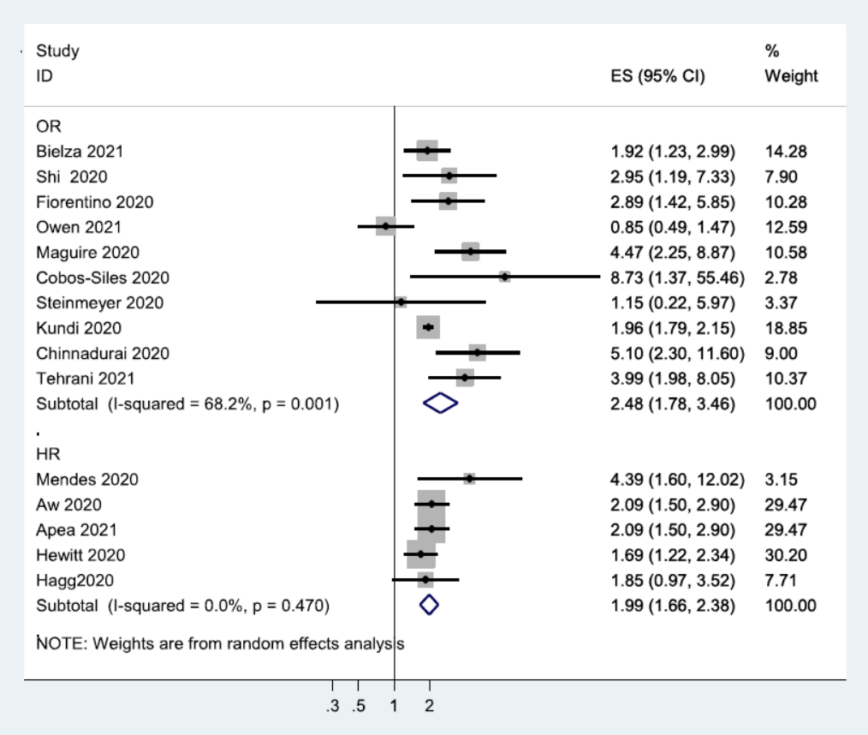
Decreased mortality Increased mortality

Slide 5
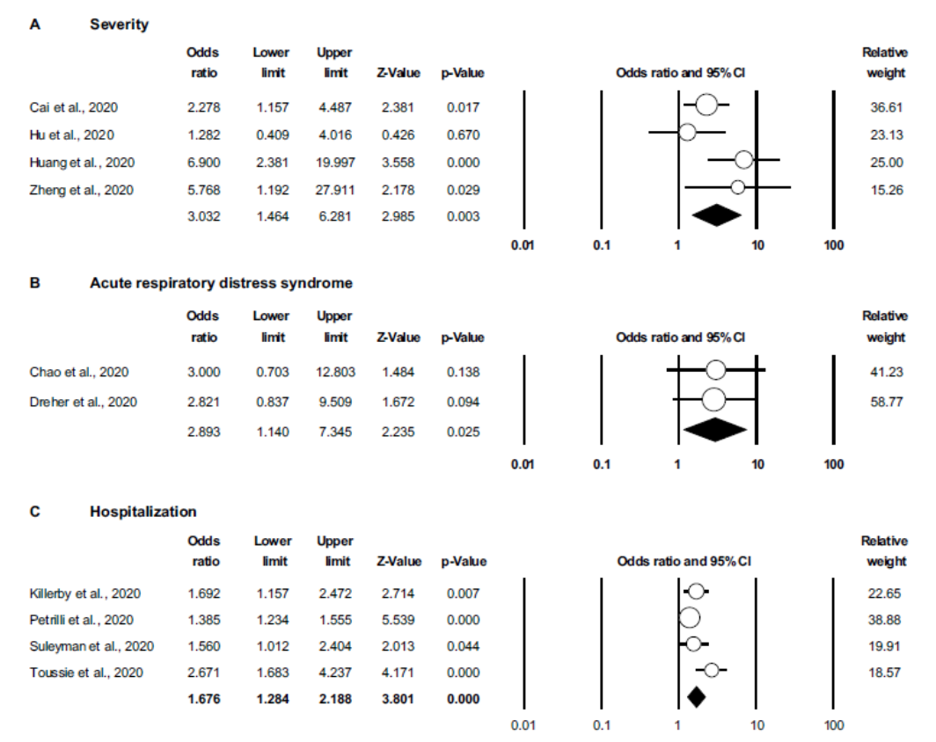

Slide 6
