Slide 1
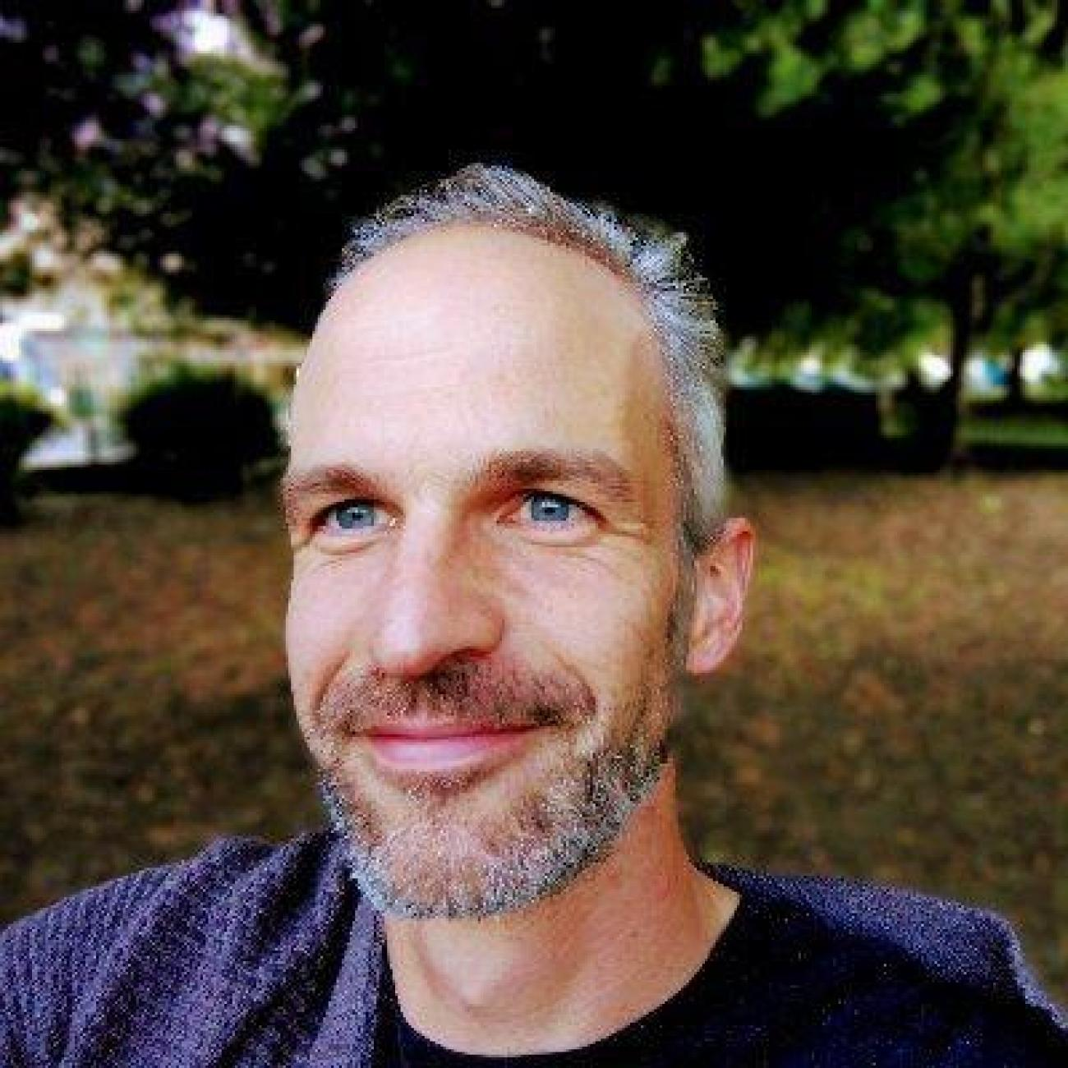
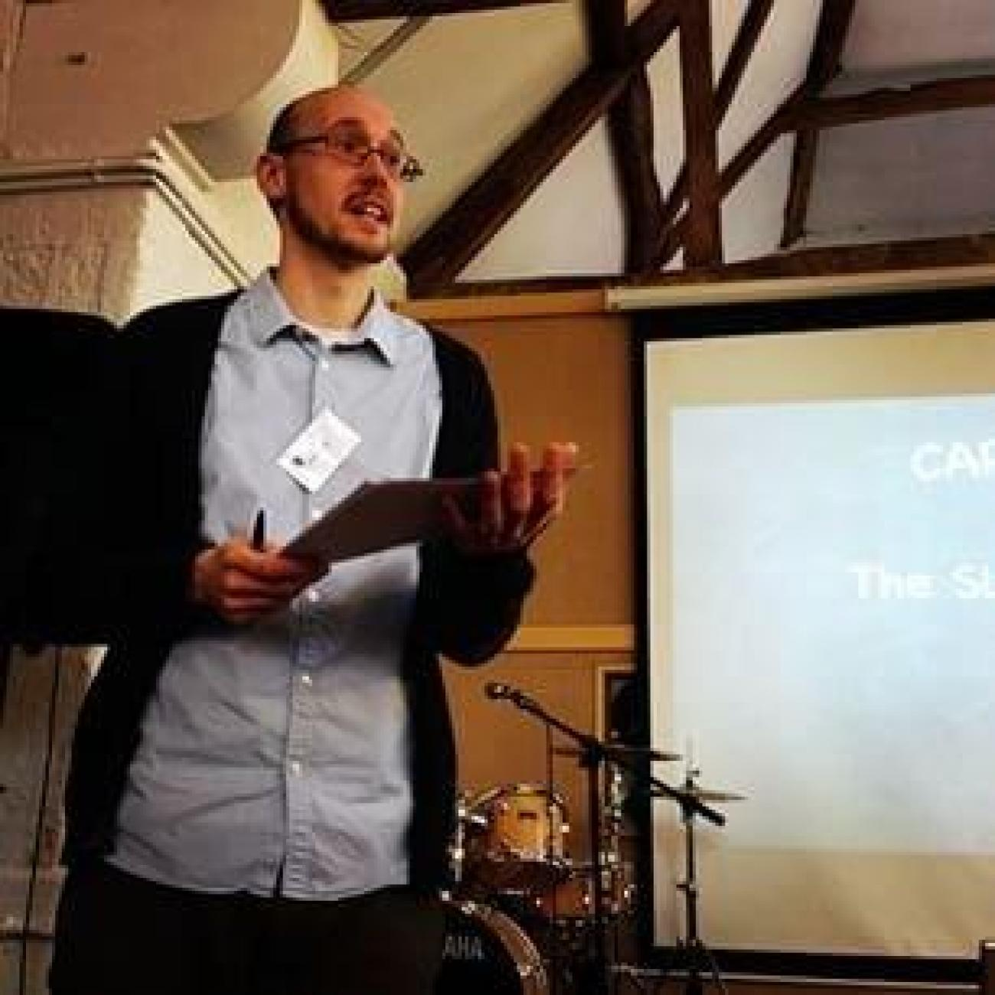
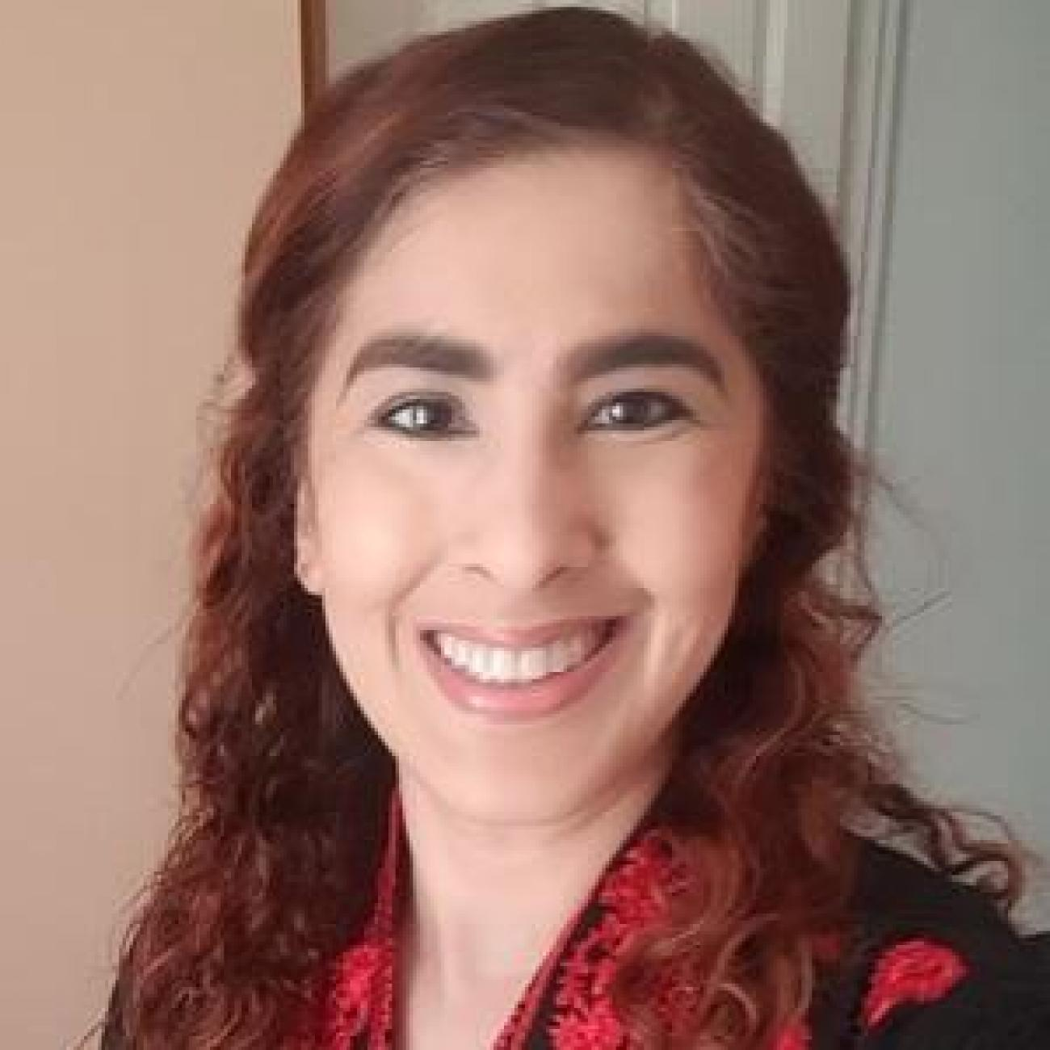
Diversifying Capacities: Understanding and developing creative communities, connectivity and capacities Will May, Professor Modern and Contemporary Literature, University of Southampton (w.may@soton.ac.uk) Dan Ashton, Professor of Cultural and Creative Industries, University of Southampton (d.k.ashton@soton.ac.uk) Aiysha Jahan, Postdoctoral Fellow in Creative Industries, University of Southampton (a.jahan@soton.ac.uk)
Networks of Practice Solent University Friday 19th January 2024

Slide 2
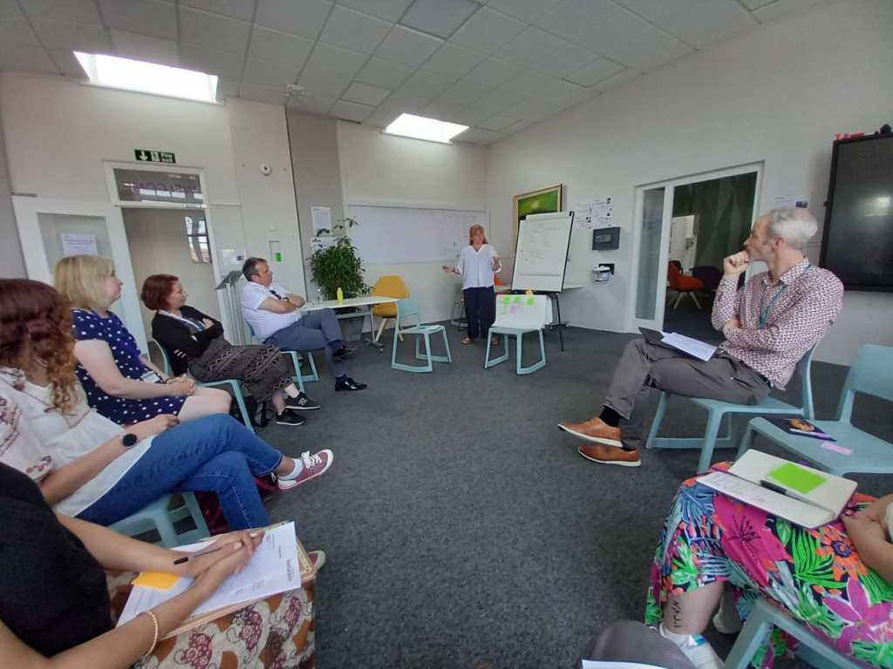
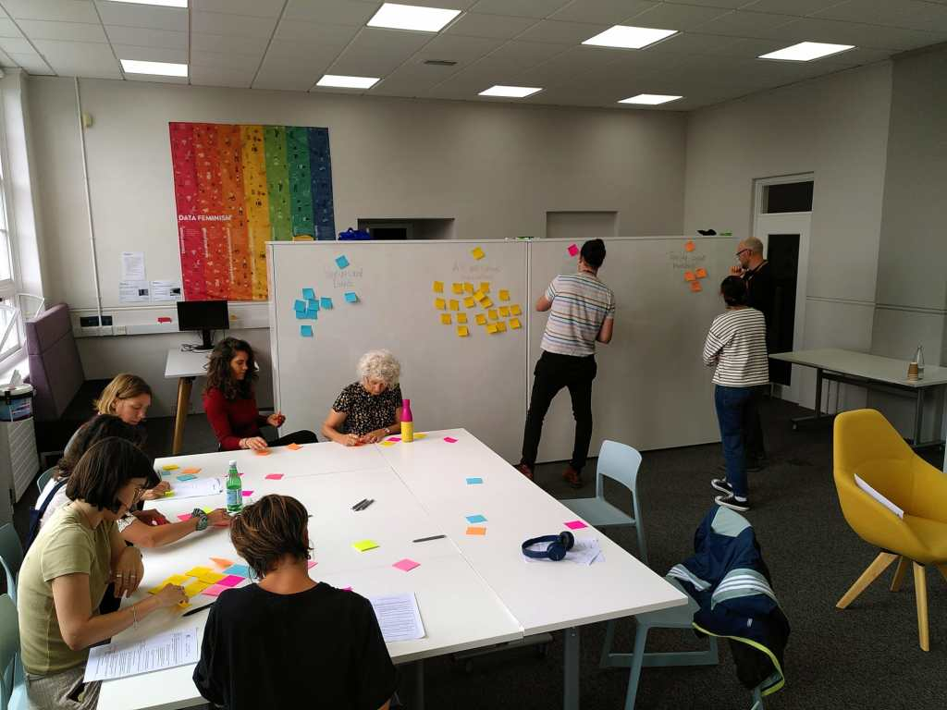
Diverse Capacities https://diversecapacities.wordpress.com/

Slide 3
Cultural and creative sector contexts: Communities, connectivity and capacity
https://assets.kpmg.com/content/dam/kpmg/uk/pdf/2020/01/nmw-youth-rates.pdf
https://www.local.gov.uk/topics/culture-tourism-leisure-and-sport/commission-culture-and-local-government
https://www.andtowns.co.uk/tcer-mapping

Slide 4
Four Phases
Local Government Officers
Creative Practitioners

Slide 5
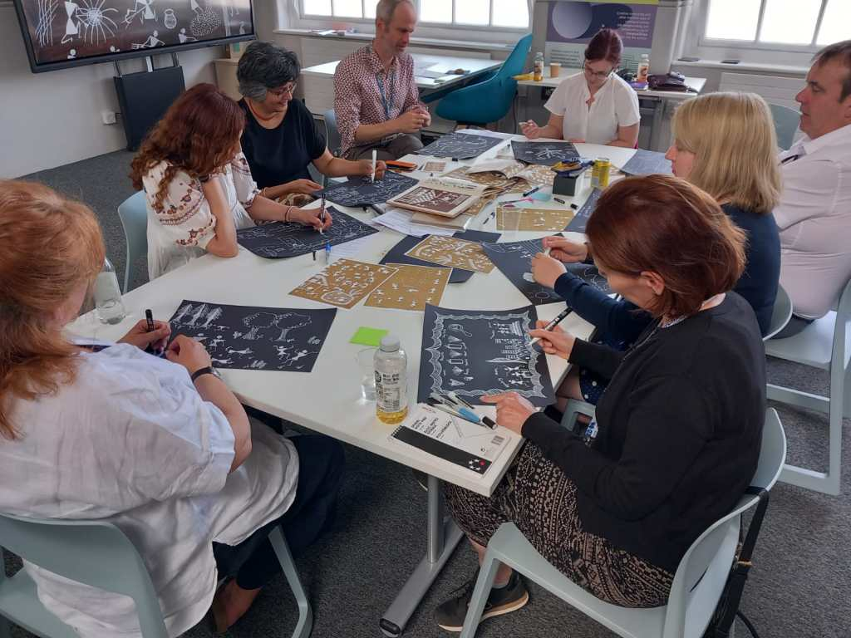
Workshop 1 with local government officers
What might a network of local government officers learn from each other about supporting creativity and culture across the region?

Slide 6
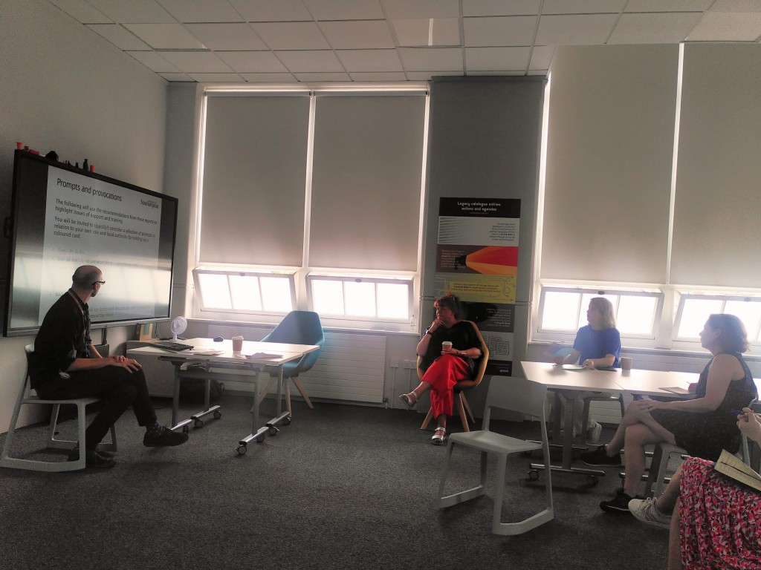
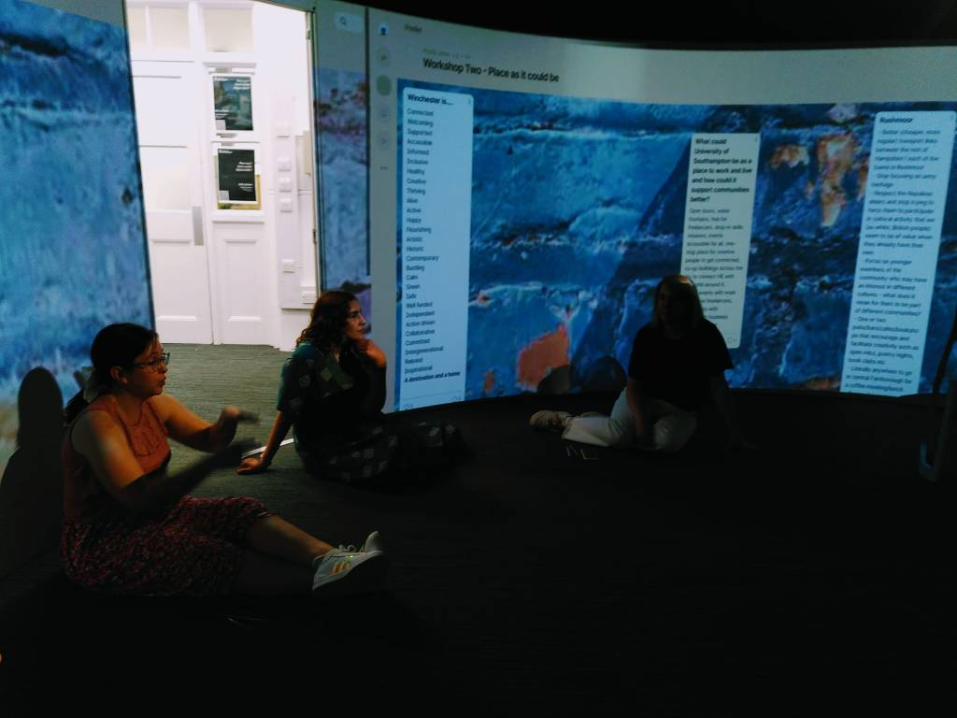
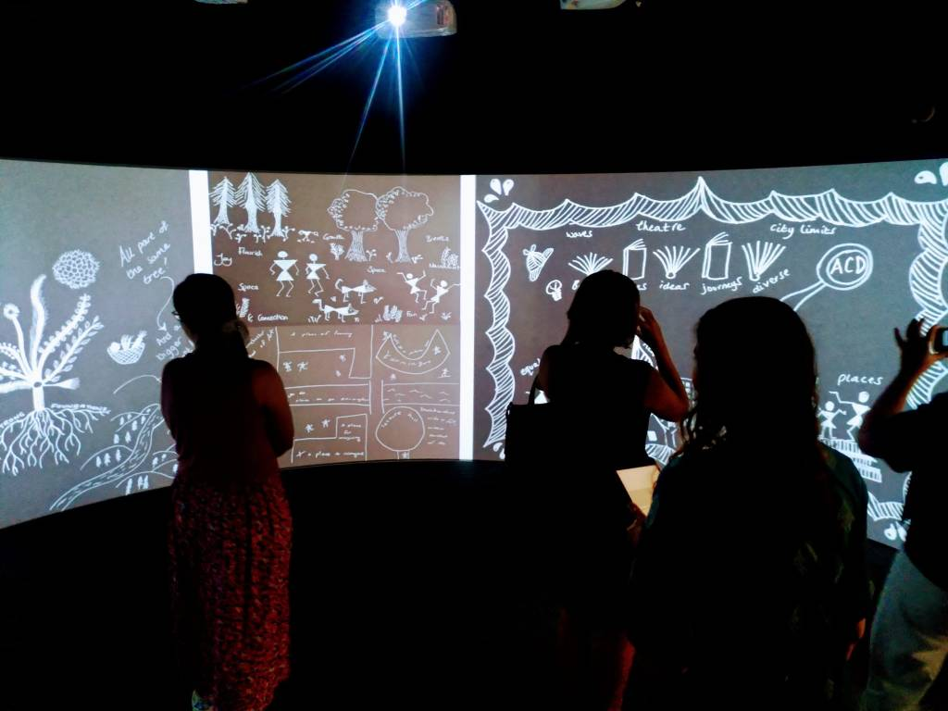
Workshop 2 with local government officers
The focus of this workshop grew from discussions in Workshop One, where some of the questions we asked centred on understanding creative freelancing and supporting freelance creatives in the region

Slide 7
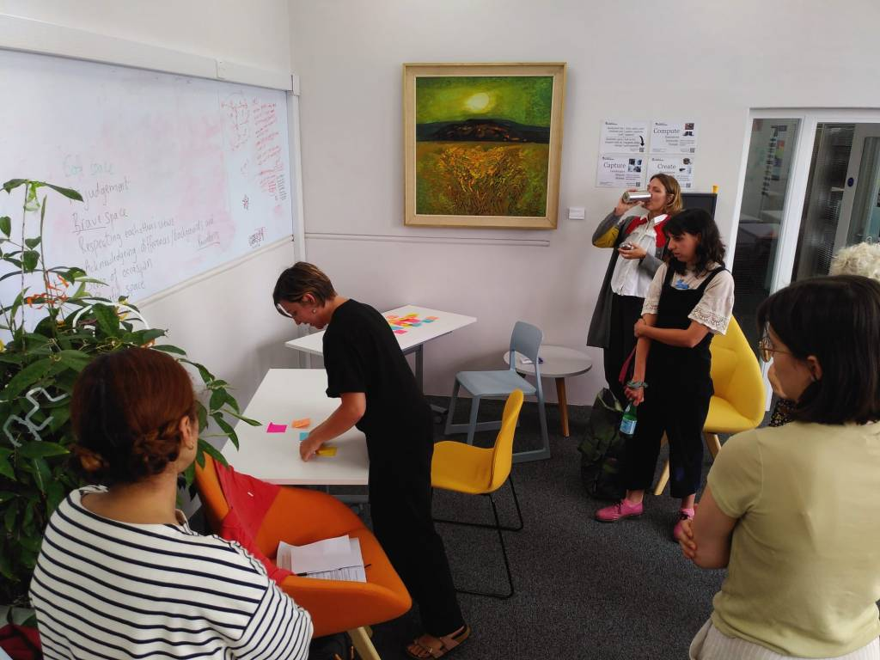
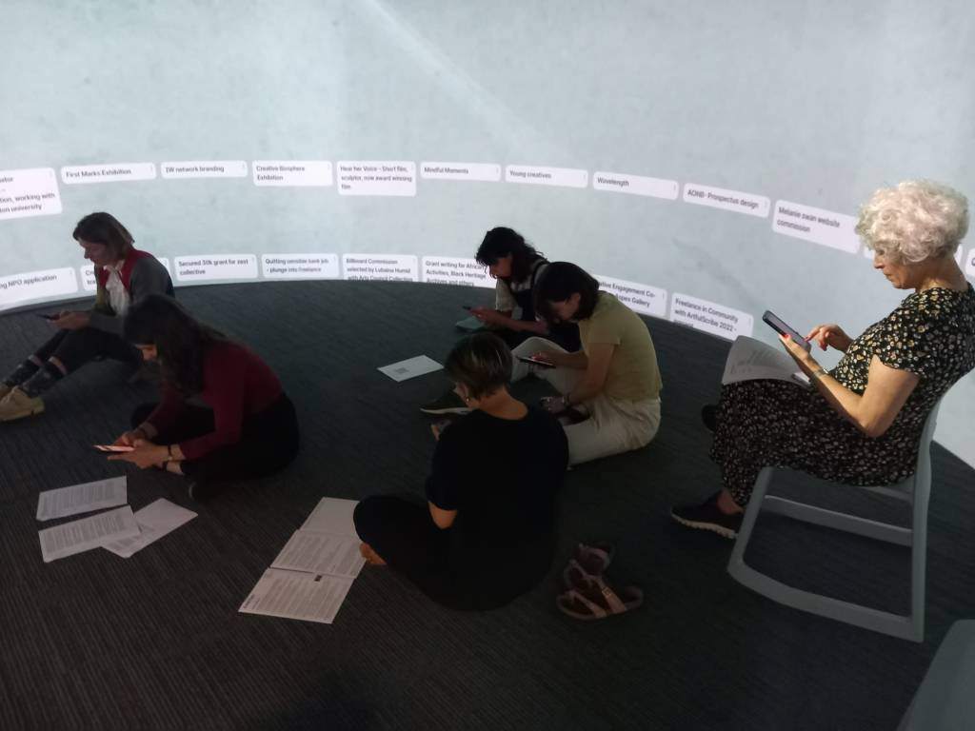
Workshop 1 with creative practitioners
The creative practitioners shared places, events, funders, mentors and organisations that had been a part of their freelance journey in the Solent.
They then selected some elements from the journey/story that would tell a narrative about one of their freelance experiences.
We came together in the Igloo, the 360-degree fully immersive audio-visual centre, to create career timelines. Freelancers posted significant moments from their career on a Padlet we’d designed for the activity and these appeared on the wall of the Igloo

Slide 8
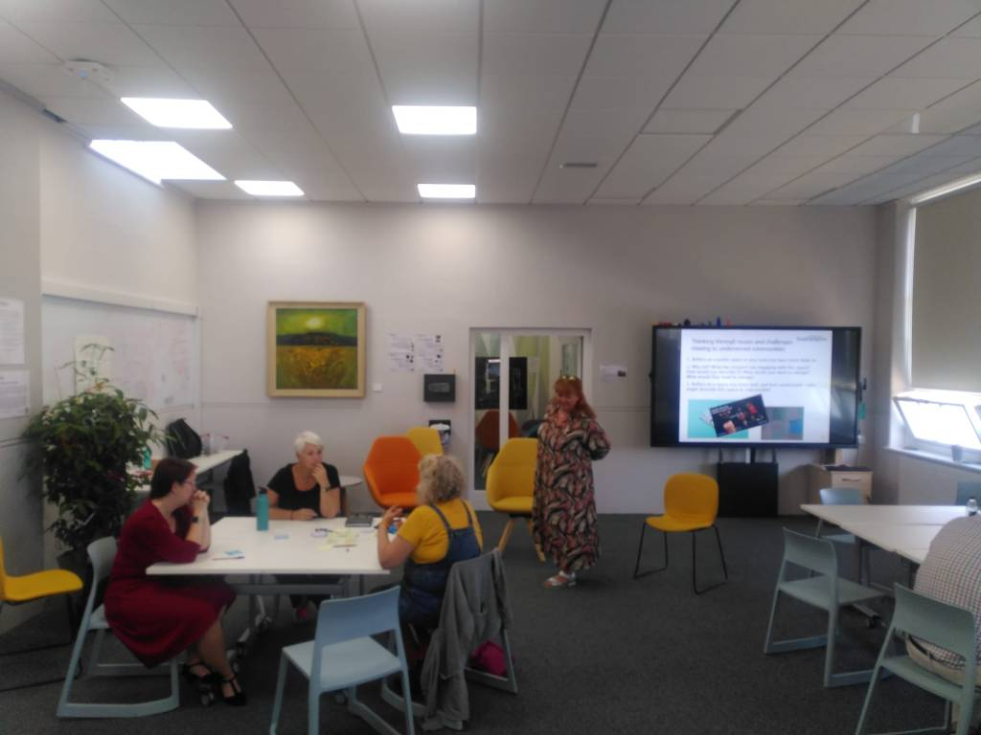
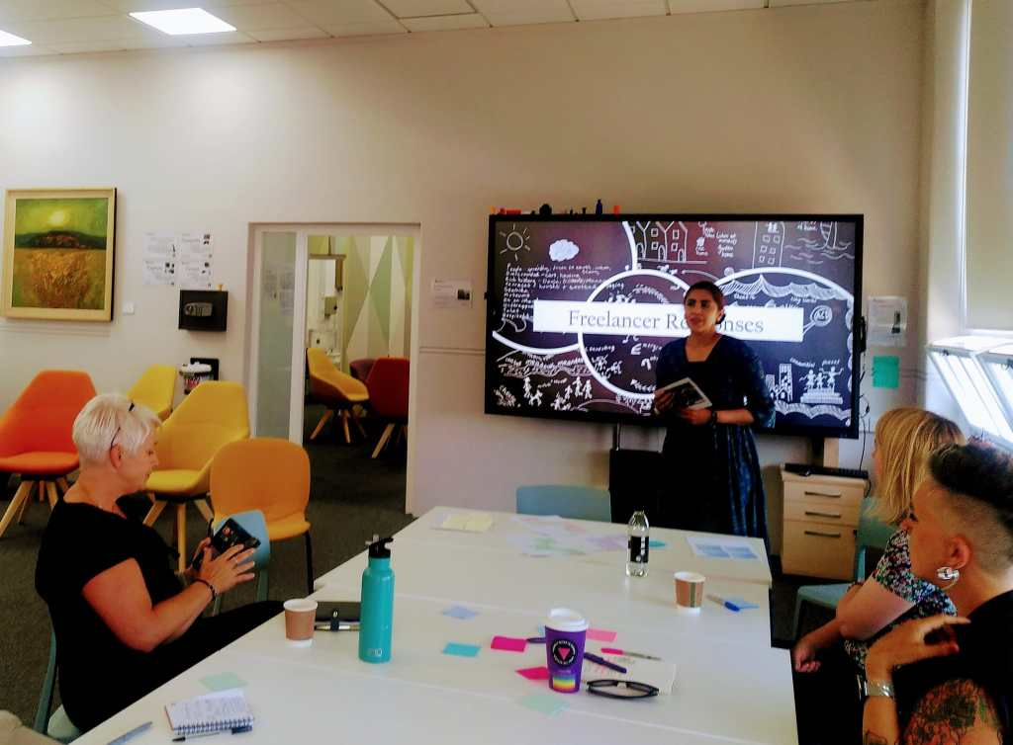
Workshop 3 with local government officers
The focus of this workshop was based on a key challenge that was also highlighted in workshop one: engaging diverse communities.

Slide 9
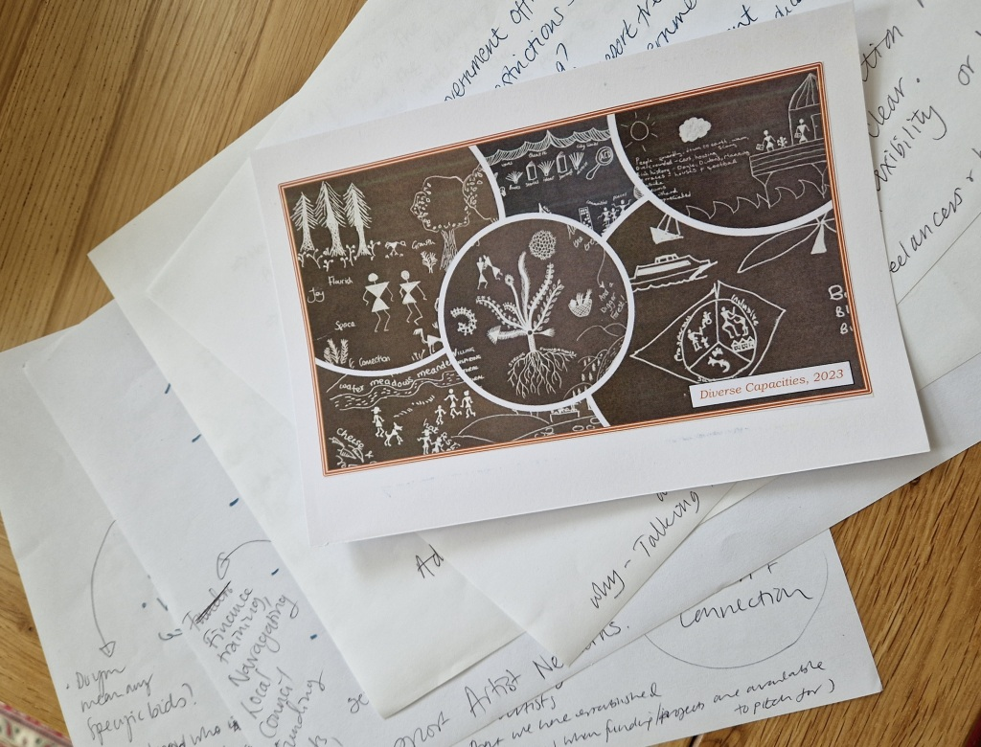
Postcards between participants and within places
Workshop 1 with local government officers
Workshop 2 with local government officers
Workshop 1 with creative practitioners
Workshop 3 with local government officers

Slide 10
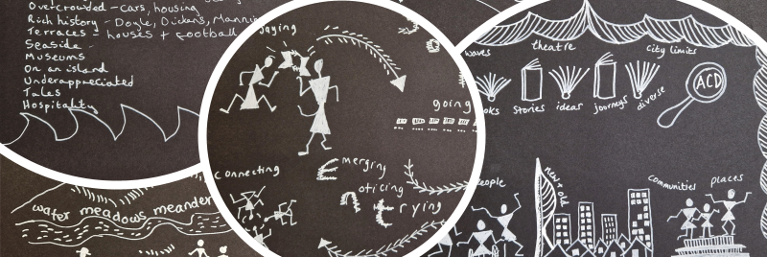
Exchanges through postcards

Slide 11
How can local government support you?
Recognise their power as gatekeepers
Training
Work with us and offer opportunities for consultation
Setting up as self-employed
Tax
Invoicing
Leadership
Finance
How can local government support you?

Slide 12
What deters you from working with us?
Seems complicated / inaccessible
Opportunities not always run well
Lack of access to opportunities
Unrealistic expectations
What deters you from working with us?

Slide 13
How can we work better with you?
Fair pay
Building and nurturing relationships
Consultation
Streamlining application process
Realistic timelines and expectations
Co-design opportunities
How can we work better with you?

Slide 14
How can we help you navigate complex systems?
How-to guide
Open-space forums
Mailing lists
Website / portal
Roadmaps
Named point-of-contact
How can we help you navigate complex systems?

Slide 15
Key insights
Freelancers keen on training that local government could offer
LGOs to recognise their role as gatekeepers
Consultation will result in much more effective support for freelancers
LGOs signposting opportunities and making related tendering processes accessible
LGOs reviewing expectations on renumeration
LGOs understanding (and changing) challenges associated with invoicing
Mutual understanding of working practices and constraints, which could then inform the future (e.g. precarious working and addressing this in ways funding is constructed)
Roadmaps for working with local government
The ideal scenario: working together with LGOs to co-design opportunities that would benefit both groups and enrich communities

Slide 16
Exhibition in Portsmouth Guildhall (July 2024)
Policy brief and ‘think-kit’ on building LGO creative networks
Developing South Asian writers’ network with mentoring and anthology
Showcase of creative works on Friday January 26th
What’s next?

Slide 17
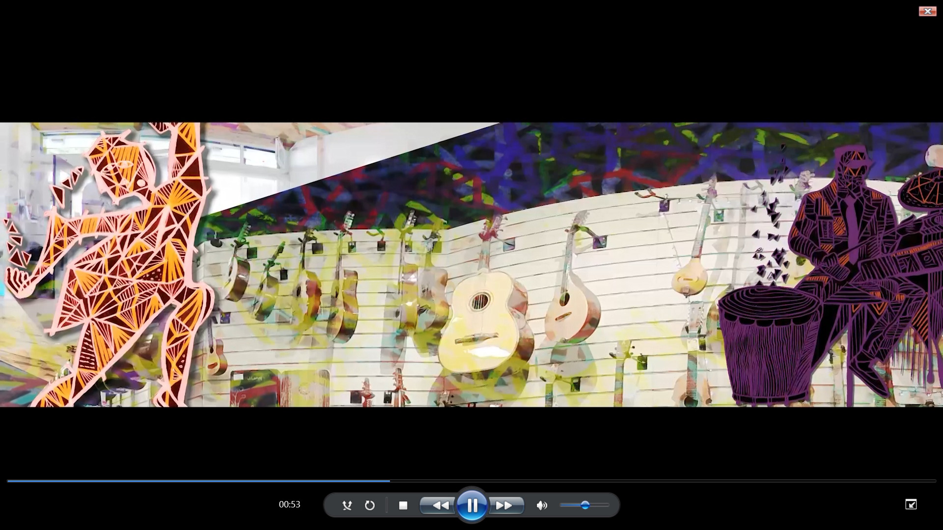
Julien Masson Places of Creativity (2024)
https://drive.google.com/file/d/1_feVf_QX-pfBmVHFcVNmi1VBWlkUIFPd/view?usp=sharing

Slide 18
Any questions?

