Slide 1
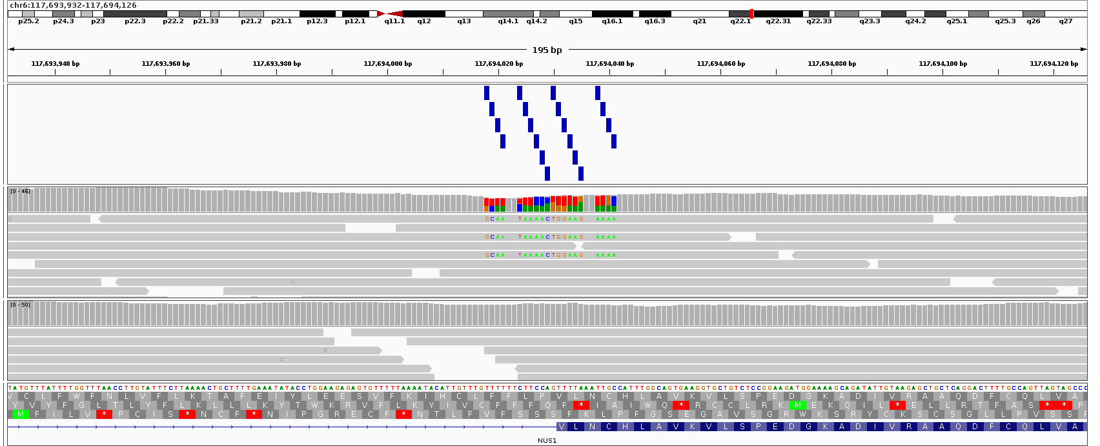
A
B
Green and red probes colocalized
Green and red probed split
Normal 3
Inverted 3
C
24bp inversion detected as 20 separate SNVs
DELs with small internal elements retained
D
INVs with loss (>10%)
Interlinked DUPs
Simple INVs
DUP-TRIPs
Complex SVs
SV category
* *
Mode of inheritance
†
DNA validation
Ambiguity
RNA-seq
Final Review
Mode of inheritance
Validation
MLPA
Ambiguity
RNA-seq
Final Review
De novo
Unknown
PCR/Sanger
Nanopore
Unambiguous
Expression outlier
Likely diagnostic
Inherited from affected parent
PacBio
Ambiguous with short reads
Monoallelic expression
Likely diagnostic but more evidence beneficial
From carrier mother (X-linked)
Unknown
FISH
Ambiguity solved by long reads
Truncation
Refuted by follow up
From unaffected mother
Exome reanalysis
Exon skipping / fusion
Validated but no information
Uninformative

