Slide 1
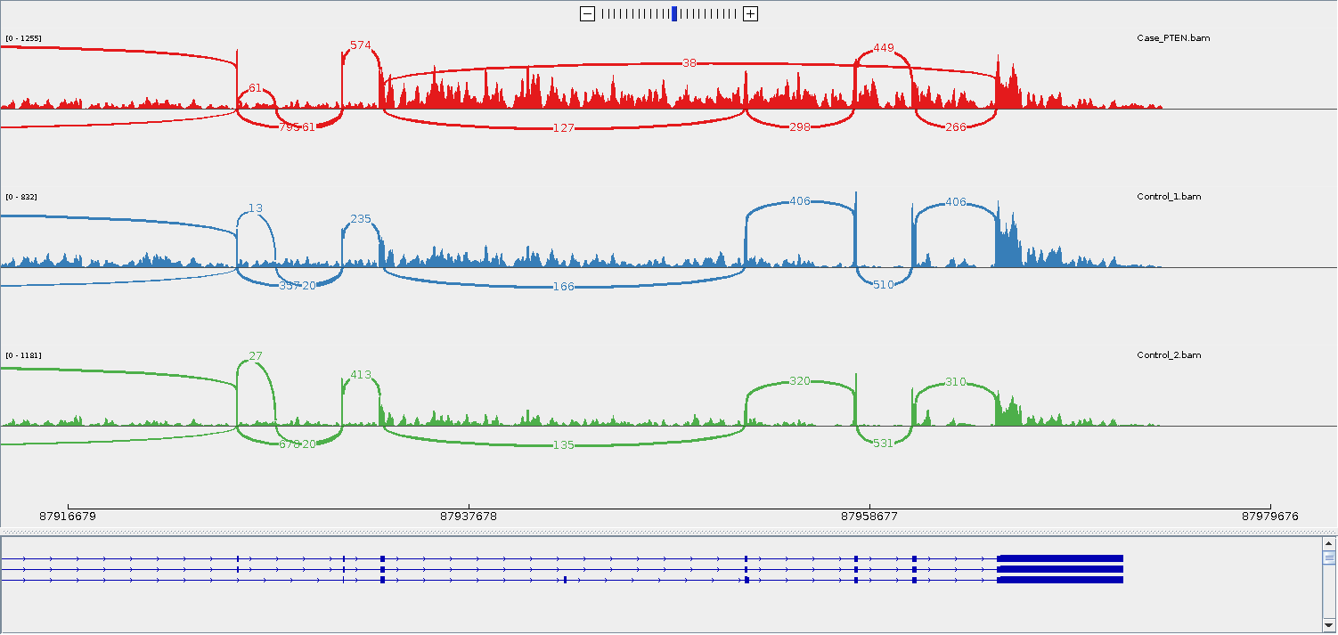
A
19:35,725,592-35,725,631
19:35,727,557-35,727,596
19:35,733,784-35,733,823
RNAseq
13G / 0A
47T / 0C
Genome
Breakpoint in exon 12
p.(Gly1419Gly) exon 16
p.(Asp2364Gly) exon 30
B
0-1,255
Family 3
0-832
Control 1
0-1,181
Control 2
87,916,679
87,937,678
87,958,677
87,979,676

