Slide 1
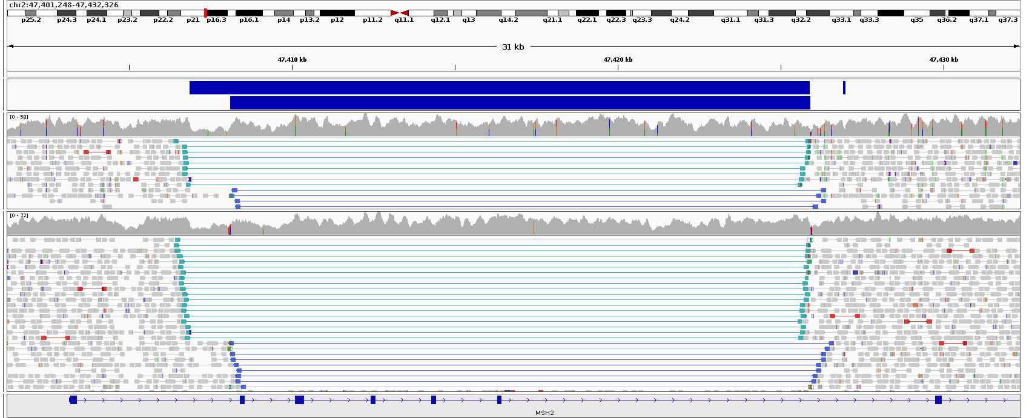
A
Family 1
B
Family 16
MantaINV
bowel cancer in 40s
MantaINV
CRC in 40s
Family 16
cancer in mid-60’s, died from septicemia linked to the cancer
Family 17
endometrial cancer at 39
liver cancer secondary to primary bowel cancer at 34
C
MSH2 inversion at 47.4Mb
TCC of bladder at 42,
cecal cancer at 45
MSI +ve (5/5 markers)
3
1
Family 17
Definitions
Ca Bladder
Ca Bowel
Ca Endometrium
Other
Ca, primary
site unknown
bowel cancer at 45
leg sarcoma at 44,
endometrial cancer at 55,
renal pelvis cancer at 60
bowel cancer at 42
MSI test failed
40,000,000
45,000,000
50,000,000
55,000,000

