Slide 1
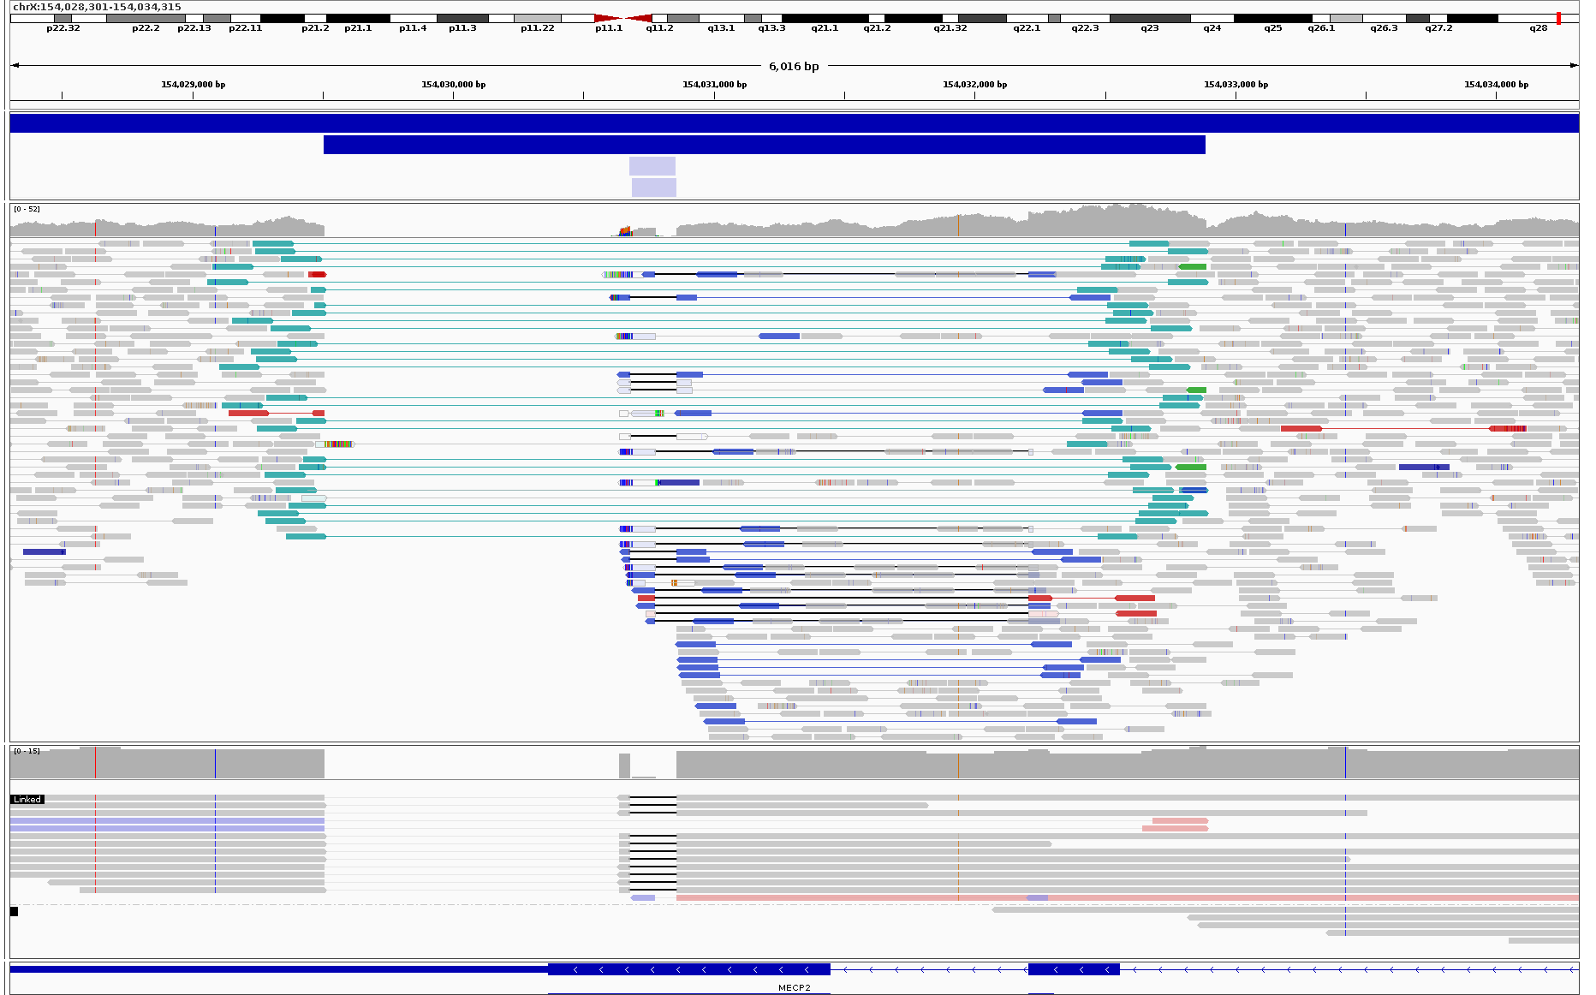
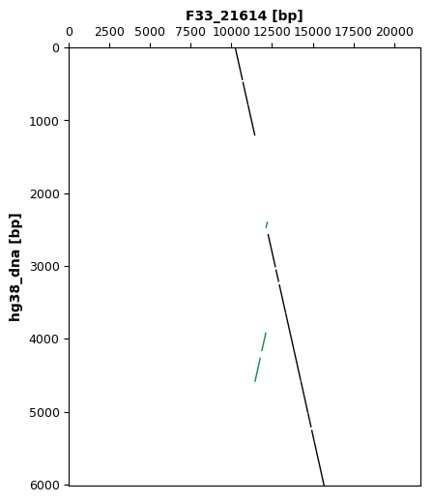
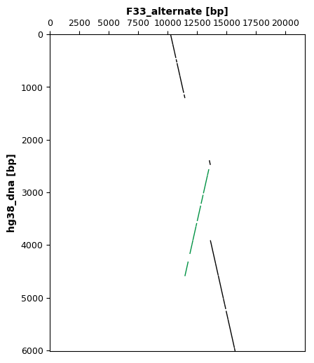
A
CANVAS:REF
170bp INV
180bp DEL
3,382bp INV
21,614bp read
B
20,000
Truncation at Leu336
15,000
Family 33 21,614bp read
BP1
BP2
10,000
BP3
1,000
2,000
3,000
4,000
5,000
6,000
C
20,000
Truncation at Ile137
15,000
BP2
Family 33 alternate structure
BP1
10,000
BP3
1,000
2,000
3,000
4,000
5,000
6,000

