Slide 1
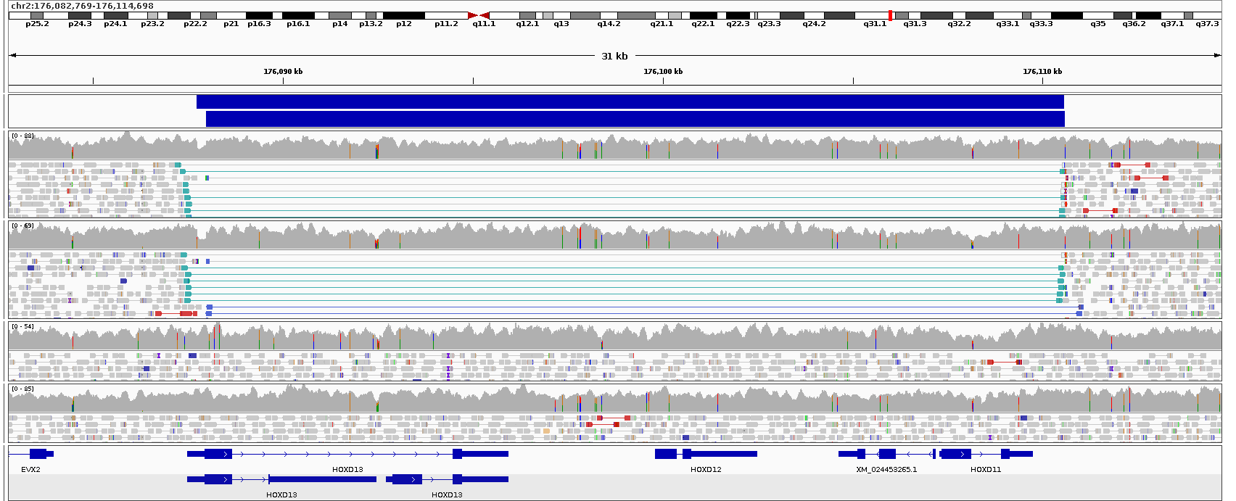
A
Proband
Son
Mother
Father
B
Gene mapped to chromosome 2q24-q32 using microsatellites
Ulnaless mouse described with mesomelic shortening
Three generation family described with an unusual novel autosomal dominant bone disorder
1999
1998
1997
1996
1995
1994
1993
1992
1991
1990
Kantaputra mesomelic dysplasia: a 2nd reported family.
Karyotyping & Sanger analysis of HOXD11 normal
“We intend to continue to search for mutations or rearrangements in the regulatory region of the HOXD cluster in this family, the second reported family with the distinct Kantaputra type mesomelic dysplasia.”
“…as the aCGH analysis does not exclude balanced structural rearrangements, one can speculate that the phenotype in patients reported by Shears et al is caused by chromosomal rearrangements affecting HOXD locus regulation.”
2000
244K Agilent aCGH detects 2q31.1-q31.2 duplications in original family but no CNVs in UK family
2001
2002
2003
2004
2005
2006
2007
2008
2009
2010
2011
Sanger validation (ongoing)
770kb inversion identified in Ulnaless mouse
2012
WGS data delivery
Array testing repeated with higher resolution
Inversion detected
Negative report from 100KGP
2013
2023
2022
2021
2020
2019
2018
2017
2016
2015
2014

