Slide 1
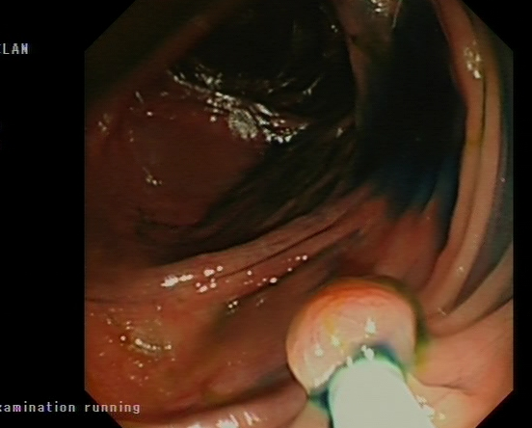
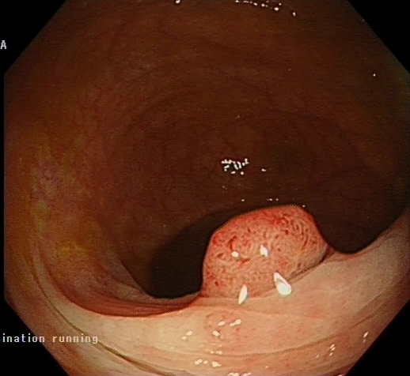
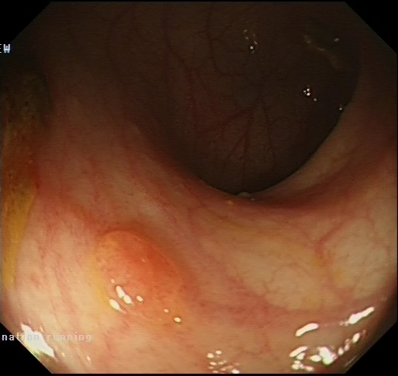
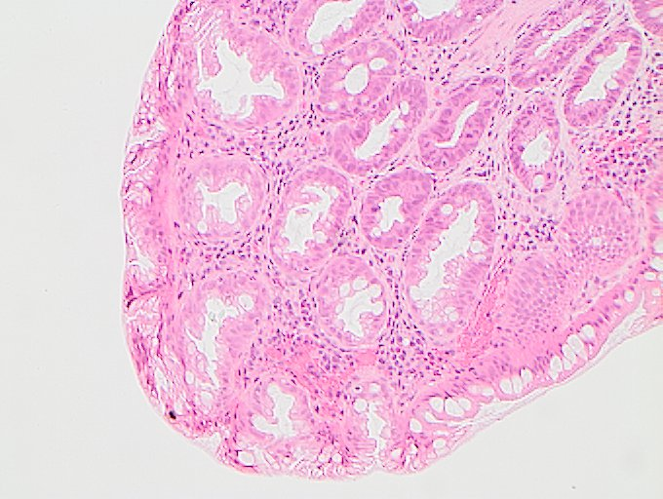
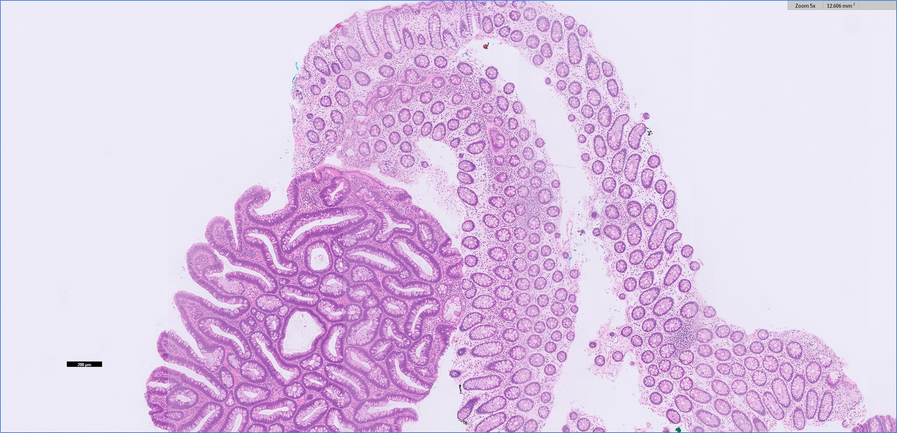
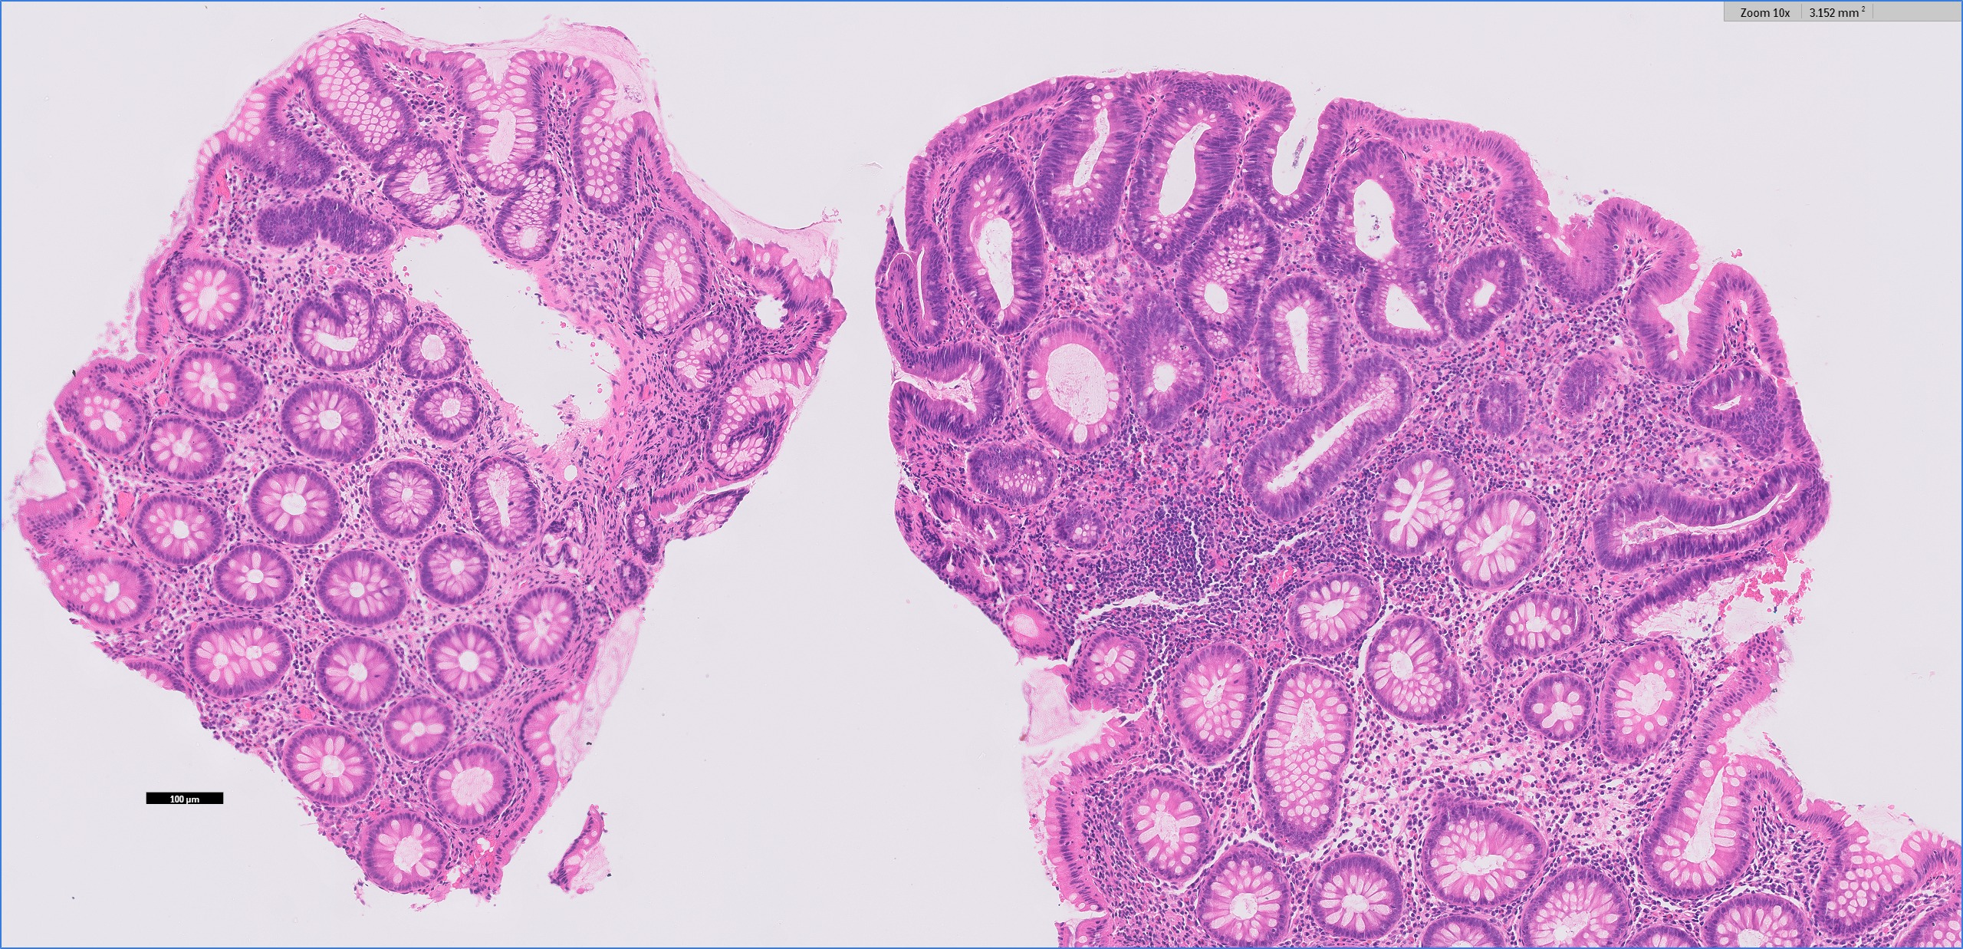
A
Family 43
B
II-1 II-2 II-3
I-1
I-2
Polyposis
carcinoma
INV / WT
NA
C
II-1 II-2 II-3
II-1
?
II-2
II-3
1 Polyp
WT / WT
Polyposis
INV / WT
Polyposis
INV / WT
11kb del
25bp del
D
111,440,257
111,452,111
111,496,633
111,639,964
112,769,976
111,639,989
111,952,019
111,676,773
111,951,934
116,946,042
A
B
C
D
E
F
CAMK4
STARD4 (UTR)
NREP
APC
5q
FR
XR
EF
CR
11q
95,852,454
97,602,984
98,009,035
98,945,055
G
H
I
E
5der
B
I
D
A
H
11der
G
C
A
PC
E
F
112,768,000
112,770,000
112,772,000
5:112,769,747-112,770,175
F
G
0-30,370
APC
APC

