Slide 1
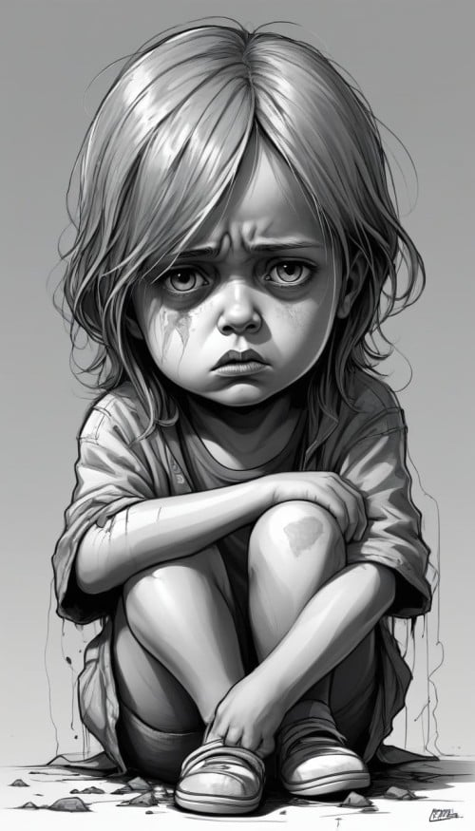
Workshop: Trauma focused CBT within Bipolar Disorder Thomas Richardson University of Southampton T.H.Richardson@soton.ac.uk, @DrTomRichardson

Slide 2
Aims for session
Overlap between trauma and Bipolar
Formulation
Evidence base
Adaptations for CBT for PTSD in this population

Slide 3
Slides
https://tinyurl.com/2p9hsw2v

Slide 4
Time for a poll
Who has worked clinically with Bipolar?
Who has worked clinically with PTSD?
Who has worked clinically with PTSD/trauma in the context of Bipolar?

Slide 5
Trauma & bipolar
Childhood abuse and parental loss identified as a risk factors for Bipolar disorder (Marangoni et al., 2016).
Those with Bipolar Disorder 2.6 times more likely to have childhood adversity than those without mental health problems (4 times for emotional abuse) (Palmier-Claus et al., 2016).
Umbrella review of environmental risk factors for Bipolar suggested childhood adversity is a risk factor (Bortolato et al., 2017).
45% those with Bipolar have had exposure to an extremely stressful life event, 40% during childhood. More likely than depression, and, more likely to have lifetime PTSD (26%) (McGraw & Parker, 2017).

Slide 6
Trauma & bipolar
Estimates of prevalence of PTSD within Bipolar range from 8% to 59%, higher in Bipolar I than Bipolar II (Hernandez et al., 2023).
Four fold risk of developing Bipolar in 5 years after diagnosis of PTSD (Okkels et al, 2017)
Trauma often followed onset of mood suggesting greater vulnerability to traumatic experiences e.g. relationship break up, legal problems, major financial crisis, serious drug and alcohol difficulties (McGraw & Parker, 2017).
I.e. acute mood episodes lead to trauma.
So there is often complex PTSD with childhood trauma plus trauma due to Bipolar (being assaulted, sectioned etc)

Slide 7
Trauma & bipolar
Those with Bipolar disorder and PTSD more likely to be depressed (rather than manic), female, history of suicide attempts, comorbid Personality disorder, less likely to be hospitalised for psychosis (Reddy et al., 2017).
Those with Bipolar and childhood trauma have more severe symptoms of depression and mania, anxiety, earlier onset, more likelihood of comorbid substance use, more total episodes, more suicide attempts, greater risk of rapid cycling (Agnew-Blais, 2016, Lebovitz et al., 2021).
More depressive symptoms in those with trauma (Frost et al., 2020).

Slide 8
Blurred boundaries: PTSD and Bipolar
PTSD & complex PTSD
Sleep problems
Anxiety, hyper-vigilance/arousal, irritability
Avoidance
Negative cognitions and mood
Negative self-concept
Interpersonal difficulties
Emotion dysregulation High risk self-harm and suicide, risk-taking
Bipolar
Sleep problems
High levels of anxiety, agitation/irritability when manic
Avoidance when anxious Negative cognitions and mood
Negative self-concept, shame
Interpersonal difficulties
Emotion dysregulation
High risk self harm and suicide, risk taking

Slide 9
Small group exercise
Discuss:
What is the link between trauma and Bipolar?
What psychological mechanisms link both?
How would you formulate both together?

Slide 10
Psychological Mechanisms
Not a lot of research!
More conflicting appraisals about mood changes in Bipolar for those with comorbid PTSD (Frost et al., 2020).
Internalised shame has been shown to correlate with experiences of childhood abuse and emotional neglect in Bipolar Disorder (Fowke et al., 2012).

Slide 11
Psychological Mechanisms
Hou & Richardson (in prep)
Greater childhood trauma correlates with higher dysfunctional attitudes,
more severe perfectionism, and lower self-compassion.
Mediation model:
- Greater dysfunctional attitudes
- Greater perfectionism
- Lower self-compassion
More childhood trauma
Greater anxiety

Slide 12
Cognitive model of PTSD (Ehlers & Clark 2000)
Nature of Trauma Memory
Negative Appraisals of Trauma and/or its Sequelae
Current Threat
Intrusions
Arousal Symptoms
Strong Emotions
Strategies Intended to Control Threat/Symptoms
Avoidance/Safety Behaviours
Notes:
Examples of negative appraisals: I can’t trust anyone
The world is completely dangerous
All men are rapists
I am going crazy
My life is over/ruined
It happened because I’m bad
I deserve to be punished
If I drive, I’ll have another accident

Slide 13
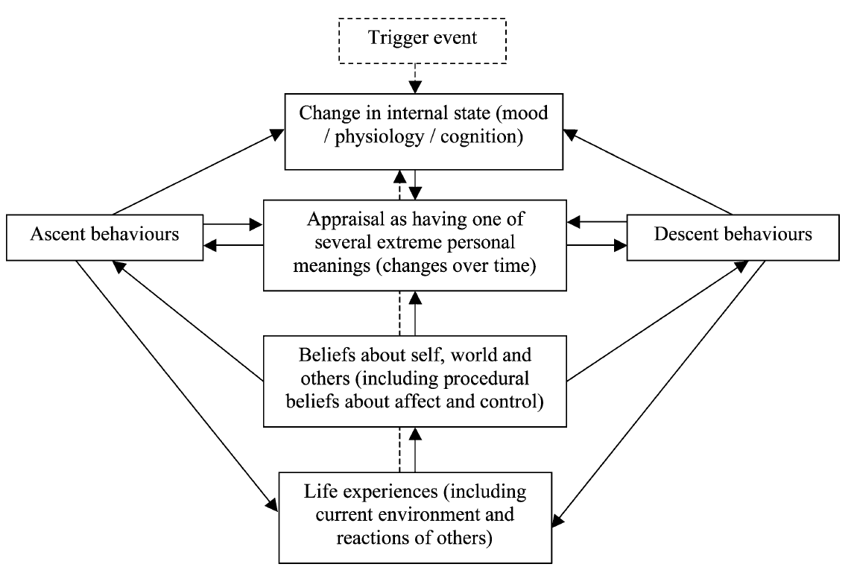
Mansell model: Bipolar

Slide 14
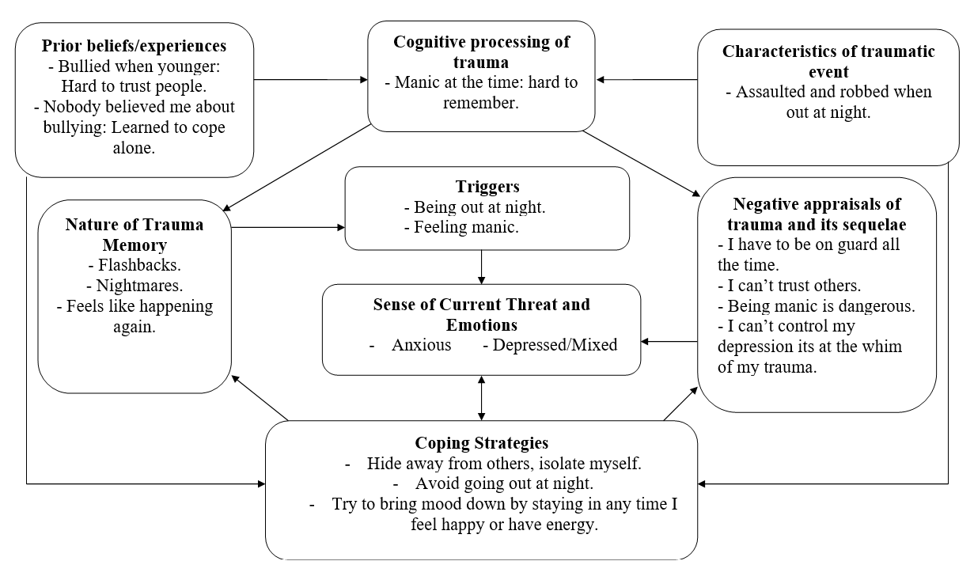
Formulation using Bipolar model

Slide 15
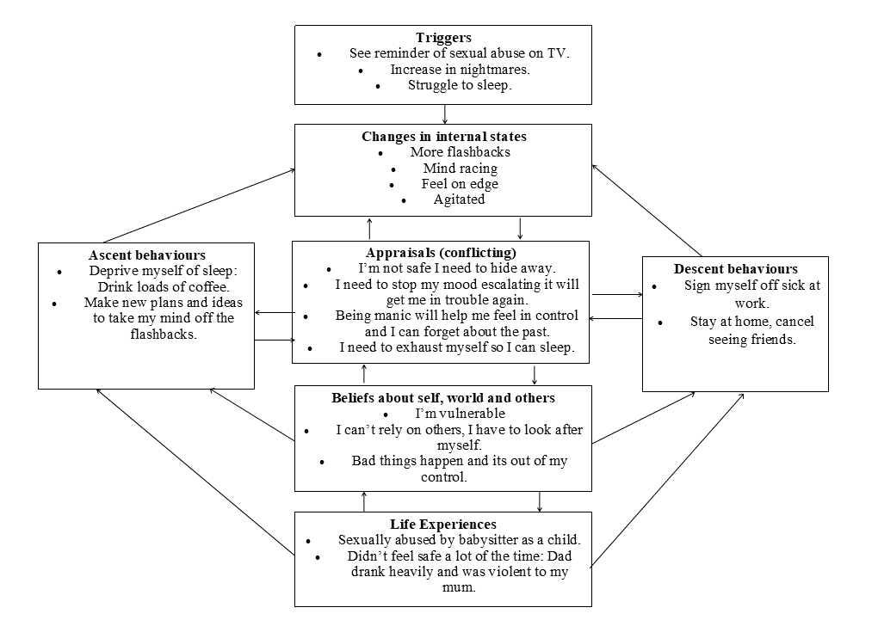
Formulation using PTSD model

Slide 16
Group Exercise
Read vignette
Half formulate using PTSD model, half using Bipolar model

Slide 17
Formulation tips
You can put trauma in formulation even if don’t meet criteria for PTSD!
The consequences of mania and resulting treatment (sectioned etc.) can themselves be traumatic.
Formulate together: Trauma related Bipolar or Bipolar-related PTSD
Map out interactions between the two.
Formulate early childhood impact, and impact of more recent episodes.

Slide 18
Formulation tips
Cognitive processing during trauma: Impacted by mood state at the time.
Sense of current threat might be triggered by mood: E.g. Depressed, think back to time were in hospital when depressed.
Thoughts/beliefs linking both e.g. ‘I only feel safe and confident when I’m manic’.
Sleep problems due to nightmares may trigger mood changes.

Slide 19
Evidence base
Currently no RCTs of trauma focused CBT within Bipolar.
RCT of CBT for PTSD in SMI (including Bipolar) showed good completion and effectiveness (Mueser et la., 2008).
Case series: Narrative exposure therapy with four bipolar patients included could be an effective and safe treatment (Mauritz et al., 2022).

Slide 20
Evidence base
Recent feasibility study of prolonged exposure with 32 participants with Bipolar disorder found 75% completion of all ten sessions (Katz et al., 2023).
Reduced PTSD symptom severity and suicidality, depression symptoms.
The standard prolonged exposure protocol was used with no modifications.
No increase in manic symptoms over time.

Slide 21
Evidence base: EMDR
RCTs: Those with Bipolar and trauma.
Reduce impact for EMDR compared to supportive therapy at reducing affective symptoms (in particular mixed), and improving functioning.
No impact on relapse rates.
Same impact on trauma symptoms.
However no difference on hospitalization and drop out: Suggests safety and acceptability.
Hogg et al., 2013; Moreno-Alcazar et al., 2017.

Slide 22
Considerations
Current mood: Unlikely to engage in trauma work if manic or severely depressed.
Focus on stabilization of mood first.
Agree with client what is ‘stable enough’ for trauma work, when to pause.
Mood monitoring important throughout trauma work (but careful client does not panic if feel sad after reliving sessions, doesn’t mean depression necessarily!).
Graded approach: Start with less challenging memories first.

Slide 23
Stabilisation in Bipolar
Debate in literature generally about whether stabilisation (grounding, PTSD psychoed, emotional coping skills, risk management/safety planning) needed prior to trauma work.
Trial for complex PTSD due to CSA compared 16 sessions of EMDR to 16 sessions of EMDR with 8 sessions of stabilisation beforehand: No differences in drop out or outcome (Van Vliet et al., 2021).

Slide 24
Stabilisation in Bipolar
For Bipolar Disorder, little research about if stabilisation required.
However, be cautious: stabilisation likely necessary. Anecdotally trauma work can trigger mania.
Stabilisation usually involves relapse prevention:
Identifying early warning signs
Triggers
Symptoms
Coping strategies (e.g. reducing activity, mindfulness)
Psychoeduation group can be a useful part of stabilisation.

Slide 25
Group Exercise
Role play, one client one therapist.
Discuss:
Worries about trauma work
How to address these worries, proceed carefully
What memories to work on

Slide 26
CBT what to cover
Outside of additional considerations, preparation and stabilization, therapy content will be very similar i.e.:
Identifying hot spots
Identifying negative appraisals
Reliving memories
Updating and rescripting

Slide 27
CBT for PTSD in Bipolar Tips
Hierarchy prioritize PTSD memories
Memories of being manic/sectioned, feeling out of control (you're stable now, you’re in control), challenge guilt related to what did (not your fault).
Imagery re-scripting, beware of extra sensitive imagery in Bipolar.
Stimulus discrimination: Link to mood monitoring: Are you safe now? Are you more stable?
Ensure 90 minutes: Allow time for discussing mood diary at start, and time for grounding/distress tolerance skills at end of sessions if needed.

Slide 28
CBT for PTSD in Bipolar Tips
Thought challenging: Challenge thoughts fueling both mood and trauma: e.g. I cant trust others, have to be independent.
Reclaiming life: Link to behavioural activation.
Core belief work: Challenging, compassionate reframes e.g. ‘I’m not good enough’.

Slide 29
CBT for PTSD in Bipolar Tips
As well as targeting traumatic memories, possibility of trying to relive, update and rescript memories of trauma where no PTSD symptoms but relate to mood symptoms
E.g. Update/rescript memories related to high standards e.g. Criticized for not coming top of class: Update with imaging being congratulated for trying hard.
What do you know now? I don’t have to be perfect.
Early memories relating to perfectionism high standards (rescript memory of being criticised for not getting 100%, memories of perceived failures).
Memories of being manic/sectioned (you're stable now, you’re in control).
Update/rescript memories related to shame from incidents when manic (e.g. spending life savings: It wasn't your fault)

Slide 30
CBT what to cover
Negative cognitions: Challenge those which relate to mood changes as well (e.g. belief that I have to cope alone, I can’t trust anyone).
90 minute sessions. Allow time to check mood diary at start, and allow for grounding/distress tolerance at end of sessions if needed.
Stimulus discrimination and updates: Focus on mood as well e.g. ‘I was really unwell and vulnerable then, I’m much more stable then, so I’m safer.
Focus on ‘little T’ traumas related to Bipolar e.g. experiences of failure, emotional abuse, bullying.

Slide 31
Group Exercise
Role ply, one client one therapist.
Discuss:
Ideas for rescripting specific trauma memories.
How working on these may address bipolar specific beliefs (e.g. I am useless)

Slide 32
EMDR and Bipolar: Specific Protocols
Mood –stabilising protocol.
Illness awareness protocol.
Adherence enhance protocol.
Prodromal symptoms protocol.
De-Idealization of Manic Symptoms protocol.

Slide 33
Thank you!
Thoughts, comments, questions?
Chapter in book in press:
Trauma focused therapy in Bipolar Disorder: Adapting CBT and EMDR
Thomas Richardson & Benedikt L. Amann.

Slide 35
EMDR therapists needed to participate in thesis research project
This project is exploring how ‘EMDR is best conducted and adapted for trauma focused work within bipolar disorder’. At present there is limited guidance offered for EMDR therapists to how they should approach the treatment of trauma in bipolar disorder. This study aims to produce a consensus generated from therapist’s perspectives that will inform and guide clinical practice for trauma work in bipolar disorder. Participants need to be EMDR trained and have experiences of working with individuals with bipolar Disorder using ANY therapeutic approach. However, It does not have to be EMDR specific. It involves completion of an online survey over 3 rounds and doesn’t take long to complete.
If you are interested in taken part in this project, please scan the QR code for more information. Your participation is greatly appreciated.
Leeanne Nicholls, Trainee Clinical Psychologist, University of Southampton
Email: l.nicholls@soton.ac.uk

