Slide 1
Working with dysfunctional attitudes and perfectionism in Bipolar
Dr. Thomas Richardson
University of Southampton

Slide 2
Acknowledgements
Funded by Health Education England (DClin training for CW)
Thank you to Bipolar UK and Crest BD for advertising our studies.
All our participants and PPI group.
University of Southampton team: Emma Palmer-Cooper, Chloe Woods.
Sarah Brothwell and Helen Sessions for helping me with my own high standards!
CONFLICT OF INTEREST STATEMENT
I have been paid for delivering training on psychological therapy for Bipolar and will receive royalties from a book on the area.

Slide 3
Intro: Dysfunctional Attitudes
Deep, strongly held beliefs about achievement and others.
Shown to predict poor response to CBT for depression
(Keller, 1983)
Specific factor structure for the dysfunctional attitudes scale in Bipolar (Lam et al., 2004)
Goal attainment (e.g. ‘If I try hard enough I should be able to excel in anything I attempt’)
Achievement (e.g. If I don’t set the highest standards for myself, I am likely to end up a second-rate person’)
Dependency (e.g. What others think of me is very important)

Slide 4
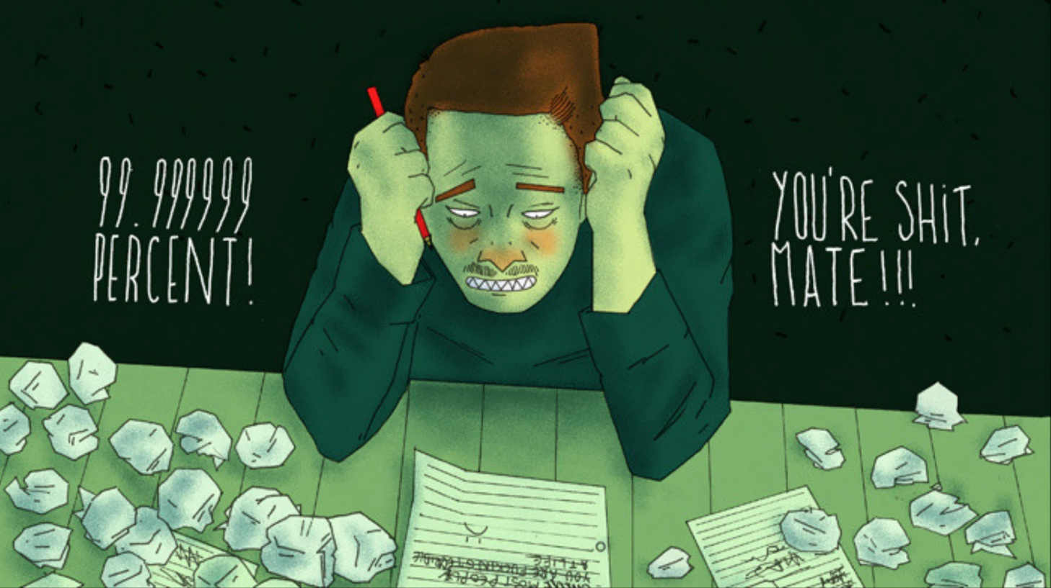
Intro: perfectionism
Pursuit of high standards and self-criticism for not meeting these.
Shown to be a trans-diagnostic factor in a number of mental health problems (Limburg et al., 2017)
Example questions from Almost Perfect Scale Revised:
I have high standards for my performance at work or school.
I have high expectations for myself.
My best just never seems to be good enough for me.
I like to always be organized and disciplined.

Slide 5
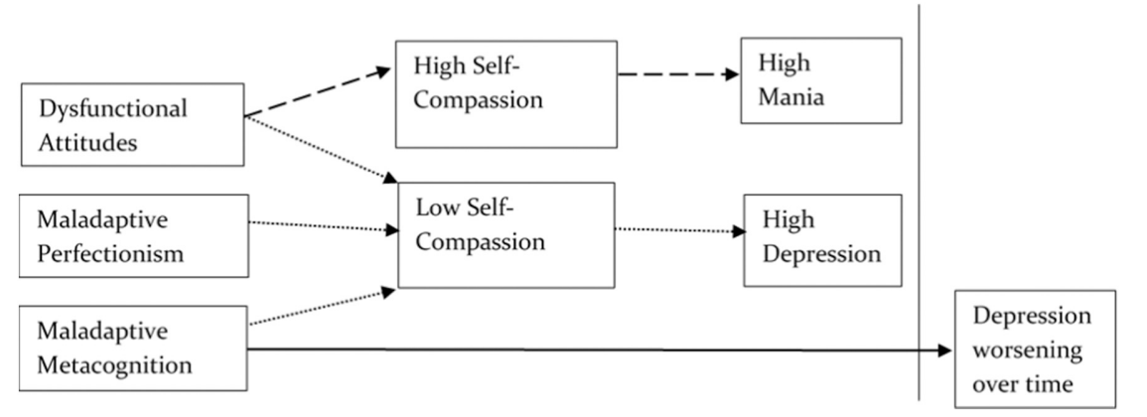
Dysfunctional Attitudes and perfectionism in bipolar disorder
Greater perfectionism within BD is linked to more severe symptoms of depression and anxiety.
Self-compassion appears to be a mediating variable.
(Fletcher et al., 2019, Palmer-Cooper, Woods & Richardson, 2023).

Slide 6
Dysfunctional Attitudes and perfectionism in bipolar disorder
In depression and Bipolar Disorder, specific perfectionism sub-types linked with more severe symptoms:
Concern over mistakes
Doubts about actions
Other-oriented perfectionism
Parental criticism
Self-oriented perfectionism
Socially prescribed perfectionism.
No relationship for organisation and personal standards.
Little evidence about links with manic symptoms.
(Lea, Richardson & Rauze, 2023).

Slide 7
Dysfunctional Attitudes and perfectionism in bipolar disorder
Woods, Richardson & Palmer-Cooper (2023), meta-analysis of 23 papers:
Those with Bipolar overall higher dysfunctional attitudes than healthy controls (medium effect size=.7).
No difference when compared to unipolar depression.
Dysfunctional attitudes higher for those depressed compared to euthymic (medium effect size=.71).
Most research cross-sectional: Can’t say which comes first.
Not enough data to look at subscale differences with depression (e.g. achievement).

Slide 8
Dysfunctional Attitudes and perfectionism in bipolar disorder
Hou & Richardson (in prep)
98 adults with Bipolar Disorder.
Greater childhood trauma correlates with higher dysfunctional attitudes,
more severe perfectionism, and lower self-compassion.
Mediation model:
- Greater dysfunctional attitudes
- Greater perfectionism
- Lower self-compassion
More childhood trauma
Greater anxiety

Slide 9
Evidence: cbt for perfectionism and dysfunctional attitudes
Galloway et al (2022) meta-analysis on CBT for perfectionism:
Medium to large effect sizes for reduced clinical perfectionism, concern over mistakes and personal standards.
Reduced symptoms fo depression and anxiety.
Most research in non-clinical populations, none with Bipolar specifically.
Small studies have suggested that compassion-focused therapy and Acceptance and Commitment Therapy can reduce perfectionism (again not in Bipolar specifically) (Birni & Satici, 2023; Ong et al., 2019)

Slide 10
Evidence: cbt for perfectionism and dysfunctional attitudes
Woods, Richardson & Palmer-Cooper (2023), meta-analysis:
3 studies combined showed reduction of dysfunctiuonal attitudes in Bipolar specifically.
2 studies CBT, 1 mindfulness-based cognitive therapy.
2 studies no changes to focus on dysfunctional attitudes specifically: So we can expect larger effects with specific adaptations.

Slide 11
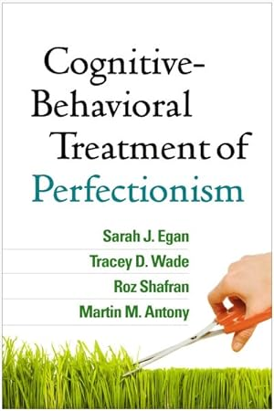
Specific cbt elements used
Core elements of CBT for perfectionism:
Psychoeducation impact of beliefs.
Cognitive restarting of beliefs.
Behavioural experiments to test beliefs about achievement and mistakes.
Noticing patterns of avoidance: Exposure around this.
Approach: Don’t say people have to lower their standards straight off (you want them to realise this themselves!)

Slide 12
Specific cbt elements used: bipolar specific
Formulating link with mania and depression (interaction with life events):
When you ‘fail’: Self-critical thoughts leading to depression
When you do well: Higher ambitions and goal directed behavior lead to mania.
Diary of impact of perfectionist thoughts on moods.
Cognitive restructuring: Noticing difference between beliefs about self when depressed vs. manic.
Focus on flexibility about beliefs: Continuum rather than all or nothing approach.
Exposure and experiments: Make mistakes!
Include in relapse prevention plan.

Slide 13
Specific cbt elements used: bipolar specific
Beware of family, friends, employers reinforcing achievement beliefs.
Re-evaluate importance of achievement: What would family say, values rather than goals.
Increase self-compassion
Behavioural activation: Schedule activities not linked to achievement, rest, down-time.
Reframe core beliefs and rules for living
“Other people won’t respect me unless I am outstanding”
Vs. “Other people like me for who I am and my real
friends still care about me when things go wrong”.

Slide 14
Potential issues for bipolar
Where in stages of change is the client?
Anxiety about impact of softening standards.
Guided socratic approach about pros and cons of these beliefs.
Client trying to be ‘perfect patient’ in therapy.

Slide 15
conclusion
Lots of evidence that perfectionism and dysfunctional attitudes are elevated in Bipolar Disorder.
Linked with more severe symptoms of depression and anxiety.
Little evidence on effectiveness of CBT for these difficulties in Bipolar specifically.
But evidence that these can improve in Bipolar.
A specific focus on perfectionism and dysfunctional attitudes in Bipolar likely to have larger effects: Intervention development and trial needed.

Slide 16
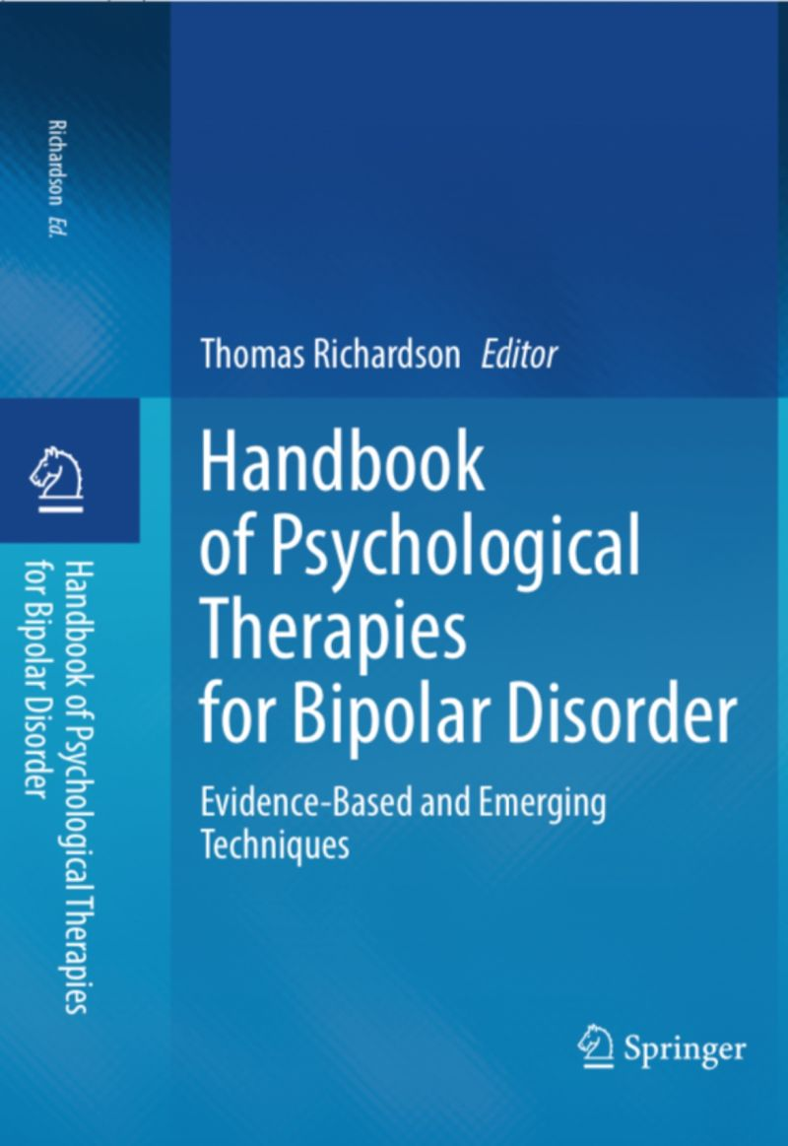
Chapter in book in press:
Working with dysfunctional attitudes and perfectionism in Bipolar Disorder.
Thomas Richardson.

