Slide 1
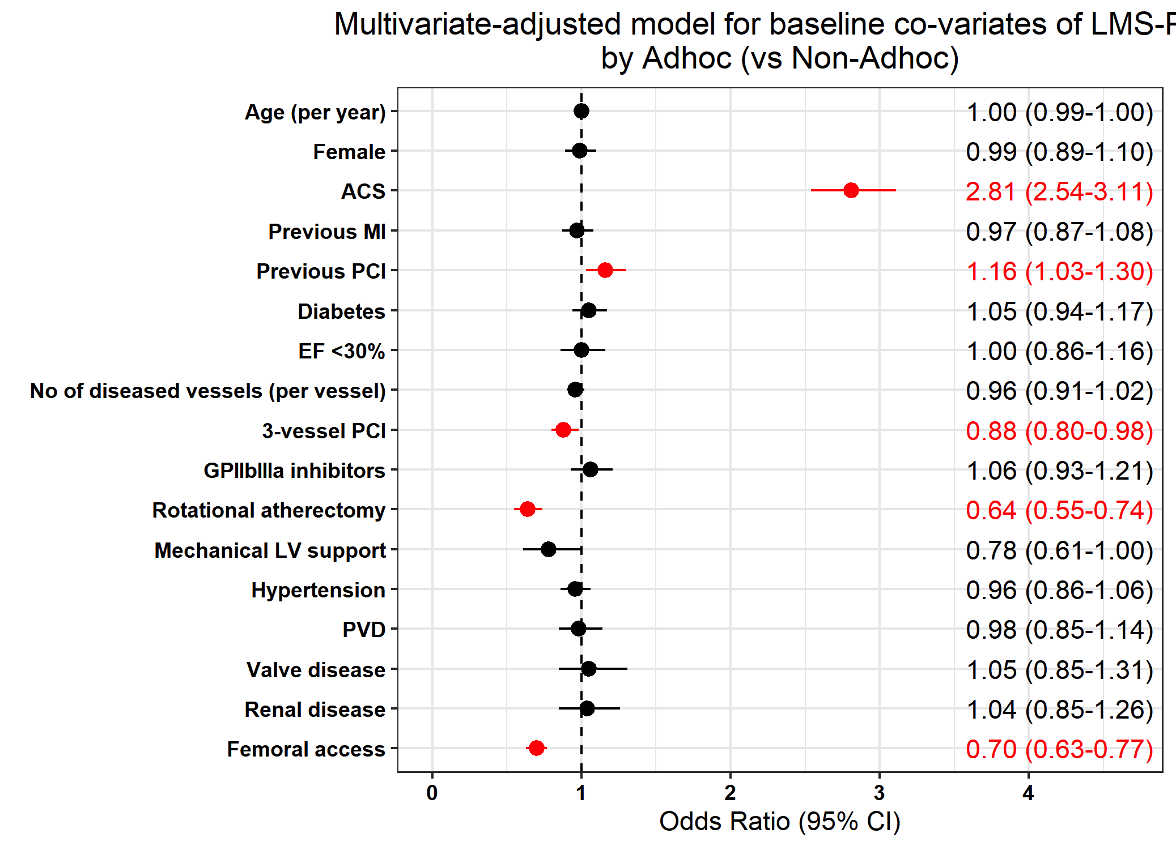
Figure 2: Predictors of uLMS-PCI being undertaken on an ad-hoc basis: Multi-variate adjusted model of the independent associated of ad-hoc uLMS-PCI in the United Kingdom 2006-2018

