Slide 1




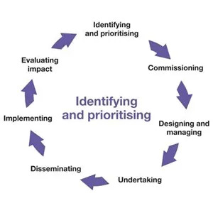

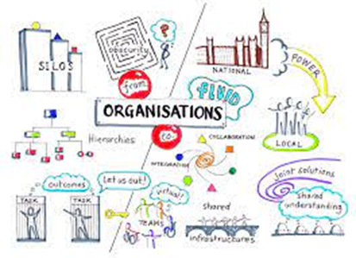


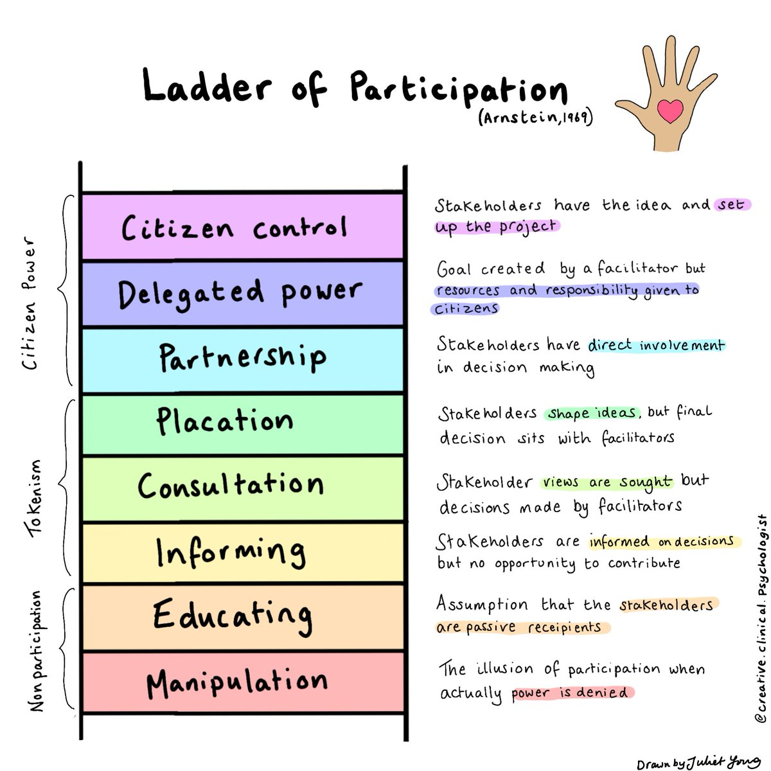
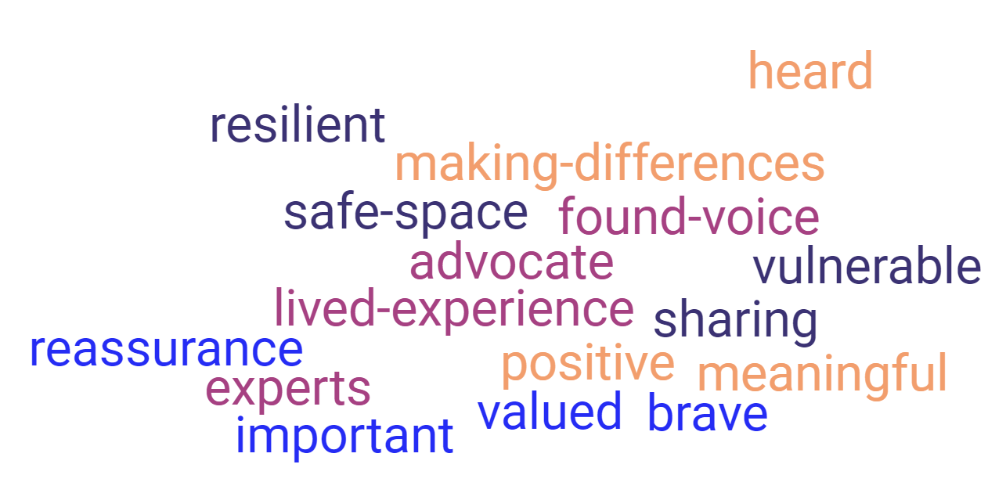
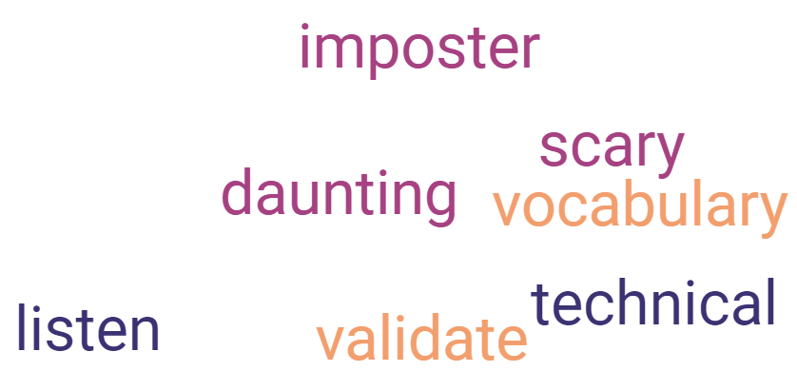
PUBLIC INVOLVEMENT IN RESEARCH
MAKING it make sense. speaks volumes.
Sonia Newman 5565999 Public Involvement in Research 2023
PUBLIC INVOLVEMENT IN RESEARCH. MAKING IT MAKE SENSE. SPEAKS VOLUMES. © 2023 by Sonia Newman is licensed under CC BY 4.0
Sure Start, now called Family Hubs, was established to help young children and their families living in disadvantaged areas. It is widely understood that people from socially disadvantaged groups are underrepresented in research (Bonevski et al, 2014), and it remains a priority for reducing health disparities; yet, engaging these groups is challenging (Erves et al, 2016). Previously the term ‘hard to reach’ was used by researchers for groups they found difficult to access (Sydor, 2013), however, more recently terms such as ‘seldom heard’, ‘underrepresented’, ‘underserved’ and ‘easy to ignore’ are more commonly used. My aim is to better understand the research context and vocabulary for public involvement and how I can translate and apply this to my project in a way that makes sense to underserved groups and furthermore, make sense to the research community.
I set out to understand what the literature says about public involvement in research. It is defined by the NIHR as research being carried out ‘with’ or ‘by’ members of the public; an active partnership with members of the public and researchers that influences and shapes research (INVOLVE, 2017). A critical analysis has provided me with a better understanding of the strengths and weaknesses of various approaches to public involvement, and guide me in choosing the best approach to use for involving and engaging disadvantaged families. Previously, parents views have typically been sought on just a specific part of a project. This type of targeted consultation, often seems tokenistic. In contrast, the user-led approach emphasises parents at the centre of decision-making, where they are involved in generating ideas and taking the lead in directing the nature of the research, as described by Hughes and Duffy (2018). The latter, requires a significant investment of time and resource to establish trust and maintain collaborative relationships with the public (Domecq et al. 2014).
Rolfe et al’s (2001) reflective cycle ‘what?’, ‘so what?’, ‘now what?’ has enabled me to make sense of and process my thoughts and feelings. This journey has unearthed several frustrations; my professional role and how it sits in the space between being bridge builder and translator for both researchers and people. I am grappling with how to make sense of and understand research vocabulary, so I can help it make sense to patients and members of the public, even more so to people from underserved and disadvantaged groups, who wouldn’t normally get involved in research and furthermore, so I can make it make sense to researchers. Grappling with these frustrations against the backdrop of literature has enabled me to understand: It has also reminded me of the power of people’s lived experience. When I hear someone else’s story, I stand in their shoes and reflect on what matters most and how they might feel. This helps me to have a different perspective. Fraser (2001) proposed the idea of having ‘knowledge spaces’ where people can come together and share their knowledge and perspectives to inform decision-making and where system and life worlds can come together. Sharing lived experiences and feeling listened to, is an important part of building trust. These are some of the positive attributes that public members have shared of being involved in research and some of the challenges too. It’s an important reminder that people matter most and I must try not to lose sight of the person in the ‘messiness’:
Reflecting on my levels of confidence with different aspects of public involvement and engagement: Following conversations with staff at the family hub, my proposed involvement and engagement project with parents, is using a…
Most Confident: Making contact with community organisations, building rapport, listening to people’s lived experiences
Public involvement should happen throughout the research cycle then
Research will be more relevant, participant friendly, ethically sound, improving outcomes for patients and service users (Bagley et al. 2016)
Involving the public in the decision-making process and avoiding tokenism
Habermas’ (1985) concept of ‘system and life worlds’ reveal further frustrations;
The ‘system world’ which values the institutional structures and processes, where vocabulary is about the ‘quotable’s and satisfying funders
The ‘life world’ which values people, their experiences, and feelings
Both are motivated by different priorities. The two worlds are not particularly compatible, which makes pulling them together very challenging, however, it is necessary if it is to be meaningful for each.
Least Confident: Engaging with people with disability or impairment. Explaining research to a non-academic audience
Research Cycle – Nuffield Department of Primary Care Health Sciences (2021)
Navigating the Messiness & Complexities
… PARTICIPATORY AND USER-LED APPROACH
Referring to Arnsteins (1969) framework, has been a helpful reminder of the levels of public involvement and the balance of power, when it comes to decision- making, in order to avoid tokenism.
To design an animation, communicating what health research is, from the perspective of people who wouldn’t normally understand or get involved in research.
With a previous project, I have used a targeted approach, seeking parents views and experiences. However, the limitation of this has meant that decision-making remained with the research team.
Using some of the learning from the module, I will take moments to ‘stand in the shoes of parents’, reflecting on what matters most to them in designing the animation.
Initially a participatory approach, so that parents feel empowered, included and actively involved in all aspects of the project (Oliver et al, 2004). It means they can develop understanding and confidence in research, before moving towards a user-led approach, once their confidence increases and they feel able to generate their own ideas, make decisions and take the lead in directing projects.
The animation will benefit the wider community accessing services at the Family Hub in raising curiosity in health research and will add value to the research community in providing a different perspective, from the people’s voice.
The context of both the ‘messiness’ and
How my role sits in the ‘space between’ and
The challenge of ‘making it work for both’
References: Arnstein, S.R. (1969) ‘A ladder of citizen participation’, Journal of the American Institute of Planners, 35(4), pp. 216–224. doi:10.1080/01944366908977225. Bagley, H.J. et al. (2016) ‘A patient and Public Involvement (PPI) toolkit for meaningful and flexible involvement in clinical trials – A WORK IN PROGRESS’, Research Involvement and Engagement, 2(1). doi:10.1186/s40900-016-0029-8. Bonevski, B. et al. (2014) ‘Reaching the hard-to-reach: A systematic review of strategies for improving health and medical research with socially disadvantaged groups’, BMC Medical Research Methodology, 14(1). doi:10.1186/1471-2288-14-42. Domecq, J.P. et al. (2014) ‘Patient engagement in research: A systematic review’, BMC Health Services Research, 14(1). doi:10.1186/1472-6963-14-89. Erves, J.C. et al. (2016) ‘Needs, priorities, and recommendations for engaging underrepresented populations in clinical research: A community perspective’, Journal of Community Health, 42(3), pp. 472–480. doi:10.1007/s10900-016-0279-2. Fraser, N. (2001) ‘Recognition without ethics?’, Theory, Culture & Society, 18(2–3), pp. 21–42. doi:10.1177/02632760122051760. Habermas, J. (1985) The Theory of Communicative Action: Lifeword and System: A Critique of Functionalist Reason Vol 2. Beacon Press. Hughes, M. and Duffy, C. (2018) ‘Public involvement in health and Social Sciences Research: A concept analysis’, Health Expectations, 21(6), pp. 1183–1190. doi:10.1111/hex.12825. Oliver, S. et al. (2004) ‘Involving consumers in research and development agenda setting for the NHS: Developing an evidence-based approach’, Health Technology Assessment, 8(15). doi:10.3310/hta8150. PPI Research cycle (2021) Nuffield Department of Primary Care Health Sciences, University of Oxford. Available at: https://www.phc.ox.ac.uk/images/ppi/research-cycle/view (Accessed: 16 May 2023). Rolfe, G., Freshwater, D. and Jasper, M. (2001) Critical reflection for nursing and the helping professions: A user’s guide. London: Palgrave Macmillan. Sydor, A. (2013) ‘Conducting research into hidden or hard-to-reach populations’, Nurse Researcher, 20(3), pp. 33–37. doi:10.7748/nr2013.01.20.3.33.c9495. What is public involvement in research? (2017) INVOLVE | INVOLVE Supporting public involvement in NHS, public health and social care research. Available at: http://www.invo.org.uk/ (Accessed: 16 May 2023).

