Slide 1
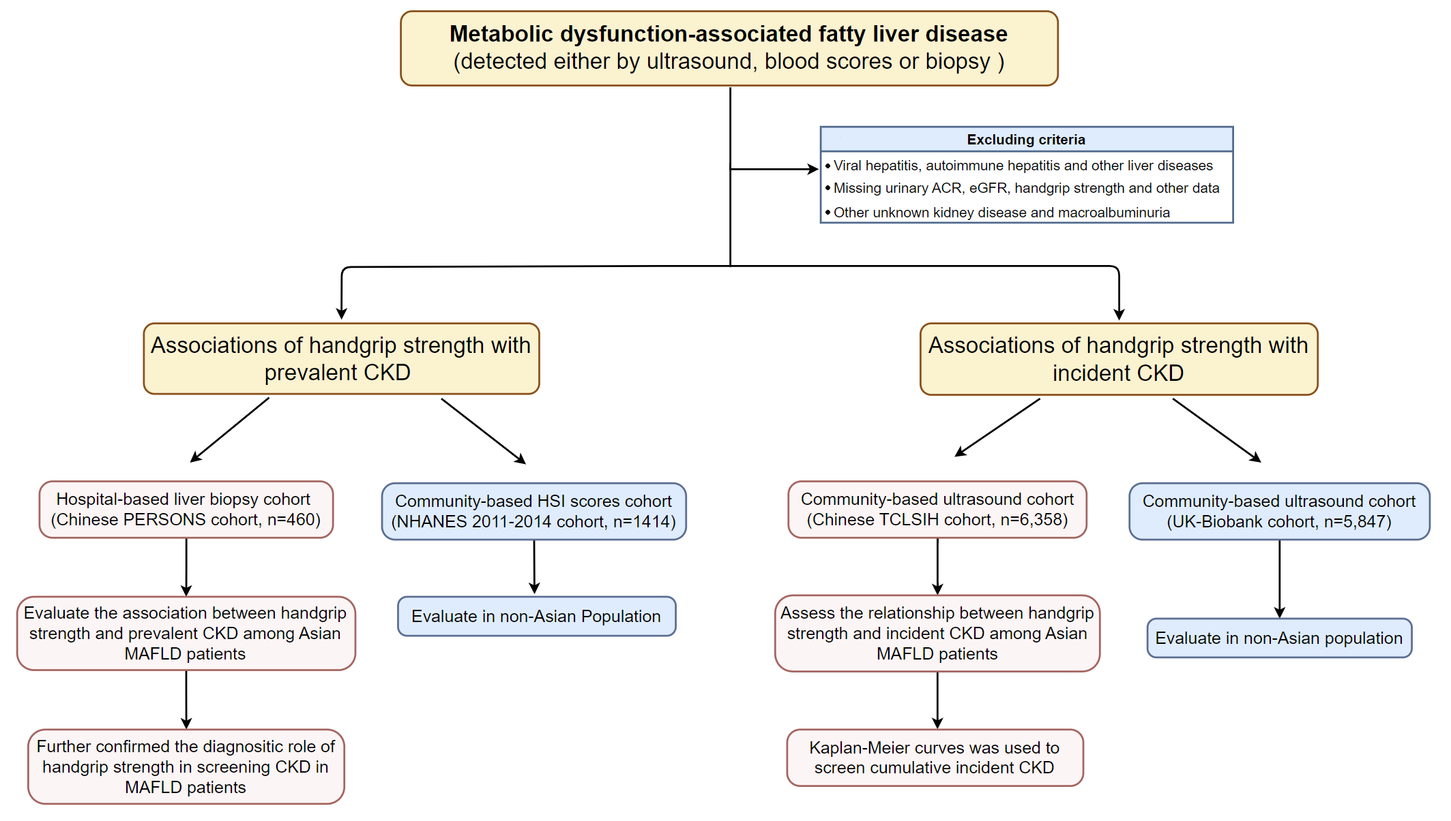
Notes:
Figure 1

Slide 2
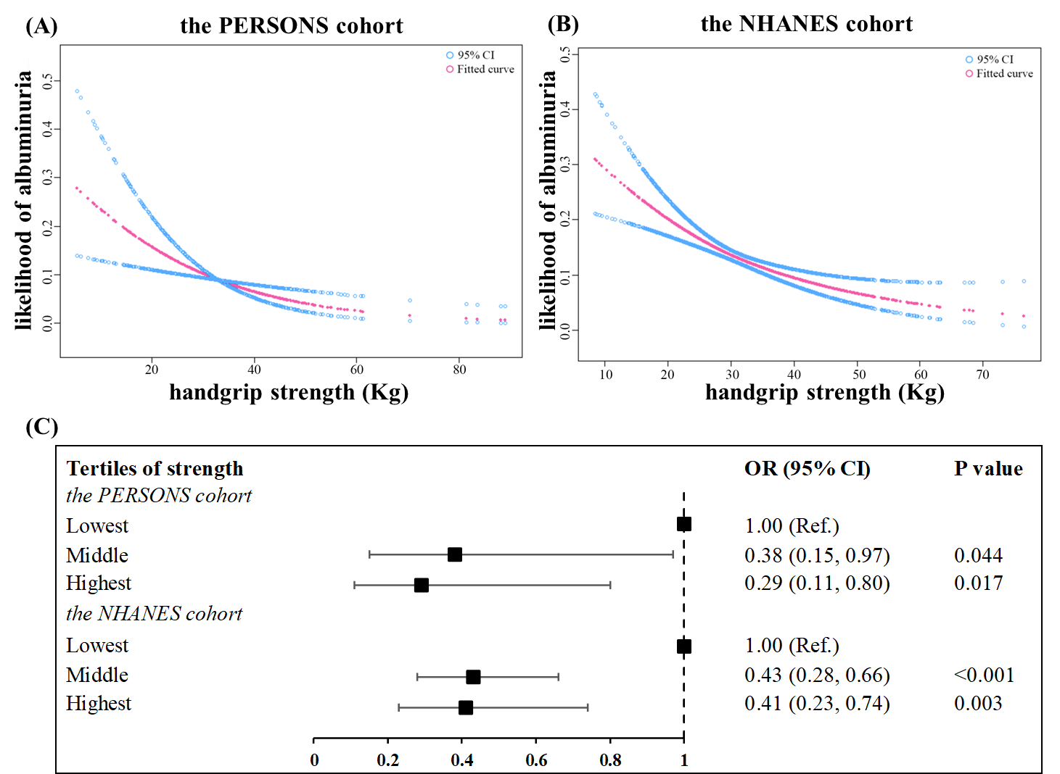
Notes:
Figure 2

Slide 3
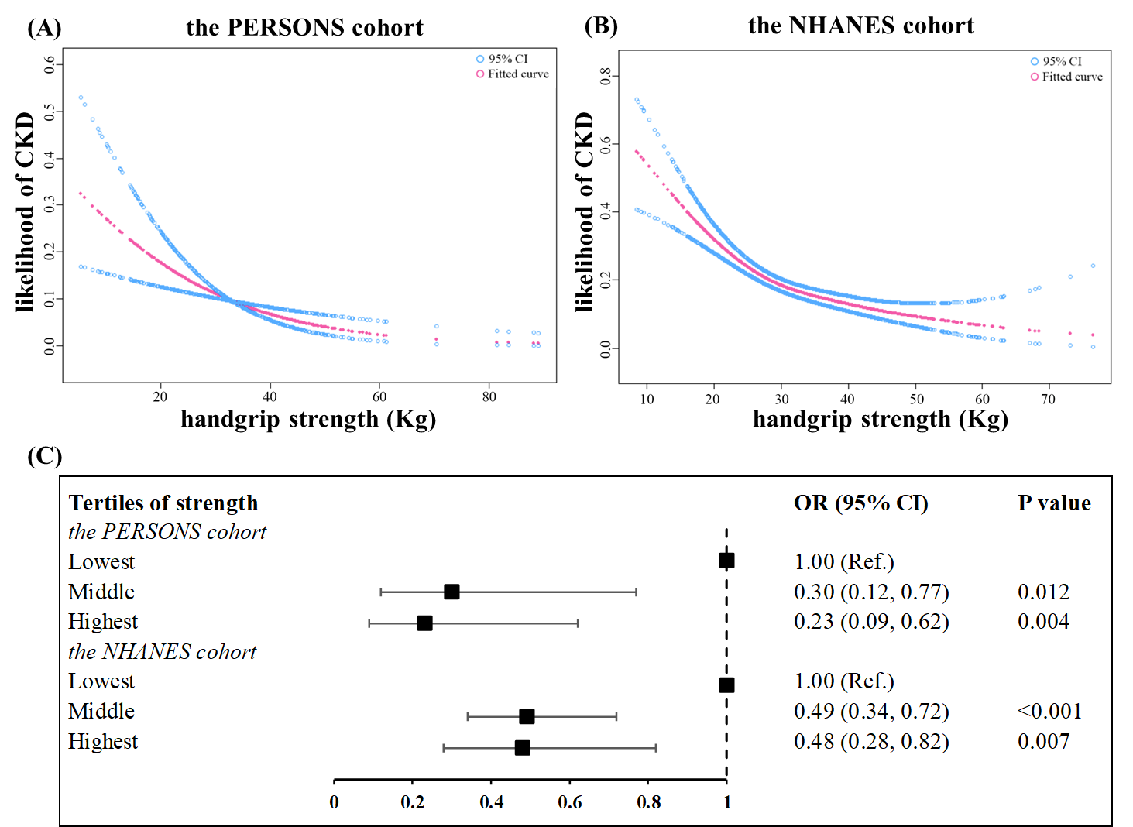
Notes:
Figure 3

Slide 4
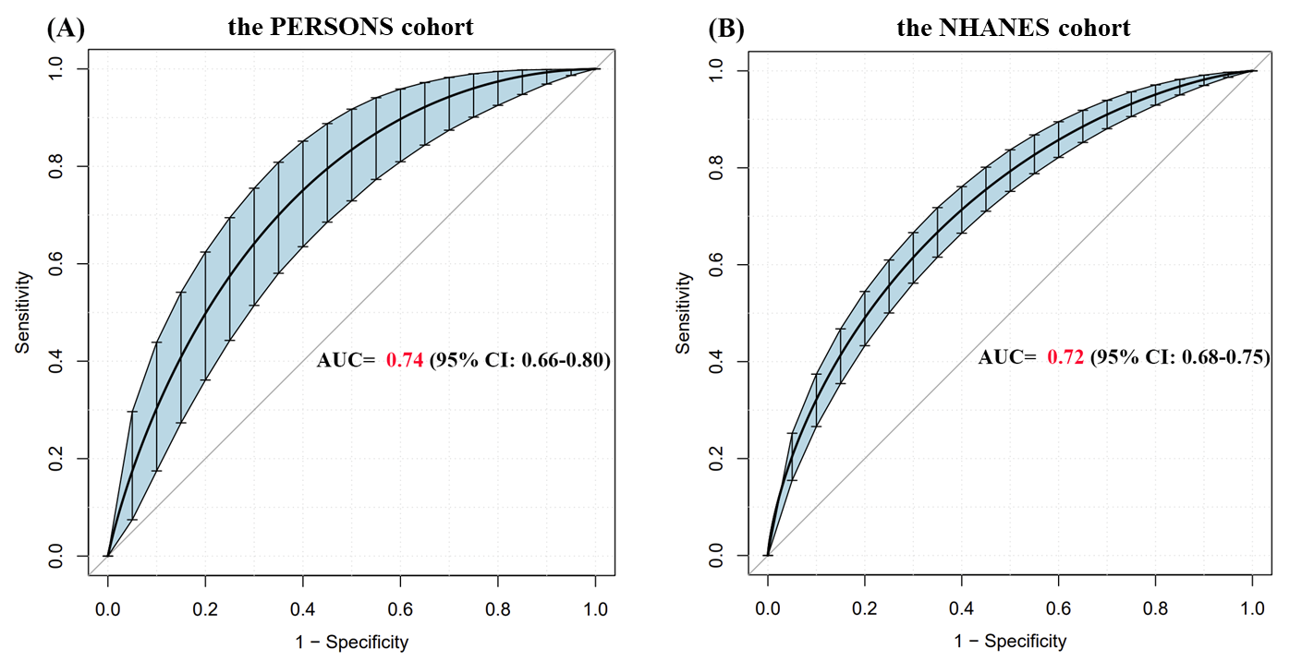
Notes:
Figure 4

Slide 5
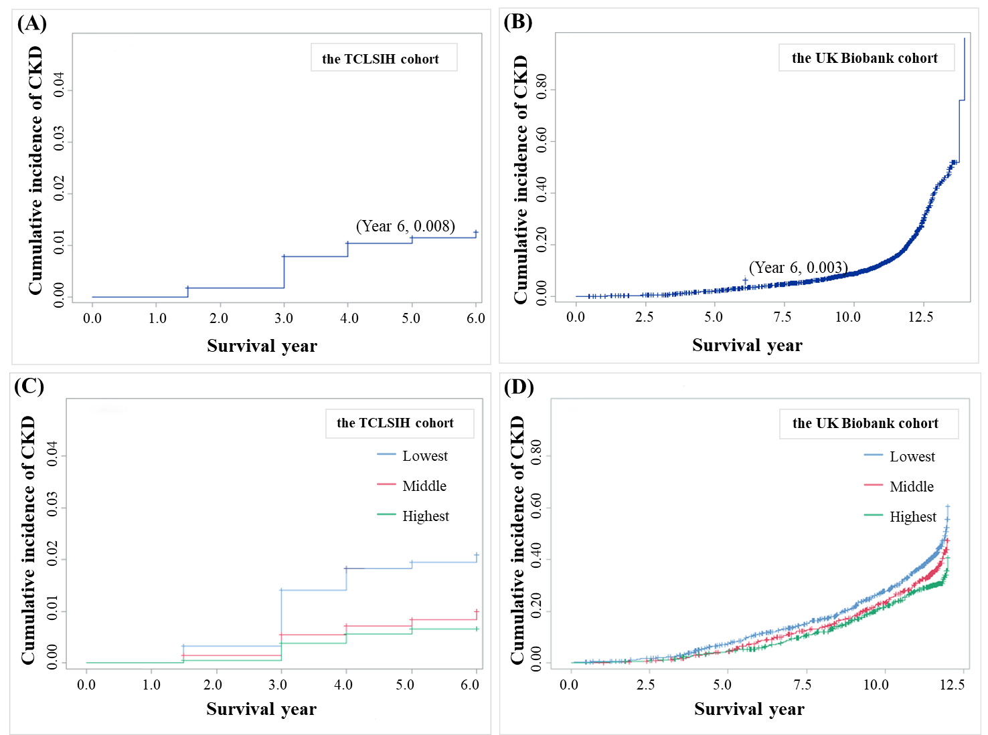
Notes:
Figure 5

