Slide 1



The Bipolar UK Commission Survey: Access to Psychological Therapies
Dr. Thomas Richardson
Associate Professor of Clinical Psychology, University of Southampton, UK
@DrTomRichardson
T.H.Richardson@soton.ac.uk

Slide 2
Conflict of Interest Declaration
I have received payments for training NHS services about Bipolar Disorder.
I receive royalties from a book on psychological therapies for Bipolar.
Notes:
Comparable to lithium in reduced risk of relapse.

Slide 3
Bipolar and Psychological Therapies: Evidence
Miklowitz et al. (2021): Meta-analysis of 39 RCTs showed psychoeducation delivered via family therapy or a in a group setting reduced the risk of relapse:
50% reduction in relapse for therapy + medication (compared to medication alone).
Group or family interventions better at reducing relapse risk.
CBT, family therapy and interpersonal therapy reduce depression symptom severity
Notes:
Comparable to lithium in reduced risk of relapse.

Slide 4
Bipolar and Psychological Therapies: Evidence
NICE guidelines: Psychological therapies should be offered in the long-term management of Bipolar disorder in secondary care, 16-20 sessions.
Department of Health/Health Education England extra funding (IAPT-SMI) for training for CBT for Bipolar.
National Health Service: Universal healthcare, provided free at point of delivery.
Notes:
Comparable to lithium in reduced risk of relapse.

Slide 5
Overview: Common therapy components
Psychoeducation
Identify triggers
Identify early warning signs
Behavioural strategies
Mood monitoring
Thought identifying and challenging
Relapse prevention plan
Behavioural activation for acute symptoms
Challenge cognitive vulnerability: Dysfunctional assumptions, perfectionism.

Slide 6

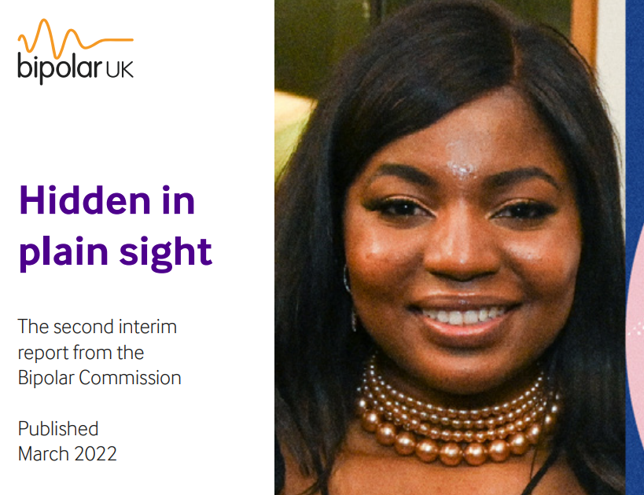
Bipolar and Psychological Therapies: Access
Survey of over a thousand UK based individuals.
Only 69% had ever been offered psychological therapy on NHS.
Only 20% had ever been offered group-based psychoeducation.
26% had been told that they couldn’t access psychological therapy on the NHS.
49% had to self-fund their own therapy at some point.
Postcode lottery: Some specialist Bipolar services (e.g. Birmingham): Some not offered anything.

Slide 7
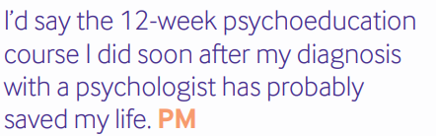
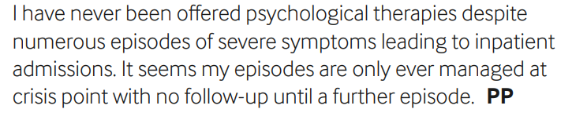
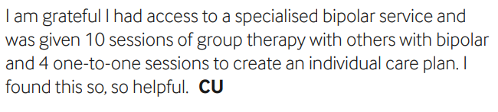
Bipolar and Psychological Therapies: Access

Slide 8
Predictors of Receiving Therapy
No impact of:
Where in country
Gender
Age
Whether received inpatient care in the past yea
Employed
Income

Slide 9
Predictors of Receiving Therapy
Referral for therapy on NHS:
Bipolar II disorder more likely than Bipolar II disorder:
56.1% vs. 48.6%: ᵡ=3.8, p<.05.
More likely if under special Bipolar service:
84.6% vs. 66.9%: ᵡ=15.5, p<.001.
More likely if under a crisis team recently:
76.3% vs. 62%: ᵡ=22.2, p<.001.
Same effects for referral for CBT specifically.

Slide 10
Predictors of Receiving Therapy
Having to pay privately for therapy:
Bipolar II disorder more likely than Bipolar I disorder:
75.1% vs. 67.9%: ᵡ=3.8, p<.10.
More likely for Gay/Bi than heterosexual individuals:
60.5% vs. 47.7%: ᵡ=8.3, p<.01.
More likely if currently employed than unemployed:
55.5% vs. 45.4%: ᵡ=9.6, p<.01.
More likely if mid/high income (compared to low or on benefits)
59% vs. 45.7%: ᵡ=14.9, p<.001.

Slide 11
Conclusions
Majority of people in UK have been offered therapy through the NHS.
However still poor access.
Wide variation: Post code lottery in places.
Need to increase access to psychoeducation groups in particular.

Slide 12

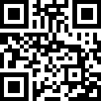
Book on Psychological Therapies ready for pre-order:

