Slide 1
M and E cell per4gRNA Data
17/04/2021

Slide 2
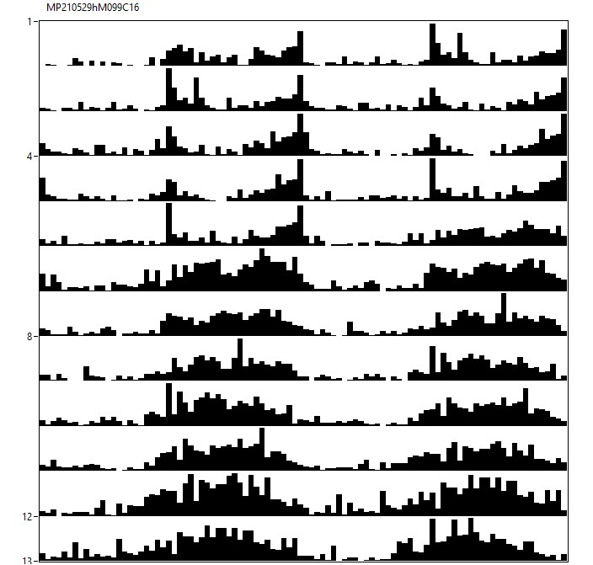
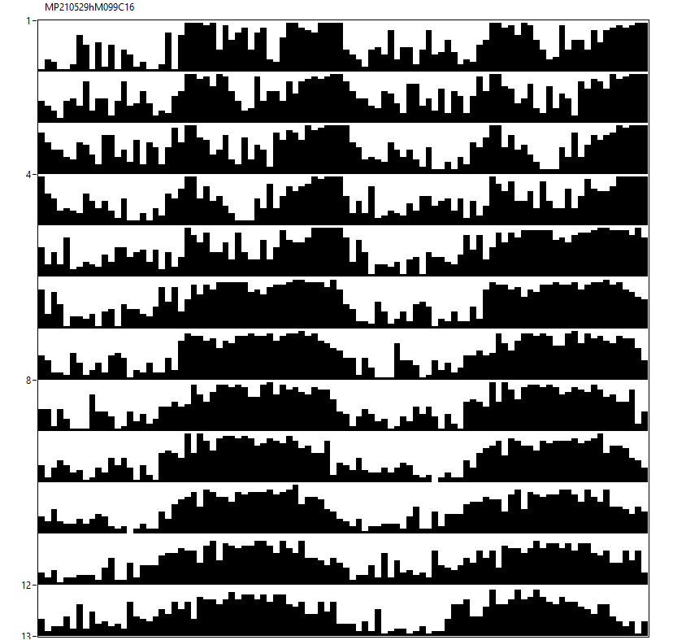
12♂ w[*];per4gRNA/CyO;UAS-Cas9/(TM6BTb[1]) [12hL:12hD]₅>[DD]₇ 23°C
M99

Slide 3
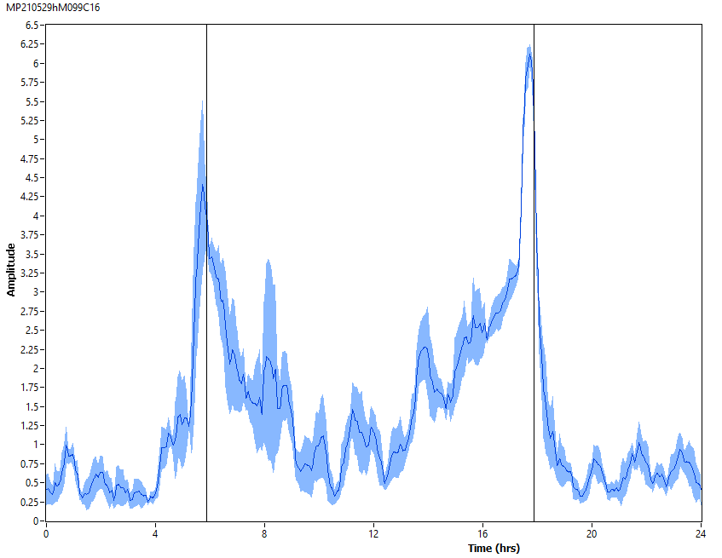
12♂ w[*];per4gRNA/CyO;UAS-Cas9/(TM6BTb[1]) [12hL:12hD]₅ 23°C
M99

Slide 4
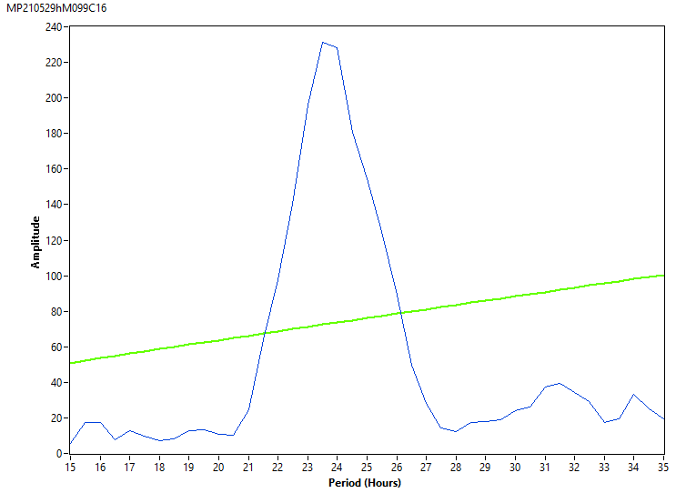
12♂ w[*];per4gRNA/CyO;UAS-Cas9/(TM6BTb[1]) [DD]₇ 23°C
M99

Slide 5
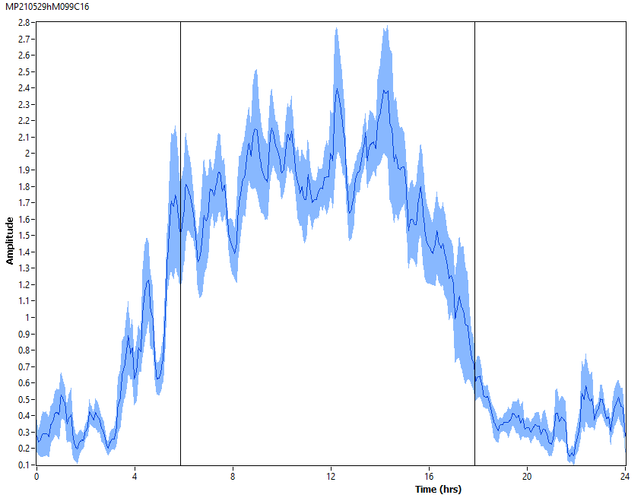
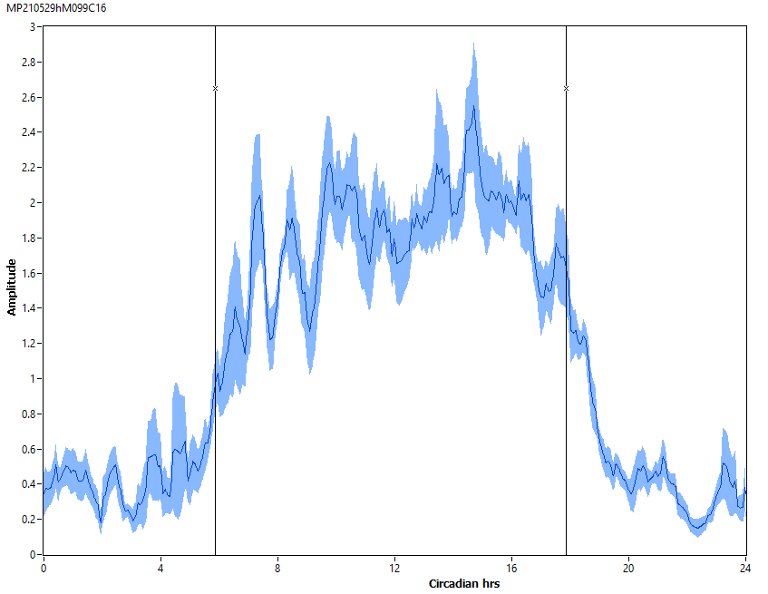
12♂ w[*];per4gRNA/CyO;UAS-Cas9/(TM6BTb[1]) [DD]₇ 23°C
M99

Slide 6
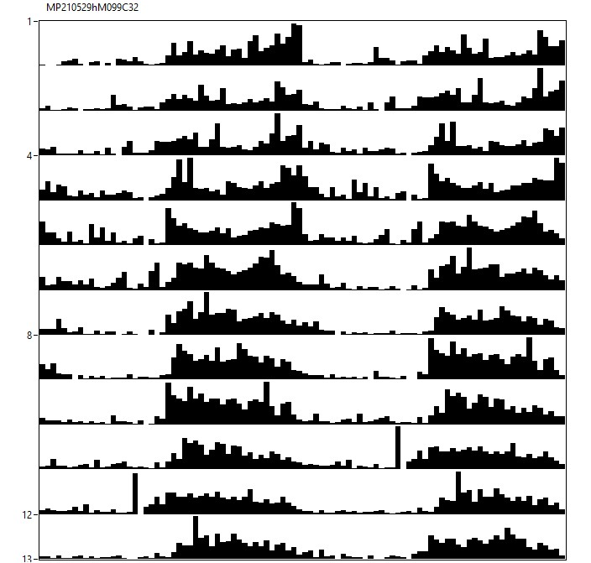
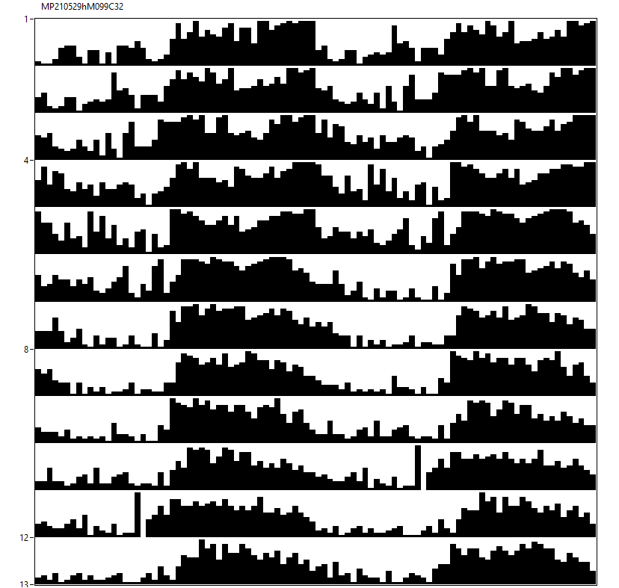
12♀ w[*];per4gRNA/CyO;UAS-Cas9/(TM6BTb[1]) [12hL:12hD]₅>[DD]₇ 23°C
M99

Slide 7
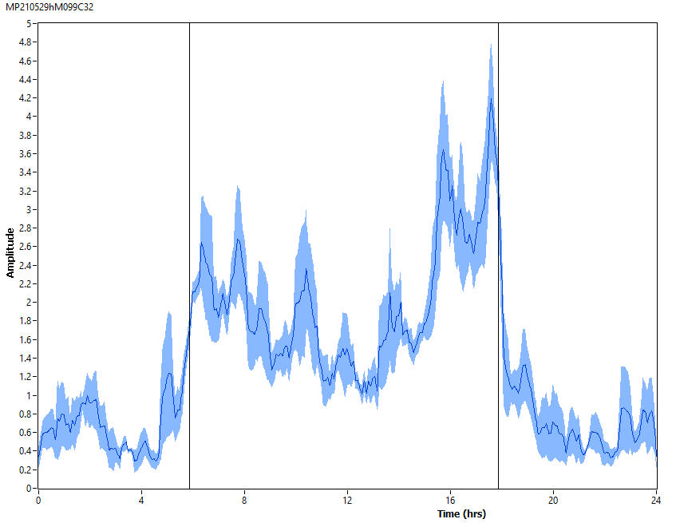
12♀ w[*];per4gRNA/CyO;UAS-Cas9/(TM6BTb[1]) [12hL:12hD]₅ 23°C
M99

Slide 8
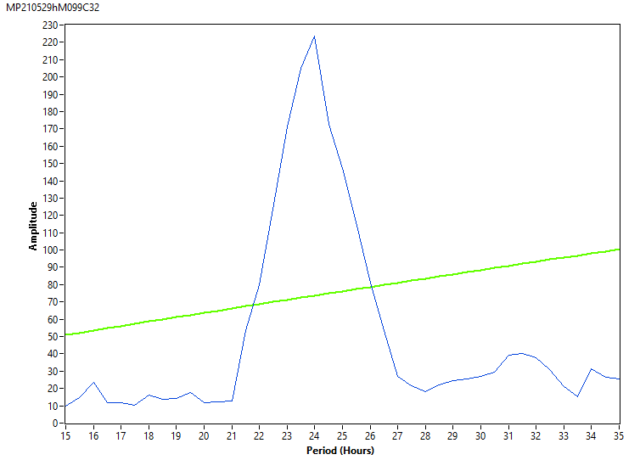
12♀ w[*];per4gRNA/CyO;UAS-Cas9/(TM6BTb[1]) [DD]₇ 23°C
M99

Slide 9
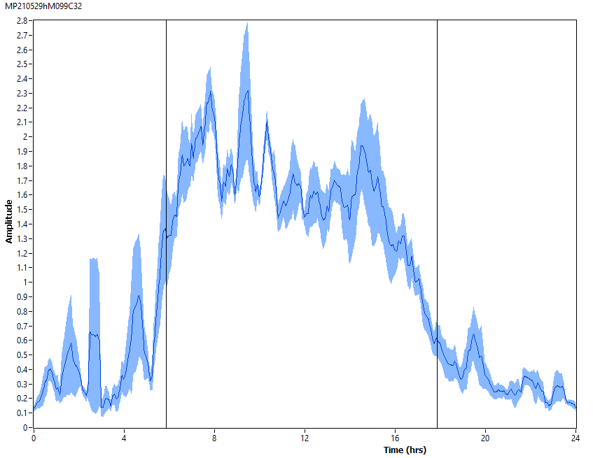
12♀ w[*];per4gRNA/CyO;UAS-Cas9/(TM6BTb[1]) [DD]₇ 23°C
M99

Slide 10
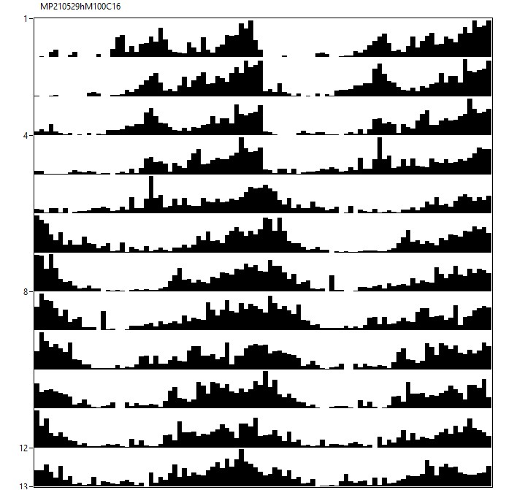
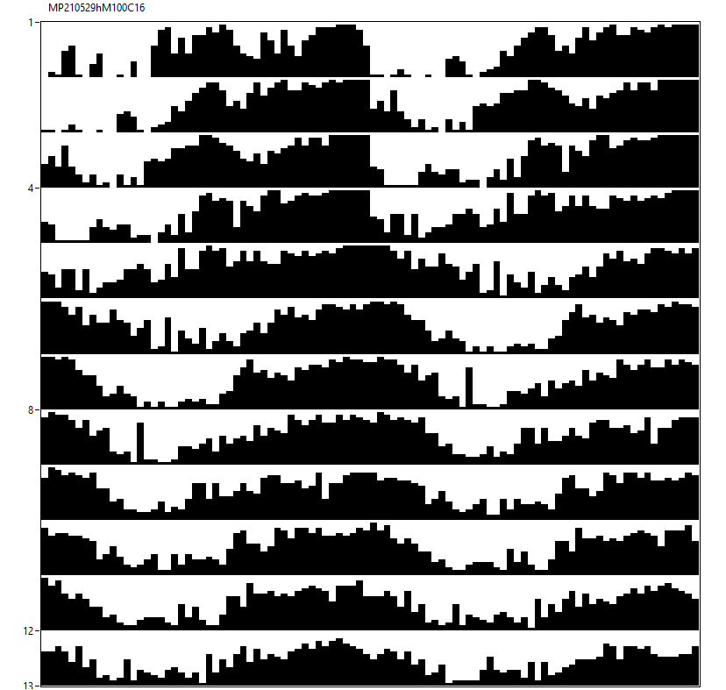
10♂ w[*];per4gRNA/CyO;UAS-Cas9/(TM6BTb[1]) [12hR:12hD]₅>[RR]₇ 23°C
M100

Slide 11
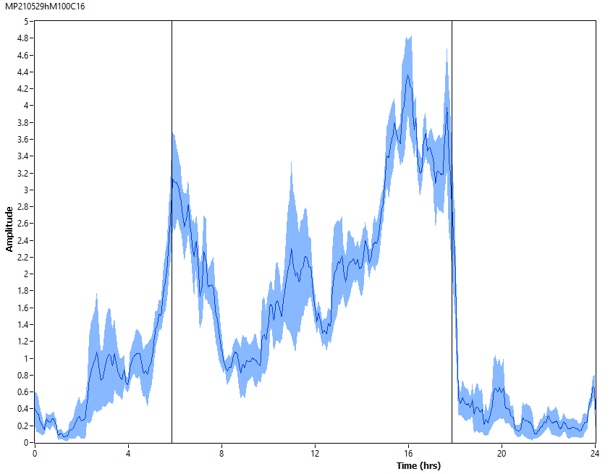
10♂ w[*];per4gRNA/CyO;UAS-Cas9/(TM6BTb[1]) [12hR:12hD]₅ 23°C
M100

Slide 12
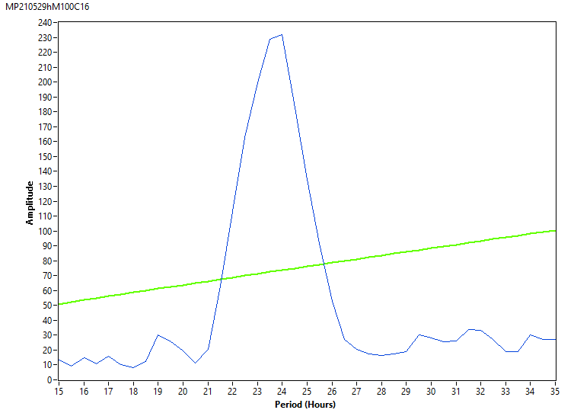
10♂ w[*];per4gRNA/CyO;UAS-Cas9/(TM6BTb[1]) [RR]₇ 23°C
M100

Slide 13
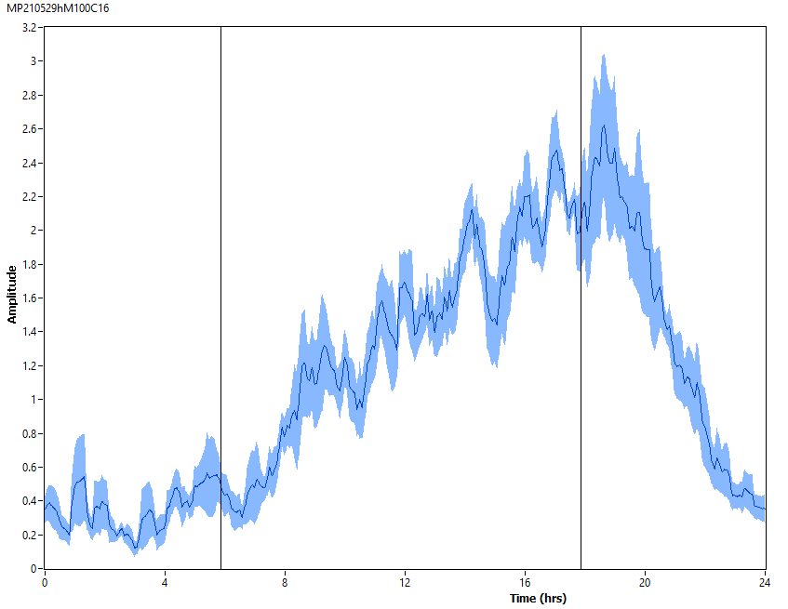
10♂ w[*];per4gRNA/CyO;UAS-Cas9/(TM6BTb[1]) [RR]₇ 23°C
M100

Slide 14
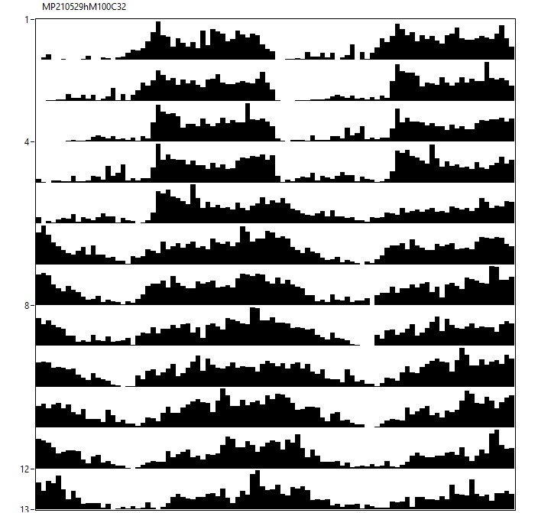
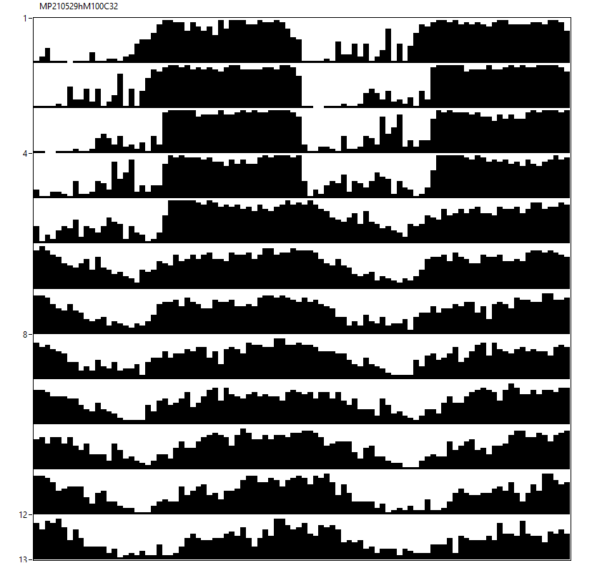
12♀ w[*];per4gRNA/CyO;UAS-Cas9/(TM6BTb[1]) [12hR:12hD]₅>[RR]₇ 23°C
M100

Slide 15
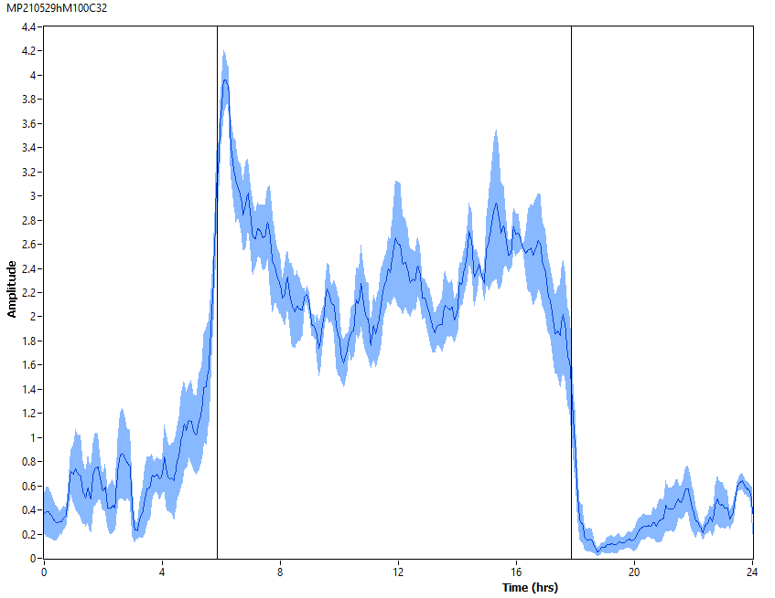
12♀ w[*];per4gRNA/CyO;UAS-Cas9/(TM6BTb[1]) [12hR:12hD]₅ 23°C
M100

Slide 16
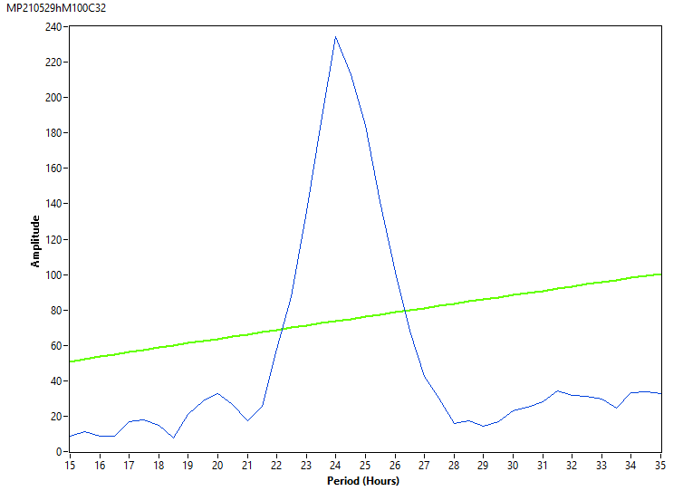
12♀ w[*];per4gRNA/CyO;UAS-Cas9/(TM6BTb[1]) [RR]₇ 23°C
M100

Slide 17
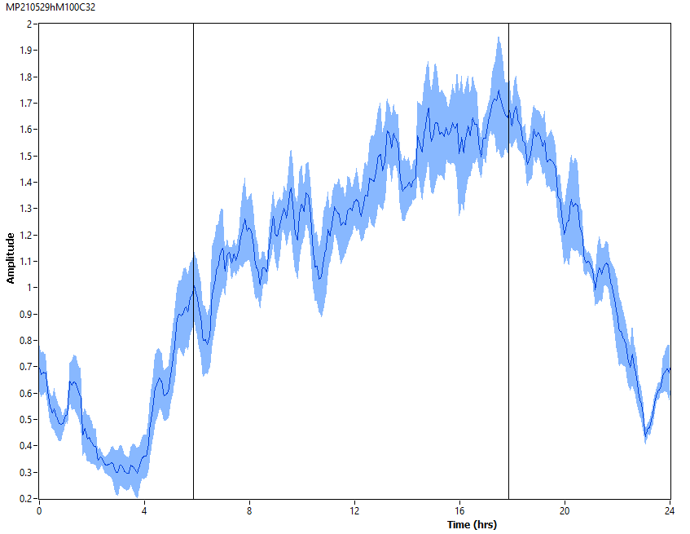
12♀ w[*];per4gRNA/CyO;UAS-Cas9/(TM6BTb[1]) [RR]₇ 23°C
M100

Slide 18
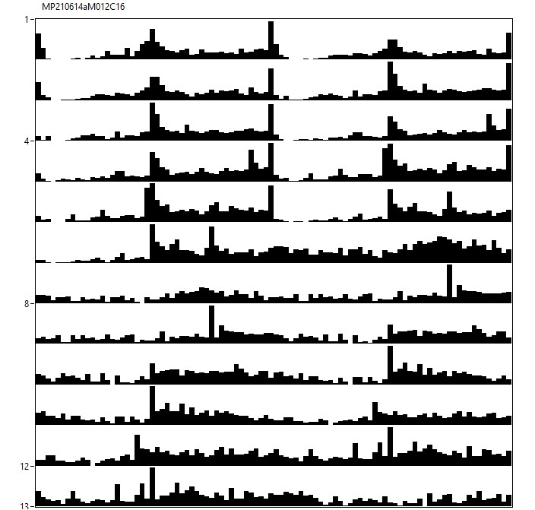
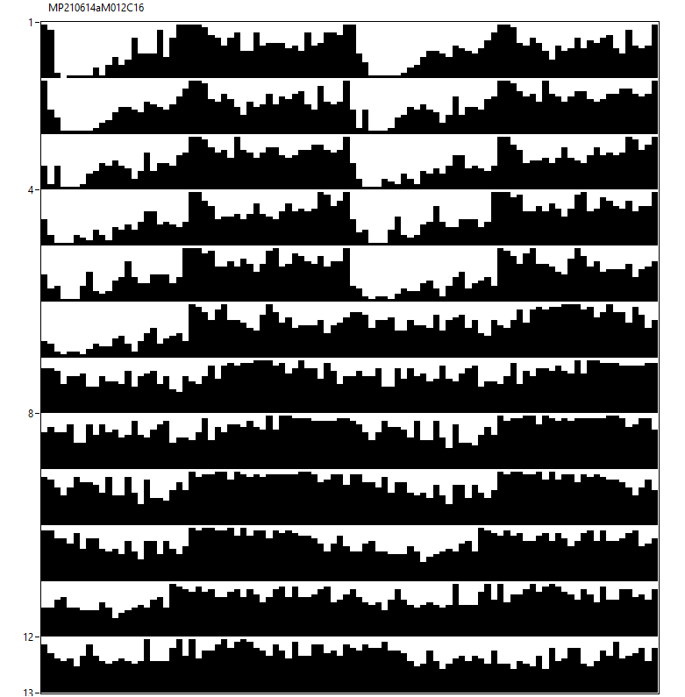
24♂ w[*];per4gRNA/Clk[856]-Gal4;UAS-Cas9/+ [12hL:12hD]₅>[DD]₇ 23°C
M64+12

Slide 19
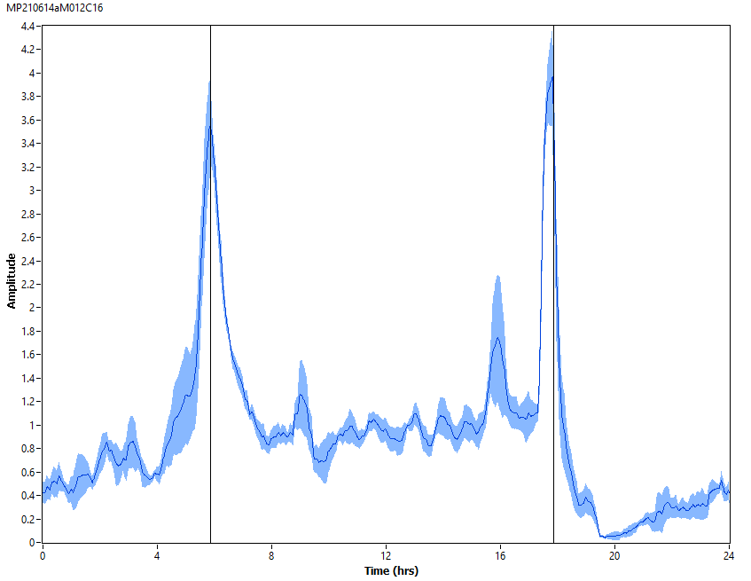
24♂ w[*];per4gRNA/Clk[856]-Gal4;UAS-Cas9/+ [12hL:12hD]₅ 23°C
M64+12

Slide 20
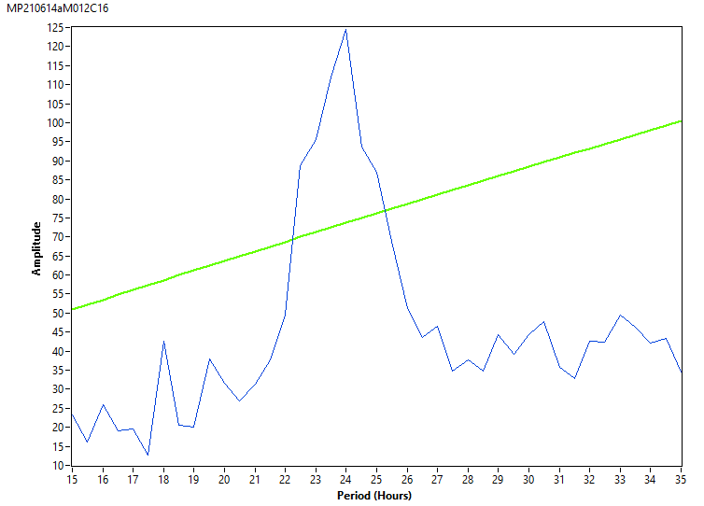
24♂ w[*];per4gRNA/Clk[856]-Gal4;UAS-Cas9/+ [DD]₇ 23°C
M64+12

Slide 21
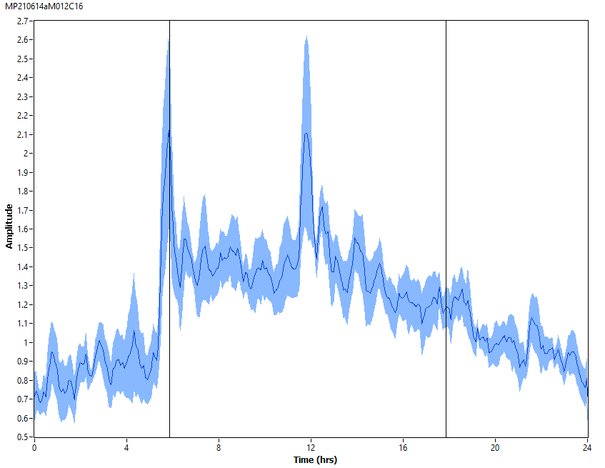
24♂ w[*];per4gRNA/Clk[856]-Gal4;UAS-Cas9/+ [DD]₇ 23°C
M64+12

Slide 22
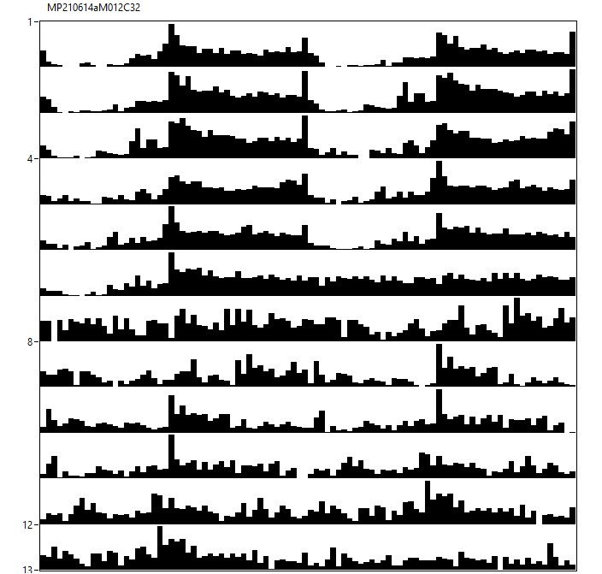
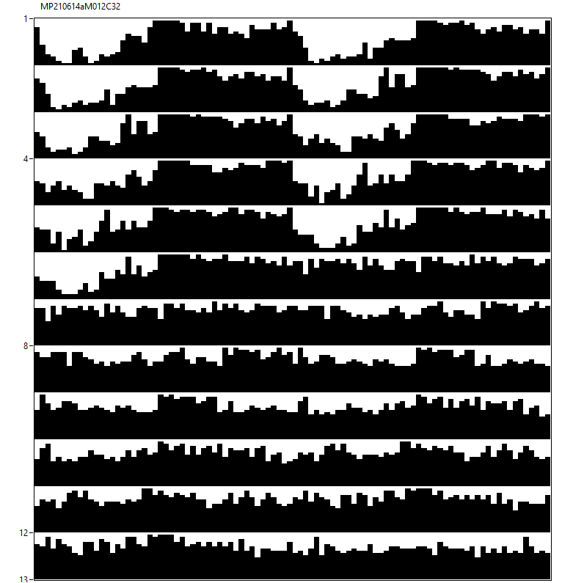
17♀ w[*];per4gRNA/Clk[856]-Gal4;UAS-Cas9/+ [12hL:12hD]₅>[DD]₇ 23°C
M64+12

Slide 23
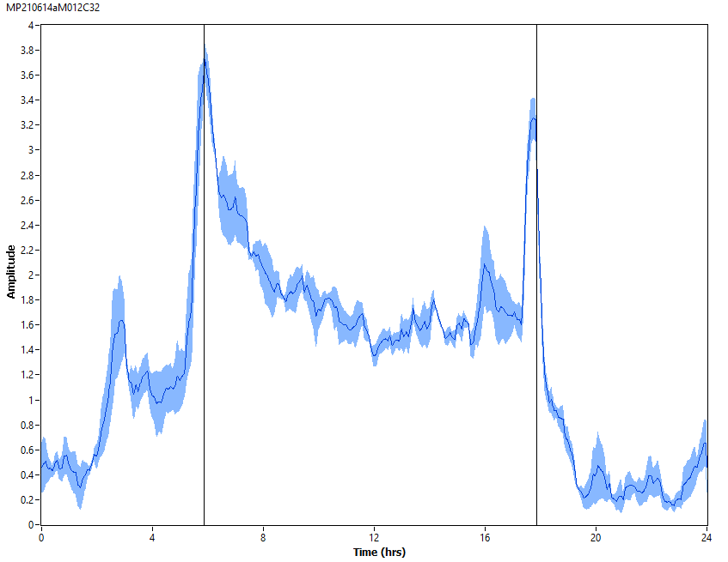
17♀ w[*];per4gRNA/Clk[856]-Gal4;UAS-Cas9/+ [12hL:12hD]₅ 23°C
M64+12

Slide 24
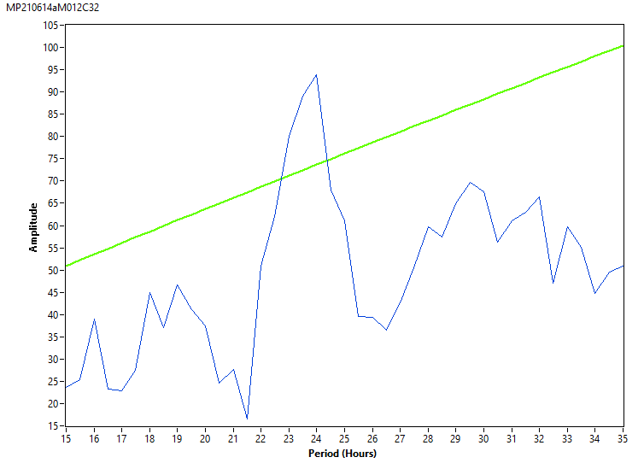
17♀ w[*];per4gRNA/Clk[856]-Gal4;UAS-Cas9/+ [DD]₇ 23°C
M64+12

Slide 25
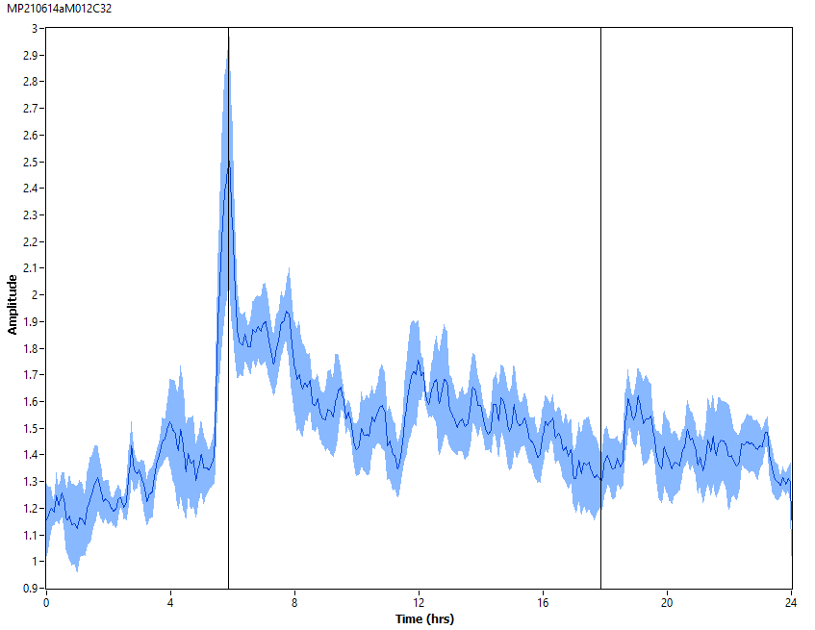
17♀ w[*];per4gRNA/Clk[856]-Gal4;UAS-Cas9/+ [DD]₇ 23°C
M64+12

Slide 26
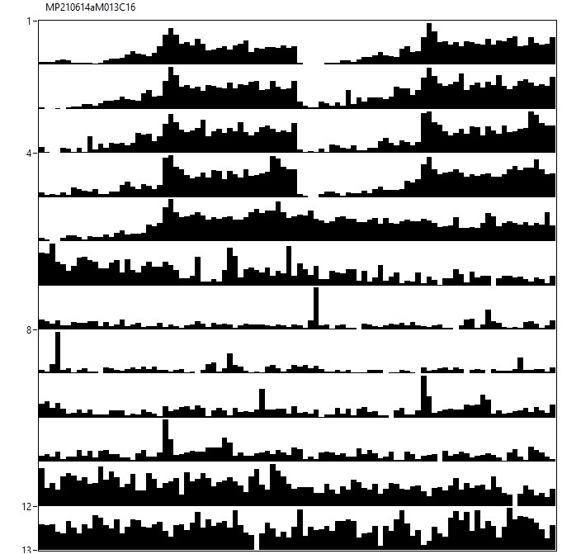
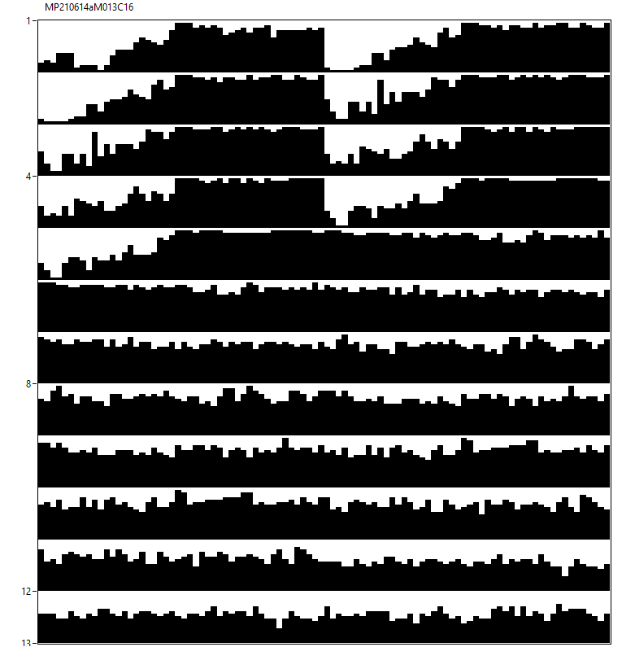
22♂ w[*];per4gRNA/Clk[856]-Gal4;UAS-Cas9/+ [12hR:12hD]₅>[RR]₇ 23°C
M65+13

Slide 27
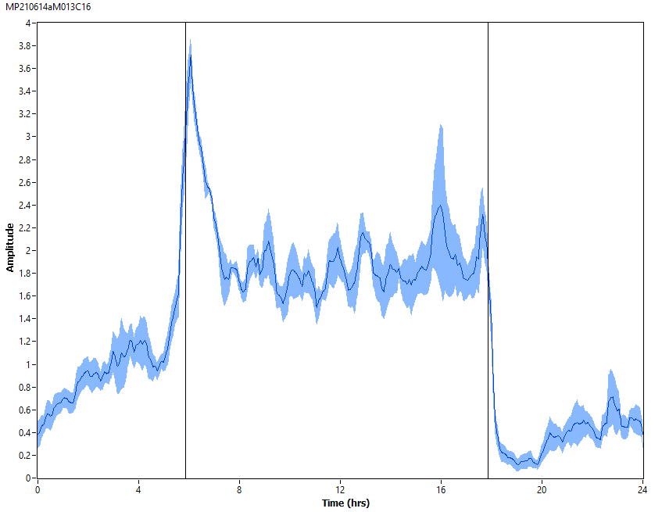
22♂ w[*];per4gRNA/Clk[856]-Gal4;UAS-Cas9/+ [12hR:12hD]₅ 23°C
M65+13

Slide 28
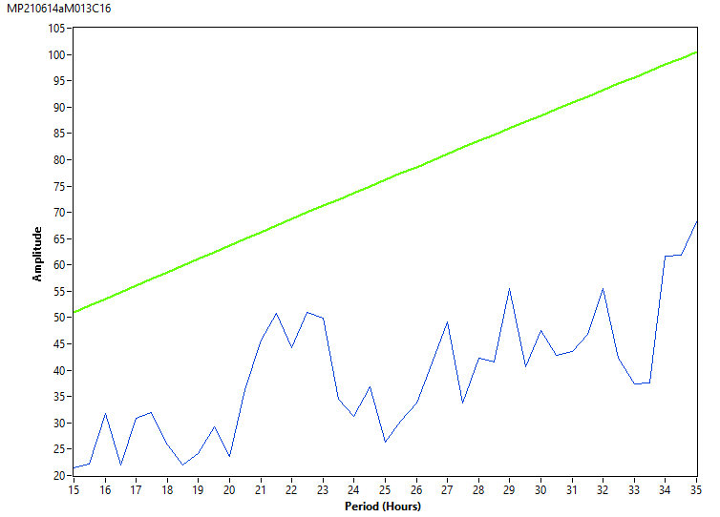
22♂ w[*];per4gRNA/Clk[856]-Gal4;UAS-Cas9/+ [RR]₇ 23°C
M65+13

Slide 29
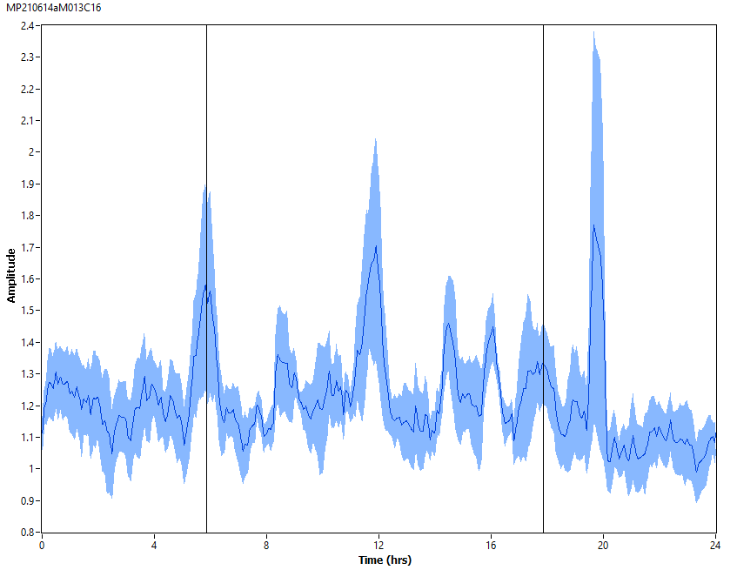
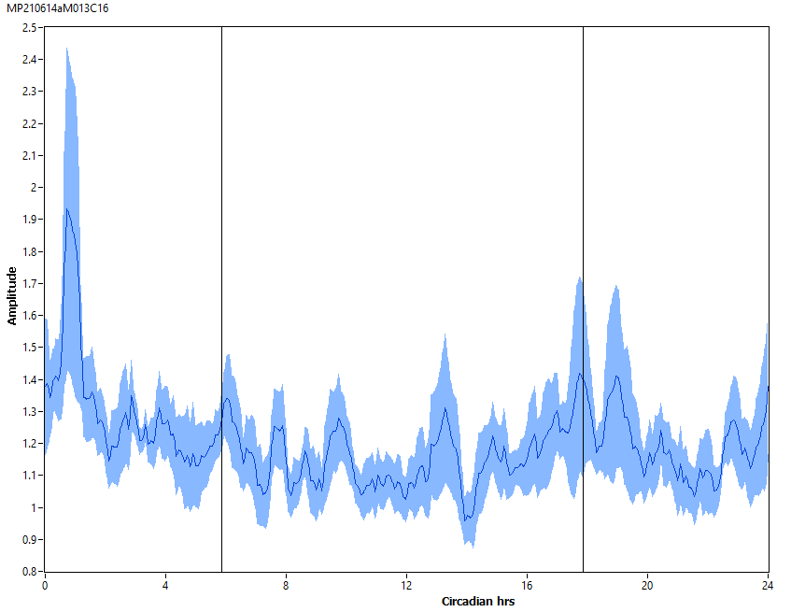
22♂ w[*];per4gRNA/Clk[856]-Gal4;UAS-Cas9/+ [RR]₇ 23°C
M65+13

Slide 30
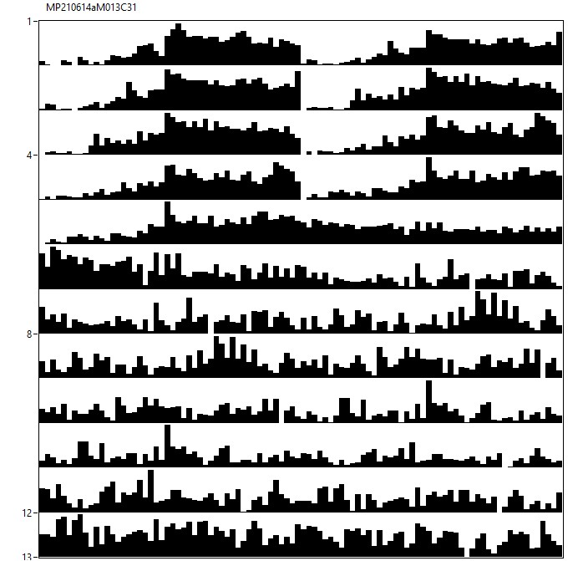
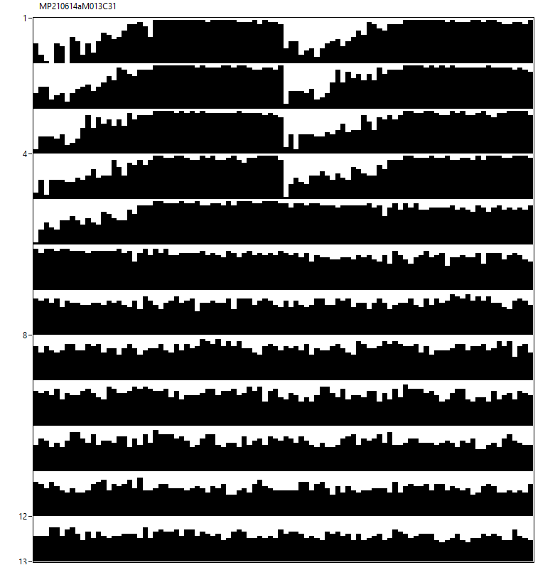
15♀ w[*];per4gRNA/Clk[856]-Gal4;UAS-Cas9/+ [12hR:12hD]₅>[RR]₇ 23°C
M65+13

Slide 31
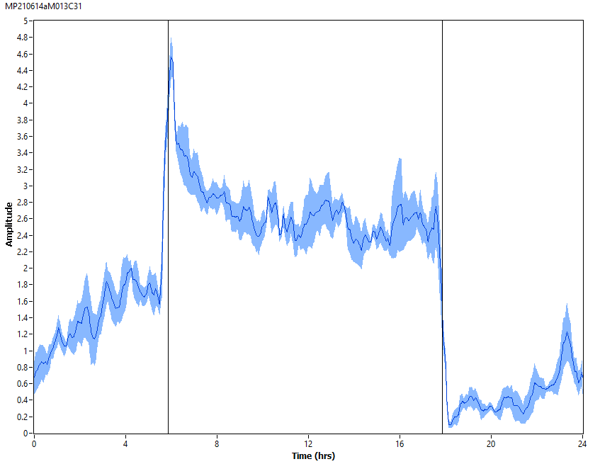
15♀ w[*];per4gRNA/Clk[856]-Gal4;UAS-Cas9/+ [12hR:12hD]₅ 23°C
M65+13

Slide 32
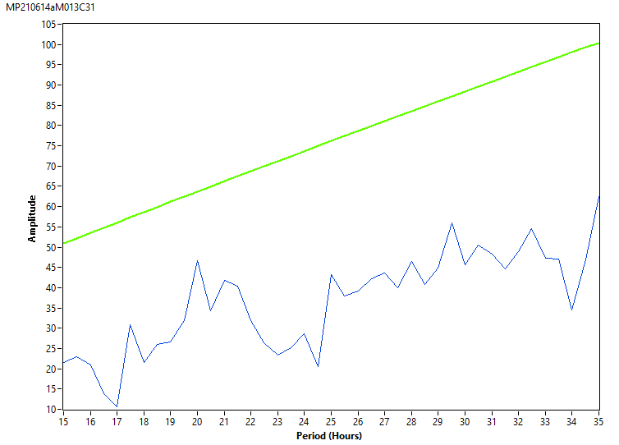
15♀ w[*];per4gRNA/Clk[856]-Gal4;UAS-Cas9/+ [RR]₇ 23°C
M65+13

Slide 33
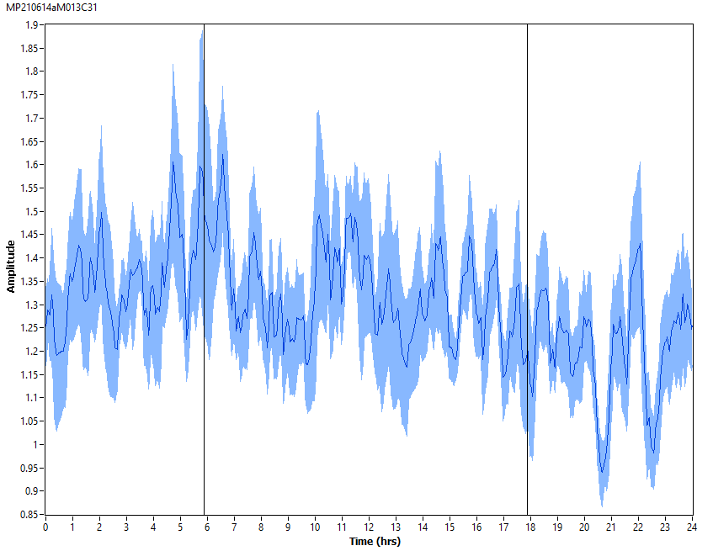
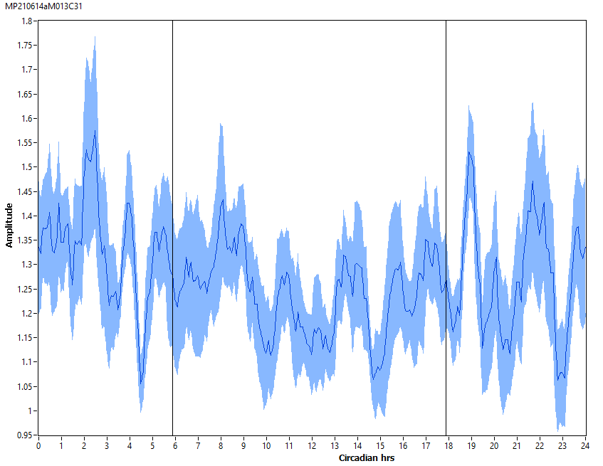
15♀ w[*];per4gRNA/Clk[856]-Gal4;UAS-Cas9/+ [RR]₇ 23°C
M65+13

Slide 34
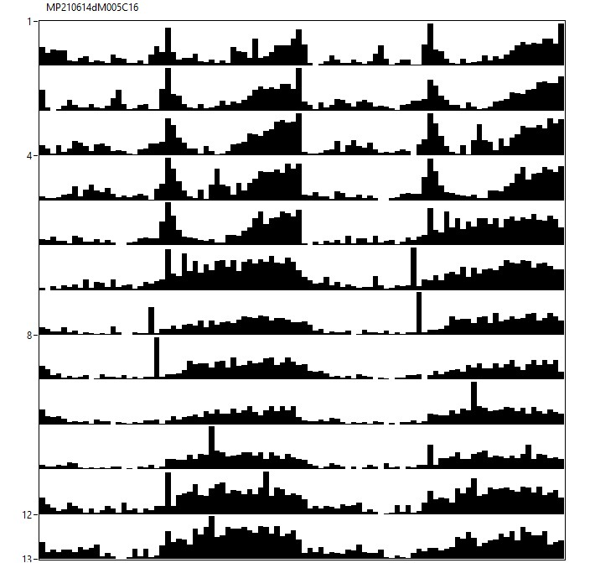
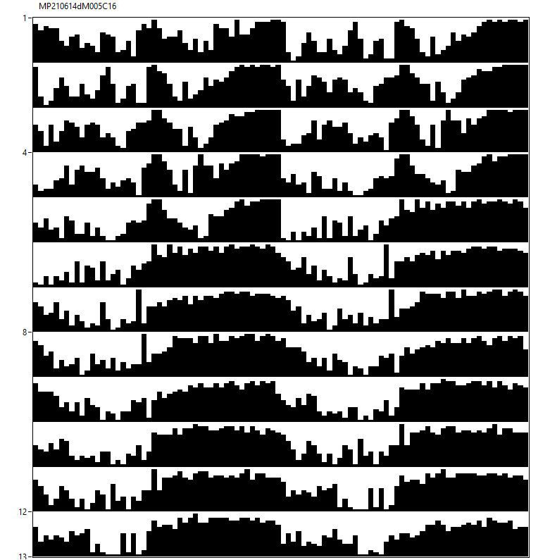
13♂ w[*];per4gRNA/MB122B-Gal4;UAS-Cas9/+ [12hL:12hD]₅>[DD]₇ 23°C
M58+5

Slide 35
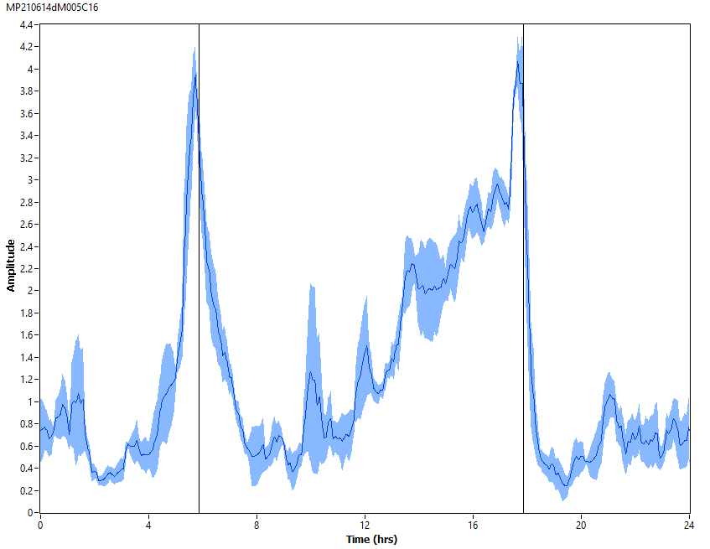
13♂ w[*];per4gRNA/MB122B-Gal4;UAS-Cas9/+ [12hL:12hD]₅ 23°C
M58+5

Slide 36
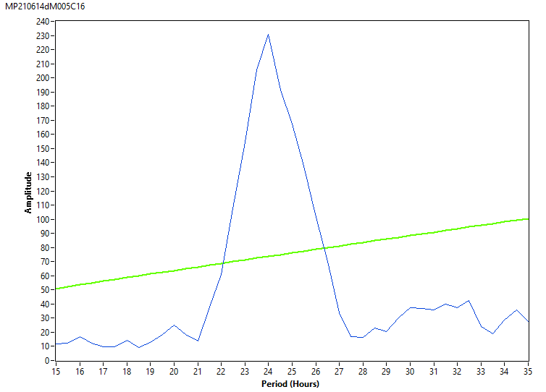
13♂ w[*];per4gRNA/MB122B-Gal4;UAS-Cas9/+ [DD]₇ 23°C
M58+5

Slide 37
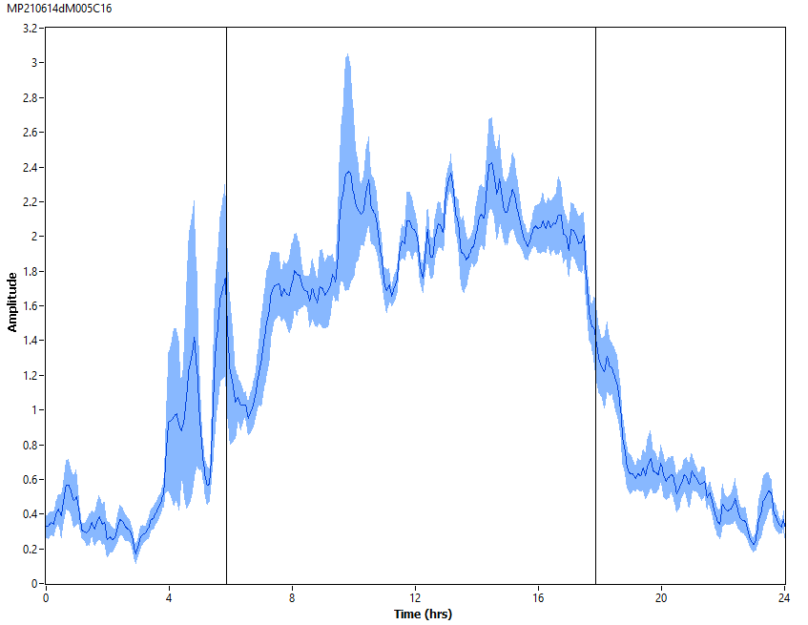
13♂ w[*];per4gRNA/MB122B-Gal4;UAS-Cas9/+ [DD]₇ 23°C
M58+5

Slide 38
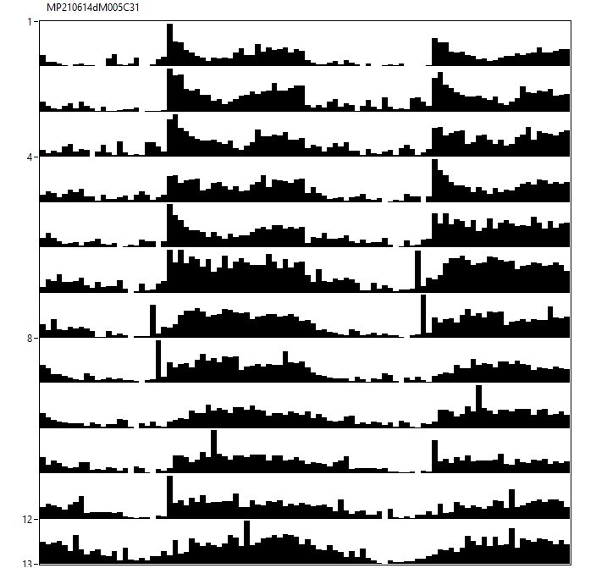
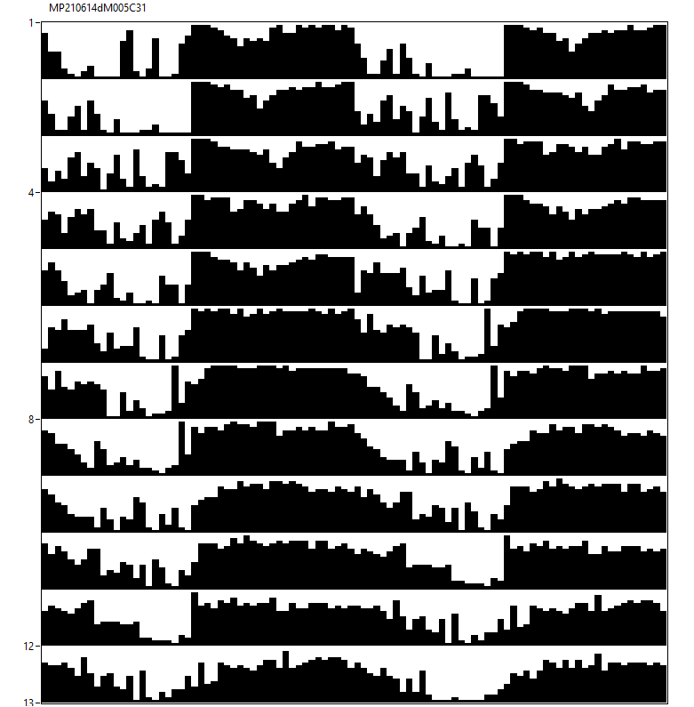
16♀ w[*];per4gRNA/MB122B-Gal4;UAS-Cas9/+ [12hL:12hD]₅>[DD]₇ 23°C
M58+5

Slide 39

16♀ w[*];per4gRNA/MB122B-Gal4;UAS-Cas9/+ [12hL:12hD]₅ 23°C
M58+5

Slide 40

16♀ w[*];per4gRNA/MB122B-Gal4;UAS-Cas9/+ [DD]₇ 23°C
M58+5

Slide 41

16♀ w[*];per4gRNA/MB122B-Gal4;UAS-Cas9/+ [DD]₇ 23°C
M58+5

Slide 42


13♂ w[*];per4gRNA/MB122B-Gal4;UAS-Cas9/+ [12hR:12hD]₅>[RR]₇ 23°C
M14+59

Slide 43

13♂ w[*];per4gRNA/MB122B-Gal4;UAS-Cas9/+ [12hR:12hD]₅ 23°C
M14+59

Slide 44

13♂ w[*];per4gRNA/MB122B-Gal4;UAS-Cas9/+ [RR]₇ 23°C
M14+59

Slide 45

13♂ w[*];per4gRNA/MB122B-Gal4;UAS-Cas9/+ [RR]₇ 23°C
M14+59

Slide 46


24♀ w[*];per4gRNA/MB122B-Gal4;UAS-Cas9/+ [12hR:12hD]₅>[RR]₇ 23°C
M14+59

Slide 47

24♀ w[*];per4gRNA/MB122B-Gal4;UAS-Cas9/+ [12hR:12hD]₅ 23°C
M14+59

Slide 48

24♀ w[*];per4gRNA/MB122B-Gal4;UAS-Cas9/+ [RR]₇ 23°C
M14+59

Slide 49

24♀ w[*];per4gRNA/MB122B-Gal4;UAS-Cas9/+ [RR]₇ 23°C
M14+59

Slide 50


13♂ w[*];per4gRNA/ss00681-Gal4;UAS-Cas9/+ [12hL:12hD]₅>[DD]₇ 23°C
M56+25

Slide 51

13♂ w[*];per4gRNA/ss00681-Gal4;UAS-Cas9/+ [12hL:12hD]₅ 23°C
M56+25

Slide 52

13♂ w[*];per4gRNA/ss00681-Gal4;UAS-Cas9/+ [DD]₇ 23°C
M56+25

Slide 53

13♂ w[*];per4gRNA/ss00681-Gal4;UAS-Cas9/+ [DD]₇ 23°C
M56+25

Slide 54


17♀ w[*];per4gRNA/ss00681-Gal4;UAS-Cas9/+ [12hL:12hD]₅>[DD]₇ 23°C
M56+25

Slide 55

17♀ w[*];per4gRNA/ss00681-Gal4;UAS-Cas9/+ [12hL:12hD]₅ 23°C
M56+25

Slide 56

17♀ w[*];per4gRNA/ss00681-Gal4;UAS-Cas9/+ [DD]₇ 23°C
M56+25

Slide 57


17♀ w[*];per4gRNA/ss00681-Gal4;UAS-Cas9/+ [DD]₇ 23°C
M56+25

Slide 58


17♂ w[*];per4gRNA/ss00681-Gal4;UAS-Cas9/+ [12hR:12hD]₅>[RR]₇ 23°C
M47+57

Slide 59

17♂ w[*];per4gRNA/ss00681-Gal4;UAS-Cas9/+ [12hR:12hD]₅ 23°C
M47+57

Slide 60

17♂ w[*];per4gRNA/ss00681-Gal4;UAS-Cas9/+ [RR]₇ 23°C
M47+57

Slide 61


17♂ w[*];per4gRNA/ss00681-Gal4;UAS-Cas9/+ [RR]₇ 23°C
M47+57

Slide 62


24♀ w[*];per4gRNA/ss00681-Gal4;UAS-Cas9/+ [12hR:12hD]₅>[RR]₇ 23°C
M47+57

Slide 63

24♀ w[*];per4gRNA/ss00681-Gal4;UAS-Cas9/+ [12hR:12hD]₅ 23°C
M47+57

Slide 64

24♀ w[*];per4gRNA/ss00681-Gal4;UAS-Cas9/+ [RR]₇ 23°C
M47+57

Slide 65


24♀ w[*];per4gRNA/ss00681-Gal4;UAS-Cas9/+ [RR]₇ 23°C
M47+57

Slide 66


21♂ w[*];per4gRNA/+;UAS-Cas9/ChAT2A-Gal4 [12hL:12hD]₅>[DD]₇ 23°C
M40+16

Slide 67

21♂ w[*];per4gRNA/+;UAS-Cas9/ChAT2A-Gal4 [12hL:12hD]₅ 23°C
M40+16

Slide 68

21♂ w[*];per4gRNA/+;UAS-Cas9/ChAT2A-Gal4 [DD]₇ 23°C
M40+16

Slide 69


21♂ w[*];per4gRNA/+;UAS-Cas9/ChAT2A-Gal4 [DD]₇ 23°C
M40+16

Slide 70


24♀ w[*];per4gRNA/+;UAS-Cas9/ChAT2A-Gal4 [12hL:12hD]₅>[DD]₇ 23°C
M40+16

Slide 71

24♀ w[*];per4gRNA/+;UAS-Cas9/ChAT2A-Gal4 [12hL:12hD]₅ 23°C
M40+16

Slide 72

24♀ w[*];per4gRNA/+;UAS-Cas9/ChAT2A-Gal4 [DD]₇ 23°C
M40+16

Slide 73

24♀ w[*];per4gRNA/+;UAS-Cas9/ChAT2A-Gal4 [DD]₇ 23°C
M40+16

Slide 74


20♂ w[*];per4gRNA/+;UAS-Cas9/ChAT2A-Gal4 [12hR:12hD]₅>[RR]₇ 23°C
M41+101

Slide 75

20♂ w[*];per4gRNA/+;UAS-Cas9/ChAT2A-Gal4 [12hR:12hD]₅ 23°C
M41+101

Slide 76

20♂ w[*];per4gRNA/+;UAS-Cas9/ChAT2A-Gal4 [RR]₇ 23°C
M41+101

Slide 77


20♂ w[*];per4gRNA/+;UAS-Cas9/ChAT2A-Gal4 [RR]₇ 23°C
M41+101

Slide 78


30♀ w[*];per4gRNA/+;UAS-Cas9/ChAT2A-Gal4 [12hR:12hD]₅>[RR]₇ 23°C
M41+101

Slide 79

30♀ w[*];per4gRNA/+;UAS-Cas9/ChAT2A-Gal4 [12hR:12hD]₅ 23°C
M41+101

Slide 80

30♀ w[*];per4gRNA/+;UAS-Cas9/ChAT2A-Gal4 [RR]₇ 23°C
M41+101

Slide 81

30♀ w[*];per4gRNA/+;UAS-Cas9/ChAT2A-Gal4 [RR]₇ 23°C
M41+101

Slide 82

10♂ w[*];per4gRNA/ChAT4.7.4;UAS-Cas9/cryGal80 [12hL:12hD]₅>[DD]₇ 23°C
M18

Slide 83

10♂ w[*];per4gRNA/ChAT4.7.4;UAS-Cas9/cryGal80 [12hL:12hD]₅ 23°C
M18

Slide 84

10♂ w[*];per4gRNA/ChAT4.7.4;UAS-Cas9/cryGal80 [DD]₇ 23°C
M18

Slide 85


10♂ w[*];per4gRNA/ChAT4.7.4;UAS-Cas9/cryGal80 [DD]₇ 23°C
M18

Slide 86

12♀ w[*];per4gRNA/ChAT4.7.4;UAS-Cas9/cryGal80 [12hL:12hD]₅>[DD]₇ 23°C
M18

Slide 87

12♀ w[*];per4gRNA/ChAT4.7.4;UAS-Cas9/cryGal80 [12hL:12hD]₅ 23°C
M18

Slide 88

12♀ w[*];per4gRNA/ChAT4.7.4;UAS-Cas9/cryGal80 [DD]₇ 23°C
M18

Slide 89

12♀ w[*];per4gRNA/ChAT4.7.4;UAS-Cas9/cryGal80 [DD]₇ 23°C
M18

Slide 90

13♂ w[*];per4gRNA/ChAT4.7.4;UAS-Cas9/cryGal80 [12hR:12hD]₅>[RR]₇ 23°C
M19

Slide 91

13♂ w[*];per4gRNA/ChAT4.7.4;UAS-Cas9/cryGal80 [12hR:12hD]₅ 23°C
M19

Slide 92

13♂ w[*];per4gRNA/ChAT4.7.4;UAS-Cas9/cryGal80 [RR]₇ 23°C
M19

Slide 93


13♂ w[*];per4gRNA/ChAT4.7.4;UAS-Cas9/cryGal80 [RR]₇ 23°C
M19

Slide 94

12♀ w[*];per4gRNA/ChAT4.7.4;UAS-Cas9/cryGal80 [12hR:12hD]₅>[RR]₇ 23°C
M19

Slide 95

12♀ w[*];per4gRNA/ChAT4.7.4;UAS-Cas9/cryGal80 [12hR:12hD]₅ 23°C
M19

Slide 96

12♀ w[*];per4gRNA/ChAT4.7.4;UAS-Cas9/cryGal80 [RR]₇ 23°C
M19

Slide 97

12♀ w[*];per4gRNA/ChAT4.7.4;UAS-Cas9/cryGal80 [RR]₇ 23°C
M19

Slide 98

9♂ w[*];per4gRNA/ChAT4.7.4;UAS-Cas9/cryGal80 [12hL:12hD]₅>[DD]₇ 23°C
M6

Slide 99

9♂ w[*];per4gRNA/ChAT4.7.4;UAS-Cas9/cryGal80 [12hL:12hD]₅ 23°C
M6

Slide 100

9♂ w[*];per4gRNA/ChAT4.7.4;UAS-Cas9/cryGal80 [DD]₇ 23°C
M6

Slide 101

9♂ w[*];per4gRNA/ChAT4.7.4;UAS-Cas9/cryGal80 [DD]₇ 23°C
M6

Slide 102

11♀ w[*];per4gRNA/ChAT4.7.4;UAS-Cas9/cryGal80 [12hL:12hD]₅>[DD]₇ 23°C
M6

Slide 103

11♀ w[*];per4gRNA/ChAT4.7.4;UAS-Cas9/cryGal80 [12hL:12hD]₅ 23°C
M6

Slide 104

11♀ w[*];per4gRNA/ChAT4.7.4;UAS-Cas9/cryGal80 [DD]₇ 23°C
M6

Slide 105

11♀ w[*];per4gRNA/ChAT4.7.4;UAS-Cas9/cryGal80 [DD]₇ 23°C
M6

Slide 106

15♂ w[*];per4gRNA/ChAT4.7.4;UAS-Cas9/cryGal80 [12hR:12hD]₅>[RR]₇ 23°C
M9

Slide 107

15♂ w[*];per4gRNA/ChAT4.7.4;UAS-Cas9/cryGal80 [12hR:12hD]₅ 23°C
M9

Slide 108

15♂ w[*];per4gRNA/ChAT4.7.4;UAS-Cas9/cryGal80 [RR]₇ 23°C
M9

Slide 109

15♂ w[*];per4gRNA/ChAT4.7.4;UAS-Cas9/cryGal80 [RR]₇ 23°C
M9

Slide 110

15♀ w[*];per4gRNA/ChAT4.7.4;UAS-Cas9/cryGal80 [12hR:12hD]₅>[RR]₇ 23°C
M9

Slide 111

15♀ w[*];per4gRNA/ChAT4.7.4;UAS-Cas9/cryGal80 [12hR:12hD]₅ 23°C
M9

Slide 112

15♀ w[*];per4gRNA/ChAT4.7.4;UAS-Cas9/cryGal80 [RR]₇ 23°C
M9

Slide 113

15♀ w[*];per4gRNA/ChAT4.7.4;UAS-Cas9/cryGal80 [RR]₇ 23°C
M9

Slide 114

16♂ UASdcr2w[*];per4gRNA/PdfGal4;UAS-Cas9/+ [12hL:12hD]₅>[DD]₇ 23°C
M19bst

Slide 115

16♂ UASdcr2w[*];per4gRNA/PdfGal4;UAS-Cas9/+ [12hL:12hD]₅ 23°C
M19bst

Slide 116

16♂ UASdcr2w[*];per4gRNA/PdfGal4;UAS-Cas9/+ [DD]₇ 23°C
M19

Slide 117

16♂ UASdcr2w[*];per4gRNA/PdfGal4;UAS-Cas9/+ [DD]₇ 23°C
M19

Slide 118

11♀ UASdcr2w[*];per4gRNA/PdfGal4;UAS-Cas9/+ [12hL:12hD]₅>[DD]₇ 23°C
M19bst

Slide 119

11♀ UASdcr2w[*];per4gRNA/PdfGal4;UAS-Cas9/+ [12hL:12hD]₅ 23°C
M19bst

Slide 120

11♀ UASdcr2w[*];per4gRNA/PdfGal4;UAS-Cas9/+ [DD]₇ 23°C
M19

Slide 121

11♀ UASdcr2w[*];per4gRNA/PdfGal4;UAS-Cas9/+ [DD]₇ 23°C
M19

Slide 122

11♂ UASdcr2w[*];per4gRNA/PdfGal4;UAS-Cas9/+ [12hR:12hD]₅>[RR]₇ 23°C
M27bst

Slide 123

11♂ UASdcr2w[*];per4gRNA/PdfGal4;UAS-Cas9/+ [12hR:12hD]₅ 23°C
M27bst

Slide 124

11♂ UASdcr2w[*];per4gRNA/PdfGal4;UAS-Cas9/+ [RR]₇ 23°C
M27

Slide 125


11♂ UASdcr2w[*];per4gRNA/PdfGal4;UAS-Cas9/+ [RR]₇ 23°C
M27

Slide 126

10♀ UASdcr2w[*];per4gRNA/PdfGal4;UAS-Cas9/+ [12hR:12hD]₅>[RR]₇ 23°C
M27bst

Slide 127

10♀ UASdcr2w[*];per4gRNA/PdfGal4;UAS-Cas9/+ [12hR:12hD]₅ 23°C
M27bst

Slide 128

10♀ UASdcr2w[*];per4gRNA/PdfGal4;UAS-Cas9/+ [RR]₇ 23°C
M27

Slide 129

10♀ UASdcr2w[*];per4gRNA/PdfGal4;UAS-Cas9/+ [RR]₇ 23°C
M27

Slide 130

5♂ w[*];per4gRNA/PdfGal4;UAS-Cas9/+ [12hR:12hD]₅>[RR]₇ 23°C
M18

Slide 131

5♂ w[*];per4gRNA/PdfGal4;UAS-Cas9/+ [12hR:12hD]₅ 23°C
M18

Slide 132

5♂ w[*];per4gRNA/PdfGal4;UAS-Cas9/+ [RR]₇ 23°C
M18

Slide 133


5♂ w[*];per4gRNA/PdfGal4;UAS-Cas9/+ [RR]₇ 23°C
M18

Slide 134

7♀ w[*];per4gRNA/PdfGal4;UAS-Cas9/+ [12hR:12hD]₅>[RR]₇ 23°C
M18

Slide 135

7♀ w[*];per4gRNA/PdfGal4;UAS-Cas9/+ [12hR:12hD]₅ 23°C
M18

Slide 136

7♀ w[*];per4gRNA/PdfGal4;UAS-Cas9/+ [RR]₇ 23°C
M18

Slide 137

7♀ w[*];per4gRNA/PdfGal4;UAS-Cas9/+ [RR]₇ 23°C
M18

Slide 138

10♂ w[*];per4gRNA/ChATGal4.7.4;UAS-Cas9/PdfGal4 [12hL:12hD]₅>[DD]₇ 23°C
M46

Slide 139

10♂ w[*];per4gRNA/ChATGal4.7.4;UAS-Cas9/PdfGal4 [12hL:12hD]₅ 23°C
M46

Slide 140

10♂ w[*];per4gRNA/ChATGal4.7.4;UAS-Cas9/PdfGal4 [DD]₇ 23°C
M46

Slide 141

10♂ w[*];per4gRNA/ChATGal4.7.4;UAS-Cas9/PdfGal4 [DD]₇ 23°C
M46

Slide 142

10♀ w[*];per4gRNA/ChATGal4.7.4;UAS-Cas9/PdfGal4 [12hL:12hD]₅>[DD]₇ 23°C
M46

Slide 143

10♀ w[*];per4gRNA/ChATGal4.7.4;UAS-Cas9/PdfGal4 [12hL:12hD]₅ 23°C
M46

Slide 144

10♀ w[*];per4gRNA/ChATGal4.7.4;UAS-Cas9/PdfGal4 [DD]₇ 23°C
M46

Slide 145


10♀ w[*];per4gRNA/ChATGal4.7.4;UAS-Cas9/PdfGal4 [DD]₇ 23°C
M46

Slide 146

10♂ w[*];per4gRNA/ChATGal4.7.4;UAS-Cas9/PdfGal4 [12hR:12hD]₅>[RR]₇ 23°C
M5

Slide 147

10♂ w[*];per4gRNA/ChATGal4.7.4;UAS-Cas9/PdfGal4 [12hR:12hD]₅ 23°C
M5

Slide 148

10♂ w[*];per4gRNA/ChATGal4.7.4;UAS-Cas9/PdfGal4 [RR]₇ 23°C
M5

Slide 149


10♂ w[*];per4gRNA/ChATGal4.7.4;UAS-Cas9/PdfGal4 [RR]₇ 23°C
M5

Slide 150

13♀ w[*];per4gRNA/ChATGal4.7.4;UAS-Cas9/PdfGal4 [12hR:12hD]₅>[RR]₇ 23°C
M5

Slide 151

13♀ w[*];per4gRNA/ChATGal4.7.4;UAS-Cas9/PdfGal4 [12hR:12hD]₅ 23°C
M5

Slide 152

13♀ w[*];per4gRNA/ChATGal4.7.4;UAS-Cas9/PdfGal4 [RR]₇ 23°C
M5

Slide 153

13♀ w[*];per4gRNA/ChATGal4.7.4;UAS-Cas9/PdfGal4 [RR]₇ 23°C
M5

Slide 154

10♂ w[*];per4gRNA/ChATGal4.7.4;UAS-Cas9/PdfGal4 [12hR:12hD]₅>[RR]₇ 23°C
M47

Slide 155

10♂ w[*];per4gRNA/ChATGal4.7.4;UAS-Cas9/PdfGal4 [12hR:12hD]₅ 23°C
M47

Slide 156

10♂ w[*];per4gRNA/ChATGal4.7.4;UAS-Cas9/PdfGal4 [RR]₇ 23°C
M47

Slide 157

10♂ w[*];per4gRNA/ChATGal4.7.4;UAS-Cas9/PdfGal4 [RR]₇ 23°C
M47

Slide 158

14♀ w[*];per4gRNA/ChATGal4.7.4;UAS-Cas9/PdfGal4 [12hR:12hD]₅>[RR]₇ 23°C
M47

Slide 159

14♀ w[*];per4gRNA/ChATGal4.7.4;UAS-Cas9/PdfGal4 [12hR:12hD]₅ 23°C
M47

Slide 160

14♀ w[*];per4gRNA/ChATGal4.7.4;UAS-Cas9/PdfGal4 [RR]₇ 23°C
M47

Slide 161

14♀ w[*];per4gRNA/ChATGal4.7.4;UAS-Cas9/PdfGal4 [RR]₇ 23°C
M47

Slide 162

10♂ w[*];per4gRNA/ChATGal4.7.4;UAS-Cas9/+ [12hL:12hD]₅>[DD]₇ 23°C
M15

Slide 163

10♂ w[*];per4gRNA/ChATGal4.7.4;UAS-Cas9/+ [12hL:12hD]₅ 23°C
M15

Slide 164

10♂ w[*];per4gRNA/ChATGal4.7.4;UAS-Cas9/+ [DD]₇ 23°C
M15

Slide 165


10♂ w[*];per4gRNA/ChATGal4.7.4;UAS-Cas9/+ [DD]₇ 23°C
M15

Slide 166

4♀ w[*];per4gRNA/ChATGal4.7.4;UAS-Cas9/+ [12hL:12hD]₅>[DD]₇ 23°C
M15

Slide 167

4♀ w[*];per4gRNA/ChATGal4.7.4;UAS-Cas9/+ [12hL:12hD]₅ 23°C
M15

Slide 168

4♀ w[*];per4gRNA/ChATGal4.7.4;UAS-Cas9/+ [DD]₇ 23°C
M15

Slide 169


4♀ w[*];per4gRNA/ChATGal4.7.4;UAS-Cas9/+ [DD]₇ 23°C
M15

Slide 170

12♂ w[*];per4gRNA/ChATGal4.7.4;UAS-Cas9/+ [12hL:12hD]₅>[DD]₇ 23°C
M56

Slide 171

12♂ w[*];per4gRNA/ChATGal4.7.4;UAS-Cas9/+ [12hL:12hD]₅ 23°C
M56

Slide 172

12♂ w[*];per4gRNA/ChATGal4.7.4;UAS-Cas9/+ [DD]₇ 23°C
M56

Slide 173


12♂ w[*];per4gRNA/ChATGal4.7.4;UAS-Cas9/+ [DD]₇ 23°C
M56

Slide 174

16♀ w[*];per4gRNA/ChATGal4.7.4;UAS-Cas9/+ [12hL:12hD]₅>[DD]₇ 23°C
M56

Slide 175

16♀ w[*];per4gRNA/ChATGal4.7.4;UAS-Cas9/+ [12hL:12hD]₅ 23°C
M56

Slide 176

16♀ w[*];per4gRNA/ChATGal4.7.4;UAS-Cas9/+ [DD]₇ 23°C
M56

Slide 177


16♀ w[*];per4gRNA/ChATGal4.7.4;UAS-Cas9/+ [DD]₇ 23°C
M56

Slide 178

17♂ w[*];per4gRNA/ChATGal4.7.4;UAS-Cas9/+ [12hR:12hD]₅>[RR]₇ 23°C
M16+17

Slide 179

17♂ w[*];per4gRNA/ChATGal4.7.4;UAS-Cas9/+ [12hR:12hD]₅ 23°C
M16+17

Slide 180

17♂ w[*];per4gRNA/ChATGal4.7.4;UAS-Cas9/+ [RR]₇ 23°C
M16+17

Slide 181


17♂ w[*];per4gRNA/ChATGal4.7.4;UAS-Cas9/+ [RR]₇ 23°C
M16+17

Slide 182

15♀ w[*];per4gRNA/ChATGal4.7.4;UAS-Cas9/+ [12hR:12hD]₅>[RR]₇ 23°C
M16+17

Slide 183

15♀ w[*];per4gRNA/ChATGal4.7.4;UAS-Cas9/+ [12hR:12hD]₅ 23°C
M16+17

Slide 184

15♀ w[*];per4gRNA/ChATGal4.7.4;UAS-Cas9/+ [RR]₇ 23°C
M16+17

Slide 185


15♀ w[*];per4gRNA/ChATGal4.7.4;UAS-Cas9/+ [RR]₇ 23°C
M16+17

Slide 186

13♂ w[*];per4gRNA/TUG;UAS-Cas9/Pdf-Gal80 [12hL:12hD]₅>[DD]₇ 23°C
M9

Slide 187

13♂ w[*];per4gRNA/TUG;UAS-Cas9/Pdf-Gal80 [12hL:12hD]₅ 23°C
M9

Slide 188

13♂ w[*];per4gRNA/TUG;UAS-Cas9/Pdf-Gal80 [DD]₇ 23°C
M9

Slide 189

13♂ w[*];per4gRNA/TUG;UAS-Cas9/Pdf-Gal80 [DD]₇ 23°C
M9

Slide 190

14♀ w[*];per4gRNA/TUG;UAS-Cas9/Pdf-Gal80 [12hL:12hD]₅>[DD]₇ 23°C
M9

Slide 191

14♀ w[*];per4gRNA/TUG;UAS-Cas9/Pdf-Gal80 [12hL:12hD]₅ 23°C
M9

Slide 192

14♀ w[*];per4gRNA/TUG;UAS-Cas9/Pdf-Gal80 [DD]₇ 23°C
M9

Slide 193

14♀ w[*];per4gRNA/TUG;UAS-Cas9/Pdf-Gal80 [DD]₇ 23°C
M9

Slide 194

6♂ w[*];per4gRNA/TUG;UAS-Cas9/Pdf-Gal80 [12hR:12hD]₅>[RR]₇ 23°C
M18

Slide 195

6♂ w[*];per4gRNA/TUG;UAS-Cas9/Pdf-Gal80 [12hR:12hD]₅ 23°C
M18

Slide 196

6♂ w[*];per4gRNA/TUG;UAS-Cas9/Pdf-Gal80 [RR]₇ 23°C
M18

Slide 197

6♂ w[*];per4gRNA/TUG;UAS-Cas9/Pdf-Gal80 [RR]₇ 23°C
M18

Slide 198

5♀ w[*];per4gRNA/TUG;UAS-Cas9/Pdf-Gal80 [12hR:12hD]₅>[RR]₇ 23°C
M18

Slide 199

5♀ w[*];per4gRNA/TUG;UAS-Cas9/Pdf-Gal80 [12hR:12hD]₅ 23°C
M18

Slide 200

5♀ w[*];per4gRNA/TUG;UAS-Cas9/Pdf-Gal80 [RR]₇ 23°C
M18

Slide 201

5♀ w[*];per4gRNA/TUG;UAS-Cas9/Pdf-Gal80 [RR]₇ 23°C
M18

Slide 202

11♂ w[*];per4gRNA/TUG;UAS-Cas9/Pdf-Gal80 [12hR:12hD]₅>[RR]₇ 23°C
M19

Slide 203

11♂ w[*];per4gRNA/TUG;UAS-Cas9/Pdf-Gal80 [12hR:12hD]₅ 23°C
M19

Slide 204

11♂ w[*];per4gRNA/TUG;UAS-Cas9/Pdf-Gal80 [RR]₇ 23°C
M19

Slide 205

11♂ w[*];per4gRNA/TUG;UAS-Cas9/Pdf-Gal80 [RR]₇ 23°C
M19

Slide 206

10♀ w[*];per4gRNA/TUG;UAS-Cas9/Pdf-Gal80 [12hR:12hD]₅>[RR]₇ 23°C
M19

Slide 207

10♀ w[*];per4gRNA/TUG;UAS-Cas9/Pdf-Gal80 [12hR:12hD]₅ 23°C
M19

Slide 208

10♀ w[*];per4gRNA/TUG;UAS-Cas9/Pdf-Gal80 [RR]₇ 23°C
M19

Slide 209

10♀ w[*];per4gRNA/TUG;UAS-Cas9/Pdf-Gal80 [RR]₇ 23°C
M19

Slide 210

14♂ w[*];per4gRNA/TUG;UAS-Cas9/ChAT-Gal80 [12hL:12hD]₅>[DD]₇ 23°C
M16

Slide 211

14♂ w[*];per4gRNA/TUG;UAS-Cas9/ChAT-Gal80 [12hL:12hD]₅ 23°C
M16

Slide 212

14♂ w[*];per4gRNA/TUG;UAS-Cas9/ChAT-Gal80 [DD]₇ 23°C
M16

Slide 213


14♂ w[*];per4gRNA/TUG;UAS-Cas9/ChAT-Gal80 [DD]₇ 23°C
M16

Slide 214

13♀ w[*];per4gRNA/TUG;UAS-Cas9/ChAT-Gal80 [12hL:12hD]₅>[DD]₇ 23°C
M16

Slide 215

13♀ w[*];per4gRNA/TUG;UAS-Cas9/ChAT-Gal80 [12hL:12hD]₅ 23°C
M16

Slide 216

13♀ w[*];per4gRNA/TUG;UAS-Cas9/ChAT-Gal80 [DD]₇ 23°C
M16

Slide 217

13♀ w[*];per4gRNA/TUG;UAS-Cas9/ChAT-Gal80 [DD]₇ 23°C
M16

Slide 218

14♂ w[*];per4gRNA/TUG;UAS-Cas9/ChAT-Gal80 [12hR:12hD]₅>[RR]₇ 23°C
M29

Slide 219

14♂ w[*];per4gRNA/TUG;UAS-Cas9/ChAT-Gal80 [12hR:12hD]₅ 23°C
M29

Slide 220

14♂ w[*];per4gRNA/TUG;UAS-Cas9/ChAT-Gal80 [RR]₇ 23°C
M29

Slide 221

14♂ w[*];per4gRNA/TUG;UAS-Cas9/ChAT-Gal80 [RR]₇ 23°C
M29

Slide 222

13♀ w[*];per4gRNA/TUG;UAS-Cas9/ChAT-Gal80 [12hR:12hD]₅>[RR]₇ 23°C
M29

Slide 223

13♀ w[*];per4gRNA/TUG;UAS-Cas9/ChAT-Gal80 [12hR:12hD]₅ 23°C
M29

Slide 224

13♀ w[*];per4gRNA/TUG;UAS-Cas9/ChAT-Gal80 [RR]₇ 23°C
M29

Slide 225

13♀ w[*];per4gRNA/TUG;UAS-Cas9/ChAT-Gal80 [RR]₇ 23°C
M29

Slide 226

14♂ w[*];per4gRNA/TUG;UAS-Cas9/ChAT-Gal80 [12hR:12hD]₅>[RR]₇ 23°C
M97
MARS

Slide 227

14♂ w[*];per4gRNA/TUG;UAS-Cas9/ChAT-Gal80 [12hR:12hD]₅ 23°C
M97
MARS

Slide 228

14♂ w[*];per4gRNA/TUG;UAS-Cas9/ChAT-Gal80 [RR]₇ 23°C
M97
MARS

Slide 229

14♂ w[*];per4gRNA/TUG;UAS-Cas9/ChAT-Gal80 [RR]₇ 23°C
M97
MARS

Slide 230

7♀ w[*];per4gRNA/TUG;UAS-Cas9/ChAT-Gal80 [12hR:12hD]₅>[RR]₇ 23°C
M97
MARS

Slide 231

7♀ w[*];per4gRNA/TUG;UAS-Cas9/ChAT-Gal80 [12hR:12hD]₅ 23°C
M97
MARS

Slide 232

7♀ w[*];per4gRNA/TUG;UAS-Cas9/ChAT-Gal80 [RR]₇ 23°C
M97
MARS

Slide 233

7♀ w[*];per4gRNA/TUG;UAS-Cas9/ChAT-Gal80 [RR]₇ 23°C
M97
MARS

Slide 234

8♂ w[*];per4gRNA/Clk856-Gal4;UAS-Cas9/ChAT-Gal80 [12hL:12hD]₅>[DD]₇ 23°C
M18

Slide 235

8♂ w[*];per4gRNA/Clk856-Gal4;UAS-Cas9/ChAT-Gal80 [12hL:12hD]₅ 23°C
M18

Slide 236

8♂ w[*];per4gRNA/Clk856-Gal4;UAS-Cas9/ChAT-Gal80 [DD]₇ 23°C
M18

Slide 237

8♂ w[*];per4gRNA/Clk856-Gal4;UAS-Cas9/ChAT-Gal80 [DD]₇ 23°C
M18

Slide 238

9♀ w[*];per4gRNA/Clk856-Gal4;UAS-Cas9/ChAT-Gal80 [12hL:12hD]₅>[DD]₇ 23°C
M18

Slide 239

9♀ w[*];per4gRNA/Clk856-Gal4;UAS-Cas9/ChAT-Gal80 [12hL:12hD]₅ 23°C
M18

Slide 240

9♀ w[*];per4gRNA/Clk856-Gal4;UAS-Cas9/ChAT-Gal80 [DD]₇ 23°C
M18

Slide 241

9♀ w[*];per4gRNA/Clk856-Gal4;UAS-Cas9/ChAT-Gal80 [DD]₇ 23°C
M18

Slide 242

16♂ w[*];per4gRNA/Clk856-Gal4;UAS-Cas9/ChAT-Gal80 [12hL:12hD]₅>[DD]₇ 23°C
M58

Slide 243

16♂ w[*];per4gRNA/Clk856-Gal4;UAS-Cas9/ChAT-Gal80 [12hL:12hD]₅ 23°C
M58

Slide 244

16♂ w[*];per4gRNA/Clk856-Gal4;UAS-Cas9/ChAT-Gal80 [DD]₇ 23°C
M58

Slide 245


16♂ w[*];per4gRNA/Clk856-Gal4;UAS-Cas9/ChAT-Gal80 [DD]₇ 23°C
M58

Slide 246

9♀ w[*];per4gRNA/Clk856-Gal4;UAS-Cas9/ChAT-Gal80 [12hL:12hD]₅>[DD]₇ 23°C
M58

Slide 247

9♀ w[*];per4gRNA/Clk856-Gal4;UAS-Cas9/ChAT-Gal80 [12hL:12hD]₅ 23°C
M58

Slide 248

9♀ w[*];per4gRNA/Clk856-Gal4;UAS-Cas9/ChAT-Gal80 [DD]₇ 23°C
M58

Slide 249

9♀ w[*];per4gRNA/Clk856-Gal4;UAS-Cas9/ChAT-Gal80 [DD]₇ 23°C
M58

Slide 250

15♂ w[*];per4gRNA/Clk856-Gal4;UAS-Cas9/ChAT-Gal80 [12hR:12hD]₅>[RR]₇ 23°C
M17

Slide 251

15♂ w[*];per4gRNA/Clk856-Gal4;UAS-Cas9/ChAT-Gal80 [12hR:12hD]₅ 23°C
M17

Slide 252

15♂ w[*];per4gRNA/Clk856-Gal4;UAS-Cas9/ChAT-Gal80 [RR]₇ 23°C
M17

Slide 253

15♂ w[*];per4gRNA/Clk856-Gal4;UAS-Cas9/ChAT-Gal80 [RR]₇ 23°C
M17

Slide 254

12♀ w[*];per4gRNA/Clk856-Gal4;UAS-Cas9/ChAT-Gal80 [12hR:12hD]₅>[RR]₇ 23°C
M17

Slide 255

12♀ w[*];per4gRNA/Clk856-Gal4;UAS-Cas9/ChAT-Gal80 [12hR:12hD]₅ 23°C
M17

Slide 256

12♀ w[*];per4gRNA/Clk856-Gal4;UAS-Cas9/ChAT-Gal80 [RR]₇ 23°C
M17

Slide 257

12♀ w[*];per4gRNA/Clk856-Gal4;UAS-Cas9/ChAT-Gal80 [RR]₇ 23°C
M17

Slide 258

5♂ w[*];per4gRNA/Pdf-Gal80;UAS-Cas9/cry-Gal4.13 [12hL:12hD]₅>[DD]₇ 23°C
M95

Slide 259

5♂ w[*];per4gRNA/Pdf-Gal80;UAS-Cas9/cry-Gal4.13 [12hL:12hD]₅ 23°C
M95

Slide 260

5♂ w[*];per4gRNA/Pdf-Gal80;UAS-Cas9/cry-Gal4.13 [DD]₇ 23°C
M95

Slide 261

5♂ w[*];per4gRNA/Pdf-Gal80;UAS-Cas9/cry-Gal4.13 [DD]₇ 23°C
M95

Slide 262

4♀ w[*];per4gRNA/Pdf-Gal80;UAS-Cas9/cry-Gal4.13 [12hL:12hD]₅>[DD]₇ 23°C
M95

Slide 263

4♀ w[*];per4gRNA/Pdf-Gal80;UAS-Cas9/cry-Gal4.13 [12hL:12hD]₅ 23°C
M95

Slide 264

4♀ w[*];per4gRNA/Pdf-Gal80;UAS-Cas9/cry-Gal4.13 [DD]₇ 23°C
M95

Slide 265

4♀ w[*];per4gRNA/Pdf-Gal80;UAS-Cas9/cry-Gal4.13 [DD]₇ 23°C
M95

Slide 266

7♂ w[*];per4gRNA/Pdf-Gal80;UAS-Cas9/cry-Gal4.13 [12hR:12hD]₅>[RR]₇ 23°C
M96

Slide 267

7♂ w[*];per4gRNA/Pdf-Gal80;UAS-Cas9/cry-Gal4.13 [12hR:12hD]₅ 23°C
M96

Slide 268

7♂ w[*];per4gRNA/Pdf-Gal80;UAS-Cas9/cry-Gal4.13 [RR]₇ 23°C
M96

Slide 269


7♂ w[*];per4gRNA/Pdf-Gal80;UAS-Cas9/cry-Gal4.13 [RR]₇ 23°C
M96

Slide 270

13♂ w[*];per4gRNA/Pdf-Gal80;UAS-Cas9/cry-Gal4.13 [12hR:12hD]₅>[RR]₇ 23°C
M5

Slide 271

13♂ w[*];per4gRNA/Pdf-Gal80;UAS-Cas9/cry-Gal4.13 [12hR:12hD]₅ 23°C
M5

Slide 272

13♂ w[*];per4gRNA/Pdf-Gal80;UAS-Cas9/cry-Gal4.13 [RR]₇ 23°C
M5

Slide 273


13♂ w[*];per4gRNA/Pdf-Gal80;UAS-Cas9/cry-Gal4.13 [RR]₇ 23°C
M5

Slide 274

16♀ w[*];per4gRNA/Pdf-Gal80;UAS-Cas9/cry-Gal4.13 [12hR:12hD]₅>[RR]₇ 23°C
M5

Slide 275

16♀ w[*];per4gRNA/Pdf-Gal80;UAS-Cas9/cry-Gal4.13 [12hR:12hD]₅ 23°C
M5

Slide 276

16♀ w[*];per4gRNA/Pdf-Gal80;UAS-Cas9/cry-Gal4.13 [RR]₇ 23°C
M5

Slide 277


16♀ w[*];per4gRNA/Pdf-Gal80;UAS-Cas9/cry-Gal4.13 [RR]₇ 23°C
M5

Slide 278

12♂ w[*];per4gRNA/TUG;UAS-Cas9/cry-Gal80 [12hL:12hD]₅>[DD]₇ 23°C
M101

Slide 279

12♂ w[*];per4gRNA/TUG;UAS-Cas9/cry-Gal80 [12hL:12hD]₅ 23°C
M101

Slide 280

12♂ w[*];per4gRNA/TUG;UAS-Cas9/cry-Gal80 [DD]₇ 23°C
M101

Slide 281

12♂ w[*];per4gRNA/TUG;UAS-Cas9/cry-Gal80 [DD]₇ 23°C
M101

Slide 282

14♀ w[*];per4gRNA/TUG;UAS-Cas9/cry-Gal80 [12hL:12hD]₅>[DD]₇ 23°C
M101

Slide 283

14♀ w[*];per4gRNA/TUG;UAS-Cas9/cry-Gal80 [12hL:12hD]₅ 23°C
M101

Slide 284

14♀ w[*];per4gRNA/TUG;UAS-Cas9/cry-Gal80 [DD]₇ 23°C
M101

Slide 285


14♀ w[*];per4gRNA/TUG;UAS-Cas9/cry-Gal80 [DD]₇ 23°C
M101

Slide 286

14♂ w[*];per4gRNA/TUG;UAS-Cas9/cry-Gal80 [12hR:12hD]₅>[RR]₇ 23°C
M102

Slide 287

14♂ w[*];per4gRNA/TUG;UAS-Cas9/cry-Gal80 [12hR:12hD]₅ 23°C
M102

Slide 288

14♂ w[*];per4gRNA/TUG;UAS-Cas9/cry-Gal80 [RR]₇ 23°C
M102

Slide 289


14♂ w[*];per4gRNA/TUG;UAS-Cas9/cry-Gal80 [RR]₇ 23°C
M102

Slide 290

11♀ w[*];per4gRNA/TUG;UAS-Cas9/cry-Gal80 [12hR:12hD]₅>[RR]₇ 23°C
M102

Slide 291

11♀ w[*];per4gRNA/TUG;UAS-Cas9/cry-Gal80 [12hR:12hD]₅ 23°C
M102

Slide 292

11♀ w[*];per4gRNA/TUG;UAS-Cas9/cry-Gal80 [RR]₇ 23°C
M102

Slide 293


11♀ w[*];per4gRNA/TUG;UAS-Cas9/cry-Gal80 [RR]₇ 23°C
M102

