Slide 1
M and E cell tim3gRNA Data
17/04/2021

Slide 2
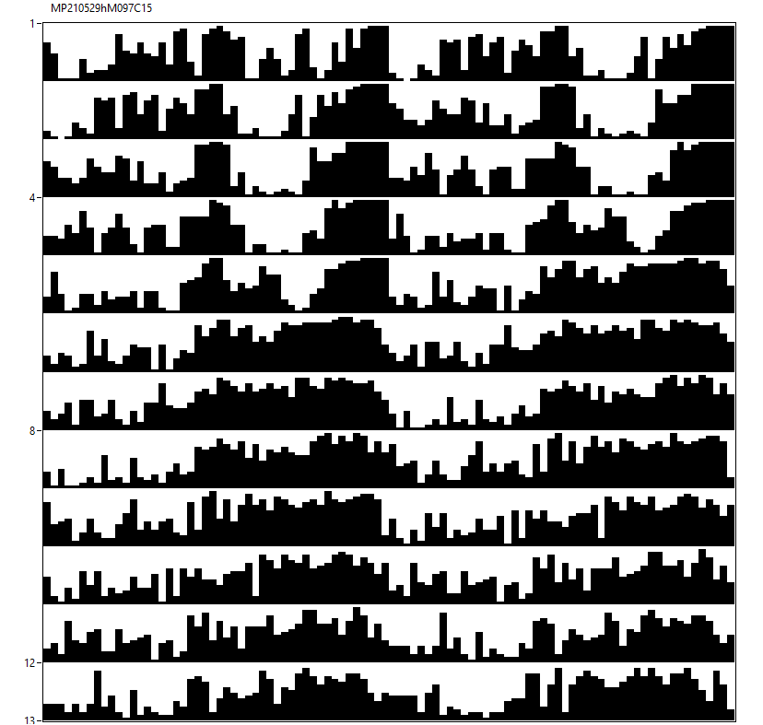
14♂ w[*];tim3gRNA;UAS-Cas9 [12hL:12hD]₅>[DD]₇ 23°C
M97

Slide 3
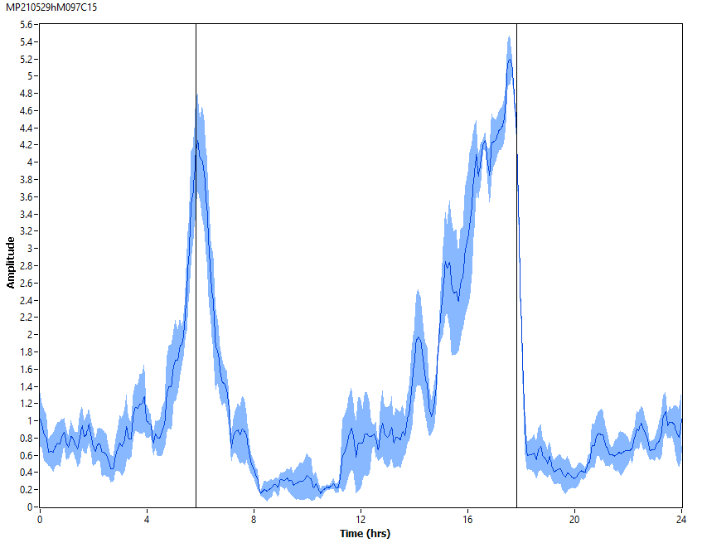
14♂ w[*];tim3gRNA;UAS-Cas9 [12hL:12hD]₅ 23°C
M97

Slide 4
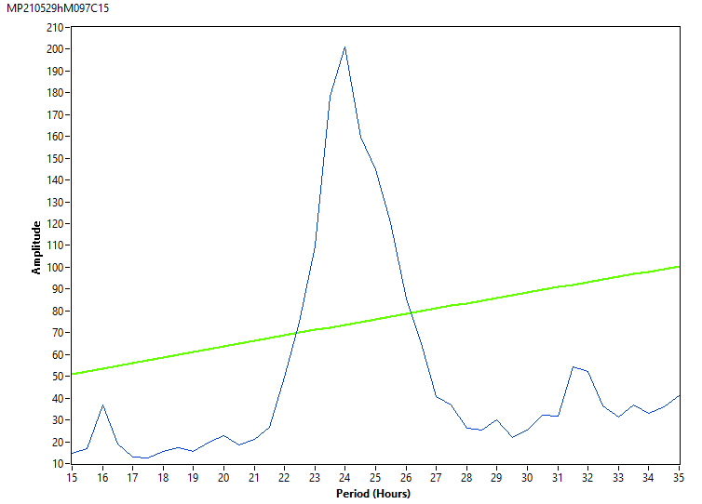
14♂ w[*];tim3gRNA;UAS-Cas9 [DD]₇ 23°C
M97

Slide 5
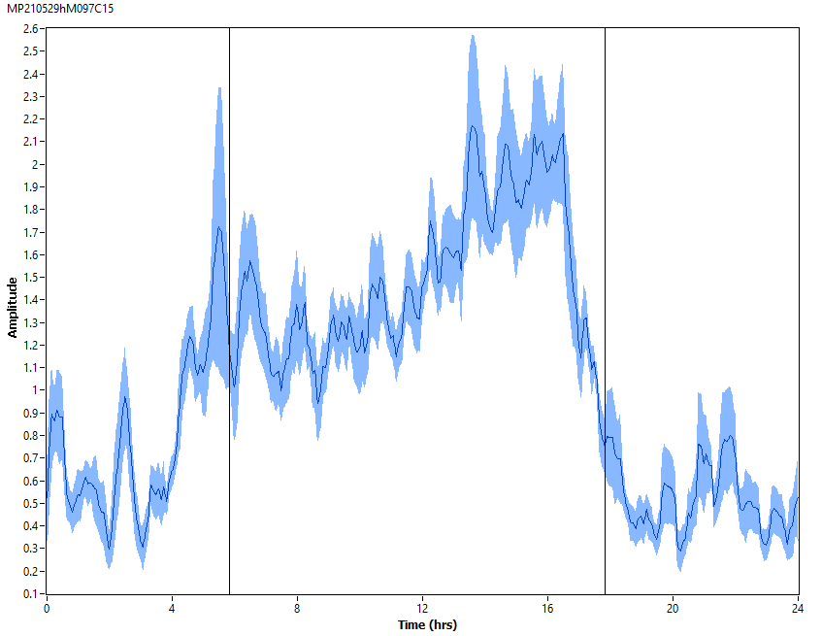
14♂ w[*];tim3gRNA;UAS-Cas9 [DD]₇ 23°C
M97

Slide 6
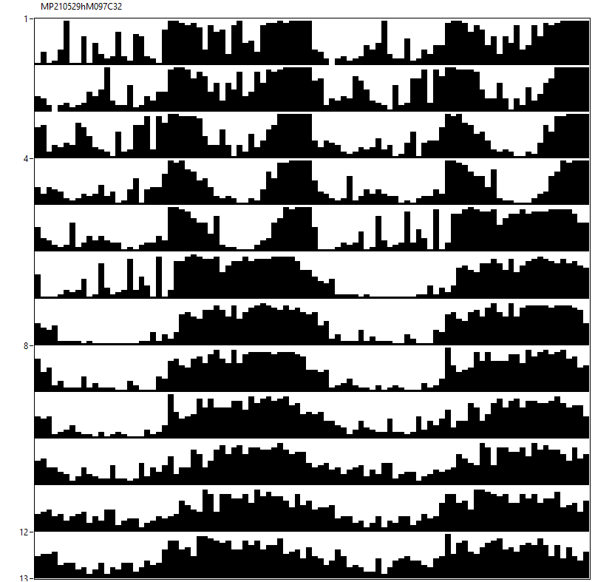
15♀ w[*];tim3gRNA;UAS-Cas9 [12hL:12hD]₅>[DD]₇ 23°C
M97

Slide 7
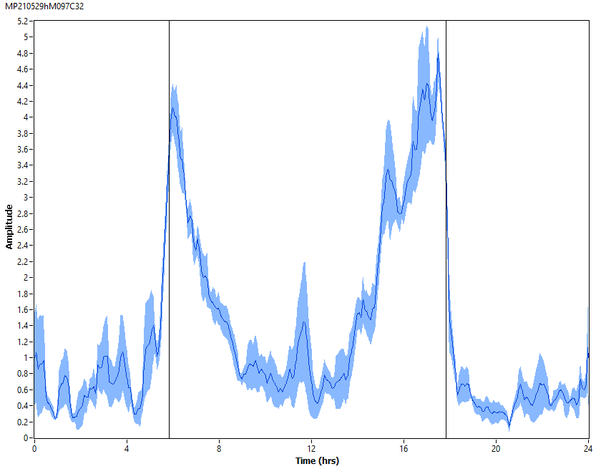
15♀ w[*];tim3gRNA;UAS-Cas9 [12hL:12hD]₅ 23°C
M97

Slide 8
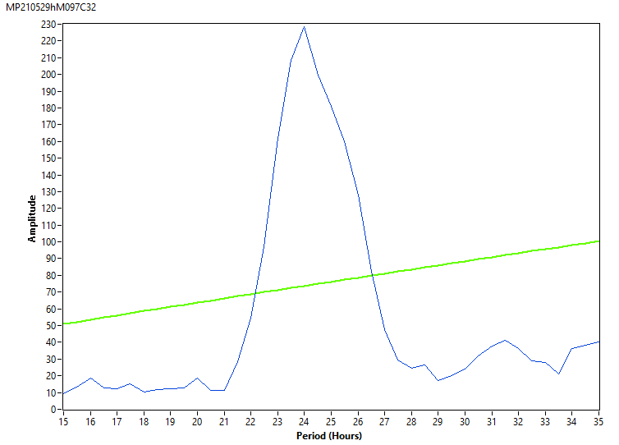
15♀ w[*];tim3gRNA;UAS-Cas9 [DD]₇ 23°C
M97

Slide 9
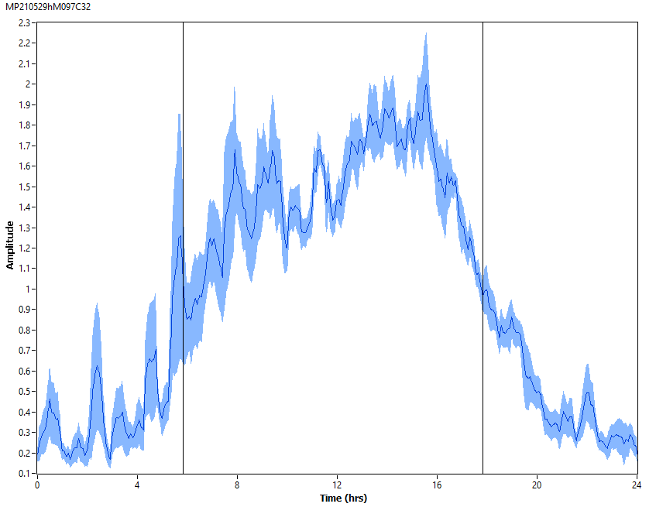
15♀ w[*];tim3gRNA;UAS-Cas9 [DD]₇ 23°C
M97

Slide 10
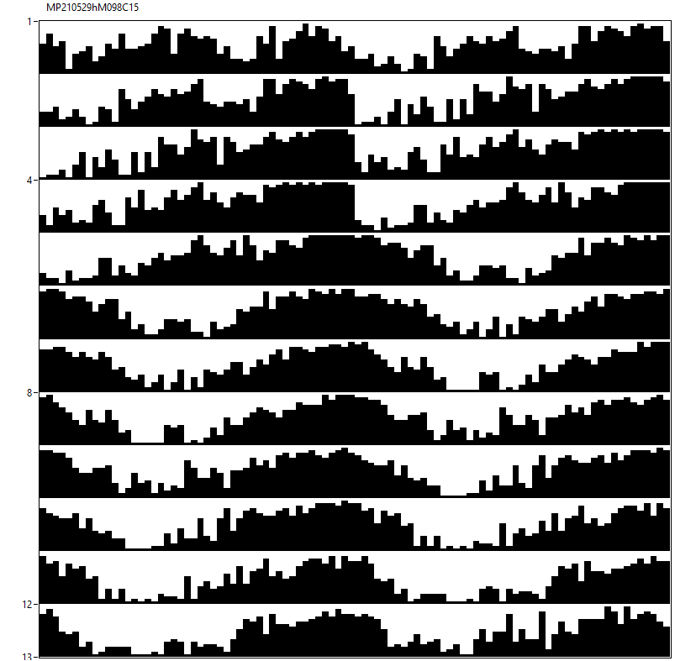
13♂ w[*];tim3gRNA;UAS-Cas9 [12hR:12hD]₅>[RR]₇ 23°C
M98

Slide 11
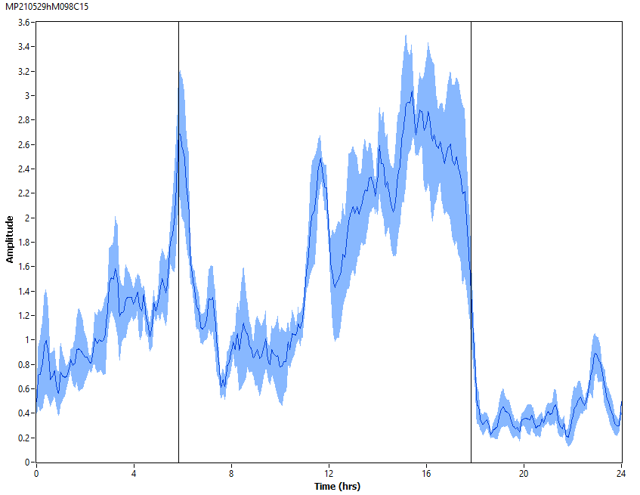
13♂ w[*];tim3gRNA;UAS-Cas9 [12hR:12hD]₅ 23°C
M98

Slide 12
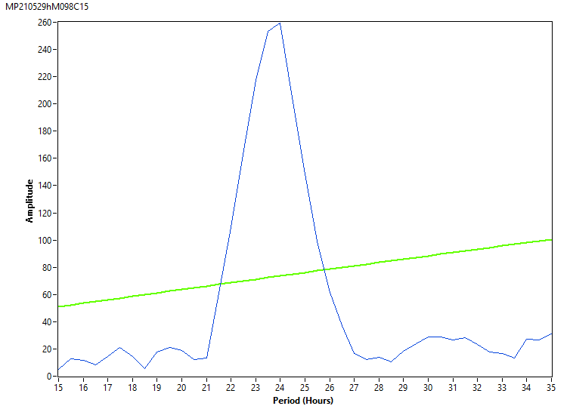
13♂ w[*];tim3gRNA;UAS-Cas9 [RR]₇ 23°C
M98

Slide 13
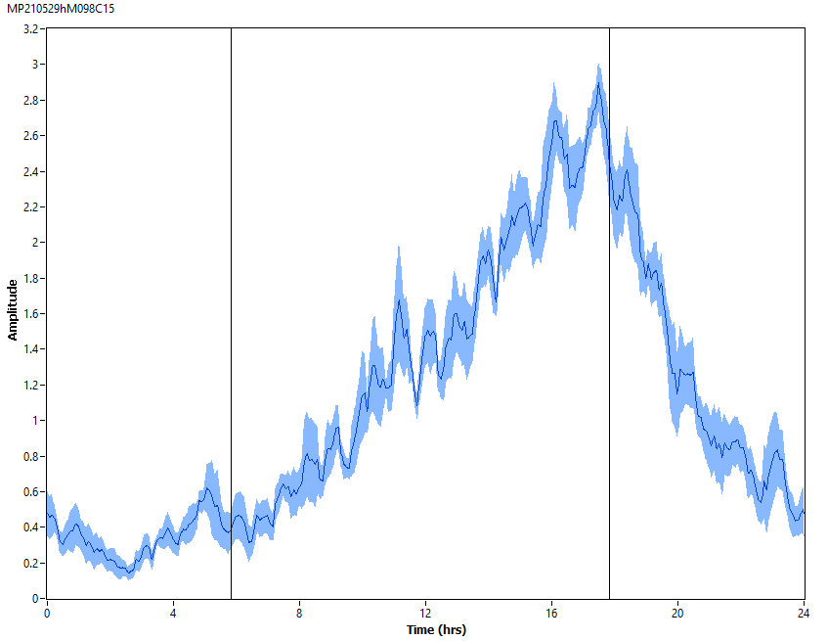
13♂ w[*];tim3gRNA;UAS-Cas9 [RR]₇ 23°C
M98

Slide 14
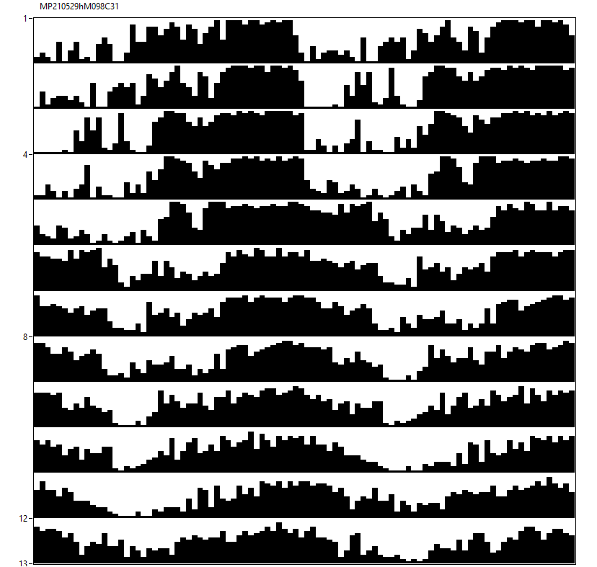
12♀ w[*];tim3gRNA;UAS-Cas9 [12hR:12hD]₅>[RR]₇ 23°C
M98

Slide 15
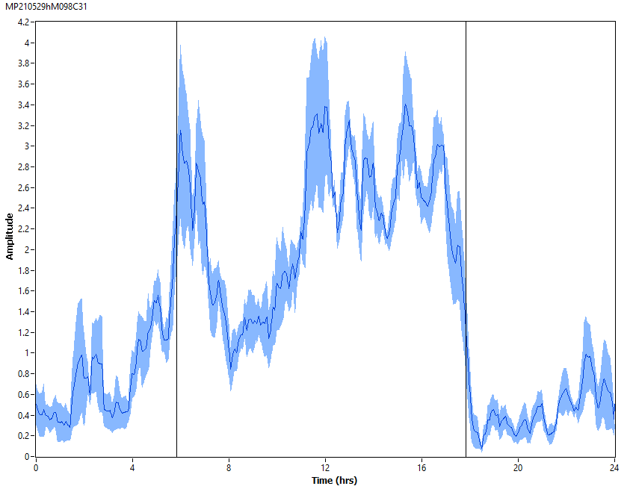
12♀ w[*];tim3gRNA;UAS-Cas9 [12hR:12hD]₅ 23°C
M98

Slide 16
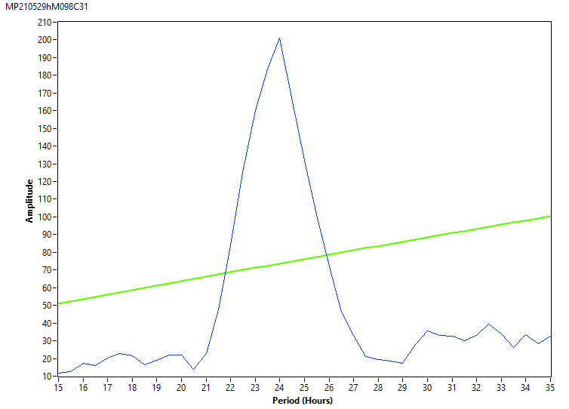
12♀ w[*];tim3gRNA;UAS-Cas9 [RR]₇ 23°C
M98

Slide 17
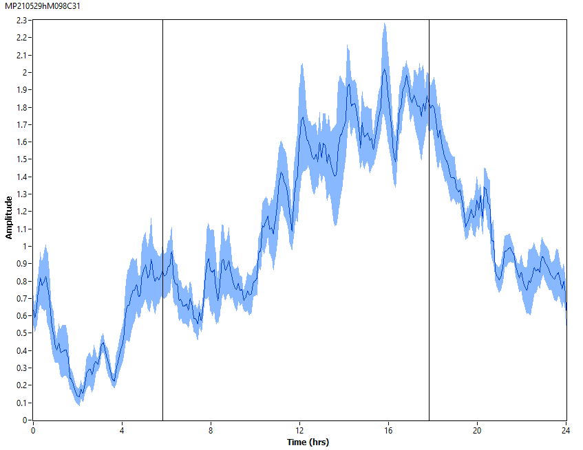
12♀ w[*];tim3gRNA;UAS-Cas9 [RR]₇ 23°C
M98

Slide 18
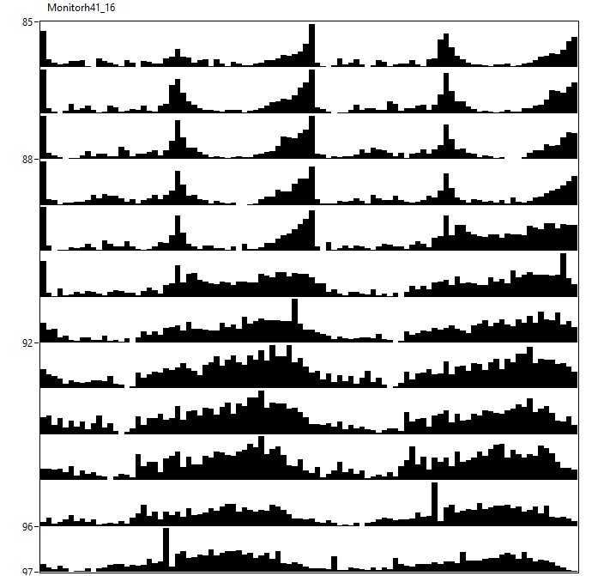
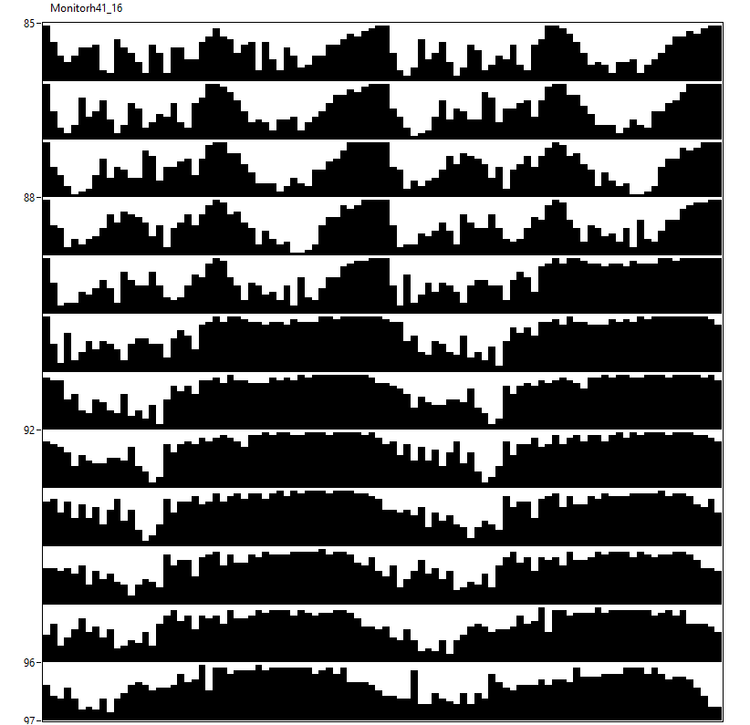
15♂ w[*];tim3gRNA/attP40;UAS-Cas9/+ [12hL:12hD]₅>[DD]₇ 23°C
M41

Slide 19
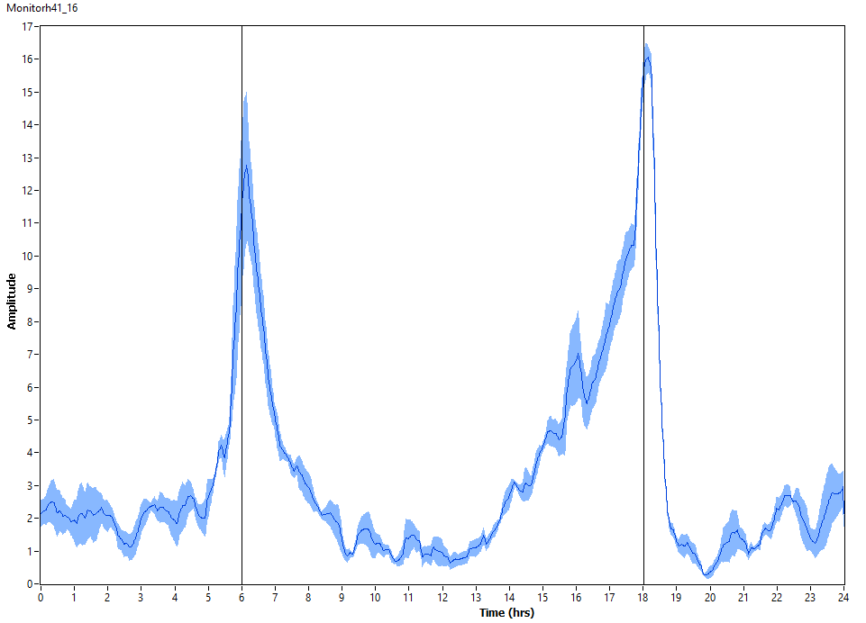
15♂ w[*];tim3gRNA/attP40;UAS-Cas9/+ [12hL:12hD]₅ 23°C
M41

Slide 20
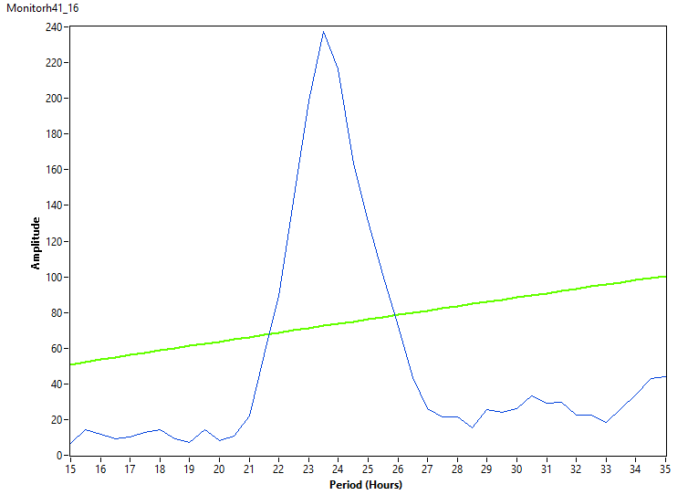
15♂ w[*];tim3gRNA/attP40;UAS-Cas9/+ [DD]₇ 23°C
M41

Slide 21
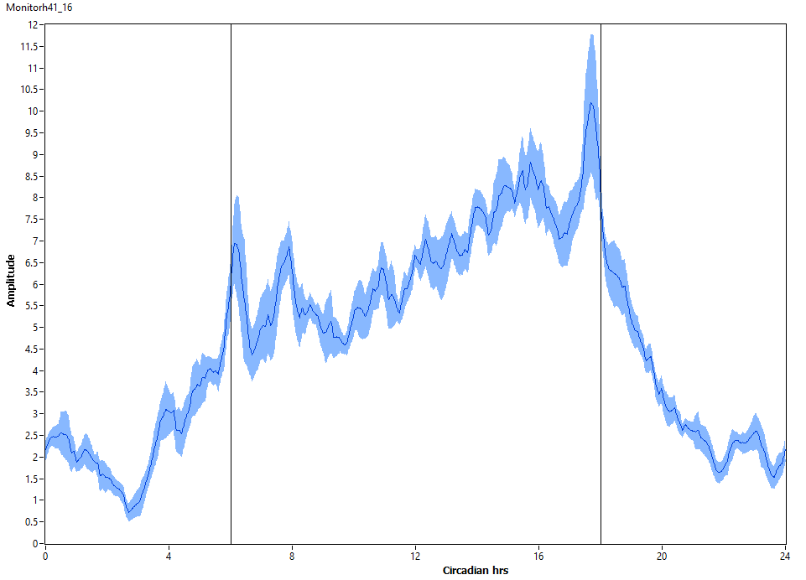
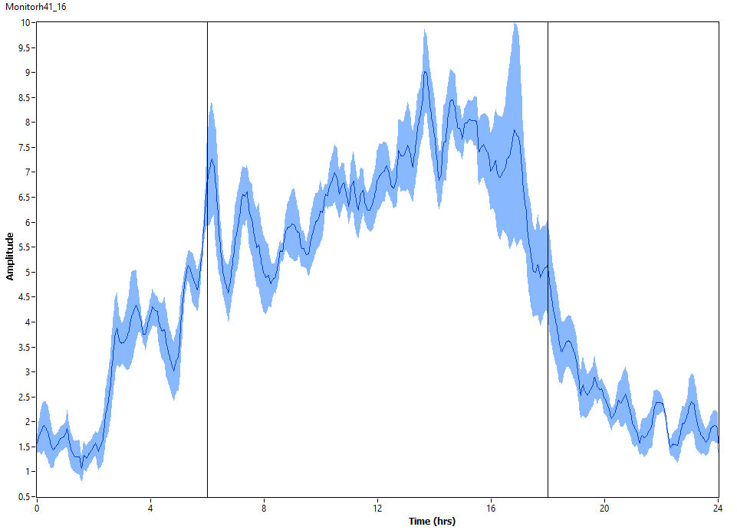
15♂ w[*];tim3gRNA/attP40;UAS-Cas9/+ [DD]₇ 23°C
M41

Slide 22
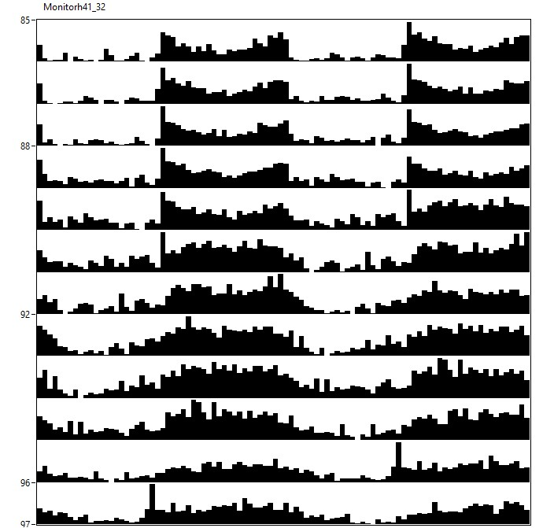
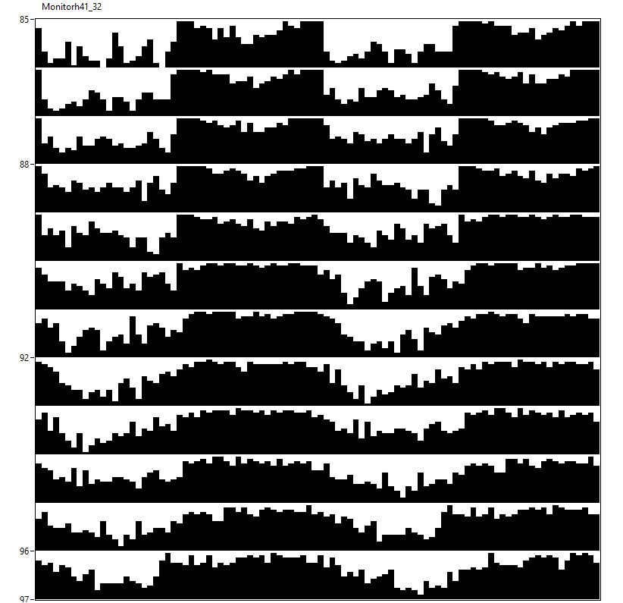
12♀ w[*];tim3gRNA/attP40;UAS-Cas9/+ [12hL:12hD]₅>[DD]₇ 23°C
M41

Slide 23
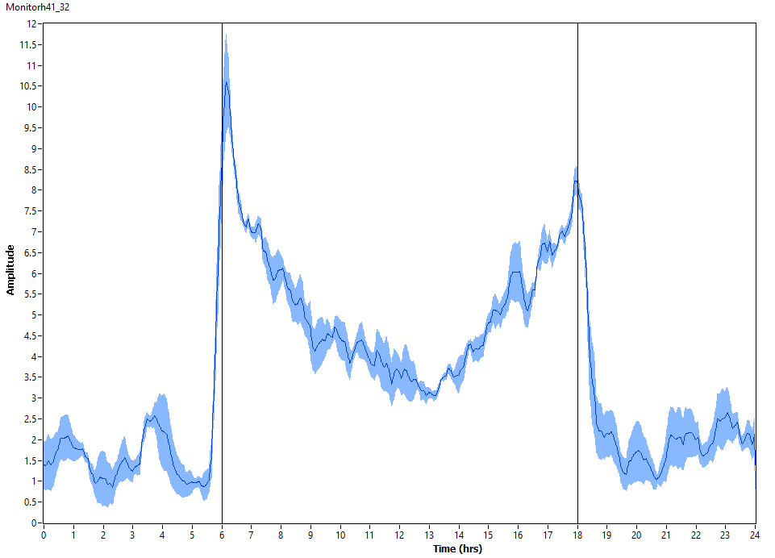
12♀ w[*];tim3gRNA/attP40;UAS-Cas9/+ [12hL:12hD]₅ 23°C
M41

Slide 24
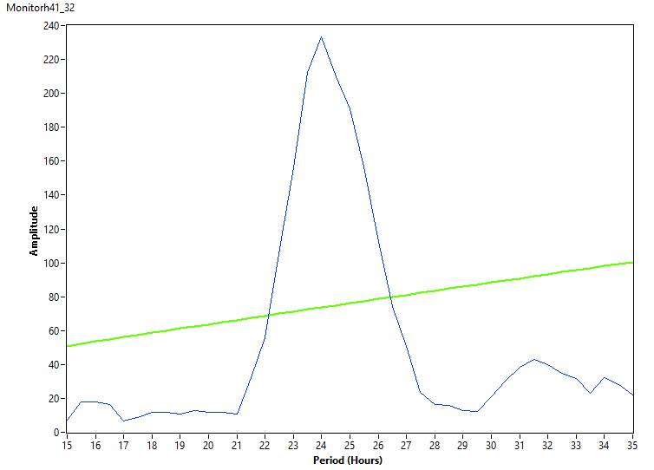
12♀ w[*];tim3gRNA/attP40;UAS-Cas9/+ [DD]₇ 23°C
M41

Slide 25
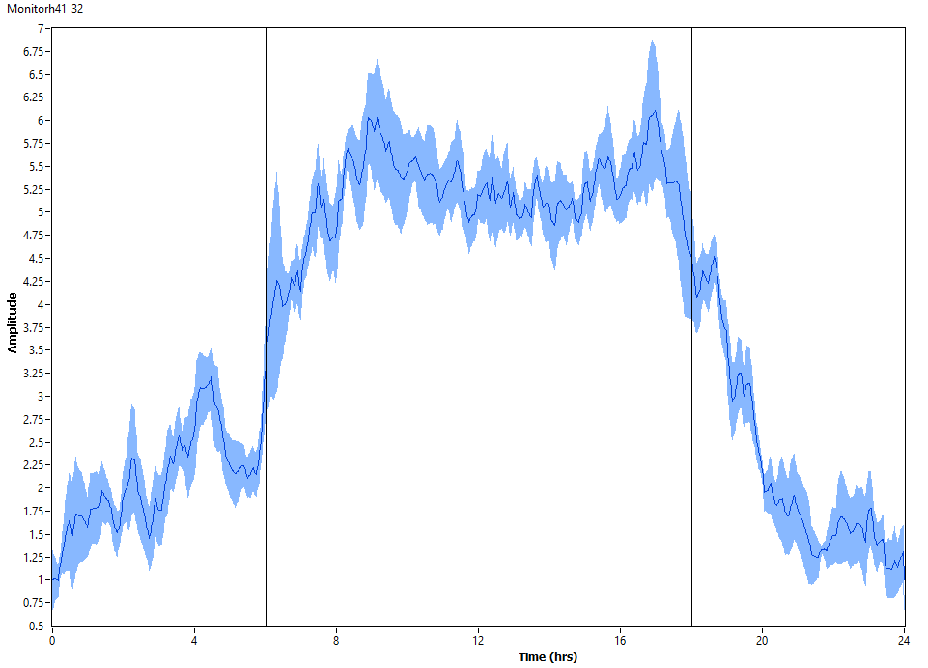
12♀ w[*];tim3gRNA/attP40;UAS-Cas9/+ [DD]₇ 23°C
M41

Slide 26
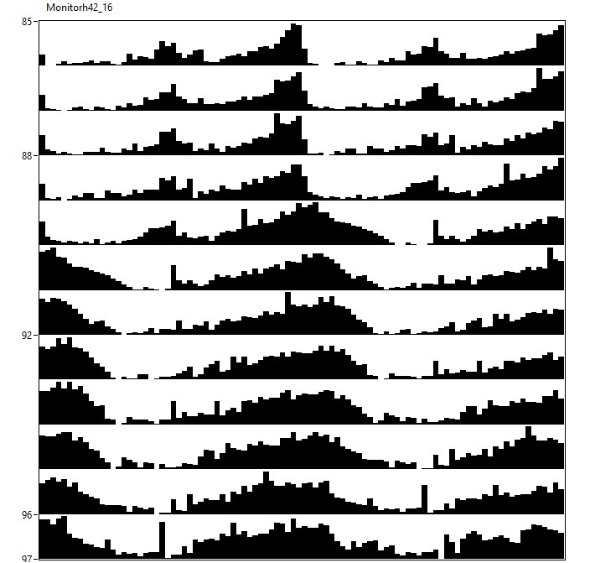
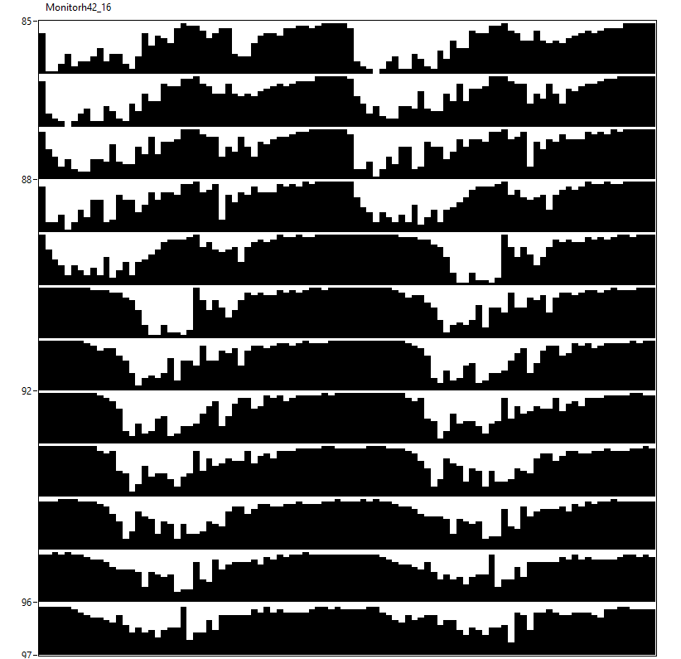
13♂ w[*];tim3gRNA/attP40;UAS-Cas9/+ [12hR:12hD]₅>[RR]₇ 23°C
M42

Slide 27
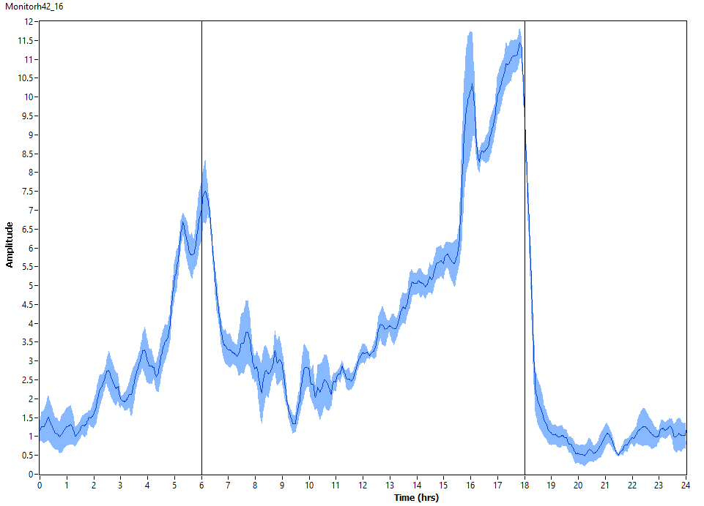
13♂ w[*];tim3gRNA/attP40;UAS-Cas9/+ [12hR:12hD]₅ 23°C
M42

Slide 28
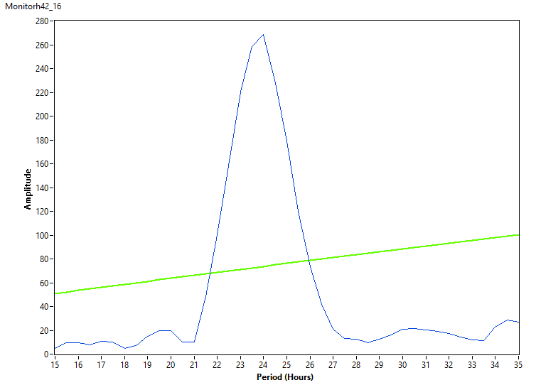
13♂ w[*];tim3gRNA/attP40;UAS-Cas9/+ [RR]₇ 23°C
M42

Slide 29
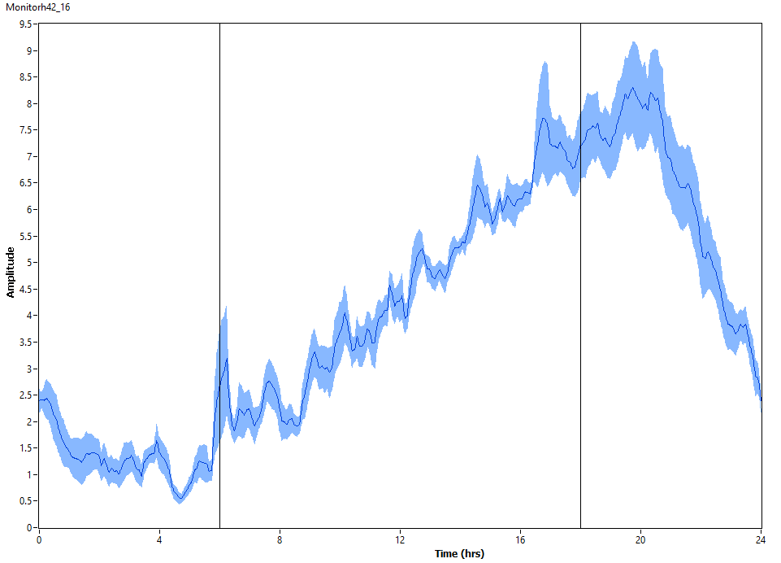
13♂ w[*];tim3gRNA/attP40;UAS-Cas9/+ [RR]₇ 23°C
M42

Slide 30
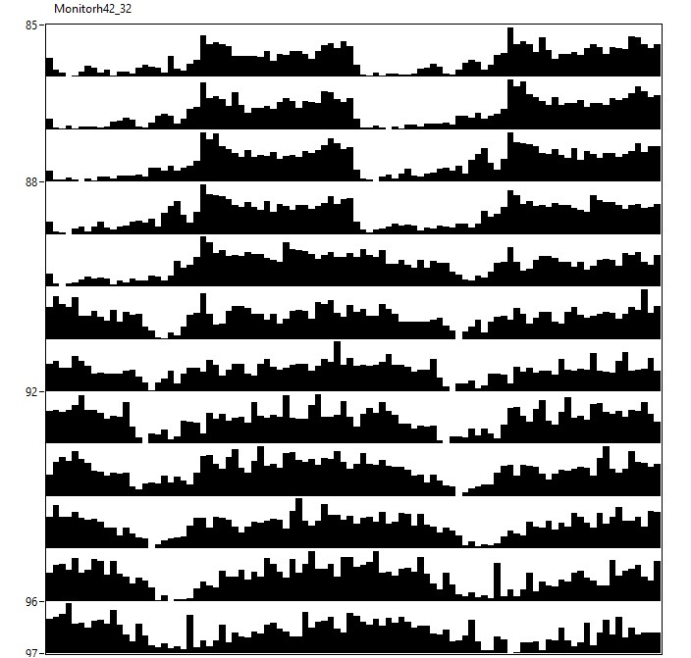
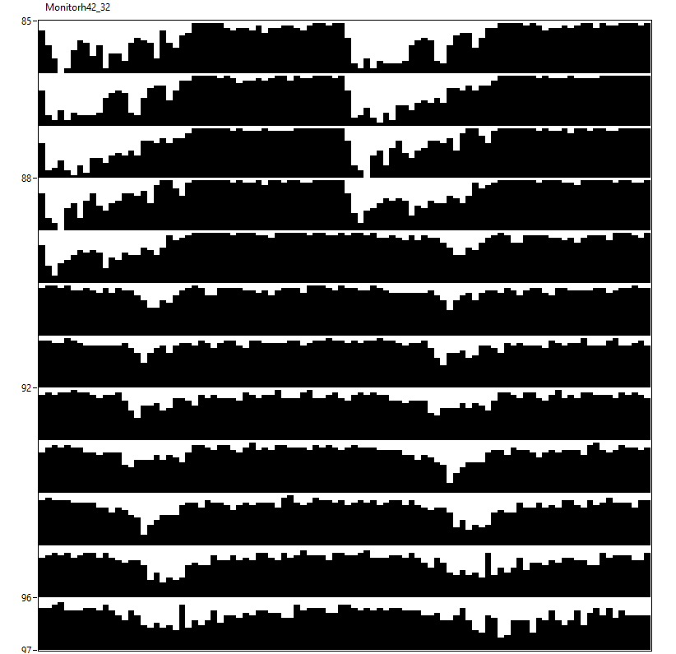
15♀ w[*];tim3gRNA/attP40;UAS-Cas9/+ [12hR:12hD]₅>[RR]₇ 23°C
M42

Slide 31
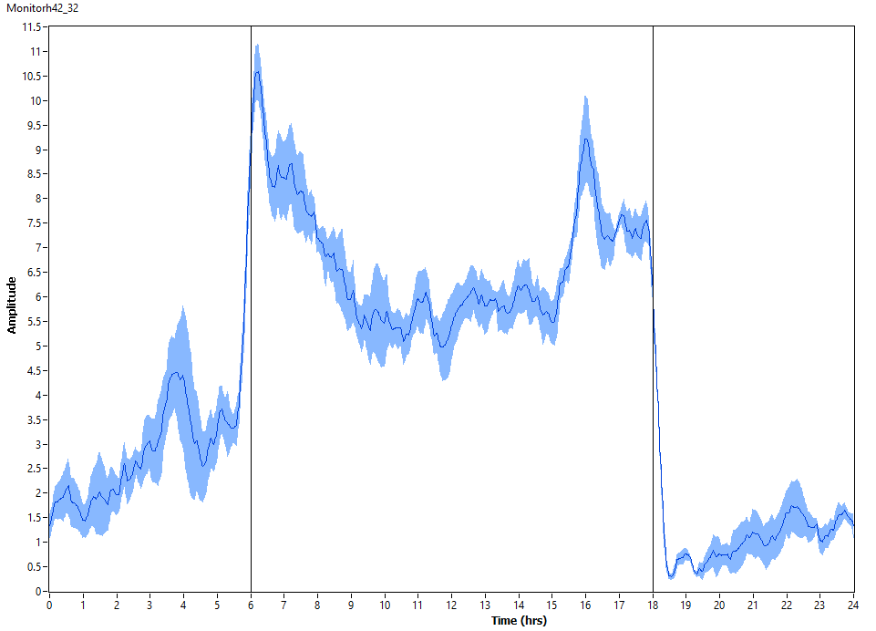
15♀ w[*];tim3gRNA/attP40;UAS-Cas9/+ [12hR:12hD]₅ 23°C
M42

Slide 32
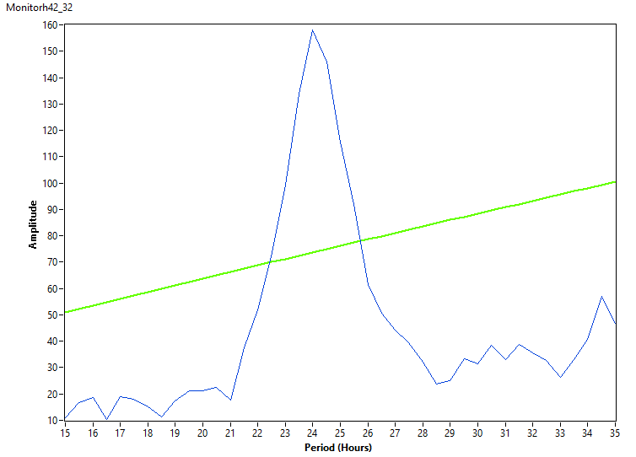
15♀ w[*];tim3gRNA/attP40;UAS-Cas9/+ [RR]₇ 23°C
M42

Slide 33
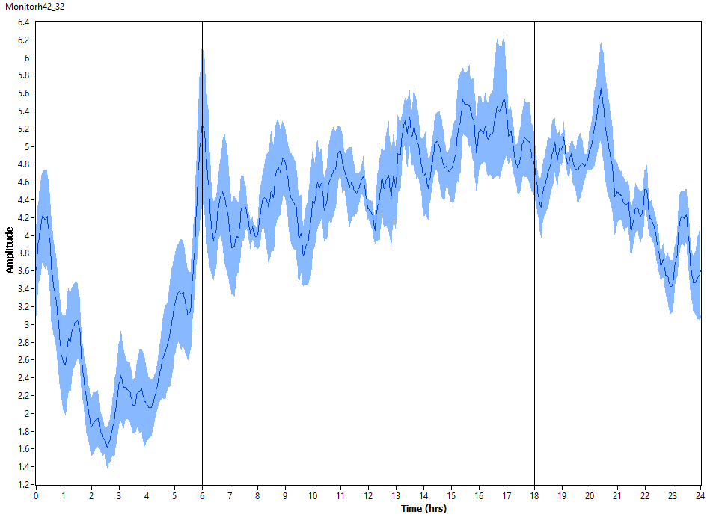
15♀ w[*];tim3gRNA/attP40;UAS-Cas9/+ [RR]₇ 23°C
M42

Slide 34
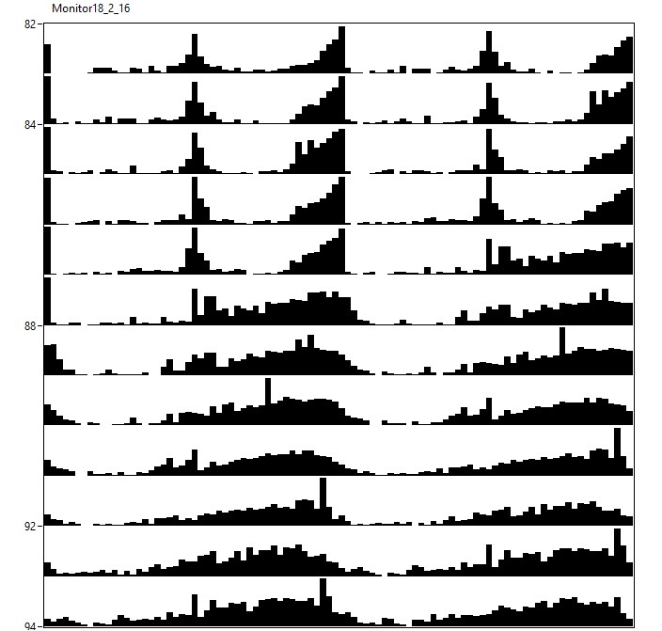
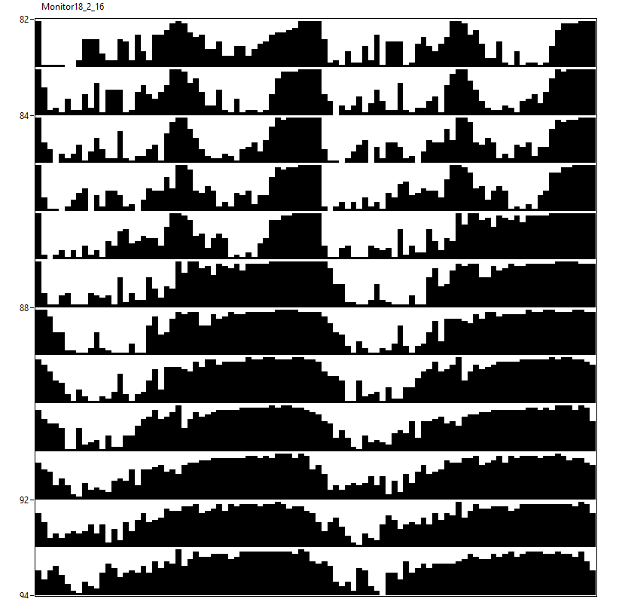
16♂ w[*];tim3gRNA/attP40;UAS-Cas9/+ [12hL:12hD]₅>[DD]₇ 23°C
M18

Slide 35
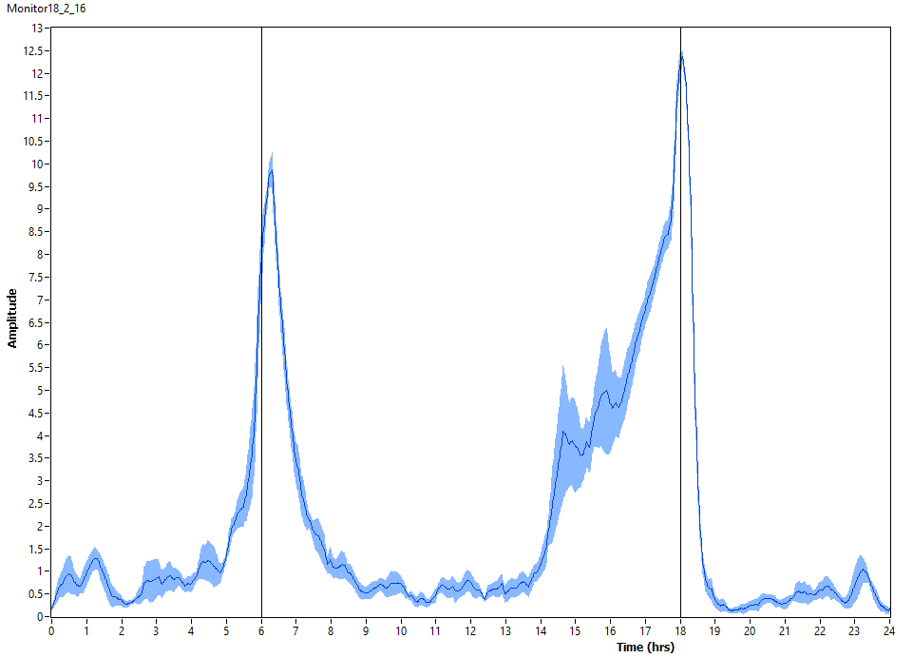
16♂ w[*];tim3gRNA/attP40;UAS-Cas9/+ [12hL:12hD]₅ 23°C
M18

Slide 36
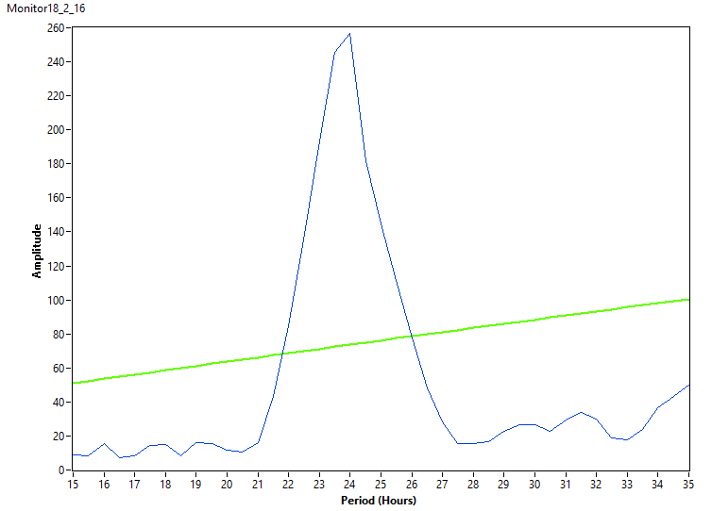
16♂ w[*];tim3gRNA/attP40;UAS-Cas9/+ [DD]₇ 23°C
M18

Slide 37
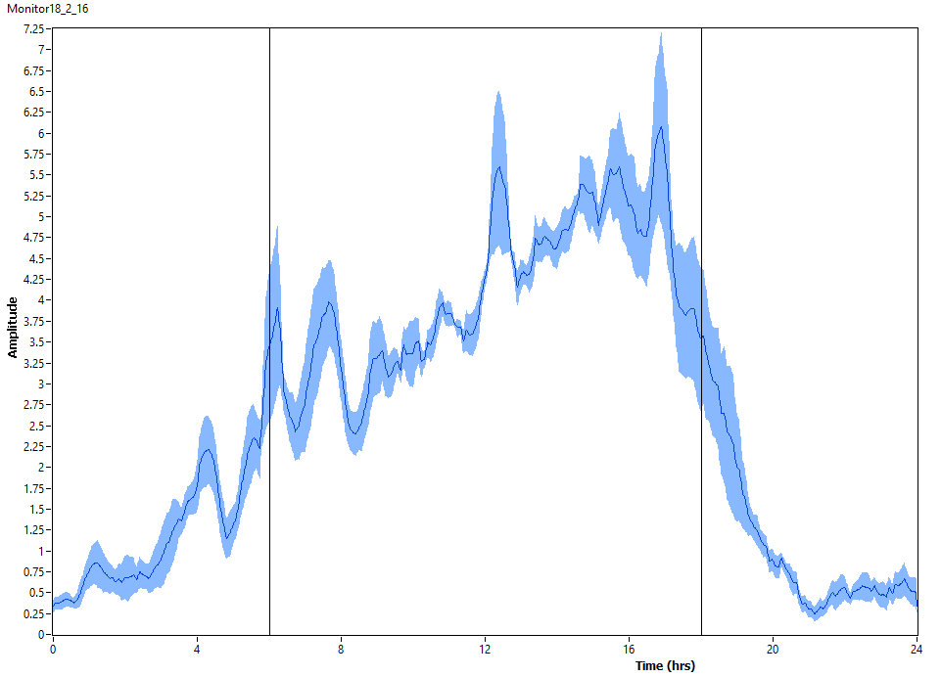
16♂ w[*];tim3gRNA/attP40;UAS-Cas9/+ [DD]₇ 23°C
M18

Slide 38
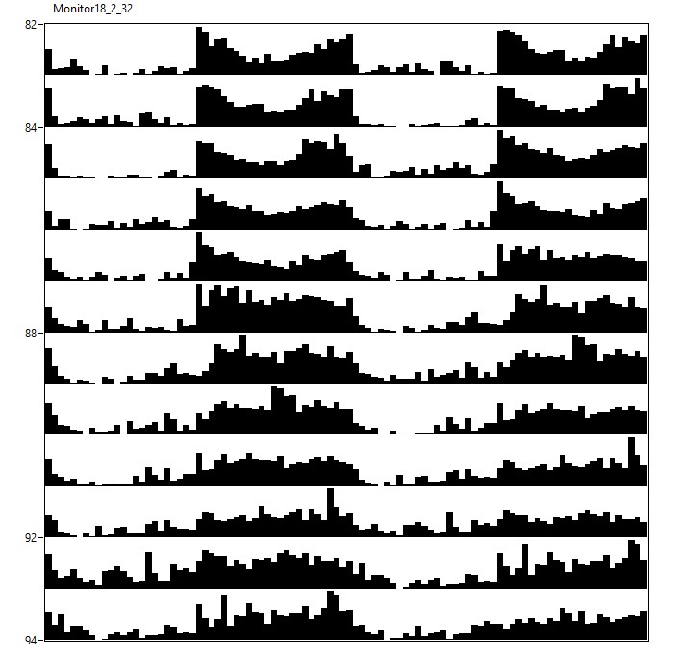
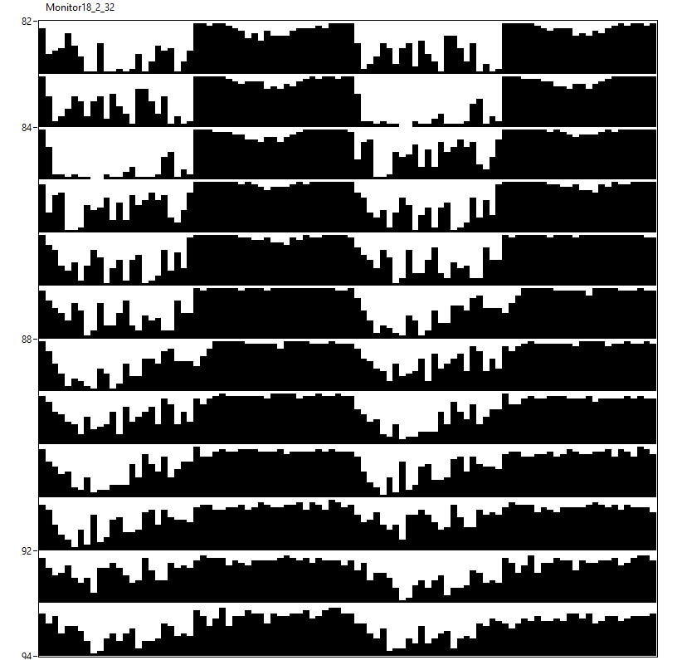
14♀ w[*];tim3gRNA/attP40;UAS-Cas9/+ [12hL:12hD]₅>[DD]₇ 23°C
M18

Slide 39
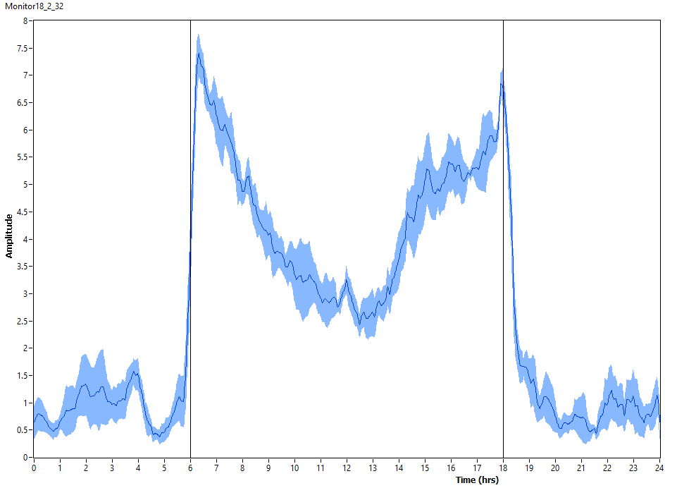
14♀ w[*];tim3gRNA/attP40;UAS-Cas9/+ [12hL:12hD]₅ 23°C
M18

Slide 40
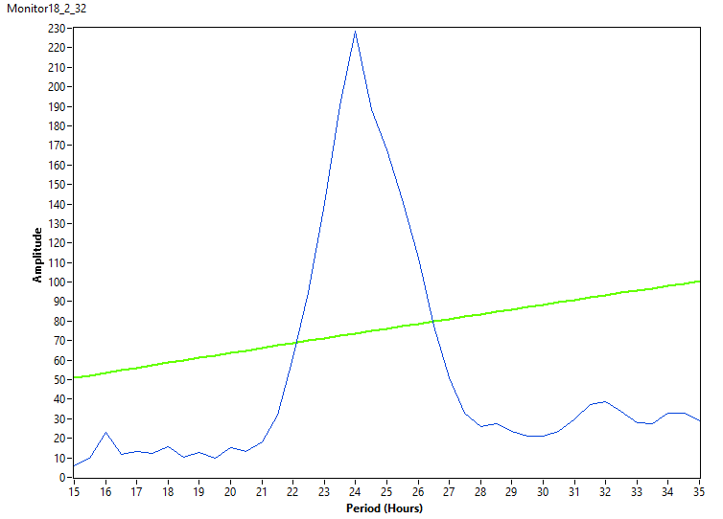
14♀ w[*];tim3gRNA/attP40;UAS-Cas9/+ [DD]₇ 23°C
M18

Slide 41
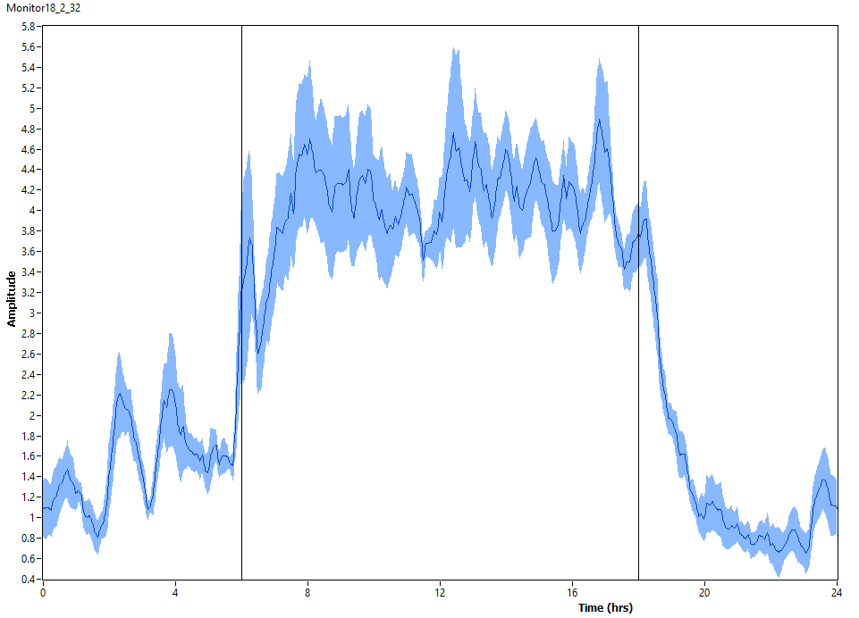
14♀ w[*];tim3gRNA/attP40;UAS-Cas9/+ [DD]₇ 23°C
M18

Slide 42
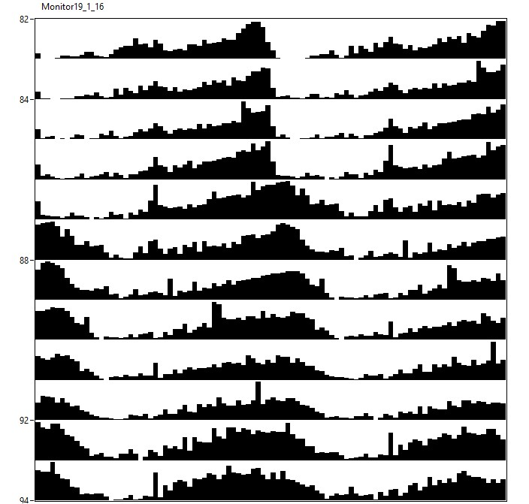
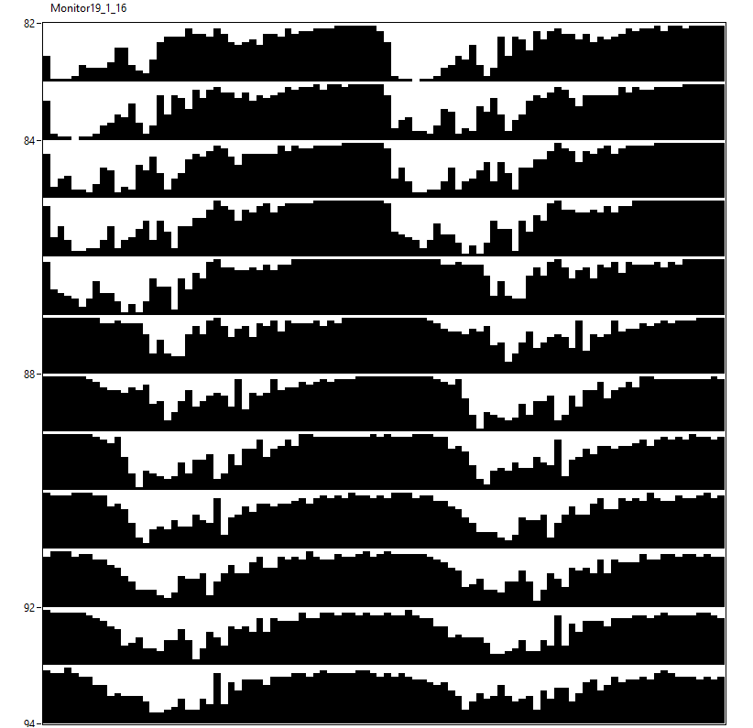
15♂ w[*];tim3gRNA/attP40;UAS-Cas9/+ [12hR:12hD]₅>[RR]₇ 23°C
M19

Slide 43
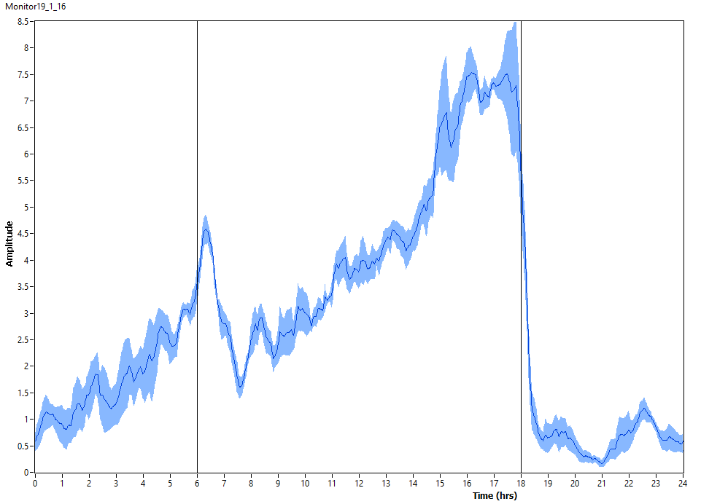
15♂ w[*];tim3gRNA/attP40;UAS-Cas9/+ [12hR:12hD]₅ 23°C
M19

Slide 44

15♂ w[*];tim3gRNA/attP40;UAS-Cas9/+ [RR]₇ 23°C
M19

Slide 45

15♂ w[*];tim3gRNA/attP40;UAS-Cas9/+ [RR]₇ 23°C
M19

Slide 46


14♀ w[*];tim3gRNA/attP40;UAS-Cas9/+ [12hR:12hD]₅>[RR]₇ 23°C
M19

Slide 47

14♀ w[*];tim3gRNA/attP40;UAS-Cas9/+ [12hR:12hD]₅ 23°C
M19

Slide 48

14♀ w[*];tim3gRNA/attP40;UAS-Cas9/+ [RR]₇ 23°C
M19

Slide 49

14♀ w[*];tim3gRNA/attP40;UAS-Cas9/+ [RR]₇ 23°C
M19

Slide 50


24♂ w[*];tim3gRNA/Clk[856]-Gal4;UAS-Cas9/+ [12hL:12hD]₅>[DD]₇ 23°C
M22+23

Slide 51

24♂ w[*];tim3gRNA/Clk[856]-Gal4;UAS-Cas9/+ [12hL:12hD]₅ 23°C
M22+23

Slide 52

24♂ w[*];tim3gRNA/Clk[856]-Gal4;UAS-Cas9/+ [DD]₇ 23°C
M22+23

Slide 53


24♂ w[*];tim3gRNA/Clk[856]-Gal4;UAS-Cas9/+ [DD]₇ 23°C
M22+23

Slide 54


20♀ w[*];tim3gRNA/Clk[856]-Gal4;UAS-Cas9/+ [12hL:12hD]₅>[DD]₇ 23°C
M22+23

Slide 55

20♀ w[*];tim3gRNA/Clk[856]-Gal4;UAS-Cas9/+ [12hL:12hD]₅ 23°C
M22+23

Slide 56

20♀ w[*];tim3gRNA/Clk[856]-Gal4;UAS-Cas9/+ [DD]₇ 23°C
M22+23

Slide 57

20♀ w[*];tim3gRNA/Clk[856]-Gal4;UAS-Cas9/+ [DD]₇ 23°C
M22+23

Slide 58


22♂ w[*];tim3gRNA/Clk[856]-Gal4;UAS-Cas9/+ [12hR:12hD]₅>[RR]₇ 23°C
M28+29

Slide 59

22♂ w[*];tim3gRNA/Clk[856]-Gal4;UAS-Cas9/+ [12hR:12hD]₅ 23°C
M28+29

Slide 60

22♂ w[*];tim3gRNA/Clk[856]-Gal4;UAS-Cas9/+ [RR]₇ 23°C
M28+29

Slide 61


22♂ w[*];tim3gRNA/Clk[856]-Gal4;UAS-Cas9/+ [RR]₇ 23°C
M28+29

Slide 62


22♀ w[*];tim3gRNA/Clk[856]-Gal4;UAS-Cas9/+ [12hR:12hD]₅>[RR]₇ 23°C
M28+29

Slide 63

22♀ w[*];tim3gRNA/Clk[856]-Gal4;UAS-Cas9/+ [12hR:12hD]₅ 23°C
M28+29

Slide 64

22♀ w[*];tim3gRNA/Clk[856]-Gal4;UAS-Cas9/+ [RR]₇ 23°C
M28+29

Slide 65


22♀ w[*];tim3gRNA/Clk[856]-Gal4;UAS-Cas9/+ [RR]₇ 23°C
M28+29

Slide 66


18♂ w[*];tim3gRNA/MB122B-Gal4;UAS-Cas9/+ [12hL:12hD]₅>[DD]₇ 23°C
M12+62

Slide 67

18♂ w[*];tim3gRNA/MB122B-Gal4;UAS-Cas9/+ [12hL:12hD]₅ 23°C
M12+62

Slide 68

18♂ w[*];tim3gRNA/MB122B-Gal4;UAS-Cas9/+ [DD]₇ 23°C
M12+62

Slide 69

18♂ w[*];tim3gRNA/MB122B-Gal4;UAS-Cas9/+ [DD]₇ 23°C
M12+62

Slide 70


19♀ w[*];tim3gRNA/MB122B-Gal4;UAS-Cas9/+ [12hL:12hD]₅>[DD]₇ 23°C
M12+62

Slide 71

19♀ w[*];tim3gRNA/MB122B-Gal4;UAS-Cas9/+ [12hL:12hD]₅ 23°C
M12+62

Slide 72

19♀ w[*];tim3gRNA/MB122B-Gal4;UAS-Cas9/+ [DD]₇ 23°C
M12+62

Slide 73

19♀ w[*];tim3gRNA/MB122B-Gal4;UAS-Cas9/+ [DD]₇ 23°C
M12+62

Slide 74


18♂ w[*];tim3gRNA/MB122B-Gal4;UAS-Cas9/+ [12hR:12hD]₅>[RR]₇ 23°C
M13+63

Slide 75

18♂ w[*];tim3gRNA/MB122B-Gal4;UAS-Cas9/+ [12hR:12hD]₅ 23°C
M13+63

Slide 76

18♂ w[*];tim3gRNA/MB122B-Gal4;UAS-Cas9/+ [RR]₇ 23°C
M13+63

Slide 77

18♂ w[*];tim3gRNA/MB122B-Gal4;UAS-Cas9/+ [RR]₇ 23°C
M13+63

Slide 78


24♀ w[*];tim3gRNA/MB122B-Gal4;UAS-Cas9/+ [12hR:12hD]₅>[RR]₇ 23°C
M13+63

Slide 79

24♀ w[*];tim3gRNA/MB122B-Gal4;UAS-Cas9/+ [12hR:12hD]₅ 23°C
M13+63

Slide 80

24♀ w[*];tim3gRNA/MB122B-Gal4;UAS-Cas9/+ [RR]₇ 23°C
M13+63

Slide 81

24♀ w[*];tim3gRNA/MB122B-Gal4;UAS-Cas9/+ [RR]₇ 23°C
M13+63

Slide 82


23♂ w[*];tim3gRNA/ss00681-Gal4;UAS-Cas9/+ [12hL:12hD]₅>[DD]₇ 23°C
M43+44

Slide 83

23♂ w[*];tim3gRNA/ss00681-Gal4;UAS-Cas9/+ [12hL:12hD]₅ 23°C
M43+44

Slide 84

23♂ w[*];tim3gRNA/ss00681-Gal4;UAS-Cas9/+ [DD]₇ 23°C
M43+44

Slide 85


23♂ w[*];tim3gRNA/ss00681-Gal4;UAS-Cas9/+ [DD]₇ 23°C
M43+44

Slide 86


27♀ w[*];tim3gRNA/ss00681-Gal4;UAS-Cas9/+ [12hL:12hD]₅>[DD]₇ 23°C
M43+44

Slide 87

27♀ w[*];tim3gRNA/ss00681-Gal4;UAS-Cas9/+ [12hL:12hD]₅ 23°C
M43+44

Slide 88

27♀ w[*];tim3gRNA/ss00681-Gal4;UAS-Cas9/+ [DD]₇ 23°C
M43+44

Slide 89


27♀ w[*];tim3gRNA/ss00681-Gal4;UAS-Cas9/+ [DD]₇ 23°C
M43+44

Slide 90


28♂ w[*];tim3gRNA/ss00681-Gal4;UAS-Cas9/+ [12hR:12hD]₅>[RR]₇ 23°C
M45+46

Slide 91

28♂ w[*];tim3gRNA/ss00681-Gal4;UAS-Cas9/+ [12hR:12hD]₅ 23°C
M45+46

Slide 92

28♂ w[*];tim3gRNA/ss00681-Gal4;UAS-Cas9/+ [RR]₇ 23°C
M45+46

Slide 93

28♂ w[*];tim3gRNA/ss00681-Gal4;UAS-Cas9/+ [RR]₇ 23°C
M45+46

Slide 94


31♀ w[*];tim3gRNA/ss00681-Gal4;UAS-Cas9/+ [12hR:12hD]₅>[RR]₇ 23°C
M45+46

Slide 95

31♀ w[*];tim3gRNA/ss00681-Gal4;UAS-Cas9/+ [12hR:12hD]₅ 23°C
M45+46

Slide 96

31♀ w[*];tim3gRNA/ss00681-Gal4;UAS-Cas9/+ [RR]₇ 23°C
M45+46

Slide 97

31♀ w[*];tim3gRNA/ss00681-Gal4;UAS-Cas9/+ [RR]₇ 23°C
M45+46

Slide 98


21♂ w[*];tim3gRNA/+;UAS-Cas9/ChAT2A-Gal4 [12hL:12hD]₅>[DD]₇ 23°C
M60+16

Slide 99

21♂ w[*];tim3gRNA/+;UAS-Cas9/ChAT2A-Gal4 [12hL:12hD]₅ 23°C
M60+16

Slide 100

21♂ w[*];tim3gRNA/+;UAS-Cas9/ChAT2A-Gal4 [DD]₇ 23°C
M60+16

Slide 101


21♂ w[*];tim3gRNA/+;UAS-Cas9/ChAT2A-Gal4 [DD]₇ 23°C
M60+16

Slide 102


22♀ w[*];tim3gRNA/+;UAS-Cas9/ChAT2A-Gal4 [12hL:12hD]₅>[DD]₇ 23°C
M60+16

Slide 103

22♀ w[*];tim3gRNA/+;UAS-Cas9/ChAT2A-Gal4 [12hL:12hD]₅ 23°C
M60+16

Slide 104

22♀ w[*];tim3gRNA/+;UAS-Cas9/ChAT2A-Gal4 [DD]₇ 23°C
M60+16

Slide 105

22♀ w[*];tim3gRNA/+;UAS-Cas9/ChAT2A-Gal4 [DD]₇ 23°C
M60+16

Slide 106


26♂ w[*];tim3gRNA/+;UAS-Cas9/ChAT2A-Gal4 [12hR:12hD]₅>[RR]₇ 23°C
M12+13

Slide 107

26♂ w[*];tim3gRNA/+;UAS-Cas9/ChAT2A-Gal4 [12hR:12hD]₅ 23°C
M12+13

Slide 108

26♂ w[*];tim3gRNA/+;UAS-Cas9/ChAT2A-Gal4 [RR]₇ 23°C
M12+13

Slide 109


26♂ w[*];tim3gRNA/+;UAS-Cas9/ChAT2A-Gal4 [RR]₇ 23°C
M12+13

Slide 110


27♀ w[*];tim3gRNA/+;UAS-Cas9/ChAT2A-Gal4 [12hR:12hD]₅>[RR]₇ 23°C
M12+13

Slide 111

27♀ w[*];tim3gRNA/+;UAS-Cas9/ChAT2A-Gal4 [12hR:12hD]₅ 23°C
M12+13

Slide 112

27♀ w[*];tim3gRNA/+;UAS-Cas9/ChAT2A-Gal4 [RR]₇ 23°C
M12+13

Slide 113

27♀ w[*];tim3gRNA/+;UAS-Cas9/ChAT2A-Gal4 [RR]₇ 23°C
M12+13

Slide 114

10♂ w[*];tim3gRNA/CyO;UAS-Cas9/cryGal4.13 [12hL:12hD]₅>[DD]₇ 23°C
M93

Slide 115

10♂ w[*];tim3gRNA/CyO;UAS-Cas9/cryGal4.13 [12hL:12hD]₅ 23°C
M93

Slide 116

10♂ w[*];tim3gRNA/CyO;UAS-Cas9/cryGal4.13 [DD]₇ 23°C
M93

Slide 117

10♂ w[*];tim3gRNA/CyO;UAS-Cas9/cryGal4.13 [DD]₇ 23°C
M93

Slide 118

6♀ w[*];tim3gRNA/CyO;UAS-Cas9/cryGal4.13 [12hL:12hD]₅>[DD]₇ 23°C
M93

Slide 119

6♀ w[*];tim3gRNA/CyO;UAS-Cas9/cryGal4.13 [12hL:12hD]₅ 23°C
M93

Slide 120

6♀ w[*];tim3gRNA/CyO;UAS-Cas9/cryGal4.13 [DD]₇ 23°C
M93

Slide 121

6♀ w[*];tim3gRNA/CyO;UAS-Cas9/cryGal4.13 [DD]₇ 23°C
M93

Slide 122

15♂ w[*];tim3gRNA/Clk856-Gal4;UAS-Cas9/ChAT-Gal80 [12hL:12hD]₅>[DD]₇ 23°C
M43

Slide 123

15♂ w[*];tim3gRNA/Clk856-Gal4;UAS-Cas9/ChAT-Gal80 [12hL:12hD]₅ 23°C
M43

Slide 124

15♂ w[*];tim3gRNA/Clk856-Gal4;UAS-Cas9/ChAT-Gal80 [DD]₇ 23°C
M43

Slide 125

15♂ w[*];tim3gRNA/Clk856-Gal4;UAS-Cas9/ChAT-Gal80 [DD]₇ 23°C
M43

Slide 126

15♀ w[*];tim3gRNA/Clk856-Gal4;UAS-Cas9/ChAT-Gal80 [12hL:12hD]₅>[DD]₇ 23°C
M43

Slide 127

15♀ w[*];tim3gRNA/Clk856-Gal4;UAS-Cas9/ChAT-Gal80 [12hL:12hD]₅ 23°C
M43

Slide 128

15♀ w[*];tim3gRNA/Clk856-Gal4;UAS-Cas9/ChAT-Gal80 [DD]₇ 23°C
M43

Slide 129

15♀ w[*];tim3gRNA/Clk856-Gal4;UAS-Cas9/ChAT-Gal80 [DD]₇ 23°C
M43

Slide 130

7♂ w[*];tim3gRNA/Clk856-Gal4;UAS-Cas9/ChAT-Gal80 [12hL:12hD]₅>[DD]₇ 23°C
M98

Slide 131

7♂ w[*];tim3gRNA/Clk856-Gal4;UAS-Cas9/ChAT-Gal80 [12hL:12hD]₅ 23°C
M98

Slide 132

7♂ w[*];tim3gRNA/Clk856-Gal4;UAS-Cas9/ChAT-Gal80 [DD]₇ 23°C
M98

Slide 133

7♂ w[*];tim3gRNA/Clk856-Gal4;UAS-Cas9/ChAT-Gal80 [DD]₇ 23°C
M98

Slide 134

9♀ w[*];tim3gRNA/Clk856-Gal4;UAS-Cas9/ChAT-Gal80 [12hL:12hD]₅>[DD]₇ 23°C
M98

Slide 135

9♀ w[*];tim3gRNA/Clk856-Gal4;UAS-Cas9/ChAT-Gal80 [12hL:12hD]₅ 23°C
M98

Slide 136

9♀ w[*];tim3gRNA/Clk856-Gal4;UAS-Cas9/ChAT-Gal80 [DD]₇ 23°C
M98

Slide 137

9♀ w[*];tim3gRNA/Clk856-Gal4;UAS-Cas9/ChAT-Gal80 [DD]₇ 23°C
M98

Slide 138

16♂ w[*];tim3gRNA/Clk856Gal4;UAS-Cas9/ChATGal80 [12hR:12hD]₅>[RR]₇ 23°C
M13+14

Slide 139

16♂ w[*];tim3gRNA/Clk856Gal4;UAS-Cas9/ChATGal80 [12hR:12hD]₅ 23°C
M13+14

Slide 140

16♂ w[*];tim3gRNA/Clk856Gal4;UAS-Cas9/ChATGal80 [RR]₇ 23°C
M13+14

Slide 141

16♂ w[*];tim3gRNA/Clk856Gal4;UAS-Cas9/ChATGal80 [RR]₇ 23°C
M13+14

Slide 142

16♀ w[*];tim3gRNA/Clk856Gal4;UAS-Cas9/ChATGal80 [12hR:12hD]₅>[RR]₇ 23°C
M13+14

Slide 143

16♀ w[*];tim3gRNA/Clk856Gal4;UAS-Cas9/ChATGal80 [12hR:12hD]₅ 23°C
M13+14

Slide 144

16♀ w[*];tim3gRNA/Clk856Gal4;UAS-Cas9/ChATGal80 [RR]₇ 23°C
M13+14

Slide 145

16♀ w[*];tim3gRNA/Clk856Gal4;UAS-Cas9/ChATGal80 [RR]₇ 23°C
M13+14

Slide 146

29♂ w[*];tim3gRNA/Pdf-Gal80;UAS-Cas9/cryGal4.13 [12hL:12hD]₅>[DD]₇ 23°C
M7+8

Slide 147

29♂ w[*];tim3gRNA/Pdf-Gal80;UAS-Cas9/cryGal4.13 [12hL:12hD]₅ 23°C
M7+8

Slide 148

29♂ w[*];tim3gRNA/Pdf-Gal80;UAS-Cas9/cryGal4.13 [DD]₇ 23°C
M7+8

Slide 149

29♂ w[*];tim3gRNA/Pdf-Gal80;UAS-Cas9/cryGal4.13 [DD]₇ 23°C
M7+8

Slide 150

27♀ w[*];tim3gRNA/Pdf-Gal80;UAS-Cas9/cryGal4.13 [12hL:12hD]₅>[DD]₇ 23°C
M7+8

Slide 151

27♀ w[*];tim3gRNA/Pdf-Gal80;UAS-Cas9/cryGal4.13 [12hL:12hD]₅ 23°C
M7+8

Slide 152

27♀ w[*];tim3gRNA/Pdf-Gal80;UAS-Cas9/cryGal4.13 [DD]₇ 23°C
M7+8

Slide 153

27♀ w[*];tim3gRNA/Pdf-Gal80;UAS-Cas9/cryGal4.13 [DD]₇ 23°C
M7+8

Slide 154

24♂ w[*];tim3gRNA/Pdf-Gal80;UAS-Cas9/cryGal4.13 [12hR:12hD]₅>[RR]₇ 23°C
M18+19

Slide 155

24♂ w[*];tim3gRNA/Pdf-Gal80;UAS-Cas9/cryGal4.13 [12hR:12hD]₅ 23°C
M18+19

Slide 156

24♂ w[*];tim3gRNA/Pdf-Gal80;UAS-Cas9/cryGal4.13 [RR]₇ 23°C
M18+19

Slide 157


24♂ w[*];tim3gRNA/Pdf-Gal80;UAS-Cas9/cryGal4.13 [RR]₇ 23°C
M18+19

Slide 158

29♀ w[*];tim3gRNA/Pdf-Gal80;UAS-Cas9/cryGal4.13 [12hR:12hD]₅>[RR]₇ 23°C
M18+19

Slide 159

29♀ w[*];tim3gRNA/Pdf-Gal80;UAS-Cas9/cryGal4.13 [12hR:12hD]₅ 23°C
M18+19

Slide 160

29♀ w[*];tim3gRNA/Pdf-Gal80;UAS-Cas9/cryGal4.13 [RR]₇ 23°C
M18+19

Slide 161

29♀ w[*];tim3gRNA/Pdf-Gal80;UAS-Cas9/cryGal4.13 [RR]₇ 23°C
M18+19

Slide 162

25♂ w[*];tim3gRNA/ChAT-Gal4.7.4;UAS-Cas9/+ [12hL:12hD]₅>[DD]₇ 23°C
M56+57

Slide 163

25♂ w[*];tim3gRNA/ChAT-Gal4.7.4;UAS-Cas9/+ [12hL:12hD]₅ 23°C
M56+57

Slide 164

25♂ w[*];tim3gRNA/ChAT-Gal4.7.4;UAS-Cas9/+ [DD]₇ 23°C
M56+57

Slide 165


25♂ w[*];tim3gRNA/ChAT-Gal4.7.4;UAS-Cas9/+ [DD]₇ 23°C
M56+57

Slide 166

20♀ w[*];tim3gRNA/ChAT-Gal4.7.4;UAS-Cas9/+ [12hL:12hD]₅>[DD]₇ 23°C
M56+57

Slide 167

20♀ w[*];tim3gRNA/ChAT-Gal4.7.4;UAS-Cas9/+ [12hL:12hD]₅ 23°C
M56+57

Slide 168

20♀ w[*];tim3gRNA/ChAT-Gal4.7.4;UAS-Cas9/+ [DD]₇ 23°C
M56+57

Slide 169


20♀ w[*];tim3gRNA/ChAT-Gal4.7.4;UAS-Cas9/+ [DD]₇ 23°C
M56+57

Slide 170

19♂ w[*];tim3gRNA/ChAT-Gal4.7.4;UAS-Cas9/+ [12hR:12hD]₅>[RR]₇ 23°C
M58+59

Slide 171

19♂ w[*];tim3gRNA/ChAT-Gal4.7.4;UAS-Cas9/+ [12hR:12hD]₅ 23°C
M58+59

Slide 172

19♂ w[*];tim3gRNA/ChAT-Gal4.7.4;UAS-Cas9/+ [RR]₇ 23°C
M58+59

Slide 173


19♂ w[*];tim3gRNA/ChAT-Gal4.7.4;UAS-Cas9/+ [RR]₇ 23°C
M58+59

Slide 174

20♀ w[*];tim3gRNA/ChAT-Gal4.7.4;UAS-Cas9/+ [12hR:12hD]₅>[RR]₇ 23°C
M58+59

Slide 175

20♀ w[*];tim3gRNA/ChAT-Gal4.7.4;UAS-Cas9/+ [12hR:12hD]₅ 23°C
M58+59

Slide 176

20♀ w[*];tim3gRNA/ChAT-Gal4.7.4;UAS-Cas9/+ [RR]₇ 23°C
M58+59

Slide 177


20♀ w[*];tim3gRNA/ChAT-Gal4.7.4;UAS-Cas9/+ [RR]₇ 23°C
M58+59

Slide 178

8♂ w[*];tim3gRNA/ChAT-Gal4.7.4;UAS-Cas9/cry-Gal80 [12hL:12hD]₅>[DD]₇ 23°C
M44

Slide 179

8♂ w[*];tim3gRNA/ChAT-Gal4.7.4;UAS-Cas9/cry-Gal80 [12hL:12hD]₅ 23°C
M44

Slide 180

8♂ w[*];tim3gRNA/ChAT-Gal4.7.4;UAS-Cas9/cry-Gal80 [DD]₇ 23°C
M44

Slide 181


8♂ w[*];tim3gRNA/ChAT-Gal4.7.4;UAS-Cas9/cry-Gal80 [DD]₇ 23°C
M44

Slide 182

10♀ w[*];tim3gRNA/ChAT-Gal4.7.4;UAS-Cas9/cry-Gal80 [12hL:12hD]₅>[DD]₇ 23°C
M44

Slide 183

10♀ w[*];tim3gRNA/ChAT-Gal4.7.4;UAS-Cas9/cry-Gal80 [12hL:12hD]₅ 23°C
M44

Slide 184

10♀ w[*];tim3gRNA/ChAT-Gal4.7.4;UAS-Cas9/cry-Gal80 [DD]₇ 23°C
M44

Slide 185

10♀ w[*];tim3gRNA/ChAT-Gal4.7.4;UAS-Cas9/cry-Gal80 [DD]₇ 23°C
M44

Slide 186

8♂ w[*];tim3gRNA/ChAT-Gal4.7.4;UAS-Cas9/cry-Gal80 [12hL:12hD]₅>[DD]₇ 23°C
M22

Slide 187

8♂ w[*];tim3gRNA/ChAT-Gal4.7.4;UAS-Cas9/cry-Gal80 [12hL:12hD]₅ 23°C
M22

Slide 188

8♂ w[*];tim3gRNA/ChAT-Gal4.7.4;UAS-Cas9/cry-Gal80 [DD]₇ 23°C
M22

Slide 189


8♂ w[*];tim3gRNA/ChAT-Gal4.7.4;UAS-Cas9/cry-Gal80 [DD]₇ 23°C
M22

Slide 190

10♀ w[*];tim3gRNA/ChAT-Gal4.7.4;UAS-Cas9/cry-Gal80 [12hL:12hD]₅>[DD]₇ 23°C
M22

Slide 191

10♀ w[*];tim3gRNA/ChAT-Gal4.7.4;UAS-Cas9/cry-Gal80 [12hL:12hD]₅ 23°C
M22

Slide 192

10♀ w[*];tim3gRNA/ChAT-Gal4.7.4;UAS-Cas9/cry-Gal80 [DD]₇ 23°C
M22

Slide 193


10♀ w[*];tim3gRNA/ChAT-Gal4.7.4;UAS-Cas9/cry-Gal80 [DD]₇ 23°C
M22

Slide 194

14♂ w[*];tim3gRNA/ChAT-Gal4.7.4;UAS-Cas9/cry-Gal80 [12hR:12hD]₅>[RR]₇ 23°C
M45+46

Slide 195

14♂ w[*];tim3gRNA/ChAT-Gal4.7.4;UAS-Cas9/cry-Gal80 [12hR:12hD]₅ 23°C
M45+46

Slide 196

14♂ w[*];tim3gRNA/ChAT-Gal4.7.4;UAS-Cas9/cry-Gal80 [RR]₇ 23°C
M45+46

Slide 197

14♂ w[*];tim3gRNA/ChAT-Gal4.7.4;UAS-Cas9/cry-Gal80 [RR]₇ 23°C
M45+46

Slide 198

23♀ w[*];tim3gRNA/ChAT-Gal4.7.4;UAS-Cas9/cry-Gal80 [12hR:12hD]₅>[RR]₇ 23°C
M45+46

Slide 199

23♀ w[*];tim3gRNA/ChAT-Gal4.7.4;UAS-Cas9/cry-Gal80 [12hR:12hD]₅ 23°C
M45+46

Slide 200

23♀ w[*];tim3gRNA/ChAT-Gal4.7.4;UAS-Cas9/cry-Gal80 [RR]₇ 23°C
M45+46

Slide 201


23♀ w[*];tim3gRNA/ChAT-Gal4.7.4;UAS-Cas9/cry-Gal80 [RR]₇ 23°C
M45+46

Slide 202

14♂ w[*];tim3gRNA/ChAT-Gal4.7.4;UAS-Cas9/cry-Gal80 [12hR:12hD]₅>[RR]₇ 23°C
M23

Slide 203

14♂ w[*];tim3gRNA/ChAT-Gal4.7.4;UAS-Cas9/cry-Gal80 [12hR:12hD]₅ 23°C
M23

Slide 204

14♂ w[*];tim3gRNA/ChAT-Gal4.7.4;UAS-Cas9/cry-Gal80 [RR]₇ 23°C
M23

Slide 205

14♂ w[*];tim3gRNA/ChAT-Gal4.7.4;UAS-Cas9/cry-Gal80 [RR]₇ 23°C
M23

Slide 206

23♀ w[*];tim3gRNA/ChAT-Gal4.7.4;UAS-Cas9/cry-Gal80 [12hR:12hD]₅>[RR]₇ 23°C
M23

Slide 207

23♀ w[*];tim3gRNA/ChAT-Gal4.7.4;UAS-Cas9/cry-Gal80 [12hR:12hD]₅ 23°C
M23

Slide 208

23♀ w[*];tim3gRNA/ChAT-Gal4.7.4;UAS-Cas9/cry-Gal80 [RR]₇ 23°C
M23

Slide 209

23♀ w[*];tim3gRNA/ChAT-Gal4.7.4;UAS-Cas9/cry-Gal80 [RR]₇ 23°C
M23

Slide 210

14♂ w[*];tim3gRNA/TUG;UAS-Cas9/ChAT-Gal80 [12hL:12hD]₅>[DD]₇ 23°C
M24

Slide 211

14♂ w[*];tim3gRNA/TUG;UAS-Cas9/ChAT-Gal80 [12hL:12hD]₅ 23°C
M24

Slide 212

14♂ w[*];tim3gRNA/TUG;UAS-Cas9/ChAT-Gal80 [DD]₇ 23°C
M24

Slide 213

14♂ w[*];tim3gRNA/TUG;UAS-Cas9/ChAT-Gal80 [DD]₇ 23°C
M24

Slide 214

16♀ w[*];tim3gRNA/TUG;UAS-Cas9/ChAT-Gal80 [12hL:12hD]₅>[DD]₇ 23°C
M24

Slide 215

16♀ w[*];tim3gRNA/TUG;UAS-Cas9/ChAT-Gal80 [12hL:12hD]₅ 23°C
M24

Slide 216

16♀ w[*];tim3gRNA/TUG;UAS-Cas9/ChAT-Gal80 [DD]₇ 23°C
M24

Slide 217

16♀ w[*];tim3gRNA/TUG;UAS-Cas9/ChAT-Gal80 [DD]₇ 23°C
M24

Slide 218

16♂ w[*];tim3gRNA/TUG;UAS-Cas9/ChAT-Gal80 [12hR:12hD]₅>[RR]₇ 23°C
M25

Slide 219

16♂ w[*];tim3gRNA/TUG;UAS-Cas9/ChAT-Gal80 [12hR:12hD]₅ 23°C
M25

Slide 220

16♂ w[*];tim3gRNA/TUG;UAS-Cas9/ChAT-Gal80 [RR]₇ 23°C
M25

Slide 221

16♂ w[*];tim3gRNA/TUG;UAS-Cas9/ChAT-Gal80 [RR]₇ 23°C
M25

Slide 222

14♀ w[*];tim3gRNA/TUG;UAS-Cas9/ChAT-Gal80 [12hR:12hD]₅>[RR]₇ 23°C
M25

Slide 223

14♀ w[*];tim3gRNA/TUG;UAS-Cas9/ChAT-Gal80 [12hR:12hD]₅ 23°C
M25

Slide 224

14♀ w[*];tim3gRNA/TUG;UAS-Cas9/ChAT-Gal80 [RR]₇ 23°C
M25

Slide 225

14♀ w[*];tim3gRNA/TUG;UAS-Cas9/ChAT-Gal80 [RR]₇ 23°C
M25

Slide 226

15♂ w[*];tim3gRNA/TUG;UAS-Cas9/Pdf-Gal80 [12hL:12hD]₅>[DD]₇ 23°C
M97

Slide 227

15♂ w[*];tim3gRNA/TUG;UAS-Cas9/Pdf-Gal80 [12hL:12hD]₅ 23°C
M97

Slide 228

15♂ w[*];tim3gRNA/TUG;UAS-Cas9/Pdf-Gal80 [DD]₇ 23°C
M97

Slide 229

15♂ w[*];tim3gRNA/TUG;UAS-Cas9/Pdf-Gal80 [DD]₇ 23°C
M97

Slide 230

11♀ w[*];tim3gRNA/TUG;UAS-Cas9/Pdf-Gal80 [12hL:12hD]₅>[DD]₇ 23°C
M97

Slide 231

11♀ w[*];tim3gRNA/TUG;UAS-Cas9/Pdf-Gal80 [12hL:12hD]₅ 23°C
M97

Slide 232

11♀ w[*];tim3gRNA/TUG;UAS-Cas9/Pdf-Gal80 [DD]₇ 23°C
M97

Slide 233


11♀ w[*];tim3gRNA/TUG;UAS-Cas9/Pdf-Gal80 [DD]₇ 23°C
M97

Slide 234

13♂ w[*];tim3gRNA/TUG;UAS-Cas9/Pdf-Gal80 [12hR:12hD]₅>[RR]₇ 23°C
M98

Slide 235

13♂ w[*];tim3gRNA/TUG;UAS-Cas9/Pdf-Gal80 [12hR:12hD]₅ 23°C
M98

Slide 236

13♂ w[*];tim3gRNA/TUG;UAS-Cas9/Pdf-Gal80 [RR]₇ 23°C
M98

Slide 237

13♂ w[*];tim3gRNA/TUG;UAS-Cas9/Pdf-Gal80 [RR]₇ 23°C
M98

Slide 238

15♀ w[*];tim3gRNA/TUG;UAS-Cas9/Pdf-Gal80 [12hR:12hD]₅>[RR]₇ 23°C
M98

Slide 239

15♀ w[*];tim3gRNA/TUG;UAS-Cas9/Pdf-Gal80 [12hR:12hD]₅ 23°C
M98

Slide 240

15♀ w[*];tim3gRNA/TUG;UAS-Cas9/Pdf-Gal80 [RR]₇ 23°C
M98

Slide 241

15♀ w[*];tim3gRNA/TUG;UAS-Cas9/Pdf-Gal80 [RR]₇ 23°C
M98

Slide 242

6♂ w[*];tim3gRNA/TUG;UAS-Cas9/cryGal80 [12hL:12hD]₅>[DD]₇ 23°C
M45

Slide 243

6♂ w[*];tim3gRNA/TUG;UAS-Cas9/cryGal80 [12hL:12hD]₅ 23°C
M45

Slide 244

6♂ w[*];tim3gRNA/TUG;UAS-Cas9/cryGal80 [DD]₇ 23°C
M45

Slide 245


6♂ w[*];tim3gRNA/TUG;UAS-Cas9/cryGal80 [DD]₇ 23°C
M45

Slide 246

12♀ w[*];tim3gRNA/TUG;UAS-Cas9/cryGal80 [12hL:12hD]₅>[DD]₇ 23°C
M45

Slide 247

12♀ w[*];tim3gRNA/TUG;UAS-Cas9/cryGal80 [12hL:12hD]₅ 23°C
M45

Slide 248

12♀ w[*];tim3gRNA/TUG;UAS-Cas9/cryGal80 [DD]₇ 23°C
M45

Slide 249

12♀ w[*];tim3gRNA/TUG;UAS-Cas9/cryGal80 [DD]₇ 23°C
M45

Slide 250

6♂ w[*];tim3gRNA/TUG;UAS-Cas9/TM6BTb[1] [12hL:12hD]₅>[DD]₇ 23°C
M46

Slide 251

6♂ w[*];tim3gRNA/TUG;UAS-Cas9/TM6BTb[1] [12hL:12hD]₅ 23°C
M46

Slide 252

6♂ w[*];tim3gRNA/TUG;UAS-Cas9/TM6BTb[1] [DD]₇ 23°C
M46

Slide 253

6♂ w[*];tim3gRNA/TUG;UAS-Cas9/TM6BTb[1] [DD]₇ 23°C
M46

Slide 254

9♀ w[*];tim3gRNA/TUG;UAS-Cas9/TM6BTb[1] [12hL:12hD]₅>[DD]₇ 23°C
M46

Slide 255

9♀ w[*];tim3gRNA/TUG;UAS-Cas9/TM6BTb[1] [12hL:12hD]₅ 23°C
M46

Slide 256

9♀ w[*];tim3gRNA/TUG;UAS-Cas9/TM6BTb[1] [DD]₇ 23°C
M46

Slide 257

9♀ w[*];tim3gRNA/TUG;UAS-Cas9/TM6BTb[1] [DD]₇ 23°C
M46

Slide 258

12♂ w[*];tim3gRNA/Pdf-Gal4;UAS-Cas9/+ [12hL:12hD]₅>[DD]₇ 23°C
M99

Slide 259

12♂ w[*];tim3gRNA/Pdf-Gal4;UAS-Cas9/+ [12hL:12hD]₅ 23°C
M99

Slide 260

12♂ w[*];tim3gRNA/Pdf-Gal4;UAS-Cas9/+ [DD]₇ 23°C
M99

Slide 261

12♂ w[*];tim3gRNA/Pdf-Gal4;UAS-Cas9/+ [DD]₇ 23°C
M99

Slide 262

11♀ w[*];tim3gRNA/Pdf-Gal4;UAS-Cas9/+ [12hL:12hD]₅>[DD]₇ 23°C
M99

Slide 263

11♀ w[*];tim3gRNA/Pdf-Gal4;UAS-Cas9/+ [12hL:12hD]₅ 23°C
M99

Slide 264

11♀ w[*];tim3gRNA/Pdf-Gal4;UAS-Cas9/+ [DD]₇ 23°C
M99

Slide 265


11♀ w[*];tim3gRNA/Pdf-Gal4;UAS-Cas9/+ [DD]₇ 23°C
M99

Slide 266

13♂ w[*];tim3gRNA/Pdf-Gal4;UAS-Cas9/+ [12hR:12hD]₅>[RR]₇ 23°C
M100

Slide 267

13♂ w[*];tim3gRNA/Pdf-Gal4;UAS-Cas9/+ [12hR:12hD]₅ 23°C
M100

Slide 268

13♂ w[*];tim3gRNA/Pdf-Gal4;UAS-Cas9/+ [RR]₇ 23°C
M100

Slide 269


13♂ w[*];tim3gRNA/Pdf-Gal4;UAS-Cas9/+ [RR]₇ 23°C
M100

Slide 270

13♀ w[*];tim3gRNA/Pdf-Gal4;UAS-Cas9/+ [12hR:12hD]₅>[RR]₇ 23°C
M100

Slide 271

13♀ w[*];tim3gRNA/Pdf-Gal4;UAS-Cas9/+ [12hR:12hD]₅ 23°C
M100

Slide 272

13♀ w[*];tim3gRNA/Pdf-Gal4;UAS-Cas9/+ [RR]₇ 23°C
M100

Slide 273


13♀ w[*];tim3gRNA/Pdf-Gal4;UAS-Cas9/+ [RR]₇ 23°C
M100

Slide 274

10♂ w[*];tim3gRNA/ChATGal4.7.4;UAS-Cas9/PdfGal4 [12hL:12hD]₅>[DD]₇ 23°C
M28

Slide 275

10♂ w[*];tim3gRNA/ChATGal4.7.4;UAS-Cas9/PdfGal4 [12hL:12hD]₅ 23°C
M28

Slide 276

10♂ w[*];tim3gRNA/ChATGal4.7.4;UAS-Cas9/PdfGal4 [DD]₇ 23°C
M28

Slide 277

10♂ w[*];tim3gRNA/ChATGal4.7.4;UAS-Cas9/PdfGal4 [DD]₇ 23°C
M28

Slide 278

12♀ w[*];tim3gRNA/ChATGal4.7.4;UAS-Cas9/PdfGal4 [12hL:12hD]₅>[DD]₇ 23°C
M28

Slide 279

12♀ w[*];tim3gRNA/ChATGal4.7.4;UAS-Cas9/PdfGal4 [12hL:12hD]₅ 23°C
M28

Slide 280

12♀ w[*];tim3gRNA/ChATGal4.7.4;UAS-Cas9/PdfGal4 [DD]₇ 23°C
M28

Slide 281


12♀ w[*];tim3gRNA/ChATGal4.7.4;UAS-Cas9/PdfGal4 [DD]₇ 23°C
M28

Slide 282

11♂ w[*];tim3gRNA/ChATGal4.7.4;UAS-Cas9/PdfGal4 [12hL:12hD]₅>[DD]₇ 23°C
M56

Slide 283

11♂ w[*];tim3gRNA/ChATGal4.7.4;UAS-Cas9/PdfGal4 [12hL:12hD]₅ 23°C
M56

Slide 284

11♂ w[*];tim3gRNA/ChATGal4.7.4;UAS-Cas9/PdfGal4 [DD]₇ 23°C
M56

Slide 285

11♂ w[*];tim3gRNA/ChATGal4.7.4;UAS-Cas9/PdfGal4 [DD]₇ 23°C
M56

Slide 286

15♀ w[*];tim3gRNA/ChATGal4.7.4;UAS-Cas9/PdfGal4 [12hL:12hD]₅>[DD]₇ 23°C
M56

Slide 287

15♀ w[*];tim3gRNA/ChATGal4.7.4;UAS-Cas9/PdfGal4 [12hL:12hD]₅ 23°C
M56

Slide 288

15♀ w[*];tim3gRNA/ChATGal4.7.4;UAS-Cas9/PdfGal4 [DD]₇ 23°C
M56

Slide 289


15♀ w[*];tim3gRNA/ChATGal4.7.4;UAS-Cas9/PdfGal4 [DD]₇ 23°C
M56

Slide 290

8♂ w[*];tim3gRNA/ChATGal4.7.4;UAS-Cas9/PdfGal4 [12hR:12hD]₅>[RR]₇ 23°C
M29

Slide 291

8♂ w[*];tim3gRNA/ChATGal4.7.4;UAS-Cas9/PdfGal4 [12hR:12hD]₅ 23°C
M29

Slide 292

8♂ w[*];tim3gRNA/ChATGal4.7.4;UAS-Cas9/PdfGal4 [RR]₇ 23°C
M29

Slide 293


8♂ w[*];tim3gRNA/ChATGal4.7.4;UAS-Cas9/PdfGal4 [RR]₇ 23°C
M29

Slide 294

12♀ w[*];tim3gRNA/ChATGal4.7.4;UAS-Cas9/PdfGal4 [12hR:12hD]₅>[RR]₇ 23°C
M29

Slide 295

12♀ w[*];tim3gRNA/ChATGal4.7.4;UAS-Cas9/PdfGal4 [12hR:12hD]₅ 23°C
M29

Slide 296

12♀ w[*];tim3gRNA/ChATGal4.7.4;UAS-Cas9/PdfGal4 [RR]₇ 23°C
M29

Slide 297

12♀ w[*];tim3gRNA/ChATGal4.7.4;UAS-Cas9/PdfGal4 [RR]₇ 23°C
M29

Slide 298

6♂ w[*];tim3gRNA/ChATGal4.7.4;UAS-Cas9/PdfGal4 [12hR:12hD]₅>[RR]₇ 23°C
M57

Slide 299

6♂ w[*];tim3gRNA/ChATGal4.7.4;UAS-Cas9/PdfGal4 [12hR:12hD]₅ 23°C
M57

Slide 300

6♂ w[*];tim3gRNA/ChATGal4.7.4;UAS-Cas9/PdfGal4 [RR]₇ 23°C
M57

Slide 301


6♂ w[*];tim3gRNA/ChATGal4.7.4;UAS-Cas9/PdfGal4 [RR]₇ 23°C
M57

Slide 302

14♀ w[*];tim3gRNA/ChATGal4.7.4;UAS-Cas9/PdfGal4 [12hR:12hD]₅>[RR]₇ 23°C
M57

Slide 303

14♀ w[*];tim3gRNA/ChATGal4.7.4;UAS-Cas9/PdfGal4 [12hR:12hD]₅ 23°C
M57

Slide 304

14♀ w[*];tim3gRNA/ChATGal4.7.4;UAS-Cas9/PdfGal4 [RR]₇ 23°C
M57

Slide 305

14♀ w[*];tim3gRNA/ChATGal4.7.4;UAS-Cas9/PdfGal4 [RR]₇ 23°C
M57

Slide 306

14♂ w[*];tim3gRNA/TUG;UAS-Cas9/ChAT-Gal80 [12hL:12hD]₅>[DD]₇ 23°C
M18

Slide 307

14♂ w[*];tim3gRNA/TUG;UAS-Cas9/ChAT-Gal80 [12hL:12hD]₅ 23°C
M18

Slide 308

14♂ w[*];tim3gRNA/TUG;UAS-Cas9/ChAT-Gal80 [DD]₇ 23°C
M18

Slide 309

14♂ w[*];tim3gRNA/TUG;UAS-Cas9/ChAT-Gal80 [DD]₇ 23°C
M18

Slide 310

12♀ w[*];tim3gRNA/TUG;UAS-Cas9/ChAT-Gal80 [12hL:12hD]₅>[DD]₇ 23°C
M18

Slide 311

12♀ w[*];tim3gRNA/TUG;UAS-Cas9/ChAT-Gal80 [12hL:12hD]₅ 23°C
M18

Slide 312

12♀ w[*];tim3gRNA/TUG;UAS-Cas9/ChAT-Gal80 [DD]₇ 23°C
M18

Slide 313

12♀ w[*];tim3gRNA/TUG;UAS-Cas9/ChAT-Gal80 [DD]₇ 23°C
M18

Slide 314

25♂ w[*];tim3gRNA/TUG;UAS-Cas9/ChAT-Gal80 [12hR:12hD]₅>[RR]₇ 23°C
M19+60

Slide 315

25♂ w[*];tim3gRNA/TUG;UAS-Cas9/ChAT-Gal80 [12hR:12hD]₅ 23°C
M19+60

Slide 316

25♂ w[*];tim3gRNA/TUG;UAS-Cas9/ChAT-Gal80 [RR]₇ 23°C
M19+60

Slide 317

25♂ w[*];tim3gRNA/TUG;UAS-Cas9/ChAT-Gal80 [RR]₇ 23°C
M19+60

Slide 318

27♀ w[*];tim3gRNA/TUG;UAS-Cas9/ChAT-Gal80 [12hR:12hD]₅>[RR]₇ 23°C
M19+60

Slide 319

27♀ w[*];tim3gRNA/TUG;UAS-Cas9/ChAT-Gal80 [12hR:12hD]₅ 23°C
M19+60

Slide 320

27♀ w[*];tim3gRNA/TUG;UAS-Cas9/ChAT-Gal80 [RR]₇ 23°C
M19+60

Slide 321

27♀ w[*];tim3gRNA/TUG;UAS-Cas9/ChAT-Gal80 [RR]₇ 23°C
M19+60

